Slide 1
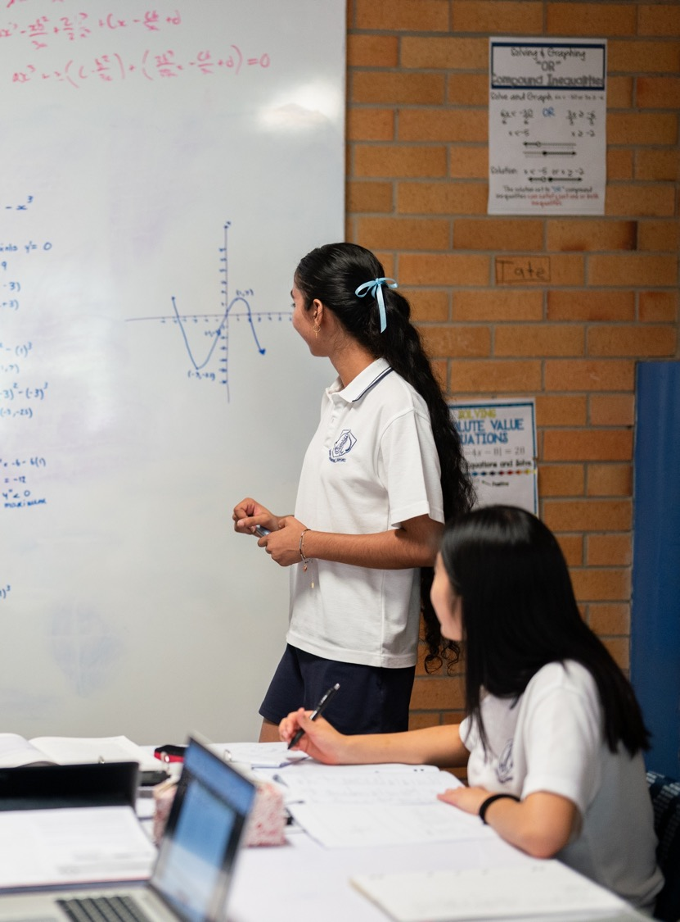
Continuity and differentiability
Mathematics Advanced – Stage 6 (Year 12)
Differentiation applications

Slide 2
Learning intentions and success criteria
Learning intentions
To be able to determine whether a function is differentiable at a point.
To understand the relationship between differentiability and continuity.
Success criteria
I can determine from the graph of a function where the derivative will not exist.
I can classify functions as continuous/discontinuous and differentiable/not differentiable.
I can explain the relationship between differentiability and continuity.
I can identify points where a function is continuous but not differentiable.

Slide 3
Retrieval practice

Slide 4
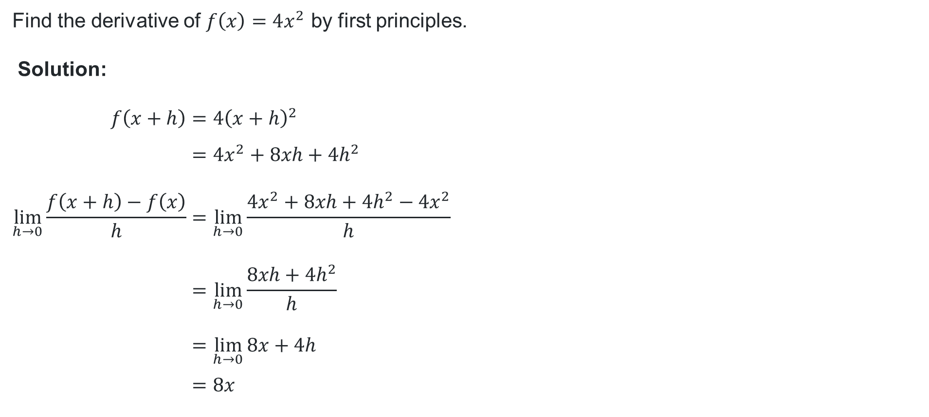
First principles
Find the derivative of $f\left(x\right)=4x^{2}$ by first principles.
Solution:
$$f\left(x+h\right)=4{\left(x+h\right)}^{2} \\ =4x^{2}+8xh+4h^{2} \\ \lim_{h→0}{\frac{f\left(x+h\right)−f\left(x\right)}{h}}=\lim_{h→0}{\frac{4x^{2}+8xh+4h^{2}−4x^{2}}{h}} \\ =\lim_{h→0}{\frac{8xh+4h^{2}}{h}} \\ =\lim_{h→0}{8x+4h} \\ =8x$$

Slide 5
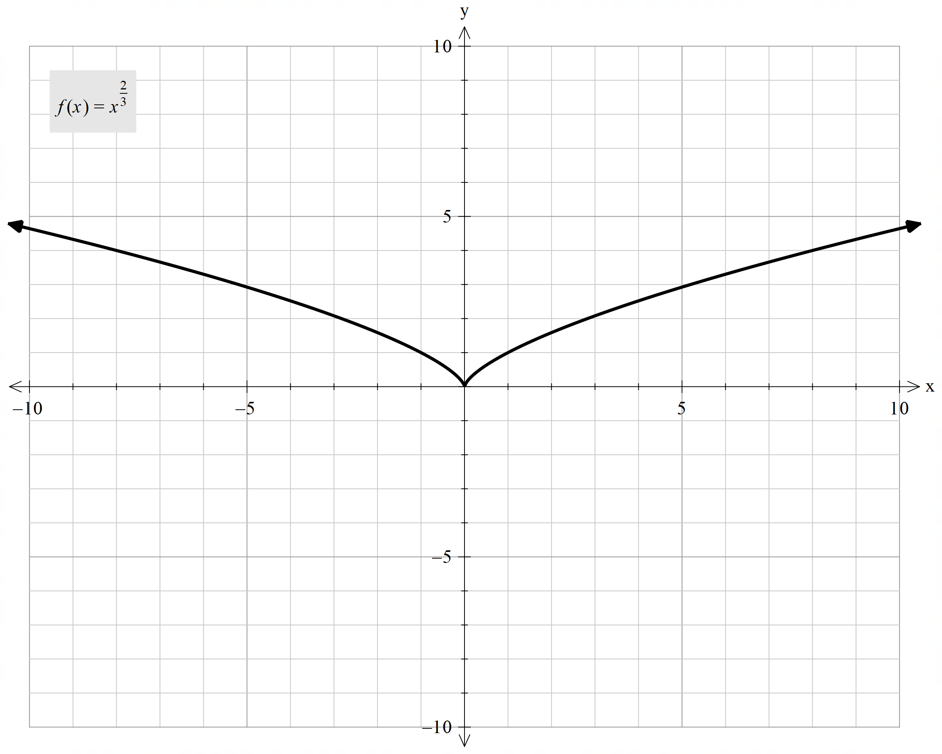
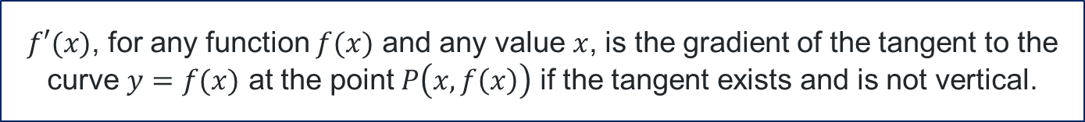
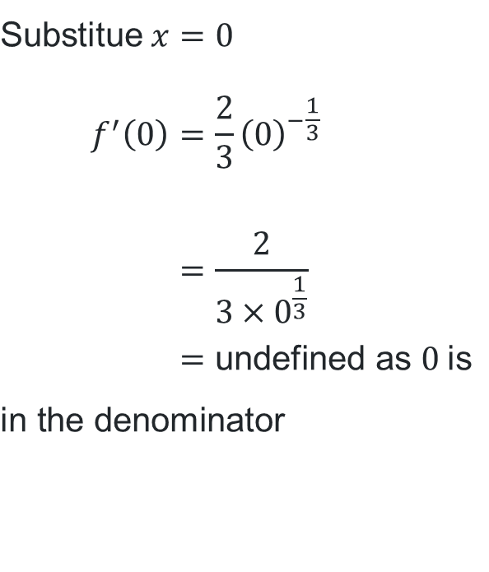
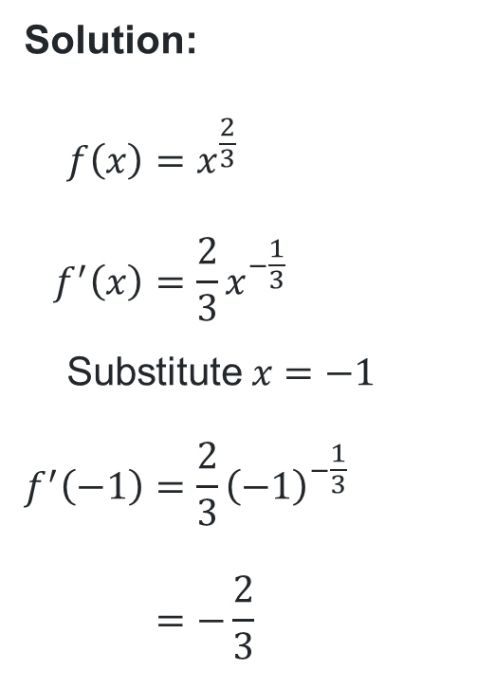
Gradient of the tangent
What is the gradient of the tangent of the curve $f\left(x\right)=x^{\frac{2}{3}}$ at $x=−1$ and $x=0$.
Solution:
$$f\left(x\right)=x^{\frac{2}{3}} \\ f^{′}\left(x\right)=\frac{2}{3}x^{−\frac{1}{3}} \\ \text{Substitute} x=−1 \\ f^{′}\left(−1\right)=\frac{2}{3}{\left(−1\right)}^{−\frac{1}{3}} \\ =−\frac{2}{3}$$
$$\text{Substitue} x=0 \\ f^{′}\left(0\right)=\frac{2}{3}{\left(0\right)}^{−\frac{1}{3}} \\ =\frac{2}{3×0^{\frac{1}{3}}} \\ =\text{undefined} \text{as} 0 \text{is} \\ \text{in} \text{the} \text{denominator}$$
$f′(x)$, for any function $f(x)$ and any value $x$, is the gradient of the tangent to the curve $y=f(x)$ at the point $P\left(x,f\left(x\right)\right)$ if the tangent exists and is not vertical.

Slide 6
Gradient of the tangent (2)
A graph is differentiable at a point if it is smooth and has one clear tangent and therefore one gradient.
For a graph to be differentiable at a point:
the graph must not have a vertical tangent

Slide 7
Connecting learning

Slide 8
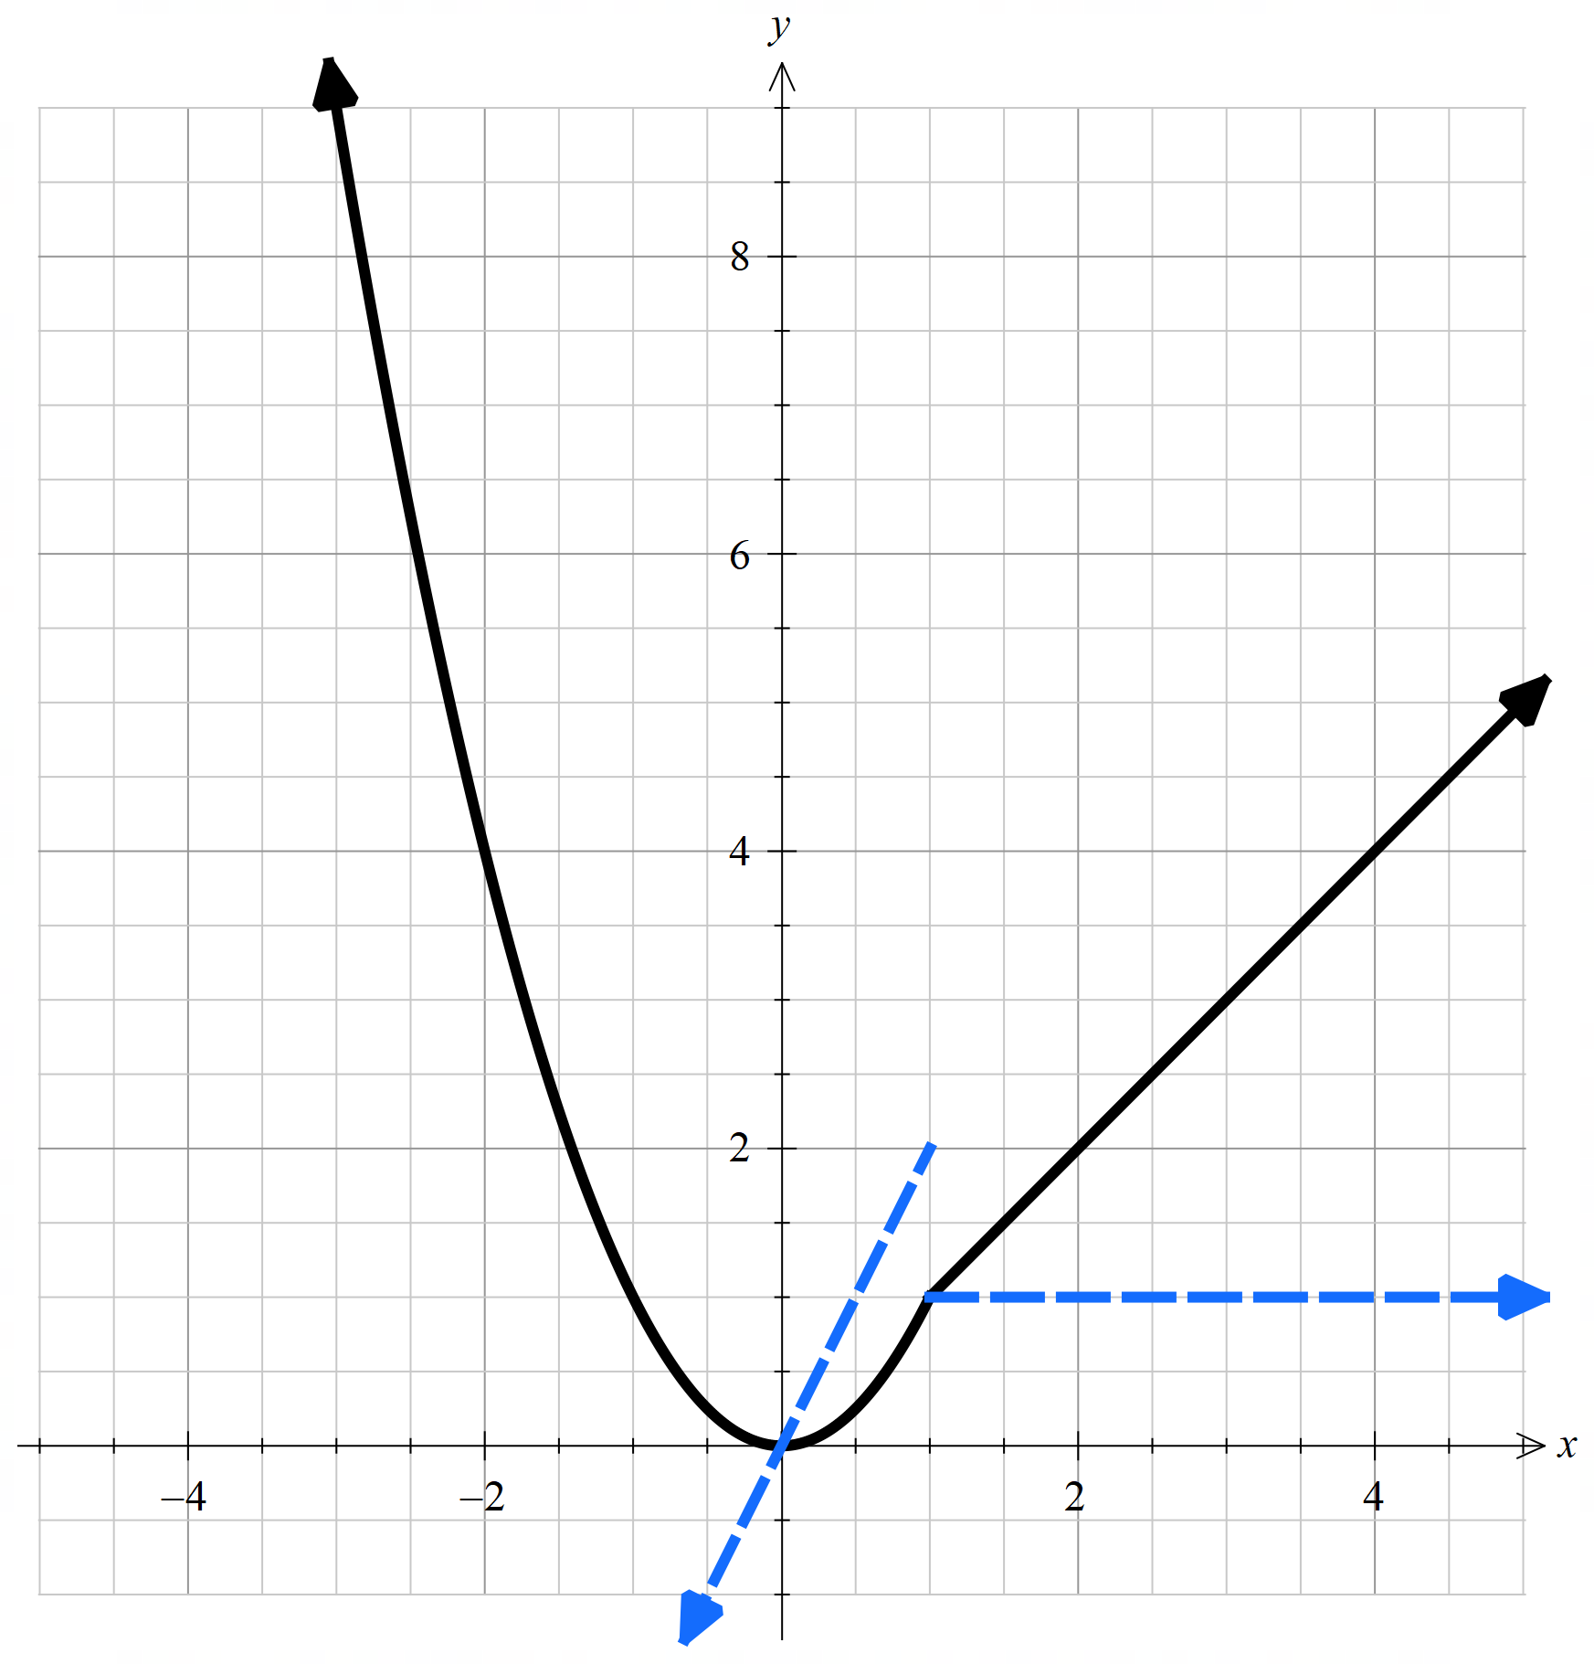
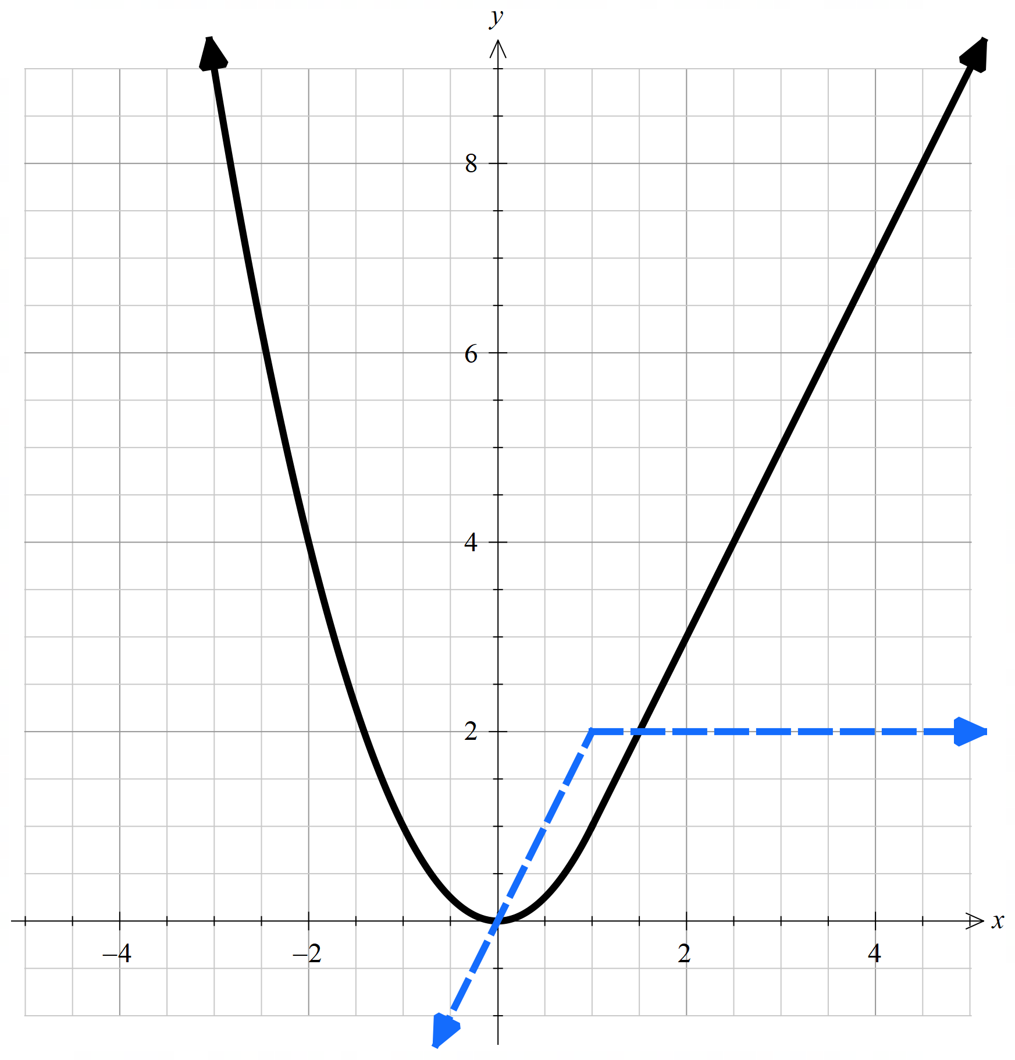
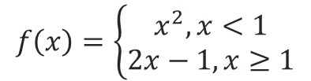
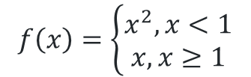
Piecewise-defined functions and differentiability
$$f\left(x\right)=\left\{\begin{aligned}x^{2}, x<1 \\ x, x≥1\end{aligned}\right.$$
$$f\left(x\right)=\left\{\begin{aligned}x^{2}, x<1 \\ 2x−1, x≥1\end{aligned}\right.$$

Slide 9
Releasing responsibility

Slide 10
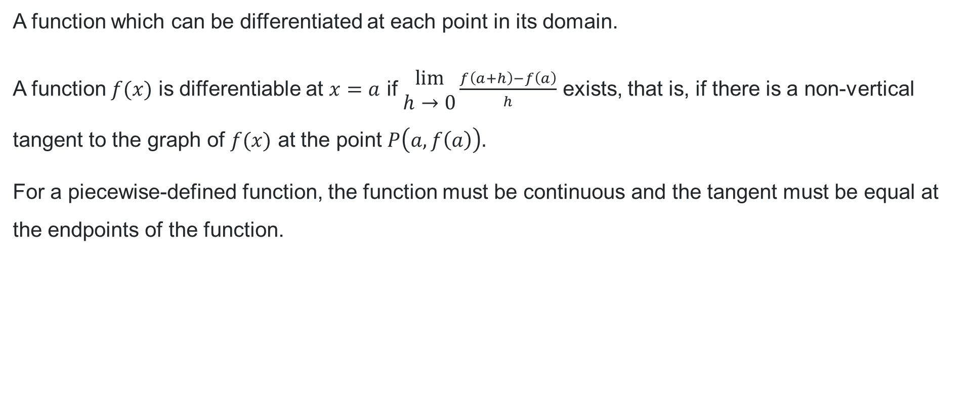
Differentiable
Definition
A function which can be differentiated at each point in its domain.
A function $f(x)$ is differentiable at $x=a$ if $\begin{aligned}lim⁡ \\ h→0\end{aligned}{\frac{f\left(a+h\right)−f\left(a\right)}{h}}$ exists, that is, if there is a non-vertical tangent to the graph of $f(x)$ at the point $P\left(a, f\left(a\right)\right).$
For a piecewise-defined function, the function must be continuous and the tangent must be equal at the endpoints of the function.

Slide 11
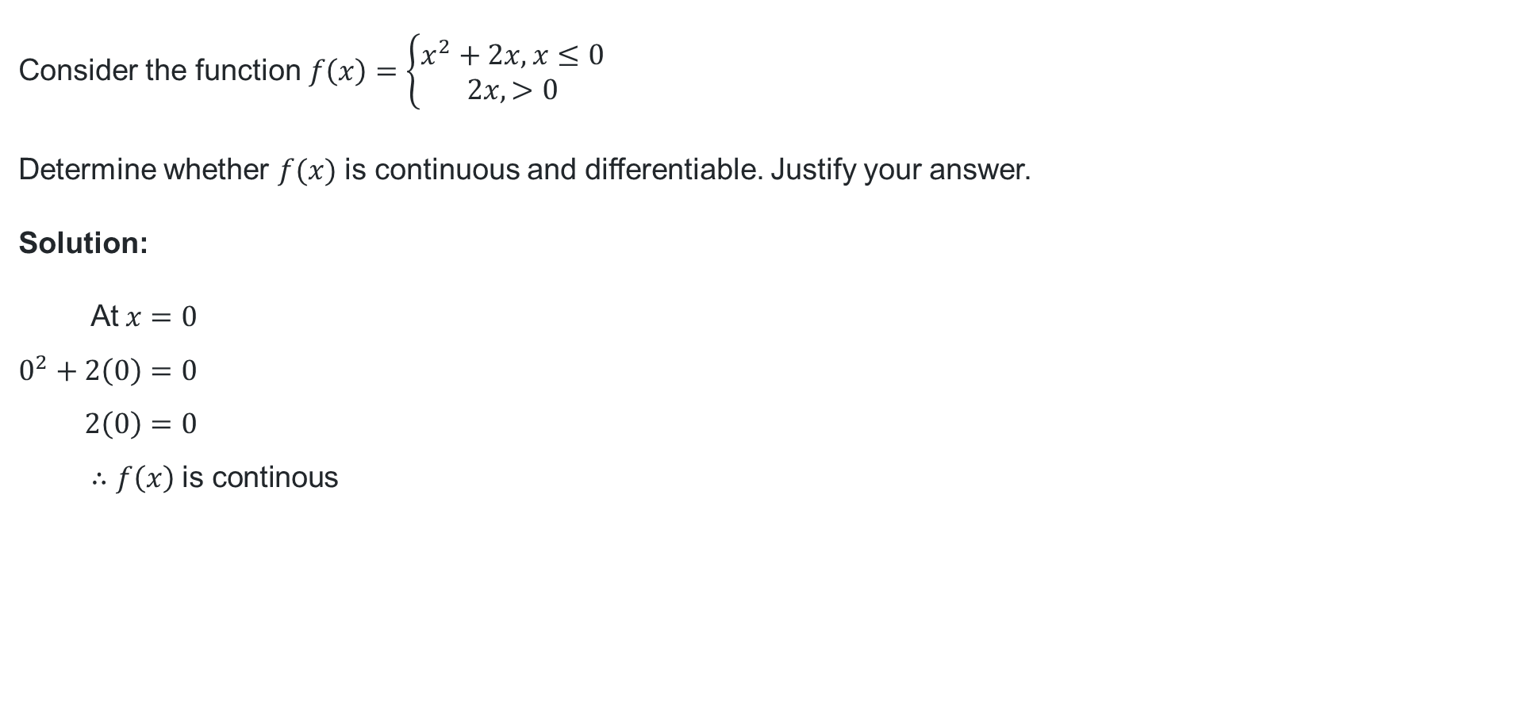
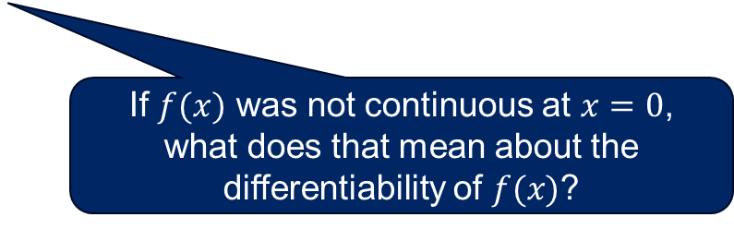

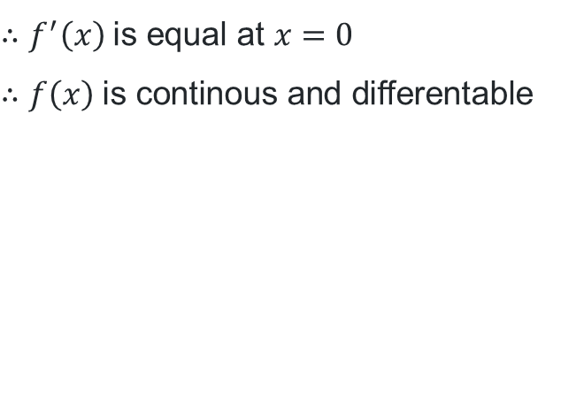
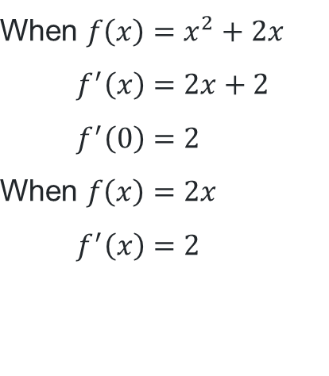
Question 1
Worked example
Consider the function$f\left(x\right)=\left\{\begin{aligned}x^{2}+2x, x≤0 \\ 2x, >0\end{aligned}\right.$
Determine whether $f(x)$ is continuous and differentiable. Justify your answer.
Solution:
$$\text{At} x=0 \\ 0^{2}+2\left(0\right)=0 \\ 2\left(0\right)=0 \\ ∴f\left(x\right) \text{is} \text{continous}$$
Why was the point
$x=0$ checked?
$$\text{When} f\left(x\right)=x^{2}+2x \\ f^{′}\left(x\right)=2x+2 \\ f^{′}\left(0\right)=2 \\ \text{When} f\left(x\right)=2x \\ f^{′}\left(x\right)=2$$
$$∴f^{′}\left(x\right) \text{is} \text{equal} \text{at} x=0 \\ ∴f\left(x\right) \text{is} \text{continous} \text{and} \text{differentable}$$
If $f(x)$ was not continuous at $x=0$, what does that mean about the differentiability of $f(x)$?

Slide 12

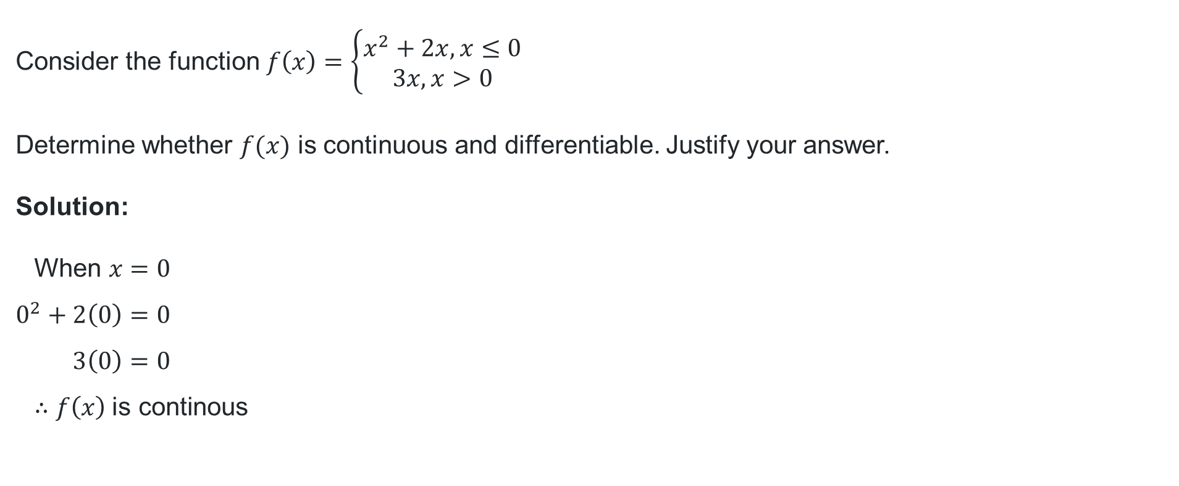
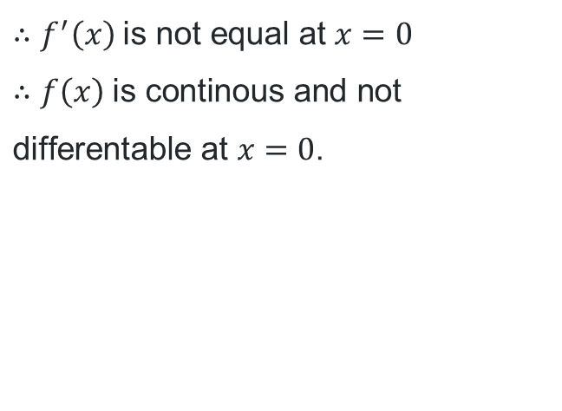
Question 2
Your turn
Consider the function$f\left(x\right)=\left\{\begin{aligned}x^{2}+2x, x≤0 \\ 3x, x>0\end{aligned}\right.$
Determine whether $f(x)$ is continuous and differentiable. Justify your answer.
Solution:
$$\text{When} x=0 \\ 0^{2}+2\left(0\right)=0 \\ 3\left(0\right)=0 \\ ∴f\left(x\right) \text{is} \text{continous}$$
$$\text{When} f\left(x\right)=x^{2}+2x \\ f^{′}\left(x\right)=2x+2 \\ f^{′}\left(0\right)=2 \\ \text{When} f\left(x\right)=3x \\ f^{′}\left(x\right)=3$$
$$∴f^{′}\left(x\right) \text{is} \text{not} \text{equal} \text{at} x=0$$
$∴f\left(x\right) \text{is} \text{continous} \text{and} \text{not} \text{differentable} \text{at} x=0$.

Slide 13
Statement 1
Always, sometimes, never
If a function is differentiable at a point, then it is continuous at that point.

Slide 14
Statement 2
Always, sometimes, never
If a function is continuous at a point, then it is differentiable at that point.

Slide 15
Statement 3
Always, sometimes, never
If a function is discontinuous at a point, then it is not differentiable at that point.

Slide 16
Statement 4
Always, sometimes, never
If a function is differentiable at all points in the domain, then it is continuous at all points in the domain.

Slide 17
Always, sometimes, never
If a function is differentiable at a point, then it is continuous at that point. – Always
If a function is continuous at a point, then it is differentiable at that point. – Sometimes
If a function is discontinuous at a point, then it is differentiable at that point. – Never
If a function is differentiable at all points in the domain, then it is continuous at all points in the domain. – Always

Slide 18
Independent practice

Slide 19
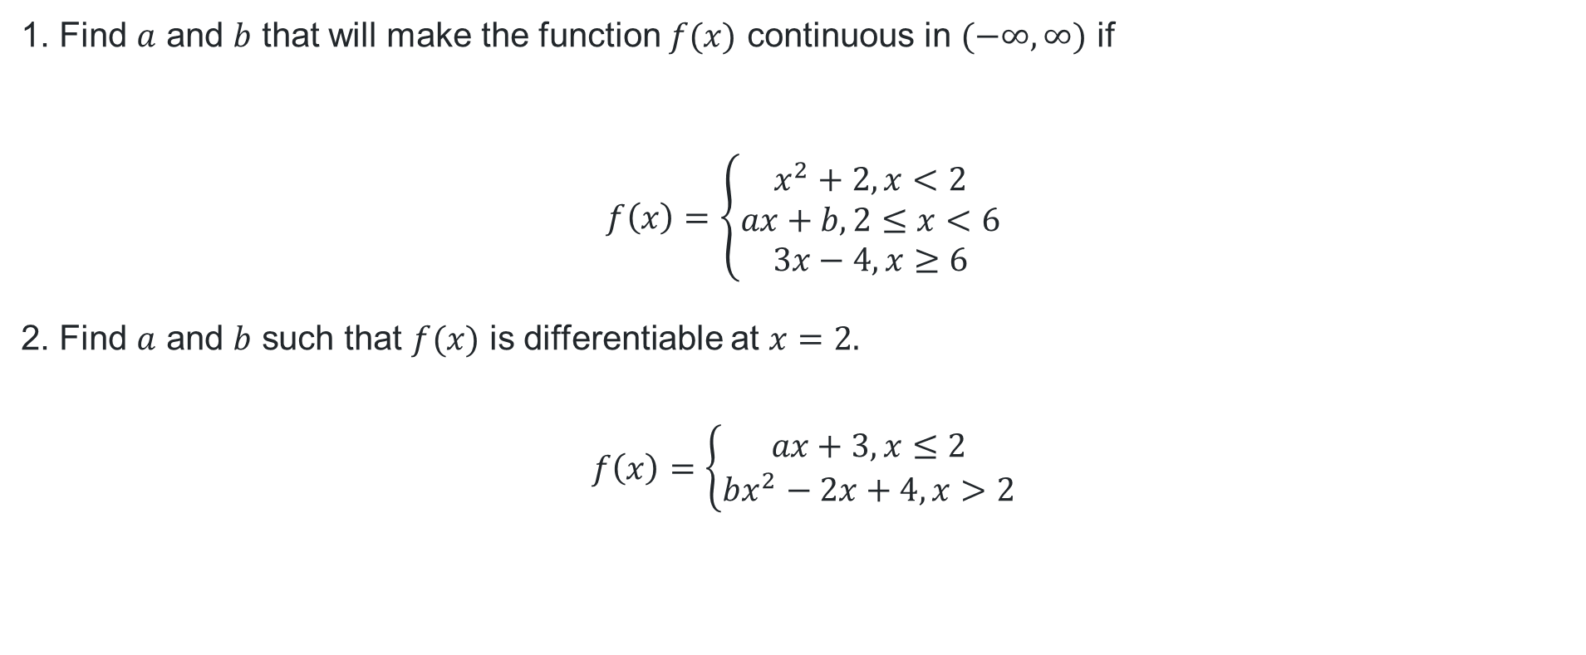
Continuous and differentiable
1. Find $a$ and $b$ that will make the function $f(x)$ continuous in $(−∞,∞)$ if
$$f\left(x\right)=\left\{\begin{aligned}x^{2}+2, x<2 \\ ax+b, 2≤x<6 \\ 3x−4, x≥6\end{aligned}\right.$$
2. Find $a$ and $b$ such that $f(x)$ is differentiable at $x=2.$
$$f\left(x\right)=\left\{\begin{aligned}ax+3, x≤2 \\ bx^{2}−2x+4, x>2\end{aligned}\right.$$

Slide 20
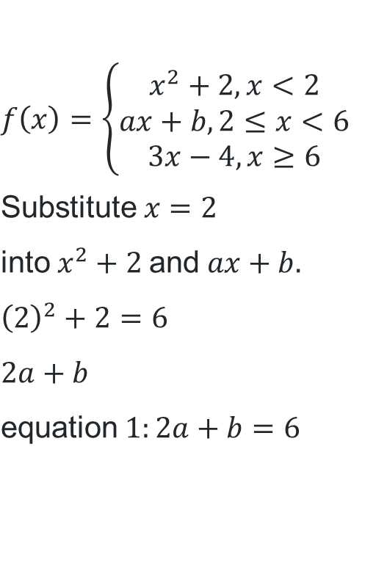
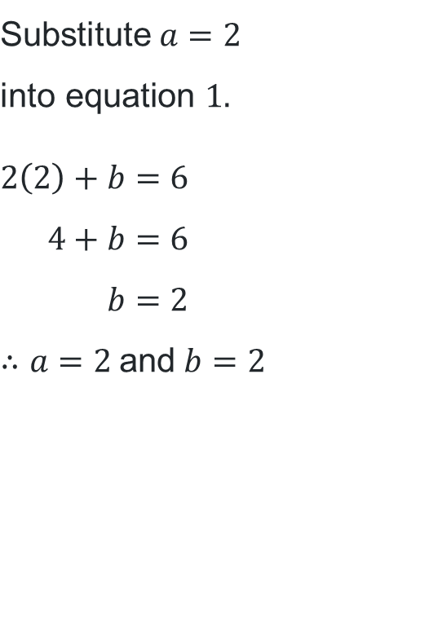
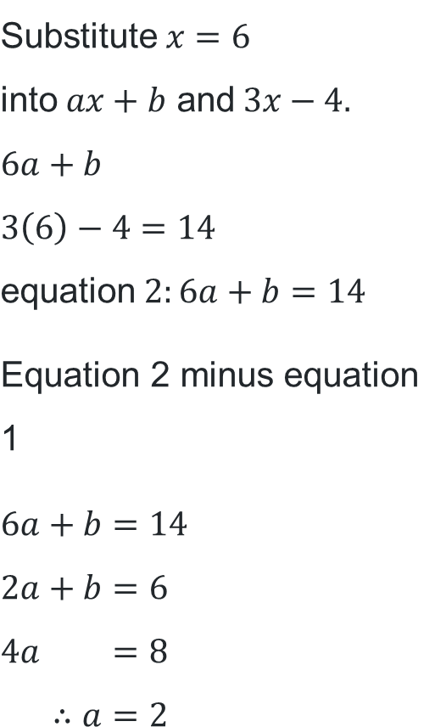
Question 1 solution
$$f\left(x\right)=\left\{\begin{aligned}x^{2}+2, x<2 \\ ax+b, 2≤x<6 \\ 3x−4, x≥6\end{aligned}\right. \\ \text{Substitute} x=2 \\ \text{into} x^{2}+2 \text{and} ax+b. \\ {\left(2\right)}^{2}+2=6 \\ 2a+b \\ \text{equation} 1:2a+b=6$$
$$\text{Substitute} x=6 \\ \text{into} ax+b \text{and} 3x−4. \\ 6a+b \\ 3\left(6\right)−4=14 \\ \text{equation} 2:6a+b=14$$
$$\text{Equation}\text{ 2 }\text{minus} \text{equation}\text{ 1}$$
$$6a+b=14 \\ 2a+b=6 \\ 4a =8 \\ ∴a=2$$
$$\text{Substitute} a=2 \\ \text{into} \text{equation} 1.$$
$$2\left(2\right)+b=6 \\ 4+b=6 \\ b=2 \\ ∴a=2 \text{and} b=2$$

Slide 21
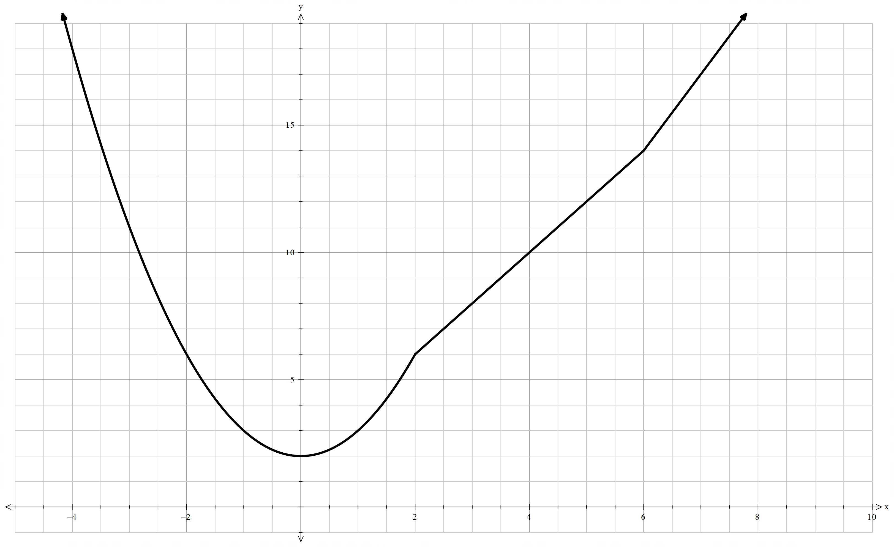
Graph of question 1

Slide 22
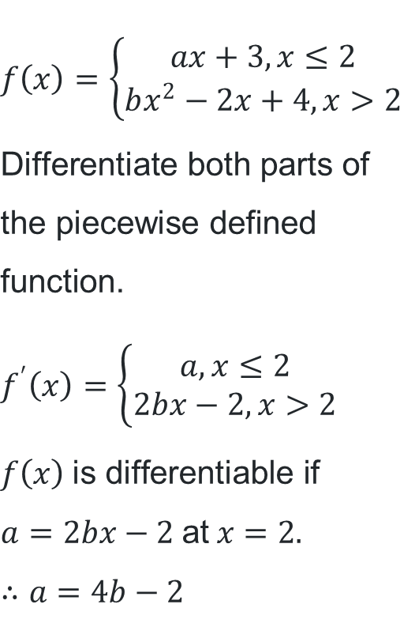
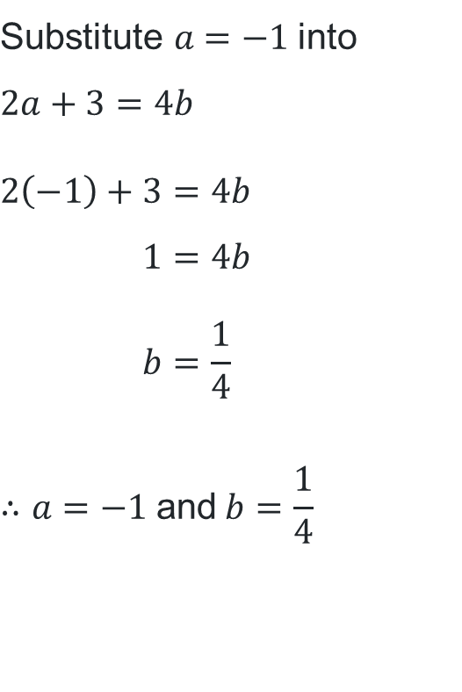
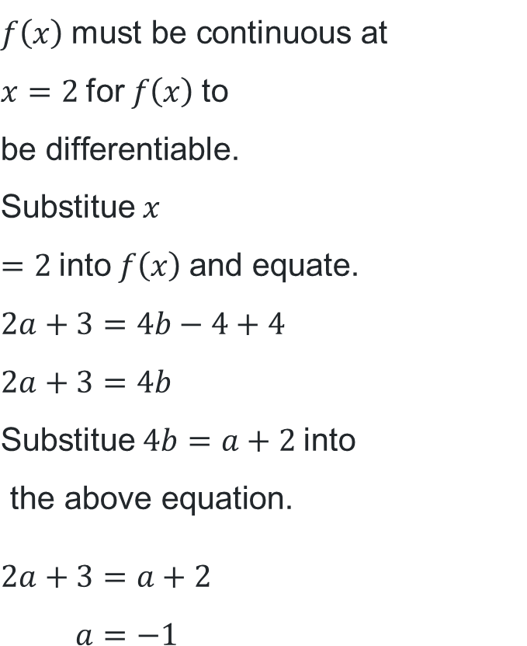
Question 2 solution
$$f\left(x\right)=\left\{\begin{aligned}ax+3, x≤2 \\ bx^{2}−2x+4, x>2\end{aligned}\right. \\ \text{Differentiate} \text{both} \text{parts} \text{of} \text{the} \text{piecewise} \text{defined} \text{function}\text{.} \\ f^{′}\left(x\right)=\left\{\begin{aligned}a, x≤2 \\ 2bx−2, x>2\end{aligned}\right. \\ f\left(x\right) \text{is} \text{differentiable} \text{if} \\ a=2bx−2 \text{at} x=2. \\ ∴a=4b−2$$
$$f\left(x\right) \text{must} \text{be} \text{continuous} \text{at} \\ x=2 \text{for} f\left(x\right) \text{to} \\ \text{be} \text{differentiable}\text{.} \\ \text{Substitue} x=2 \text{into} f\left(x\right) \text{and} \text{equate}\text{.} \\ 2a+3=4b−4+4 \\ 2a+3=4b \\ \text{Substitue} 4b=a+2 \text{into} \\ \text{the} \text{above} \text{equation}\text{.}$$
$$2a+3=a+2 \\ a=−1$$
$$\text{Substitute} a=−1 \text{into} \\ 2a+3=4b$$
$$2\left(−1\right)+3=4b \\ 1=4b \\ b=\frac{1}{4}$$
$$∴a=−1 \text{and} b=\frac{1}{4}$$

Slide 23
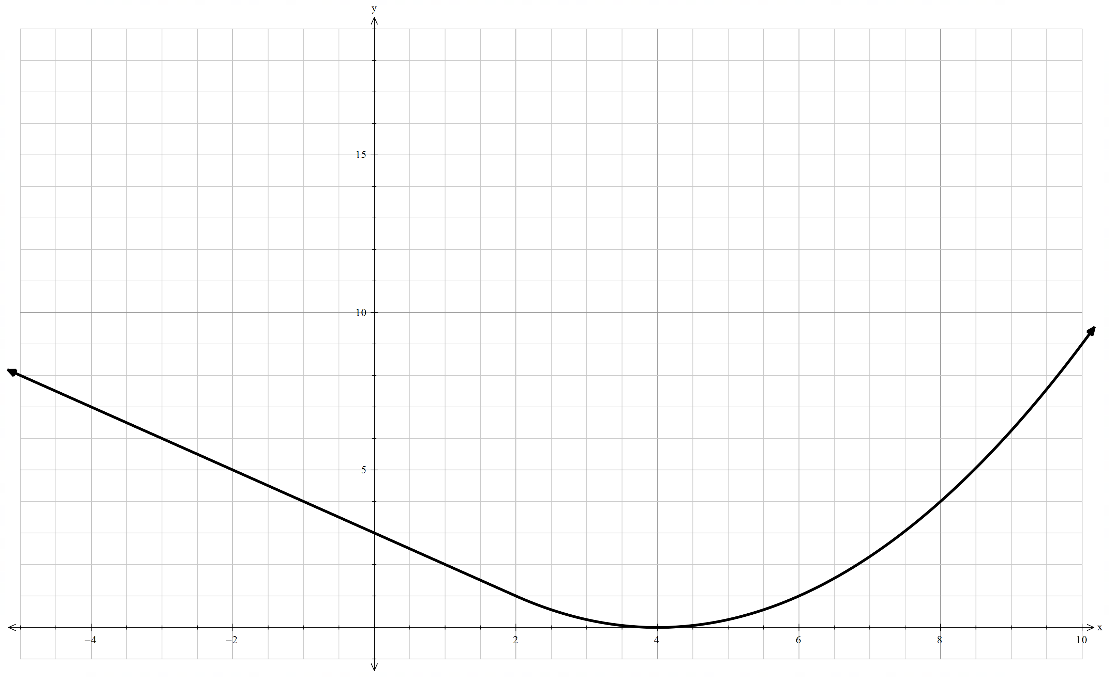
Graph of question 2

Slide 24
References
This presentation contains NSW Curriculum and syllabus content. The NSW Curriculum is developed by the NSW Education Standards Authority. This content is prepared by NESA for and on behalf of the Crown in the right of the State of New South Wales. The material is protected by Crown copyright.
Please refer to the NESA Copyright Disclaimer for more information https://educationstandards.nsw.edu.au/wps/portal/nesa/mini-footer/copyright.
NESA holds the only official and up-to-date versions of the NSW Curriculum and syllabus documents. Please visit the NSW Education Standards Authority (NESA) website https://educationstandards.nsw.edu.au/wps/portal/nesa/home and the NSW Curriculum website https://curriculum.nsw.edu.au.
Mathematics Advanced 11-12 Syllabus © NSW Education Standards Authority (NESA) for and on behalf of the Crown in right of the State of New South Wales, 2024.
.

Slide 25
Copyright
© State of New South Wales (Department of Education), 2026
The copyright material published in this resource is subject to the Copyright Act 1968 (Cth) and is owned by the NSW Department of Education or, where indicated, by a party other than the NSW Department of Education (third-party material).
Copyright material available in this resource and owned by the NSW Department of Education is licensed under a Creative Commons Attribution 4.0 International (CC BY 4.0) license.
This license allows you to share and adapt the material for any purpose, even commercially.
Attribution should be given to © State of New South Wales (Department of Education), 2026.
Material in this resource not available under a Creative Commons license:
the NSW Department of Education logo, other logos and trademark-protected material
Material owned by a third party that has been reproduced with permission. You will need to obtain permission from the third party to reuse its material.
Links to third-party material and websites
Please note that the provided (reading/viewing material/list/links/texts) are a suggestion only and implies no endorsement, by the New South Wales Department of Education, of any author, publisher, or book title. School principals and teachers are best placed to assess the suitability of resources that would complement the curriculum and reflect the needs and interests of their students.
If you use the links provided in this document to access a third-party’s website, you acknowledge that the terms of use, including licence terms set out on the third-party’s website apply to the use which may be made of the materials on that third-party website or where permitted by the Copyright Act 1968 (Cth). The department accepts no responsibility for content on third-party websites.

