Slide 1
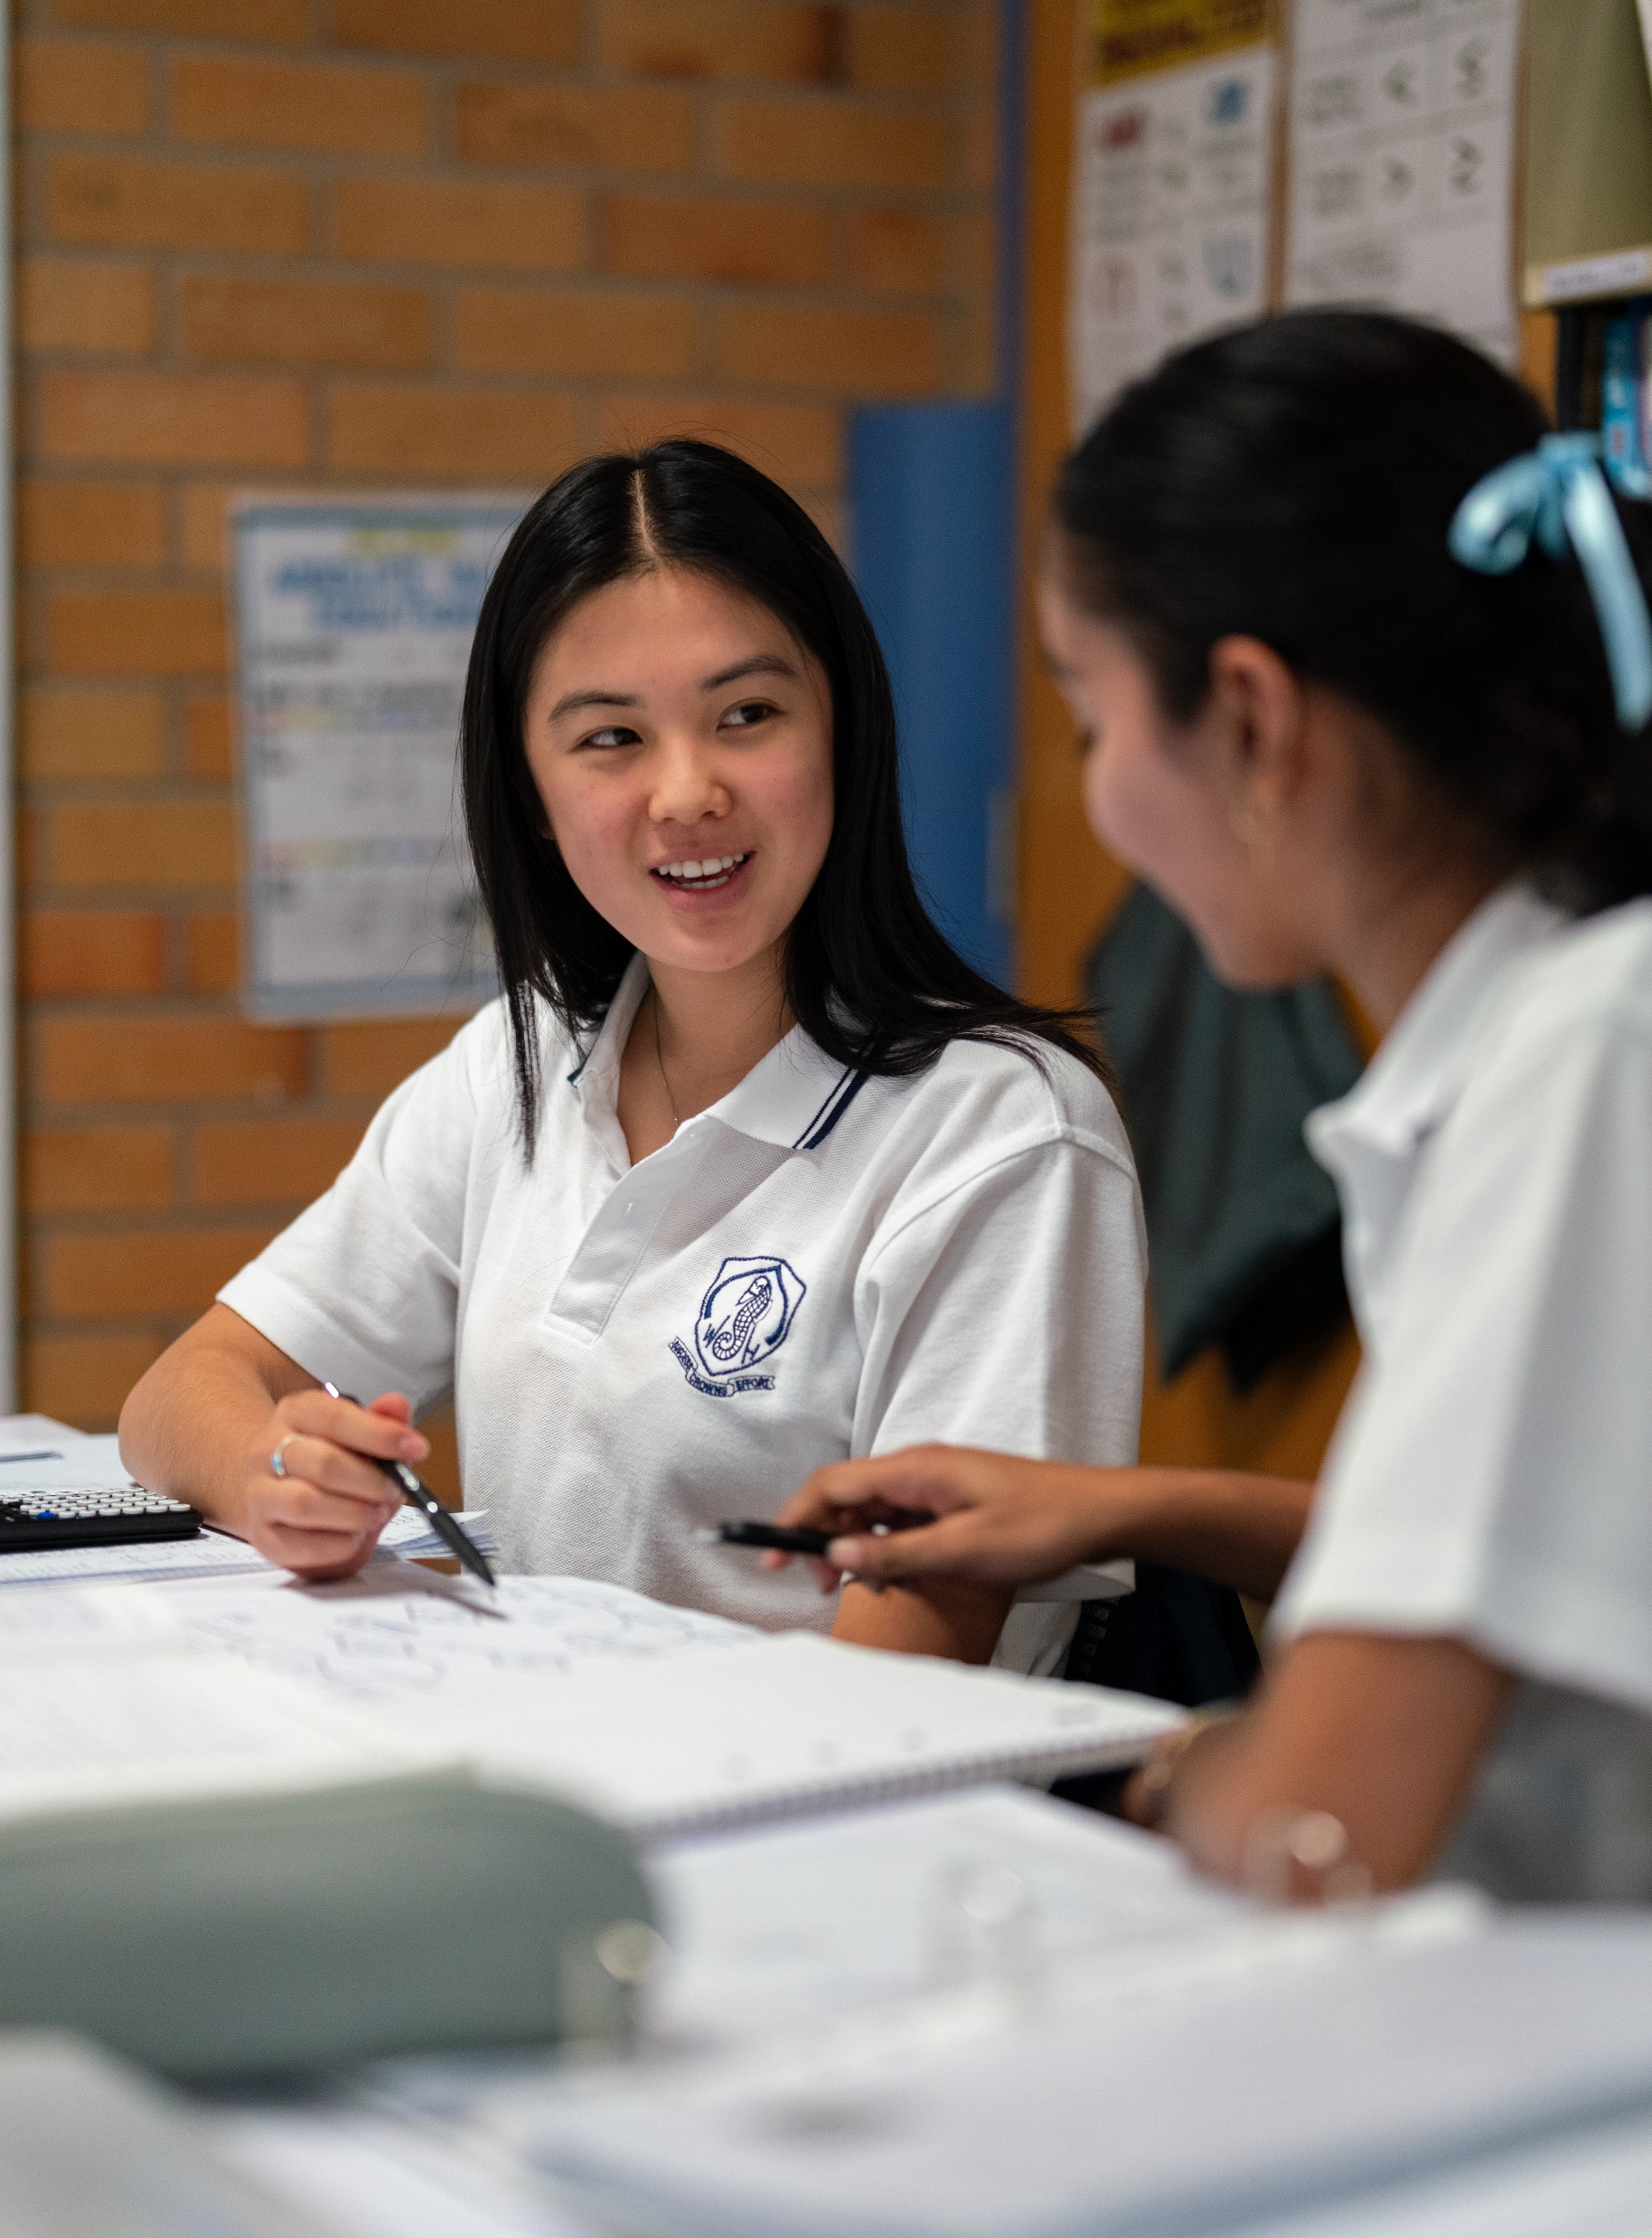
Where are the bees?
Stage 5
Unit 13 – Bivariate relationships

Slide 2
Explore

Slide 3
Modelling bee data
For each set of data
Explain which variable is the independent variable
Draw a scatter plot
Describe the relationship formed by the variables, if any
Fit a line of best fit by eye, if appropriate
Find the equation for your line of best fit
Explain what the gradient and y-intercept of the line of best fit represent
Describe any limitations of your models

Slide 4
Summarise

Slide 5
Summarising the bee data
When does the data suggest that bee colonies will die out?
Does the data support a claim that increasing the number of bees would increase food production?
Is there any association between the sample size and the number of mites?
Is there any association between the number of standing guards and the number of hovering guards in a colony?

Slide 6
Copyright
© State of New South Wales (Department of Education), 2024
The copyright material published in this resource is subject to the Copyright Act 1968 (Cth) and is owned by the NSW Department of Education or, where indicated, by a party other than the NSW Department of Education (third-party material).
Copyright material available in this resource and owned by the NSW Department of Education is licensed under a Creative Commons Attribution 4.0 International (CC BY 4.0) licence.
This licence allows you to share and adapt the material for any purpose, even commercially.
Attribution should be given to © State of New South Wales (Department of Education), 2024.
Material in this resource not available under a Creative Commons licence:
the NSW Department of Education logo, other logos and trademark-protected material
Material owned by a third party that has been reproduced with permission. You will need to obtain permission from the third party to reuse its material.
Links to third-party material and websites
Please note that the provided (reading/viewing material/list/links/texts) are a suggestion only and implies no endorsement, by the New South Wales Department of Education, of any author, publisher, or book title. School principals and teachers are best placed to assess the suitability of resources that would complement the curriculum and reflect the needs and interests of their students.
If you use the links provided in this document to access a third party’s website, you acknowledge that the terms of use, including licence terms set out on the third-party’s website apply to the use which may be made of the materials on that third-party website or where permitted by the Copyright Act 1968 (Cth). The department accepts no responsibility for content on third-party websites.

