Slide 1
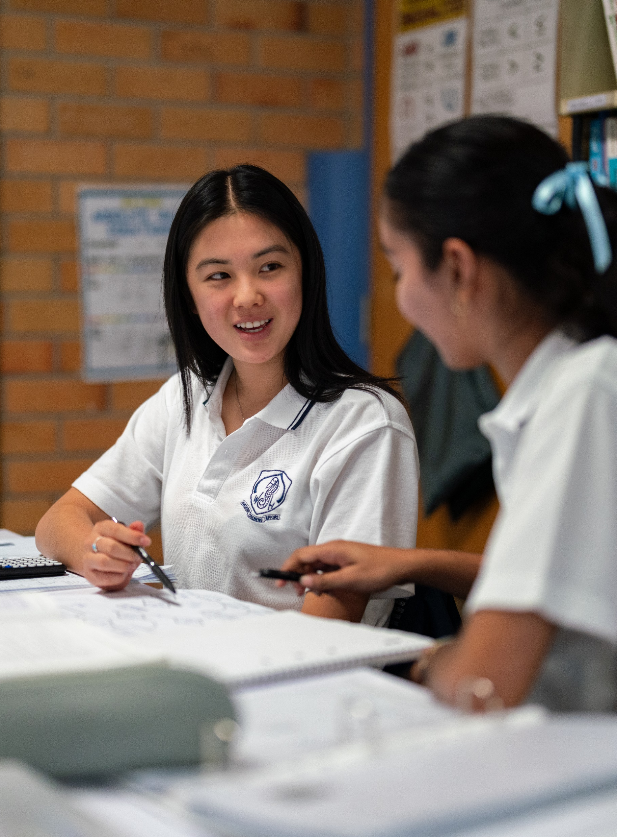
Causation
Stage 5
Unit 13 – Bivariate relationships

Slide 2
Launch

Slide 3
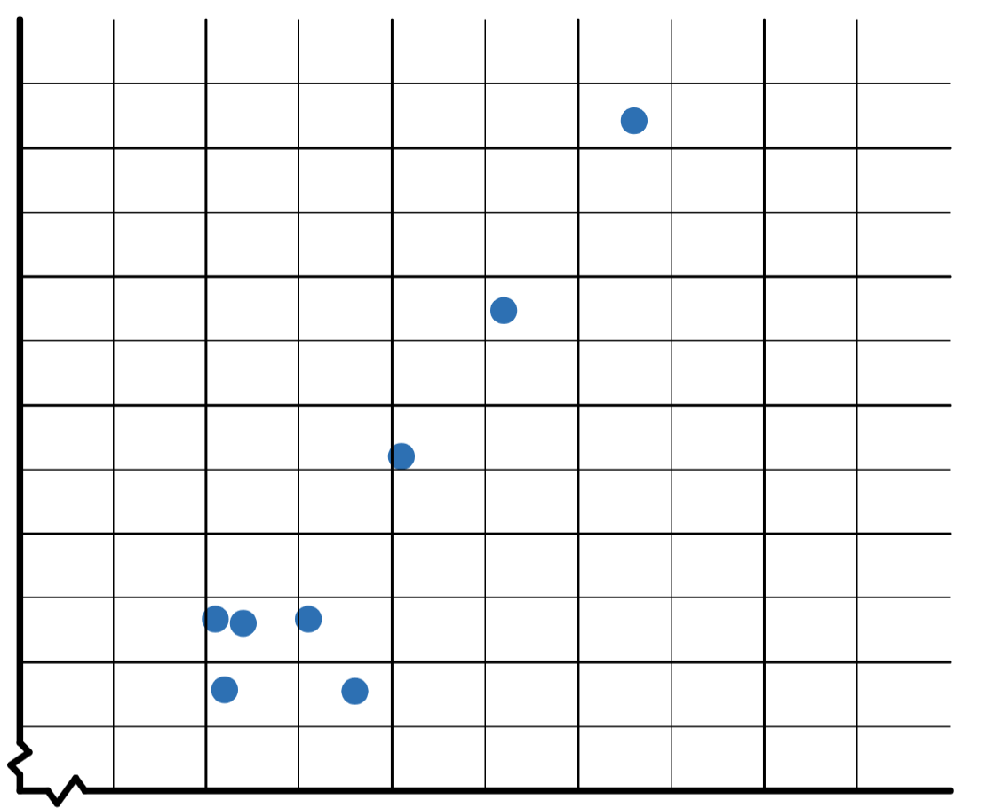
Causation (1)
Slow reveal graph (1)
What do you notice?
What do you wonder?

Slide 4
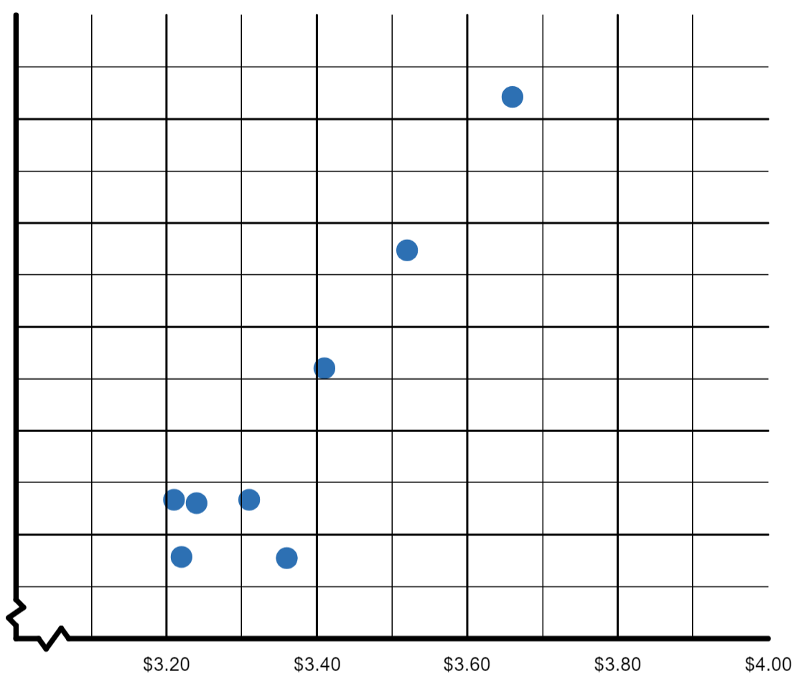
Causation (2)
Slow reveal graph (2)
What do you think this graph could be about?
What new information is now included?

Slide 5
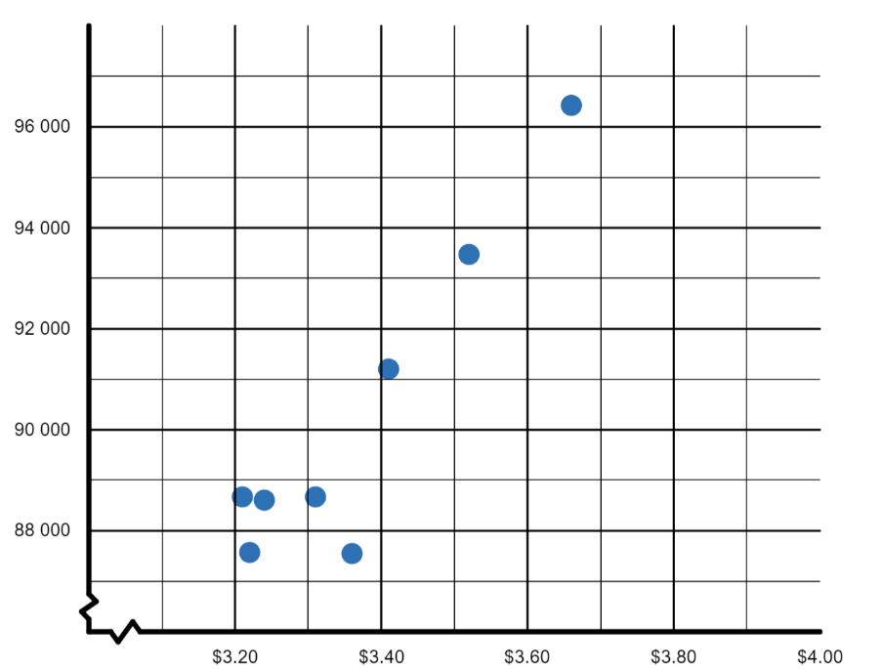
Causation (3)
Slow reveal graph (3)
What new information is now included?
How do these values affect your thinking about the scatter plot?

Slide 6
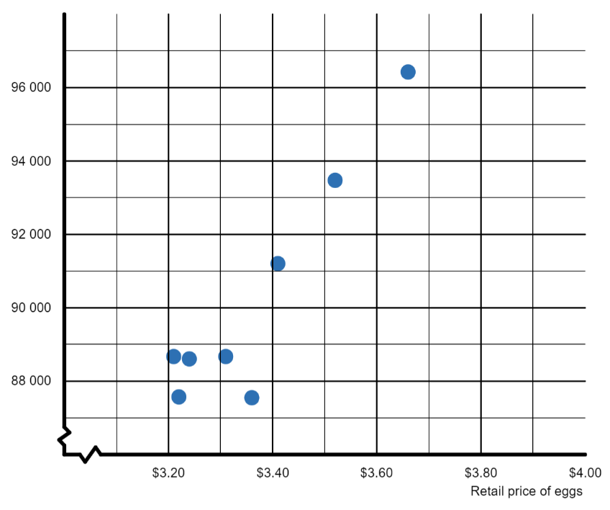
Causation (4)
Slow reveal graph (4)
What new information is now included?
What could the vertical axis represent?

Slide 7
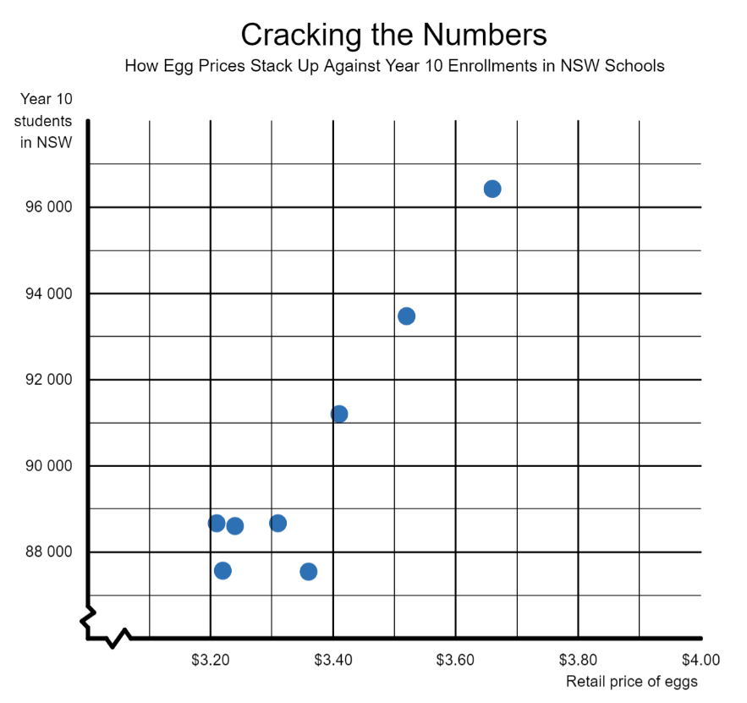
Causation (5)
Slow reveal graph (5)
What’s that got to do with the price of eggs?
What new information is now included?
Source: Adapted from Eggs by NSW Government (n.d.) and Schools by Australian Bureau of Statistics (2023)

Slide 8
Explore

Slide 9
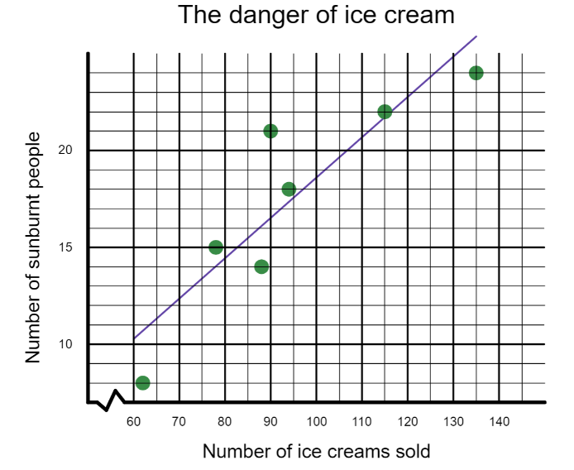
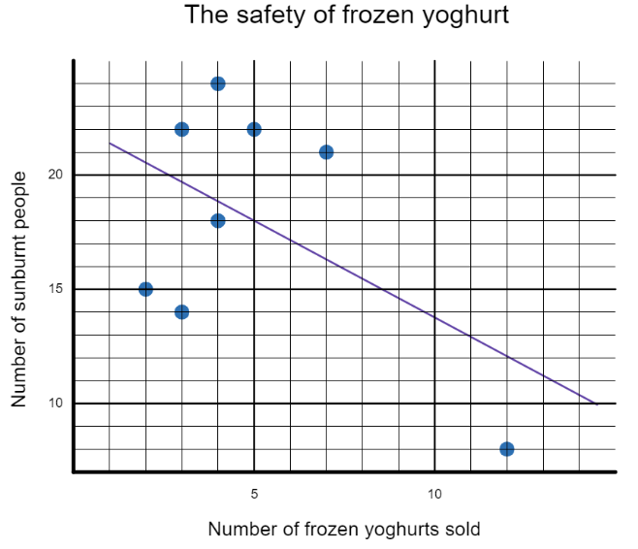
Causation (6)
Comparing scatterplots
A local frozen yoghurt shop owner collected data for 8 days to compare sales of ice cream
at a nearby ice cream shop with the number of people who are sunburnt at the nearby
beach. He believes that in the interests of public safety the ice cream store should be closed.

Slide 10
Apply

Slide 11
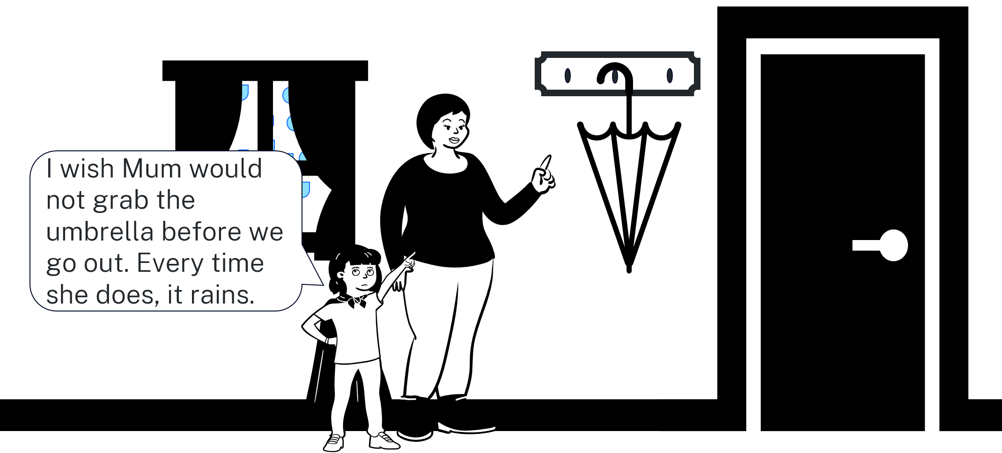
Causation (7)
Comic

Slide 12
Copyright
© State of New South Wales (Department of Education), 2024
The copyright material published in this resource is subject to the Copyright Act 1968 (Cth) and is owned by the NSW Department of Education or, where indicated, by a party other than the NSW Department of Education (third-party material).
Copyright material available in this resource and owned by the NSW Department of Education is licensed under a Creative Commons Attribution 4.0 International (CC BY 4.0) licence.
This licence allows you to share and adapt the material for any purpose, even commercially.
Attribution should be given to © State of New South Wales (Department of Education), 2024.
Material in this resource not available under a Creative Commons licence:
the NSW Department of Education logo, other logos and trademark-protected material
Material owned by a third party that has been reproduced with permission. You will need to obtain permission from the third party to reuse its material.
Links to third-party material and websites
Please note that the provided (reading/viewing material/list/links/texts) are a suggestion only and implies no endorsement, by the New South Wales Department of Education, of any author, publisher, or book title. School principals and teachers are best placed to assess the suitability of resources that would complement the curriculum and reflect the needs and interests of their students.
If you use the links provided in this document to access a third party’s website, you acknowledge that the terms of use, including licence terms set out on the third-party’s website apply to the use which may be made of the materials on that third-party website or where permitted by the Copyright Act 1968 (Cth). The department accepts no responsibility for content on third-party websites.

