Slide 1

Population clock
NSW Department of Education
Stage 5

Slide 2
Explore
NSW Department of Education

Slide 3
World’s population (1)
2023 and historical data
Group | 2000 population | Yearly change (%) | 2023 population
World | 6 148 898 975 | 1.37% | 8 118 835 999
$$FV=PV{\left(1+r\right)}^{n}$$

Slide 4
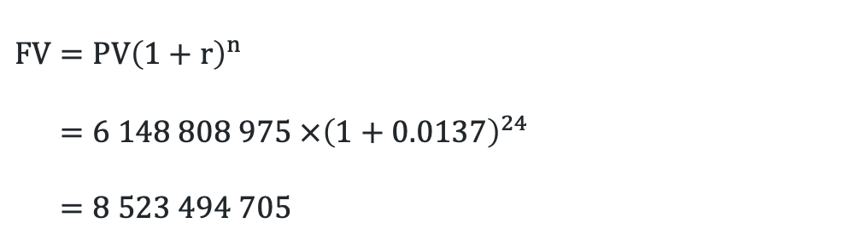
World’s population (2)
2023 and historical data worked solution
Group | 2000 population | Yearly change (%) | 2023 population
World | 6 148 898 975 | 1.37% | 8 118 835 999
$$FV=PV{\left(1+r\right)}^{n} \\ =6 148 808 975 ×{\left(1+0.0137\right)}^{24} \\ =8 523 494 705$$

Slide 5
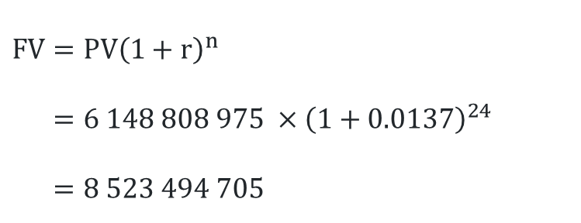
World’s population (3)
Self-explanation prompts
Group | 2000 population | Yearly change (%) | 2023 population
World | 6 148 898 975 | 1.37% | 8 118 835 999
$$FV=PV{\left(1+r\right)}^{n} \\ =6 148 808 975 ×{\left(1+0.0137\right)}^{24} \\ =8 523 494 705$$
What does the number represent?
Where has the number 24 come from?
This number differs from the 2023 population. Why?

Slide 6
Summarise

Slide 7
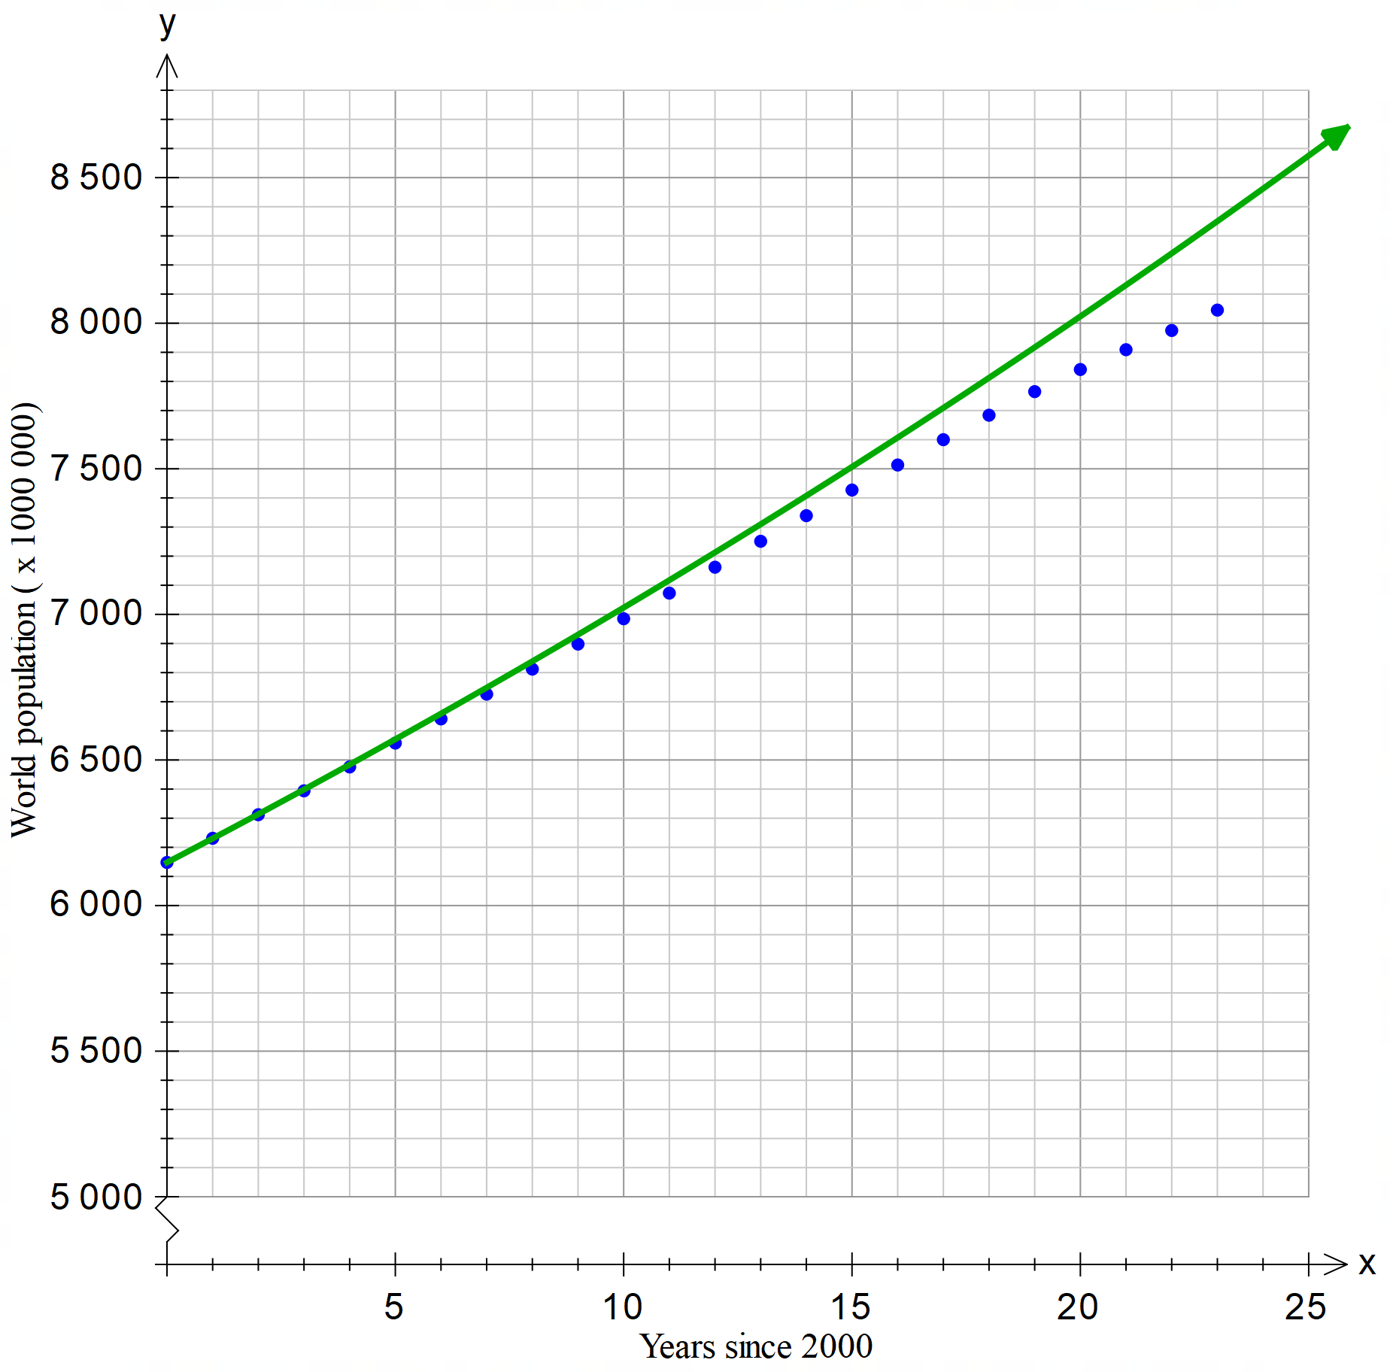
World population
Predicted v actual
Is the green line predicted or actual population? How do you know?

Slide 8
PMI Table
Exponential graphs to model population growth
What are the pluses, and minuses to using an exponential graph to model population growth?
What do you find interesting?
Plus | Minus | Interesting

Slide 9
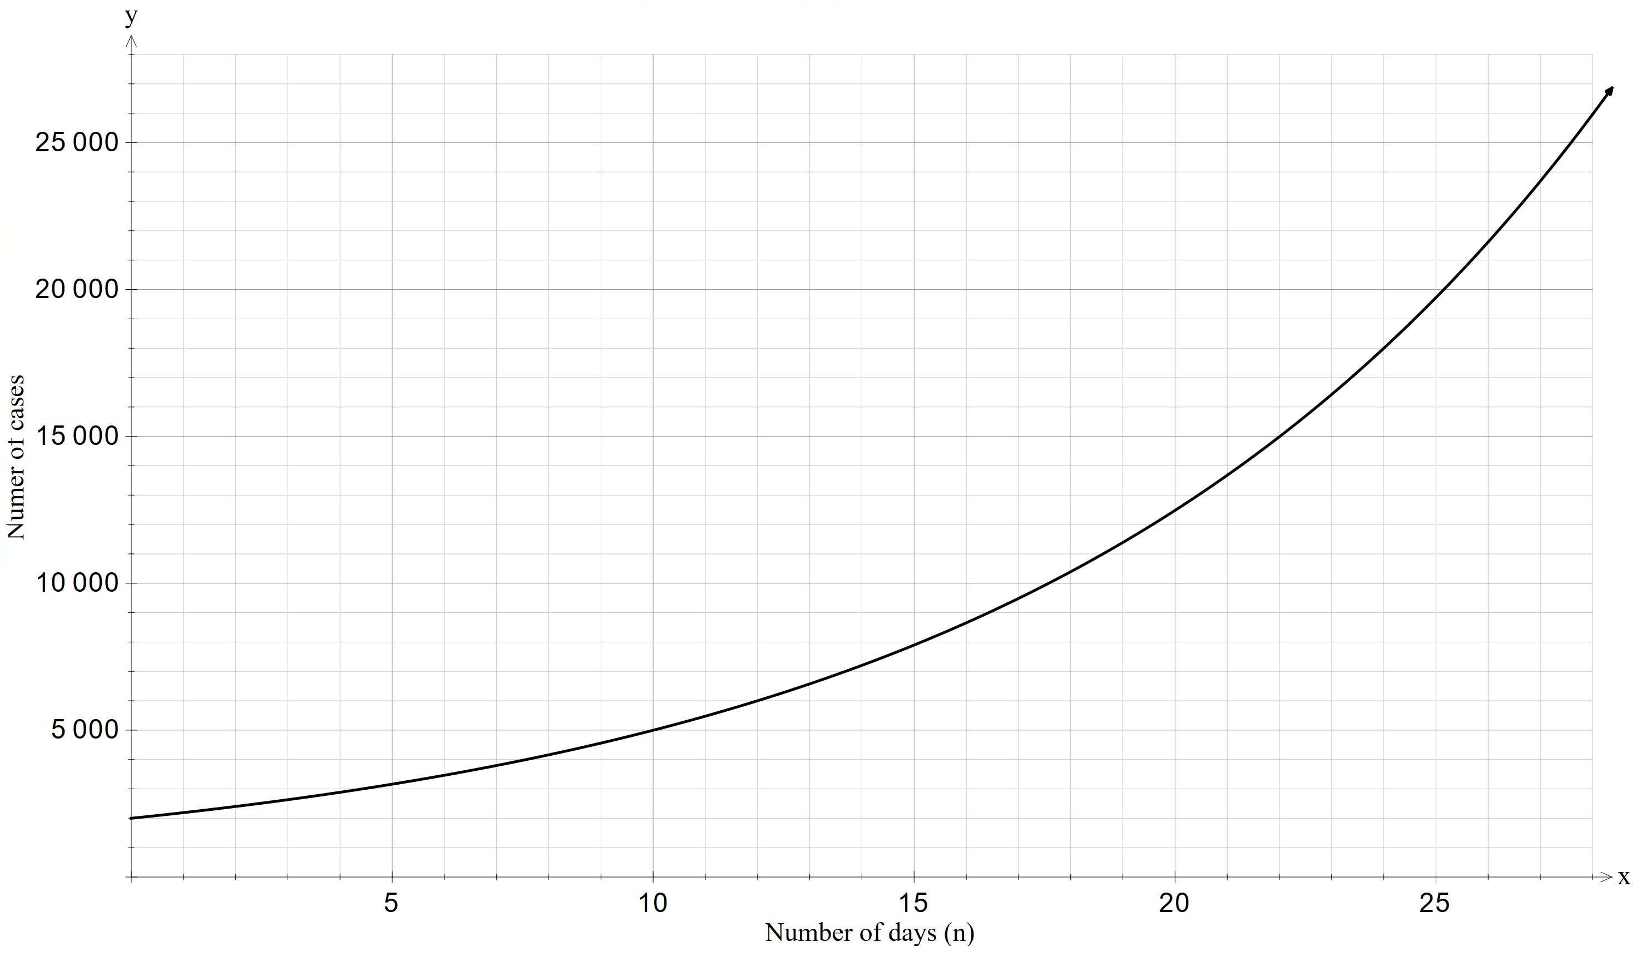

COVID-19 model (1)
Worked example 1
The graph below models the number of cases of COVID-19 (y) over the number of days (n).
Use the graph to predict the case numbers after 23 days.
$$≈16800 cases$$

Slide 10
COVID-19 model (2)
Worked example 1 – self-explanation prompts
The graph below models the number of cases of COVID-19 (y) over the number of days (n).
Use the graph to predict the case numbers after 23 days.
$$≈16800 cases$$
Describe how the red line was constructed.
What does the vertical line tell us? How?
What are some limitations to the model?

Slide 11
COVID-19 model (3)
Your turn – question 1
The graph below models the number of cases of COVID-19 (y) over the number of days (n).
Use the graph to predict the cases after 10 days.

Slide 12

COVID-19 model (4)
Your turn – solution 1
The graph below models the number of cases of COVID-19 (y) over the number of days (n).
Use the graph to predict the cases after 10 days.
$$≈5000 cases$$

Slide 13
Copyright
© State of New South Wales (Department of Education), 2024
The copyright material published in this resource is subject to the Copyright Act 1968 (Cth) and is owned by the NSW Department of Education or, where indicated, by a party other than the NSW Department of Education (third-party material).
Copyright material available in this resource and owned by the NSW Department of Education is licensed under a Creative Commons Attribution 4.0 International (CC BY 4.0) license.
This license allows you to share and adapt the material for any purpose, even commercially.
Attribution should be given to © State of New South Wales (Department of Education), 2024.
Material in this resource not available under a Creative Commons license:
the NSW Department of Education logo, other logos and trademark-protected material
Material owned by a third party that has been reproduced with permission. You will need to obtain permission from the third party to reuse its material.
Links to third-party material and websites
Please note that the provided (reading/viewing material/list/links/texts) are a suggestion only and implies no endorsement, by the New South Wales Department of Education, of any author, publisher, or book title. School principals and teachers are best placed to assess the suitability of resources that would complement the curriculum and reflect the needs and interests of their students.
If you use the links provided in this document to access a third-party’s website, you acknowledge that the terms of use, including licence terms set out on the third-party’s website apply to the use which may be made of the materials on that third-party website or where permitted by the Copyright Act 1968 (Cth). The department accepts no responsibility for content on third-party websites.

