Slide 1
Cos it’s the angle
Explicit teaching

Slide 2
Launch

Slide 3
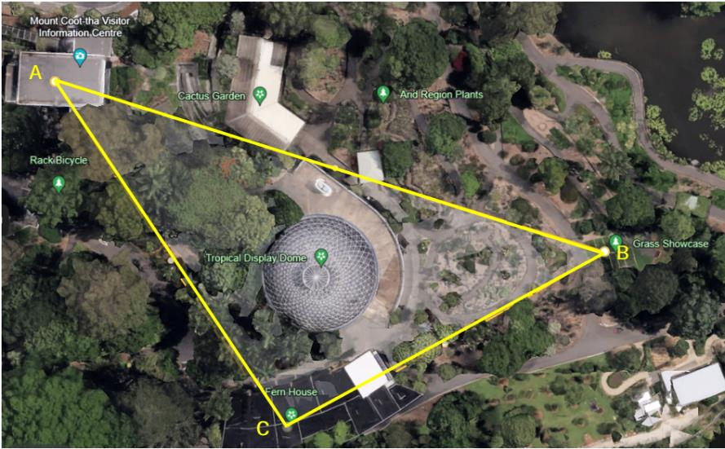
Cos it’s the angle (1)
Which is the longest?

Slide 4
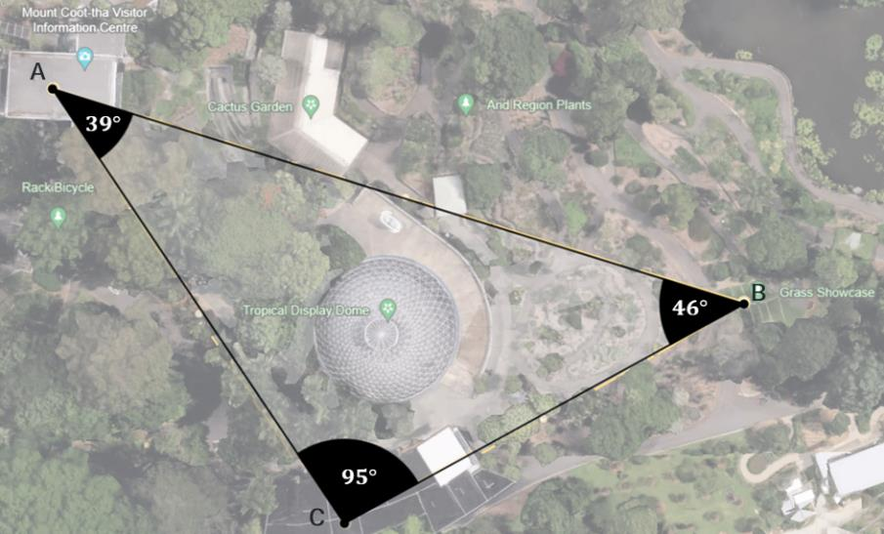
Cos it’s the angle (2)
Would you change your answer?
$$46°$$
$$95°$$

Slide 5
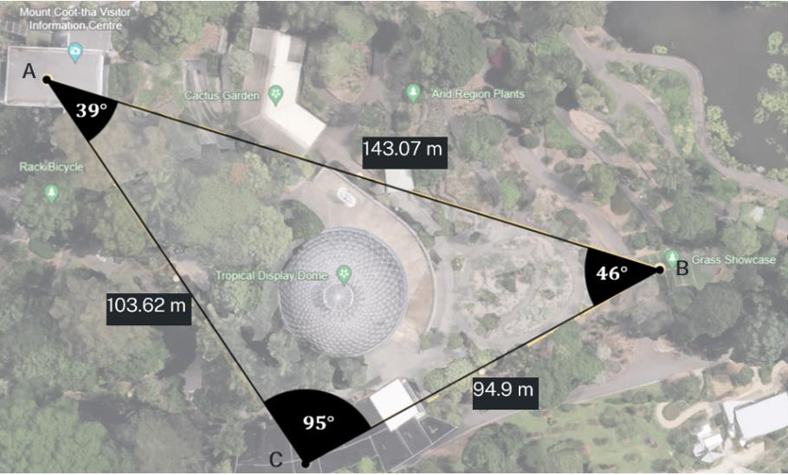
Cos it’s the angle (3)
What do you notice and wonder?

Slide 6
Explore

Slide 7
Cos it’s the angle (4)
Acute, right angled and obtuse triangle

Slide 8
Cos it’s the angle (5)
Changing the subject – self-explanation prompts
Rearrange $c^{2}=a^{2}+b^{2}−2ab \cos{C}$ into $\cos{C}=\frac{a^{2}+b^{2}−c^{2}}{2ab}$
$$c^{2}=a^{2}+b^{2}−2ab\cos{C} \\ 2ab\cos{C=a^{2}+b^{2}−c^{2}} \\ \frac{2ab\cos{C}}{2ab}=\frac{a^{2}+b^{2}−c^{2}}{2ab} \\ \cos{C=\frac{a^{2}+b^{2}−c^{2}}{2ab}}$$
How do we get to this from the previous line?
How is this different from the previous line?
Why have we stopped here?

Slide 9
Summarise

Slide 10
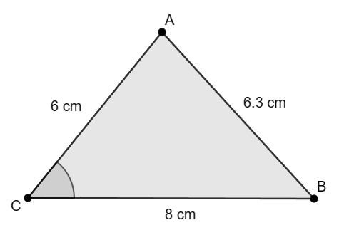
Cos it’s the angle (6)
Example 1
$$\cos{C}=\frac{a^{2}+b^{2}−c^{2}}{2ab}$$
$$\cos{C}=\frac{8^{2}+6^{2}−{6.3}^{2}}{2×8×6} \\ =\frac{60.31}{96} \\ C=\cos^{−1}\left(\frac{60.31}{96}\right) \\ C=51.08040583 \\ C≈51°5′$$
Find the missing angle at C.

Slide 11
Cos it’s the angle (7)
Example 1 – self-explanation prompts
$$\cos{C}=\frac{a^{2}+b^{2}−c^{2}}{2ab}$$
$$\cos{C}=\frac{8^{2}+6^{2}−{6.3}^{2}}{2×8×6} \\ =\frac{60.31}{96} \\ C=\cos^{−1}\left(\frac{60.31}{96}\right) \\ C=51.08040583 \\ C≈51°5′$$
Find the missing angle at C.
What has changed?
Why was this symbol used?
Why do we write this?

Slide 12
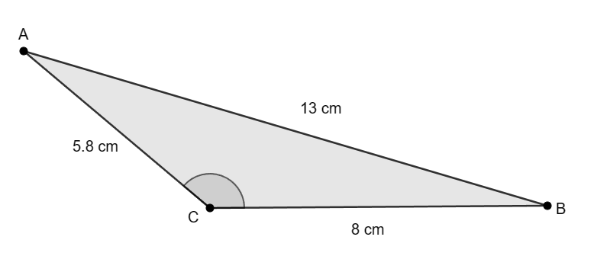
Cos it’s the angle (8)
Your turn – question 1
Find the missing angle at C.

Slide 13
Cos it’s the angle (9)
Your turn – solution 1
Find the missing angle at C.
$$\cos{C}=\frac{a^{2}+b^{2}−c^{2}}{2ab} \\ \cos{C}=\frac{8^{2}+{5.8}^{2}−{13}^{2}}{2×8×5.8} \\ \cos{C}=\frac{−71.36}{92.8} \\ C=\cos^{−1}{\frac{−71.36}{92.8}} \\ C=140.2610839.. \\ C≈140°16′$$

Slide 14
Apply

Slide 15
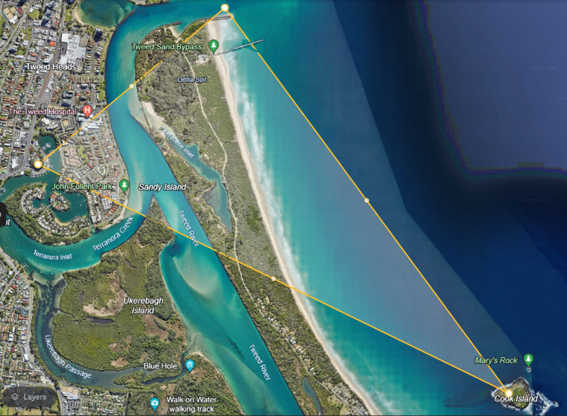
Cos it’s the angle (10)
Finding my bearings

Slide 16
Copyright
© State of New South Wales (Department of Education), 2024
The copyright material published in this resource is subject to the Copyright Act 1968 (Cth) and is owned by the NSW Department of Education or, where indicated, by a party other than the NSW Department of Education (third-party material).
Copyright material available in this resource and owned by the NSW Department of Education is licensed under a Creative Commons Attribution 4.0 International (CC BY 4.0) license.
This license allows you to share and adapt the material for any purpose, even commercially.
Attribution should be given to © State of New South Wales (Department of Education), 2024.
Material in this resource not available under a Creative Commons license:
the NSW Department of Education logo, other logos and trademark-protected material
Material owned by a third party that has been reproduced with permission. You will need to obtain permission from the third party to reuse its material.
Links to third-party material and websites
Please note that the provided (reading/viewing material/list/links/texts) are a suggestion only and implies no endorsement, by the New South Wales Department of Education, of any author, publisher, or book title. School principals and teachers are best placed to assess the suitability of resources that would complement the curriculum and reflect the needs and interests of their students.
If you use the links provided in this document to access a third-party’s website, you acknowledge that the terms of use, including licence terms set out on the third-party’s website apply to the use which may be made of the materials on that third-party website or where permitted by the Copyright Act 1968 (Cth). The department accepts no responsibility for content on third-party websites.

