Slide 1
GPS positioning
Explicit teaching

Slide 2
Explore

Slide 3
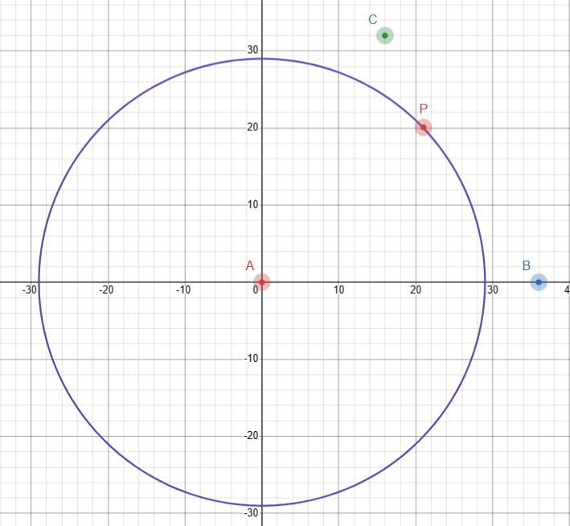
GPS positioning (3)
Desmos – drawing a circle
Distance is 29 km

Slide 4
GPS positioning (4)
Formula for the graph of a circle
$${\left(x−a\right)}^{2}+{\left(y−b\right)}^{2}=r^{2}$$

Slide 5
Summarise

Slide 6
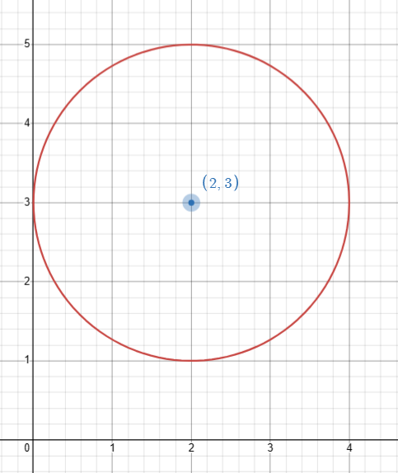
GPS positioning (5)
Example 1
Write the equation of the circle from the graph.
Centre of the circle is $(2,3).$
Radius is $2$.
Equation of the circle is ${(x−2)}^{2}+{(y−3)}^{2}=2^{2}$

Slide 7
GPS positioning (6)
Example 1 – self-explanation prompts
Write the equation of the circle from the graph.
Centre of the circle is $(2,3).$
Radius is $2$.
Equation of the circle is ${(x−2)}^{2}+{(y−3)}^{2}=2^{2}$
Why did we subtract 3?
Why did we subtract 2?
Where does the 2 come from?

Slide 8
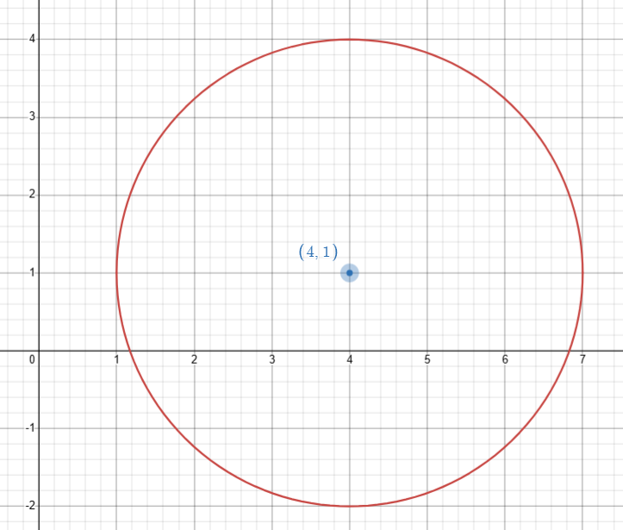
GPS positioning (7)
Your turn – question 1
Write the equation of the circle from the graph.
Centre of the circle is:
Radius is:
Equation of the circle is:

Slide 9
GPS positioning (8)
Your turn – solution 1
Write the equation of the circle from the graph.
Centre of the circle is $(4,1)$.
Radius is $3$.
Equation of the circle is ${(x−4)}^{2}+{(y−1)}^{2}=3^{2}$.

Slide 10
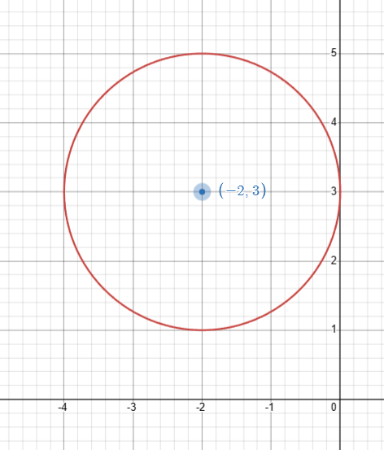
GPS positioning (9)
Example 2
Write the equation of the circle from the graph.
Centre of the circle is $(−2,3).$
Radius is $2$.
Equation of the circle is ${(x+2)}^{2}+{(y−3)}^{2}=2^{2}$.

Slide 11
GPS positioning (10)
Example 2 – self-explanation prompts
Write the equation of the circle from the graph.
Centre of the circle is $(−2,3).$
Radius is $2$.
Equation of the circle is ${(x+2)}^{2}+{(y−3)}^{2}=2^{2}$
Why did we subtract 3?
Why did we add 2?
Where does the 2 come from?

Slide 12
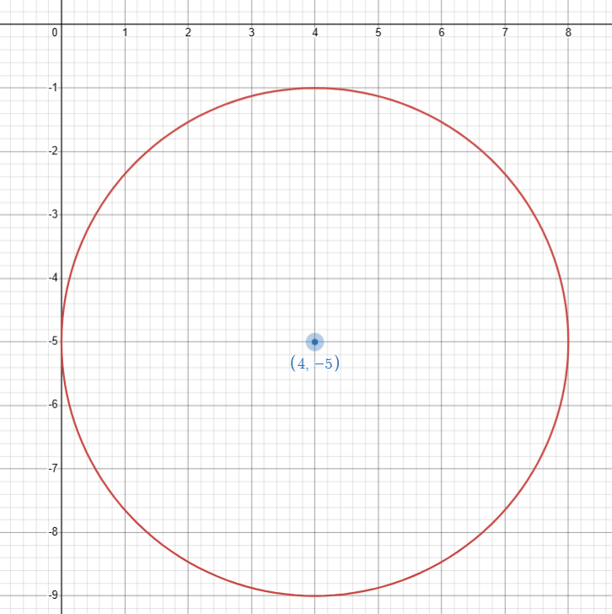
GPS positioning (11)
Your turn – question 2
Write the equation of the circle from the graph.

Slide 13
GPS positioning (12)
Your turn – solution 2
Write the equation of the circle from the graph.
Centre of the circle is $(4, −5)$.
Radius is $4$.
Equation of the circle is ${(x−4)}^{2}+{(y+5)}^{2}=4^{2}$.

Slide 14
Copyright
© State of New South Wales (Department of Education), 2024
The copyright material published in this resource is subject to the Copyright Act 1968 (Cth) and is owned by the NSW Department of Education or, where indicated, by a party other than the NSW Department of Education (third-party material).
Copyright material available in this resource and owned by the NSW Department of Education is licensed under a Creative Commons Attribution 4.0 International (CC BY 4.0) license.
This license allows you to share and adapt the material for any purpose, even commercially.
Attribution should be given to © State of New South Wales (Department of Education), 2024.
Material in this resource not available under a Creative Commons license:
the NSW Department of Education logo, other logos and trademark-protected material
Material owned by a third party that has been reproduced with permission. You will need to obtain permission from the third party to reuse its material.
Links to third-party material and websites
Please note that the provided (reading/viewing material/list/links/texts) are a suggestion only and implies no endorsement, by the New South Wales Department of Education, of any author, publisher, or book title. School principals and teachers are best placed to assess the suitability of resources that would complement the curriculum and reflect the needs and interests of their students.
If you use the links provided in this document to access a third-party’s website, you acknowledge that the terms of use, including licence terms set out on the third-party’s website apply to the use which may be made of the materials on that third-party website or where permitted by the Copyright Act 1968 (Cth). The department accepts no responsibility for content on third-party websites.

