Slide 1
Unitary method
Stage 4
Further multiplicative thinking

Slide 2
Summarise

Slide 3
Unitary method (1)
Worked example 1
17% of a quantity is 221. Calculate 100% of the quantity.
$$17\%=221$$
$$÷17= ÷17$$
$$1\%=13$$
$$×100= ×100$$
$$100\%=1 300$$

Slide 4
Unitary method (2)
Self-explanation prompts
17% of a quantity is 221. Calculate 100% of the quantity.
$$17\%=221$$
$$÷17= ÷17$$
$$1\%=13$$
$$×100= ×100$$
$$100\%=1 300$$
Why is the equation being divided by 17 and not 17%?
Why does $×100$ appear twice?
How can you check if you are correct?

Slide 5
Unitary method (3)
Your turn – question 1
36% of a quantity is 54. Find 100% of the quantity.

Slide 6
Unitary method (4)
Your turn – solutions 1
36% of a quantity is 54. Find 100% of that quantity.
$$36\%=54$$
$$÷36= ÷36$$
$$1\%=1.5$$
$$×100= ×100$$
$$100\%=150$$

Slide 7
Apply

Slide 8
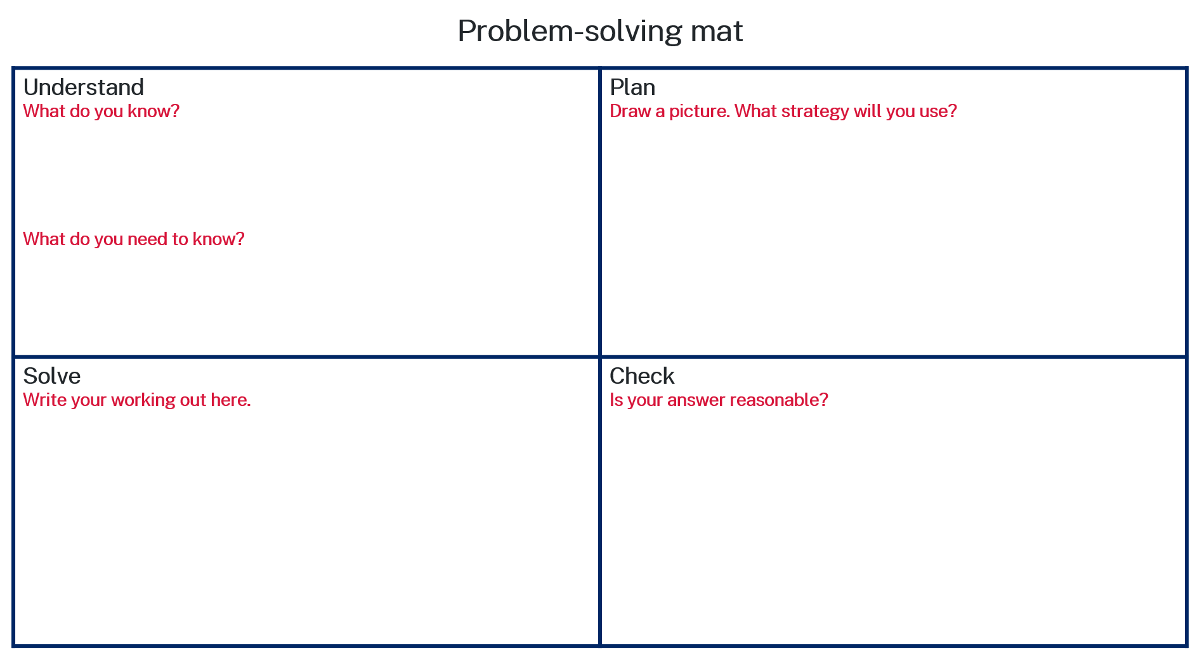
Unitary method (5)
Polya’s problem-solving process
When a farmer grows strawberries, the farmer finds 16% are unsuitable for sale. If 24 kg are unsuitable for sale, how many kilograms of strawberries does the farmer grow?

Slide 9
Unitary method (6)
Polya’s problem-solving process
When a farmer grows strawberries, the farmer finds 16% are unsuitable for sale. If 24 kg are unsuitable for sale, how many kilograms of strawberries does the farmer grow?
16% = 24 kg
What is 100%?

Slide 10
Unitary method (7)
Polya’s problem-solving process (3)
When a farmer grows strawberries, the farmer finds 16% are unsuitable for sale. If 24 kg are unsuitable for sale, how many kilograms of strawberries does the farmer grow?
16% = 24 kg
24kg
16%
What is 100%?
The Unitary method.

Slide 11
Unitary method (8)
Polya’s problem-solving process (4)
When a farmer grows strawberries, the farmer finds 16% are unsuitable for sale. If 24 kg are unsuitable for sale, how many kilograms of strawberries does the farmer grow?
16% = 24 kg
24kg
16%
What is 100%?
The Unitary method.
$$16\% = 24 kg$$
$$÷16= ÷16$$
$$1\% =1.5 kg$$
$$×100= ×100$$
$$100\% =150 kg$$

Slide 12
Unitary method (9)
Polya’s problem-solving process (5)
When a farmer grows strawberries, the farmer finds 16% are unsuitable for sale. If 24 kg are unsuitable for sale, how many kilograms of strawberries does the farmer grow?
16% = 24 kg
24kg
16%
What is 100%?
The Unitary method.
$$16\% = 24 kg$$
$$÷16= ÷16$$
$$1\% =1.5 kg$$
$$×100= ×100$$
$$100\% =150 kg$$
150 kg is approximately 6 times bigger than 24. 16% x 6 = 96% which is close to 100%, so it seems reasonable.

Slide 13
Copyright
© State of New South Wales (Department of Education), 2024
The copyright material published in this resource is subject to the Copyright Act 1968 (Cth) and is owned by the NSW Department of Education or, where indicated, by a party other than the NSW Department of Education (third-party material).
Copyright material available in this resource and owned by the NSW Department of Education is licensed under a Creative Commons Attribution 4.0 International (CC BY 4.0) licence.
This licence allows you to share and adapt the material for any purpose, even commercially.
Attribution should be given to © State of New South Wales (Department of Education), 2024.
Material in this resource not available under a Creative Commons licence:
the NSW Department of Education logo, other logos and trademark-protected material
Material owned by a third party that has been reproduced with permission. You will need to obtain permission from the third party to reuse its material.
Links to third-party material and websites
Please note that the provided (reading/viewing material/list/links/texts) are a suggestion only and implies no endorsement, by the New South Wales Department of Education, of any author, publisher, or book title. School principals and teachers are best placed to assess the suitability of resources that would complement the curriculum and reflect the needs and interests of their students.
If you use the links provided in this document to access a third party’s website, you acknowledge that the terms of use, including licence terms set out on the third-party’s website apply to the use which may be made of the materials on that third-party website or where permitted by the Copyright Act 1968 (Cth). The department accepts no responsibility for content on third-party websites.

