Slide 1
About this presentation – 1
Instructions for use
This resource is developed to support schools in building their knowledge and understanding of the curriculum implementation journey outlined in the ‘Leading a whole-school curriculum process: Illustration of practice’ (IoP). The resource:
provides a step-by-step guide illustrating how the school leadership team strategically developed staff capacity in a targeted curriculum area to support continuous growth and improvement.
is intended solely as an example to guide other schools looking to apply similar approaches in their own contexts.
is informed by, and may support, both the Implementation and Progress Monitoring (IPM) and the Question, Data, Analysis and Impact (QDAI) cycle of the School Excellence Plan (SEP).

Slide 2
About this presentation – 2
Instructions for use
How to use the resource
Slides 6–8 provides the overview and outlines the scope of the presentation.
Additionally, each slide includes a purpose statement in the notes section, instructions for the facilitator and/or a suggested script, and additional resources as required.
Schools may adopt the presentation as-is, using the provided structure and resources.
Alternatively, schools may adapt the content to align with their specific context, priorities, and audience.
Importantly, the presentation is designed to be flexible—schools may choose to adopt or adapt one, two or all three drivers to suit their unique needs, school context and circumstances.

Slide 3
About this presentation – 3
Instructions for use
Timeframe for implementation
There is extensive information in this resource. There is no expectation that this will all be achieved in a specific timeframe. The suggested time on each slide is indicative only.
Each school may determine a timeframe that reflects its context and specific needs.
Intended audience
The primary audience for this resource is secondary school senior leadership teams, executive teams and school staff.
It may also be used by Directors, Educational Leadership (DELs), Principals School Leadership (PSLs), Principal Coach Mentors (PCMs) and other Education support staff.

Slide 4
Leading strategic implementation process for continuous growth and improvement
XXX School leadership team
Date:
Name of the facilitator:
Notes:
Purpose: Introduction to the Leading strategic implementation process for continuous growth and improvement
Suggested time: 2 minutes
Instructions for the facilitator:
Write the school’s name, date, and the facilitator’s name.
The facilitator welcomes everyone and introduces the professional learning focus on strategic planning and implementation as the cornerstone of continuous growth and improvement.
Highlight that the session is led by school facilitators.
Encourage active participation, discussion, and idea-sharing throughout the professional learning.
NOTE: The suggested time on each slide is indicative only and should be adjusted to suit the school’s context.

Slide 5
Acknowledgement of Country
We recognise the Ongoing Custodians of the lands and waterways where we work and live. We pay respect to Elders past and present as ongoing teachers of knowledge, songlines and stories. We strive to ensure every Aboriginal and Torres Strait Islander learner in NSW achieves their potential through education.
‘Gaawaa’ created by Finley Andrews from John Palmer Public School on Dharug Country as part of the 2022 Schools Reconciliation Challenge.
Notes:
Purpose: Acknowledge of country
Suggested time: 2 minutes
Instructions for the facilitator:
Start the session by acknowledgement of country.
Suggested script:
I recognise the Ongoing Custodians of the lands and waterways where we work and live. We pay respect to Elders past and present as ongoing teachers of knowledge, songlines and stories. We strive to ensure every Aboriginal and Torres Strait Islander learner in NSW achieves their potential through education.

Slide 6
Overview (1)
Leading strategic implementation process for continuous growth and improvement
 | Section | Item | Slides
 |  | Welcome Acknowledgement of Country Overview Purpose and outcome | 4–9
Building knowledge and understanding | Section 1 | Aligning key priorities – policies and frameworks | 10–18
 | Section 2 | Implementation journey – the 3 drivers | 19–23
 | Section 3 | Strategic implementation process | 24–28
Leading the implementation | Section 4 | Leading driver 1 – contextual planning and strategic alignment | 29–40
 | Section 5 | Leading driver 2 – from strategy to action – leading processes and practices | 41–52
 | Section 6 | Leading driver 3 – fostering collaboration for growth and improvement | 53–64
Notes:
Purpose: Introducing overview of the professional learning
Suggested time: 2 minutes
Instructions for the facilitator/s:
Outline that the professional learning is structured in two parts – Building knowledge and understanding and Leading the implementation.
Suggested script:
The professional learning is divided into two parts: Building knowledge and understanding and Leading the implementation. This distinction is visually represented on the slide through blue and red markers.

Slide 7
Overview (2)
Leading strategic implementation process for continuous growth and improvement
Building knowledge and understanding | Section 1 | Aligning key priorities – policies and frameworks | 10–18
 | Section 2 | Implementation journey – the 3 drivers | 19–23
 | Section 3 | Strategic implementation process | 24–28
Notes:
Purpose: Introducing the first part of the professional learning – Building knowledge and understanding
Suggested time: 5 minutes
Instructions for the facilitator/s:
Emphasise the importance of building knowledge and understanding of the process before diving into the implementation stage.
Suggested script:
As shown on the slide, this part is divided into three sections—each designed to build our knowledge and understanding of the whole school curriculum implementation process that the school in the Illustration of practice followed.
The first section focuses on key alignments, showing how the implementation process draws from a range of policies and frameworks. This alignment is what makes the process sustainable.
Next, we’ll unpack the three key drivers of the curriculum implementation journey, followed by a deep dive into the strategic implementation process.
Through this part we’ll build a solid understanding of the implementation process before we move into the next part—Leading the Implementation—where we start applying it to our own context.
And finally, we’ll keep coming back to this whenever we need to clarify the purpose or intent behind specific steps in the implementation process.

Slide 8
Overview (3)
Leading strategic implementation process for continuous growth and improvement
Leading the implementation | Section 4 | Leading driver 1 – contextual planning and strategic alignment | 29–40
 | Section 5 | Leading driver 2 – from strategy to action – leading processes and practices | 41–52
 | Section 6 | Leading driver 3 – fostering collaboration for growth and improvement | 53–64
Notes:
Purpose: Introducing the second part of the professional learning – Leading the implementation
Suggested time: 5 minutes
Instructions for the facilitator/s:
Emphasise that this next part of the professional learning focuses on putting knowledge into action through Leading the implementation.
Leading the Strategic implementation process is a gradual and reflective journey.
In many cases, this will span over a year to ensure deep understanding and effective application.
Schools will need to align this process with the school’s excellence plan, adapt and contextualise the process to suit their unique needs and environments.
The timeline should be flexible and responsive to maximise the impact of the professional learning.
The goal is for the school to implement curriculum initiatives effectively by engaging with the process in a meaningful and strategic way.
Ongoing collaboration, reflection, adaptation, and support are essential to success throughout this journey.
Suggested script:
In the second part, we shift from building knowledge to applying it—using the three key drivers to lead a process of continuous growth and improvement.
As we begin implementing each driver, our students’ needs and our school’s priorities will guide both the drivers we choose to focus on and the specific areas we address within each one.
The timeline will also be tailored to reflect our school’s context and aligned with our School Excellence Plan.
Our goal is to implement a curriculum initiative effectively—by engaging meaningfully and strategically, and by contextualising the process outlined in this presentation.
Through ongoing collaboration, reflection, adaptation, and mutual support, we’ll set ourselves up for success throughout this learning journey.

Slide 9
Purpose and outcome
Leading strategic implementation process for continuous growth and improvement
Purpose
To recognise how teaching and learning initiatives should reflect the alignment between policy, frameworks and school priorities.
To support colleagues to plan, evaluate and modify whole-school curriculum initiatives that improve practice and student learning in every classroom.
Outcome
Working in partnership with colleagues and developing knowledge, skills and understanding to effectively implement whole-school curriculum initiatives.
Working in partnership with colleagues to plan, evaluate and modify whole-school curriculum initiatives to improve student growth and achievement.
Standard 6
6.3 Engage with colleagues and improve practice
6.4 Apply professional learning and improve student learning
Notes:
Purpose: Outline Purpose and Outcome of the professional learning
Suggested time: 2 minutes
Instructions for the facilitator/s:
Introduce the overall purpose and outcomes of the professional learning displayed on the slide.
The professional learning is aligned with Teacher Standard 6, emphasising collaboration with colleagues to plan, evaluate, and modify practice and student learning.

Slide 10
Aligning key priorities
1
Our Plan for NSW Public Education
The role of principal
The role of deputy principal
The role of middle leaders
School Excellence Framework (SEF)
SEF Improvement Model
High Impact Professional Learning (HIPL)
School Excellence Plan (SEP)
Policies and frameworks
Notes:
Purpose: Introduce the Key alignments for continuous growth and improvement
Suggested time: 2 minutes
Suggested script:
We’ll start this professional learning by highlighting how it aligns with relevant policies and frameworks.
As mentioned earlier, this is a foundational step. It’s essential for us, as a team, to clearly understand how this work connects to these broader directions.
These alignments are what help sustain the impact of what we’re doing.
By establishing and referring back to these connections, we’re more likely to stay on track—especially during times when things feel unclear or overwhelming.
Understanding these links strengthens our approach, brings greater clarity to our work, and reinforces the practices we’re aiming to embed.
Ultimately, this part of the learning ensures that our efforts are purposeful, informed, and aligned with both our school priorities and the wider educational landscape.

Slide 11
Plan for NSW Public Education
Our commitment: Every student learns, grows and belongs in an equitable and outstanding education system.
Deliver outstanding leadership, teaching and learning
Deliver effective teaching practices underpinned by high expectations
Strengthen educational and instructional leadership
Notes:
Purpose: To showcase the alignment with the Plan for Public Education
Suggested time: 2 minutes
Suggested script:
The first document in this series is Our Plan for Public Education.
It sets the direction and priorities and harnesses the commitment of our teachers and schools to provide an outstanding education for every learner. It consists of six focus areas.
This professional learning (PL) aligns with the focus area of delivering outstanding leadership, teaching, and learning, and aims to:
support schools in delivering school excellence through continuous improvement
guide schools and the leadership teams in implementing effective teaching practices
strengthen educational and instructional leadership
improve how data is used to inform teaching

Slide 12
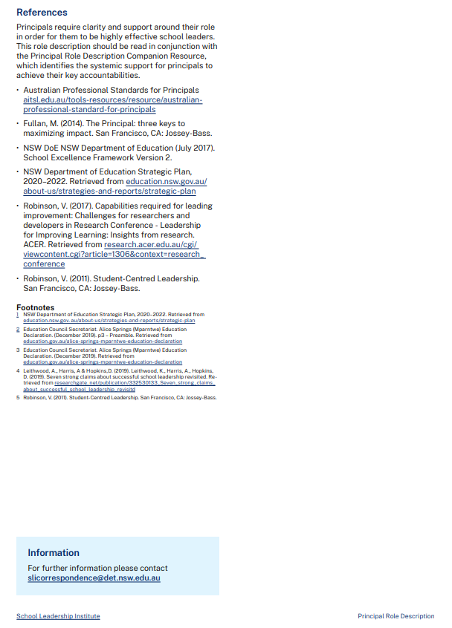
The role of principal
Achieving equity and excellence
Leading teaching and learning
Have high expectations and a sustained focus on improving student development, progress and achievement by seeking, reflecting and acting on evidence-informed leadership and pedagogical practices.
Developing self and others
Lead whole-school evidence-informed professional learning that has a positive impact on staff performance and development, and therefore student progress and achievement.
Leading improvement, innovation and change
Embed a collaborative, consultative culture of continuous improvement which is research-based and evidence-informed.
Notes:
Purpose: To showcase the alignment with the principal role statement
Suggested time: 5 minutes
Suggested script:
The last slide presented the strategic vision for the future of public education, aimed at improving student learning outcomes. Now, it is crucial to understand how this vision is implemented in schools. The School Leadership Institute has developed role statements for senior leaders, middle leaders, and classroom teachers. These statements provide a clear line of responsibility in achieving excellence, as outlined in the Plan for Public Education.
We will begin by reviewing specific sections of the Principal’s role description, followed by the Deputy Principal’s role description, and finally the Head Teacher’s role description. This will help us understand how senior leaders, middle leaders, and teachers all contribute to working toward a common vision.
Additionally, we’ll explore how this professional learning supports that work by equipping us with the tools and processes needed to lead excellence in our context.
The Principal Role Description developed by School Leadership Institute (SLI) highlights the key responsililities of a principal. This professional learning (PL), along with the strategic implementation process—which we will explore later in the session—is aligned with, and supports principals in meeting, their responsibilities in the areas shown on the screen and in the following ways:
Principals are accountable for aligning the school’s strategic vision with department priorities, ensuring that excellence and equity are central to school culture and practice.
The PL provides principals with a process to develop a shared vision that fosters positive relationships across the school community.
Principals lead with collaboration, collegiality, and empathy, ensuring that all staff are supported in their professional growth.
The PL offers a process and step-by-step guidance on how to create a culture of collaboration.
As leaders of learning, principals are responsible for driving the quality of teaching, learning, and student wellbeing.
The PL supports principals in maintaining focus by narrowing down priorities through collaborative reflection and planning.
Principal leadership is pivotal in ensuring sustained, positive impacts on teacher and student learning, as well as overall school improvement.
The PL provides principals with a strategic implementation process to drive systemic improvement across the school.
Resources:
Link: The role of principal- https://education.nsw.gov.au/leadership-pathways/principals/principal-role-description-2021

Slide 13
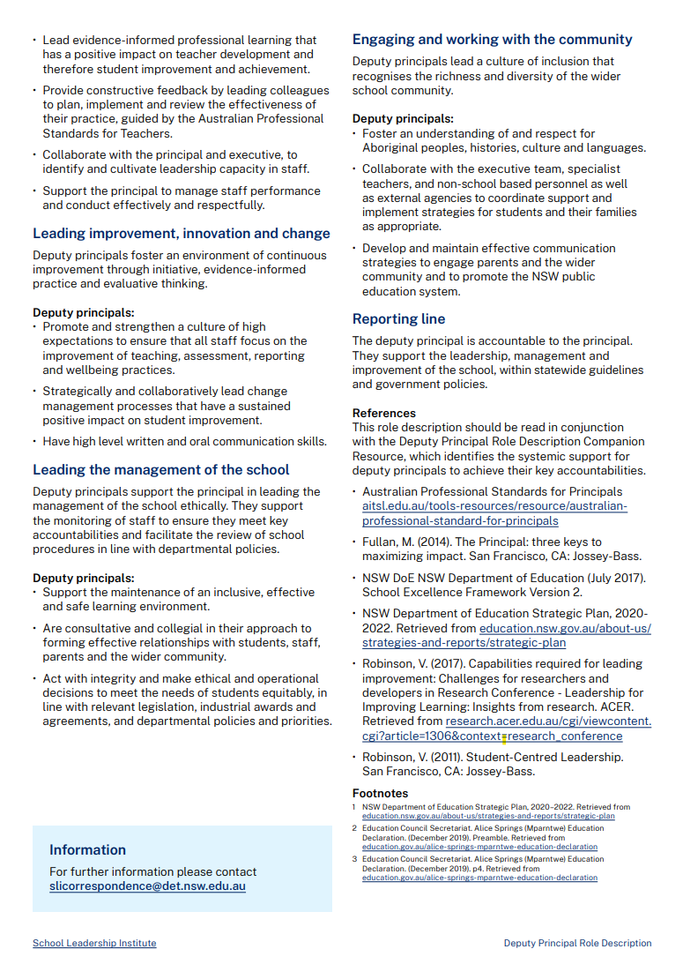
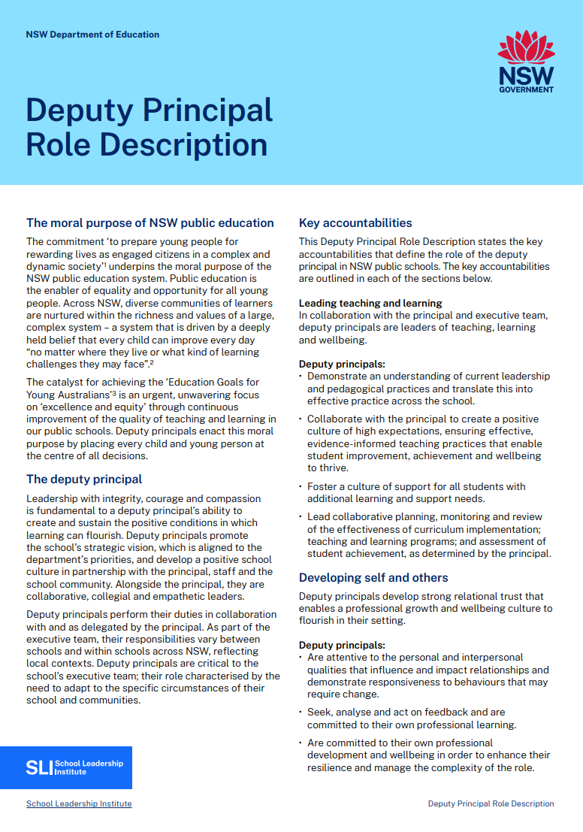
The role of deputy principal
Achieving equity and excellence
Leading teaching and learning
Lead collaborative planning, monitoring and review of the effectiveness of curriculum implementation; teaching and learning programs; and assessment of student achievement.
Developing self and others
Lead evidence-informed professional learning that has a positive impact on teacher development and therefore student improvement and achievement.
Leading improvement, innovation and change
Promote and strengthen a culture of high expectations to ensure that all staff focus on the improvement of teaching, assessment, reporting and wellbeing practices.
Notes:
Purpose: To showcase the alignment with the deputy principal role statement
Suggested time: 5 minutes
Suggested script:
Building on the Principal role description, we now look at the key responsibilities outlined in the Deputy Principal role description, developed by the School Leadership Institute. These responsibilities align closely with the Principal role description, and this professional learning (PL) supports Deputy Principals in the following ways:
Leading teaching and learning: The PL helps Deputy Principals build expertise by providing a process that fosters collaboration and capacity building in teaching and learning.
Developing self and others: The PL provides evidence-based reflection and planning opportunities focused on improving teaching practices.
Leading improvement, innovation, and change: The PL offers step-by-step guidance in narrowing the focus to key priorities, fostering continuous improvement and change.
In summary, this PL provides targeted support for both Deputy Principals and Principals, offering a strategic process, guidance, and tools necessary to lead, support, and improve teaching, learning, and overall school culture.
Resources
Link: School Leadership Institute resources: Deputy Principals - https://education.nsw.gov.au/leadership-pathways/deputy-principal

Slide 14
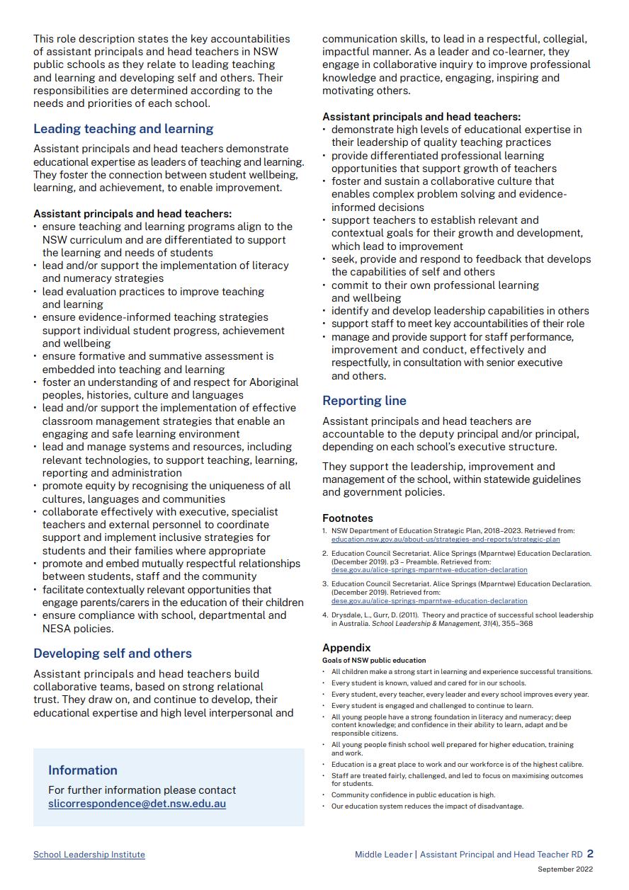
The role of middle leaders I Head teachers
Achieving equity and excellence
Leading teaching and learning
Lead evaluation practices to improve teaching and learning.
Ensure evidence informed teaching strategies support individual student progress, achievement and wellbeing.
Develop self and others
Demonstrate high levels of educational expertise in their leadership of quality teaching practices.
Foster and sustain a collaborative culture that enables complex problem solving and evidence-informed decisions.
Provide differentiated professional learning opportunities that support growth of teachers.
Notes:
Purpose: To showcase the alignment with the middle leader/ head teacher role statement
Suggested time: 5 minutes
Suggested script:
Here is the Head Teacher / middle leaders role description developed by School Leadership Institute.
It is important to note that the roles of the Principal, Deputy Principal, and Head Teacher are closely aligned in their shared responsibility for improving teaching, learning, and student outcomes.
The PL provides a structured approach to support these leaders in developing distributed leadership, fostering collaboration, and using evidence-based practices to drive equity and excellence throughout the school.
Information on these role descriptors can be found on the School Leadership Institute webpage.
Resources
Link: School Leadership Institute resources: Middle Leaders- https://education.nsw.gov.au/leadership-pathways/assistant-principals-and-head-teachers

Slide 15
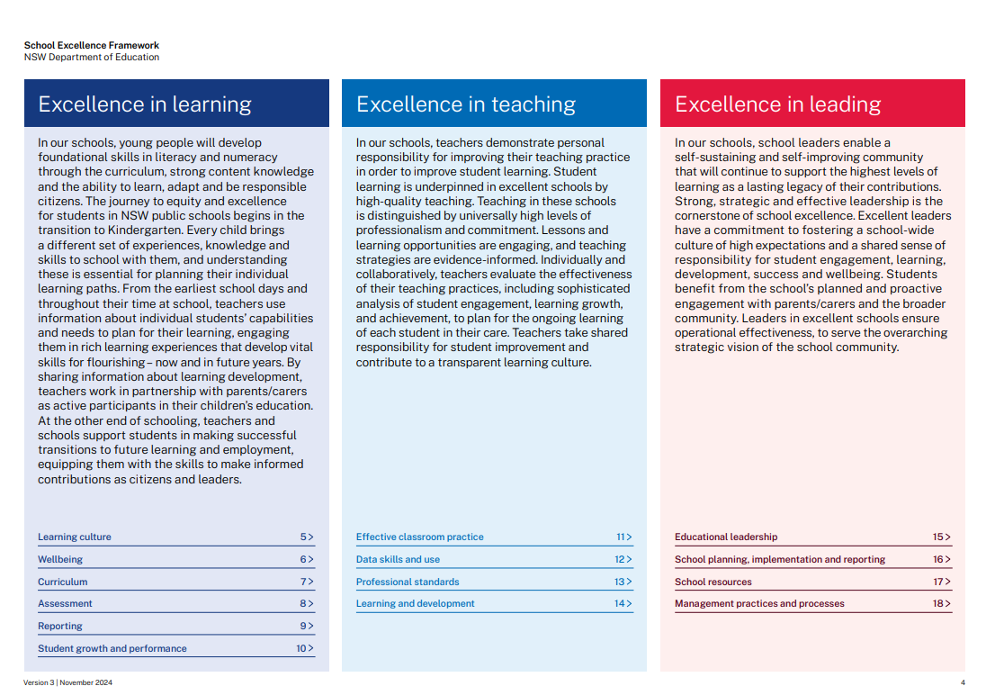
School Excellence Framework
Leaders' role in achieving school excellence
The Framework:
is a statement of what is valued as excellence for NSW public schools, both now and into the future.
This professional learning:
assist schools in exploring what excellence looks like in curriculum teaching, and learning
builds processes of shared leadership
assists in developing an approach to implementing evidence-based strategies.
Notes:
Purpose: To showcase the alignment with the School Excellence Framework as part of the School Excellence Cycle
Suggested time: 5 minutes
Suggested script:
The next key framework that the professional learning draws from in the School Excellence Framework (SEF).
This professional learning will help our team use the SEF to identify what excellence looks like in the areas of curriculum, teaching, and learning. We will then use this to identify focus areas and collaboratively plan the next steps to drive long-term improvement.
The PL is designed to help develop effective leadership and teaching strategies that are grounded in research and evidence-based methods. It will also help us build a shared language for effective teaching, continuous growth, curriculum improvement, and enhanced student outcomes through shared leadership.
About SEF:
The SEF is a statement of what is valued as excellence for NSW public schools, both now and into the future.
The Framework identifies quality practice across the three key domains of education – learning, teaching and leading – to help schools plan and monitor strategies for ongoing improvement.
The school planning and reporting approach is underpinned by the SEF.
The SEF underpins the development of a shared language that supports a whole school approach to effective evidence-based teaching, mentoring and/or coaching and the evaluation of classroom practice to refine and improve curriculum implementation in schools. Refer to the key ‘excelling’ statements of the themes. The leading domain also maintains a focus on distributed instructional leadership to sustain a culture of effective, evidence-based teaching and ongoing improvement.
The SEF is evidence-based and identifies explicit school practices that directly relate to continuous, school-wide improvement and better student outcomes.
Resources
Link: School Excellence Framework (SEF) - https://education.nsw.gov.au/about-us/strategies-and-reports/school-excellence-and-accountability/school-excellence/about-sef

Slide 16
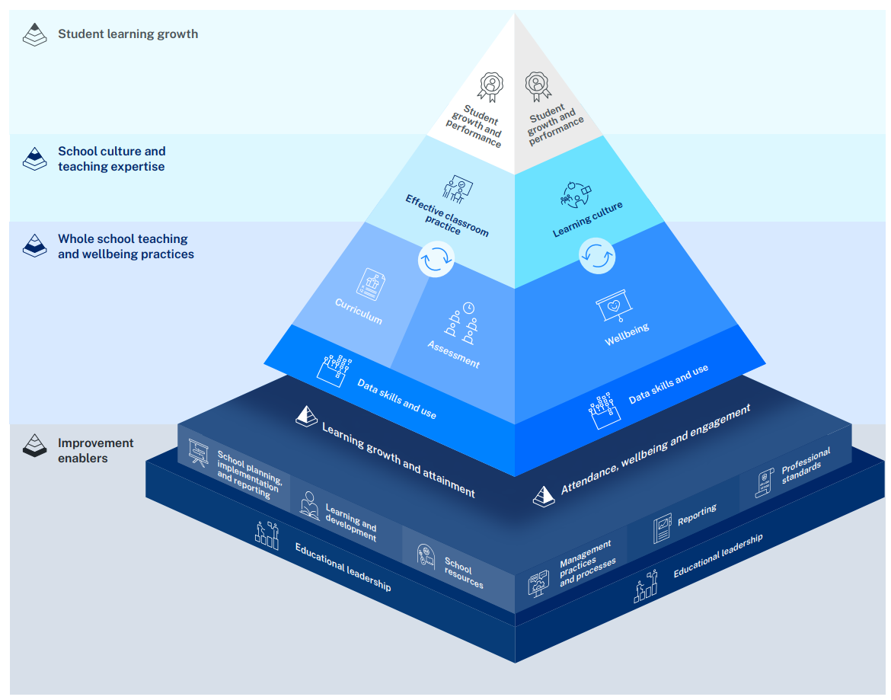
SEF Improvement Model
Achieving school excellence
SEF elements:
Effective classroom practice
Learning and development
Educational leadership
Notes:
Purpose: To showcase the alignment with the School Excellence Framework (SEF) Improvement Model
Suggested time: 5 minutes
Suggested script:
The professional learning is closely aligned with the Effective Classroom Practice and Learning and Development elements in the Learning Domain, as well as Educational Leadership in the Leadership Domain. It is highlighted on the screen.
By exploring the excellence statements of each element, along with the excellence statements within each theme, we will gain a clearer understanding of where our school currently stands and what excellence will look like moving forward.
This will be one of the activities when we explore the rest of the professional learning, and the processes provided. For now, it is important to understand that:
if we identify ourselves as excelling in these themes, our goal will be to plan initiatives that foster continuous improvement.
on the other hand, if we identify ourselves as sustaining and growing or delivering, this reflection will guide us in planning targeted initiatives and narrowing our focus to ensure sustained growth and improvement.
About the SEF Improvement model:
School Excellence is at the core of all work across NSW public schools, focusing on continuous school improvement.
The approach to School Excellence is built on a single, integrated school plan and annual report that incorporates a strong self-assessment process.
The School Excellence Framework (SEF) Improvement Model supports the School Excellence cycle in determining focus areas for improvement.
The model provides a visual of the SEF and shows how the elements and domains are related and interconnected.
Resources
Link: School Excellence - https://education.nsw.gov.au/about-us/strategies-and-reports/school-excellence-and-accountability/school-excellence

Slide 17
High Impact Professional Learning
Principles of building capacity
Informed by global research, the model supports the professional growth of all teaching staff.
This professional learning is underpinned by HIPL principles. It:
assists in maintaining a focus on student learning and growth
builds teaching quality
provides strategies process to enable continuous growth.
Notes:
Purpose: To showcase the alignment with the High Impact Professional Learning model
Suggested time: 5 minutes
Suggested script:
The High Impact Professional Learning (HIPL) model forms the foundation of this professional learning, as it supports the leadership team in creating environments that build staff capacity while keeping student needs at the centre of the curriculum initiative.
The five elements of HIPL will be explored and applied through the process we use to lead the initiative. It is important to understand that the HIPL model emphasises a continuous cycle of growth and implementation — a journey that mirrors our own commitment to ongoing improvement and development through capacity building.
About HIPL model:
The HIPL model is a set of 5 elements, informed by global research, that support the professional growth of all teaching staff to strengthen teaching practice to improve student growth and performance.
The diagram illustrates how the five elements of the HIPL model work together to support teaching and leading in schools:
Strengthening teaching quality to improve student growth and performance is at the centre of professional learning.
The three HIPL elements that describe the cycle of continuous professional learning surround this core purpose.
Supporting this cycle are the strategic actions of school leaders, focused on enabling continuous and coherent professional learning.
Resources
Link: High Impact Professional Learning- https://education.nsw.gov.au/teaching-and-learning/professional-learning/high-impact-professional-learning

Slide 18
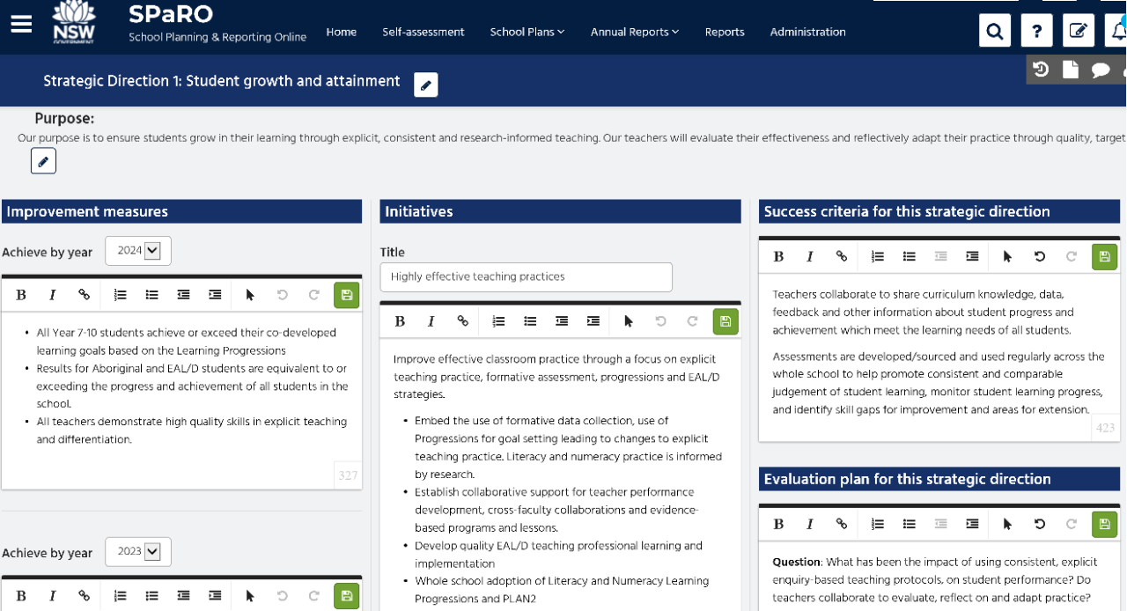
School Excellence Plan
Guiding you to the intended destination
A School Excellence Plan (SEP) reflects where the school is at and how it will further improve learning, teaching and leading.
This professional learning:
assists in analysing the school context
identifies key priorities
supports the design and implementation of strategic initiatives
supports the Implementation and Progress Monitoring (IPM) and Question, Data, Analysis and Impact (QDAI) cycle.
School Excellence Plan (SEP)
Notes:
Purpose: To bring it all together - the School Excellence Plan
Suggested time: 5 minutes
Suggested script:
Finally, the School Excellence Plan (SEP) is a dynamic, working document that outlines the steps schools take to improve learning outcomes and support the achievement and growth of all students.
This professional learning supports schools through their IPM and QDAI process.
It assists in identifying priorities, narrowing the focus, and provides a practical example of how to design and implement initiatives that are strategic, follow a structured process, and remain centred on improving student learning.
It does this by:
analysing the school’s context,
identifying key priorities, and
leading the implementation of key drivers for targeted initiatives.
About SEP:
To ensure continuous improvement, the SEP reflects where the school is at and how it will further improve learning, teaching and leading. This is based on the analysis of the school's current situation and the School Excellence Framework.
A school’s context and Our Plan for Public Education provide the direction for SEP.
HIPL underpins SEP, while the leadership role descriptions assist in identifying key accountabilities for leading and implementing initiatives that drive continuous growth and improvement.

Slide 19
Implementation journey
2
Contextual planning and strategic alignment
From strategy to action -leading processes and practices
Fostering collaboration for growth and improvement
The 3 drivers
Notes:
Purpose: Introduction to the next section on Implementation journey – the 3 drivers
Suggested time: 3 minutes
Instructions for the facilitator/s:
Informed by key policies and frameworks, the next two sections highlight the school’s professional learning journey to build staff capacity in formative assessment and explicit teaching at a whole-school level. This journey is presented through three key drivers, which are outlined in this section. The strategic implementation process for these drivers will be explored in Section 3.
The following slides unpack what this journey entailed and how it supported continuous improvement across the school, as highlighted in the Illustration of Practice.
The implementation journey has three key drivers:
Contextual planning and strategic alignment
From strategy to action – leading practices and processes
Fostering collaboration for growth and improvement
These drivers form the foundation of the strategic implementation process, which will be further examined in Section 3 through actionable steps and practical examples.
As schools lead their own improvement journeys, they are encouraged to adopt, adapt and refine these approaches to suit their unique contexts and evolving needs.

Slide 20
Implementation journey (1)
Three drivers of continuous growth and improvement
The drivers:
Contextual planning and strategic alignment.
From strategy to action – leading processes and practices.
Fostering collaboration for growth and improvement.
Each driver includes:
key focus areas
reflection questions
a collaborative planning and implementation process.
Contextual planning and strategic alignment
From strategy to action -leading processes and practices
Fostering collaboration for growth and improvement
Notes:
Purpose: Understanding School Excellence Journey and its three drivers
Suggested time: 5 minutes
Suggested script:
Guided by key policies and frameworks, this section takes us through the school’s professional learning journey—the one captured in the Illustration of Practice. We’ll look at what the school actually did to build staff capacity in formative assessment and explicit teaching across the whole school.
That journey is organised around three key drivers, which we’ll explore in this section. Then in Section 3, we’ll take a closer look at how each of these drivers was implemented in practice.
The key to successful implementation lies in adopting, adapting, and refining these approaches to suit our school’s unique context.
So, what you see on the screen are the three key drivers of the implementation journey:
Contextual planning and strategic alignment
From strategy to action – leading processes and practices
Fostering collaboration for growth and improvement
To unpack each of these drivers, we are provided with a set of focus areas, reflection questions to prompt deeper thinking, and a five-step implementation process.
All of this is designed to help us understand the process and to co-design a clear, actionable plan that’s tailored to our school’s context.
This approach is intentionally collaborative, reflective, and grounded in evidence-informed practice.

Slide 21
Contextual planning and strategic alignment
Driver 1 - purpose and outcome
Purpose
understanding the unique needs of the school community.
aligning curriculum initiatives and resources to support student learning.
Outcome
curriculum initiative is well aligned with the school’s priorities.
staff development is effectively supported.
data and evidence are used to inform planning.
Contextual planning and strategic alignment
From strategy to action -leading processes and practices
Fostering collaboration for growth and improvement
Notes:
Purpose: Identifying the purpose and outcome of Driver 1 – Contextual planning and strategic alignment
Suggested time: 3 minutes
Suggested script:
Let’s begin by looking at the first driver — Contextual planning and strategic alignment.
On the screen, you’ll see the purpose and intended outcomes of this driver.
This is about understanding the unique needs of our school community, and making sure that our priorities, resources, and curriculum initiatives are all working together to support student learning and staff development.
It’s the starting point of the implementation journey — and when it’s led and implemented well, it helps schools build a supportive, evidence-based environment that truly meets the needs of both students and staff.
We’ll dive deeper into this driver in Section 4, where we’ll apply the Strategic Implementation Process to bring this work to life in our school context.
Resources to lead driver 1:
Illustration of practice 1 – contextual planning and strategic alignment
Driver 1 - reflection and implementation guide

Slide 22
From strategy to action – leading processes and practices
Driver 2 – purpose and outcome
Purpose
aligning leadership actions with school priorities and needs.
facilitating collaboration and shared decision-making.
Outcome
translating curriculum initiatives into clear, actionable steps.
strengthening collaboration to support effective curriculum implementation.
building reflective practices and developing leadership capacity.
Contextual planning and strategic alignment
From strategy to action -leading processes and practices
Fostering collaboration for growth and improvement
Notes:
Purpose: Identifying the purpose and outcome of Driver 2 – From strategy to action – leading processes and practices
Suggested time: 3 minutes
Suggested script:
Now let’s move to the second driver — From Strategy to Action - leading Processes and Practices.
On the screen, you’ll see the purpose and intended outcomes of this driver.
This driver is all about turning strategic goals into meaningful, practical actions.
It’s about developing leadership processes and practices that are aligned with our school’s priorities and tailored to the contextual needs — ensuring that leadership strategies directly supports the school’s overarching goals.
It also highlights the importance of collaboration and shared decision-making, creating a culture where the whole school community is empowered to contribute and work together towards common objectives.
Resources to lead driver 2:
Illustration of practice 2 – From strategy to action – leading processes and practices
Driver 2 - reflection and implementation guide

Slide 23
Fostering collaboration for growth and improvement
Driver 3 – purpose and outcome
Purpose
building capacity among staff at all expertise levels.
leveraging partner input to refine strategies.
capturing timely insights from staff, students, and parents.
Outcome
improved evaluative practices to assess impact of collaboration on teaching and learning.
sustainable, long-term value is ensured in whole-school curriculum initiatives.
Contextual planning and strategic alignment
From strategy to action -leading processes and practices
Fostering collaboration for growth and improvement
Notes:
Purpose: Identifying the purpose and outcome of Driver 3 – Fostering collaboration for growth and improvement
Suggested time: 3 minutes
Suggested script:
Finally, let’s take a look at the third driver — Fostering Collaboration for Growth and Improvement.
On the screen, you’ll see the purpose and intended outcomes of this driver.
This driver is centred on building staff capacity at all levels, gathering timely and purposeful feedback from key stakeholders, and leveraging strategic partnerships to strengthen and refine your school’s strategies.
It’s also about continually assessing the impact of collaboration — not just on teaching practices, but on student learning as well.
The goal is long-term, sustainable improvement that genuinely adds value to our whole school community.
Resources to lead driver 3:
Illustration of practice 3 – Fostering collaboration for growth and improvement
Driver 3 - reflection and implementation guide

Slide 24
Strategic implementation process
3
Key focus areas
Reflection questions
Collaborative planning and implementation
The process
Notes:
Purpose: Introduction to the next section, Strategic implementation process – the process
Suggested time: 2 minutes
Instructions for the facilitator/s:
In this section, the Strategic implementation process – as highlighted in the Leading a whole school curriculum process- Illustration of practice - is unpacked.
It provides a structured approach for identifying school priorities, streamlining processes and translating priorities into effective actions.
This approach ensures that leadership efforts are aligned with the key focus areas and lead to meaningful, sustainable change.

Slide 25
Strategic implementation process
Process for leading the 3 drivers
1. Key focus areas
2. Reflection questions
3. Collaborative planning and implementation
A 3-step process for implementing the drivers
Notes:
Purpose: To highlight the importance of, and unpack the process of, strategic implementation process
Suggested time: 5 minutes
Suggested script:
On the screen is a 3-step process, which is the strategic implementation process highlighted in the ‘Leading a whole school curriculum process- Illustration of practice’.
This process provides a structured approach to implementing the key drivers for continuous improvement.
The process unfolds in three steps:
key focus areas – supports the identification of key priorities within each driver.
reflection questions – a set of targeted questions designed to critically examine current practices, challenges, and opportunities within each focus area. This step also helps build clarity and refine the focus.
collaborative planning and implementation – This facilitates team-based discussions to develop actionable strategies, ensuring all staff are engaged in a shared and effective approach to implementation.
Each step will be unpacked in this section and applied as we lead Drivers 1, 2, and 3 in Sections 3–5.

Slide 26
1. Key focus areas (1)
Step 1 of the Strategic implementation process
Each driver is built around five key focus areas to help schools:
clarify priorities
enable a shared understanding
ensuring a targeted approach
identify strengths and areas for growth.
1. Key focus areas
2. Reflection questions
3. Collaborative planning and implementation
Notes:
Purpose: To highlight the importance of, and unpack the process of, Key focus areas
Suggested time: 3 minutes
Suggested script:
Each driver is structured around five key focus areas, providing a clear and organised approach to identifying the most important aspects of each driver. These focus areas help schools to:
Clarify priorities – ensuring leadership teams and staff have a shared understanding of what needs to be addressed.
Take a targeted approach – focusing efforts on specific areas that drive the most impact.
Identify strengths and areas for growth – recognising what is already working well and pinpointing aspects that need further development.
By using these key focus areas alongside reflection questions, schools can strategically refine their focus and align their actions with improvement goals. This approach ensures consistency in reflection and data collection.
Resources
For Key focus areas, access:
Driver 1- Reflection and implementation guide
Driver 2- Reflection and implementation guide
Driver 3- Reflection and implementation guide

Slide 27
2. Reflection questions (1)
Step 2 of the Strategic implementation process
Each focus area is accompanied by reflection questions. These questions help to:
refine thinking
assist teams in assessing their current practices and processes
support the collection of baseline data
explore one or more focus areas in greater depth.
1. Key focus areas
2. Reflection questions
3. Collaborative planning and implementation
Notes:
Purpose: To highlight the importance of, and unpack the process of, Reflection questions
Suggested time: 3 minutes
Suggested script:
The next part of the Strategic implementation process is the Reflection questions.
Each focus area is accompanied by reflection questions.
These questions play a vital role in collating baseline data through individual and collaborative reflection.
They challenge assumptions, clarify the purpose, narrow the focus, and refine personal thinking before individuals can move through the collaborative planning and implementation process.
Resources
For Reflection questions, access:
Driver 1- Reflection and implementation guide
Driver 2- Reflection and implementation guide
Driver 3- Reflection and implementation guide

Slide 28
3. Collaborative planning and implementation (1)
Step 3 of the Strategic implementation process
Individual reflection
Review and adjust
Collaborative discussion
Collaborative planning and implementation process
1. Key focus areas
2. Reflection questions
3. Collaborative planning and implementation
Develop collaborative implementation plan
Identify challenges and opportunities
Notes:
Purpose: To highlight the importance of, and unpack the process of, Collaborative planning and implementation
Suggested time: 5 minutes
Suggested script:
The next step in the Strategic implementation process is Collaborative Planning and Implementation.
Before we jump into this stage, it’s really important that we had the time to reflect individually—using the key focus areas and the reflection questions. Why? Because when we take the time to clarify our own thinking first, we bring more depth and clarity to the group conversation. It sets us up for more meaningful collaboration.
So, what does Collaborative Planning and Implementation actually involve? It’s a structured approach where team members work together to design and carry out initiatives that improve practice and outcomes. Here’s how it works:
Individual reflection – Each team member reflects on their current practice and experiences to identify areas for growth.
Collaborative discussion – Everyone comes together to share their reflections, discuss ideas, and build a shared understanding.
Identify challenges and opportunities – As a team, we pinpoint the things that could help or hinder the success of your plan.
Develop a collaborative implementation plan – Together, we create a clear plan with actions, responsibilities, and timelines.
Review and adjust – Finally, the team checks in regularly to review progress and make adjustments as needed to keep improving.
This step is all about making sure the process is shared, strategic, and sustainable.
Resources
For Collaborative planning and implementation process, access:
Driver 1- Reflection and implementation guide
Driver 2- Reflection and implementation guide
Driver 3- Reflection and implementation guide
The following sections will explore practical applications of the Strategic Implementation process in leading the three drivers.

Slide 29
Leading driver 1
4
Contextual planning and strategic alignment
From strategy to action -leading processes and practices
Fostering collaboration for growth and improvement
Contextual planning and strategic alignment
Notes:
Purpose: Introduction to Leading driver 1- applying the Strategic implementation process
Suggested time: 2 minutes
Instructions for the facilitator:
This section will support leadership teams in applying each stage of the Strategic Implementation process, providing a practical understanding of how to lead Driver 1 for continuous growth and improvement.

Slide 30
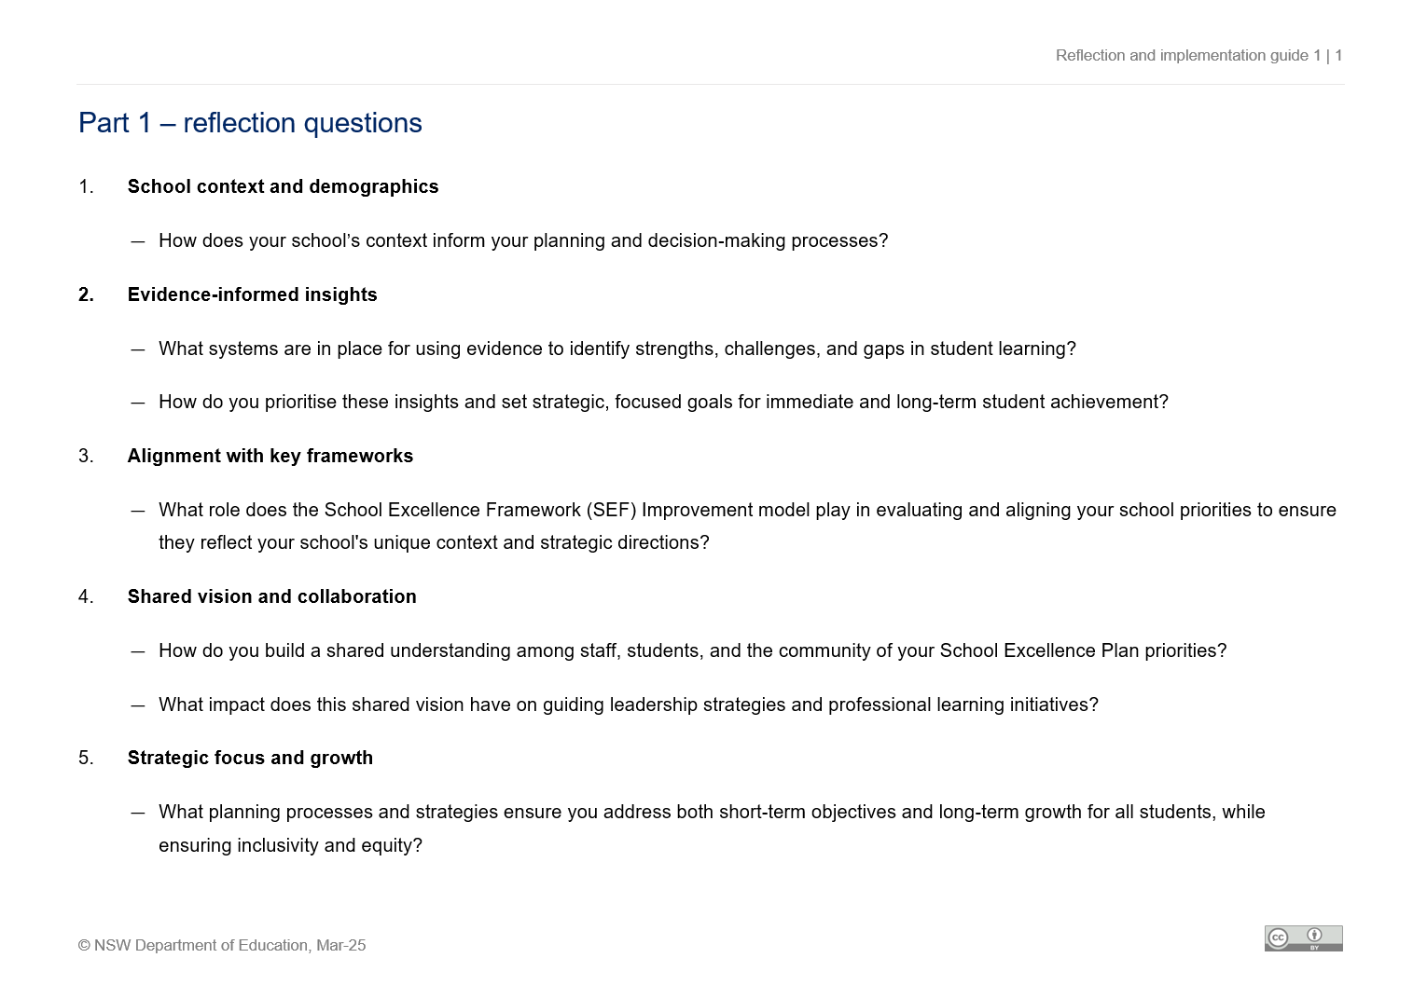
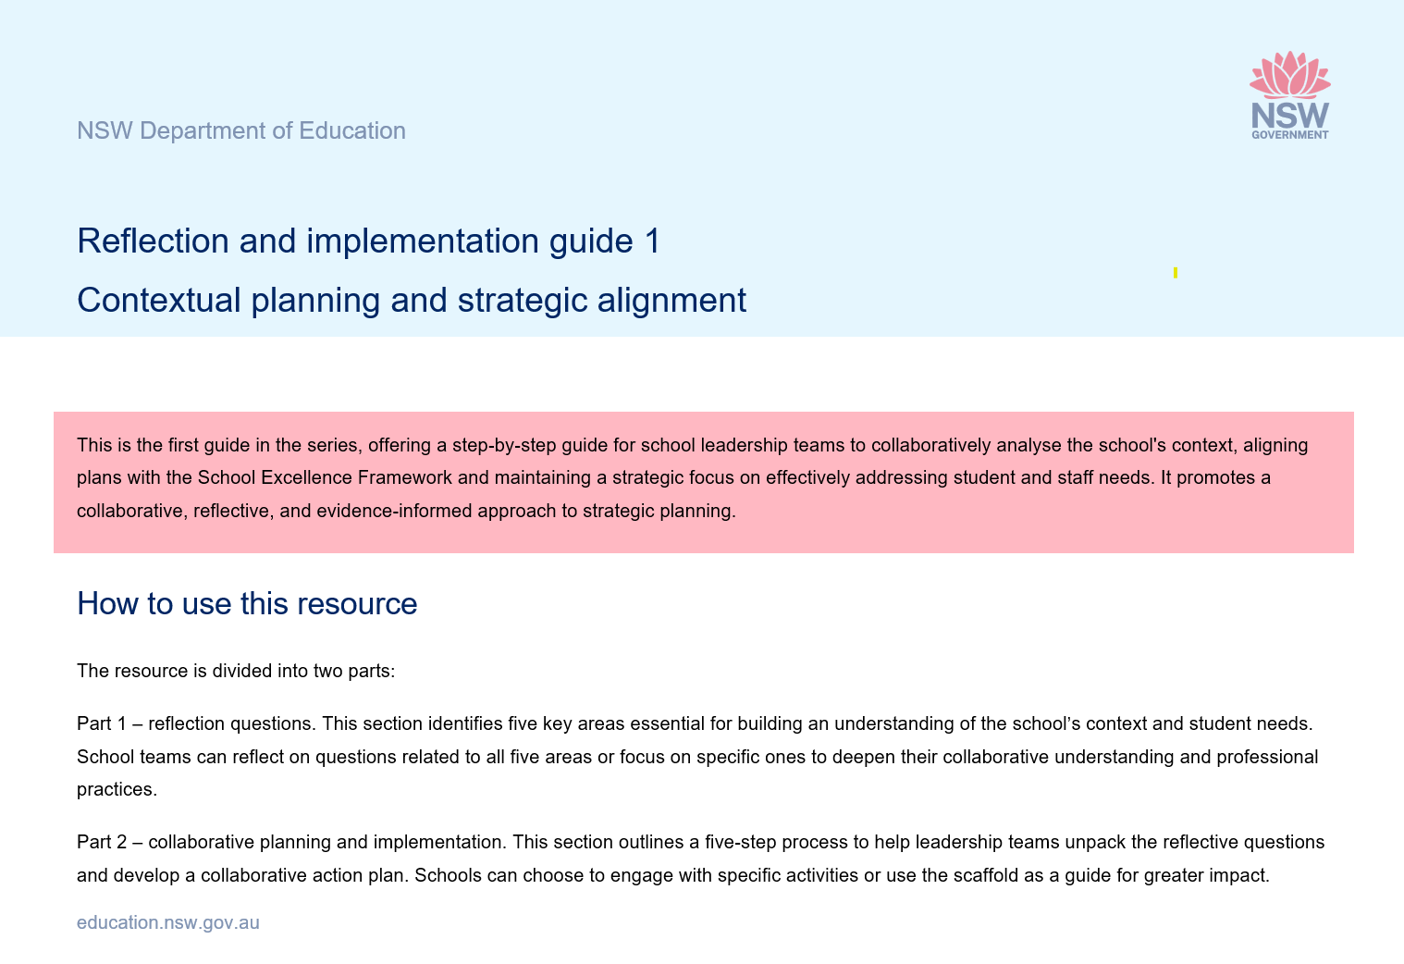
Resources for leading driver 1
Contextual planning and strategic alignment
Resources used in this section:
Illustration of practice 1
Driver 1 – reflection and implementation guide
SEF Improvement model
School Excellence Plan
Contextual data (student performance data)
Notes:
Purpose: To identify resources that will assist in leading driver 1
Suggested time: 2 minutes
Instructions for the facilitator:
The slide lists the resources used in this section.
Schools are encouraged to refer to their School Excellence Plan and student performance data to make the content relevant to their specific context and needs.
Resources:
Illustration of practice 1
Driver 1 - reflection and implemation guide
copies of the School Excellence Framework (SEF) Improvement model
the School Excellence Plan (SEP)
Contextual data could include:
student performance data (such as assessments, attendance, engagement surveys)
demographic and community insights
staff professional learning plan
stakeholder feedback (for example, surveys, evaluation reports)
Additional recourses on the second last slide of this section
The resources provided on this slide offer additional support for exploring Driver 1.
The school leadership team may choose to engage with these resources as part of their inquiry.

Slide 31
Process for leading driver 1
Contextual planning and strategic alignment
Use the illustration of practice 1 ‘Contextual planning and strategic alignment’, and apply the 3 key steps of the strategic implementation process for a structured approach to:
analyse school context
align curriculum initiatives
develop an implementation plan.
1. Key focus areas
2. Reflection questions
3. Collaborative planning and implementation
Notes:
Purpose: Overview of the process of leading driver 1
Suggested time: 2 minutes
Suggested script:
On this slide, we're looking at the process for leading Driver 1 and working towards the outcomes we saw earlier on Slide 21.
What we’re focusing on here is how to build and lead a curriculum initiative in a way that’s strategic and sustainable.
We will be watching Illustration of Practice 1 (IoP)– Contextual Planning and Strategic Alignment as a practical example. This IoP will highlight what it looks like when Driver 1 is led well in a real school context.
The three key steps in the strategic implementation process—outlined here in navy blue—give us a structured way forward. They help ensure that what we’re doing is clear, consistent, and has real purpose behind it.

Slide 32
1. Key focus areas (2)
Applying strategic implementation framework
Watch the illustration of practice 1 ‘Contextual planning and strategic alignment’ (3:56).
Activity:
discuss in pairs the key insights from the clip.
Guiding prompt:
what are some key focus areas identified in the clip for building a consistent understanding of the school's context and student needs?
1. Key focus areas
2. Reflection questions
3. Collaborative planning and implementation
Notes:
Purpose: Reflecting on key focus areas to build contextual understanding
Suggested time: 15 minutes
Suggested script:
Let’s move into the first step together.
We’re going to watch Illustration of Practice 1: Contextual Planning and Strategic Alignment — it runs for about four minutes. As you watch, keep in mind how the leaders in the clip builds clarity and aligns their approach with the school’s context and needs.
Play the video (3:56)
Now, I’d like you to turn to a partner and have a quick discussion. Use this guiding prompt to focus your conversation:
What are some key focus areas identified in the clip for building a consistent understanding of the school’s context and student needs?
After 5 minutes, we’ll come back together, and I’ll invite a few pairs to share their insights with the group.

Slide 33
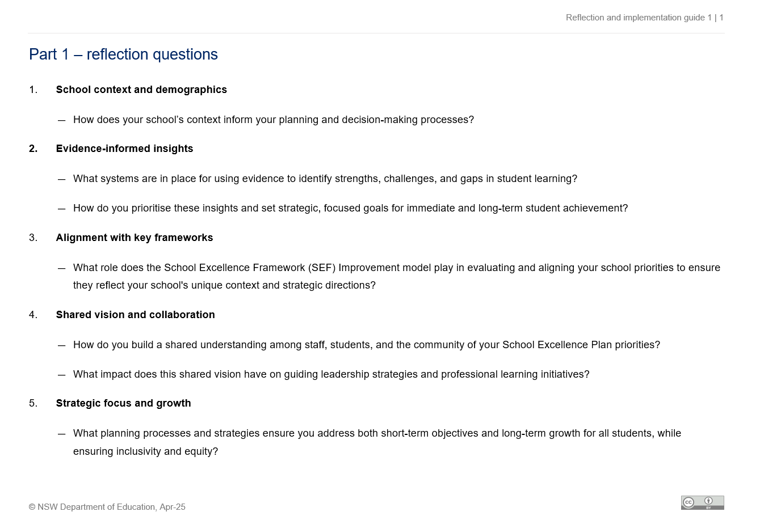
2. Reflection questions (2)
Deepen your understanding
Use the ‘Part 1 – focus areas and reflection questions’ from the ‘Driver 1 – reflection and implementation guide’.
Activity:
reflect on the 5 focus areas identified and consider each of the reflection questions individually.
Guiding prompt:
what are your insights into our school’s current practices?
1. Key focus areas
2. Reflection questions
3. Collaborative planning and implementation
Notes:
Purpose: Refining understanding by using Reflection questions
Suggested time: 10 minutes
Suggested script:
Next, we’re going to use the ‘Part 1 – Focus areas and reflection Questions’ from the ‘Driver 1 – Reflection and Implementation Guide’.
As a team, take some time to explore the five focus areas that have been identified. I’ll guide you through each of the reflection questions one by one.
As you work through them, I’d like you to think carefully about our current practices in relation to each focus area.
Here’s a guiding prompt to help shape your thinking:
What are your insights into your school's current practices?
This step is important. It’s designed to help us sharpen our perspective and build a clearer understanding of where we believe we’re currently at, before we move into the next stage — Individual Reflection — as part of the collaborative planning and implementation process.

Slide 34
3. Collaborative planning and implementation (2)
Individual reflections
Use the ‘Part 1 – reflection questions’ from the ‘Driver 1 – reflection and implementation guide’.
Activity
Use the guiding prompts from the guide to:
write your personal reflections and insights based on your experience in ‘Table 1 – individual reflection’
rank the focus areas in terms of high to low priority.
1. Key focus areas
2. Reflection questions
3. Collaborative planning and implementation
Individual reflection
Review and adjust
Collaborative discussion
Develop collaborative implementation plan
Identify challenges and opportunities
Notes:
Purpose: To guide participants in reflecting and allow them to prioritise key focus areas
Suggested timeframe: 15-20 minutes
Suggested script:
Now we’re moving into Part 1 – Individual Reflection from the Driver 1 – Reflection and Implementation Guide.
I’d like you to take a few minutes to jot down your personal reflections and insights in Table 1 – Individual Reflection.
As you work through each of the five focus areas, think about your own experience and your school’s current practices.
Here are a few questions to guide your thinking:
Which areas offer the greatest opportunities for growth in planning whole-school curriculum initiatives?
How well is this area currently being addressed in our context?
What are the potential consequences of not prioritising this area for whole-school curriculum implementation?
Once you’ve reflected on each area, take a moment to rank them from high to low priority based on your insights.
I’ll give you some time to work through this before we move on to the next step.

Slide 35
3. Collaborative planning and implementation (3)
Collaborative discussion
Individual reflection
Use the ‘Step 2 – collaborative discussion’ from the ‘Driver 1 – reflection and implementation guide’.
Activity
Use the guiding prompts from the guide to:
discuss each question as a team
record the insight in a shared format or use ‘Table 2 – team discussion’ from the guide.
Review and adjust
Collaborative discussion
Develop collaborative implementation plan
Identify challenges and opportunities
Notes:
Purpose: To deepen understanding and alignment within the team
Suggested time: 30-45 minutes
Suggested script:
Now let’s move into Step 2 – Collaborative Discussion from the Driver 1 – Reflection and Implementation Guide.
In your teams, take some time to discuss each of the reflection questions together.
You can record your team’s key insights either in a shared format or directly in Table 2 – Team Discussion from the guide.
Here are a couple of prompts to guide your conversation:
What patterns or recurring themes are emerging from your individual reflections?
Are there any areas where perspectives differ or even conflict?
What evidence supports these observations and insights?
Make sure the discussion is open and inclusive—encourage everyone to share their thoughts.
Once your team has had a chance to talk through the questions, we’ll come back together, and I’ll ask a few groups to share a quick summary of the main insights or themes that came up in your discussions.

Slide 36
3. Collaborative planning and implementation (4)
Identify challenges and opportunities
Use the ‘Step 3 – identify challenges and opportunities’ from the ‘Driver 1 – reflection and implementation guide’.
Individual reflection
Activity
Use the guiding prompts from the guide to:
identify challenges that hinder effective planning and implementation of curriculum initiatives
highlight opportunities to strengthen alignment, collaboration, or inclusivity
record the insight in a shared format or use ‘Table 3 – identify challenges and opportunities’ from the guide.
Review and adjust
Collaborative discussion
Develop collaborative implementation plan
Identify challenges and opportunities
Notes:
Purpose: To foster critical thinking and encourage actionable insights
Suggested time: 20-30 minutes
Suggested script:
We’re now moving into Step 3 – Identify Challenges and Opportunities from the Driver 1 – Reflection and Implementation Guide.
As a team, take this time to reflect on the challenges that may be getting in the way of effective whole-school curriculum planning.
Also, start identifying opportunities—where can we strengthen alignment, improve collaboration, or build greater inclusivity within our team or across the school?
You can record your group’s insights in a shared format or use Table 3 – Identify Challenges and Opportunities from the guide.
As you work through this, I encourage you to think critically about potential obstacles as well as areas for growth. What might be holding you back, and what could help move things forward? Here are some guiding prompts that are from the guide:
what are the common challenges that hinder effective whole-school planning for curriculum implementation?
where are the opportunities to improve alignment between planning and implementation?
how can collaboration be strengthened to ensure that all voices are included, and the focus remains on improving whole-school curriculum implementation?
I’ll give you some time now to discuss and capture your ideas before we move on.

Slide 37
3. Collaborative planning and implementation (5)
Develop a collaborative implementation plan
Use the ‘Step 4 – develop a collaborative plan’ from the ‘Driver 1 – reflection and implementation guide’.
Activity
Use the guiding prompts from the guide to:
design an action plan focusing on the chosen area/s
outline key actions, assigning responsibilities, set timelines and establishing success indicators
record the insight in ‘Table 4 – develop a collaborative implementation plan’ from the guide.
Individual reflection
Review and adjust
Collaborative discussion
Develop collaborative implementation plan
Identify challenges and opportunities
Notes:
Purpose: To collaboratively create an actionable plan that addresses key focus areas
Suggested time: 45-60 minutes
Suggested script:
Alright, let’s move into Step 4 – Develop a collaborative implementation plan, which you’ll find in the Driver 1 – Reflection and Implementation Guide.
At this stage, your role is to support your team in designing an action plan that targets the area or areas you’ve identified for improvement.
You’ll want to help the team:
Outline key actions they’ll take, assign responsibilities to team members, set realistic timelines, and establish clear success criteria for each action.
Make sure you record all of this in Table 4 – Develop a collaborative implementation plan in the guide.
You can use these guiding prompts to keep the conversation focused:
what steps will be taken to address each challenge?
how will collaboration and shared ownership be promoted throughout the curriculum planning and implementation process?
how will the effectiveness of the changes in curriculum implementation be measured ?
what will successful implementation look like and how will you know it?
What will successful implementation look like? How will you know?
And finally, remind participants to make sure their plan is practical, measurable, and genuinely developed together.

Slide 38
3. Collaborative planning and implementation (6)
Review and adjust
Use ‘Step 5 – review and adjust’ from the ‘Driver 1 – reflection and implementation guide’.
Activity
Use the guiding prompts from the guide to:
plan for ongoing review sessions and establish methods for evidence collection and evaluation
identify evidence such as feedback, observations, and outcomes to evaluate success
record the insight in ‘Table 5 – review and adjust’ from the guide.
Individual reflection
Review and adjust
Collaborative discussion
Develop collaborative implementation plan
Identify challenges and opportunities
Notes:
Purpose: To establish a process for evaluating the success of the plan using evidence and feedback
Timeframe: schedule regular check-ins (e.g., monthly or quarterly)
Suggested script:
Now let’s move into Step 5 – Review and Adjust, which you’ll find in the Driver 1 – Reflection and Implementation Guide.
At this stage, think about how you’ll measure the effectiveness of your plan and make improvements over time.
Also, identify types of evidence you can use—this might include feedback from staff or students, classroom observations, or student outcomes.
Think about:
How to plan regular review sessions,
Decide how evidence will be collected, and
Determine how you’ll evaluate what’s working and what needs adjusting.
Record all of this in Table 5 – Review and Adjust in the guide.
Here are two guiding prompts to support the conversation:
What method will we use to collect evidence? (e.g., surveys, observations, data analysis)
How often will we review progress and adjust the plan if needed?
The aim here is to build in a cycle of reflection and refinement—so the plan stays relevant and responsive.

Slide 39
Additional resources – further reading
Driver 1 – contextual planning and strategic alignment
Our Plan for NSW Public Education
School Excellence Policy
School Excellence Framework
School Excellence Framework Improvement Model
School Excellence Cycle
School Excellence Plan
School planning for curriculum implementation
Phases of curriculum implementation
Curriculum implementation journey - principal
Curriculum implementation journey – deputy principal
Curriculum implementation journey – head teacher
School Leadership Institute
Notes:
Purpose: To provide additional resources relevant to Driver 1 – Contextual planning and strategic alignment.
Suggested time: 2 minutes
Suggested script:
To wrap up, just a quick note on the additional resources provided.
These are designed to support further exploration of the key driver we’ve focused on so far.
You are encouraged to explore these resources at their own pace to further develop your leadership capacity.
These resources can be a great starting point for deeper conversations or for our future planning sessions.

Slide 40
Further support (1)
Evaluation and contact
Join T and L statewide staffroom
Teaching and Learning 7–12 team
Contact email: secondaryteachingandlearning@det.nsw.edu.au
Notes:
Purpose: Feedback and further assistance
Suggested time: 2 minutes
Suggested script:
This concludes the section on building understanding and applying the Strategic implementation process to leading Driver 1.
Please ask the team to take a few moments to complete the survey.
Your feedback will help the Secondary Teaching and Learning team evaluate the learning resources, including the Illustration of practice 1, the Reflection and implementation guide 1, and the Strategic implementation process.
You are encouraged to join the Secondary Teaching and Learning Statewide Staffroom to collaborate with like-minded educators and leaders. Go to the link provided on the slide to register.
The Secondary Teaching and Learning team can be contacted with any further questions using the email provided on the screen.

Slide 41
Leading driver 2
5
Contextual planning and strategic alignment
From strategy to action -leading processes and practices
Fostering collaboration for growth and improvement
From strategy to action – leaning processes and practices
Notes:
Purpose: Introduction to Leading driver 2- applying the Strategic implementation process
Suggested time: 2 minutes
Instructions for the facilitator:
This section will support leadership teams in applying each part of the Strategic implementation process, providing a practical understanding of how to lead Driver 2, from strategy to action – leading processes and practices, for continuous growth and improvement.
Using the High Impact Professional Learning principles, the process supports evidence-based planning to align curriculum and professional learning initiatives with school goals and address staff and student needs.

Slide 42
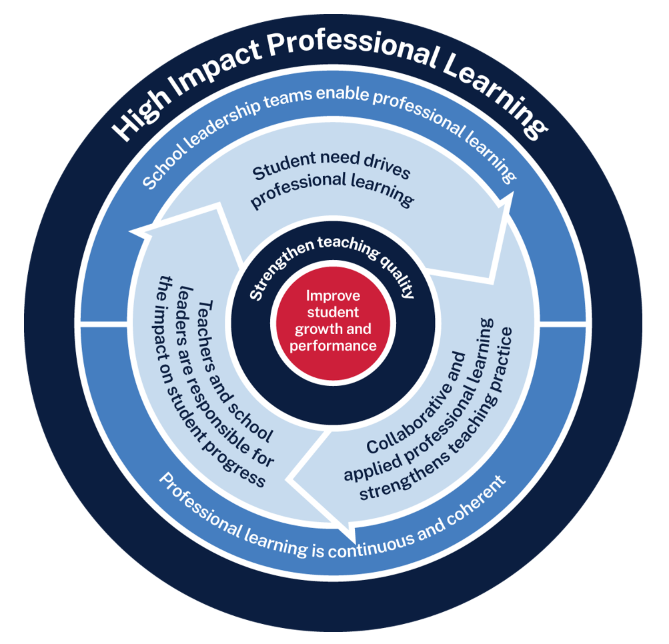
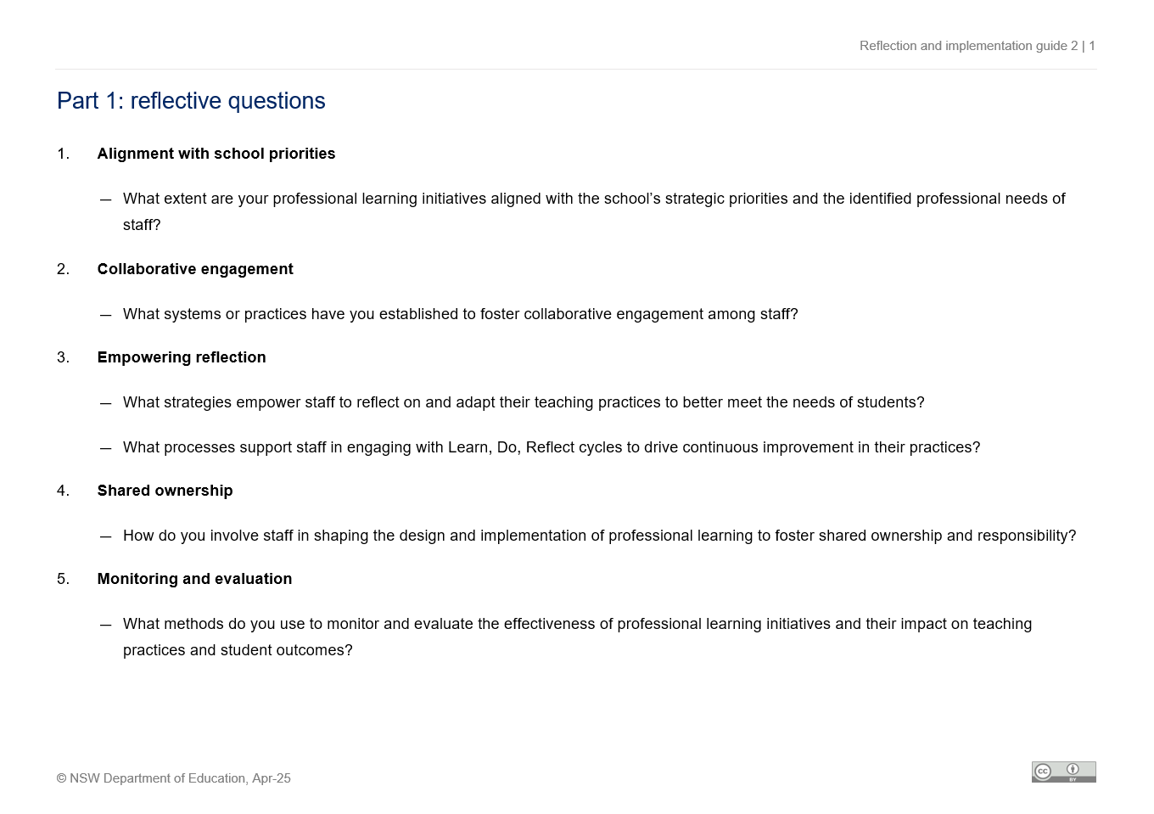
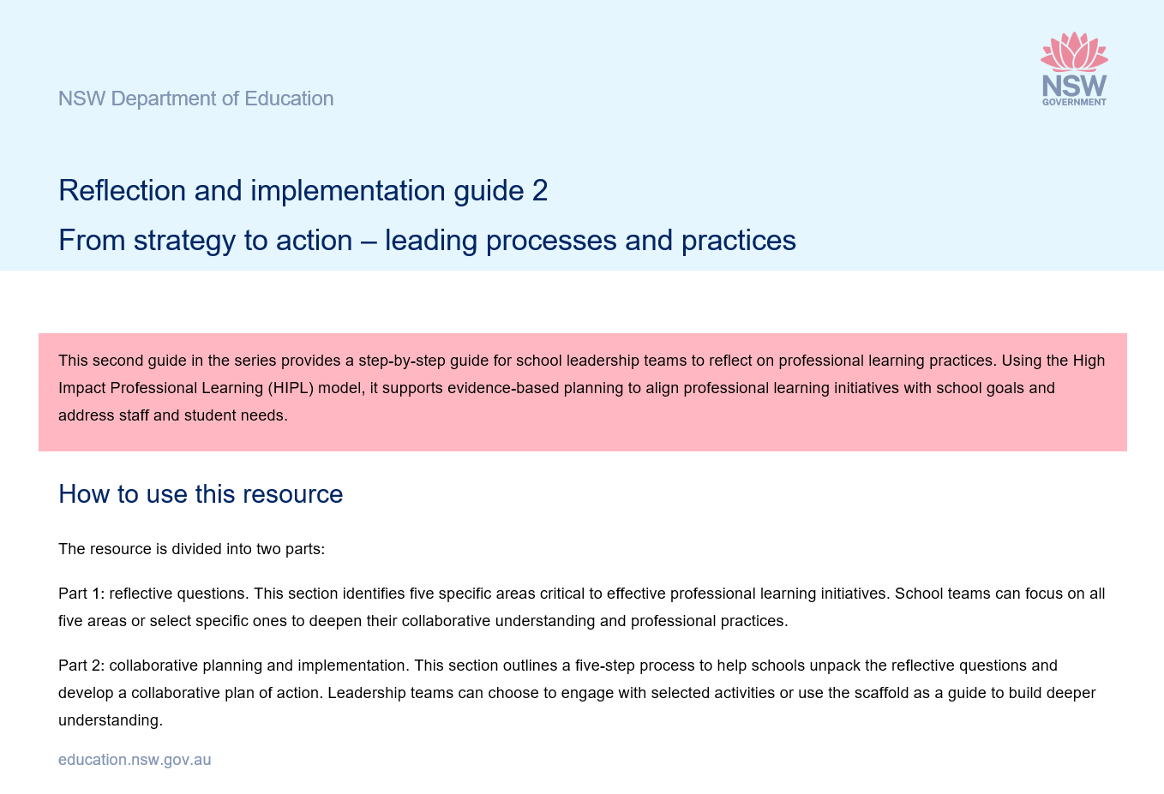
Resources for leading driver 2
From strategy to action – leaning processes and practices
Resources:
Driver 2 – reflection and implementation guide
Illustration of practice 2
School Excellence Plan
High Impact Professional Learning model
staff professional learning plan/s
Notes:
Purpose: To identify resources that will assist in leading driver 2
Suggested time: 2 minutes
Instructions for the facilitator:
The slide lists the resources used in this section.
Schools are encouraged to refer to their School Excellence Plan, High Impact Professional Learning model and staff professional learning plan/s to make the content relevant to their specific context and needs.
Resources:
Driver 2 - reflection and implementation guide
Illustration of practice 2
High Impact professional Learning (HIPL) model
School Excellence Plan (SEP)
Contextual data could include:
staff professional learning plan
student performance data (such as assessments, attendance, engagement surveys)
examples of evidence-based practices such as explicit teaching, formative assessment etc.
Additional recourses on the second last slide of this section
The resources provided support further exploration of the key driver.
The school leadership team can choose to explore these resources as part of their professional learning journey.

Slide 43
Process for leading driver 2
From strategy to action – leaning processes and practices
Use the illustration of practice 2 ‘From strategy to action – leaning processes and practices’, and apply the 3 key steps of the strategic implementation process for a structured approach to:
align curriculum initiatives and professional learning needs
strengthen reflective practices
evaluate curriculum impact on teaching and learning.
1. Key focus areas
2. Reflection questions
3. Collaborative planning and implementation
Notes:
Purpose: Overview of the process of leading driver 2
Suggested time: 2 minutes
Suggested script:
This slide introduces the process for achieving the outcomes linked to Driver 2.
The next few slides will walk us through how to build and lead an action plan to support this.
We'll be drawing on Illustration of Practice 2: From strategy to action – learning processes and practices, which provides a practical guide to leading Driver 2 in action.
The approach is grounded in the Strategic implementation .process, using three clear steps to bring consistency, clarity, and purpose to the implementation process

Slide 44
1. Key focus areas (3)
Applying strategic implementation framework
Watch the illustration of practice 2 ‘From strategy to action – leaning processes and practices’ (3:39).
Activity:
discuss in pairs the key insights from the clip.
Guiding prompt:
what are some key focus areas identified in the clip for building staff capacity across the whole school?
1. Key focus areas
2. Reflection questions
3. Collaborative planning and implementation
Notes:
Purpose: Reflecting on key focus areas to build contextual understanding
Suggested time: 10 minutes
Suggested script:
Let’s move into the next part of the session.
We’re going to watch a short clip—Illustration of Practice 2: From strategy to action – learning processes and practices. It’s just under four minutes long.
After watching, I’d like you to turn to a partner and discuss some of the key insights that stood out to you.
You might use this prompt to guide your conversation:
What are some of the key focus areas highlighted in the clip for building staff capacity across the whole school?
Once you’ve had a few minutes to chat, we’ll come back together and share some of your insights with the group.

Slide 45
2. Reflection questions (3)
Deepen your understanding
Use the ‘Part 1 – reflection questions’ from the ‘Reflection and implementation guide 2’.
Activity:
reflect on the 5 focus areas identified and consider each of the reflection questions individually.
Guiding prompt:
how do your insights align with the current practices/process at school or at your faculty level?
1. Key focus areas
2. Reflection questions
3. Collaborative planning and implementation
Notes:
Purpose: Refining understanding by using Reflection questions
Suggested time: 10 minutes
Suggested script:
Now, let’s take a few minutes now for deeper individual reflection.
I’d like you to use Part 1 – the reflection questions from the Driver 2 – Reflection and Implementation Guide. These questions are based around the five key focus areas we’ve been looking at.
Take your time to go through each one and really think about how it connects with your own current practice.
A prompt that might help as you're reflecting:
How do your insights align with what’s currently happening at your school or in your faculty?
This isn’t about finding the perfect answer – it’s about pausing to think deeply. This step is really important because it helps you sharpen your perspective before we move into the next phase of the collaborative planning and implementation process.

Slide 46
3. Collaborative planning and implementation (7)
Individual reflections
Use the ‘Part 1 – reflection questions’ from the ‘Driver 2 – reflection and implementation guide’.
Activity
Use the guiding prompts from the guide to:
write your personal reflections and insights based on your experience and your school’s context in ‘Table 1 – individual reflection’
rank the focus areas in terms of high to low priority.
1. Key focus areas
2. Reflection questions
3. Collaborative planning and implementation
Individual reflection
Review and adjust
Collaborative discussion
Develop collaborative implementation plan
Identify challenges and opportunities
Notes:
Purpose: To guide participants in reflecting and allow them to prioritise key focus areas
Suggested timeframe: 15-20 minutes
Suggested script:
Now, we’re going to spend some time on personal reflection using the insights from the previous part.
Please turn to Part 1 – the Reflection Questions in the Driver 2: reflection and implementation guide.
Take a few minutes to go through each of the reflection question and jot down your thoughts and insights in Table 1 – Individual reflection. Consider your own experiences and the context of your faculty/team/school as you respond.
As you work through each of the five focus areas, think about how they apply to your practice.
Once you’ve reflected, rank the focus areas from highest to lowest priority, based on what’s most relevant or pressing in your context.
I’ll give you some quiet time to complete this before we move on to the next step.

Slide 47
3. Collaborative planning and implementation (8)
Collaborative discussion
Use the ‘Step 2 – collaborative discussion’ from the ‘Driver 2 – reflection and implementation guide’.
Activity
Use the guiding prompts from the guide to:
discuss each question as a team
record the insight in a shared format or use ‘Table 2 – team discussion’ from the guide.
Individual reflection
Review and adjust
Collaborative discussion
Develop collaborative implementation plan
Identify challenges and opportunities
Notes:
Purpose: To deepen understanding and alignment within the team
Suggested time: 30-45 minutes
Suggested script:
Now, let's move on to ‘Step 2 – Collaborative discussion’ from the ‘Driver 2 - reflection and implementation guide.’
I’d like you to discuss each reflection question as a team. As you go through the discussion, make sure to capture your insights in a shared format, or you can use ‘Table 2 – Team discussion’ from the guide.
Use the guiding prompts provided in the guide and focus on these key points:
What patterns or recurring themes are coming up from everyone’s individual reflections?
Are there areas where you see conflicting perspectives?
Which curriculum initiative could best address this high-priority area?
Remember, this is a space for open dialogue, so encourage everyone in your group to share their thoughts and make sure all voices are heard.
Once the discussion is finished, I’ll ask you to summarise the main insights and themes that ca.me up. Let’s get started.

Slide 48
3. Collaborative planning and implementation (9)
Identify challenges and opportunities
Use the ‘Step 3 – identify challenges and opportunities’ from the ‘Driver 2 – reflection and implementation guide’.
Activity
Use the guiding prompts from the guide to:
identify challenges that hinder effective planning
highlight opportunities to strengthen alignment and collaboration
record insights in a shared format or use ‘Table 3 – identify challenges and opportunities’ from the guide.
Individual reflection
Review and adjust
Collaborative discussion
Develop collaborative implementation plan
Identify challenges and opportunities
Notes:
Purpose: To foster critical thinking and encourage actionable insights
Suggested time: 20-30 minutes
Suggested script:
Now, let’s move on to ‘Step 3 – Identify challenges and opportunities’ from the ‘Driver 2 - reflection and implementation guide.’
In this step, I’ll help you identify the challenges that might be hindering effective planning. At the same time, we’ll highlight opportunities to strengthen alignment, collaboration, or inclusivity within your team or the broader school.
Make sure you use the guiding prompts from the guide and record your group’s insights in a shared format, or you can use ‘Table 3 – Identify Challenges and Opportunities’ from the guide.
I encourage you to think critically about any potential obstacles and areas where there’s room for growth.
Take some time to discuss these points as a group and capture your ideas. Let’s dive in!

Slide 49
3. Collaborative planning and implementation (10)
Develop a collaborative plan
Use the ‘Step 4 – develop a collaborative plan’ from the ‘Driver 2 – reflection and implementation guide’.
Activity
Use the guiding prompts from the guide to:
design an action plan focusing on the chosen area/s
outline key actions, assigning responsibilities, set timelines and establishing success indicators
record the insight in ‘Table 4 – develop a collaborative implementation plan’ from the guide.
Individual reflection
Review and adjust
Collaborative discussion
Develop collaborative implementation plan
Identify challenges and opportunities
Notes:
Purpose: To collaboratively create an actionable plan that addresses key focus areas
Suggested time: 45-60 minutes
Suggested script:
Now, let’s move on to ‘Step 4 – Develop a collaborative plan’ from the ‘Driver 2 - reflection and implementation guide.’
I’ll be guiding you through the process of designing an action plan focused on the area(s) you’ve chosen for improvement. Together, we’ll outline the key actions, assign responsibilities, set timelines, and determine success indicators for each action.
Make sure to record your group’s insights in ‘Table 4 – Develop a collaborative plan’ from the guide.
Use the guiding prompts from the guide and focus on:
What steps will you take to address each challenge and promote collaboration?
How will you measure the effectiveness of the changes and ensure shared ownership?
As you create your plan, I encourage you to make sure it’s practical, measurable, and collaboratively owned. Let’s get started!

Slide 50
3. Collaborative planning and implementation (11)
Review and adjust
Use ‘Step 5 – review and adjust’ from the ‘Driver 2 – reflection and implementation guide’.
Activity
Use the guiding prompts from the guide to:
plan for ongoing review sessions and establish methods for evidence collection and evaluation
identify evidence such as feedback, observations, and outcomes to evaluate success
record the insight in ‘Table 5 – review and adjust’ from the guide.
Individual reflection
Review and adjust
Collaborative discussion
Develop collaborative implementation plan
Identify challenges and opportunities
Notes:
Purpose: To establish a process for evaluating the success of the plan using evidence and feedback
Timeframe: schedule regular check-ins (e.g., monthly or quarterly)
Suggested script:
Let’s move into ‘Step 5 – Review and adjust’ from the ‘Driver 2 - reflection and implementation guide.’
At this stage, I’d like you to start thinking about how you’ll measure the effectiveness of your plan and make improvements over time.
Talk as a group about what kind of evidence you’ll use—this might include things like feedback from staff or students, classroom observations, or actual outcomes you’re seeing.
Also, think about how often you’ll come back together to review your progress and make adjustments as needed. It’s really important to have a clear process for collecting and evaluating evidence so you can keep improving.
You can use ‘Table 5 – Review and adjust’ from the guide to capture your team’s ideas.
Use the guiding prompts from the guide for discussion and think about:
What methods will you use to collect evidence—surveys, observations, something else?
How often will you review your progress and make changes if needed?
Take a few minutes to work through this, and don’t forget to jot down your insights as you go.

Slide 51
Additional resources – further reading (2)
Driver 2 – from strategy to action – leading practices and processes
Evidence-based teaching practices: Explicit teaching and Effective assessment practices
High impact professional learning
Leading effective curriculum implementation
School professional learning self-assessment tool
Research on professional learning (nsw.gov.au)
Professional learning for teachers and school staff policy
Notes:
Purpose: To provide additional resources relevant to Driver 2 – From strategy to action – leading practices and processes
Suggested time: 2 minutes
Suggested script:
To wrap up, just a quick note on the additional resources provided.
These are designed to support further exploration of the key driver we’ve focused on so far.
You are encouraged to explore these resources at their own pace to further develop your leadership capacity.
These resources can be a great starting point for deeper conversations or for our future planning sessions.

Slide 52
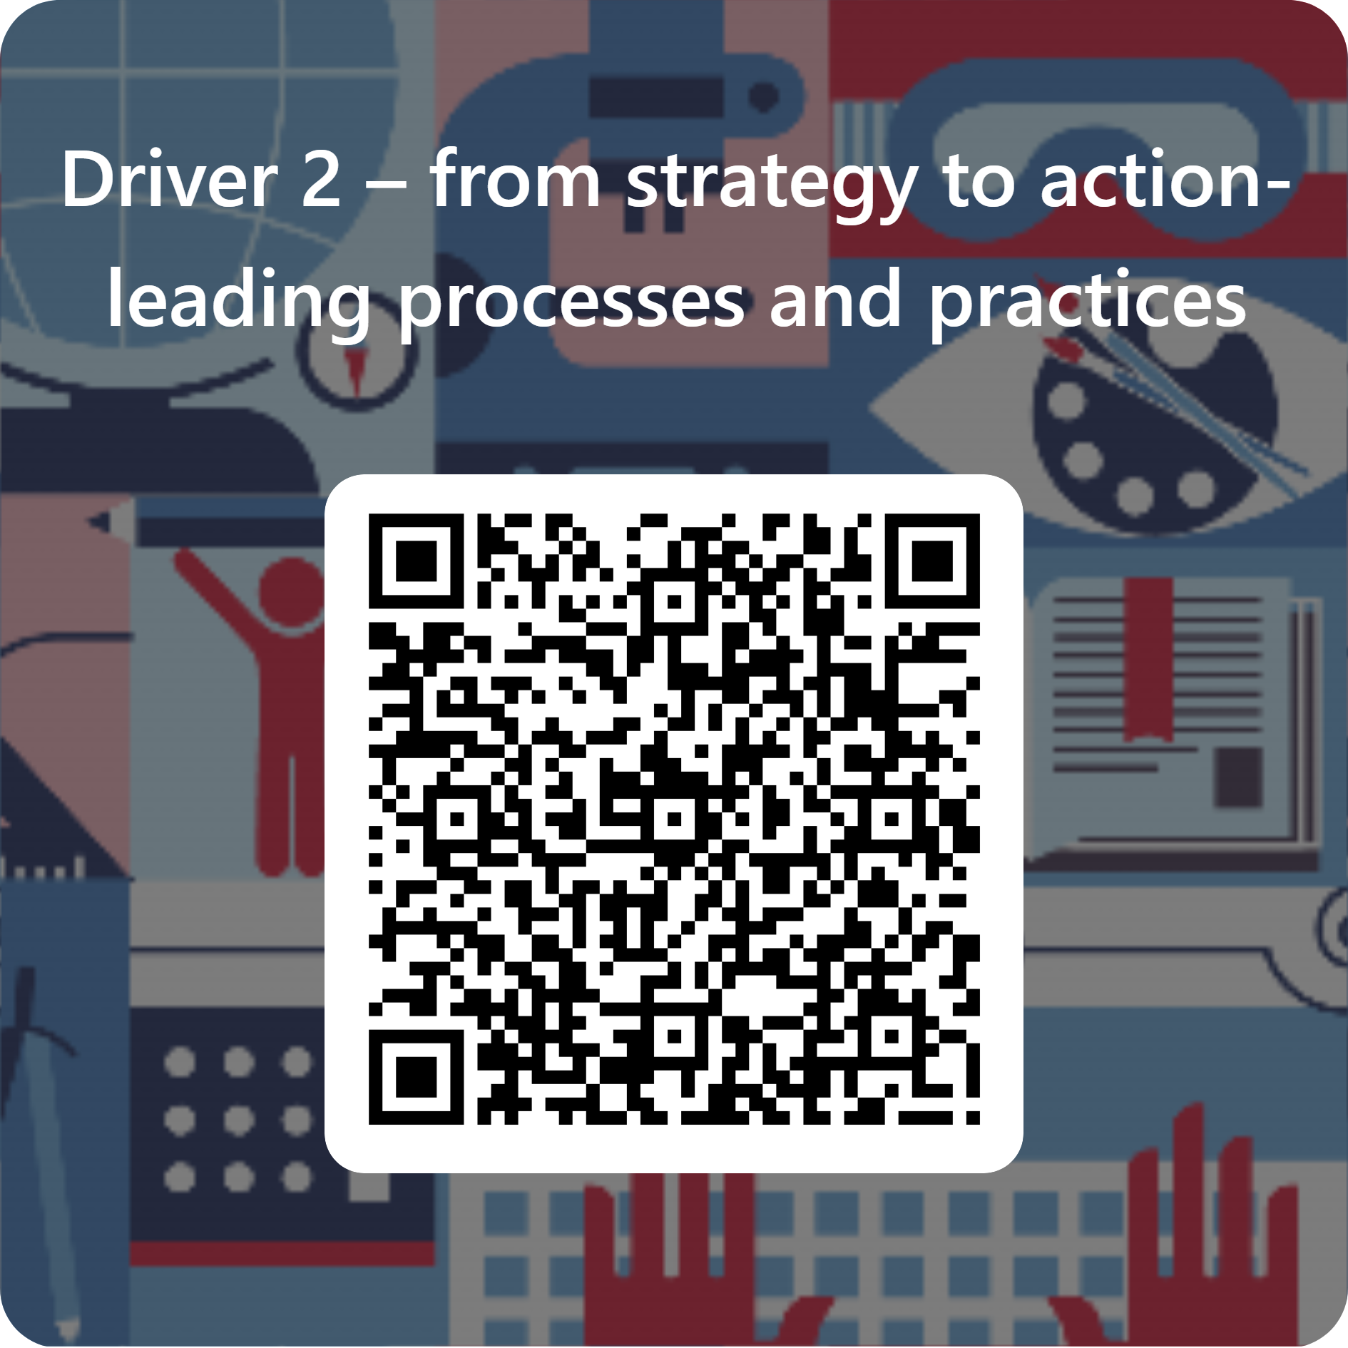
Further support (2)
Evaluation and contact
Join T and L statewide staffroom
Teaching and Learning 7–12 team
Contact email: secondaryteachingandlearning@det.nsw.edu.au
Notes:
Purpose: Feedback and further assistance
Suggested time: 2 minutes
Suggested script:
This concludes the section on leading Driver 2- From strategy to action – leading processes and practices.
Please ask the team to take a few moments to complete the survey.
Your feedback will help the Secondary Teaching and Learning team evaluate the learning resources, including the Illustration of practice 2, the Reflection and implementation guide 2, and the Strategic implementation process.
You are encouraged to join the Secondary Teaching and Learning Statewide Staffroom to collaborate with like-minded educators and leaders. Go to the link provided on the slide to register.
The Secondary Teaching and Learning team can be contacted with any further questions using the email provided on the screen.

Slide 53
Leading driver 3
6
Contextual planning and strategic alignment
From strategy to action -leading processes and practices
Fostering collaboration for growth and improvement
Fostering collaboration for growth and improvement
Notes:
Purpose: Introduction to Leading driver 3- applying the Strategic implementation process
Suggested time: 2 minutes
Instructions for the facilitator:
This section will support leadership teams in applying each stage of the Strategic implementation process, providing a practical understanding of how to lead Driver 3, Fostering collaboration for growth and improvement, for achieving continuous growth and improvement.
The process will assist school teams to align efforts, identify action steps, and refine strategies to leverage collaboration and expertise within their school community.

Slide 54
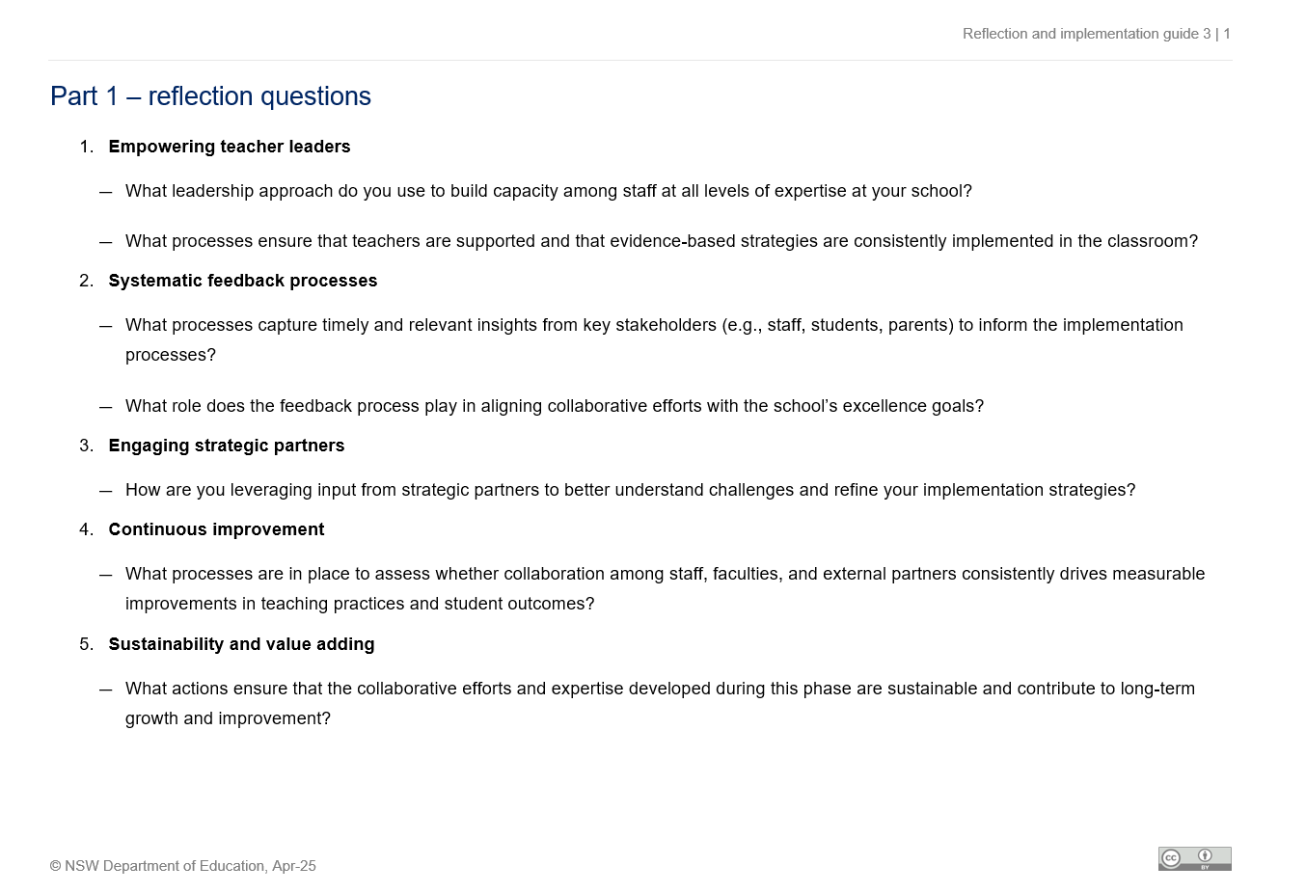
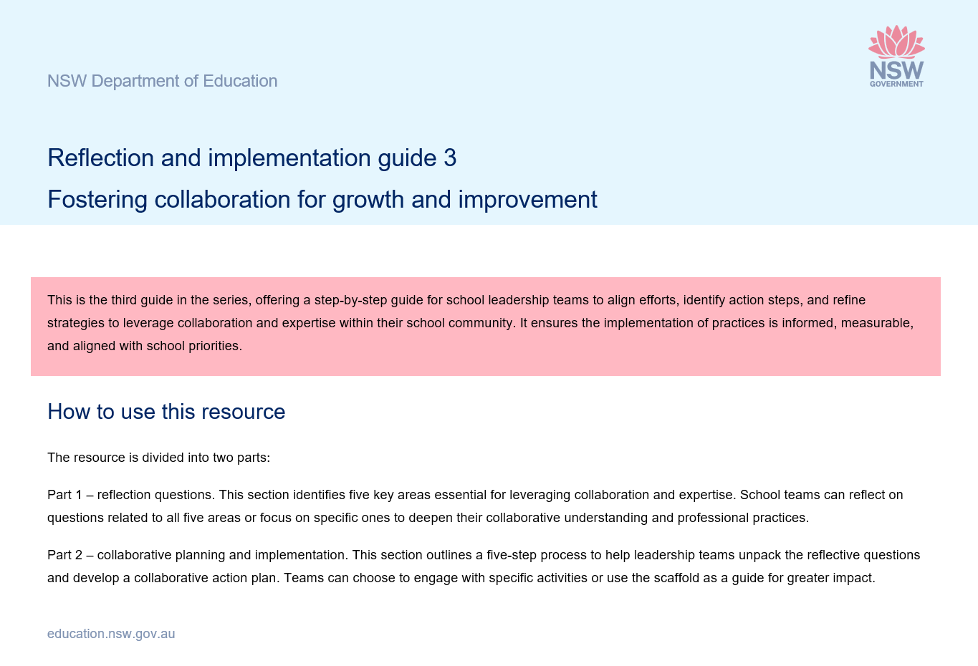
Resources for leading driver 3
Fostering collaboration for growth and improvement
Resources:
Driver 3 – reflection and implementation guide
Illustration of practice 3
School Excellence Plan
any examples of collaboration frameworks: quality teaching rounds, professional learning communities or any other
Notes:
Purpose: To identify resources that will assist in leading driver 3
Suggested time: 2 minutes
Instructions for the facilitator:
The slide lists the resources used in this section.
Schools are encouraged to refer to their School Excellence Plan, examples of collaborative frameworks - quality teaching rounds, professional learning communities - to make the content relevant to their specific context and needs.
Resources:
Driver 3 - reflection and implementation guide
Illustration of practice 3
the School Excellence Plan (SEP)
Contextual data could include:
examples of collaboration frameworks such as Quality teaching rounds, Professional learning communities (PLCs), team teaching, collaborative inquiry or any other.
Additional recourses on the second last slide of this section
The resources provided support further exploration of the key driver.
The school leadership team can choose to explore these resources as part of their professional learning journey.

Slide 55
Process for leading driver 2 (2)
Fostering collaboration for growth and improvement
Use the illustration of practice 3 ‘Fostering collaboration for growth and improvement’, and apply the 3 key steps of the strategic implementation process for a structured approach to:
building collaborative practices to lead curriculum initiate across the whole school
developing teaching and leading capacity at all levels of expertise.
1. Key focus areas
2. Reflection questions
3. Collaborative planning and implementation
Notes:
Purpose: Overview of the process of leading driver 3
Suggested time: 2 minutes
Suggested script:
On this slide, you’ll see an overview of the process for achieving the outcomes of Driver 3—that’s what we’re focusing on here.
The next few slides will walk you through the steps to build and lead an action plan.
We’ll also be drawing on Illustration of Practice 3: Fostering collaboration for growth and improvement, which acts as a guide for how to lead this work effectively.
This structured approach, based on the three key steps of the Strategic implementation process, helps ensure clarity, consistency, and purposeful implementation across the team

Slide 56
1. Key focus areas (4)
Applying strategic implementation framework
Watch the illustration of practice 3 ‘Fostering collaboration for growth and improvement’ (3:56).
Activity:
discuss in pairs the key insights from the clip.
Guiding prompt:
what are some key focus areas identified in the clip for building collaborative practices across the whole school?
1. Key focus areas
2. Reflection questions
3. Collaborative planning and implementation
Notes:
Purpose: Reflecting on key focus areas to build contextual understanding
Suggested time: 10 minutes
Suggested script:
We’re going to go through the next few steps together.
First, we’ll watch Illustration of Practice 3: Fostering collaboration for growth and improvement—it’s a short clip, just under four minutes.
After watching, I’d like you to turn to a partner and chat about the key insights that stood out to you.
Here’s a guiding question to help frame your discussion:
What are some key focus areas mentioned in the clip for building collaborative practices across the whole school?
Once you’ve had a few minutes to discuss in pairs, I’ll invite some of you to share your thoughts with the whole group. Let’s go ahead and watch the clip.

Slide 57
2. Reflection questions (4)
Deepen your understanding
Use the ‘Part 1 – reflection questions’ from the ‘Driver 3 – reflection and implementation guide’.
Activity:
reflect on the 5 focus areas identified and consider each of the reflective questions individually.
Guiding Prompt:
how do your insights align with the current practices/process at school or at your faculty level?
1. Key focus areas
2. Reflection questions
3. Collaborative planning and implementation
Notes:
Purpose: Refining understanding by using Reflection questions
Suggested time: 10 minutes
Suggested script:
Now we’re going to take some time to reflect using Part 1 – reflection questions from the Driver 3 – reflection and implementation guide.
I’d like each team to reflect on the five focus areas that have been identified. As you go through, take a moment to consider each question individually and think about how it connects to your current practice.
A guiding prompt you might use is:
How do your insights align with what’s currently happening at your team/school or within your faculty?
This step is really valuable—it’ll help you refine your perspective and get a clearer understanding before we move on to the next stage: Individual Reflection as part of the collaborative planning and implementation process.
Take your time with this one—let’s begin.

Slide 58
3. Collaborative planning and implementation (12)
Individual reflections
Use the ‘Part 1 – reflection questions’ from the ‘Driver 3 – reflection and implementation guide’.
Activity
Use the guiding prompts from the guide to:
write your personal reflections and insights based on your experience and your school’s context in ‘Table 1 – individual reflection’
rank the focus areas in terms of high to low priority.
1. Key focus areas
2. Reflection questions
3. Collaborative planning and implementation
Individual reflection
Review and adjust
Collaborative discussion
Develop collaborative implementation plan
Identify challenges and opportunities
Notes:
Purpose: To guide participants in reflecting and allow them to prioritise key focus areas
Suggested time: 15-20 minutes
Suggested script:
Now we’re going to shift into some individual reflection.
Please turn to Part 1 – Reflection questions in the Driver 3 – reflection and implementation guide. I’d like you to take a few minutes and go through the guiding prompts to write down your personal reflections and insights in Table 1 – Individual reflection, thinking about your own experiences and your school’s context.
As you go through each of the five focus areas, consider how they apply to your own practice.
Once you’ve done that, have a go at ranking the focus areas—from highest to lowest priority—based on what feels most relevant or pressing for you.
I’ll give you some quiet time now to work through this before we move on to the next step.

Slide 59
3. Collaborative planning and implementation (13)
Collaborative discussion
Use the ‘Step 2 – collaborative discussion’ from the ‘Driver 3 – reflection and implementation guide’.
Activity
Use the guiding prompts from the guide to:
discuss each question as a team
record the insight in a shared format or use ‘Table 2 – team discussion’ from the guide.
Individual reflection
Review and adjust
Collaborative discussion
Develop collaborative implementation plan
Identify challenges and opportunities
Notes:
Purpose: To deepen understanding and alignment within the team
Suggested time: 30-45 minutes
Suggested script:
Let’s move on to Step 2 – Collaborative discussion from the Driver 3 – reflection and implementation guide.
In your groups, I’d like you to talk through each of the reflection questions together. As you go, make sure someone’s capturing your group’s insights—either in a shared format or directly in Table 2 – Team discussion from the guide.
Use the guiding prompts from the guide to help your conversation:
This is a chance to have an open, honest conversation—so make sure everyone gets a chance to contribute.
Once you’ve had your discussion, I’ll ask each group to share a quick summary of the key themes or insights that came up. Let’s get started.

Slide 60
3. Collaborative planning and implementation (14)
Identify challenges and opportunities
Use the ‘Step 3 – identify challenges and opportunities’ from the ‘Driver 3 – reflection and implementation guide’.
Individual reflection
Activity
Use the guiding prompts from the guide to:
identify challenges that hinder effective planning
highlight opportunities to strengthen alignment and collaboration
record the insight in a shared format or use ‘Table 3 – identify challenges and opportunities’ from the guide.
Review and adjust
Collaborative discussion
Develop collaborative implementation plan
Identify challenges and opportunities
Notes:
Purpose: To foster critical thinking and encourage actionable insights
Suggested time: 20-30 minutes
Suggested script:
Let’s move into Step 3 – Identify challenges and opportunities from the Driver 3 – Reflection and implementation guide.
As a group, I’d like you to take some time to identify any challenges that might be getting in the way of effective planning in your context. Then, think about the opportunities you have to strengthen things like alignment, collaboration, or inclusivity—either within your team or across the school.
Use the guiding prompts from the guide and jot down your group’s insights in a shared format or use Table 3 – Identify challenges and opportunities from the guide.
Take this time to really think critically about what might be holding things back, and where there’s room to grow. I’ll give you time now to discuss and capture your ideas before we move on.

Slide 61
3. Collaborative planning and implementation (15)
Develop a collaborative plan
Use the ‘Step 4 – develop a collaborative plan’ from the ‘Driver 3 – reflection and implementation guide’.
Activity
Use the guiding prompts from the guide to:
design an action plan focusing on the chosen area/s
outline key actions, assigning responsibilities, set timelines and establishing success indicators
record the insight in ‘Table 4 – develop a collaborative plan’ from the guide.
Individual reflection
Review and adjust
Collaborative discussion
Develop collaborative implementation plan
Identify challenges and opportunities
Notes:
Purpose: To collaboratively create an actionable plan that addresses key focus areas
Suggested time: 45-60 minutes
Suggested script:
Now let’s move into Step 4 – Develop a collaborative plan from the Driver 3 – Reflection and implementation guide.
As a team, you’re going to start designing an action plan that focuses on the area—or areas—you’ve identified for improvement.
Think about the key actions you'll need to take, who’s going to be responsible for each one, the timelines you’ll work within, and how you’ll measure success. You can record everything in Table 4 – Develop a collaborative plan from the guide.
Use the guiding prompts provided in the guide to help shape your thinking:
The goal here is to come up with something practical, measurable, and genuinely collaborative. Take your time, and when you’re ready, we’ll move to the final step.

Slide 62
3. Collaborative planning and implementation (16)
Review and adjust
Use ‘Step 5 – review and adjust’ from the ‘Driver 3 – reflection and implementation guide’.
Activity
Use the guiding prompts from the guide to:
plan for ongoing review sessions and establish methods for evidence collection and evaluation
identify evidence such as feedback, observations, and outcomes to evaluate success
record the insight in ‘Table 5 – review and adjust’ from the guide.
Individual reflection
Review and adjust
Collaborative discussion
Develop collaborative implementation plan
Identify challenges and opportunities
Notes:
Purpose: To establish a process for evaluating the success of the plan using evidence and feedback
Timeframe: schedule regular check-ins (e.g., monthly or quarterly)
Suggested script:
Let’s move into our final step—Step 5: Review and adjust from the Driver 3 – Reflection and implementation guide.
At this stage, I’d like you to think about how you’ll measure the effectiveness of your plan over time, and how you’ll make adjustments as needed.
What kind of evidence will you collect? This could be things like feedback from staff or students, classroom observations, or even outcome data. Also, think about how often you’ll review your progress and tweak the plan if needed.
You can use Table 5 – Review and adjust in the guide to capture your ideas.
This part of the guide includes some guiding prompts to assist your thinking and discussion:
Go ahead and discuss that as a group and take the time to record your thinking and action plan.

Slide 63
Additional resources – further reading (3)
Driver 3 – fostering collaboration for growth and improvement
School planning for curriculum implementation
Curriculum networks
Statewide Staffrooms
Principles for building capacity
Establishing communities of practice
Research on professional learning (nsw.gov.au)
Leading teaching and learning – AITSL (PDF 70KB)
What works best
Notes:
Purpose: To provide additional resources relevant to Driver 3 – Fostering collaboration for growth and improvement
Suggested time: 2 minutes
Suggested script:
To wrap up, just a quick note on the additional resources provided.
These are designed to support further exploration of the key driver we’ve focused on so far.
You are encouraged to explore these resources at their own pace to further develop your leadership capacity.
These resources can be a great starting point for deeper conversations or for our future planning sessions.

Slide 64
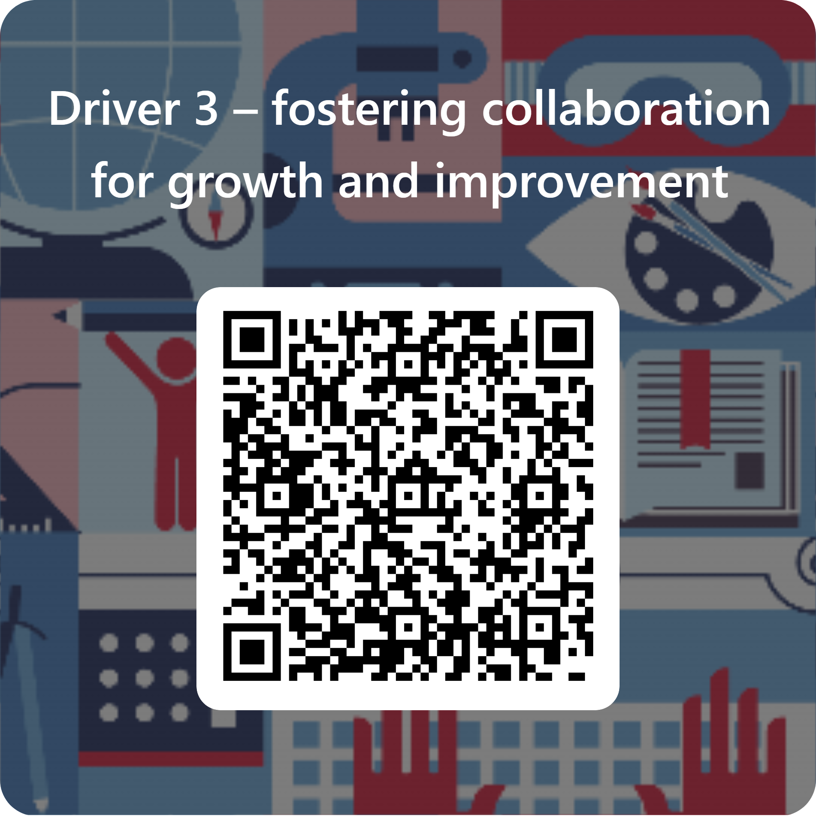
Further support (3)
Evaluation and contact
Join T and L statewide staffroom
Teaching and Learning 7–12 team
Contact email: secondaryteachingandlearning@det.nsw.edu.au
Notes:
Purpose: Feedback and further assistance
Suggested time: 2 minutes
Suggested script:
This concludes the section on leading Driver 3- Fostering collaboration for growth and improvement.
Please ask the team to take a few moments to complete the survey.
Your feedback will help the Secondary Teaching and Learning team evaluate the learning resources, including the Illustration of practice 3, the Reflection and implementation guide 3, and the Strategic implementation process.
You are encouraged to join the Secondary Teaching and Learning Statewide Staffroom to collaborate with like-minded educators and leaders. Go to the link provided on the slide to register.
The Secondary Teaching and Learning team can be contacted with any further questions using the email provided on the screen.

Slide 65
Copyright
© State of New South Wales (Department of Education), 2025
The copyright material published in this resource is subject to the Copyright Act 1968 (Cth) and is owned by the NSW Department of Education or, where indicated, by a party other than the NSW Department of Education (third-party material).
Copyright material available in this resource and owned by the NSW Department of Education is licensed under a Creative Commons Attribution 4.0 International (CC BY 4.0) license.
This license allows you to share and adapt the material for any purpose, even commercially.
Attribution should be given to © State of New South Wales (Department of Education), 2025.
Material in this resource not available under a Creative Commons license:
the NSW Department of Education logo, other logos and trademark-protected material
Material owned by a third party that has been reproduced with permission. You will need to obtain permission from the third party to reuse its material.
Links to third-party material and websites
Please note that the provided (reading/viewing material/list/links/texts) are a suggestion only and implies no endorsement, by the New South Wales Department of Education, of any author, publisher, or book title. School principals and teachers are best placed to assess the suitability of resources that would complement the curriculum and reflect the needs and interests of their students.
If you use the links provided in this document to access a third-party’s website, you acknowledge that the terms of use, including licence terms set out on the third-party’s website apply to the use which may be made of the materials on that third-party website or where permitted by the Copyright Act 1968 (Cth). The department accepts no responsibility for content on third-party websites.
Notes:
Slide not shared

