Slide 1
Chi sono io?
Who am I?

Slide 2
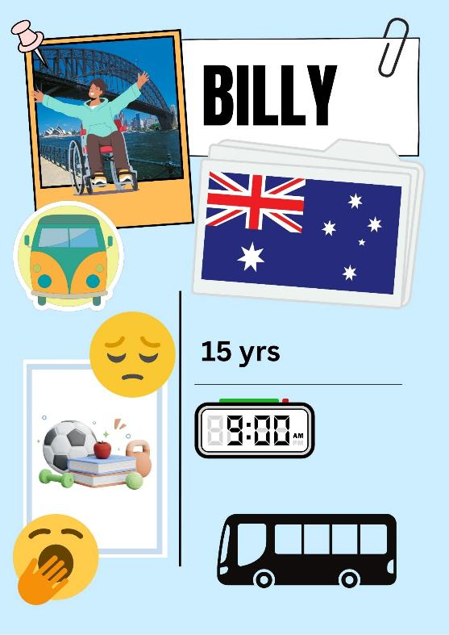
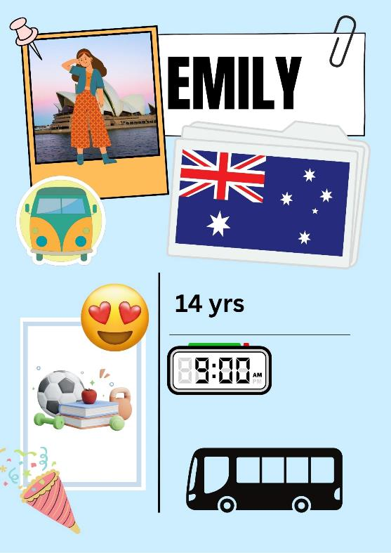
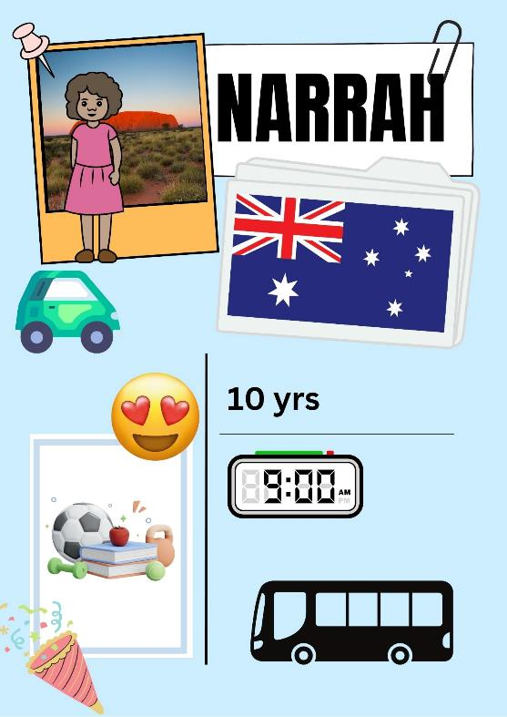
Chi sono io? (1 of 5)
Notes:
Who am I? – Chi sono io?
I live in Australia – Abito in Australia.
I go to school by bus at 9:00 – Arrivo a scuola in autobus alle nove.
I am trendy – Sono di moda.
My favourite subject is PE because it’s fun – La mia materia preferita è l’educazione fisica perché è divertente.
I am 14 years old – Ho quattordici anni.
I am Emily – Mi chiamo Emily.

Slide 3
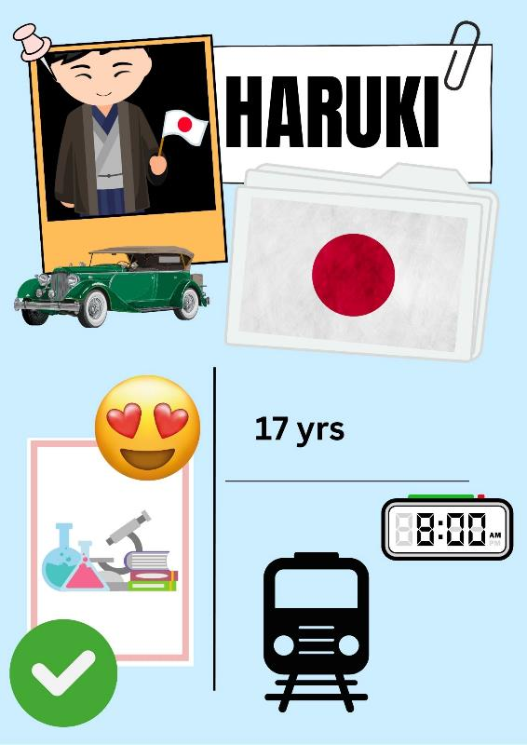
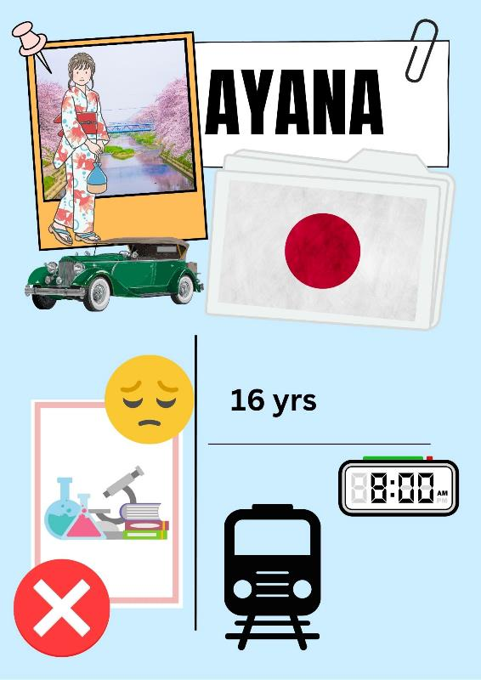
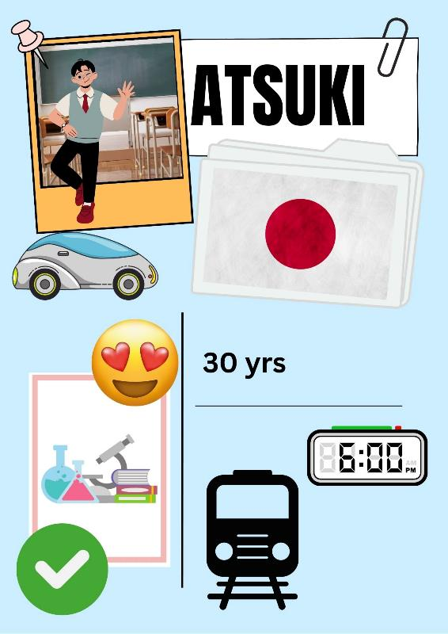
Chi sono io? (2 of 5)
Notes:
Who am I? – Chi sono io?
I live in Australia – Abito in Giappone.
I go to school by train at 8:00 am - Arrivo a scuola in treno alle otto.
I am traditional - Sono tradizionale.
I love science and I am good at science – Mi piacciono molto le scienze e sono bravo in scienze.
I am 17 yrs old – Ho diciassette anni.
I am Haruki – Mi chiamo Haruki.

Slide 4
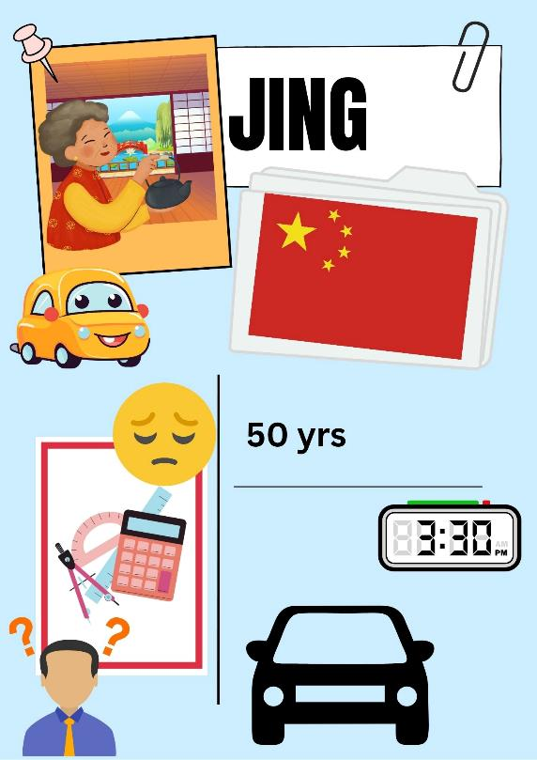
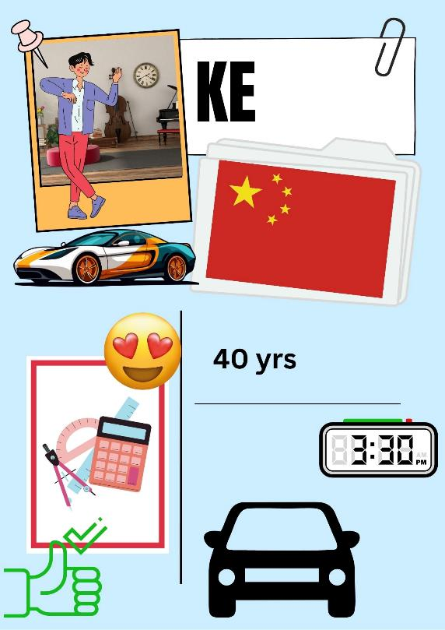
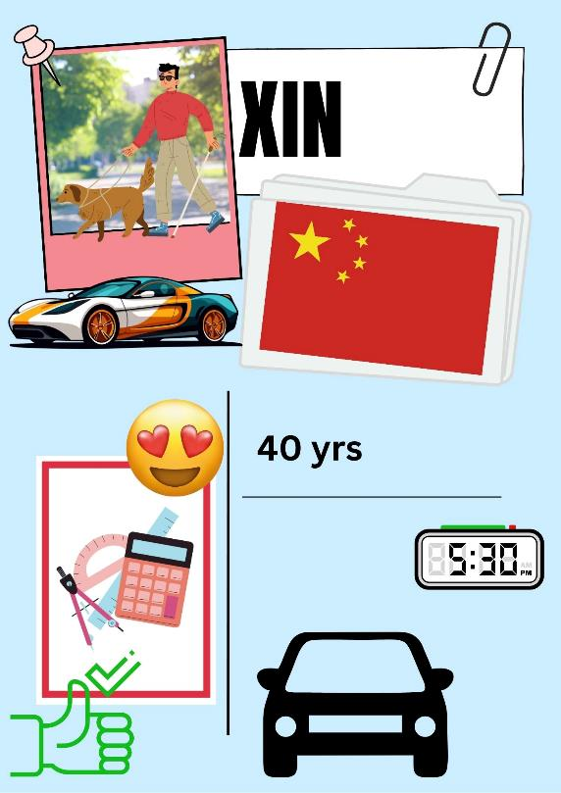
Chi sono io? (3 of 5)
Notes:
Who am I? – Chi sono io?
I live in China – Abito in Cina.
I go to school by car – Arrivo a scuolo in macchina.
I am sporty – Sono sportivo.
I am 40 years old – Ho quarant’anni.
I love Maths because it is useful – Mi piace la matematica perché è utile.
I arrive home at 5:30 – Torno a casa alle cinque e mezza.
I am Xin – Sono Xin.

Slide 5
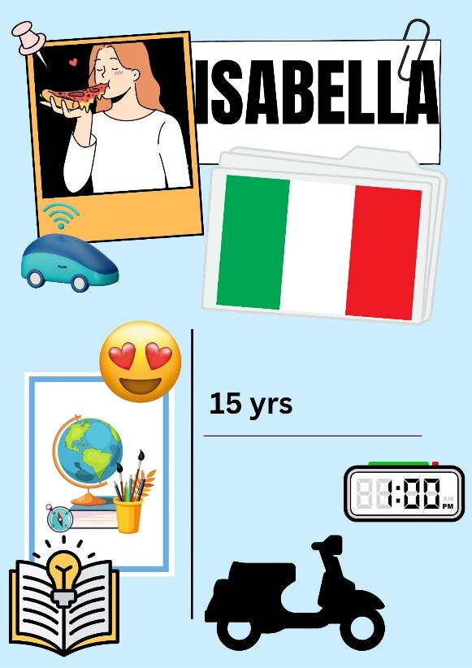
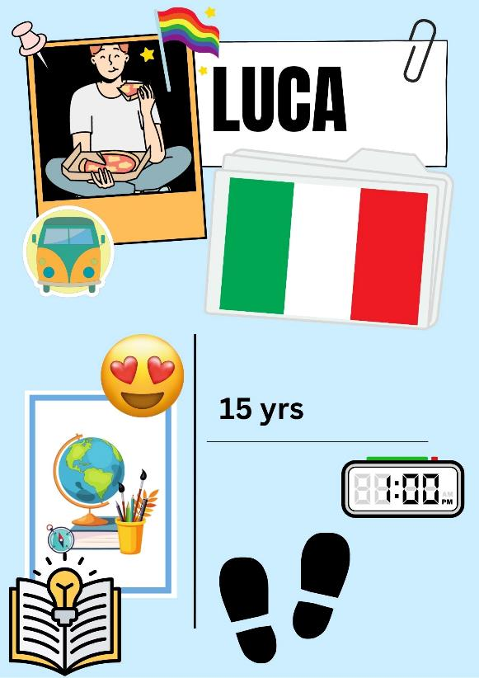
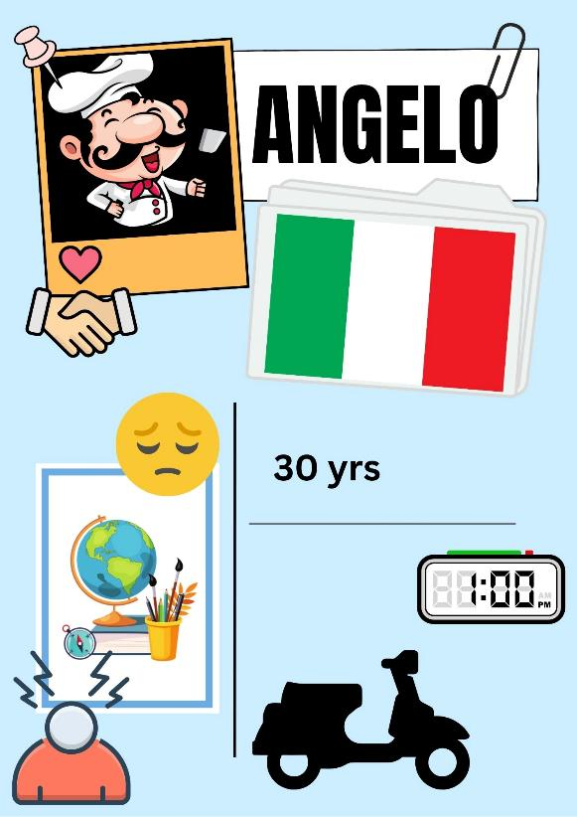
Chi sono io? (4 of 5)
Notes:
Who am I? – Chi sono io?
I live in Italy – Abito in Cina.
I go home at 1:00 by scooter – Torno a casa all’una in monopattino.
My favourite subject is geography because it’s interesting – La mia materia preferita è la geografia perché è interessante.
I am 15 years old – Ho quindici anni.
I am intelligent – Sono intelligente.
I am Isabella – Mi chiamo Isabella.

Slide 6
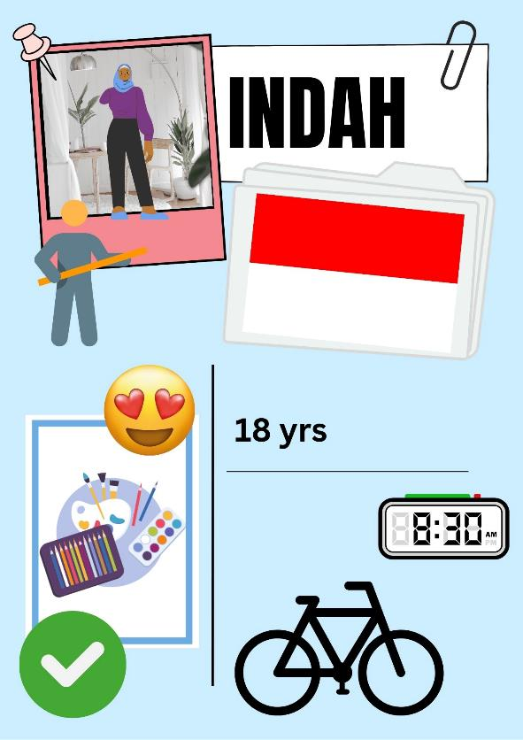
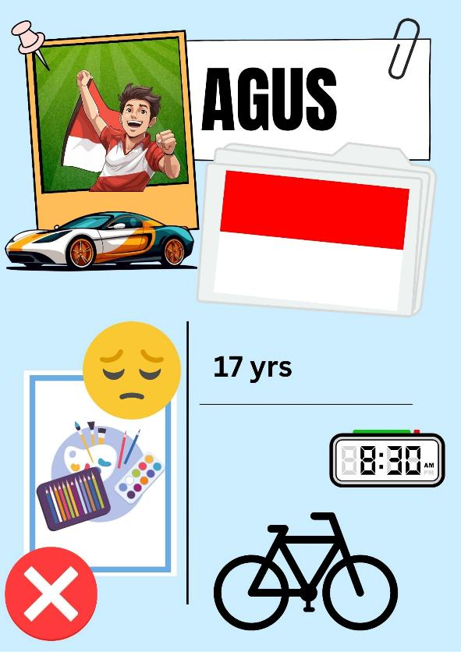
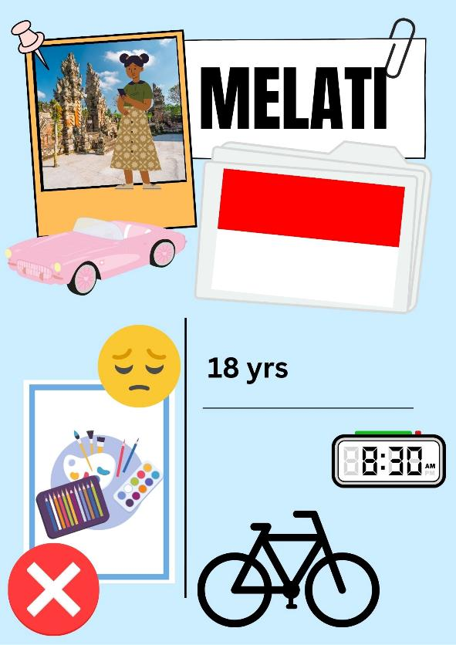
Chi sono io? (5 of 5)
Notes:
Who am I? – Chi sono io?
I live in Indonesia – Abito in Indonesia.
I get to school at 8:30 by bike – Arrivo a scuola alle otto e mezza in bici.
I don’t like Art, I’m not good at it – Non mi piace l’arte, non sono bravo in arte.
I am sporty – Sono sportivo.
I am 17 years old – Ho diciassette anni.
I am Agus – Mi chiamo Agus.

Slide 7
Copyright
© State of New South Wales (Department of Education), 2024
The copyright material published in this resource is subject to the Copyright Act 1968 (Cth) and is owned by the NSW Department of Education or, where indicated, by a party other than the NSW Department of Education (third-party material).
Copyright material available in this resource and owned by the NSW Department of Education is licensed under a Creative Commons Attribution 4.0 International (CC BY 4.0) license.
This license allows you to share and adapt the material for any purpose, even commercially.
Attribution should be given to © State of New South Wales (Department of Education), 2024.
Material in this resource not available under a Creative Commons license:
the NSW Department of Education logo, other logos and trademark-protected material
Material owned by a third party that has been reproduced with permission. You will need to obtain permission from the third party to reuse its material.
Links to third-party material and websites
Please note that the provided (reading/viewing material/list/links/texts) are a suggestion only and implies no endorsement, by the New South Wales Department of Education, of any author, publisher, or book title. School principals and teachers are best placed to assess the suitability of resources that would complement the curriculum and reflect the needs and interests of their students.
If you use the links provided in this document to access a third party’s website, you acknowledge that the terms of use, including licence terms set out on the third-party’s website apply to the use which may be made of the materials on that third-party website or where permitted by the Copyright Act 1968 (Cth). The department accepts no responsibility for content on third-party websites.

