Slide 1
En ville
Places in town

Slide 2
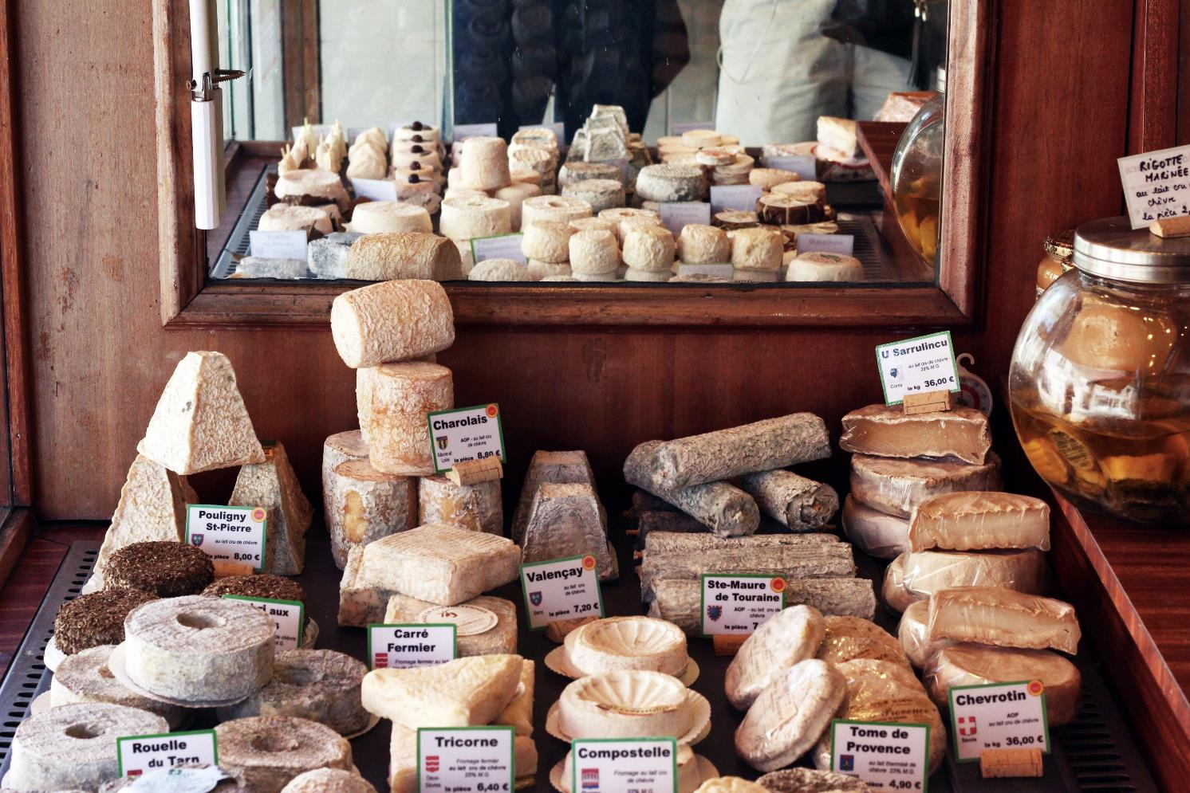
The cheese shop
Image licensed under Unsplash License.
Notes:
la fromagerie: the cheese shop

Slide 3
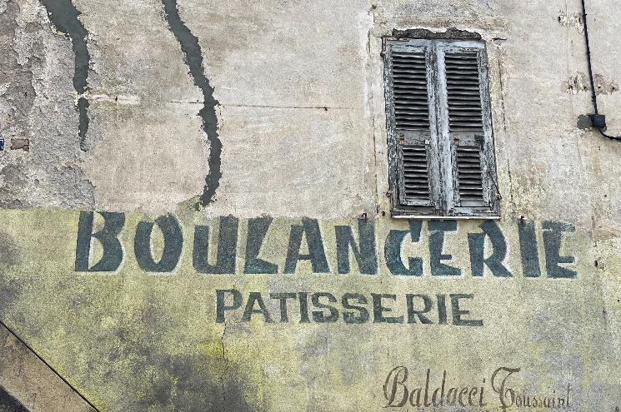
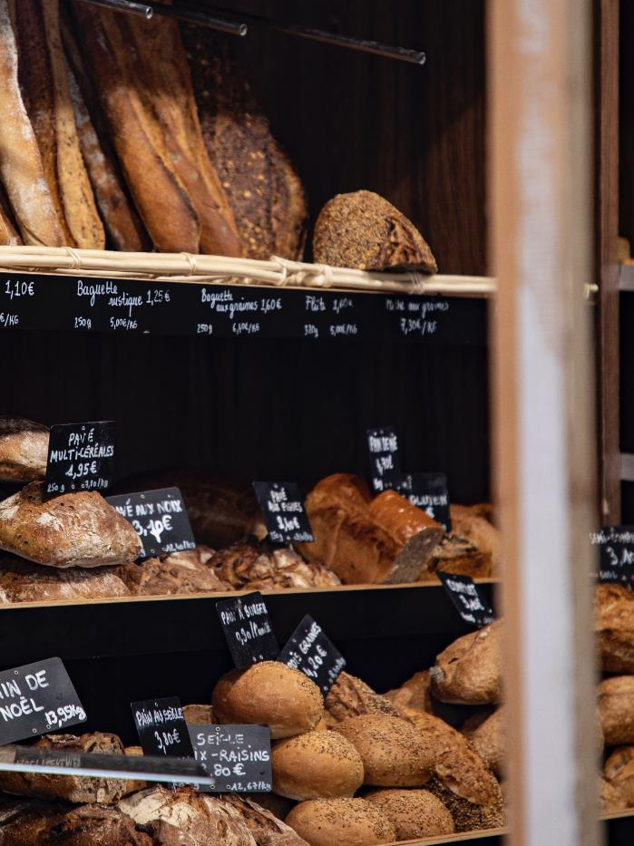
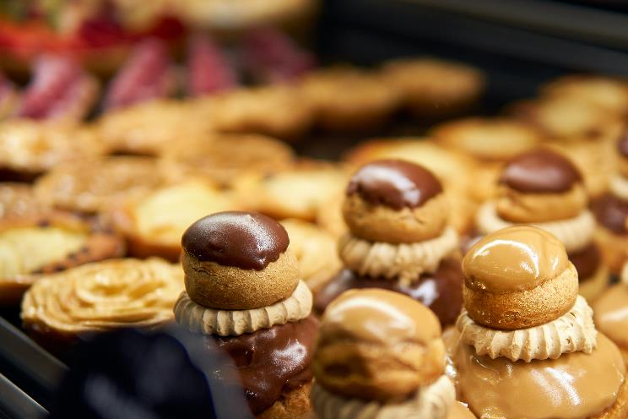
The cake shop and bakery
Image licensed under Unsplash License.
Image licensed under Unsplash License.
Image licensed under Unsplash License.
Notes:
la boulangerie/pâtisserie: the bakery/cake shop

Slide 4
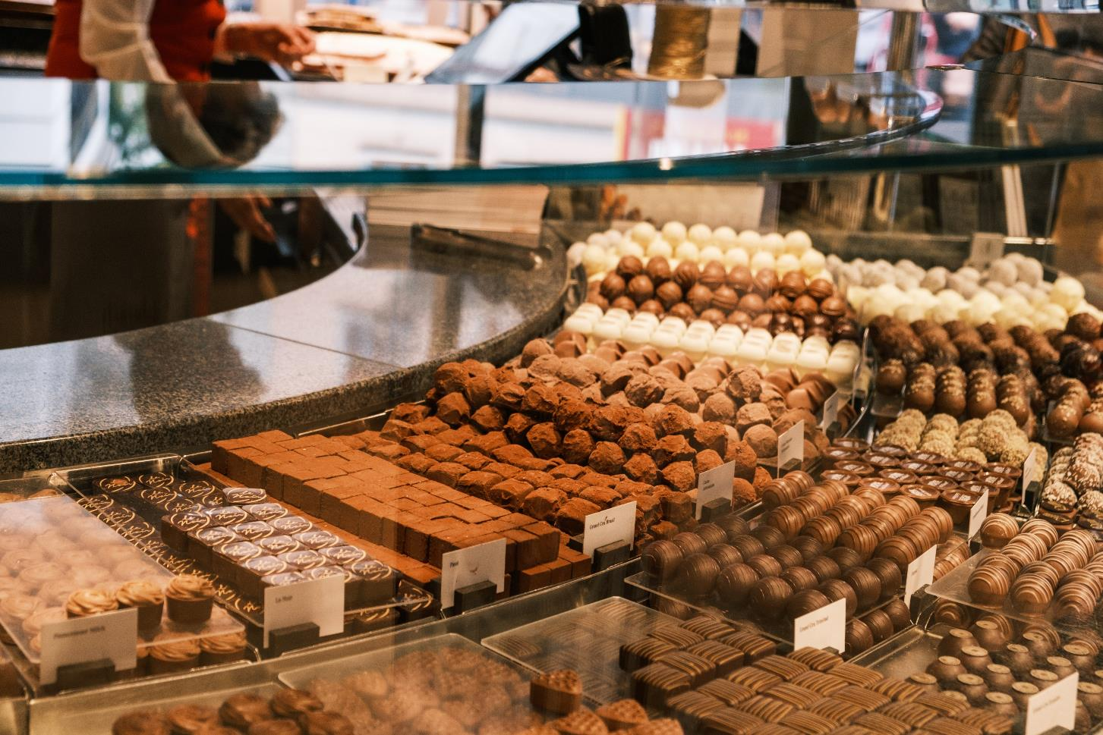
The chocolate shop
Image licensed under Unsplash License.
Notes:
la chocolaterie: the chocolate shop

Slide 5
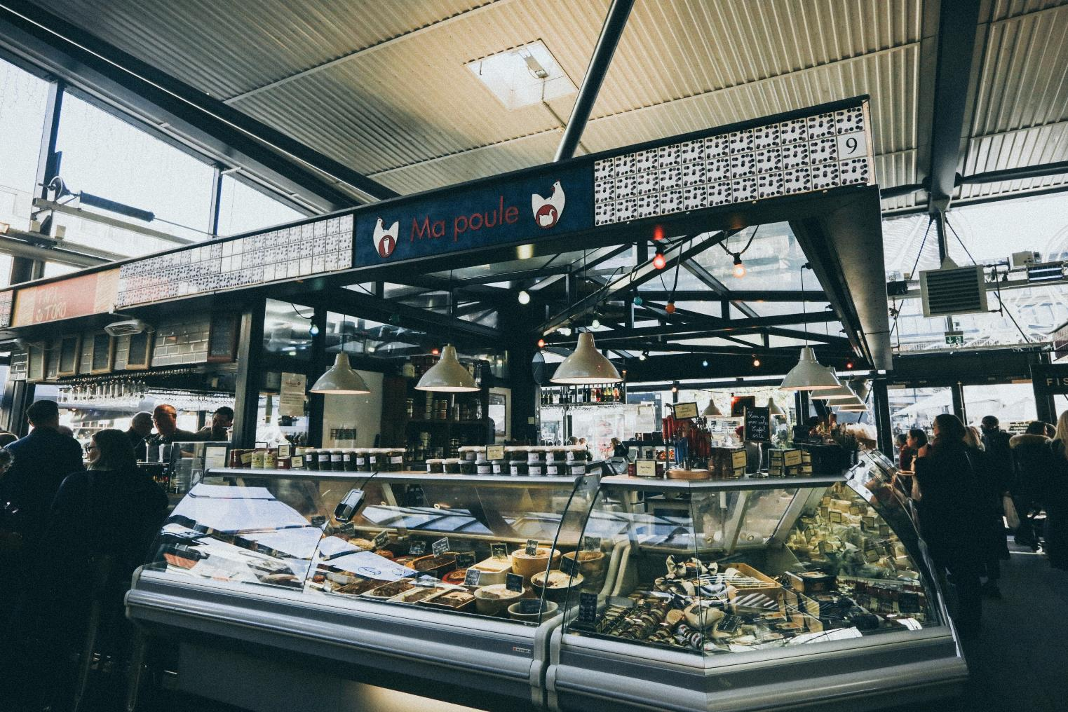
The delicatessen
Image licensed under Unsplash License.
Notes:
la charcuterie: the delicatessen

Slide 6
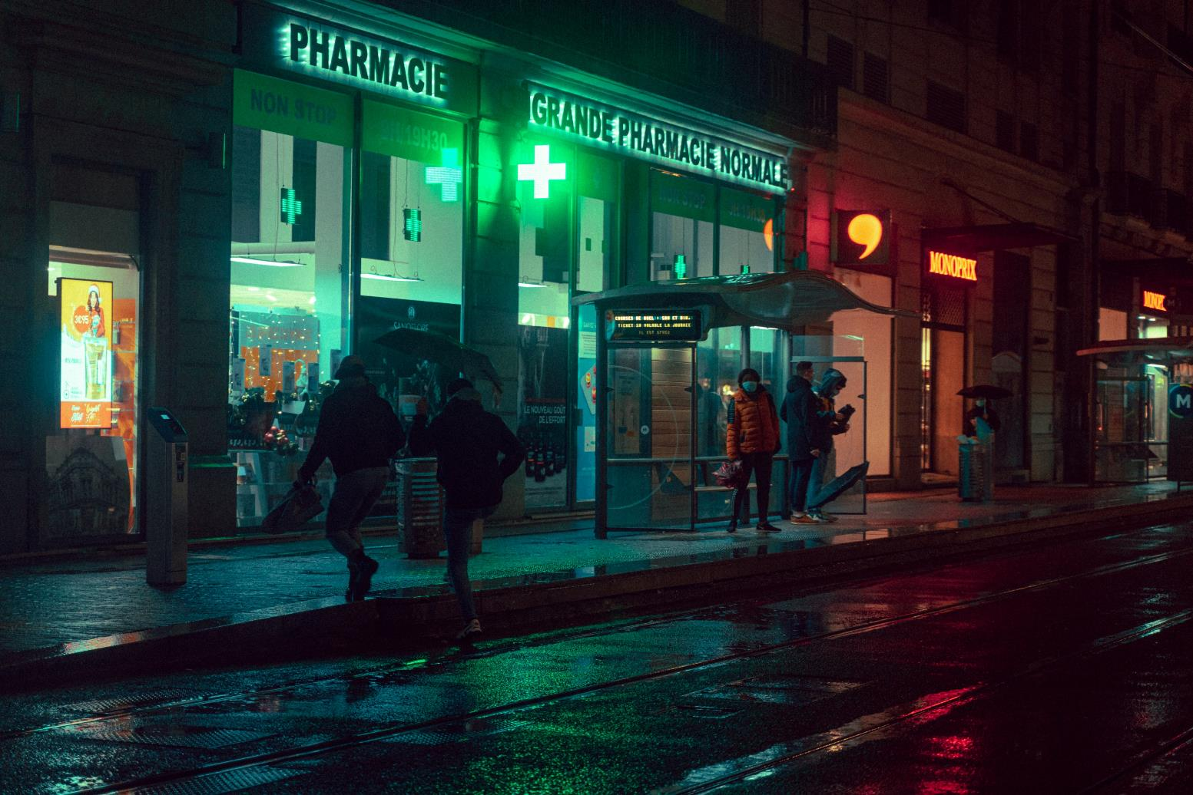
The chemist
Image licensed under Unsplash License.
Notes:
la pharmacie: the chemist
(note the green cross which has been in use to identify pharmacies in France since the early 1800s)

Slide 7
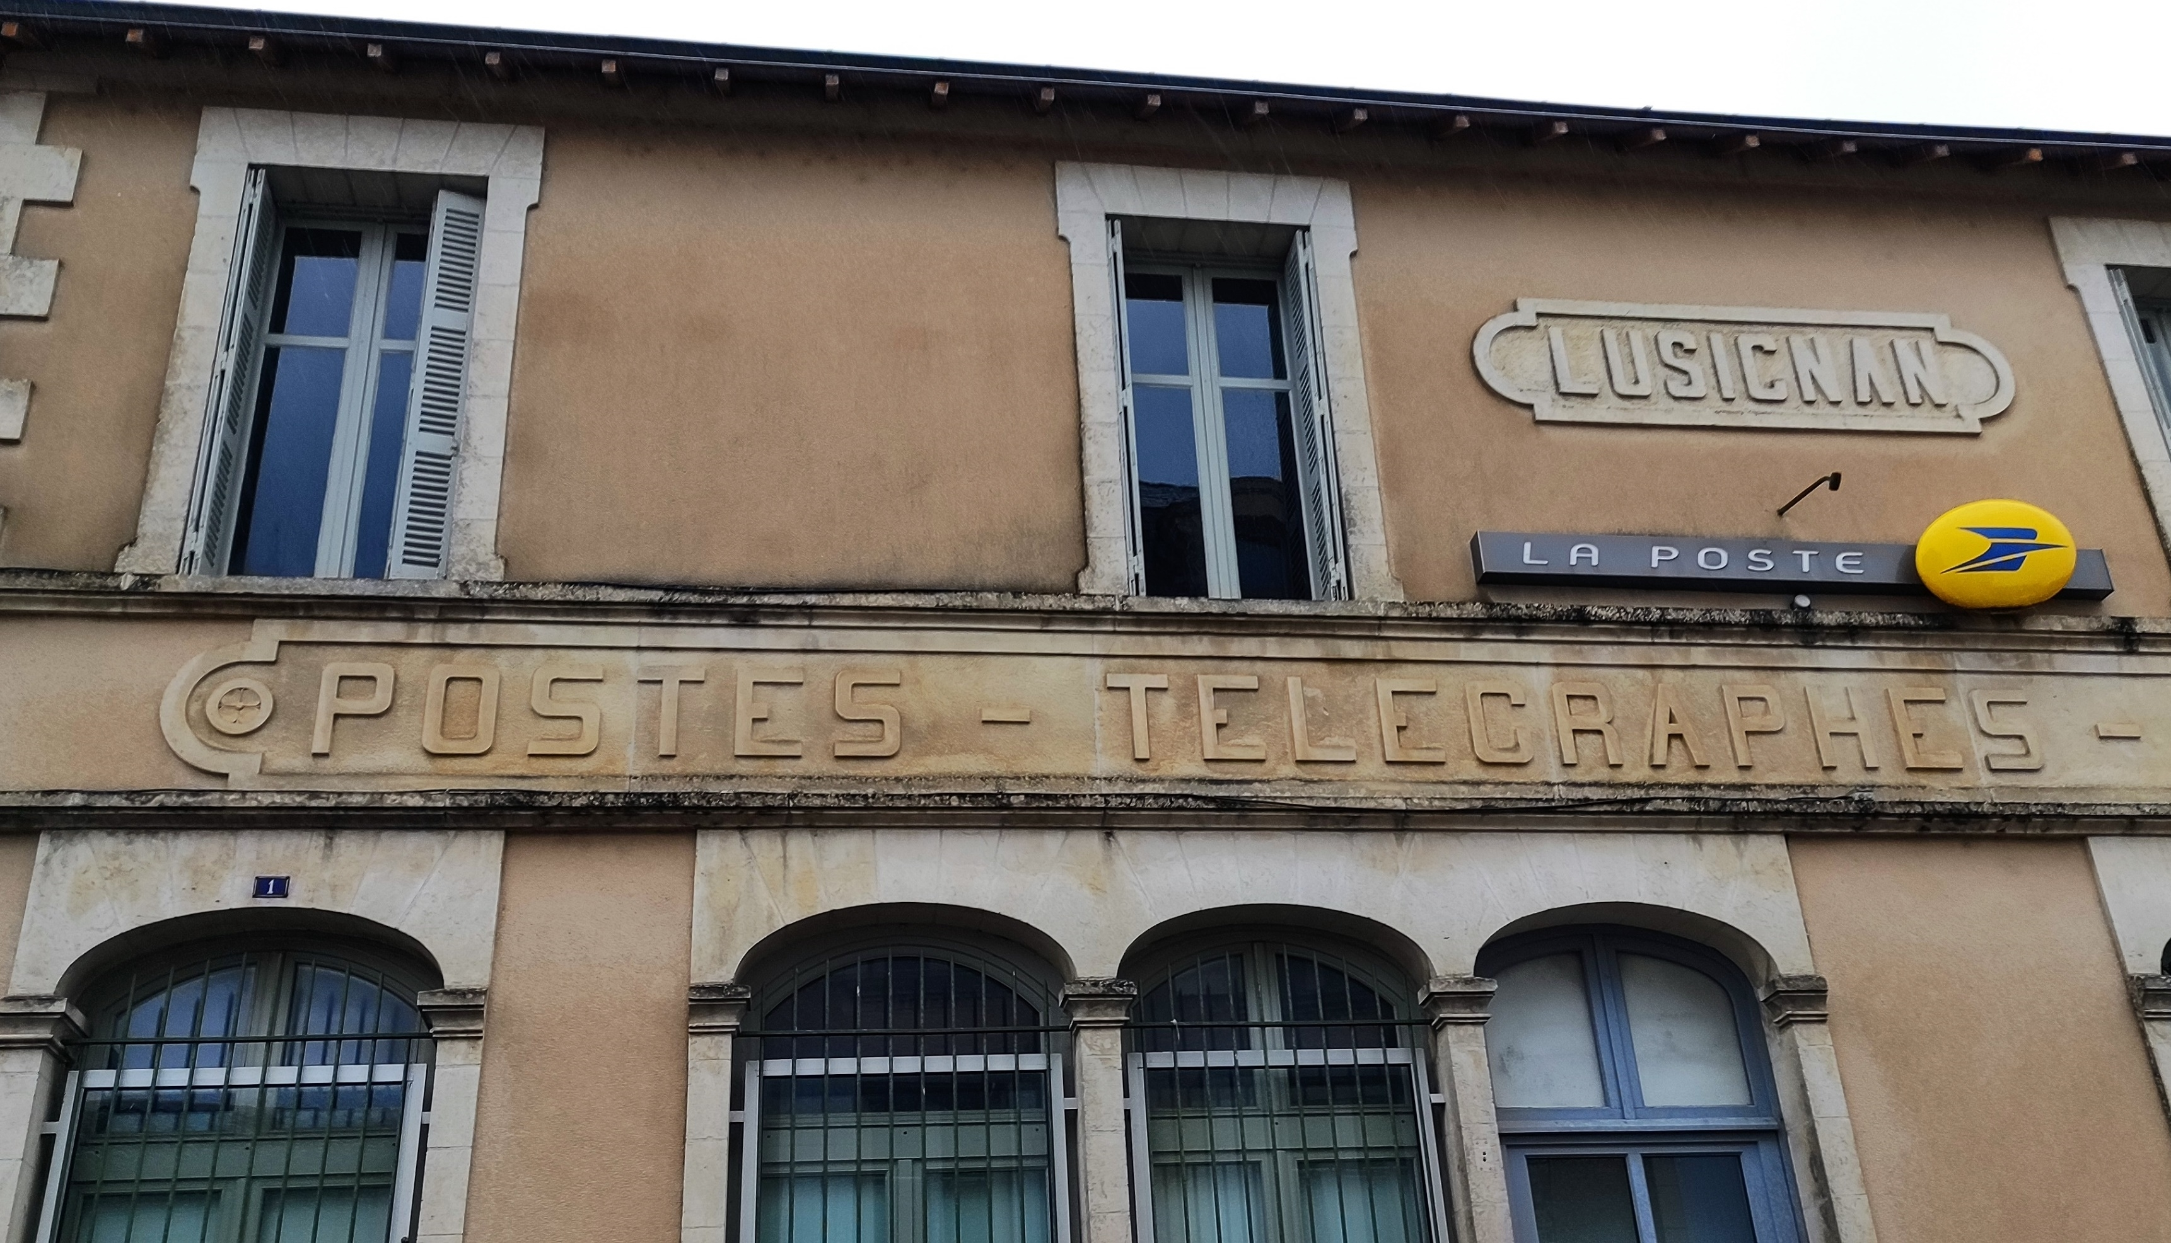
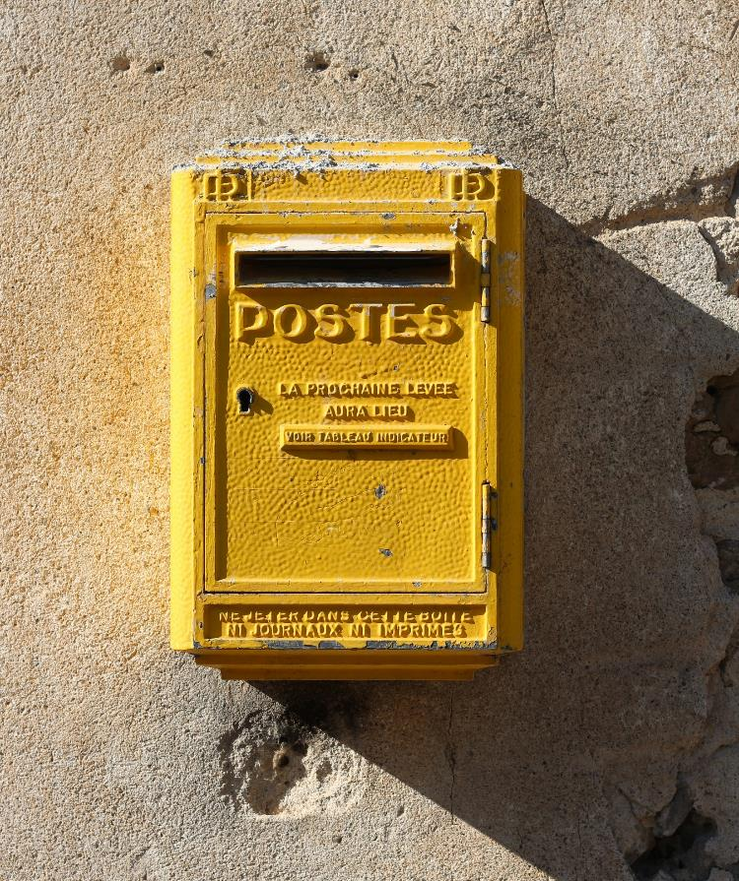
The post office
‘Facade du Bureau de Poste de Lusignan 3’ by Caillou15 is licensed under CC BY-SA-4.0.
Image licensed under
Unsplash License.
Notes:
le bureau de poste/la poste: the post office
(note the blue and yellow colour of the French postal service; letterboxes are fixed to the walls of buildings, probably due to the fact that footpaths are narrow and often non-existent)

Slide 8
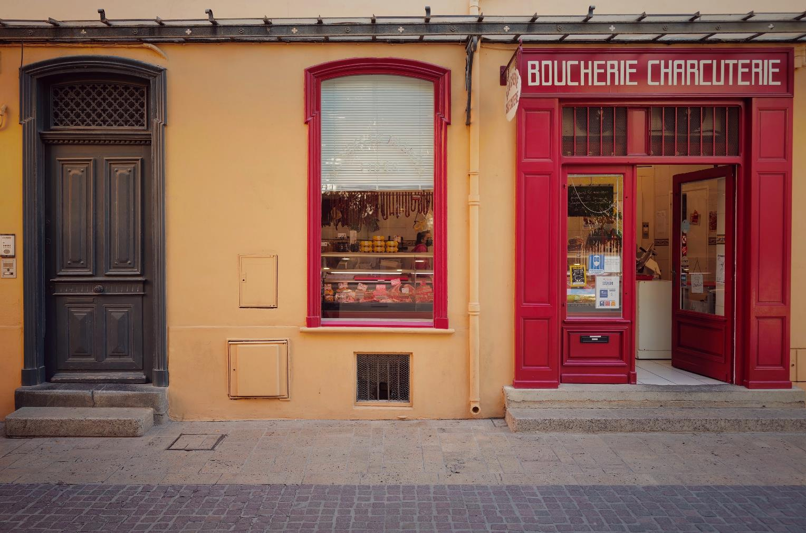
The butcher
Image licensed under Unsplash License.
Notes:
la boucherie/charcuterie: the butcher
(Can also serve as a boucherie chevaline, a horse butcher. Horse meat became popular during the Second French Empire when Paris was under siege and meat was in short supply. The thousands of horses in the city were also consuming the grain needed for human consumption. It has been considered appropriate eating since.)

Slide 9
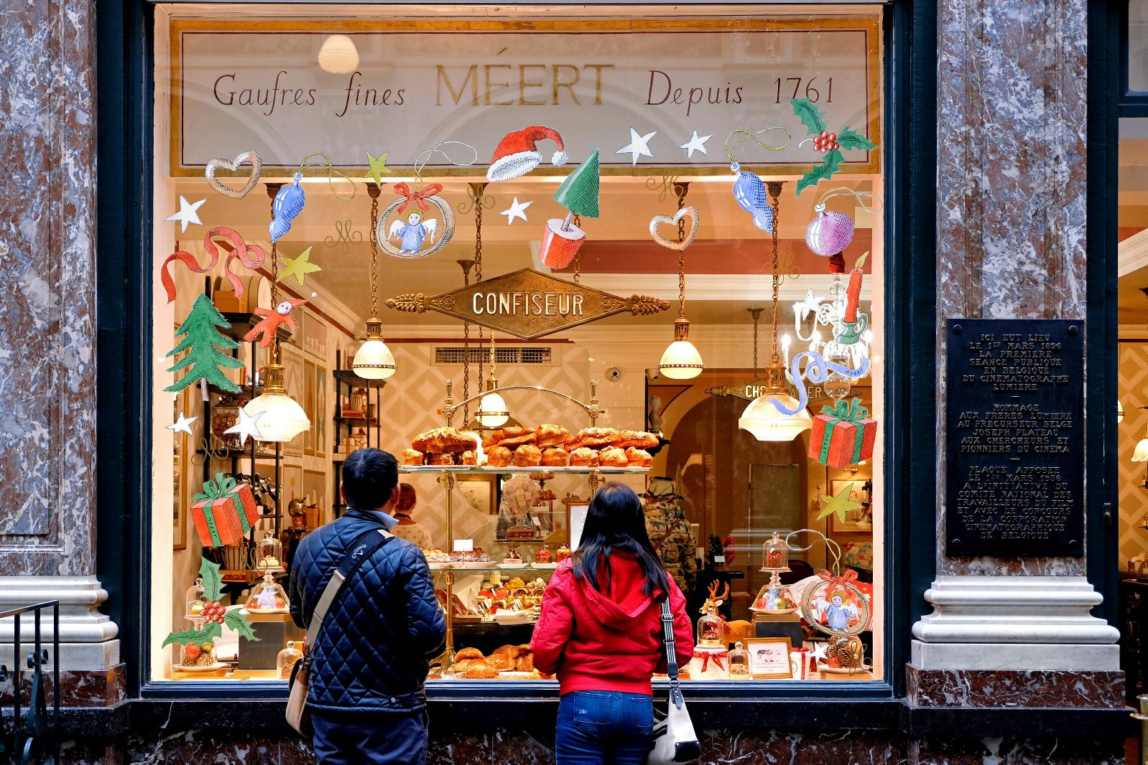
The sweet shop
Image licensed under Unsplash License.
Notes:
la confiserie: the sweet shop
(often serves as a pastry shop, particularly in smaller towns)

Slide 10
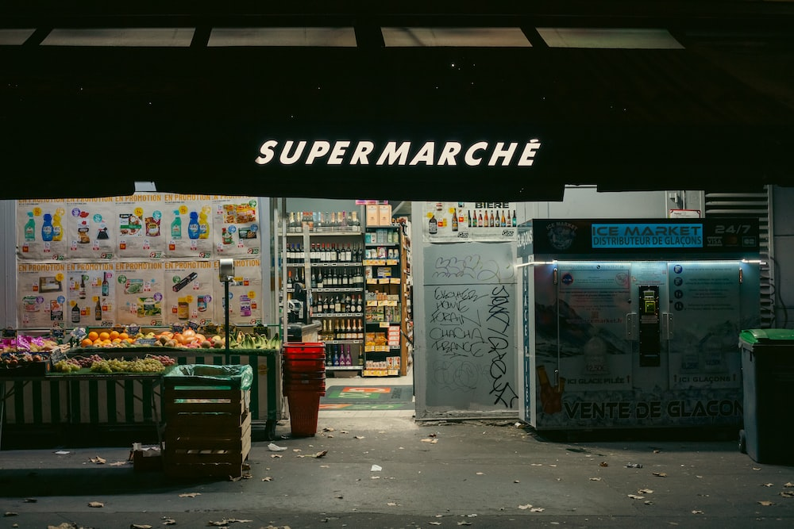
The supermarket
Image licensed under Unsplash License.
Notes:
le supermarché: supermarket

Slide 11
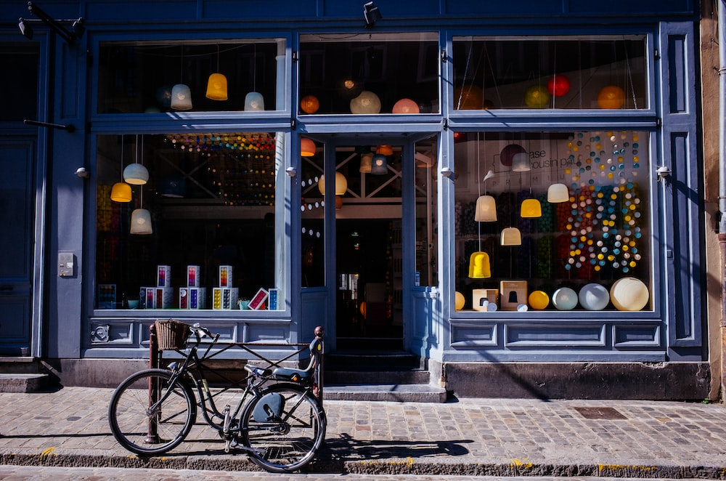
The shop
Image licensed under Unsplash License.
Notes:
le magasin: general word for shop

Slide 12
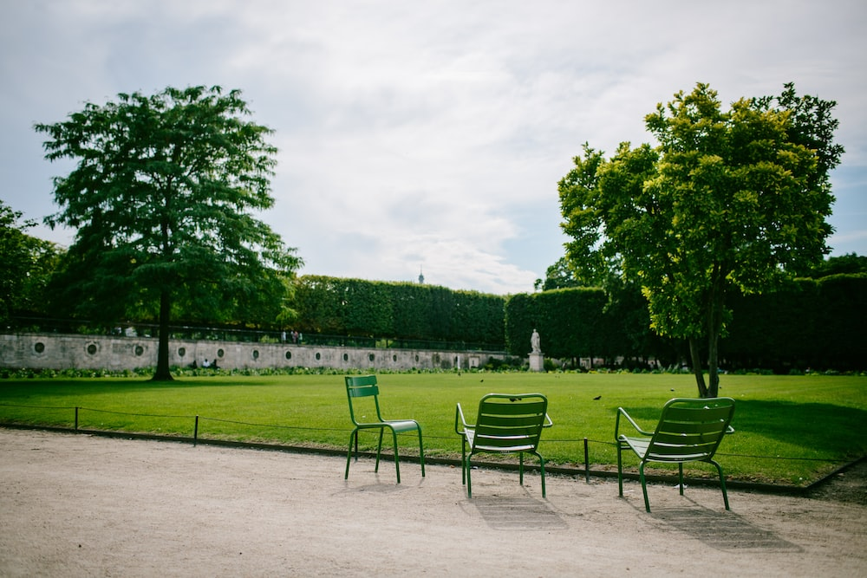
The park
Image licensed under Unsplash License.
Notes:
le parc: park

Slide 13
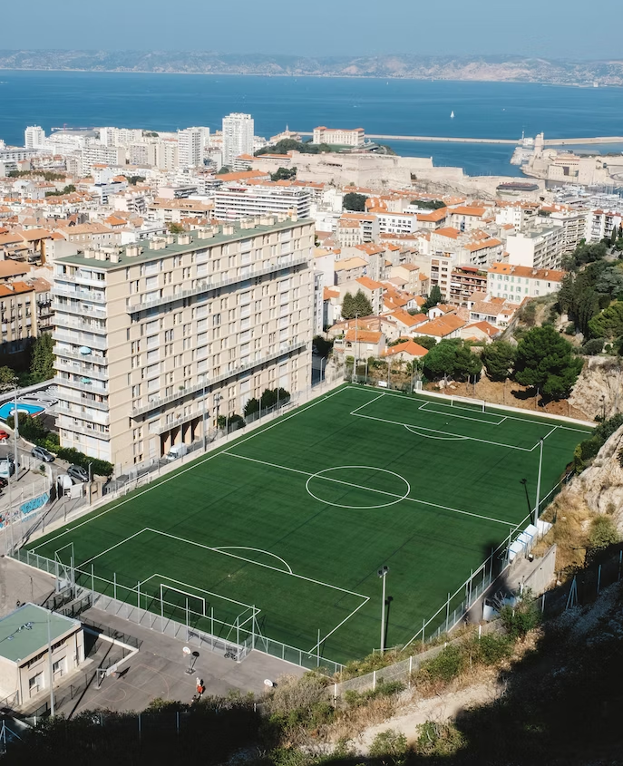
The sports field
Image licensed under Unsplash License.
Notes:
le terrain de sport: sporting field

Slide 14
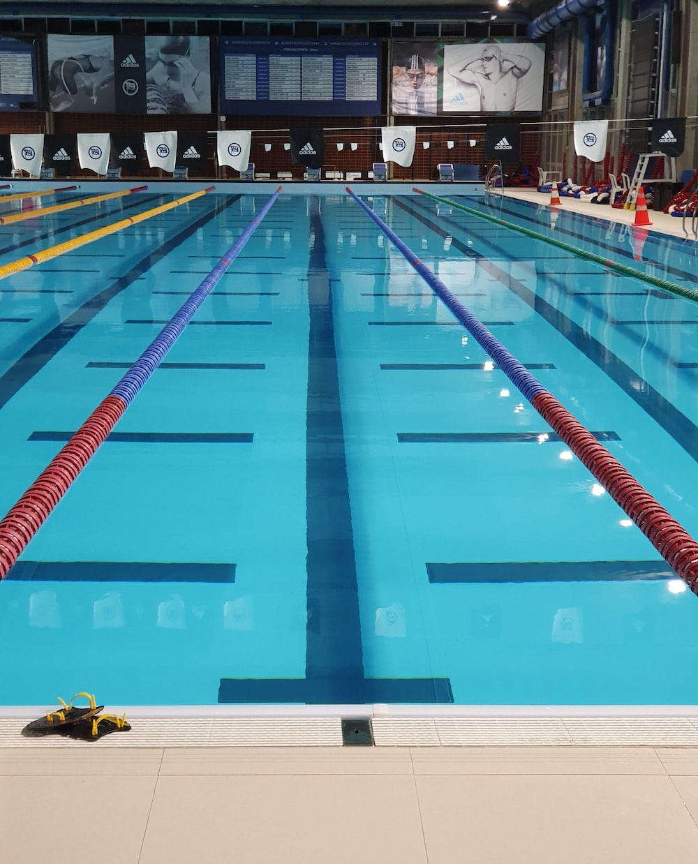
The pool
Image licensed under Unsplash License.
Notes:
la piscine: the pool

Slide 15

The cinema
Image licensed under Unsplash License.
Notes:
le cinéma: the cinema

Slide 16
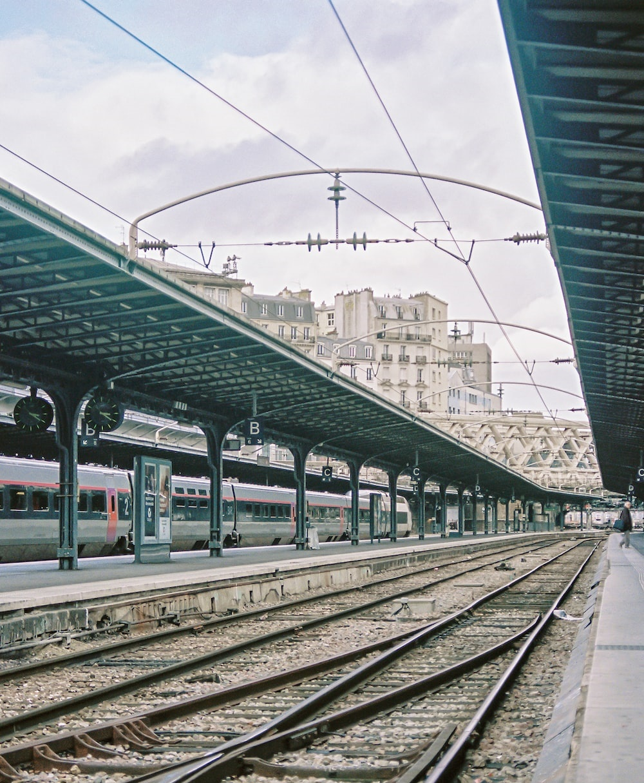
The train station
Image licensed under Unsplash License.
Notes:
la gare: the train station

Slide 17
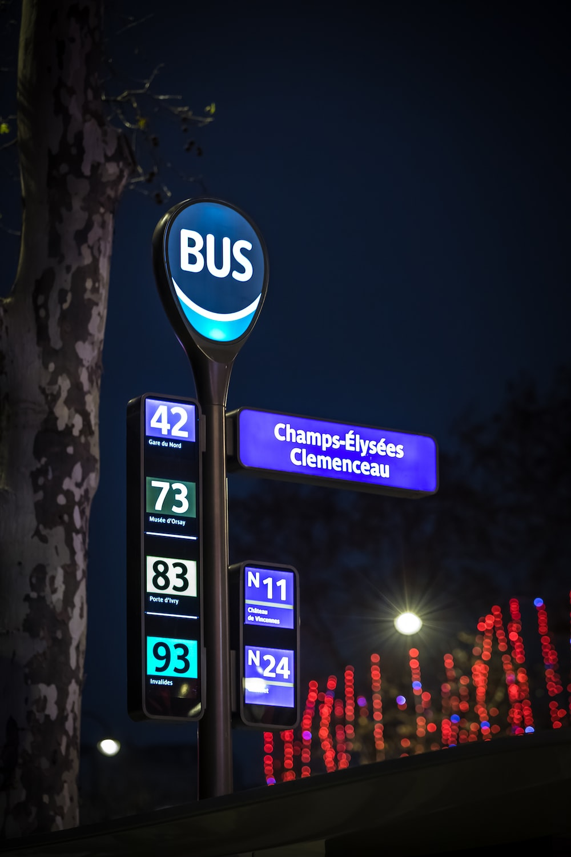
The bus stop
Image licensed under Unsplash License.
Notes:
l’arrêt de bus: bus stop

Slide 18
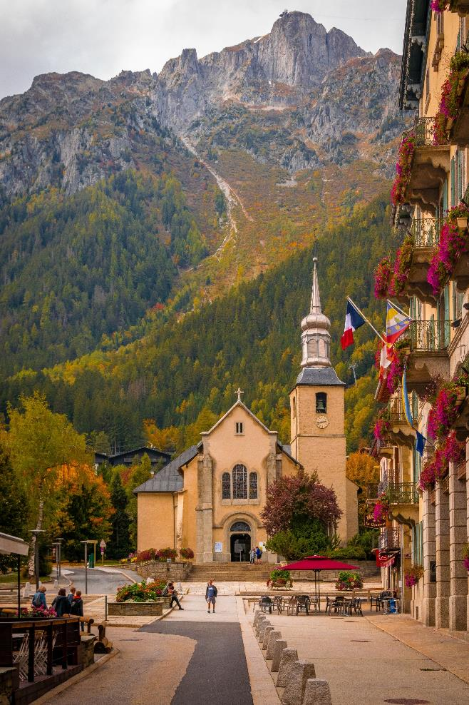
The church
Image licensed under Unsplash License.
Notes:
l’église: church
(note the town square in front of the church)
Churches were historically not only places of worship but also meeting places. The square in front of the church would be filled on a Sunday with village people to meet with their friends, discuss local politics and gossip. Squares such as these were also used as places where public announcements were made. They were also a place of public executions and torture.

Slide 19
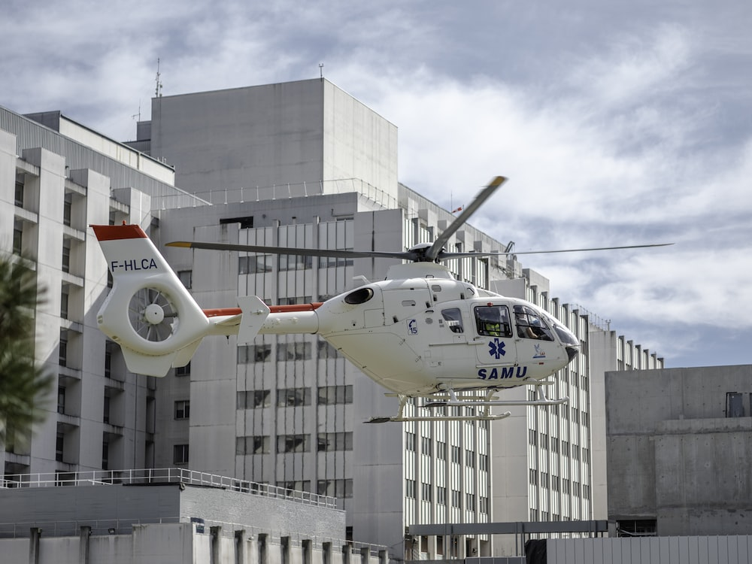
The hospital
Image licensed under Unsplash License.
Notes:
l’hôpital: the hospital

Slide 20
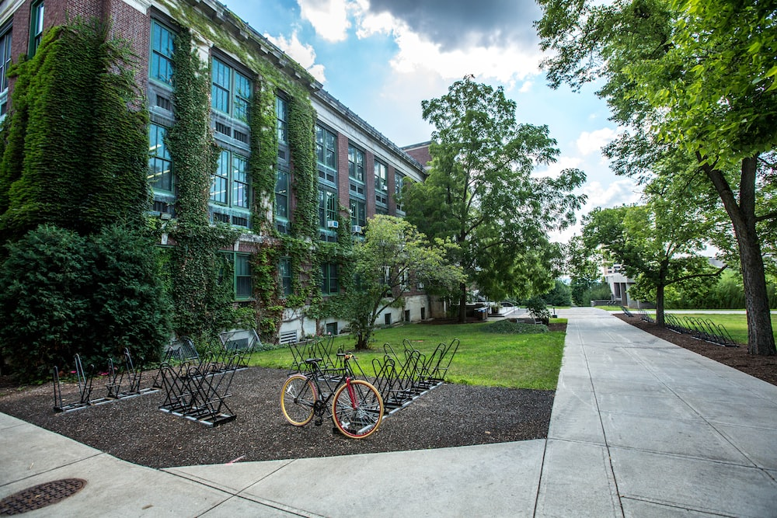
The school
Image licensed under Unsplash License.
Notes:
l’école: the school

Slide 21
Copyright
© State of New South Wales (Department of Education), 2023
The copyright material published in this resource is subject to the Copyright Act 1968 (Cth) and is owned by the NSW Department of Education or, where indicated, by a party other than the NSW Department of Education (third-party material).
Copyright material available in this resource and owned by the NSW Department of Education is licensed under a Creative Commons Attribution 4.0 International (CC BY 4.0) licence.
This license allows you to share and adapt the material for any purpose, even commercially.
Attribution should be given to © State of New South Wales (Department of Education), 2023.
Material in this resource not available under a Creative Commons license:
the NSW Department of Education logo, other logos and trademark-protected material
Material owned by a third party that has been reproduced with permission. You will need to obtain permission from the third party to reuse its material.
Links to third-party material and websites
Please note that the provided (reading/viewing material/list/links/texts) are a suggestion only and implies no endorsement, by the New South Wales Department of Education, of any author, publisher, or book title. School principals and teachers are best placed to assess the suitability of resources that would complement the curriculum and reflect the needs and interests of their students.
If you use the links provided in this document to access a third party’s website, you acknowledge that the terms of use, including licence terms set out on the third-party’s website apply to the use which may be made of the materials on that third-party website or where permitted by the Copyright Act 1968 (Cth). The department accepts no responsibility for content on third-party websites.

Slide 22

© State of New South Wales (Department of Education) 2023

