Slide 1
Snakes and Ladders
Stage 3

Slide 2
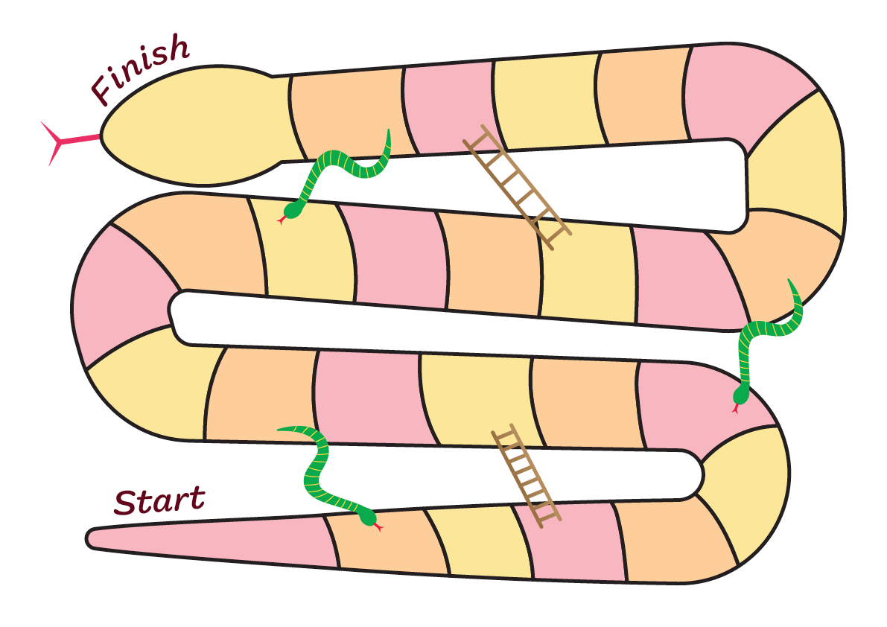
Snakes and ladders – English
The best
thing
Playing
Going
to
Swimming carnival
Teacher
Learning
Most
exciting
School
holidays
Athletics
carnival
The best
thing
Sport
Learn
Performance
Lunchtime
Going to
Happiest
Free
time
The
canteen
Most
interesting
The best
thing
Learning
Recess
Playing
Funniest
Going
Excursion
Friends

Slide 3
Snakes and ladders – Vietnamese
cô
giáo
điều tốt
nhất
chơi
đi
lễ hội
bơi lội
học hỏi
thú vị
nhất
kỳ nghỉ
hè
lễ hội
thể thao
điều tốt
nhất
thể
thao
học hỏi
biểu
diễn
giờ ăn
trưa
đi
vui nhất
giờ
chơi
căn
-tin
hay
nhất
điều tuyệt
vời nhất
học
hỏi
giờ ra
chơi
chơi
vui
nhất
đi dã
ngoại
các
bạn
đi

Slide 4
Copyright
© State of New South Wales (Department of Education), 2024
The copyright material published in this resource is subject to the Copyright Act 1968 (Cth) and is owned by the NSW Department of Education or, where indicated, by a party other than the NSW Department of Education (third-party material).
Copyright material available in this resource and owned by the NSW Department of Education is licensed under a Creative Commons Attribution 4.0 International (CC BY 4.0) license.
This license allows you to share and adapt the material for any purpose, even commercially.
Attribution should be given to © State of New South Wales (Department of Education), 2024.
Material in this resource not available under a Creative Commons license:
the NSW Department of Education logo, other logos and trademark-protected material
Material owned by a third party that has been reproduced with permission. You will need to obtain permission from the third party to reuse its material.
Links to third-party material and websites
Please note that the provided (reading/viewing material/list/links/texts) are a suggestion only and implies no endorsement, by the New South Wales Department of Education, of any author, publisher, or book title. School principals and teachers are best placed to assess the suitability of resources that would complement the curriculum and reflect the needs and interests of their students.
If you use the links provided in this document to access a third-party’s website, you acknowledge that the terms of use, including licence terms set out on the third-party’s website apply to the use which may be made of the materials on that third-party website or where permitted by the Copyright Act 1968 (Cth). The department accepts no responsibility for content on third-party websites.

