Slide 1
About this presentation
Facilitator instructions
This slide deck contains 3 parts that require some preplanning.
Part A – Strategy overview, approach and impact – opportunity to collect data that could be used in Part C. The presenter will need to facilitate this.
Part B – Implementing the strategies through techniques – the group activity requires pre-planning.
Part C – Evaluating a whole-school approach – opportunity to link to the School Excellence Plan.
Leaders should engage with Part C before implementing the professional learning with staff.
Slides are repeated across strategy modules so they can be implemented with the same structure. Note: some slides contain animations indicated by [click] in the presenter notes.

Slide 2

Gradual release of responsibility
Strategy learning module

Slide 3

Acknowledgement of Country
We recognise the Ongoing Custodians of the lands and waterways where we work and live. We pay respect to Elders past and present as ongoing teachers of knowledge, songlines and stories. We strive to ensure every Aboriginal and Torres Strait Islander learner in NSW achieves their potential through education.
‘Reflections’ created by Zara Marulanda from Blaxland High School as part of the 2021 Schools Reconciliation Challenge.
Notes:
Purpose: Acknowledgement of Country
[00:30]
Speaker notes:
I would like to acknowledge the traditional custodians of the land on which we meet today. We pay our respects to their Elders past and present. We recognise their continuing connection to land, water, and culture, and we are committed to continuing to learn from their wisdom and traditions.

Slide 4
Introduction
Notes:
Purpose: Outline the learning sequence in this module.
[00:30]
Speaker notes:

Slide 5
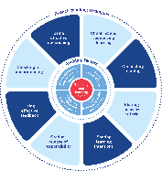
Enabling factors
Know students and how they learn
High expectations
Teachers understand how learning happens, and this informs their practice.
Students benefit from teachers holding high expectations for their learning.
Know the content and how to teach it
Safe, inclusive learning environments
Teachers know how the knowledge builds and connects to create learning that is strategic, sequenced and cumulative.
Explicit teaching both relies on, and brings about, a safe and inclusive learning environment.
Notes:
Purpose: Revisiting core knowledge
[00:30]
Speaker notes:
Explicit teaching is an optimal way to teach knowledge and skills that are new or complex.
There are important enabling factors for explicit teaching that relate to the technique we are focusing on. Let’s revisit them.
Note to presenter: you may wish for participants to read these to themselves
[click] Our understanding of the how learning happens informs our practice
[click] We know how knowledge builds across syllabuses
[click] When we hold high expectations for our students’ learning, we support and scaffold them to achieve higher levels of learning
[click] And, explicit teaching both relies on, and brings about a safe, inclusive learning environment. When the pace of the class is such that students can follow with success, they are more likely to feel they belong and develop self-efficacy (CESE 2024)
References:
CESE (Centre for Education Statistics and Evaluation) (2024) Explicit teaching drives student motivation, engagement, and achievement in NSW public schools – a What Works Best research update, NSW Department of Education.
Resources:
NSW Department of Education (2023a) Classrooms of Possibility
NSW Department of Education (2024a) Explicit instruction – implementing evidence-based teaching practices for students with disability
NSW Department of Education (2024b) Leading explicit teaching – school-facilitated workshops 1–3 on core content and the enabling factors of explicit teaching
NSW Department of Education (2024c) Strong Strides Together: Meeting the educational goals for Aboriginal and/or Torres Strait Islander students

Slide 6
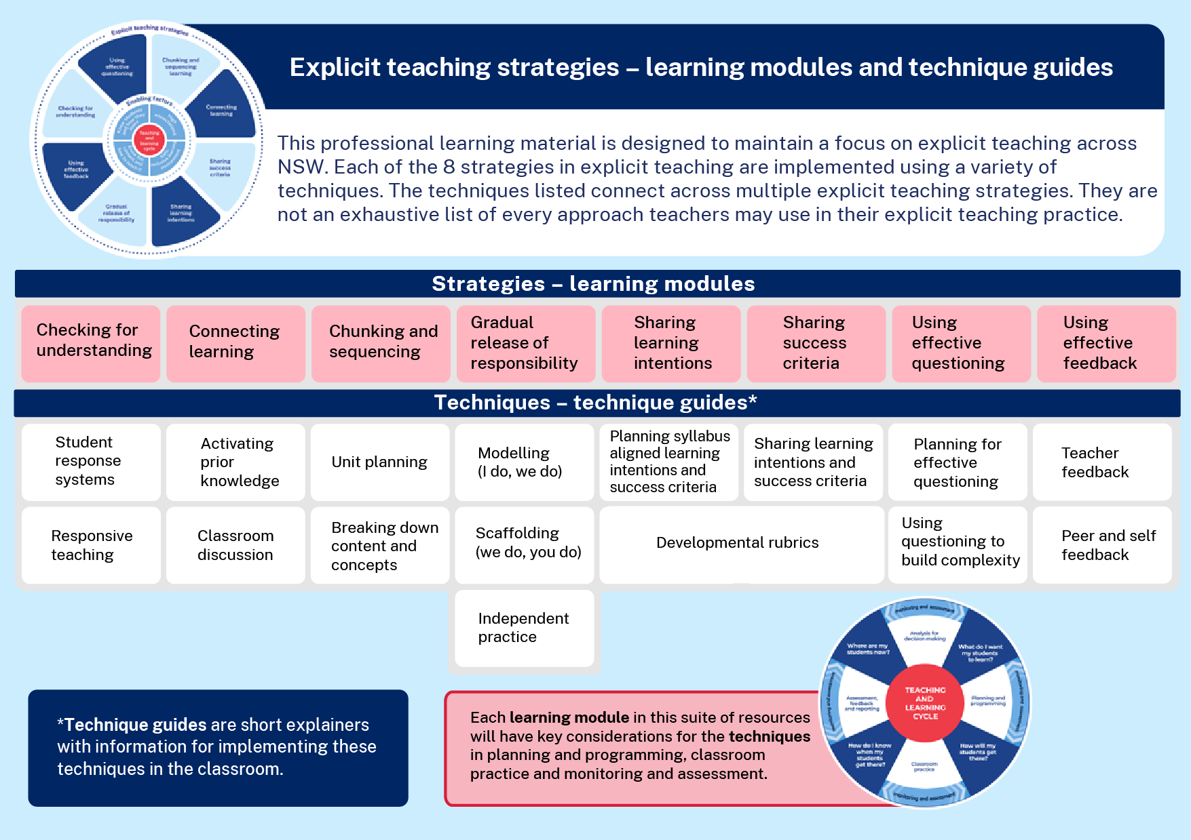
Learning modules and technique guides
Notes:
Purpose: To highlight where this module fits with other current and future modules and technique guides.
[00:30]
Speaker notes:
This module looks at one of the 8 explicit teaching strategies, gradual release of responsibility, and the techniques for this strategy. These are modelling, scaffolding and independent practice. Note that these learning modules and the corresponding technique guides will have staggered release dates.

Slide 7

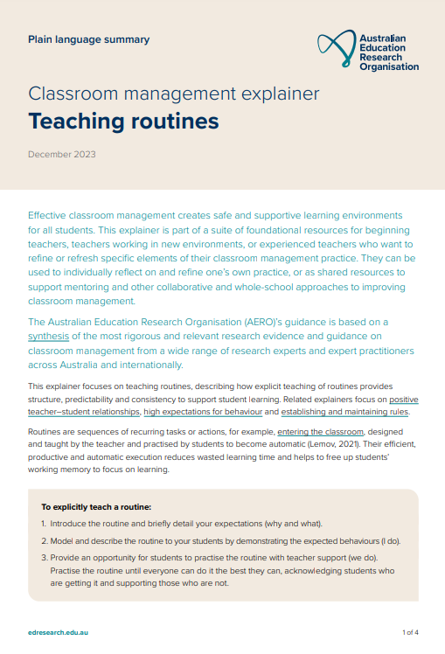
The importance of all moving together
Saves learning time¹
Frees up students’ working memory²
Certain and consistent expectations for students³
Students learn the routine more quickly when it is done in the same way across the school⁴
Fosters a strong sense of belonging⁵
Notes:
Purpose: to restate why a whole school teaching routine is powerful
[00:30]
Speaker notes:
These modules use the power of whole school teaching routines. When a group of expert teachers from across the school come together and create a whole school approach, they are far more effective than when they go it alone. Teaching routines:
[click] save learning time
[click] can free up students’ working memory
[click] provide certainty and expectations for students to contribute to a learning environment where they’re safe to participate.
[click] They’re efficient, because when done the same way across the school, students can learn the routine more quickly.
[click] and they foster a strong sense of belonging.
As we go through the learning module here, and other learning modules for explicit teaching we will revisit the idea of the whole school teaching routines.
References:
1.Archer A and Hughes C (2011) Explicit instruction: effective and efficient teaching, Guilford Press.
2. AERO (Australian Education Research Organisation) (2021) Focused classrooms: managing the classroom to maximise learning, AERO.
3. AERO (Australian Education Research Organisation) (2023a) Teaching routines: their role in classroom management, AERO.
4. McCrea P (2020) Motivated Teaching: harnessing the science of motivation to boost attention and effort in the classroom, Createspace Independent Publishing Platform.
5. McCrea P (2020) Motivated Teaching: harnessing the science of motivation to boost attention and effort in the classroom, Createspace Independent Publishing Platform.
Further reading:
Tharby A (12 May 2023) ‘We are what we do: the case for explicit and consistent school-wide routines’, Class Teaching, find the bright spots blog, accessed 20 November 2024.

Slide 8
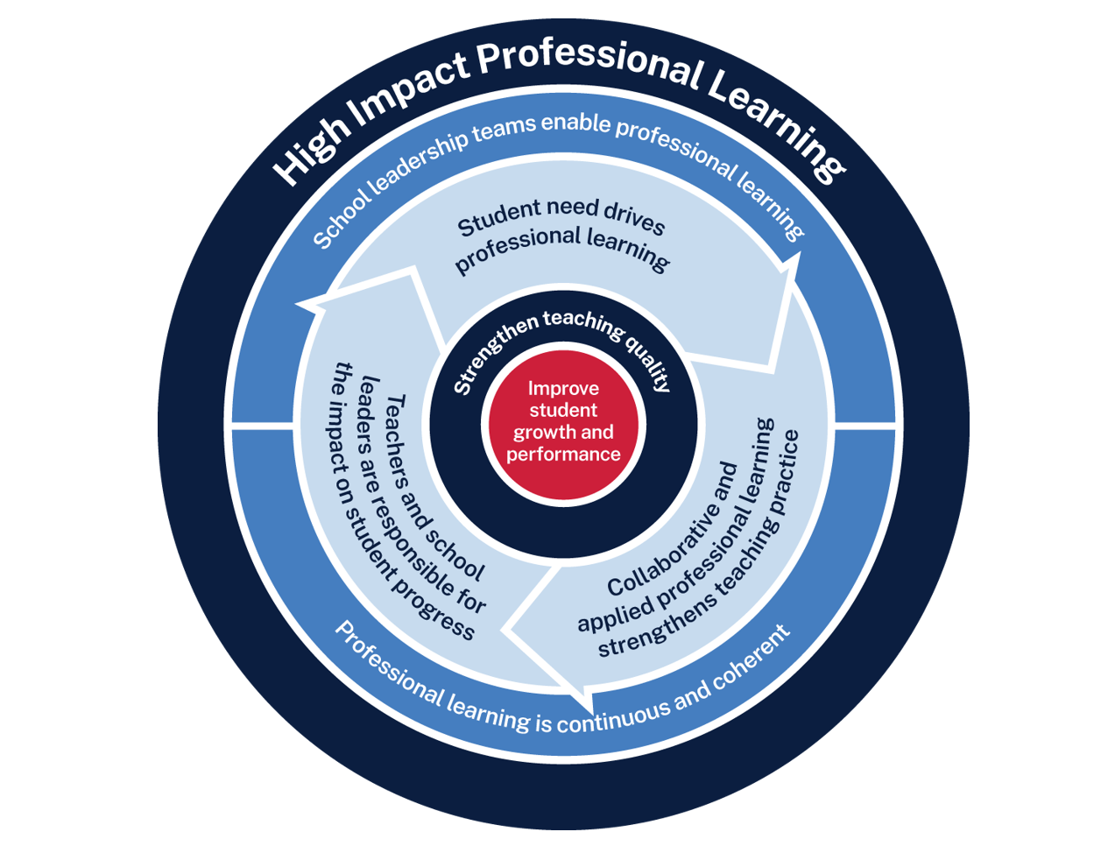
Gradual release of responsibility professional learning
Measure baseline student data and set a goal
Analyse data to determine further cycles
Use the whole school teaching approach and plan for instruction
Implement the teaching routine in the classroom and measure impact
Rehearse and give feedback to each other
Notes:
Purpose: Familiarising High Impact Professional Learning model (HIPL) and how it may inform our implementation of explicit teaching.
[01:00]
Speaker notes:
The High Impact Professional Learning (HIPL) model forms the basis of this professional learning. This model has five elements.
Professional learning is driven by identified student needs
School leadership teams enable professional learning
Collaborative and applied professional learning strengthens teaching practice
Professional learning is continuous and coherent
Teachers and school leaders are responsible for the impact of professional learning on student growth and performance
The actions and steps we take to enact each of these elements will be shaped by our increasing shared understanding of the gradual release of responsibility strategy and how specific techniques can be used to optimise the learning of our students.

Slide 9
Initial reflection point (1)
Teacher observation | 0 | 1 | 2 | 3 | 4
After modelling and guiding, did my students complete an activity that demonstrated the success criteria? | Not yet observable | Minimal parts of the success criteria | Some parts of the success criteria | Most parts of the success criteria | All parts of the success criteria
Notes:
Purpose: Initial teacher collected data as an early indicator.
[02:00]
Speaker notes:
An initial indicator is an observable change in student learning. It can help teachers to understand how effective their use of a technique may be. Initial indicators are important because they can give teachers insights into what parts of the instruction may need to be refined.
Here is an example of a tool that could be used for teacher reflection. This is one way to measure one aspect of the effectiveness of a gradual release of responsibility.
Think about one class you taught today. What parts of the scale would best describe your students?
(Allow time for teachers to reflect and share. Recording some ideas here would be beneficial as an initial point of reflection as we focus on gradual release of responsibility as a strategy.)
We will be able to refer to our early indicator observations when we evaluate our impact in Part C.
Note to presenter: There is an opportunity to use this data in the final session. This measure is not the only consideration, and schools should select a model that is right for them.
This data could be collated and compared to other “school and classroom data about growth and performance.”
For example:
NAPLAN report overview accessed through Scout
https://education.nsw.gov.au/about-us/education-data-and-research/scout/training/digital-learning-centre/naplan-report-overview
NAPLAN report overview
Learn more about the NAPLAN reports in Scout.
https://education.nsw.gov.au/about-us/education-data-and-research/scout/scout-overview/apps-and-reports/naplan---doe/class-report#tabs0
Class report
The Class report shows the distribution of students’ scaled scores across domains and proficiency levels for NAPLAN 3, 5, 7 or 9.
References:
AERO (Australian Education Research Organisation) (2023b) How students learn best: an overview of the evidence, AERO.

Slide 10




Planning and rehearsing (3)
Plan
Rehearse
Feedback
Evidence for Learning (2022) Effective Professional Development, Sydney: Evidence for Learning.
Notes:
Purpose of slide: To explain the process of rehearsing
Speaker notes:
[01:10]
Planning, rehearsing and getting feedback are crucial when we are working to develop techniques for implementing strategies. When we say rehearse, we mean:
[click] plan number of suitable questions or activities ready
[click] deliver the instruction as if doing it in class.
[click] then partners can provide feedback - what may need to be added, changed, enhanced or deleted?
Note to presenter: it is advisable to prepare the leaders beforehand if modelling and rehearsing are not yet established practices in the school.
Further reading on this research:
AERO (Australian Education Research Organistion) (2023c) Classroom management practice guide: gaining all students’ attention, AERO.
Evidence for Learning (2022) Effective professional development, Evidence for Learning.
Sims S, Fletcher-Wood H, O’Mara-Eves A, Cottingham S, Stansfield C, Van Herwegen J and Anders J (2021) What are the characteristics of teacher professional development that increase pupil achievement? A systematic review and meta-analysis, Education Endowment Foundation.

Slide 11
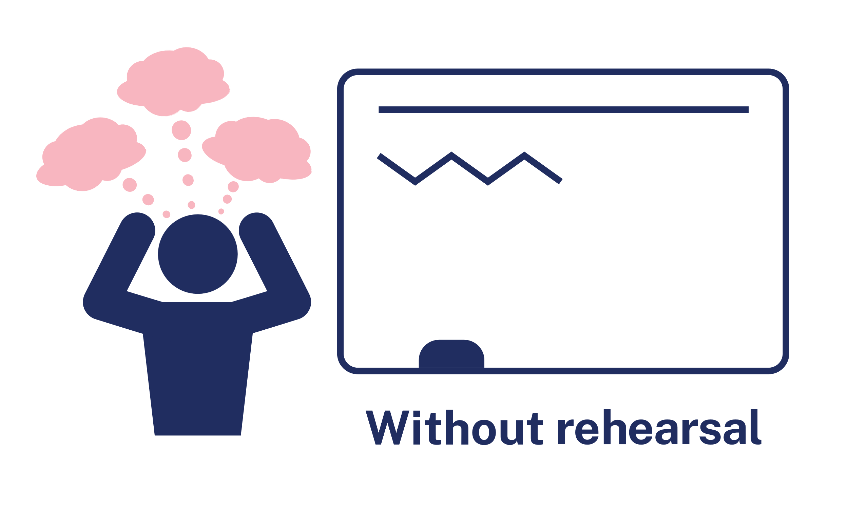

Rehearsal (1)
Notes:
Purpose of slide: To explain why rehearsing is so important
Speaker notes:
[01:10]
Application is a real key to success in professional learning.
Why might professional learning not be applied in the classroom, despite our best intentions?
[click] Research from Evidence for Learning (2022) found that rehearsing was among the key mechanisms for success in the application of PL.
New teachers often have practices described to them – but it is much clearer to have lead teachers model the practice (out of the classroom, without students) while the observer uses prompts to reflect on what made that practice successful.
Teaching is a habit-forming practice. By necessity, teaching requires us to automate a number of behaviours. The cognitive load on teachers to introduce a new behaviour is high and so we often rely on those previously formed habits.
Rehearsal (out of the classroom, without students) makes our PL a habit. When we try a rehearsed routine in a classroom, our cognitive load is reduced because we have one thing to think about, rather than 4 or 5.
This is why rehearsing is a key mechanism for success in professional learning.
References:
Evidence for Learning (2022) Effective professional development, Evidence for Learning.

Slide 12
Overview of this module
Part A – Understanding the strategy
Part B – Implementing the strategies through techniques
Part C – Evaluating a whole-school approach
Notes:
Purpose: Outline the learning sequence in this module.
Speaker notes:
[00:30]
In this module, the focus is on the gradual release of responsibility and selecting the optimal techniques for students in your class.
We will then develop principles as a whole school to reduce cognitive load for our students, giving them the best opportunity for routines to benefit their learning outcomes.
We will evaluate the impact of our work in terms of how effectively the approach has met the student need we've identified as the focus for our professional learning. We will do this by considering the short-term outcomes and the potential longer term learning outcomes for our students.

Slide 13
Understanding the strategy
Part A

Slide 14
Purpose and outcome
Purpose
To understand the mechanisms of gradual release of responsibility in the context of managing cognitive load, and optimising student understanding, engagement and participation.
Outcome
We can articulate how and why we move backwards and forwards between teacher modelling, guided and independent practice.
Notes:
Purpose: Purpose and outcome of Part A
Speaker notes:
[00:30]
This strategy learning module focuses on teachers making purposeful decisions to gradually release the responsibility for learning to students throughout lessons.
The purpose of Part A is:
To understand the mechanisms of the gradual release of responsibility in the context of managing cognitive load, and optimising student understanding, engagement and participation.
Working towards the outcome that:
We can articulate how, when and why we move backwards and forwards between teacher modelling, guided and independent practice.

Slide 15

A model of the gradual release of responsibility
Modelled
Guided
Independent
Notes:
Purpose: To recall a simple idea about modelled guided and independent before adding new and more complex concepts
[01:00]
Speaker notes:
While explicit teaching should be thought of as a holistic practice, one of the core tenets is that teachers explain, show or model first or early in a learning sequence. Once modelled, the class has a go at the same skill with guidance from the teacher. When they have demonstrated proficiency they perform it independently. This gradual release of responsibility is sometimes referred to as ‘modelled, guided, independent practice’ or ‘I do, we do, you do’.

Slide 16

Gradual release of responsibility in the classroom
I do
You do
You do
It is not always linear
We do
We do
I do
We do
I do
Notes:
Purpose: How the gradual release of responsibility works in reality
[01:00]
Speaker notes:
However, it is important to recognise that the strategy of ‘Gradual release of responsibility’ is not linear. Teachers decide to move between modelling, guided and independent practice throughout lessons and across learning sequences in response to their students. In particular, there is an extended handover in the ‘we do’ phase.

Slide 17
Gradual release of responsibility in the classroom – continued
Teacher
The concept of extended handover is central to gradual release of responsibility (Sherrington 2020).
The teacher flexibly moves between modelled, guided and independent teaching practice, responsive to student learning.
Modelling
(I do)
Guided practice
(We do)
Guided practice
(We do)
Independent practice
(I do)
Student
Image adapted from Frey and Fisher (2010) ‘Identifying instructional moves during guided learning’, The Reading Teacher, 64(2):84–95 and Sherrington (28 November 2020) ‘The art of modelling it’s all in the handover’, teacherhead blog, accessed 20 November 2024.
Notes:
Purpose: Gradual release of responsibility – extended handover
[02:00]
Speaker notes:
This graphic, adapted from Tom Sherrington (2020), depicts the realities of teaching by showing there is no smooth path and that learning is complex. It is often necessary to teach things more than once and in more than one way. As we check the students' understanding, we make responsive decisions to move forwards or backwards. The release of responsibility to students is gradual. This isn't a graphic of 'a lesson gone wrong', but a reflection of the dynamic and responsive practice required to support all students develop proficiency in their learning.
The timing of the handover needs to be responsive to the needs of students. Moving too quickly to independent practice without ensuring student readiness does not support optimal learning. The extended handover reduces this risk and is supported by providing multiple opportunities for students to practise their learning.
Another important consideration is that independent practice doesn't mean that students always work alone. It's the teacher's support that is reduced as students are ready (Hertzberg 2012). Students working in pairs or small groups independent from the teacher are also examples of independent practice.
References:
AERO (Australian Education Research Organisation) (2022) Explicit instruction: clearly explaining and effectively demonstrating what students need to learn, AERO.
Fisher D and Frey N (2021) Better learning through structured teaching: a framework for the gradual release of responsibility, 3rd edn, ASCD.
Frey N and Fisher D (2010) Identifying instructional moves during guided learning. The Reading Teacher, 64(2): 84–95.
Hertzberg M (2012) Teaching English language learners in mainstream classes, Primary English Teaching Association Australia, Australia.
Sherrington T (28 November 2020) The art of modelling it’s all in the handover, teacherhead blog, accessed 20 November 2024.

Slide 18




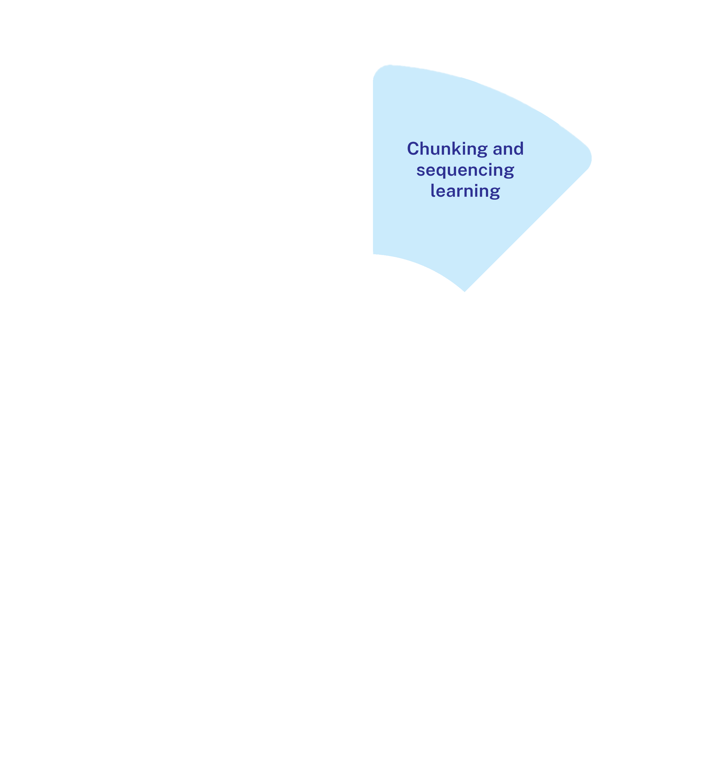
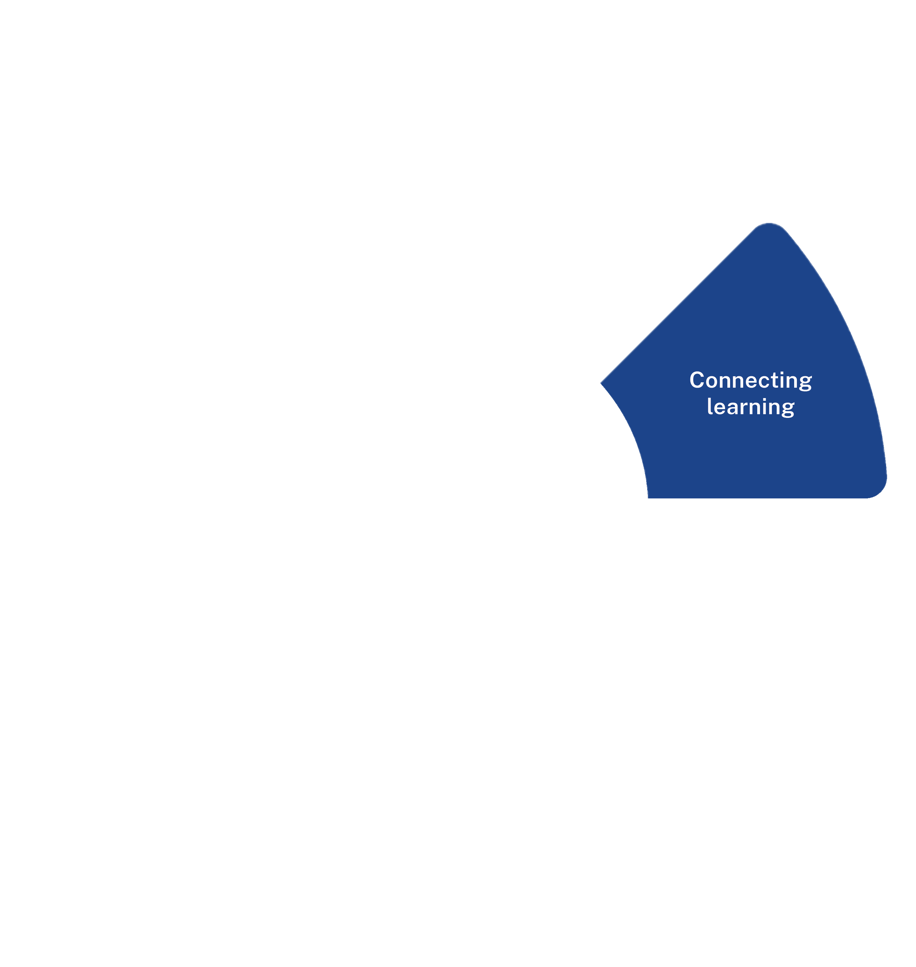

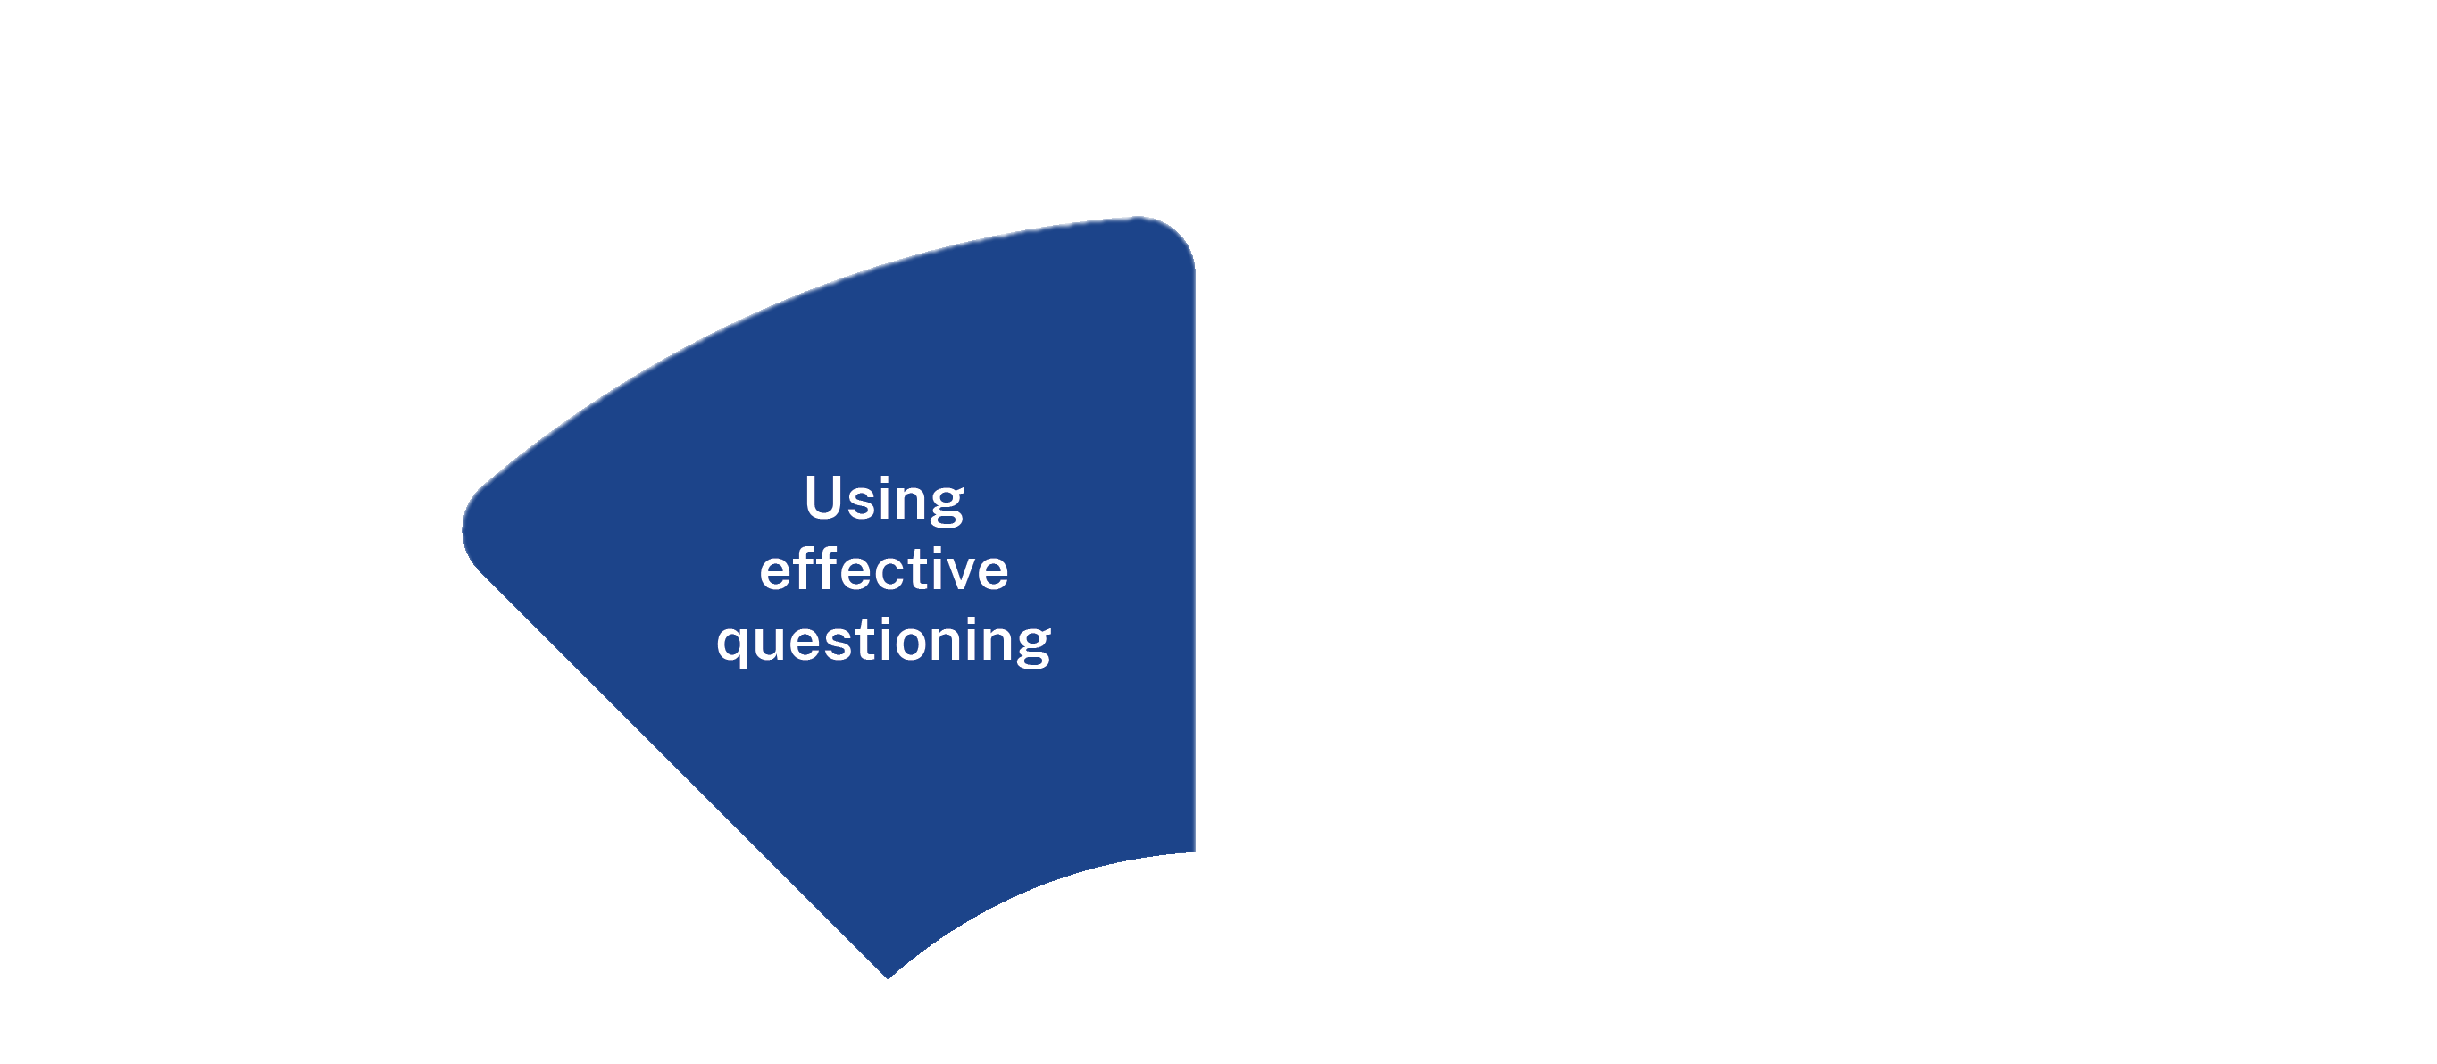
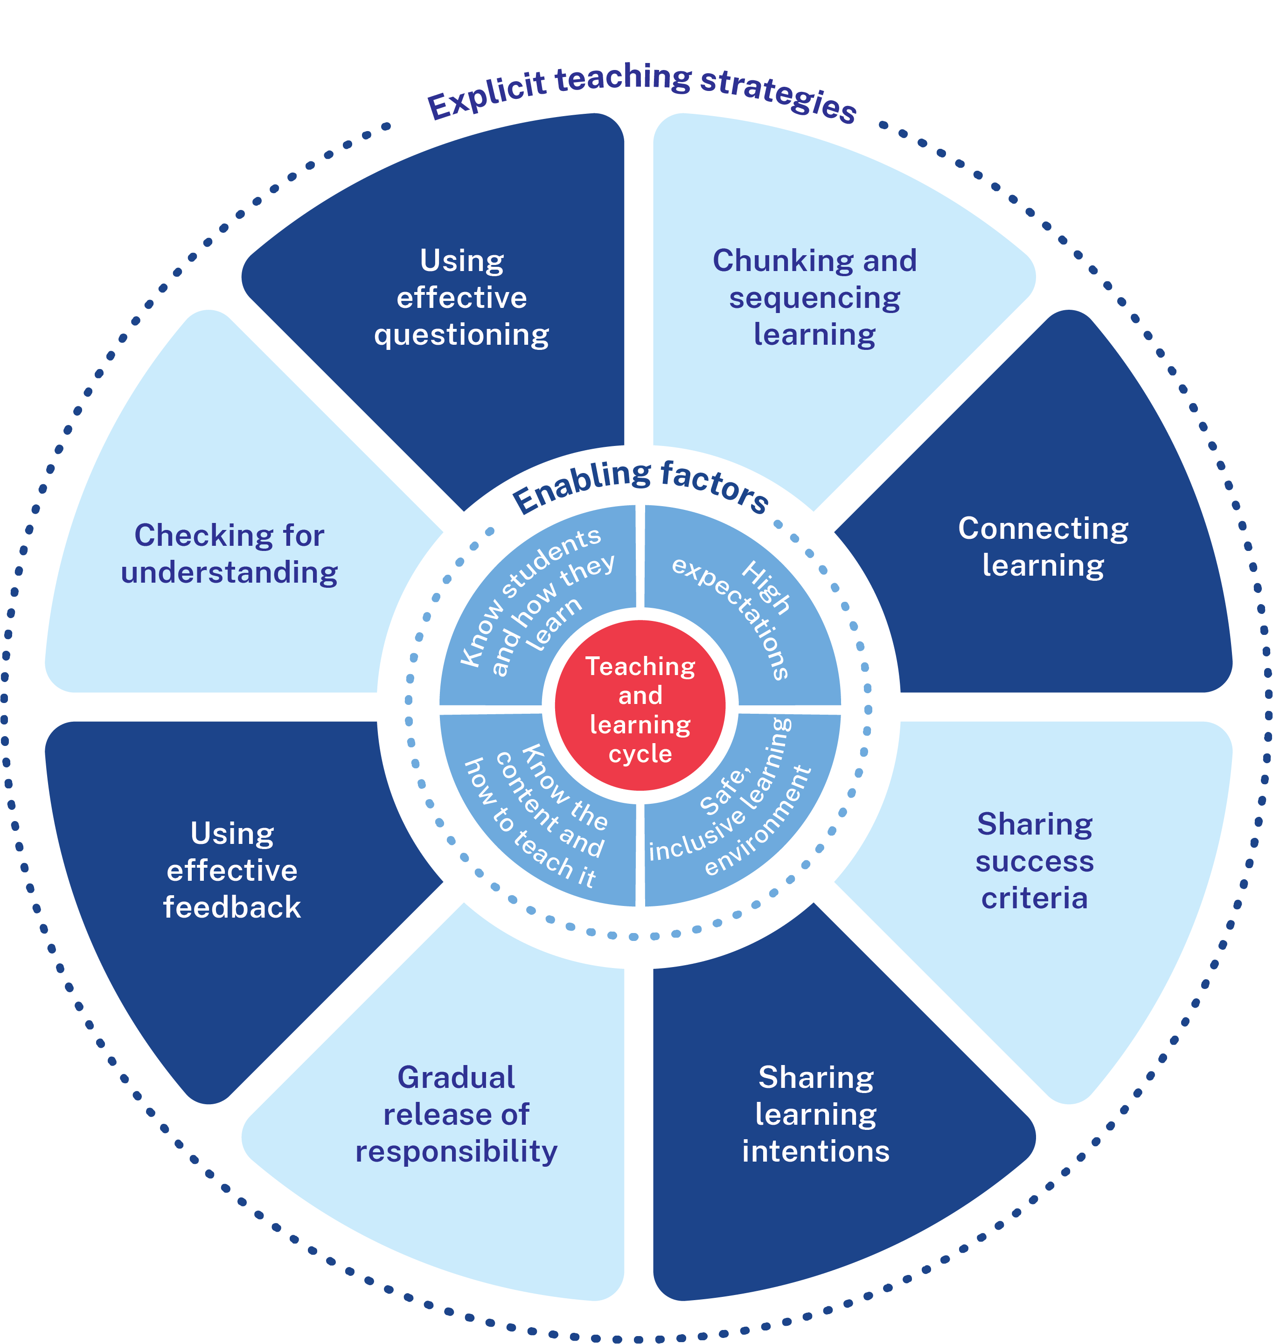
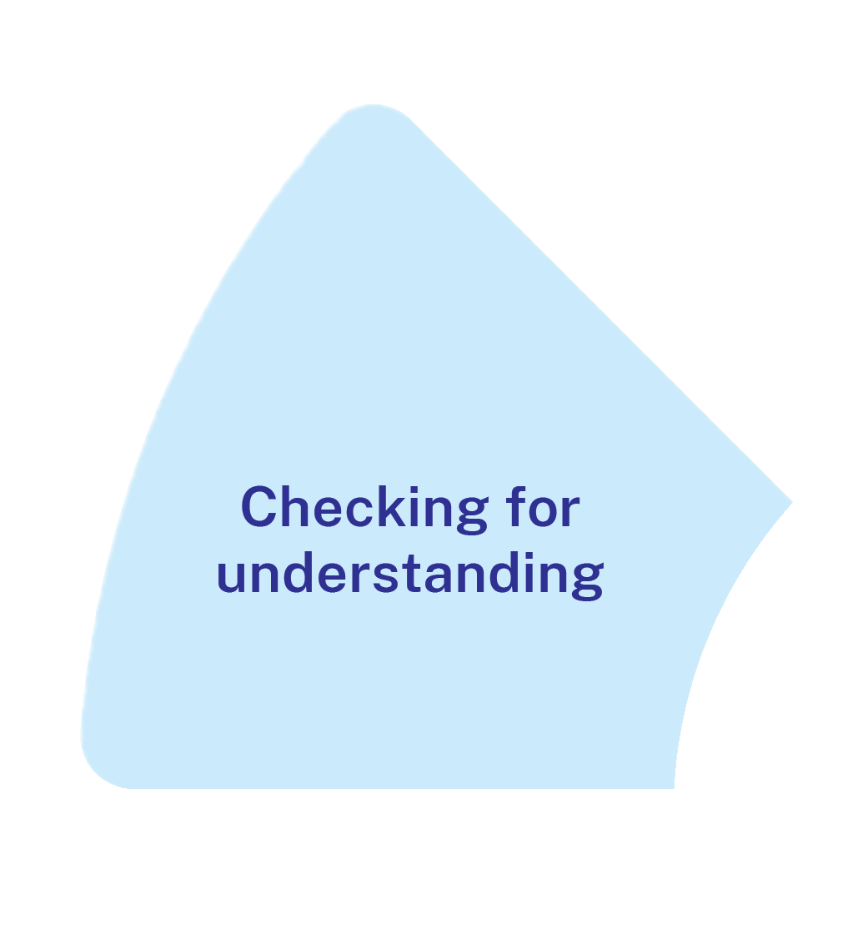
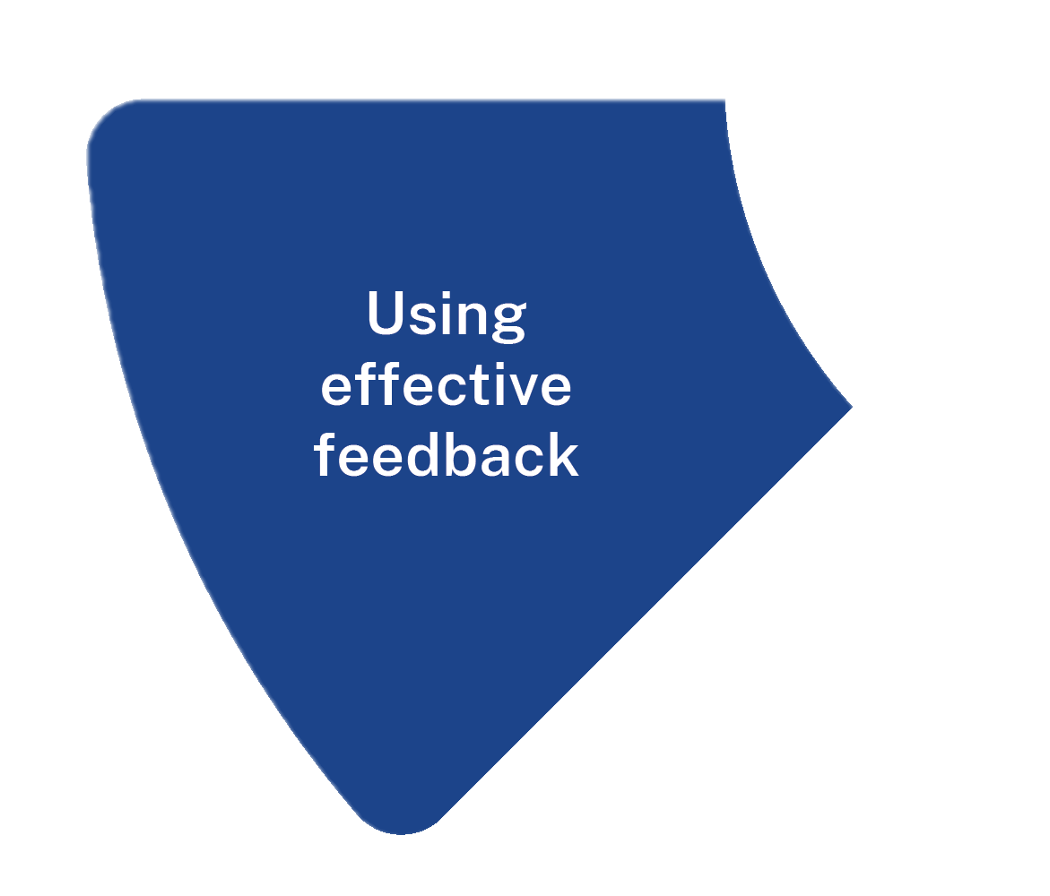
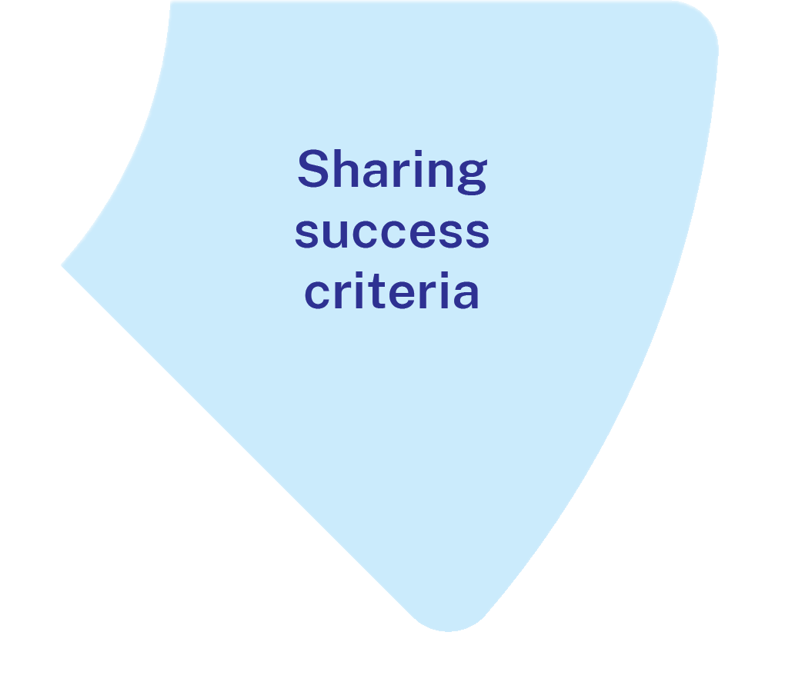
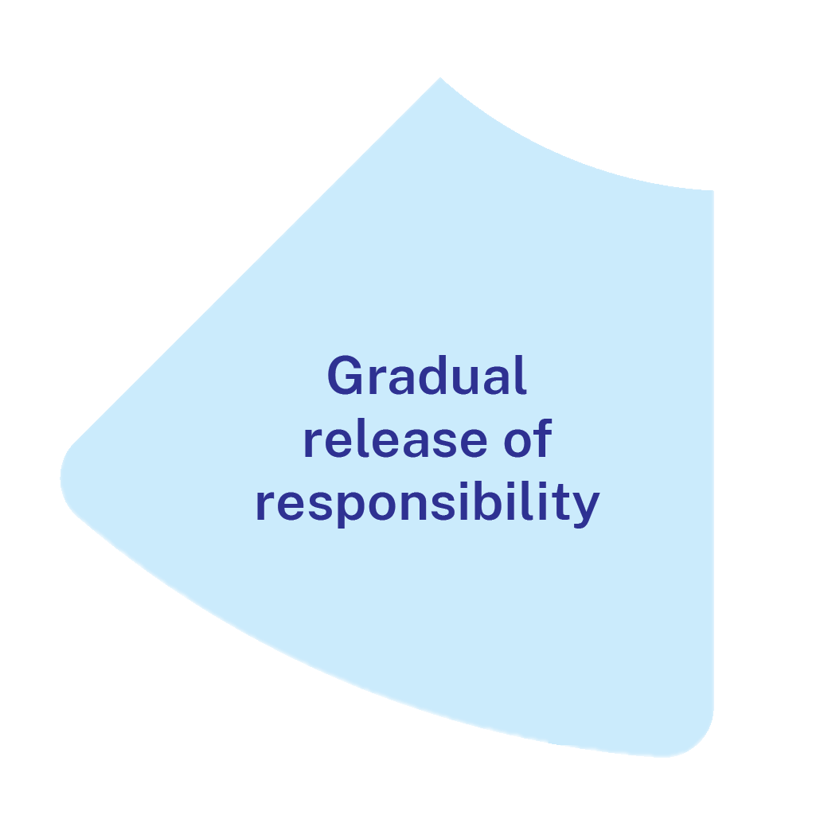
Gradual release of responsibility for HPGS
High potential and gifted students:
require structure and complete instruction when learning is new
may require less time in the modelled phase than the guided phase
may apply deeper learning sooner
may have more background knowledge
may have gaps in their understanding.
Notes:
Purpose: Gradual release for HPG students
[01:00]
Speaker notes:
The gradual release of responsibility is useful for all students. But let’s look at the implications this has for HPG students
Initially it is important that when teachers use formative assessment it results in them being taught at their level of learning to avoid repetition.
HPG students often learn more quickly than peers and may require release of responsibility into deeper, applied independent learning sooner – this should be flexible with teachers checking in with students and determining together whether and when this happens, remembering that this process is not linear. So, there may be gaps for some HPG students who may require more practise in one aspect of the learning but require more in-depth learning opportunities in others
They benefit from being given strategies on how to communicate when they are ready to be released to learn more independently.
References:
Fisher D and Frey N (2021) Better learning through structured teaching: a framework for the gradual release of responsibility, 3rd edn, ASCD.
Martin A (2016) Using load reduction instruction (LRI) to boost motivation and engagement, British Psychological Society.
Further reading:
Duggan S (30 August 2024) ‘They still need explicit teaching: why pedagogy for gifted students must shift’, Education HQ, accessed 20 November 2024.

Slide 19
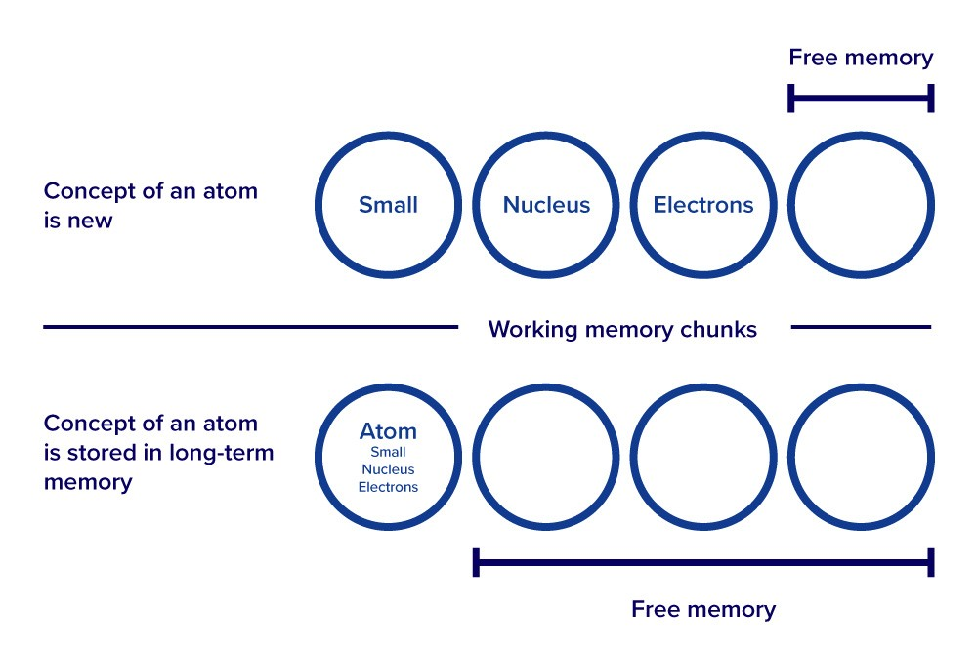
How it works
Students can only process a small amount of information at a time. By moving through the release of responsibility gradually, with ample opportunities to check that students understand and for students to practise, teachers manage students’ cognitive load.
Image adapted from Australian Education Research Organisation Limited (AERO) (2023b) How students learn best
Notes:
Purpose: How modelling works
[01:30]
Speaker notes:
In the modelled phase, the teacher breaks down an explanation into its smallest component parts for students to understand. As the students gain proficiency and move through the phases, these explanations are consolidated into students’ schema, ready to be retrieved later. A retrieved schema takes up less space in working memory.
References:
AERO (Australian Education Research Organisation) (2023b) How students learn best: an overview of the learning process and most effective teaching practices, AERO.

Slide 20
Why it’s needed
Students consolidate their learning into schemas.
A student’s schema of ‘atom’ stored in their long-term memory
Well-developed schemas enable future learning.
Atom
Small
Nucleus
Electrons
Image adapted from Australian Education Research Organisation Limited (AERO) (2023b) How students learn best
Notes:
Purpose: How modelling works
[01:30]
Speaker notes:
In the guided phase, the teacher and students apply the skill or concept together. The teacher is still involved, but the responsibility shifts toward the students. Guided practise is key, with the teacher gradually reducing support as students gain proficiency. The teacher engages students in the modelled process through checking for understanding and feedback. Prompts and scaffolds are still used.
References:
AERO (Australian Education Research Organisation) (2023b) How students learn best: an overview of the learning process and most effective teaching practices, AERO.

Slide 21
What it isn’t
What it isn’t
Moving too quickly from modelling to student independent practice
Moving on too slowly for students who have demonstrated proficiency through checks for understanding
Moving on to new information without students having proficiency of the prior task
Moving through modelled guided and independent practice without checking student understanding
Spending most of the lesson explaining, demonstrating or modelling without giving students the opportunity to practise for themselves
Notes:
Purpose: What it is and what it isn’t
[01:00]
What it is
Teaching new information at an appropriate pace for the students in the class.
Providing regular opportunities for students to practise what they’re learning during a lesson, with guidance.
Moving on to the next chunk of new information once students have demonstrated proficiency in component tasks.
Demonstrating and modelling how to complete a task for students and providing appropriate scaffolding.
What it isn’t
Teaching new information too quickly for the needs of students in the class, and the nature of the task. When teachers model and check for understanding – students will still most likely require guided practice before they can do the task independently.
Moving on to new information without students having demonstrated proficiency with the prior task.
Moving on too slowly for students who have demonstrated proficiency through checks for understanding.
Scheduling a modelled guided independent lesson components and moving through without flexibility or checking for understanding
Spending most of the lesson explaining, demonstrating or modelling without giving students the opportunity to practise for themselves.
Reference:
AERO (Australian Education Research Organisation) (2023a) Teaching routines, AERO.

Slide 22
What it is
When the learning is new, teachers explain, demonstrate and model.
The responsibility is gradually handed over to students as they develop increasing proficiency.
Teachers monitor understanding to decide whether to move backward or forward.
Notes:
Purpose: Key idea as we focus on checking for understanding
[01:00]
Speaker notes:
The gradual release of responsibility from teachers to students is essential because it is responsive to the way students learn. Teachers break down new information by explaining, demonstrating and modelling (AERO 2024d). Teachers then provide opportunities for students to apply their understanding of skills and concepts in guided and independent practice. The role of the teacher is critical, as they respond to student understanding by moving backwards and forwards between teacher modelling, guided practice and independent practice (NESA 2022; Fisher and Frey 2021). This is an efficient way of enabling misconceptions to be corrected and students to build accurate schemas.
References:
AERO (Australian Education Research Organisation) (2024a) Teach explicitly, AERO.
Fisher D and Frey N (2021) Better learning through structured teaching: a framework for the gradual release of responsibility, 3rd edn, ASCD.

Slide 23

Gradual release of responsibility summary (1)
Planning for modelled, guided and independent practice
Checking for understanding
Extended handover
Flexibility and differentiated support
Optimising learning
Notes:
Purpose: to summarise what makes the gradual release of responsibility effective
[01:00]
Speaker notes:
When using the gradual release of responsibility, it is crucial to:
[click] 1. Planning modelled, guided and independent practice
[click] 2. Checking for understanding to make responsive decisions.
[click] 3. Respond to what you find out in the checks for understanding and deciding to move backwards or forwards
[click] 4. Differentiate support for students by flexibly moving between modelled, guided and independent teaching practice and being responsive to student learning.
[click] when all 4 are in place, students are given the strong opportunity to progress in their learning without gaps in their understanding.
References:
AERO (Australian Education Research Organisation) (2022) Explicit instruction: clearly explaining and effectively demonstrating what students need to learn, AERO.
Sherrington T (28 November 2020) 'The art of modelling it’s all in the handover' , teacherhead blog, accessed 12 September 2024.

Slide 24


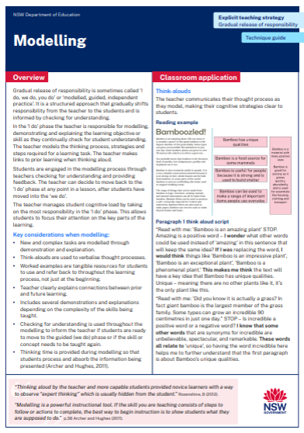
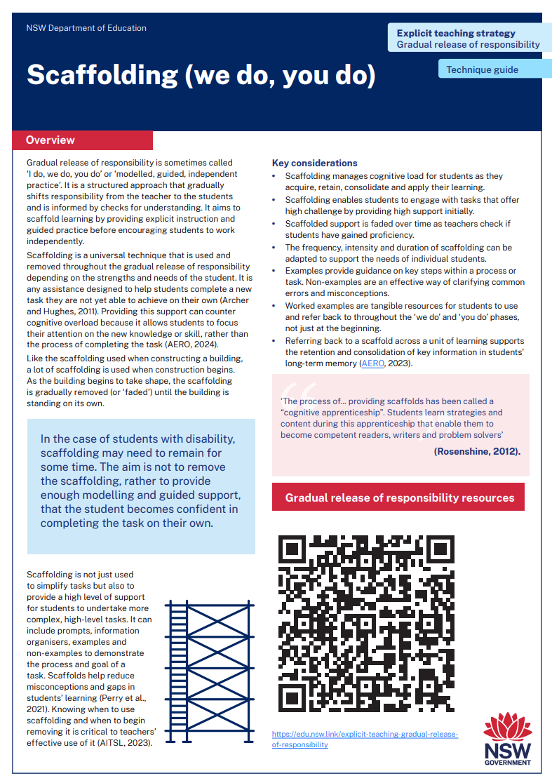
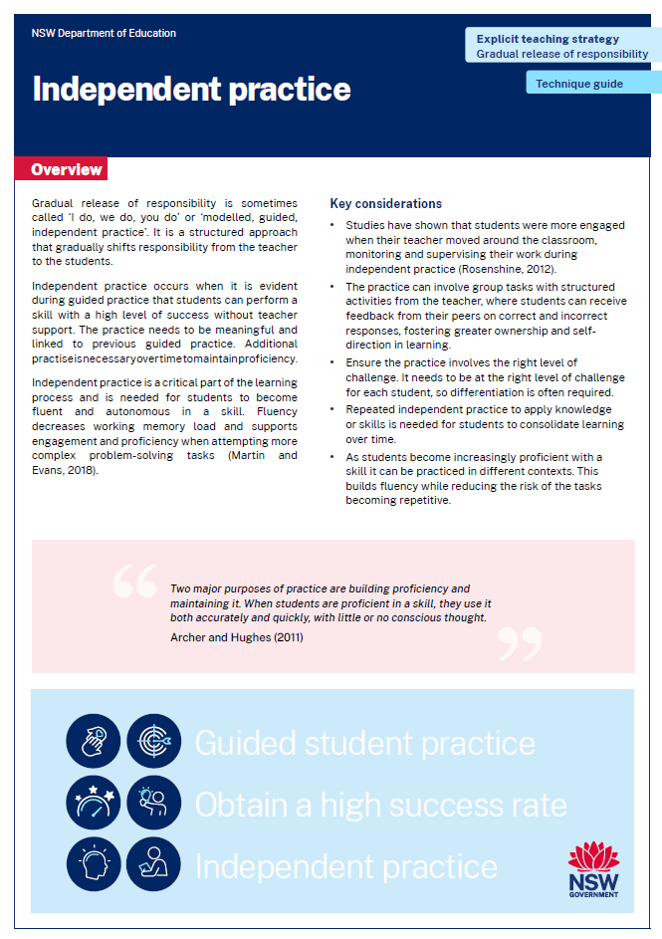
Activity 1 – technique guide discussion
Read or revise – 10 min
Discuss – 10 min
Identify the key points in either the modelling, scaffolding or independent practice technique guide.
Report back to the group to describe the connections between the technique guide and the learning in Part A.
Notes:
Purpose: Make connections between check for understanding resources to deepen knowledge.
[10:00]
Speaker notes:
Across our group we have had the opportunity to read the modelling, scaffolding or independent practice technique guides. Now, lets:
revisit the technique guides and identify the key points
discuss with your groups the connections you can make between the readings and the learning we have done in Part A so far.
Gradual release of responsibility resources:
https://education.nsw.gov.au/teaching-and-learning/curriculum/explicit-teaching/explicit-teaching-strategies/gradual-release-of-responsibility

Slide 25
In the next part of this module, we will work on implementing the strategies through techniques. We will have opportunity to plan and rehearse a gradual release of responsibility.
Notes:
Purpose of slide: To orient into the next part of the module.
[00:20]

Slide 26
Implementing the strategies through techniques
Part B

Slide 27
Part B instructions
Part B contains multiple techniques. To use Part B:
It is recommended teachers engage with modelling, scaffolding and independent practice
Select a lesson to apply gradual release of responsibility techniques
Plan and rehearse with a colleague
Get feedback from your colleague
Notes:
Purpose: To provide instructions on using Part B of the module.
[00:20]

Slide 28
Purpose and outcome (1)
Purpose
To develop a gradual release of responsibility strategy approach, by planning and rehearsing.
Outcome
We have whole-school teaching principles for gradual release of responsibility and are ready to use them in lessons.
Notes:
Purpose: Purpose and outcome of Part B
[00:30]
Speaker notes:
In this part, we're going to learn about and develop our own whole school gradual release of responsibility practice.

Slide 29
Gradual release of responsibility summary (2)
Planning for modelled, guided and independent practice
Checking for understanding
Extended handover
Flexibility and differentiated support
Optimising learning
Notes:
Purpose: to recall the summary what makes the gradual release of responsibility effective
[01:00]
Speaker notes:
When using the gradual release of responsibility, it is crucial to:
1. Plan for modelled, guided and independent practice
2. Checking for understanding to make responsive decisions.
3. Respond to what you find out in the checks for understanding and deciding to move backwards or forwards
4. Differentiate support for students by flexibly moving between modelled, guided and independent teaching practice and being responsive to student learning.
When all 4 are in place, students are given the strong opportunity to progress in their learning without gaps in their understanding.
References:
AERO (Australian Education Research Organisation) (2022) Explicit instruction: clearly explaining and effectively demonstrating what students need to learn, AERO.
Sherrington T (28 November 2020) 'The art of modelling it’s all in the handover' , teacherhead blog, accessed 12 September 2024.

Slide 30
Modelling
Technique A

Slide 31
Modelling (1)
‘Modelling is a powerful instructional tool. If the skill you are teaching consists of steps to follow or actions to complete, the best way to begin instruction is to show students what they are supposed to do’ (Archer and Hughes 2011).
Teacher uses checking for understanding to make the modelling interactive.
Notes:
Purpose of the slide: What is modelling?
[02:00]
Speaker notes:
When teaching a skill that involves steps or actions, the best way to begin instruction is by showing students exactly what they need to do. Demonstrating the process gives them a clear understanding of what is expected. (Archer and Hughes 2011)
Modelling doesn’t mean that the teacher talks all the time – students need to interact with the teacher during the modelling.
Note to presenter: You can watch Anita in a short video demonstrating how modelling can be interactive through checks for understanding.
Watch – Anita Archer Elementary Series - Instruction Must Be Interactive [00:54] – https://www.youtube.com/watch?v=UWtoZNRstSE
Further resources:
Checking for understanding strategy learning module – https://education.nsw.gov.au/teaching-and-learning/curriculum/explicit-teaching/explicit-teaching-strategies/checking-for-understanding
References:
Archer A and Hughes C (2011) Explicit instruction: effective and efficient teaching, Guilford press.

Slide 32
Modelling - how does it work?
2)
Structure and guidance help novices develop mastery over their learning.
Students learn most efficiently and effectively from modelling.
When students acquire knowledge through their own experience, it is slow and prone to error.
When learning new information, students first need to build the mental models of understanding that experts already have.
This is true for all learners including HPGS who still require modelling.
Notes:
Purpose: Using scaffolding
[01:00]
Speaker notes:
Structure and guidance help novices develop mastery over their learning (AERO 2023d).
Students learn most efficiently and effectively by modelling from an expert (AERO 2023d).
When students acquire knowledge through their own experience, it is slow and prone to error (AERO 2023d).
When learning new information, students first need to build the mental models of understanding that experts already have. Once those mental models are in place, students can move from seeing what they are learning as isolated facts to recognising connections and relationships for deeper understanding (AERO 2023d).
This is true for all learners including HPGS who still require modelling, but may be able to move to guided practice more quickly (Martin 2016)
References:
AERO (Australian Education Research Organisation) (2023d) Explicit instruction optimises learning, AERO.
Martin AJ (2016) Using load reduction instruction (LRI) to boost motivation and engagement, The British Psychological Society.

Slide 33
Modelling - key considerations
(3)
Teacher models, demonstrates and explains the learning objective or skill.
Teacher models the thinking process, strategies and steps required for a learning task.
Worked examples are tangible resources used throughout the learning process, not just at the beginning.
Checking for understanding informs the teacher when students are ready for more responsibility and guidance.
Notes:
Purpose: Key considerations for modelling
[03:00]
Speaker notes:
It’s crucial that our modelling is not only effective but also clear, concise, and consistent. This ensures students can follow along without confusion.
One technique is using think-alouds. By verbalising our thought processes while we work through a task, we make our thinking visible to students. This allows them to understand not just what we’re doing, but why we’re doing it, helping them to understand the reasoning behind the steps.
Worked examples are more than just something we show and explain to students at the start of a lesson. They are ongoing resources that students should be able to refer back to throughout the learning process. By giving students tangible examples, we provide a framework they can use to guide their work later on.
Throughout the modelling process, we need to check for understanding. This will ensure students are engaged in the modelling process and are developing in their understanding of the learning. Checks for understanding also let us know if students are ready to move to guided practice, or if we need to revisit the skill or concept again. This ensures that no student is left behind.
Finally, providing students with sufficient wait time is key. After asking a question or presenting information, allow them time to process what’s been taught. This ensures deeper understanding and gives them the opportunity to engage more fully with the material.
Note to presenter: You may like to provide some time to discuss each point.
References:
AERO (Australian Education Research Organisation) (2023b) How students learn best: an overview of the learning process and most effective teaching practices, AERO.
Archer A and Hughes C (2011) Explicit instruction: effective and efficient teaching, Guilford Press.
Rosenshine B (2012) 'Principles of instruction: research-based strategies that all teachers should know', American Educator, 36(1):12–19.

Slide 34

Think-alouds while modelling
A think-aloud is a metacognitive strategy and a verbal scaffold.
Teachers model and make their cognitive strategies clear to students.
‘Thinking aloud by the teacher and more capable students provided novice learners with a way to observe “expert thinking” which is usually hidden from the student.’
(Rosenshine 2012)
Notes:
Purpose: Modelling using think-alouds
[01:00]
Speaker notes:
A think-aloud is a teaching strategy where the teacher verbalises their internal thought process while performing a task or solving a problem. It’s like giving students a window into the teacher’s brain or 'expert thinking' as they work through each step (Rosenshine 2012).
By doing this, the teacher helps students understand why certain steps are taken, not just what the steps are. This strategy helps make invisible cognitive processes visible, aiding students in learning how to think critically and solve problems independently. It also helps clarify complex ideas and models how to approach different tasks in a structured way.
It provides a verbal scaffold for students to internalise. Teachers demonstrate using prior knowledge and applying critical thinking to new concepts. By breaking down complex skills into manageable steps, think-alouds help students develop problem-solving strategies they can use independently.
Teachers modelling the thinking process can increase student comprehension achievement and teacher awareness of metacognitive processes they employ (Fisher, Frey and Lapp, 2011).
References:
Fisher D, Frey N and Lapp D (2011) 'Coaching middle-level teachers to think aloud improves comprehension instruction and student reading achieving', The Teacher Educator, 46(3):231–243.
Rosenshine, B (2012) Principles of instruction: research-based strategies that all teachers should know. American Educator, 36(1):12–19.

Slide 35
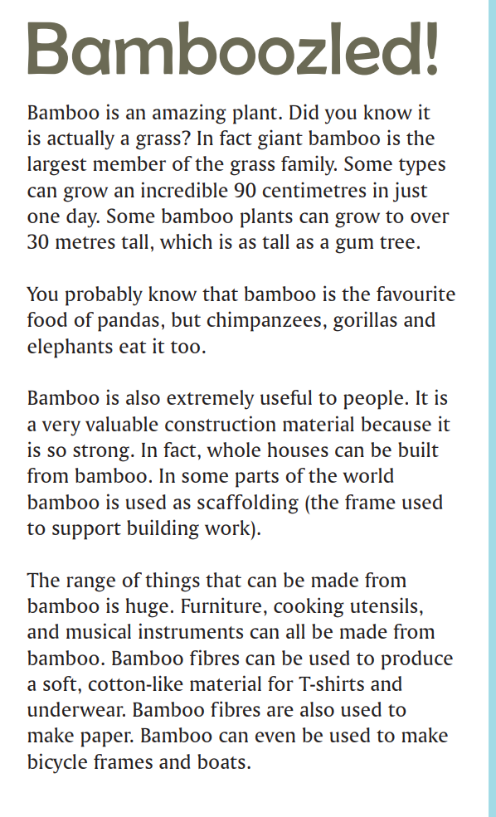
To illustrate a teaching routine for using think-alouds (1)
“Bamboo has unique qualities.”
“Bamboo is a material with many positive uses.”
“Bamboo is good for society as it grows quickly, abundantly and is used for essentials like housing, clothing and transport.”
“Bamboo is a food source for some mammals.”
“Bamboo is useful for people because it is strong and is used to build shelter.”
“Bamboo can be used to make a range of important items people use everyday.”
Extract from ACARA (2016) Year 5 Reading magazine
Notes:
Purpose: To illustrate a teaching routine for using think-alouds.
[02:30]
Speaker notes:
This is an example of a modelling teaching routine using think-alouds. It is written as what the teacher might say in the class:
When I summarise, one of the questions I ask myself is what is the main idea of each paragraph?
WORD AND PARAGRAPH LEVEL
When I read the title of the text and look at the images, I can see that it is about Bamboo, so I believe the text will be about different uses of Bamboo.
PARAGRAPH 1
Read with me: ‘Bamboo is an amazing plant’ STOP. Amazing is a positive word – I wonder what other words could be used instead of ‘amazing’ in this sentence that will keep the same idea? If I was replacing the word, I would think things like ‘Bamboo is an impressive plant’, ‘Bamboo is an exceptional plant’, ‘Bamboo is a phenomenal plant.’ This makes me think the text will have a key idea that Bamboo has unique qualities. Unique – meaning there are no other plants like it, it’s the only plant like this. [click]
Read with me: ‘Did you know it is actually a grass? In fact, giant bamboo is the largest member of the grass family. Some types can grow an incredible 90 centimetres in just one day.’ STOP – Is incredible a positive word or a negative word? I know that some other words that are synonyms for incredible are unbelievable, spectacular, and remarkable. These words all relate to ‘unique’, so having the word incredible here helps me to further understand that the first paragraph is about Bamboo’s unique qualities.
‘Some bamboo plants can grow to over 30 meters tall, which is as tall as a gum tree.’ - I know that gum trees are considered to be a very large tree and that not many plants and trees will grow this tall, especially grass. Because bamboo can grow as tall as gum trees, and I know that not many plants can do that, it confirms for me my idea that bamboo has unique qualities.
[click]
PARAGRAPH 2
We can see other key think-aloud ideas on this slide at a paragraph level, and also some think-aloud ideas at a whole-text level
WHOLE TEXT LEVEL
Amazing, incredible, extremely useful, can even be used, strong. – these are all positive words and phrases and help us to understand this piece of writing tells us about positive facts about Bamboo.
Reference
ACARA (Australian Curriculum Assessment and Reporting Authority) (2016) ‘NAPLAN 2012–2016 test papers and answers’, ACARA, accessed 10 November 2024.

Slide 36
Proportion of Australian population meeting dairy intake recommended by the Australian Dietary Guidelines – ABS 2011–12
Age group (years) | Males (%) | Females (%)
2–3 | 70.0 | 60.3
4–8 | 26.3 | 40.2
9–11 | 12.0 | 3.9
12–13 | 3.9 | 1.8
14–18 | 2.5 | 0.5
19–50 | 13.9 | 6.0
51–70 | 5.4 | 0.1
71 and over | 0.5 | 0.1
“The proportion decreases with age.”
“Most people aren’t eating enough serves of dairy.”
“Females eat less dairy than required than males.”
“What the graph doesn’t tell me.”
Adapted from ABS (2016) Australian Health Survey: consumption of food groups from the Australian Dietary Guidelines, 2011–12. ABS cat no. 4364.0.55.012. Canberra: ABS.
Notes:
Purpose: To illustrate how a teaching routine for using think-alouds.
[02:30]
Speaker notes:
This is an example of a modelling teaching routine using think-alouds. It is written as what the teacher might say in the class:
When I look at a graph the first thing I read and think about is the title, so I can be sure I understand what the whole graph is about.
Let’s read the title together “Proportion of Australian population meeting dairy intake recommended by the Australian Dietary Guidelines – ABS data 2011-12“
The title has a lot of information so I am going to break it up into parts. First, it’s about the Australian population. Then I see its about proportion of population. We’ve learned about the idea of proportion of the population in our last lesson. What does proportion of the population mean (wait) Sarah? So, when I am looking at proportion of the population, I’m looking for a percentage or per-one hundred measure. Next, I’m going to look at what this proportion or this group are doing – I see that they are meeting dairy intake, that is eating the amount of dairy foods that are recommended by our Australian Guidelines. Last, I can see ABS and I know from last lesson that this stands for the Australian Bureau of Statistics. And I can see that these statistics were collected in 2011 to 2012, and that’s a while ago now.
Categories
Read the categories across the top of the graph with me: Age group (years) Males (%) Females (%) – This reminds me that we are dealing with percentages and talking about the proportion of the population. This makes me think that there will be important differences between age groups and between males and females.
Read with me the column of percentages for males from top to bottom: “70%, 26.3%, 12%, 3.9%, 2.5%, 13.9%, 5.4%, 0.5%” I can see that the numbers keep falling mostly as the age groups get older, they increase here in the 19-50 category and drop off again in the next category. I’m wondering why that might be, as is doesn’t tell me here. I’m also wondering about the health implications for those last 2 categories 51-70 and 71 and over because I know that calcium affects bone strength. [click]
Males and females
Now I’m going to look back at comparing males with females and I thought there might be a reason why the data was split into these 2 categories. I can see that the proportion of females getting the recommended intake is in most categories much lower than for males. So, I wondering why that is. It could be because females chose to eat less dairy than males or it could be that the recommendations for females are higher than they are for males. [click]
More information needed
The data here doesn’t tell me what the recommended amount of dairy, so I’m going to think about where I would go to find that information. The title tells me it’s from the Australian Dietary guidelines so I would look that up to see if they are different for each category. [click]
The main idea
Even without that information I can see that the main idea from the data is that most people aren’t eating the recommended amount of dairy. [click]
References:
ABS (Australian Bureau of Statistics) (2016) Australian Health Survey: consumption of food groups from the Australian Dietary Guidelines, 2011–12 ABS, Canberra. ABS cat no. 4364.0.55.012.

Slide 37

Turn and talk (1)
Turn to the person next to you and explain ‘think-alouds’.
Notes:
Purpose: Activity
[02:00]
Notes to presenter: This activity could be done followed by selecting non-volunteers to share their dialogue.

Slide 38

The worked example effect
Worked examples:
are completed samples of the task
are powerful when used through the whole gradual release of responsibility – not just in modelling
help manage cognitive load as students learn new parts of a whole.
Notes:
Purpose of the slide: Modelling using worked examples
[02:00]
Speaker notes:
Worked examples are completed samples – a good example would be a template that is filled in by the teacher or a maths problem that shows the answer and all the working. They should be a realistic depiction of success at the Stage level (corresponding to syllabus content expectations, for example, realistic for expected Stage 4 student progress).
While using a worked example, the teacher explains each step, checking for understanding as they go. This includes explaining key decisions, the reasoning behind each action, and how each step contributes to solving the problem or completing the task. This not only shows students what to do, but also why it's done in a certain way.
Worked examples are powerful when used throughout the whole gradual release of responsibility – not just in modelling. In a study of 2 groups of year 9 students, one group was given worked examples only at the start (during modelling phase only) while the second group were given worked examples all through the gradual release of responsibility. The study found that the second group achieved a better result through the gradual release and in subsequent assessments. (Sweller et al. 2011)
Worked examples are tangible resources for students to use and refer back to throughout their learning.
Worked examples provide students with clear, concrete examples of what success looks like. By illustrating what they need to do, these examples help students understand the criteria for achieving success in the task. It makes complex tasks easier to understand and empowers students to approach problem-solving with confidence and clarity.
It is crucial however, that we understand the ‘expertise reversal effect’ that shows us that over-scaffolding can actually be counterproductive once students have gained expertise, leading to disengagement (Yeung et al. 1998)
It is important for teachers to be responsive to HPGS and the way they can learn more quickly and easily than similar aged peers, meaning they may progress faster and grasp content more easily.
Using explicit teaching practices with this in mind assists teachers with knowing:
when to move on,
scaffold differently – that might mean in a more complex way,
or release these students more quickly into independent learning
or application of learning in more challenging and abstract ways
References:
CESE (Centre for Independent Statistics) (2017) Cognitive load theory: research that teachers really need to understand, NSW Department of Education.
Sweller J, Ayres P and Kalyuga S (2011) Cognitive load theory: explorations in the learning science, instructional systems and performance technologies, Springer.
Yeung A, Jin P and Sweller J (1998) 'Cognitive load and learner expertise: split-attention and redundancy effects in reading with explanatory notes', Contemporary Educational Psychology, 23(1):1–21.

Slide 39
Worked example – critical paragraph
The main character shows courage throughout the story. Courage is shown through the character’s willingness to face challenges despite being afraid. For example, in chapter two, the character stands up to the bully even though he knows he might get hurt. This shows that the character consistently acts bravely, even in difficult situations.
Point (topic sentence): this sentence introduces the main idea and sets up what the rest of the paragraph will be about.
Explanation: this sentence explains the courage shown by the character and adds detail to support the topic sentence.
Evidence: this sentence provides evidence using an example from the text to support the explanation.
Linking sentence: this sentence explains the character’s bravery and links back to the main point to complete the paragraph.
Notes:
Purpose of the slide: An English worked example
[02:00]
Speaker notes:
This is an example of using a worked example for a critical paragraph. Students in an English class are introduced to a writing scaffold to construct a paragraph. The teacher uses a worked example to model and explain the thinking process and steps involved and provides opportunities for clarifying questions and ensuring the focus is on the teacher.
Note to presenter: You may like to provide some time to discuss the use and benefits of worked examples.

Slide 40
Turn and talk (2)
Turn to the person next to you and explain ‘worked examples’.
Notes:
Purpose: Activity
[02:00]
Notes to presenter: This activity could be done followed by selecting non-volunteers to share their dialogue.

Slide 41
Scaffolding (we do, you do)
Technique B

Slide 42
Scaffolding is a practice
Scaffolding is the ‘temporary, future-oriented, targeted help’ that supports learners in developing new knowledge, skills and understandings (Gibbons 2009).
It:
is temporary
enables learners to understand how to do something – not just what to do
is future-oriented (Gibbons 2009).
Notes:
Purpose: What is scaffolding?
[01:00]
Speaking notes:
When we think of scaffolding, we imagine worksheets or templates, but scaffolding must be considered as a practice.
Scaffolding is the ‘temporary, future-oriented, targeted help’ that supports learners in developing new knowledge, skills and understandings (Gibbons 2009). Scaffolding has three characteristics:
• temporary help that assists learners to move towards new concepts, levels of understanding, and new language
• enables learners to understand how to do something – not just what to do – so that they will be better able to complete a similar task independently
• is future-oriented, so that in the future, students will be able to complete the task independently (Gibbons 2009).
Sherrington (2019) re-enforces this notion ‘the whole point of scaffolding is that, eventually, it has to be taken down’.
For some learners, ‘scaffolding’ may need to remain for longer and they will continue to benefit from modelling and guided support.
Resources:
Multicultural education, Planning for teaching– https://education.nsw.gov.au/teaching-and-learning/multicultural-education/english-as-an-additional-language-or-dialect/teaching-and-learning/planning-for-teaching
Inclusive practice hub – https://education.nsw.gov.au/inside-the-department/directory-a-z/inclusive-practice/search-results?q=scaffolding&adjustments=adjustment-617
Evidence-based practices for students with disability – https://education.nsw.gov.au/inside-the-department/directory-a-z/inclusive-practice/evidence-based-practices-for-students-with-disability
References:
Gibbons P (2009) English learners, academic literacy and thinking: learning in the challenge zone, Heinemann.
Sherrington T (2019) Rosenshine’s principles in action, John Catt Educational.

Slide 43
Scaffolding – How does it work? (1)
It is assistance that is designed to help students complete more complex work (AERO 2024b).
Manages cognitive load while learning is new.
Gradually increases complexity when the learner is ready.
Notes:
Purpose: Using scaffolding
[01:00]
Speaker notes:
Scaffolding is not just used to simplify tasks but also to provide a high level of support for students to undertake more complex, high-level tasks. It can include prompts, information organisers, examples and non-examples to demonstrate the process and goal of a task. Scaffolding helps reduce misconceptions and gaps in students’ learning (Perry et al. 2021). Knowing when to use scaffolding and when to begin removing it is critical for effective use (AITSL, 2023).
When scaffolding is gradually removed, this increases the complexity of each step. As learners gain confidence and understanding, the scaffolding gradually being removed eventually allows them to tackle the full task independently.
References:
AERO (Australian Education Research Organisation) (2024b) Scaffold practice: guide student learning and gradually remove scaffolds, AERO.
AITSL (Australian Institute for Teaching and School Leadership) (2023) Addendum Accreditation of initial teacher education programs in Australia: Standards and Procedures, AITSL.
Perry T, Lea R, Jørgensen C, Cordingley P, Shapiro K, and Youdell D (2021) Cognitive science approaches in the classroom, Education Endowment Foundation.

Slide 44
Scaffolding – key considerations (2)
Effective scaffolding reduces the actions and decisions of students within a task when the learning is new.
Enables students to engage with tasks that offer high challenge by providing high support.
The frequency, intensity and duration of scaffolding can be adapted to support the needs of individual students.
Scaffolded support is faded over time as teachers check if students have gained proficiency.
Examples provide guidance on key steps within a process or task. Non-examples are an effective way of clarifying common errors and misconceptions.
Referring back to a scaffold across a unit of learning supports the retention and consolidation of key information in students’ long-term memory.
Notes:
Purpose: Key considerations for responsive teaching
[01:30]
Speaker notes:
Scaffolding manages cognitive load for students as they acquire, retain, consolidate and apply their learning. (Effective scaffolding reduces the actions and decisions of students within a task. This supports their cognitive load compared to minimally guided tasks.
Scaffolding enables students to engage with tasks that offer high challenge by providing high support.
The frequency, intensity and duration of scaffolding can be adapted to support the needs of individual students.
Scaffolded support is faded over time as teachers check if students have gained proficiency.
Examples provide guidance on key steps within a process or task. Non-examples are an effective way of clarifying common errors and misconceptions. (Deans for Impact 2023)
Referring back to a scaffold across a unit of learning supports the retention and consolidation of key information in students’ long-term memory (AERO 2023b).
References
AERO (Australian Education Research Organisation) (2023b) How students learn best: an overview of the learning process and most effective teaching practices, AERO.
Deans for Impact (2023) Using examples and non-examples, Deans for Impact.

Slide 45
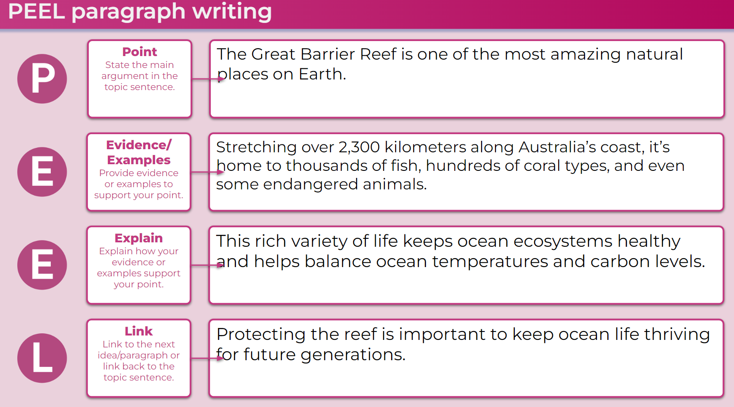
Taking the scaffolding away (1)
Notes:
Purpose: Examples of scaffolding writing
[00:30]
Speaker notes:
Over the next 4 slides, we see how the scaffolding is reduced as students focus on the next part of the paragraph.

Slide 46
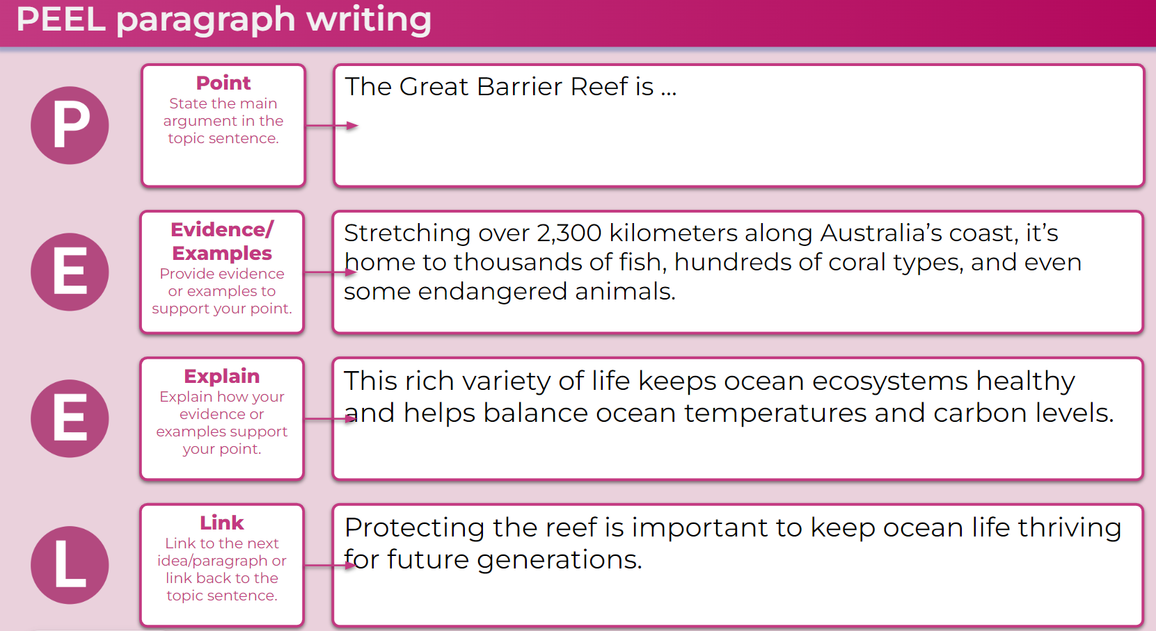
Taking the scaffolding away (2)
Notes:
Purpose: Examples of scaffolding writing
[00:30]
Speaker notes:
The topic sentence has been reduced from the model on the previous slide.

Slide 47
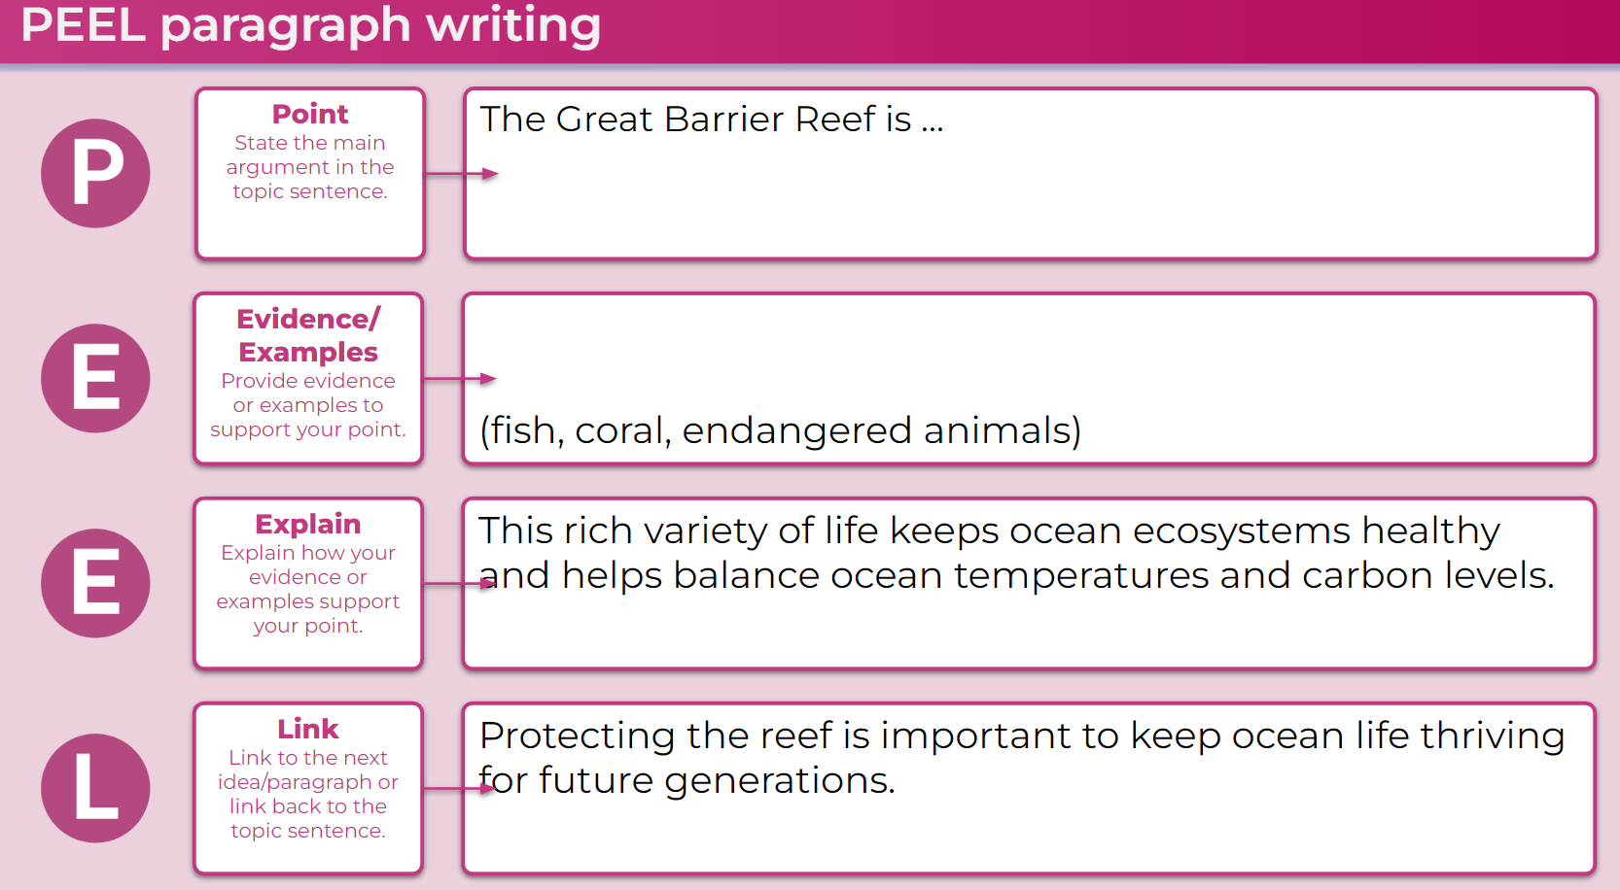
Taking the scaffolding away (23
Notes:
Purpose: Examples of scaffolding writing
[00:30]
Speaker notes:
The scaffolding is gradually removed as students demonstrate increasing proficiency.

Slide 48
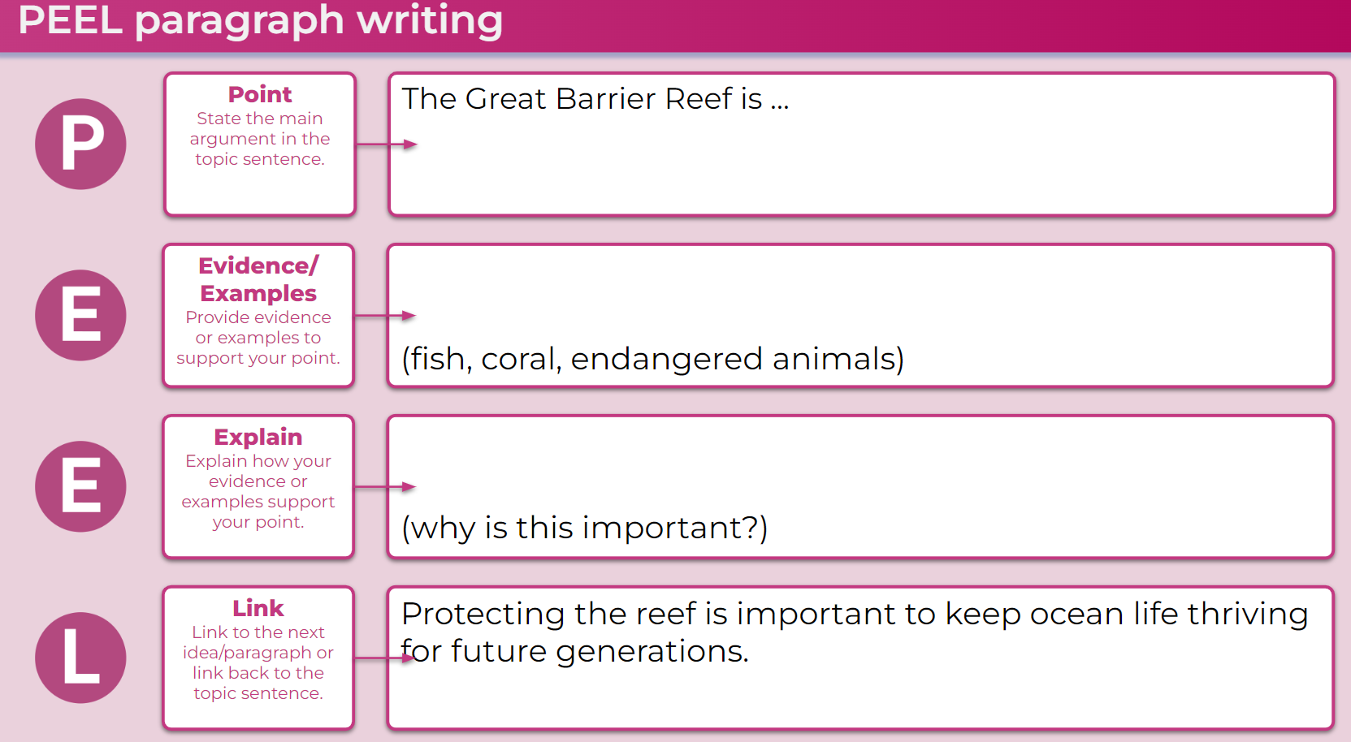
Taking the scaffolding away 24
Notes:
Purpose: Examples of scaffolding writing
[00:30]
Speaker notes:
As mentioned, it is important to note some students will require ongoing scaffolding.

Slide 49
Sentence starters and word banks
Why is teamwork important when playing sports or games?
‘Teamwork is important when playing sports because … ’
(co-operation, resources, talents)
What happens when you mix different colours together?
‘When you mix … with … , it …’
Notes:
Purpose: Examples of sentence starters and word banks
[01:30]
Speaker notes:
Sentence scaffolds (sentence frames, stems or starters) can scaffold thinking and writing (Hochman and Wexler 2017)
the teacher can then add a word bank of key vocabulary.
this supports teaching of skills in answering questions requiring an explanation.
as students become more proficient, the scaffold is faded before being removed.
This can be used in checking for understanding questions to give students the opportunity to practise expressing their thinking across different modes before they create a text.
References:
Hochman J and Wexler N (2017) The writing revolution: a guide to advancing thinking through writing in all subjects and grades, John Wiley & Sons.

Slide 50
Turn and talk (3)
Turn to the person next to you and explain what ‘scaffolding’ is.
Notes:
Purpose: Activity
[01:10]
Speaker notes:
This activity could be done before cold-calling for responses from the participants.

Slide 51
Independent practice
Technique C

Slide 52
Independent practice
‘Consider what may happen if a teacher is teaching a group of students to use a new and relatively complex strategy, and the teacher omits verification of prerequisite skills, clear demonstrations of the strategy, supported initial practice, and multiple independent practice attempts with corrective feedback. This is definitely a recipe for disaster!’
Archer and Hughes 2011:12
Notes:
Purpose: What is independent practice and reflection?
[01:00]
Speaker notes:
Independent practice occurs when it is evident during guided practice that students can perform a skill with a high level of success without teacher support. Archer and Hughes (2011) propose that during initial instruction students’ optimal rates of correct responses and about 80% while in independent practice they are approximately 90–95%.
Reference:
Archer A and Hughes C (2011) Explicit instruction: effective and efficient teaching, Guilford press.

Slide 53
Independent practice – How does it work? (1)
It:
is critical for students to develop fluency and autonomy
should be meaningful and linked to previous guided practice
enables students to consolidate their understanding.
Notes:
Purpose: What is independent practice and reflection?
[01:00]
Speaker notes:
Independent practice a critical part of the learning process and is needed for students to become fluent and autonomous in a skill. Fluency decreases working memory load and supports engagement and proficiency when attempting more complex problem-solving tasks (Martin and Evans, 2018). Additional practise is necessary over time to maintain proficiency. The practice needs to be meaningful rather than repetitive, while also linked to previous guided practice. Independent practice allows students to consolidate their understanding, through application of their learning.
Reference
Martin A and Evans P (2018) ‘Load reduction instruction: exploring a framework that assesses explicit instruction through to independent learning’, Teaching and Teacher Education, 73:203–214.

Slide 54
Independent practice – key considerations (2)
The teacher actively monitors and supervises students' independent practice (Rosenshine 2012).
Independent practice does not have to be done individually.
Repeated independent practice consolidates learning over time.
Increased skill proficiency can be practiced in different contexts.
Notes:
Purpose: Key considerations for Independent practice and reflection
[03:00]
Speaker notes:
These are key considerations to effectively facilitate independent practice:
[Provide some time to discuss each point, if needed.]
[click]
1. Actively monitoring and supervising
Studies have shown that students were more engaged when their teacher moved around the classroom, monitoring and supervising their work during independent practice (Rosenshine 2012).
[click]
2. Independent practice does not have to be done individually
It can involve group tasks, which allows students to receive feedback from their peers on correct and incorrect responses, fostering greater engagement and learning.
[click]
3. Repeated independent practice consolidates learning over time
Repeated independent practice to apply knowledge or skills is needed for students to consolidate learning over time.
[click]
4. Increased skill proficiency can be practiced in different contexts
As students become increasingly proficient with a skill it can be practiced in different contexts. This builds fluency while reducing the risk of the tasks becoming repetitive.
References:
AERO (Australian Education Research Organisation) (2024c) Extend and challenge: provide appropriately challenging opportunities for students to apply, extend and demonstrate mastery of their learning, AERO.
Rosenshine B (2012) 'Principles of instruction: research-based strategies that all teachers should know' American Educator, 36(1):12–19.

Slide 55
Building knowledge before generative learning
The aim of explicit teaching is for all students to gain the skills, knowledge and understanding to be able to do generative learning. Generative learning is where students create complex mental models or schemas that enable them to apply their knowledge to novel situations (Fiorella 2023).
Students are actively involved in guiding their learning through:
summarising learning
guided structured inquiry
peer teaching.
Knowledge must come first before students can extend their thinking to become independent learners.
Notes:
Generative learning is when students actively make connections between new and existing knowledge. The aim of generative learning is for students to create complex mental models or schemas that enable them to apply their knowledge to novel situations (Fiorella, 2023).
With repeated opportunities for independent practice, students manipulate, connect and build on knowledge. This practice leads students to develop strong schemas, so that when they engage in generative learning activities they can do so with high levels of confidence and chance for success.
Summarising: Summarising must be more than recording what students have heard or read word for word. It requires students to select the key ideas or information, then organising them to be able to explain their new learning. and integrating them into what students already know (Fiorella and Mayer, 2016). Summarising can make connections to students' existing knowledge, supporting their schema development and strengthening the transfer to long term memory. It also allows students to elaborate on and add their own interpretation to the key ideas.
Guided structured inquiry: Guided, structured inquiry can help students transfer their learning to new or unfamiliar situations. This allows them to apply and utilize their existing mental models (Kirschner and Hendrick, 2020) by engaging in more independent and challenging problem-solving activities (Kalyuga 2007; Kirschner et al. 2006). Guided, structured inquiry is most effective when introduced later in the learning process, rather than as an initial approach to a new subject area. For this approach to be successful, students need to have developed a certain level of expertise, which includes the ability to fluently recall relevant vocabulary, facts, concepts, and procedures, as well as grasp the connections between them. They also require clear guidance and adequate teacher support (Martin 2016).
Peer teaching: Peer teaching sees a student who has developed mastery explain their learning to a peer or small group, to enhance their understanding. The teacher scaffolds peer teaching by suggesting examples or analogies that can be used to support the students' explanations. When working with a peer, each student needs to organise their knowledge, clarify thoughts, and anticipate questions. Having experience with summarising learning supports the peer teaching process. This deepens their comprehension and retention of the material. As a result, peer teaching extends each persons’ thinking informed by another perspective or set of experiences (Enser et al. 2020).
‘Knowledge in the curriculum extends students’ thinking and stimulates learning, enabling them to become more independent learners, who can think in more abstract ways over time.’ (AERO, 2024d)
References:
AERO (Australian Education Research Organisation) (2024d) A knowledge-rich approach to curriculum design, AERO.
AERO (Australian Education Research Organisation) (2024c) Extend and challenge: provide appropriately challenging opportunities for students to apply, extend and demonstrate mastery of their learning, AERO.
Enser Z, Enser M, Sherrington T, and Caviglioli O (2020) Fiorella and Mayer’s generative learning in action, John Catt Educational Ltd.​
Fiorella L (2023) 'Making sense of generative learning', Educational Psychology Review, 35:1–50.
Fiorella L and Mayer R (2016) 'Eight ways to promote generative learning', Educational Psychology Review, 28:717–741.
Kalyuga S (2007) ‘Expertise reversal effect and its implications for learner-tailored instruction’, Educational Psychology Review, 19(4):509–539.​
Kirschner P and Hendrick C (2020) How learning happens: seminal works in educational psychology and what they mean in practice, Routledge.
Kirschner P, Sweller J and Clark R (2006) 'Why minimal guidance during instruction does not work: an analysis of the failure of constructivist, discovery, problem-based, experiential, and inquiry-based teaching', Educational Psychologist, 41(2):75–86.
Martin A (2016) Using load reduction instruction (LRI) to boost motivation and engagement, The British Psychological Society.​

Slide 56
Planning, rehearsing and developing the techniques

Slide 57
Creating agreed whole-school principles
Draft whole-school teaching principles for gradual release of responsibility techniques.
Notes:
Purpose: Consider how you can use the techniques in this learning module to create a whole-school approach for gradual release of responsibility.
[1:00] + additional time for the activity
Speaker notes:
Today we will be doing an activity in groups to develop whole-school principles for the gradual release of responsibility.
In your groups, draft a consensus on a gradual release of responsibility principles. Remember, these should be able to be applied broadly in classrooms across the school to enhance the learning experience of our students by helping to manage their cognitive load with familiar expectations.
The goal is to adopt a cohesive approach that supports all teachers and ensures students feel confident in participating and engaging with the content.
Examples principles
1. Use of worked examples.
Purpose – worked examples provide students with clarity on what is required to complete the task successfully.
Principles:
During the lesson, the teacher tells the students they are using a worked example to recognise what is expected of them.
Teachers explain features of the worked example that are relevant to the learning being undertaken in the lesson.
We make worked examples available throughout the gradual release of responsibility.
2. Think-alouds principles.
Purpose – think-alouds model for students the thinking and decision making required to complete a task.
Principles:
During the lesson teacher tells the students that they are doing a think-aloud.
Think alouds feature sentences like:
‘I am wondering about….. This is because…’
I know that this means… because…’
‘What I would like to know is…’
‘The first thing I would do is to ...’
‘To check I have it right, I…’

Slide 58
Planning and rehearsing (3)
Plan
Rehearse
Feedback
Evidence for Learning (2022) Effective Professional Development, Sydney: Evidence for Learning.
Notes:
Purpose of slide: To explain the process of rehearsing
Speaker notes:
[01:10]
Now that we have our routine, we have some time to plan, rehearse, and get feedback from each other. When we say rehearse, we mean:
[click] plan number of suitable questions or activities ready
[click] deliver the instruction as if doing it in class.
Then your partners
[click] will use the feedback prompts on the next slide to refine the teaching routine. What may need to be added, changed, enhanced or deleted?
Note to presenter: it is advisable to prepare the leaders beforehand if modelling and rehearsing are not yet established practices in the school.
Further reading on this research:
AERO (Australian Education Research Organistion) (2023c) Classroom management practice guide: gaining all students’ attention, AERO.
Evidence for Learning (2022) Effective professional development, Evidence for Learning.
Sims S, Fletcher-Wood H, O’Mara-Eves A, Cottingham S, Stansfield C, Van Herwegen J and Anders J (2021) What are the characteristics of teacher professional development that increase pupil achievement? A systematic review and meta-analysis, Education Endowment Foundation.

Slide 59
Rehearsal steps and feedback prompts
Select a technique to use for gradual release of responsibility (such as modelling through think-alouds).
Plan your instruction for the class.
With a partner, rehearse the teaching for this ‘gradual release of responsibility’ technique.
Use the feedback from your partner to improve your approach.
Swap with your partner for their rehearsal.
Feedback prompts
Did the teacher manage the cognitive load for learners?
Did it make the expectations of the task clear for learners?
Is the thinking of the teacher transparent?
Did it clarify common errors or misconceptions?
Notes:
Purpose: to give the steps and feedback prompts for the activity
[00:30]
Speaker notes:
Take a minute to go through the rehearsal steps and the prompts for feedback.
If you are giving feedback, we have provided a list of prompts for you to think about how the routine could be refined.
Note to presenter: this slide and the activity slide could be provided to the groups as handouts.

Slide 60
In the next part of this module, we will work on evaluating our approach to implementing the strategies through techniques.
Notes:
Speaker notes: To orient into the next part of the module.
[00:20]
Note to presenter: Develop principles for using gradual release of responsibility in the school. Select a technique to focus on with a cycle of planning and rehearsing.

Slide 61
Evaluating a whole-school approach
Part C

Slide 62
Purpose and outcome (2)
Purpose
To apply effective professional development structures, reflect on and evaluate our implementation of an explicit teaching technique.
Outcome
Refine the whole-school practices of gradual release of responsibility and plan for future success and activities.
Notes:
Purpose:
[00:30]
Speaker notes:
In this part, the focus is on reflection and evaluation. We will consider the early indicators of success and use this to plan for evaluation of longer term impact. There is also a good opportunity to refine principles that guide how we implement gradual release of responsibility across the whole school.

Slide 63
A whole-school approach

Slide 64
Initial reflection point (2)
Teacher observation | 0 | 1 | 2 | 3 | 4
After modelling and guiding, did my students complete an activity that demonstrated the success criteria? | Not yet observable | Minimal parts of the success criteria | Some parts of the success criteria | Most parts of the success criteria | All parts of the success criteria
Notes:
Purpose: Reflecting on initial observations
[02:00]
Speaker notes:
In the beginning, we established a baseline for where our students are now.
We looked at this example of a tool that could be used for teacher reflection. This was one way to measure one aspect of the effectiveness of a gradual release of responsibility.
We asked: Think about one class you taught today. What parts of the scale would best describe your students?
We know that students learn most efficiently and effectively through modelling from an expert (AERO 2023d). Guidance helps students to develop mastery as they move to independent practice.
This module looked at how teachers scaffold the learning through a gradual release of responsibility until they can become fluent and autonomous (Martin and Evans, 2018).
For example:
A teacher models writing a paragraph, then guides students in writing a paragraph, before students complete their own paragraph independently. The teacher uses the reflection guide and finds the class were at about a 2 because only some parts of the success criteria were evident in the student paragraphs they collected. The teacher uses this to reflect on their own practice.
Note to presenter: In the beginning we noted that there is an opportunity to use this data in the final session. This measure is not the only consideration, and schools should select a model that is right for them.
This data could be collated and compared to other “school and classroom data about growth and performance.”
For example:
NAPLAN report overview accessed through Scout
https://education.nsw.gov.au/about-us/education-data-and-research/scout/training/digital-learning-centre/naplan-report-overview
NAPLAN report overview
Learn more about the NAPLAN reports in Scout.
https://education.nsw.gov.au/about-us/education-data-and-research/scout/scout-overview/apps-and-reports/naplan---doe/class-report#tabs0
Class report
The Class report shows the distribution of students’ scaled scores across domains and proficiency levels for NAPLAN 3, 5, 7 or 9.
References:
AERO (Australian Education Research Organisation) (2023b) How students learn best: an overview of the learning process and most effective teaching practices, AERO.
AERO (Australian Education Research Organisation) (2023d) Explicit instruction optimises learning, AERO.
Martin A and Evans P (2018) 'Load reduction instruction: exploring a framework that assesses explicit instruction through to independent learning', Teaching and Teacher Education, 73, 203–214.

Slide 65
The mechanisms that make it work
Planning for modelled, guided and independent practice
Checking for understanding
Extended handover
Flexibility and differentiated support
Optimising learning
Notes:
Purpose: to summarise what makes the gradual release of responsibility effective
[01:00]
Speaker notes:
Lets remember when using the gradual release of responsibility, it is crucial to:
1. Planning modelled, guided and independent practice
2. Checking for understanding to make responsive decisions.
3. Respond to what you find out in the checks for understanding and deciding to move backwards or forwards
4. Differentiate support for students by flexibly moving between modelled, guided and independent teaching practice and being responsive to student learning.
When all 4 are in place, students are given the strong opportunity to progress in their learning without gaps in their understanding.
References:
AERO (Australian Education Research Organisation) (2022) Explicit instruction: clearly explaining and effectively demonstrating what students need to learn, AERO.
Sherrington T (28 November 2020) 'The art of modelling it’s all in the handover' , teacherhead blog, accessed 12 September 2024

Slide 66
The importance of all moving together (2)
Saves learning time¹
Frees up students’ working memory²
Certain and consistent expectations for students³
Students learn the routine more quickly when it is done in the same way across the school⁴
Fosters a strong sense of belonging⁵
Notes:
Purpose: to restate why a whole school teaching routine is powerful
[00:30]
These modules use the power of whole school teaching routines. When a group of expert teachers from across the school come together and create a whole school approach, they are far more effective than when they go it alone. Teaching routines:
[click] save learning time
[click] can free up students’ working memory
[click] provide certainty and expectations for students to contribute to a learning environment where they’re safe to participate.
[click] They’re efficient, because when done the same way across the school, students can learn the routine more quickly.
[click] and they foster a strong sense of belonging.
As we go through the learning module here, and other learning modules for explicit teaching we will revisit the idea of the whole school teaching routines.
References:
1.Archer A and Hughes C (2011) Explicit instruction: effective and efficient teaching. Guilford Press.
2.AERO (Australian Education Research Organisation) (2021) Focused classrooms: managing the classroom to maximise learning, AERO.
3.AERO (Australian Education Research Organisation) (2023a) Teaching routines, AERO.
4.McCrea P (2020) Motivated Teaching: harnessing the science of motivation to boost attention and effort in the classroom, Createspace Independent Publishing Platform.
5.McCrea P (2020) Motivated Teaching: harnessing the science of motivation to boost attention and effort in the classroom, Createspace Independent Publishing Platform.
Further reading:
Tharby A (17 May 2023) ‘We are what we do: the case for explicit and consistent school wide routines’, Class Teaching, Find the bright spots blog, accessed 20 November 2024.

Slide 67
Planning and rehearsing (3)
Plan
Rehearse
Feedback
Evidence for Learning (2022) Effective Professional Development, Sydney: Evidence for Learning.
Notes:
Purpose of slide: To explain the process of rehearsing
Speaker notes:
[01:10]
Now that we have our routine, we have some time to plan, rehearse, and get feedback from each other. When we say rehearse, we mean:
[click] plan number of suitable questions or activities ready
[click] deliver the instruction as if doing it in class.
Then your partners
[click] will use the feedback prompts on the next slide to refine the teaching routine. What may need to be added, changed, enhanced or deleted?
Note to presenter: it is advisable to prepare the leaders beforehand if modelling and rehearsing are not yet established practices in the school.
Further reading on this research:
AERO (Australian Education Research Organistion) (2023c) Classroom management practice guide: gaining all students’ attention, AERO.
Evidence for Learning (2022) Effective professional development, Evidence for Learning.
Sims S, Fletcher-Wood H, O’Mara-Eves A, Cottingham S, Stansfield C, Van Herwegen J and Anders J (2021) What are the characteristics of teacher professional development that increase pupil achievement? A systematic review and meta-analysis, Education Endowment Foundation.

Slide 68
Rehearsal (2)
Notes:
Purpose of slide: To explain why rehearsing is so important
Speaker notes:
[01:10]
Application is a real key to success in professional learning.
Why might professional learning not be applied in the classroom, despite our best intentions?
[click] Research from Evidence for Learning (2022) found that rehearsing was among the key mechanisms for success in the application of PL.
New teachers often have practices described to them – but it is much clearer to have lead teachers model the practice (out of the classroom, without students) while the observer uses prompts to reflect on what made that practice successful.
Teaching is a habit-forming practice. By necessity, teaching requires us to automate a number of behaviours. The cognitive load on teachers to introduce a new behaviour is high and so we often rely on those previously formed habits.
Rehearsal (out of the classroom, without students) makes our PL a habit. When we try a rehearsed routine in a classroom, our cognitive load is reduced because we have one thing to think about, rather than 4 or 5.
This is why rehearsing is a key mechanism for success in professional learning.
References:
Evidence for Learning (2022) Effective professional development, Evidence for Learning.

Slide 69
Evaluating impact on students

Slide 70
New evidence-based
'When implementing a new evidence-based practice, school personnel should measure fidelity early and often to provide timely and responsive professional development and maximise student outcomes.'
(Harn et al. 2013:186)
Notes:
Purpose:
[00:00]
Speaker notes:

Slide 71
Measures of impact
Short term
Increased engagement
Increased ability to articulate the lesson’s learning intention(s) and success criteria
Longer term
Increased understanding
Increased learning
Student data indicates learning gains
Notes:
Purpose: Measuring success
[02:00]
Speaker notes:
When we try something new in the classroom and our students experience it for the first time, it may not have the desired impact. Over time, the impact of the approach should show signs of success. Refining our implementation of the gradual release of responsibility can support student engagement. It does this by providing students with the right amount of support or independence at the right time.
Measure fidelity early and often to provide maximise student outcomes and be responsive in the approach.

Slide 72
Reflecting on initial observations
Short term
Increased engagement
Increased ability to articulate the lesson’s learning intention(s) and success criteria
Longer term
Increased understanding
Increased learning
Student data indicates learning gains
Teacher observation | 0 | 1 | 2 | 3 | 4
After modelling and guiding, did my students complete an activity that demonstrated the success criteria? | Not yet observable | Minimal parts of the success criteria | Some parts of the success criteria | Most parts of the success criteria | All parts of the success criteria
Notes:
Reflecting on initial observations and considering long term measures
Note to presenter: timing for this slide will be dependent on your own allocated time and the number of staff in attendance.
Speaking notes:
In Part A, we identified the level of students’ ability to demonstrate their learning independently after modelling and guidance. This measure can be used as an indicator – where we consider the most immediate indicator of change and use this measure to track change over time.
We could choose a different measure, but it's important it is proximal to the teaching. It should be an immediately observable/collectable indicator of change in students’ knowledge, skills, motivation, self-belief, or teacher practice. This information of what is successful helps us plan for longer term outcomes.
Activity:
What observations can you make about gradual release of responsibility techniques in the classroom?
What observations can be made about what has been successful so far, while we’ve focused on the gradual release of responsibility in classrooms?
How will we measure longer term outcomes?
How can we scale our success by refining and building the techniques and routines we’ve been developing?
Note to presenter: You may wish to display the data from the first session if it was collected. If there has been no shift identified using the early measure, discuss the barriers to success and if an adjustment to the whole-school routine is needed.
Further reading on High Impact Professional Learning:
High Impact Professional Learning
References:
AERO (Australian Education Research Organisation) (2023b) How students learn best: an overview of the learning process and most effective teaching practices, AERO.
AERO (Australian Education Research Organisation) (2023d) Explicit instruction optimises learning, AERO.
Martin A and Evans P (2018) 'Load reduction instruction: exploring a framework that assesses explicit instruction through to independent learning', Teaching and Teacher Education, 73, 203–214.
McCrea P (2020) Motivated Teaching: harnessing the science of motivation to boost attention and effort in the classroom, Createspace Independent Publishing Platform.

Slide 73
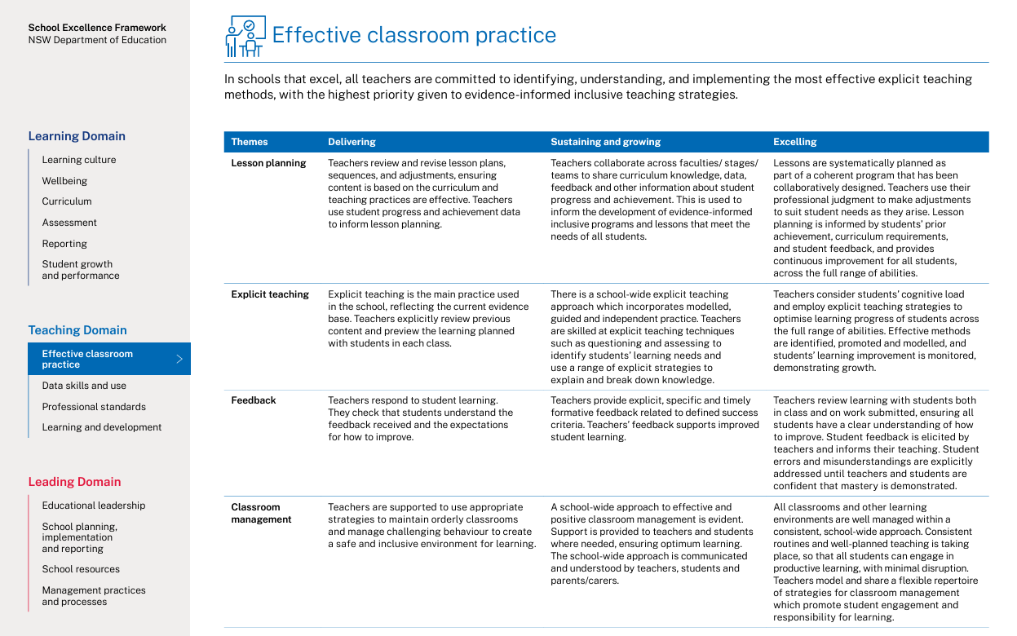
Connecting to the School Excellence Framework
‘School-wide explicit teaching approaches incorporate modelled, guided and independent practice.
Teachers consider students’ cognitive load and employ explicit teaching strategies to optimise learning progress of students across the full range of abilities. Effective methods are identified, promoted and modelled, and students’ learning improvement is monitored, demonstrating growth.’
School Excellence Framework, Teaching Domain (p 11)
73
Notes:
Purpose: Aligning the practice to the SEFv3
Note to presenter: timing for this slide will be dependent on your own allocated time and the number of staff in attendance.
Speaker notes:​
Linking to longer term outcomes, the SEF is an excellent way to measure whole-school impact over time.
Gradual release of responsibility relates to themes from the SEFv3​.
​
For example, in the teaching domain, under the element of effective classroom management, this practice aligns with the descriptors for the theme of explicit teaching and classroom management.
Activity:
Access and identify key features from delivering, sustaining and growing and excelling for the explicit teaching theme.
Access and identify key features from delivering, sustaining and growing and excelling for the classroom management theme.
Describe how our classrooms would look, feel and sound if we were to move to 'sustaining and growing' or move to 'excelling'.
Discussion points:
In ‘sustaining and growing’ the practice looks like a whole school approach to positive classroom management:
​
This extends to learning routines in ‘excelling’ where there are consistent school-wide approaches to learning routines that enable student engagement. ​
​

Slide 74
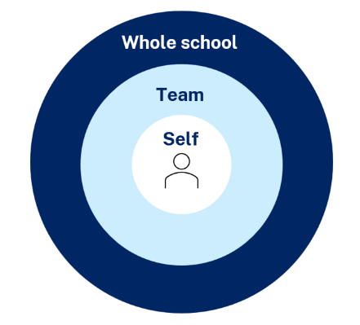
Maintaining a whole-school approach through data
Video observation and reflection
Peer observation and feedback
Teacher and student survey
Growth in assessment data
Notes:
Purpose of slide: collating and using data - suggested for school leadership team
Speaker notes:
[05:00]
Evaluating data is a way we can consider the extent to which we are being effective in achieving long term goals. Data can be collected from many perspectives, including individual teachers and students, teams and whole school. Data can include a range of things, such as observational/instructional rounds, student work samples (such as exit tickets), student self-reports, teacher reflections and assessments. Data can be quantitative and qualitative.
Reflecting on data helps us consider how efficient and effective we are being in achieving our instructional goals. It also provides key insights to inform the next steps of professional learning and whole school strategic planning.
Activity:
What data have we accessed so far and what have we learnt?
How can we select and measure data over time to consider our impact?
Further reading:
More information about using data to evaluate the curriculum aligned to the School Excellence Framework
LECI: Module 5: Using data to effectively evaluate the curriculum AC01087

Slide 75


Feedback
Please complete the Checking for understanding learning module survey to help us improve future professional learning and provide further support.
Contact us
ContactCurriculumReform@det.nsw.edu.au

Slide 76

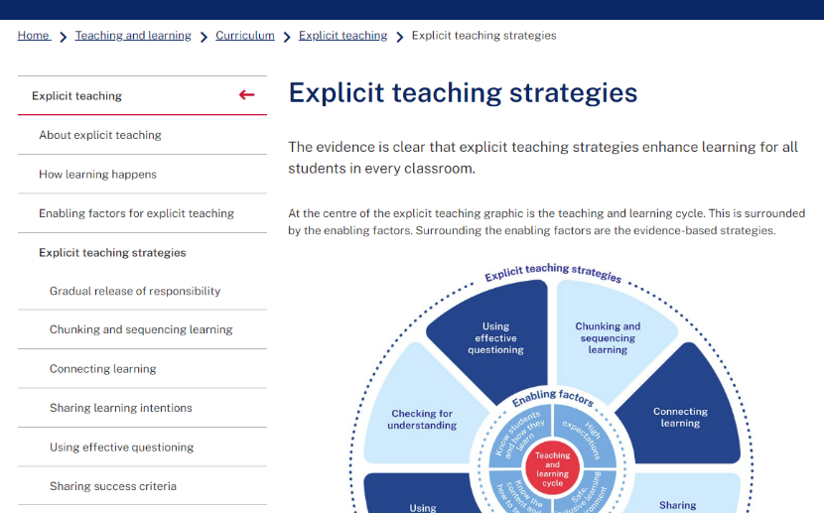
Explicit teaching strategies and resources
More information is available about:
​explicit teaching
how learning happens
the enabling factors
the explicit teaching strategies.
https://education.nsw.gov.au/teaching-and-learning/curriculum/explicit-teaching
Notes:
Purpose of slide: Next steps
Speaker notes:
[0:40]
The evidence on explicit teaching is clear, it shows us how important it is to align our teaching pedagogy with how learning occurs. Ongoing information to support this is available on the department's website.
This includes information about the enabling factors, how learning happens and the explicit teaching strategies. The website will continue to be updated as new resources are released in future.
https://education.nsw.gov.au/teaching-and-learning/curriculum/explicit-teaching

Slide 77
References (1)
This presentation contains NSW Curriculum and syllabus content. The NSW Curriculum is developed by the NSW Education Standards Authority. This content is prepared by NESA for and on behalf of the Crown in the right of the State of New South Wales. The material is protected by Crown copyright.
Please refer to the NESA Copyright Disclaimer for more information https://educationstandards.nsw.edu.au/wps/portal/nesa/mini-footer/copyright.
NESA holds the only official and up-to-date versions of the NSW Curriculum and syllabus documents. Please visit the NSW Education Standards Authority (NESA) website https://educationstandards.nsw.edu.au/wps/portal/nesa/home and the NSW Curriculum website https://curriculum.nsw.edu.au.
Archer A and Hughes C (2011) Explicit instruction: effective and efficient teaching, Guilford Press.
ABS (Australian Bureau of Statistics) (2016) Australian Health Survey: consumption of food groups from the Australian Dietary Guidelines, 2011–12 ABS, Canberra. ABS cat no. 4364.0.55.012.
ACARA (Australian Curriculum Assessment and Reporting Authority) (2016) ‘NAPLAN 2012–2016 test papers and answers’, ACARA, accessed 10 November 2024.
AERO (Australian Education Research Organisation) (2021) Focused classrooms: managing the classroom to maximise learning, AERO.
AERO (Australian Education Research Organisation) (2022) Explicit instruction: clearly explaining and effectively demonstrating what students need to learn, AERO.
AERO (Australian Education Research Organisation) (2023a) Teaching routines, AERO.
AERO (Australian Education Research Organisation) (2023b) How students learn best: an overview of the learning process and most effective teaching practices, AERO.
AERO (Australian Education Research Organisation) (2023c) Classroom management practice guide: planning for classroom management, AERO.

Slide 78
Reference list
AERO (Australian Education Research Organisation) (2023d) Explicit instruction optimises learning, AERO.
AERO (Australian Education Research Organisation) (2024a) Teach explicitly, AERO.
AERO (Australian Education Research Organisation) (2024b) Scaffold practice: guide student learning and gradually remove scaffolds, AERO.
AERO (Australian Education Research Organisation) (2024c) Extend and challenge: provide appropriately challenging opportunities for students to apply, extend and demonstrate mastery of their learning, AERO.
AERO (Australian Education Research Organisation) (2024d) A knowledge-rich approach to curriculum design, AERO.
AITSL (Australian Institute for Teaching and School Leadership) (2023) Addendum aaccreditation of initial teacher education programs in Australia: standards and procedures, AITSL.
CESE (Centre for Education Statistics and Evaluation) (2017) Cognitive load theory: research that teachers really need to understand, NSW Department of Education.
CESE (Centre for Education Statistics and Evaluation) (2024) Explicit teaching drives student motivation, engagement, and achievement in NSW public schools – a What Works Best research update, NSW Department of Education.
Deans for Impact (2023) Using examples and non-examples, Deans for Impact.
Duggan S (30 August 2024) ‘They still need explicit teaching: why pedagogy for gifted students must shift’, Education HQ, accessed 20 November 2024.
Evidence for Learning (2022) Effective professional development, Evidence for Learning.
Enser Z, Enser M, Sherrington T, and Caviglioli O (2020) Fiorella and Mayer’s generative learning in action, John Catt Educational Ltd.​

Slide 79
Reference list
Fiorella L (2023) 'Making sense of generative learning', Educational Psychology Review, 35;1–50.
Fiorella L and Mayer R (2016) 'Eight ways to promote generative learning', Educational Psychology Review, 28:717–741.
Fisher D and Frey N (2021) Better learning through structured teaching: a framework for the gradual release of responsibility, 3rd edn, ASCD.
Fisher D, Frey N and Lapp D (2011) 'Coaching middle-level teachers to think aloud improves comprehension instruction and student reading achieving', The Teacher Educator, 46(3):231–243.
Frey N and Fisher D (2010) 'Identifying instructional moves during guided learning', The Reading Teacher, 64(2):84–95.
Gibbons P (2009) English learners, academic literacy and thinking: learning in the challenge zone, Heinemann.
Harn B, Parisi D and Stoolmiller M (2013) ‘Balancing fidelity with flexibility and fit: what do we really know about fidelity of implementation in schools?’ Exceptional Children, 79:181–193.
Hertzberg M (2012) Teaching English language learners in mainstream classes, NSW PETAA (Primary English Teaching Association Australia).
Kalyuga S (2007) ‘Expertise reversal effect and its implications for learner-tailored instruction’, Educational Psychology Review, 19(4):509–539.​
Kirschner P and Hendrick C (2020) How learning happens: seminal works in educational psychology and what they mean in practice, Routledge.
Kirschner P, Sweller J and Clark R (2006) 'Why minimal guidance during instruction does not work: an analysis of the failure of constructivist, discovery, problem-based, experiential, and inquiry-based teaching', Educational Psychologist, 41(2):75–86.
McCrea P (2020) Motivated teaching: harnessing the science of motivation to boost attention and effort in the classroom, Createspace Independent Publishing Platform.

Slide 80
Reference List
Martin A J (2016) Using load reduction instruction (LRI) to boost motivation and engagement, The British Psychological Society.​
Martin A and Evans P (2018) 'Load reduction instruction: exploring a framework that assesses explicit instruction through to independent learning', Teaching and Teacher Education, 73:203–214.
NSW Department of Education (2023a) Classrooms of possibility, accessed 12 September 2024.
NSW Department of Education (2023b) Explicit instruction: implementing evidence-based teaching practices for students with disability, accessed 12 September 2024.
NSW Department of Education (2024a) Explicit instruction: implementing evidence-based teaching practices for students with disability, accessed 12 September 2024.
NSW Department of Education (2024b) Leading explicit teaching – school-facilitated workshops 1–3 on core content and the enabling factors of explicit teaching, accessed 12 September 2024.
NSW Department of Education (2024c) Strong strides together: meeting the educational goals for Aboriginal and/or Torres Strait Islander students, accessed 12 September 2024.
Perry T, Lea R, Jørgensen C, Cordingley P, Shapiro K, and Youdell D (2021) Cognitive science approaches in the classroom, Education Endowment Foundation.
Rosenshine B (2012) 'Principles of instruction: research-based strategies that all teachers should know', American Educator, 36(1):12–19.
Sherrington T (28 November 2020) 'The art of modelling it’s all in the handover'​, teacherhead blog, accessed 12 September 2024.

Slide 81
Reference List
Sims S, Fletcher-Wood H, O’Mara-Eves A, Cottingham S, Stansfield C, Van Herwegen J and Anders J (2021) What are the characteristics of teacher professional development that increase pupil achievement? A systematic review and meta-analysis, Education Endowment Foundation.
Sweller J, Ayres P and Kalyuga S (2011) Cognitive load theory: explorations in the learning science, instructional systems and performance technologies, Springer.
Tharby A (17 May 2023) 'We are what we do: the case for explicit and consistent school wide routines class teaching', Class Teaching, Find the bright spots blog, accessed 4 October 2024.
Yeung A, Jin P and Sweller J (1998) 'Cognitive load and learner expertise: split-attention and redundancy effects in reading with explanatory notes', Contemporary Educational Psychology, 23(1):1–21.

Slide 82
Copyright
© State of New South Wales (Department of Education), 2024
The copyright material published in this resource is subject to the Copyright Act 1968 (Cth) and is owned by the NSW Department of Education or, where indicated, by a party other than the NSW Department of Education (third-party material).
Copyright material available in this resource and owned by the NSW Department of Education is licensed under a Creative Commons Attribution 4.0 International (CC BY 4.0) license.
This license allows you to share and adapt the material for any purpose, even commercially.
Attribution should be given to © State of New South Wales (Department of Education), 2024.
Material in this resource not available under a Creative Commons license:
the NSW Department of Education logo, other logos and trademark-protected material
Material owned by a third party that has been reproduced with permission. You will need to obtain permission from the third party to reuse its material.
Links to third-party material and websites
Please note that the provided (reading/viewing material/list/links/texts) are a suggestion only and implies no endorsement, by the New South Wales Department of Education, of any author, publisher, or book title. School principals and teachers are best placed to assess the suitability of resources that would complement the curriculum and reflect the needs and interests of their students.
If you use the links provided in this document to access a third-party’s website, you acknowledge that the terms of use, including licence terms set out on the third-party’s website apply to the use which may be made of the materials on that third-party website or where permitted by the Copyright Act 1968 (Cth). The department accepts no responsibility for content on third-party websites.

