Slide 1
About this presentation
Facilitator instructions
This slide deck contains 3 parts that require some preplanning.
Part A – Strategy overview, approach and impact – opportunity to collect data that could be used in Part C. The presenter will need to facilitate this.
Part B – Implementing the strategies through techniques – the group activity requires pre-planning.
Part C – Evaluating a whole-school approach – opportunity to link to the School Excellence Plan.
Leaders should engage with Part C before implementing the professional learning with staff.
Slides are repeated across strategy modules so they can be implemented with the same structure. Note: some slides contain animations indicated by [click] in the presenter notes.

Slide 2

Connecting learning
Strategy learning module
Notes:
Purpose:
Time:

Slide 3

Acknowledgement of Country
We recognise the Ongoing Custodians of the lands and waterways where we work and live. We pay respect to Elders past and present as ongoing teachers of knowledge, songlines and stories. We strive to ensure every Aboriginal and Torres Strait Islander learner in NSW achieves their potential through education.
‘Kariong – Our meeting place’ created by Stella Haynes from Cammeray Public School on Eora Country as part of the 2022 Calendar for cultural diversity.
Notes:
Purpose: Acknowledgement of Country
Time: [00:30]
Speaker notes:
I would like to acknowledge the traditional custodians of the land on which we meet today. We pay our respects to their Elders past and present. We recognise their continuing connection to land, water, and culture, and we are committed to continuing to learn from their wisdom and traditions.

Slide 4
Introduction
Notes:
Purpose: Outline the learning sequence in this module.
[00:30]
Speaker notes:

Slide 5
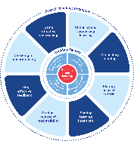
Enabling factors
Know students and how they learn
High expectations
Teachers understand how learning happens, and this informs their practice.
Students benefit from teachers holding high expectations for their learning.
Know the content and how to teach it
Safe, inclusive learning environments
Teachers know how the knowledge builds and connects to create learning that is strategic, sequenced and cumulative.
Explicit teaching both relies on, and brings about, a safe and inclusive learning environment.
Notes:
Purpose: Revisiting core knowledge
[00:30]
Speaker notes:
Let’s remind ourselves that explicit teaching is an optimal way to teach knowledge and skills that are new or complex.
There are important enabling factors for explicit teaching that relate to the technique we are focusing on. Let’s revisit them.
Note to presenter: you may wish for participants to read these to themselves
Our understanding of the how learning happens informs our practice
We know how knowledge builds across syllabuses
We hold high expectations for our students’ learning
And, explicit teaching both relies on, and brings about a safe, inclusive learning environment
Resources:
Leading explicit teaching – school-facilitated workshops 1–3 on core content and the enabling factors of explicit teaching – https://education.nsw.gov.au/teaching-and-learning/curriculum/explicit-teaching/leading-explicit-teaching
Classrooms of Possibility – https://education.nsw.gov.au/inside-the-department/teaching-and-learning/classrooms-of-possibility
Explicit instruction – implementing evidence-based teaching practices for students with disability - https://resources.education.nsw.gov.au/detail/IPR-LD230526144351
Strong Strides Together: Meeting the educational goals for Aboriginal and/or Torres Strait Islander students – https://education.nsw.gov.au/teaching-and-learning/aec/universal-resources---aboriginal-education/strong-strides-together--meeting-the-educational-goals-for-abori

Slide 6
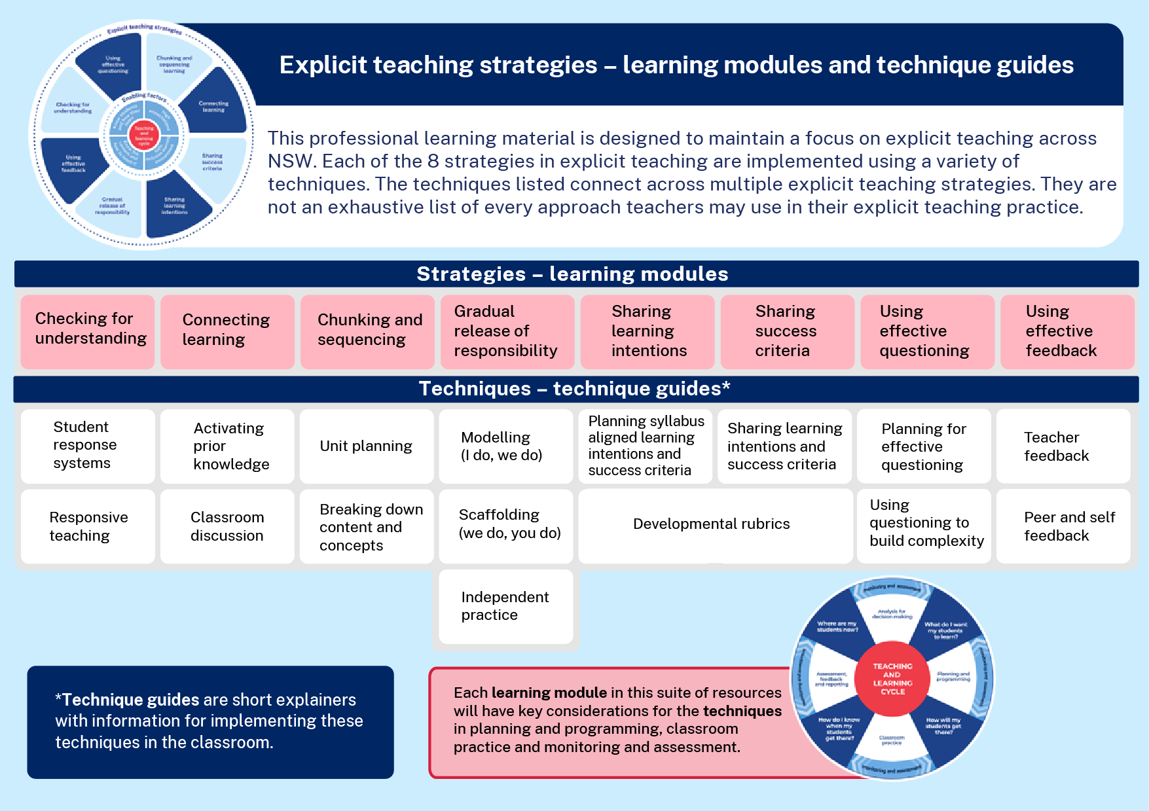
Learning modules and technique guides
Notes:
Purpose: To highlight where this module fits with other current and future modules and technique guides.
[00:30]
Speaker notes:
This module looks at one of the 8 explicit teaching strategies, connecting learning and some techniques for this strategy, activating prior knowledge and classroom discussion. Note that the remainder of these learning modules and the corresponding technique guides will have staggered release dates.

Slide 7

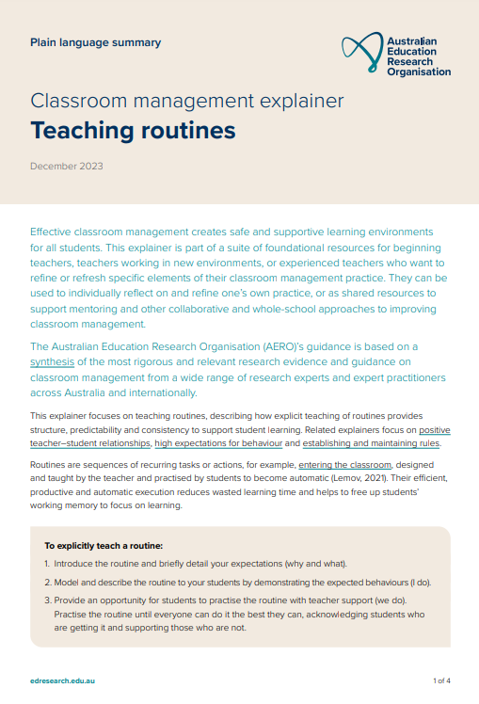
The importance of all moving together (1)
Saves learning time¹
Frees up students’ working memory²
Certain and consistent expectations for students³
Students learn the routine more quickly when it is done in the same way across the school⁴
Fosters a strong sense of belonging⁵
Notes:
Purpose: to restate why a whole school teaching routine is powerful
[00:30]
Speaker notes:
These modules use the power of whole school teaching routines. When a group of expert teachers from across the school come together and create a whole school approach, they are far more effective than when they go it alone. Teaching routines:
[click] save learning time
[click] can free up students’ working memory
[click] provide certainty and expectations for students to contribute to a learning environment where they’re safe to participate.
[click] They’re efficient, because when done the same way across the school, students can learn the routine more quickly.
[click] and they foster a strong sense of belonging.
As we go through the learning module here, and other learning modules for explicit teaching we will revisit the idea of the whole school teaching routines.
References:
1. Archer A and Hughes C (2011) Explicit instruction: effective and efficient teaching, Guilford Press.
2. AERO (Australian Education Research Organisation) (2021) Focused classrooms: managing the classroom to maximise learning, AERO.
3. AERO (Australian Education Research Organisation) (2023a) Teaching routines: their role in classroom management, AERO.
4. McCrea (2020) Motivated teaching, Createspace Independent Publishing Platform.
5. McCrea (2020) Motivated teaching, Createspace Independent Publishing Platform.
Further reading:
Tharby A (12 May 2023) We are what we do: the case for explicit and consistent school-wide routines Class Teaching, find the bright spots blog, accessed 20 November 2024.

Slide 8
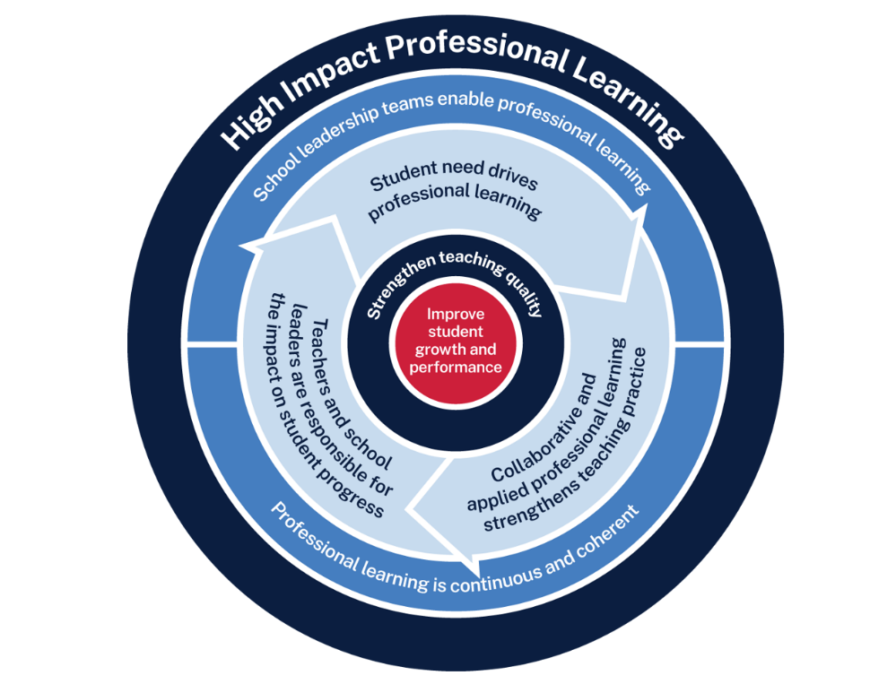
Connecting learning professional learning
Measure baseline student data and set a goal
Analyse data to determine further cycles
Use the whole-school teaching routines and, together, plan the questions they will ask
Implement the teaching routine in the classroom and measure impact
Rehearse and give each other feedback
Notes:
Purpose: Familiarising High Impact Professional Learning model (HIPL) and how it may inform our implementation of explicit teaching.
[01:00]
Speaker notes:
The High Impact Professional Learning (HIPL) model forms the basis of this professional learning. This model has five elements.
Professional learning is driven by identified student needs
School leadership teams enable professional learning
Collaborative and applied professional learning strengthens teaching practice
Professional learning is continuous and coherent
Teachers and school leaders are responsible for the impact of professional learning on student growth and performance
The actions and steps we take to enact each of these elements will be shaped by our increasing shared understanding of connecting learning strategy and how specific connecting learning techniques can be used to optimise the learning of our students.

Slide 9
Initial reflection point (1)
Teacher observation | 0 | 1 | 2 | 3 | 4
When activating prior knowledge before starting new learning, can my students retrieve previous learning? | Not yet observable | Minimal students can retrieve recent learning | Some students can retrieve recent learning | Most students can retrieve learning over longer periods time | All students can retrieve learning over longer periods time
Notes:
Purpose: Initial teacher collected data as an early indicator.
[02:00]
Speaker notes:
An initial indicator is an observable change in student learning. It can help teachers to understand how effective their use of a technique may be. Initial indicators are important because they can give teachers insights into what parts of the instruction may need to be refined.
Here is an example of a tool that could be used for teacher reflection. This is one way to measure one aspect of the effectiveness of connecting learning.
We will be able to refer to our early indicator observations when we evaluate our impact in Part C.
Note to presenter: There is an opportunity to use this data in the final session. This measure is not the only consideration, and schools should select a model that is right for them.
This data could be collated and compared to other “school and classroom data about growth and performance.”
For example:
NAPLAN report overview accessed through Scout
https://education.nsw.gov.au/about-us/education-data-and-research/scout/training/digital-learning-centre/naplan-report-overview
NAPLAN report overview
Learn more about the NAPLAN reports in Scout.
https://education.nsw.gov.au/about-us/education-data-and-research/scout/scout-overview/apps-and-reports/naplan---doe/class-report#tabs0
Class report
The Class report shows the distribution of students’ scaled scores across domains and proficiency levels for NAPLAN 3, 5, 7 or 9.
References:
AERO (Australian Education Research Organisation) (2023b) How students learn best: an overview of the learning process and the most effective teaching practices, AERO.

Slide 10




Planning and rehearsing (1)
Plan
Rehearse
Feedback
Evidence for Learning (2022) Effective professional development, Evidence for Learning.
Notes:
Purpose of slide: To explain the process of rehearsing
[01:10]
Speaker notes:
[click] plan number of suitable questions or activities ready
[click] deliver the instruction as if doing it in class.
[click] then partners can provide feedback - what may need to be added, changed, enhanced or deleted?
Note to presenter: it is advisable to prepare the leaders beforehand if modelling and rehearsing are not yet established practices in the school.
Further reading on this research:
AERO (Australian Education Research Organisation) (2023c) Classroom management practice guide: gaining all students’ attention, AERO.
Evidence for Learning (2022) Effective professional development, Evidence for Learning.
Sims S, Fletcher-Wood H, O’Mara-Eves A, Cottingham S, Stansfield C, Van Herwegen J and Anders J (2021) What are the characteristics of teacher professional development that increase pupil achievement? A systematic review and meta-analysis, Education Endowment Foundation.

Slide 11
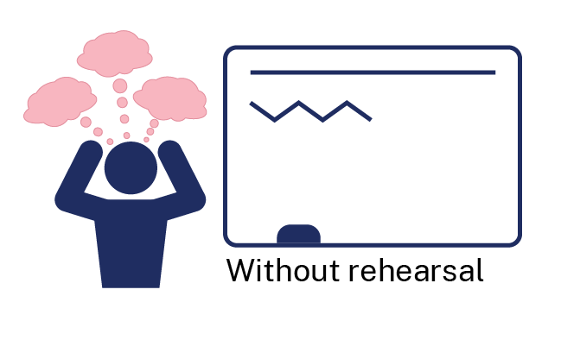
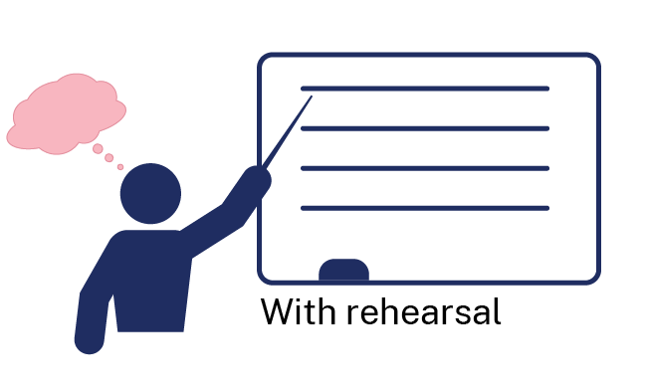
Rehearsal (1)
Notes:
Purpose of slide: To explain why rehearsing is so important
[01:10]
Speaker notes:
Application is a real key to success in professional learning.
Why might professional learning not be applied in the classroom, despite our best intentions?
Teachers often have practices described to them – but it is much clearer to have lead teachers model the practice (out of the classroom, without students) while the observer uses prompts to reflect on what made that practice successful.
Teaching is a habit-forming practice. By necessity, teaching requires us to automate a number of behaviours. The cognitive load on teachers to introduce a new behaviour is high and so we often rely on those previously formed habits.
Rehearsal (out of the classroom, without students) makes our PL a habit. When we try a rehearsed routine in a classroom, our cognitive load is reduced because we have one thing to think about, rather than 4 or 5.
This is why rehearsing is a key mechanism for success in professional learning.
References:
Evidence for Learning (2022) Effective professional development, Evidence for Learning.

Slide 12
Overview of this module
Part A – Understanding the strategy
Part B – Implementing the strategies through techniques
Part C – Evaluating a whole-school approach
Notes:
Purpose: Outline the learning sequence in this module.
[00:30]
Speaker notes:
In this module, the focus is on connecting learning and selecting the optimal techniques for students in your class.
We will then develop teaching routines as a whole school to reduce cognitive load for our students, giving them the best opportunity for routines to benefit their learning outcomes.
We will evaluate the impact of our work in terms of how effectively the approach has met the student need we've identified as the focus for our professional learning. We will do this by considering the short-term outcomes and the potential longer term learning outcomes for our students.

Slide 13
Understanding the strategy
Part A

Slide 14
Purpose and outcome (1)
Purpose
To understand the mechanisms of connecting learning in the context of managing cognitive load, schema development, and optimising student understanding, engagement and participation.
Outcome
We can articulate how and why we support students in retrieving prior learning and making connections with new learning.
Notes:
Purpose: Purpose and outcome of Part A
[00:30]
Speaker notes:
This strategy learning module focuses on teachers identifying key prior knowledge and designing activities for students to recall this knowledge. Then connections between existing and new knowledge can be made.
The purpose of Part A is:
To understand the mechanisms of connecting learning in the context of managing cognitive load, schema development, and optimising student understanding, engagement and participation.
Working towards the outcome that:
We can articulate how and why we support students in retrieving prior learning and making connections with new learning.

Slide 15
Knowledge is stored in schemas
Knowledge schema
concept
fact
procedure
Notes:
Purpose: To present a simple idea of schema before introducing more complex ideas
[00:30]
Speaker notes:
The brain stores information in long-term memory in groups of interconnected information we call schema, or mental models (AERO 2024; CESE 2017). This simple model shows a knowledge schema containing concepts, procedures, and facts.
References:
Adapted from AERO (Australian Education Research Organisation) (2024) Managing cognitive load optimises learning, AERO.
CESE (Centre for Education Statistics and Evaluation) (2017) Cognitive load theory: research that teachers really need to understand, NSW Department of Education.

Slide 16
Knowledge sticks to knowledge
Prior knowledge
Without prior knowledge
new
new
new
new
new
new
Notes:
Purpose: To present a simple idea of new knowledge connecting to existing knowledge
[00:30]
Speaker notes:
Knowledge sticks to knowledge.
Here we see a student’s prior knowledge that has been recalled. When the new learning is introduced, it can be connected to this schema.
[click]
But if there isn’t a schema available, or if the schema isn’t recalled, new knowledge has nowhere to connect to and it is easily forgotten.

Slide 17
Why connecting learning is important
Students learn most efficiently when they retrieve what they already know (prior knowledge) and then actively process that information with new knowledge to make connections between what is known and new learning.
Teachers support students to recall and make connections. This is how students develop more complex schemas and deeper understanding of the relationships that exist between ideas and concepts.
Notes:
Purpose: Key idea as we focus on connecting learning
[00:30]
Speaker notes:
[participants may read the slide text first]
This workshop will focus on the way memory works and how making and strengthening connections between what is known and new learning supports students to learn new information more efficiently.
Connecting learning supports students understanding, ability to recall information, student engagement and when connections are made between different sections of what is already known, complex schema are developed.

Slide 18
Working memory ‘test’ (1)
Without writing anything down remember this string of letters
OBX PMA PLI GDO NSU YEK ARJ LWO UNR
Notes:
Purpose: Demonstration of connecting learning (1)
[2:00]
Speaker notes:
Activity instructions: Instruct your participants to not write anything down.
On [click] a string of letters will appear.
Show this string of letters for about 15 seconds, then [click] again to remove them.
Ask participants to recall as many of the letters as they can (correctly).
See who remembered the most, discuss the difficulty of this task.

Slide 19
Working memory ‘test’ (2)
Without writing anything down remember this string of letters
BOX MAP LIP DOG SUN KEY JAR OWL RUN
Notes:
Purpose: Demonstration of connecting learning (2)
[2:00]
Speaker notes:
Activity instructions:.
On [click] the same letters as the previous slide will appear, but now arranged as words.
Show this string of words for about 15 seconds, then [click] again to remove them.
Ask participants to recall as many of the letters as they can (correctly). See who remembered the most
Discuss the relative difficulty of this task compared to when the letters were not arranged in meaningful chunks.
Most participants should find it easier to remember more letters when they have been arranged as words, this is because to remember the letters in the first activity each letter occupied a space in working memory, but when those letters were arranged as meaningful schemas (words known to the brain) each set of 3 letters only occupied one space (instead of three).

Slide 20
The role of memory in connecting learning
Working memory is like the brain's ‘workspace’. It is where the brain stores and processes small amounts of information for a short period of time (AERO 2023b).
Long-term memory stores large amounts of information for future use. The amount of information that can be held in long-term memory is potentially limitless (AERO 2023b).
Learning is a change in long-term memory.
Notes:
Purpose: Explain the role of memory in connecting learning
Time: [00:30]
Speaker notes:
Remembering learning from Workshop 2: How learning happens, lets discuss the role of memory in learning.
Working memory is like our cognitive ‘workspace’ where we store and process small amounts of information for a short amount time. In most people, it is limited to about 4 – 7 spaces.
Long term memory stores large amounts of information for future use. The amount of information that can be held in long term memory is potentially limitless, but we can ‘forget’ information from long term memory (CESE 2017).
This is important to always have front of mind, because learning is a change in long term memory (AERO 2023b).
References
AERO (Australian Education Research Organisation) (2023b) How students learn best: an overview of the learning process and the most effective teaching practices, AERO.
CESE (Centre for Education Statistics and Evaluation) (2017) Cognitive load theory: research that teachers really need to understand, NSW Department of Education.

Slide 21
Connecting learning – How does it work?
A schema occupies one space in working memory
New concept
New fact
Available ‘spaces’ in working memory
Notes:
Purpose: How connecting learning works
[0:30]
Speaker notes:
When a schema is recalled from long-term memory, it occupies one space in working memory.
Then new learning can be introduced and assimilated into the existing schema.

Slide 22
Helping to build a schema (1)
‘Atoms’
small
nucleus
electrons
Notes:
Purpose: Connecting ideas to build a schema (1)
[01:00]
Speaker notes:
In this example, the teacher begins by prompting the students to recall their concept of ‘small’ before introducing new learning on ‘atoms’.
[click]
The teacher then introduces 2 more new ideas ‘nucleus’ and ‘electrons’
There is a consolidation activity where students process this schema into long-term memory.
References:
AERO (Australian Education Research Organisation) (2022a) Explicit instruction, AERO.

Slide 23
Helping to build a schema (2) - 2
‘Atoms’
small
nucleus
protons
neutrons
electrons
Available ‘spaces’ in working memory
Notes:
Purpose: Connecting ideas to build a schema (2)
[01:00]
Speaker notes:
In the next part of the lesson, new information can be presented and connected to the existing knowledge about atoms.
This schema now only occupies one space in the working memory, so students can hold that concept in their working memory and connect the new information. [click]
References:
AERO (Australian Education Research Organisation) (2022a) Explicit instruction, AERO.

Slide 24
Helping to build a schema - 3
‘Atoms’
protons
small
nucleus
electrons
neutrons
Notes:
Purpose: Connecting ideas to build a schema (3) - animation slide only
Speakers notes:
With practice and retrieval, more information can be added such as the behaviour of atoms, atomic number, the different elements, etc which should all be connected back to the original concept or schema of an ‘atom’.
This demonstrates how learners develop more and more complex schemas.
References:
AERO (Australian Education Research Organisation) (2022a) Explicit instruction, AERO.

Slide 25
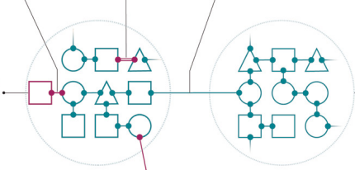
Making complex connections between schema
New connection
Strengthened connection
New connection between existing schemas
New knowledge
Notes:
Purpose:
[00:30]
Speaker notes:
Once students have developed schemas or mental models and encounter new knowledge, they can start to make new connections or strengthen existing connections.
“For example, students who have developed a mental model from learning about the features of insects, then mammals and then reptiles can draw from across these areas of learning to build more complex concepts like the relationships between the features and functions of these different animals, and how these features help them survive in the environments where they live” (AERO 2023:12).
References:
AERO (Australian Education Research Organisation) (2023a) How students learn best: an overview of the learning process and the most effective teaching practices, AERO.

Slide 26
What it isn’t
Asking students to find connections without teacher guidance.
Creating/sharing every possible connection across all KLAs.
Making references to previous activities students have completed without making clear how the learning from that activity is connected to new learning.
Assuming students have retained prior knowledge.
Notes:
Purpose: What it is and what it isn’t
Speaker notes:
[01:00]
What it isn’t
It is not asking students to find connections without teacher guidance – The teacher directs the recall of prior learning.
It is not creating/sharing every possible connection across all KLAs.
It is not making references to previous activities students have completed without making clear how the learning from that activity is connected to new learning.
It is not assuming students have retained prior knowledge – retrieval of the knowledge requires teacher prompting.

Slide 27




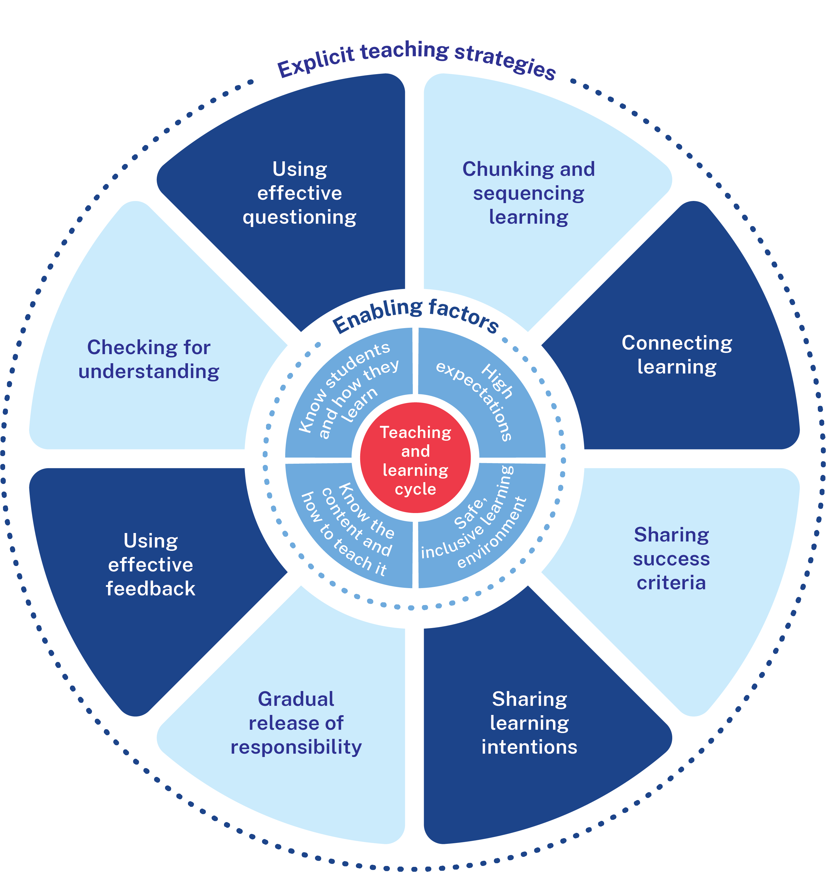
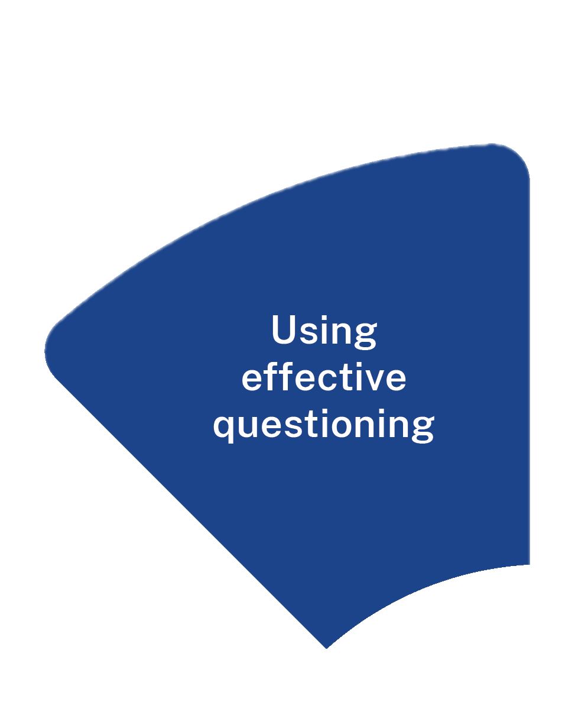
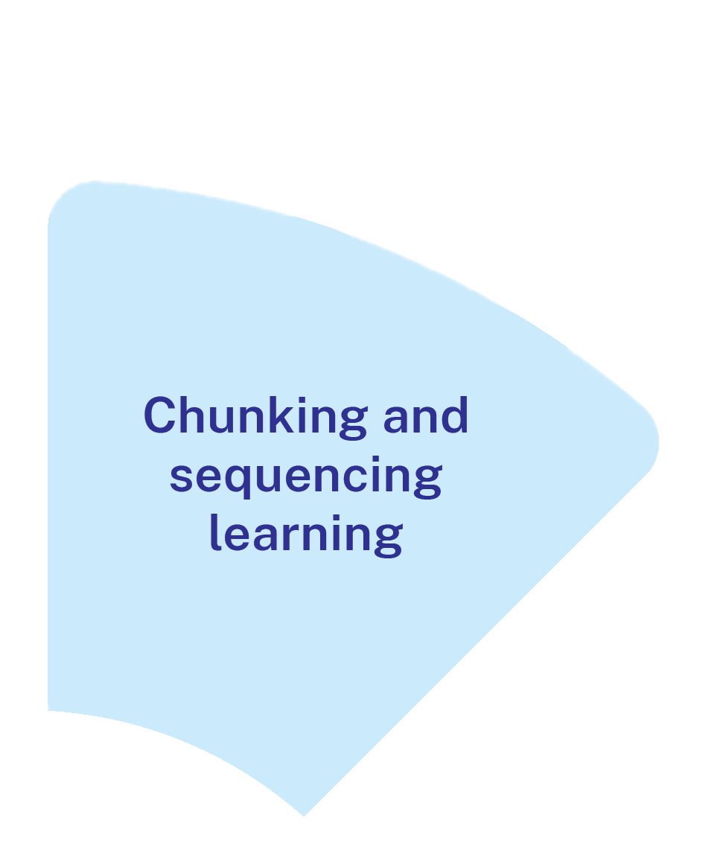
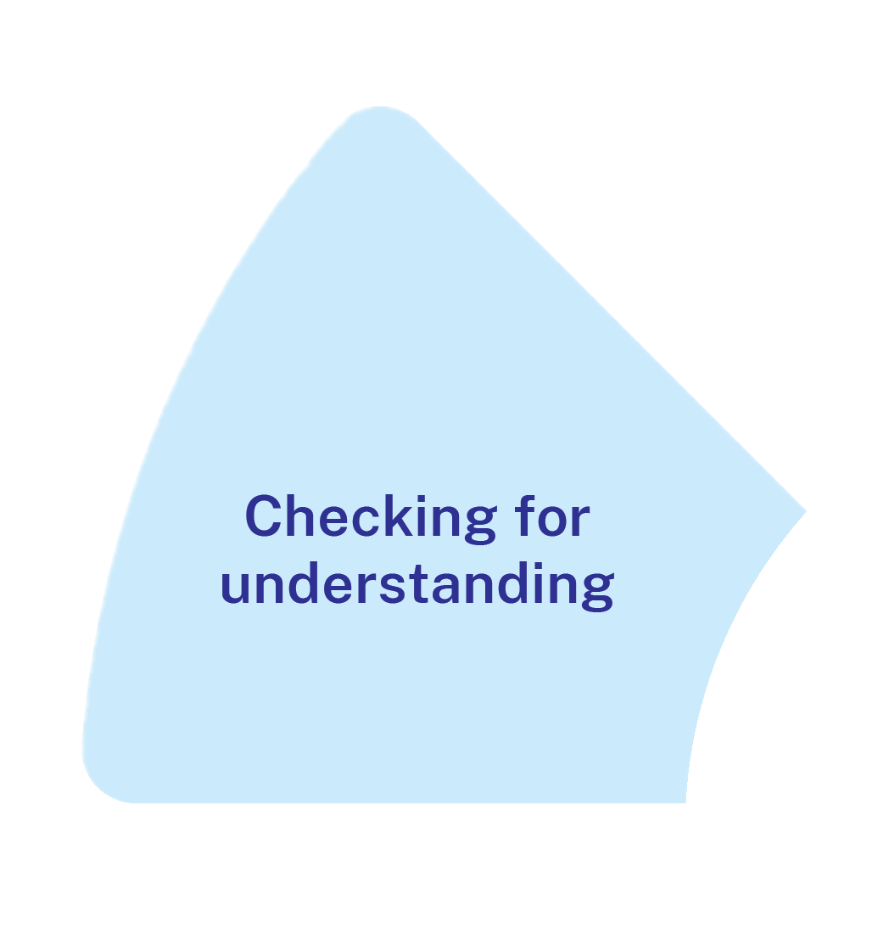
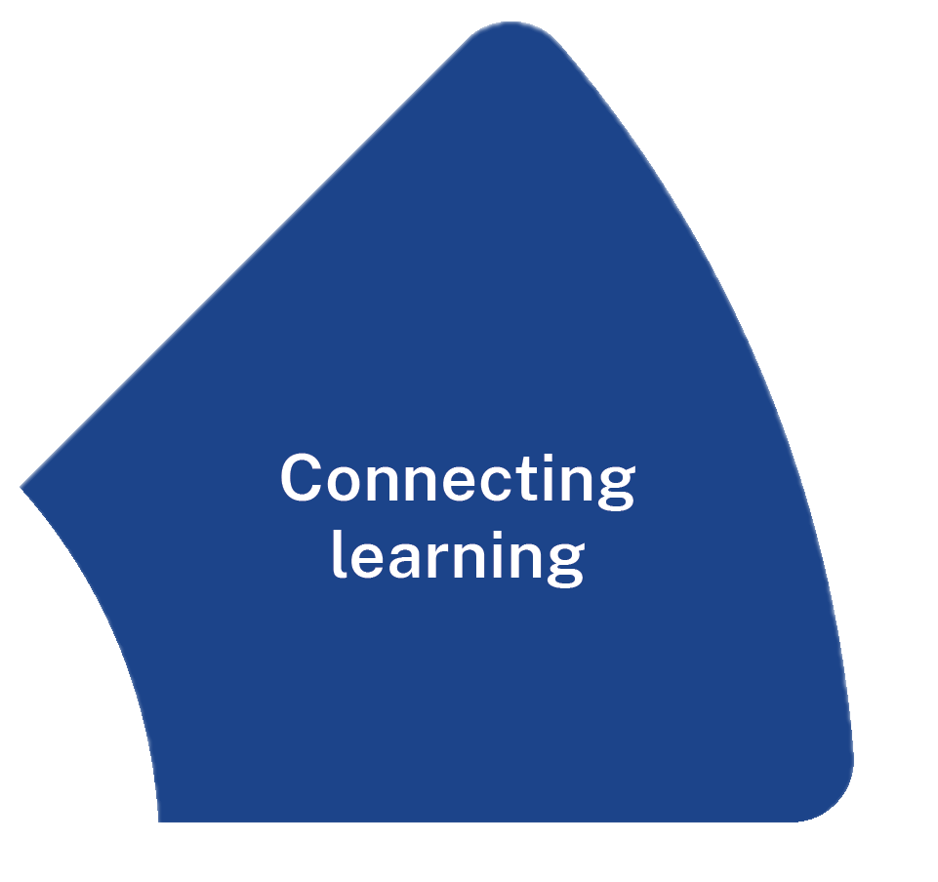
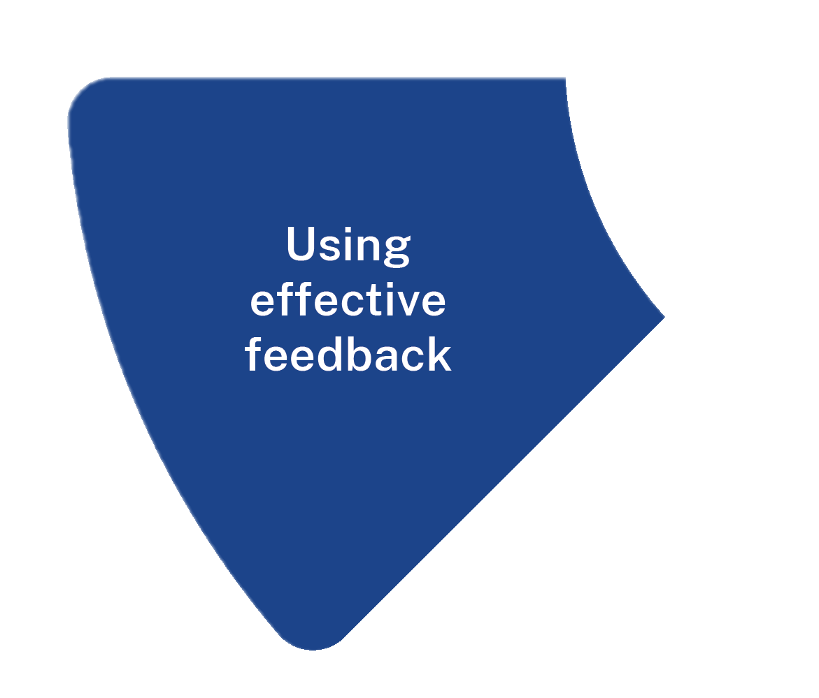
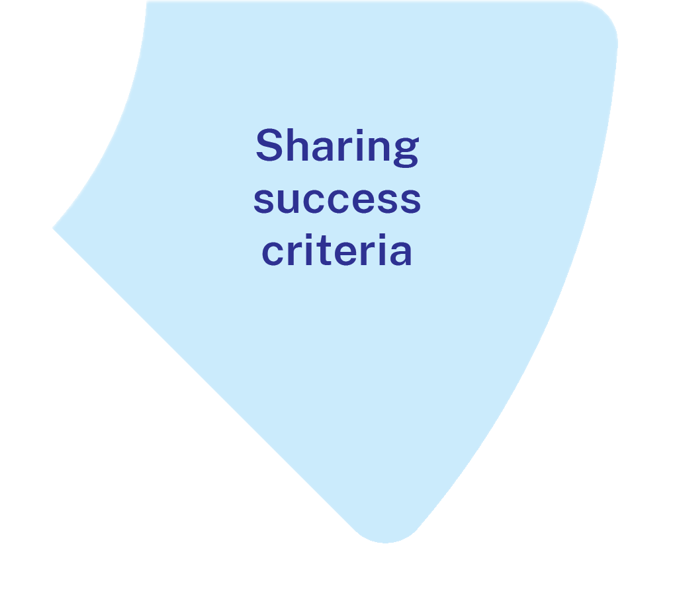
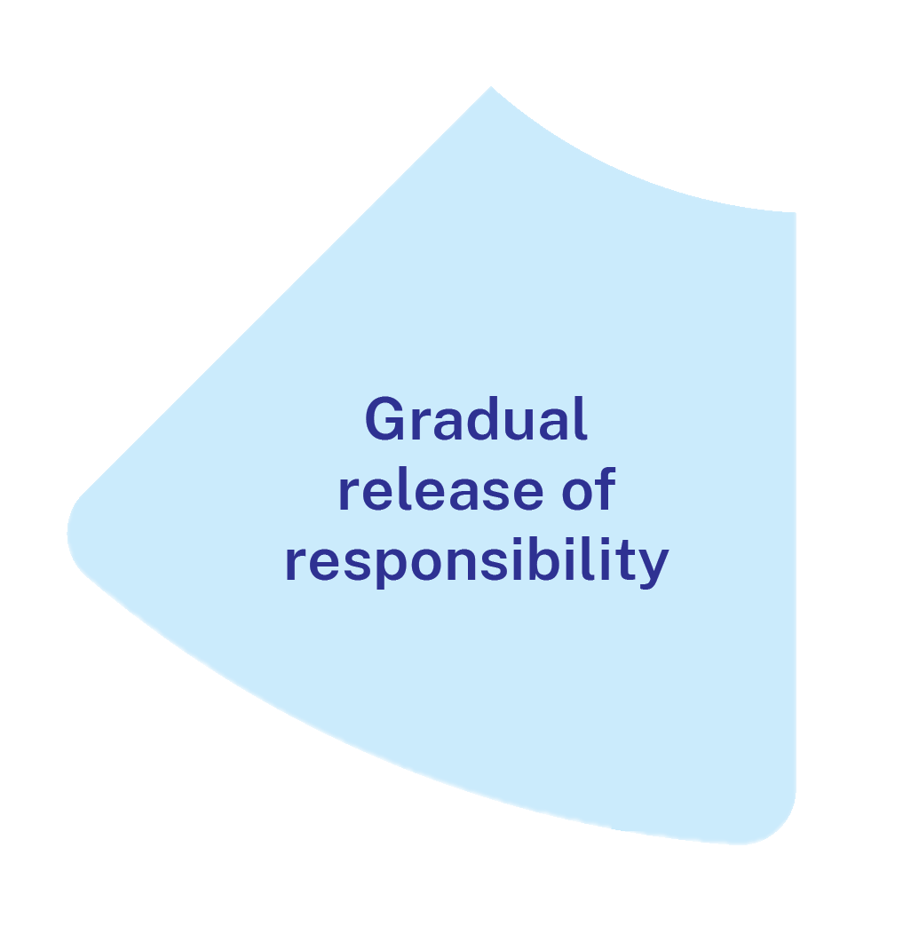

What it is
The recall of prior learning.
Supporting students to develop connections to prior learning.
Supporting students to develop connections to new learning.
Notes:
Purpose: Why connecting learning is an important explicit teaching strategy.
[01:15]
Speaker notes:
Students learn more effectively when new information is connected to existing knowledge and when students are reminded of these connections (AERO 2022).
Connecting learning supports:
Recall of prior learning – connected information, which we often call schema, is easier for the brain to recall/retrieve from long-term memory (Brown et al. 2014) the more connections the easier it is to recall (AERO 2022).
Student understanding – by making the connections between new information and what is already known we support students to understand new concepts more easily. This includes developing understanding of new concepts when they are connected to existing understanding – for instance when analogies are drawn between what is known and what is unknown, as well as developing deeper understanding of ideas and concepts as connections are made between schema to develop increasingly complex mental models (AERO 2023).
References:
AERO (Australian Education Research Organisation) (2022c) Mastery learning: planning and sequencing units to progress student learning, AERO.
AERO (Australian Education Research Organisation) (2023a) How students learn best: an overview of the learning process and the most effective teaching practices, AERO.
Brown P, Roediger H and McDaniel M (2014) Make it stick: the science of successful learning, Harvard University Press.

Slide 28
The mechanisms of connecting learning (1)
Teacher decides the essential prior knowledge
actively links to prior knowledge
Prompts students to retrieve prior knowledge into working memory
New knowledge is integrated in existing schema
Notes:
Purpose: The mechanisms of connecting learning
[00:30]
Speaker notes:
When connecting learning:
1. the teacher must decide what is the essential piece of prior knowledge that must be retrieved so the connection to new learning can be made
2. plan an activity or question to prompt students to retrieve that prior knowledge into their working memory, this might be a “do now” activity
3. keeping the prior knowledge in working memory, add a select few pieces of new information, ensuring the connections are made clear. The new information and it’s connections to each other and the exiting knowledge is consolidated using activities, so that
4. the new knowledge is integrated into long term memory as additions to an existing schema, or mental model.

Slide 29


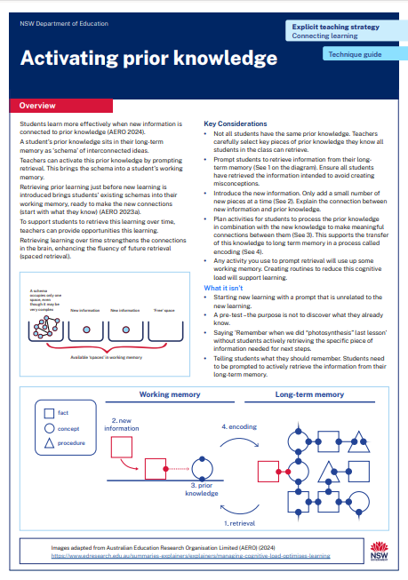
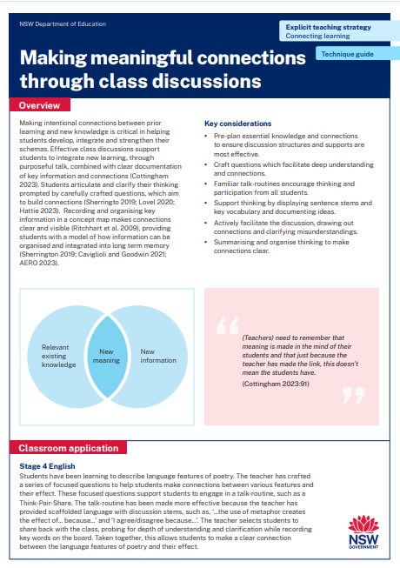
Activity 1 – Technique guide discussion
Read or revise – 10 min
Discuss – 10 min
Identify the key points in Activating prior knowledge technique guide or the Making meaningful connections through class discussions technique guide.
Describe the connections between the technique guide and the learning in Part A.
Notes:
Purpose: Deepen knowledge using connecting learning resources
[20:00]
Speaker notes:
We have had the opportunity to read [activating prior knowledge technique guide and/or the classroom discussions] technique guides. Now we can:
revisit that reading and identify the key points you observed.
discuss with your groups the connections you can make between the readings and the learning we have done in Part A so far.
Note to presenter: use your knowledge of you school context to decide which technique guide to have participants read. You may choose both or have half of the participants read one and the other half the other.
Connecting learning resources:
https://education.nsw.gov.au/teaching-and-learning/curriculum/explicit-teaching/explicit-teaching-strategies/connecting-learning

Slide 30
In the next part of this module, we will work on implementing the strategies through techniques. We will have the opportunity to plan and rehearse making connections.
Notes:
Purpose of slide: To orient into the next part of the module.
[00:20]

Slide 31
Implementing the strategies through techniques
Part B

Slide 32
Part B instructions
Part B contains multiple techniques. To use Part B:
It is recommended teachers engage with activating prior knowledge and class discussions technique guides prior to this part
Select a lesson to apply the techniques
Plan and rehearse with a colleague
Get feedback from your colleague.
Notes:
Purpose: To provide instructions on using Part B of the module.
[00:20]

Slide 33
Purpose and outcome (2)
Purpose
To understand how connecting learning can be enacted through teaching routines.
Outcome
To develop connecting learning techniques and routines by planning, rehearsing and developing these techniques for students in our school.
Notes:
Purpose of slide: Purpose and outcome of Part B
Speaker notes:
[00:20]
In this part, we're going to develop connecting learning techniques and routines.

Slide 34
The mechanisms of connecting learning (2)
Teacher decides the essential prior knowledge
actively links to prior knowledge
Prompts students to retrieve prior knowledge into working memory
New knowledge is integrated in existing schema
Notes:
Purpose: The mechanisms of connecting learning
[00:30]
Speaker notes:
When connecting learning:
1. the teacher must decide what is the essential piece of prior knowledge that must be retrieved so the connection to new learning can be made
2. plan an activity or question to prompt students to retrieve that prior knowledge into their working memory, this might be a “do now” activity
3. keeping the prior knowledge in working memory, add a select few pieces of new information, ensuring the connections are made clear. The new information and it’s connections to each other and the exiting knowledge is consolidated using activities, so that
4. the new knowledge is integrated into long term memory as additions to an existing schema, or mental model.

Slide 35
Activating prior knowledge
Technique A

Slide 36
Activating prior knowledge
Teachers design activities that prompt students to retrieve information from long-term memory.
Knowledge schema
concept
fact
procedure
Notes:
Purpose: What is activating prior knowledge?
Speaker notes:
[00:30]
We remember from our previous session the long-term memory stores our schemas of knowledge.
Teachers design activities that prompt students to retrieve a schema.
References:
Adapted from AERO (Australian Education Research Organisation) (2024) Managing cognitive load optimises learning, AERO.

Slide 37
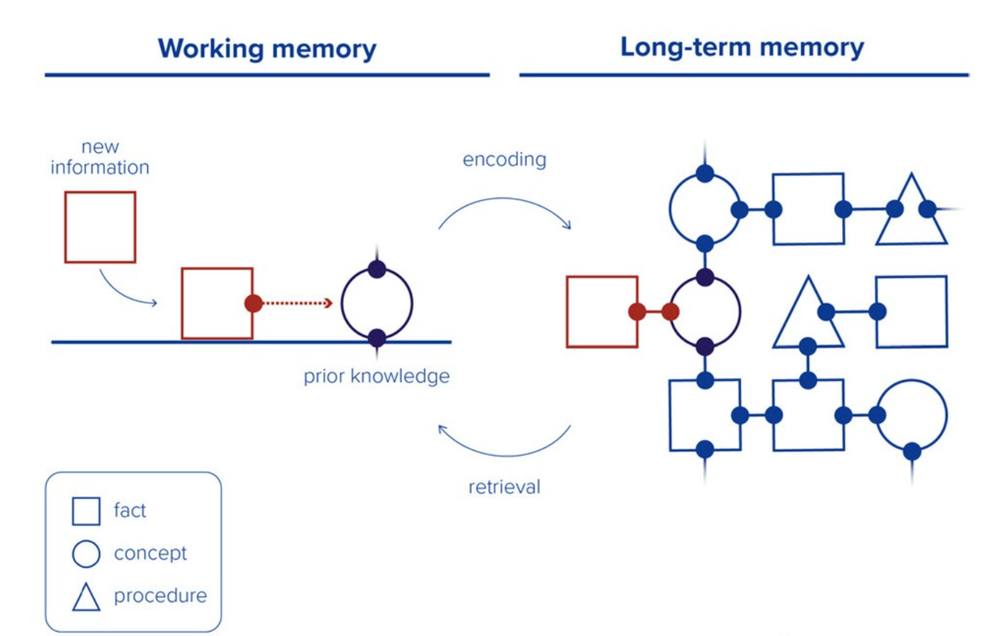

Activating prior knowledge – How does it work?
When prompted, students retrieve their existing knowledge schema from long-term memory.
It is then held in their working memory ready for an activity to connect new learning.
Notes:
Purpose: How does activating prior knowledge work?
Speaker notes:
[00:30]
When prompted, students retrieve their existing knowledge schema from long-term memory.
It is then held in their working memory ready for an activity to connect new learning.
This supports student understanding and engagement.
Any activity that prompts students to retrieve information from long-term memory into working memory activates prior knowledge.
References:
AERO (Australian Education Research Organisation) (2023b) How students learn best: an overview of the learning process and the most effective teaching practices, AERO.

Slide 38
Activating prior knowledge – Key considerations
Not all students have the same prior knowledge.
Use activities or prompts that encourage all student to actively retrieve information from their long-term memory.
Activating prior knowledge is important so that students connect pre-requisite knowledge with new learning.
Teachers may need to check for understanding to ensure the correct information has been retrieved and the correct connections are being made.
The more knowledge students have in long-term memory, the easier it is to attain new knowledge that builds on their existing knowledge base (AERO 2023c).
Notes:
Purpose: Key considerations for activating prior knowledge
Speaker notes:
[00:30]
Not all students have the same prior knowledge. For equity ensure you are only trying to retrieve information you know you have previously taught the students.
Use activities/prompts that encourage all student to actively retrieve information from their long-term memory, success is key so additional prompts or other ways of framing questions should be prepared.
Activating prior knowledge supports students to connect to existing, pre-requisite knowledge before learning something new.
Teachers may need to check for understanding to ensure the correct information has been retrieved, and/or the correct connections are being made. This will determine if changes need to be made to the planned lesson.
Resources:
You can access the check for understanding materials available here: Checking for understanding – https://education.nsw.gov.au/teaching-and-learning/curriculum/explicit-teaching/explicit-teaching-strategies/checking-for-understanding
References:
AERO (Australian Education Research Organisation) (2023d) Knowledge is central to learning, AERO.

Slide 39

Before introducing new learning
Decide the essential prior knowledge that students will be able to retrieve that is going to be connected to new learning.
Then, decide how you will prompt them to retrieve that information.
Notes:
Purpose: The importance of planning for activating prior knowledge
Speaker notes:
[00:15]
Before considering what activity should be used to activate prior knowledge, the first step is to decide the essential prior knowledge you need students to retrieve so that the new information can be connected to it, remembering working memory is limited.
Plan the connections you are going to make once the prior knowledge is retrieved, and the activity students will do to consolidate the connections.

Slide 40
Prompting retrieval
Students can be supported to retrieve prior learning by:
Verbal cues or prompts.
Displaying parts of a visual and adding to it as required.
Asking questions.
Quizzing.
Example:
Record the three main events that happened in the story we read last lesson.
Additional prompts might be given, ‘What happened when Jo rode her bike?’
This is then directly followed by new learning about narrative structure in the story.
All students need to successfully retrieve prior knowledge if they are to connect new learning to it.
Notes:
Purpose: Prompting retrieval
Speaker notes:
[01:00]
To activate prior knowledge, students need to be prompted to retrieve it from long term memory and then use it to process a cognitive task in the working memory.
Students should be supported to experience success in the process of retrieving. Consider additional prompts should students not successfully retrieve the required information on the first or subsequent attempts.
References:
AERO (Australian Education Research Organisation) (2022b) Spacing and retrieval, AERO.
AERO (Australian Education Research Organisation) (2023b) How students learn best: an overview of the learning process and the most effective teaching practices, AERO.

Slide 41
Quizzing before introducing new learning
A very brief set of focused questions designed so that:
The questions are only relevant to the prior knowledge students need to retrieve.
You expect most students will be able to answer all questions.
The number of questions is limited to focus on essential pre-requisite knowledge – balancing prompting retrieval of prior learning and managing limitations of working memory.
Design the questions with success in mind.
This is not a pre-test – the purpose is not to discover what they already know.
The purpose is to retrieve what they have already been taught, ready for the new learning.
Notes:
Purpose: Quizzes for activating prior knowledge
Speakers notes:
[01:00]
A brief quiz at the start of a lesson or before introducing new learning is ONE way to have students retrieve prior knowledge. The benefits of a quiz include they can be a routine that all students are (or can become) familiar with, reducing cognitive load, and it can be a straightforward way to have all students retrieve knowledge from long term memory.
A quiz for activating prior knowledge should be short and focus only on essential pre-requisite knowledge for the new learning.
Some points to consider when designing questions:
Questions are relevant to the specific piece of prior knowledge students need to retrieve.
Questions could be multiple choice or short answer. ‘Why’ questions can be useful, for example, ‘Why is this a clause rather than a sentence?’ (Wiliam 2011).
Design the questions with the expectation that most students will be able to answer the questions, and all students will get there with some additional prompting if needed. Think of some prompts you could use for those students who may need it or think of other ways to phrase the question/s so that students can retrieve the necessary prior information.
Teachers can choose the level of cognitive effort within a quiz by adding/removing cues and prompts.
References:
Wiliam D (2011) Embedded formative assessment, Solution tree press.

Slide 42
Turn and talk (1)
Turn to the person next to you and explain how retrieving expected pre-requisite knowledge before introducing new learning helps students.
Notes:
Purpose: Activity
[02:00]
Notes to presenter: This activity could be done followed by selecting non-volunteers to share their dialogue.

Slide 43
Class discussions (1)
Technique B

Slide 44


Class discussions (2)
From one to one
To everyone thinking and contributing
Notes:
Purpose: What is class discussion? Non-example and example of a meaningful class discussion
Speaker notes:
[02:00]
One view of classroom discussions are where the teacher directs questions to one student at a time. This first picture shows the teacher having an interaction with one student at a time. This limits the interaction and opportunity to connect ideas between students. Classroom discussions can be improved by structuring interactions between students as well as with the teacher. The second picture shows dialogue between students in the classroom as they connect their ideas.
References:
AERO (Australian Education Research Organisation) (2023d) Knowledge is central to learning, AERO.
Cottingham S (2023) Ausubel's meaningful learning in action, Hodder Education Group.
Hattie J (2023) Visible learning, the sequel: A synthesis of over 2,100 meta-analyses relating to achievement, Routledge.
Lovell O (2020) Sweller's cognitive load theory in action, John Catt Educational Limited.

Slide 45
Class discussions – How does it work?
Example of class discussion
Plan and ask questions to elicit thinking
Structure time for thinking and sharing in pairs or groups
Circulate and listen for understanding
Cold call planned questions
Cold call prompts to agree, add, or disagree with a student’s response
Notes:
Purpose: An example of how class discussion works
Speaker notes:
[02:00]
Here is an example:
Teachers set an effective discussion question ensuring that it links to the learning intentions and success criteria. Students are given time to think about their response to the question.
Students share their ideas and talk through their understanding with a partner or small group. While students are talking the teachers actively listens to student ideas and check for understanding of the concepts that were taught. The teacher can correct where needed.
During the whole class discussion, teachers mix up cold call and or other techniques such as gesture voting.
Teachers can scaffold thinking using sentence stems, vocabulary and probing questions.
Teachers can ask probing questions to clarify, connect, extend and refine thinking.
Teachers can ask their planned questions and then ask students to give reasons why they agree or disagree with the answers given. Students can be prompted to add, compare or contrast the responses given. This encourages students to attend to each other’s responses so that they can participate in deeper critical interrogation of concepts.
References:
Sherrington T (19 December 2023) ’Meaning making and the power of students talking things through – a common missing piece’, teacherhead blog, accessed 16 September 2024.

Slide 46
Class discussions – key considerations
Teach key learning and check for understanding
Example of class discussion
Plan and ask questions to elicit thinking
Structure time for thinking and sharing in pairs or groups
Circulate and listen for understanding
Cold call planned questions
Cold call prompts to agree, add, or disagree with a student’s response
Teacher creates a summary of discussion
Notes:
Purpose: Key considerations for effective classroom discussions
Speaker notes:
[02:00]
It is important that the classroom discussion comes after the students have been taught the key learning and the teacher has checked this understanding. If discussion came before student understanding, (or before the formation of their schema), the number of connections they would be able to make would be limited. There is also a risk that misunderstandings can be compounded. This is why classroom discussions are best positioned later into a sequence of learning.
After the discussion the teacher summarises and records student understanding and the key ideas of the concepts for students to refer back to in future lessons.
Reference:
Sherrington T (19 December 2023) ’Meaning making and the power of students talking things through – a common missing piece’, teacherhead blog, accessed 16 September 2024.

Slide 47
Crafting questions
Discussion questions should encourage students to:
explain and elaborate their thinking
compare and contrast new and existing knowledge
identify and explore conflicting ideas
challenge assumptions and misunderstandings
clarify and refine their thinking, adding depth and accuracy.
Examples
How are … and … similar?
Is … always true?
What are some advantages/disadvantages to … ?
Using what you know about ... , how would you … ?
What conclusions can you draw about ____?
What are some potential contradictions in these theories?
Notes:
Purpose: Understand how questions can be crafted to help make meaningful connections
Speakers notes:
[02:00]
Questions should be designed with the purpose of learning clearly in mind. In the context of making meaningful learning connections, students need opportunities to meaningfully integrate the new idea with the related existing knowledge and reconcile it with conflicting or confusable ideas (Cottingham 2023).
I'll give you a moment to read some considerations when crafting a question to connect learning.
References:
Cottingham S (2023) Ausubel's meaningful learning in action, Hodder Education Group.

Slide 48
Supports and scaffolding
Examples
How do you know this?
Can you give me an example of that?
That’s interesting, what makes you say that?
Does anyone else agree? Why?
What evidence supports this assumption?
What additional details could make this argument stronger?
What led you to this conclusion?
Probing questions should encourage students to:
probing for understanding
check for misconceptions
add extra challenge
provide scaffolding to engineer success.
Notes:
Purpose: Support and scaffolding to help students make meaningful connections
Speakers notes:
[02:00]
Teachers can guide and support students to develop depth and clarity in their responses by using well-planned, probing questions. After a students’ response, the teacher asks a series of follow-up questions before moving on, ‘probing for understanding, checking for misconceptions, adding extra challenge and providing scaffolding to engineer success’ (Sherrington 2019:30).
Examples of probing questions are in the blue box on the slide.
Always remember to allow sufficient wait time for all students to think of their answer before they are expected to respond.
References:
Sherrington T (2019) Rosenshine’s principles in action, John Catt Educational Limited.

Slide 49
Scaffolding language
Students think about what we want them to remember (Willingham 2009)
Scaffolds enable all to participate in making meaning (Sherrington 2023)
Displaying creates an external memory field, reducing cognitive load (Caviglioli and Goodwin 2021).
Stage 2 vocabulary example:
Purpose: connection between fractions and decimal notation
Terms displayed: tenths, hundredths, decimal point, equivalent, benchmark fraction
Sentence stems could include:
In my opinion...
I agree/disagree with ___ because …
Building on _ _ _’s answer ...
Notes:
Purpose: Understand how scaffolding language support students to make meaningful connections
Speakers notes:
[02:30]
We are going to look at how displaying key vocabulary and sentence stems during the discussion provides a scaffold to support students' to make meaningful connections.
Firstly, students focus their thinking on what we want them to remember (Willingham 2009)
What we think about is what we remember, so it’s important for teachers to consider what students are having to think hard about when doing a task (Willingham 2009). When the purpose of the class discussion is connect learning, we want to students to focus their thinking on deepening their understanding to connect, integrate and reconcile new learning with prior knowledge. These connections change long term memory and strengthen schemas.
Scaffolding enables all to participate in making meaning (Sherrington 2023).
Scaffolding provides targeted support to help students think about and organise their ideas during discussions, enabling them to often generate more sophisticated responses than they would without such guidance (Sherrington 2021).
Displaying key vocabulary for the topic and clarifying meanings before students begin thinking, activates prior knowledge and aids them in understanding, processing, and making sense of the material (Cottingham 2023). For example, when discussing the connection between fractions and decimal notation in Stage 2, vocabulary terms such as tenths, hundredths, decimal point, equivalent, benchmark fraction could be displayed. Sentence stems support students to frame and connect their thinking. Some examples are displayed.
Another reason for displaying scaffolds is that they create an external memory field, reducing cognitive load (Caviglioli and Goodwin 2021).
When vocabulary and sentence stems are displayed for the duration of the discussion, students can continually refer to them as they prepare and share their responses, allowing them to spend their working memory thinking more about ‘what to say’ without the added cognitive load of ‘how to say’. It is important that only essential vocabulary and sentence stems are displayed, to focus students’ attention on what is important and reduce potential overload.
Teachers should refer to the displayed vocabulary and stems during the discussion to model correct use, including restating responses in a more sophisticated and clear manner or by asking students to clarify and refine their thinking using the language displayed.
References:
Caviglioli O and Goodwin D (2021) Organise ideas: thinking by hand, extending the mind, John Catt Educational Limited.
Cottingham S (2023) Ausubel's meaningful learning in action, Hodder Education Group.
Sherrington T (7 May 2023) ‘Teaching some vs teaching all: this is where the action for improvement lies’, teacherhead blog, accessed 4 October 2024.
Sherrington T (1 December 2021) ‘Five ways to: scaffold classroom dialogue’, teacherhead blog, accessed 4 October 2024.
Willingham D (2009) Why don't students like school? A cognitive scientist answers questions about how the mind works and what it means for the classroom, Jossey-Bass/Wiley.

Slide 50
Talk routines
Provide an opportunity for all students to think and make meaning through talk.
Some examples include:
Think-pair-share | Talk moves – Turn and talk
Students think about a question individually, then pair up to discuss their thoughts before sharing with the larger group. | Students rehearse and clarify a response with a partner before sharing it with the whole group.
Notes:
Purpose: Understand how talk routines support students to make meaningful connections
Speakers notes:
[01:30]
Often in class discussions, only some students talk (remembering that we are referring to any method that effectively externalises thinking). Considering that purposeful, deep talk supports students to make meaning, the implication of only some students talking is that only some students are thinking and making meaning.
Talk routines provide an opportunity for all students to think and make meaning as all students have the opportunity to talk. In order for a talk routine to become a ‘routine’ for students, teachers should spend time establishing and consolidating expectations on participation and engagement to ensure every student feels safe and comfortable to participate, allowing them to focus on the thinking required to make connections. Introduce routines slowly and intentionally and only use routines that are highly familiar to students when learning involves deep thinking and complex connections.
There are many talk routines available, providing variations on how students engage with their peers and the class to serve a particular purpose.
Some examples of talk routines include:
- Think –pair –share where students think about a question individually, then pair up to discuss their thoughts before sharing with the larger group.
- Talk moves such as Turn and talk, where students rehearse and clarify a response with a partner before sharing with the whole group.
Further reading:
NSW Department of Education (14 July 2023) Talk moves, NSW Department of Education.

Slide 51
Recording thinking
creating a stable artefact means students can engage in longer trains of thought. With their thoughts laid out, they can riff on them and see them anew
(Turner, Goodwin and Caviglioli 2022:54).
Notes:
Purpose of slide: Understand how recording thinking during a discussion can support students to make meaningful connections
Speakers notes:
[01:15]
Recording thinking
Students’ ability to process and connect information can also be impacted by transient information, that is, information that disappears before it is able to be processed (Lovell 2020). Transient information consistently poses a challenge for students during class discussions, where “the fleeting nature of a comment made by a classmate or the teacher can leave students totally lost” (Lovell 2020:92). Expecting students to hold this information in working memory results in unnecessary mental effort that does not contribute to the learning process.
As we want students to focus their mental effort on deep thinking and connections, we can help to reduce transience by note taking during the discussion, recording key words or short phrases for students to process and consider (Caviglioli and Goodwin 2021; Lovell, 2020).
Note taking creates a stable artefact which means “students can engage in longer trains of thought. With their thoughts laid out, they can ‘riff’ on them and see them anew” (Turner, Goodwin and Caviglioli, 2022:54).
Note taking is effective in supporting students’ cognitive load during a discussion, however, they require refinement and organisation to ensure learning goes deeper (Hattie, Fisher and Frey 2017).
References
Caviglioli O and Goodwin D (2021) Organise ideas: Thinking by hand, extending the mind, John Catt Educational Limited.
Hattie J, Fisher D and Frey N (2017) Visible learning for mathematics: Grades K-12: What works best to optimize student learning, Corwin Mathematics.
Lovell O (2020) Sweller's cognitive load theory in action, John Catt Educational Limited.
Turner E, Goodwin D and Caviglioli O (2022) Annie Murphy Paul's The extended mind in action, John Catt Educational Limited.

Slide 52
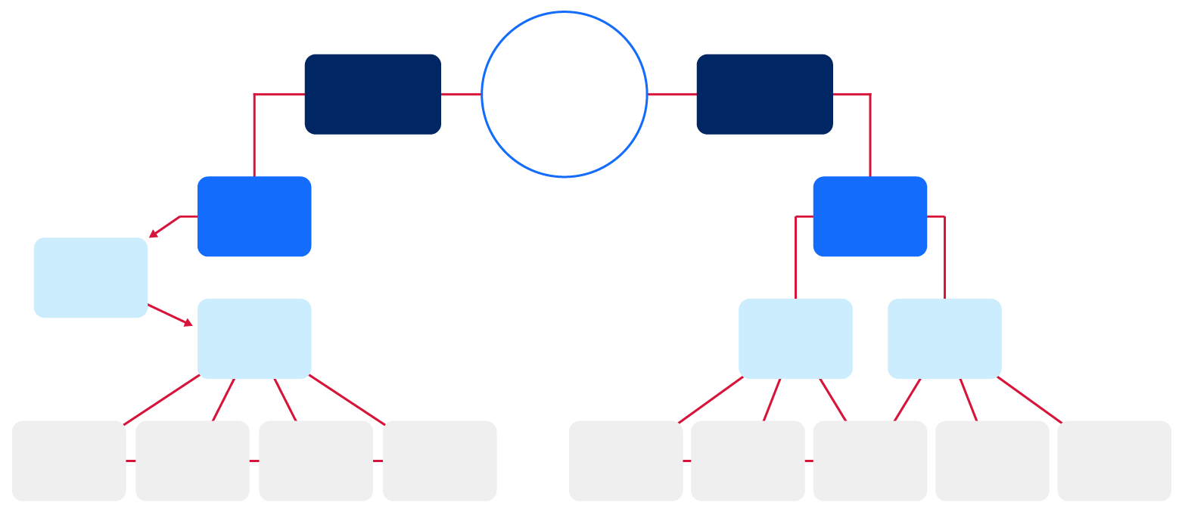
Organising thinking
To connect new learning to existing knowledge
Make / deepen connections in existing learning
Connecting learning
Activating prior knowledge
Making meaningful connections
Select prior knowledge required
Prompt retrieval
Structuring and organizing thinking
Planning and facilitating discussions
Questions about expected knowledge
Verbal
cues
Display parts of a whole for students to complete
Concept
maps
Recording
thinking
Scaffolding
language
Crafting
questions
Talk
routines
Quizzing
Notes:
Purpose of slide: Understand how organising and transforming thinking when summarizing a discussion can support students to make meaningful connections
Speakers notes:
[05:00]
Presenter note: The pre-filled concept map on this slide could be blanked out and co-constructed as part of the professional learning if time permits. This would enable reflection on the key ideas developed about the strategy and techniques. The concepts presented in this learning module do not constitute all concepts that can relate to connecting learning. This concept map could continue to be developed by leaders and teachers with further concepts and ideas related to connecting learning.
Organising and transforming thinking
The effective use of knowledge relies not only on the content itself but also on its organisation (Caviglioli and Goodwin 2021). Notes taken during a discussion serve to support working memory and we cannot assume or expect students to organise this information in a way that supports effective integration into students' long-term memory.
Grouping, ordering, and sequencing ideas into coherent structures is vital for developing strong long-term memory which can be retrieved with increasing automaticity to support learning and thinking (AERO 2023; Caviglioli and Goodwin 2021).
Teachers play a crucial role in modelling effective organisation of thinking to consolidate key information and clarify connections (Caviglioli and Goodwin 2021; Sherrington, 2019). Utilising cognitive structures, such as concept mapping, supports reflection, transforming implicit associations into explicit connections (AERO, 2023; Caviglioli and Goodwin 2021; Ritchhart, Turner and Hadar 2009).
Teachers can enhance students' metacognitive skills by employing the think-aloud strategy to help them identify, select and organise relevant aspects of new content and how this connects and integrates with prior knowledge. Concept mapping can support depth of thinking as students engage and explore relationships between new and existing knowledge. Mapping makes connections clear and visible, providing students with a model of how information can be organised and integrated into long term memory in meaningful ways to better support consolidation and recall (AERO 2023; Caviglioli and Goodwin 2021; Sherrington 2019). As students construct meaning in their own minds, teachers should progressively ask questions during the organisation process to check for understanding and establish an "acceptable shared meaning" (Caviglioli and Goodwin 2021; Cottingham 2023). It is important to note that concept maps can be referred to over time, adding further connections or by reorganising and consolidating the information.
References
AERO (Australian Education Research Organisation) (2023b) How students learn best: an overview of the learning process and the most effective teaching practices, AERO.
Caviglioli O and Goodwin D (2021) Organise ideas: thinking by hand, extending the mind, John Catt Educational Limited.
Cottingham S (2023) Ausubel's meaningful learning in action, Hodder Education Group.
Hattie J (2023) Visible learning, the sequel: a synthesis of over 2,100 meta-analyses relating to achievement, Routledge.
Sherrington T (2019) Rosenshine’s principles in action, John Catt Educational Limited.
Ritchhart R, Turner T and Hadar L (2009) ‘Uncovering students’ thinking about thinking using concept maps’, Metacognition and Learning 4:145-159. doi:10.1007/s11409-009-9040-x.

Slide 53
Turn and talk (2)
Turn to the person next to you and discuss the key components for effective class discussions.
Notes:
Purpose: Activity
[02:00]
Notes to presenter: This activity could be done followed by selecting non-volunteers to share their dialogue.

Slide 54
Strengthening connections over time
Once knowledge is established, reviewing the learning helps students to retain it for longer.
Teachers create opportunities for students to retrieve previously learnt information at spaced intervals over time.
What might this look like in a classroom?
Daily or weekly reviews
Repetition of key skills with opportunity to practise regularly for automaticity
Routines such as ‘recite, recall, apply’
Quiz questions.
Example:
What is the word problem for Pythagoras theorem?
Explain applying Pythagoras theorem
3 problems for Pythagoras theorem
Notes:
Purpose: Reviewing learning over time
Speaker notes:
[00:15]
Reviewing learning over time is necessary for students to access knowledge and improve understanding.
Reviewing learning over time should be considered distinct from connecting new learning. It is used once the knowledge is established and the function is about retaining knowledge not activating the knowledge needed for the present lesson.
Provide students with frequent, deliberately spaced opportunities to recall and independently apply previously learned knowledge and skills. This strengthens students’ ability to retrieve information from their long-term memory and apply it in new situations.
Some schools may use a daily review to begin a lesson. Other schools may review learning with a ‘Do now’ or a warm-up routine. By giving this a name, you can routinise this practice.
It is crucial for students to retrieve the correct information. Always give students access to the accurate or correct answer after reviewing so they retain the correct information.
“Retrieval practice is the strategy of getting students to actively recall their learning. When students are asked to bring information that they have previously learnt to the front of their mind to answer a question, rather than looking up the information in a textbook or having the teacher explain it again, it makes the information more retrievable or accessible in the future. Similarly, if a student cannot recall the information, it helps both teacher and student understand where there are learning gaps that can be addressed” (AERO 2021).
What might this look like in a classroom?
Daily or weekly reviews
Repetition of key skills with opportunity to practise regularly for automaticity
Routines such as ‘recite, recall, apply’
Quiz question.
References:
AERO (Australian Education Research Organisation) (2022b) Spacing and retrieval, AERO, accessed 20 November 2024.

Slide 55
Planning, rehearsing and developing routines
Notes:
Speakers notes:
[00:20]

Slide 56
Creating whole school routines
Draft whole school teaching routines for connecting learning techniques.
Notes:
Purpose: Consider how you can use the techniques in this learning module to create a whole-school routine for connecting learning.
[1:00] + additional time for the activity
Note to presenter: consideration needs to be given as to how a routine is created, for example, in small groups, cross-stage or cross-faculty, etc. If working with a larger staff group, form smaller groups.
Speaker notes:
Today we will be doing an activity in groups to develop possible whole-school routines for connecting learning.
In your groups, draft a consensus on some connecting learning routines that align with effective teaching practices. Remember, these should be routines that can be applied across the school. For activating prior learning this might look like deciding on some common principles – for instance, each lesson should start with an activation of prior learning, this should last for no longer than, say, 5 minutes, we might call this a “do now” activity, even if the nature of the activity changes (presented as a quiz, or a question or other prompt).
After drafting, the group leader will model the routine using the routine for feedback. This step is crucial as it allows the group to reflect and refine the process based on the feedback prompts provided.
Once refined, we’ll come back together and share these routines as a whole. The goal is to adopt a cohesive approach that supports all teachers to connect learning.
Example routines:
1. Create a routine around quizzing
Purpose – quizzing is used for activating prior knowledge and not checking for understanding because it is critical that students are likely to be able to answer.
Routine:
As a school, commit to the number of questions to be used for quizzing.
Design questions with success in mind.
Decide how they are presented and when in the learning sequence they occur.
2. Create a routine around concept maps for organising thinking
Purpose – concept maps are used to consolidate learning arising from class discussions.
Routine:
Decide on a basic template to adopt school-wide.
Revisit and use the template across learning sequences to build connections.

Slide 57
Planning and rehearsing (2)
Plan
Rehearse
Feedback
Evidence for Learning (2022) Effective professional development, Evidence for Learning.
Notes:
Purpose of slide: to explain the process of rehearsing
Note to presenter: it is advisable to prepare the leaders beforehand if modelling and rehearsing are not yet established practices in the school.
Speaker notes:
[01:10]
Now that we have our routine, we have some time to plan, rehearse, and get feedback from each other. When we say rehearse, we mean:
plan number of suitable questions or activities ready
deliver the instruction as if doing it in class.
then, your partners will use the feedback prompts on the next slide to refine the teaching routine. What may need to be added, changed, enhanced or deleted?
Further reading on this research:
AERO (Australian Education Research Organisation) (2023b) Gaining all students’ attention, AERO.
Evidence for Learning (2022) Effective Professional Development, Evidence for Learning.
Sims S, Fletcher-Wood H, O’Mara-Eves A, Cottingham S, Stansfield C, Van Herwegen J, Anders J (2021) What are the Characteristics of Teacher Professional Development that Increase Pupil Achievement? A systematic review and meta-analysis, Education Endowment Foundation.

Slide 58
Rehearsal steps and feedback prompts
Use your learning sequence, or the lesson plan to:
select a connecting learning technique
decide on an agreed routine
plan your instructions for the class
with a partner, rehearse the teaching for this technique
use the feedback and modelling from your partner to improve your approach
swap with your partner for their rehearsal.
Feedback prompts
Did the teacher prompt recall of essential prior knowledge?
Has the routine been successful in connecting prior and new knowledge?
Notes:
Purpose of slide: to give the steps and feedback prompts for the activity
Speaker notes:
[00:20]
Take a minute to go through the rehearsal steps and the prompts for feedback.
If you are giving feedback, we have provided a list of prompts for you to think about how the routine could be refined.
Note to presenter: this slide and the activity slide could be provided to the groups as handouts.
At step 1, one technique is suggested. This may relate to activating prior learning or classroom discussions. The group may be structured so that half work on one while the other half do the other, or the time could be split so everyone does both. This is a school-based decision.

Slide 59
In the next part of this module, we will work on evaluating our approach to implementing the strategies through techniques
Notes:
Note to presenter: Select a technique to focus on with a cycle of planning, rehearsing and developing routines. This will support developing sustainable routines in the school.

Slide 60
Evaluating a whole-school approach
Part C

Slide 61
Purpose and outcome (3)
Purpose
To apply effective professional development structures, reflect on and evaluate our implementation of an explicit teaching technique.
Outcome
We have developed our whole school practices of connecting learning and plan for future success and activities.
Notes:
Purpose of slide: Purpose and outcome of Part C
Speaker notes:
[00:30]
In this part, the focus is on reflection and evaluation. We will consider the early indicators of success and use this to plan for evaluation of longer term impact. There is also a good opportunity to refine the routines we are developing as a whole school in line with what is working in classroom presently.

Slide 62
A whole school approach

Slide 63
Initial reflection point (2)
Teacher observation | 0 | 1 | 2 | 3 | 4
When activating prior knowledge before starting new learning, can my students retrieve previous learning? | Not yet observable | Minimal students can retrieve recent learning | Some students can retrieve recent learning | Most students can retrieve learning over longer periods time | All students can retrieve learning over longer periods time
Notes:
Purpose: Reflecting on initial observations
[02:00]
Speaker notes:
In the beginning, we established a baseline for where our students are now.
Here is an example of a tool that could be used for teacher reflection. You would recognise this from earlier in the presentation. This is one way to measure one aspect of the effectiveness of connecting learning.
Think about one class you taught today. What parts of the continuum would best describe students in your class? (Allow time for teachers to reflect and share. Recording some ideas here would be beneficial as an initial point of reflection as we focus on connecting learning as a strategy.)
We know that students learn efficiently when they have an opportunity to retrieve what they already know and actively process that information with new knowledge to make connections between what is known and new learning.
This module looked at how teachers provide prompts so that all students have this opportunity.
One of the benefits of consistently giving students this opportunity at the beginning of learning is that it can help students to experience success in learning, which can affect their attention and engagement with learning activities (Martin and Evans 2018).
Note to presenter: In the beginning we noted that there is an opportunity to use this data in the final session. This measure is not the only consideration, and schools should select a model that is right for them.
This data could be collated and compared to other “school and classroom data about growth and performance.”
For example:
NAPLAN report overview accessed through Scout
https://education.nsw.gov.au/about-us/education-data-and-research/scout/training/digital-learning-centre/naplan-report-overview
NAPLAN report overview
Learn more about the NAPLAN reports in Scout.
https://education.nsw.gov.au/about-us/education-data-and-research/scout/scout-overview/apps-and-reports/naplan---doe/class-report#tabs0
Class report
The Class report shows the distribution of students’ scaled scores across domains and proficiency levels for NAPLAN 3, 5, 7 or 9.
References:
AERO (Australian Education Research Organisation) (2023a) How students learn best: an overview of the learning process and the most effective teaching practices, AERO.
Martin A and Evans P (2018) ‘Load reduction instruction: Exploring a framework that assesses explicit instruction through to independent learning’, Teaching and Teacher Education, 73:203-214.

Slide 64
The mechanisms of connecting learning (3)
Teacher decides the essential prior knowledge
actively links to prior knowledge
Prompts students to retrieve prior knowledge into working memory
New knowledge is integrated in existing schema
Notes:
Purpose: The mechanisms of connecting learning
[00:30]
Speaker notes:
When connecting learning:
1. the teacher must decide what is the essential piece of prior knowledge that must be retrieved so the connection to new learning can be made
2. plan an activity or question to prompt students to retrieve that prior knowledge into their working memory, this might be a “do now” activity
3. keeping the prior knowledge in working memory, add a select few pieces of new information, ensuring the connections are made clear. The new information and it’s connections to each other and the exiting knowledge is consolidated using activities, so that
4. the new knowledge is integrated into long term memory as additions to an existing schema, or mental model

Slide 65
The importance of all moving together (2)
Saves learning time¹
Frees up students’ working memory²
Certain and consistent expectations for students³
Students learn the routine more quickly when it is done in the same way across the school⁴
Fosters a strong sense of belonging⁵
Notes:
Purpose: to restate why a whole school teaching routine is powerful
[00:30]
Speaker notes:
These modules use the power of whole school teaching routines. When a group of expert teachers from across the school come together and create a whole school approach, they are far more effective than when they go it alone. Teaching routines:
[click] save learning time
[click] can free up students’ working memory
[click] provide certainty and expectations for students to contribute to a learning environment where they’re safe to participate
[click] they’re efficient, because when done the same way across the school, students can learn the routine more quickly
[click] and they foster a strong sense of belonging.
As we go through the learning module here, and other learning modules for explicit teaching we will revisit the idea of the whole school teaching routines.
References:
1. Archer A and Hughes C (2011) Explicit instruction: effective and efficient teaching. Guilford Press.
2. AERO (Australian Education Research Organisation) (2021a) Focused classrooms: managing the classroom to maximise learning, AERO.
3. AERO (Australian Education Research Organisation) (2023c) Teaching routines: their role in classroom management, AERO.
4. McCrea P (2020) Motivated Teaching: harnessing the science of motivation to boost attention and effort in the classroom, Createspace Independent Publishing Platform.
5. McCrea P (2020) Motivated Teaching: harnessing the science of motivation to boost attention and effort in the classroom, Createspace Independent Publishing Platform.
Further reading:
Tharby A (12 May 2023) ‘We are what we do: the case for explicit and consistent school-wide routines’, Class Teaching, find the bright spots blog, accessed 20 November 2024.

Slide 66
Planning and rehearsing (3)
Plan
Rehearse
Feedback
Evidence for Learning (2022) Effective professional development, Evidence for Learning.
Notes:
Purpose: to explain the process of rehearsing
[01:10]
Speaker notes:
Planning, rehearsing and getting feedback are crucial when we are working to develop techniques for implementing strategies. When we say rehearse, we mean:
[click] plan the lessons, models, think-alouds, worked examples and/ or activities
[click] deliver the instruction as if doing it in class.
Then partners can
[click] provide feedback – What may need to be added, changed, enhanced or deleted?
Note to presenter: it is advisable to prepare school leaders beforehand if modelling and rehearsing are not yet established practices in the school.
Further reading on this research:
AERO (Australian Education Research Organisation) (2023c) Classroom management practice guide: gaining all students’ attention, AERO.
Evidence for Learning (2022) Effective professional development, Evidence for Learning.
Sims S, Fletcher-Wood H, O’Mara-Eves A, Cottingham S, Stansfield C, Van Herwegen J and Anders J (2021) What are the characteristics of teacher professional development that increase pupil achievement? A systematic review and meta-analysis, Education Endowment Foundation.

Slide 67
Rehearsal (2)
Notes:
Purpose of slide: To explain why rehearsing is so important
Speaker notes:
[01:10]
Application is a real key to success in professional learning.
Why might professional learning not be applied in the classroom, despite our best intentions?
[click] Research from Evidence for Learning (2022) found that rehearsing was among the key mechanisms for success in the application of PL.
New teachers often have practices described to them – but it is much clearer to have lead teachers model the practice (out of the classroom, without students) while the observer uses prompts to reflect on what made that practice successful.
Teaching is a habit-forming practice. By necessity, teaching requires us to automate a number of behaviours. The cognitive load on teachers to introduce a new behaviour is high and so we often rely on those previously formed habits.
Rehearsal (out of the classroom, without students) makes our PL a habit. When we try a rehearsed routine in a classroom, our cognitive load is reduced because we have one thing to think about, rather than 4 or 5.
This is why rehearsing is a key mechanism for success in professional learning.
References:
Evidence for Learning (2022) Effective professional development, Evidence for Learning.

Slide 68
Evaluating impact on students

Slide 69
Evidence-based practice
'When implementing a new evidence-based practice, school personnel should measure fidelity early and often to provide timely and responsive professional development and maximise student outcomes.'
(Harn et al. 2013:186)
Notes:
Purpose:
[00:00]
References:
Harn B, Parisi D and Stoolmiller M (2013) ‘Balancing fidelity with flexibility and fit: what do we really know about fidelity of implementation in schools?’ Exceptional Children, 79:181-193.

Slide 70
Measures of impact
Short term
Increased ability to articulate connections between pieces of knowledge.
Longer term
Increased understanding
Increased learning
Student data indicates learning gains
Notes:
Purpose of slide: Measuring success
Speaker notes:
[2:00]
When we try something new in the classroom and our students experience it for the first time, it may not have the desired impact. Over time, the impact of the approach should show signs of success. Refining our implementation of connecting learning can support student engagement.
Measure fidelity early and often to provide maximise student outcomes and be responsive in the approach.

Slide 71
Data sources to measure impact
Short term
Increased engagement
Increased ability to articulate the lesson’s learning intention(s) and success criteria
Longer term
Increased understanding
Increased learning
Student data indicates learning gains
Teacher observation | 0 | 1 | 2 | 3 | 4
When activating prior knowledge before starting new learning, can my students retrieve previous learning? | Not yet observable | Minimal students can retrieve recent learning | Some students can retrieve recent learning | Most students can retrieve learning over longer periods time | All students can retrieve learning over longer periods time
Notes:
Purpose: Reflecting on initial observations and considering long term measures
Note to presenter: timing for this slide will be dependent on your own allocated time and the number of staff in attendance.
Speaking notes:
In Part A, we identified the level of students’ engagement in our classrooms. This measure can be used as an indicator – where we consider the most immediate indicator of change and use this measure to track change over time.
We could choose a different measure, but it's important it is proximal to the teaching. It should be an immediately observable/collectable indicator of change in students’ knowledge, skills, motivation, self-belief, or teacher practice. This information of what is successful helps us plan for longer term outcomes.
Other data sources should be considered beyond the proximal data. This might include formative assessment data and student interviews.
Activity:
What observations can you make about gradual release of responsibility techniques in the classroom?
What observations can be made about what has been successful so far, while we’ve focused on the gradual release of responsibility in classrooms?
How will we measure longer term outcomes?
How can we scale our success by refining and building the techniques and routines we’ve been developing?
Note to presenter: You may wish to display the data from the first session if it was collected. If there has been no shift identified using the early measure, discuss the barriers to success and if an adjustment to the whole-school routine is needed.
Further reading on High Impact Professional Learning:
High Impact Professional Learning
References:
McCrea P (2020) Motivated teaching: harnessing the science of motivation to boost attention and effort in the classroom, Createspace Independent Publishing Platform.

Slide 72
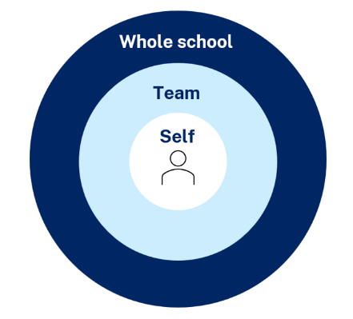
Maintaining a whole school approach through data
Video observation and reflection
Peer observation and feedback
Teacher and student survey
Growth in assessment data
Notes:
Purpose of slide: collating and using data
Speaker notes:
Evaluating data is a way we can consider the extent to which we are being effective in achieving long term goals. Data can be collected from many perspectives, including individual teachers and students, teams and whole school. Data can include a range of things, such as observational/instructional rounds, student work samples (such as exit tickets), student self-reports, teacher reflections and assessments. Data can be quantitative and qualitative.
Reflecting on data helps us consider how efficient and effective we are being in achieving our instructional goals. It also provide key insights to inform the next steps of professional learning and whole school strategic planning.
Activity:
What data have we accessed so far and what have we learnt?
How can we select and measure data over time to consider our impact?
Further reading:
More information about using data to evaluate the curriculum aligned to the School Excellence Framework
LECI: Module 5: Using data to effectively evaluate the curriculum AC01087

Slide 73
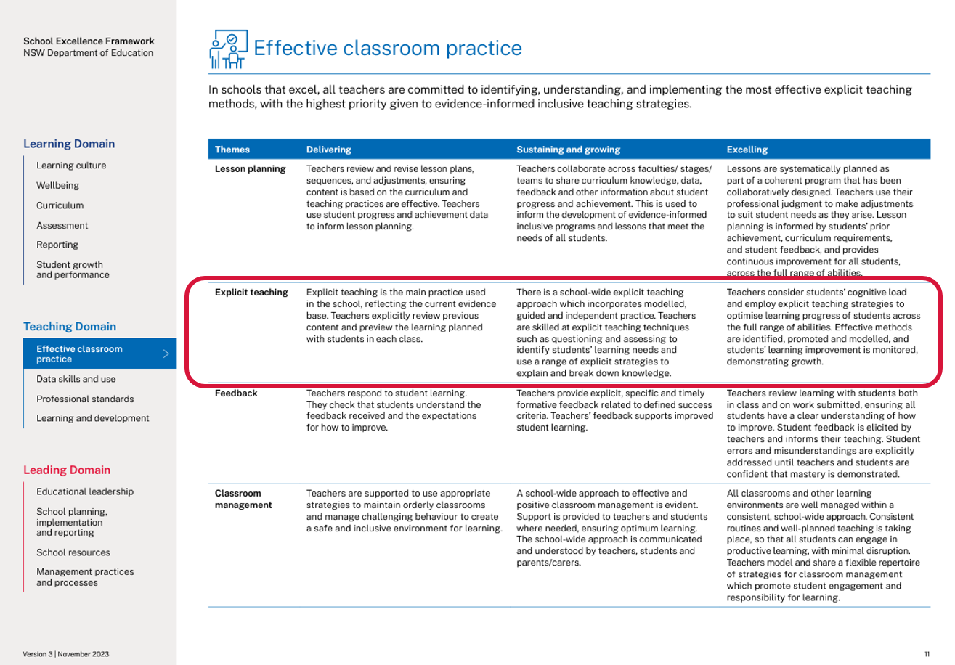
Connecting to the School Excellence Framework
‘School-wide explicit teaching approaches incorporate modelled, guided and independent practice.
Teachers consider students’ cognitive load and employ explicit teaching strategies to optimise learning progress of students across the full range of abilities. Effective methods are identified, promoted and modelled, and students’ learning improvement is monitored, demonstrating growth.’
School Excellence Framework, Teaching Domain (p 11)
73
Notes:
Purpose of slide: Aligning the practice to the SEFv3
Speaker notes:​
​
Linking to longer term outcomes, the SEF is an excellent way to measure whole-school impact over time.
Checking for understanding relates to themes from the SEFv3​
​
For example, in the teaching domain, under the element of effective classroom management, this practice aligns with the descriptors for the theme of explicit teaching and classroom management.
Activity:
Access and identify key features from delivering, sustaining and growing and excelling for the explicit teaching theme.
Access and identify key features from delivering, sustaining and growing and excelling for the classroom management theme.
Describe how our classrooms would look, feel and sound if we were to move to 'sustaining and growing' or move to 'excelling'
Discussion points:
In ‘sustaining and growing’ the practice looks like a whole school approach to positive classroom management:
​
This extends to learning routines in ‘excelling’ where there are consistent school-wide approaches to learning routines that enable student engagement. ​
​

Slide 74
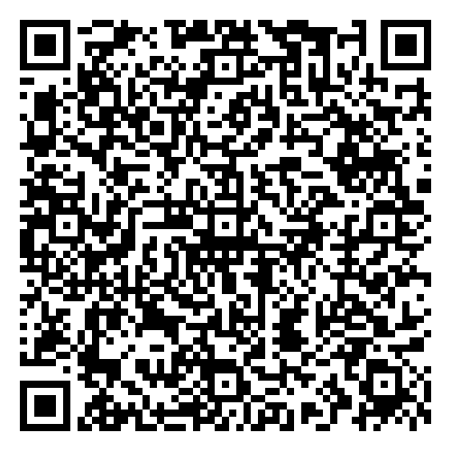

Feedback
Please complete the Checking for understanding learning module survey to help us improve future professional learning and provide further support.
Contact us
ContactCurriculumReform@det.nsw.edu.au

Slide 75

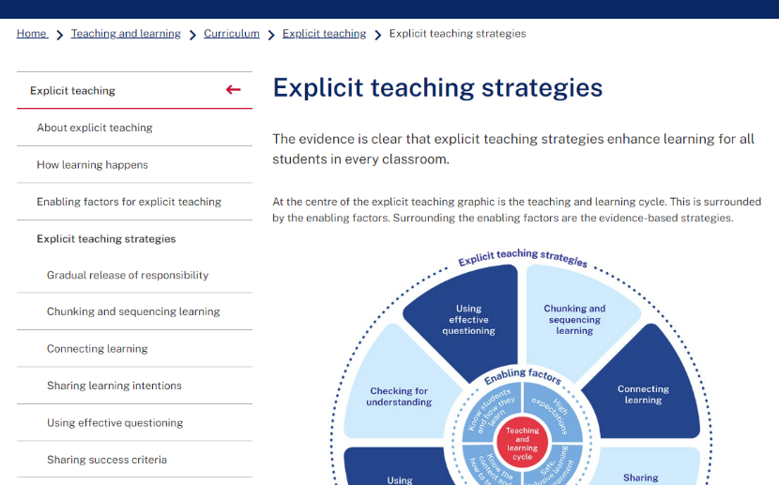

Explicit teaching strategies and resources
More information is available about:
​explicit teaching
how learning happens
the enabling factors
the explicit teaching strategies
https://education.nsw.gov.au/teaching-and-learning/curriculum/explicit-teaching
Notes:
Purpose of slide: Next steps
Speaker notes:
[0:40]
The evidence on explicit teaching is clear, it shows us how important it is to align our teaching pedagogy with how learning occurs. Ongoing information to support this is available on the department's website.
This includes information about the enabling factors, how learning happens and the explicit teaching strategies. The website will continue to be updated as new resources are released in future.
https://education.nsw.gov.au/teaching-and-learning/curriculum/explicit-teaching

Slide 76
References (1)
This presentation contains NSW Curriculum and syllabus content. The NSW Curriculum is developed by the NSW Education Standards Authority. This content is prepared by NESA for and on behalf of the Crown in the right of the State of New South Wales. The material is protected by Crown copyright.
Please refer to the NESA Copyright Disclaimer for more information https://educationstandards.nsw.edu.au/wps/portal/nesa/mini-footer/copyright.
NESA holds the only official and up-to-date versions of the NSW Curriculum and syllabus documents. Please visit the NSW Education Standards Authority (NESA) website https://educationstandards.nsw.edu.au/wps/portal/nesa/home and the NSW Curriculum website https://curriculum.nsw.edu.au.
AERO (Australian Education Research Organisation) (2021) Focused classrooms: managing the classroom to maximise learning, AERO.
AERO (Australian Education Research Organisation) (2022a) Explicit instruction, AERO, accessed 20 November 2024.
AERO (Australian Education Research Organisation) (2022b) Spacing and retrieval, AERO, accessed 20 November 2024.
AERO (Australian Education Research Organisation) (2022c) Mastery learning: planning and sequencing units to progress student learning, AERO, accessed 20 November 2024.
AERO (Australian Education Research Organisation) (2023a) Teaching routines: their role in classroom management, AERO.
AERO (Australian Education Research Organisation) (2023b) How students learn best: an overview of the learning process and the most effective teaching practices, AERO.
AERO (Australian Education Research Organisation) (2023c) Gaining all students’ attention, AERO.
AERO (Australian Education Research Organisation) (2023d) Knowledge is central to learning, AERO.

Slide 77
References (2)
AERO (Australian Education Research Organisation) (2024) Managing cognitive load optimises learning, AERO.
Archer A and Hughes C (2011) Explicit instruction: effective and efficient teaching, Guilford Press.
Brown P, Roediger H and McDaniel M (2014) Make it stick: the science of successful learning, Harvard University Press.
Caviglioli O and Goodwin D (2021) Organise ideas: thinking by hand, extending the mind, John Catt Educational Limited.
CESE (Centre for Education Statistics and Evaluation) (2017) Cognitive load theory: research that teachers really need to understand, NSW Department of Education.
CESE (Centre for Education Statistics and Evaluation) (2023) Guide to evidence-based models of collaborative inquiry, NSW Department of Education.
Cottingham S (2023) Ausubel's meaningful learning in action, Hodder Education Group.
Cowan N (2010) ‘The magical mystery four: how is working memory capacity limited, and why?’ Current directions in psychological science, 19(1):51–57.
Donohoo J, Hattie J and Eells R (2018) ‘The power of collective efficacy’, Educational Leadership, 75:40-44.
Evidence for Learning (2022) Effective professional development, Evidence for Learning.
Harn B, Parisi D and Stoolmiller M (2013) ‘Balancing fidelity with flexibility and fit: what do we really know about fidelity of implementation in schools?’ Exceptional Children, 79:181-193.
Hattie J (2017) ‘Visible Learning plus 250+ Influences on Student Achievement’, Visible Learning website, accessed 17 December 2024.
Hattie J (2023) Visible learning, the sequel: a synthesis of over 2,100 meta-analyses relating to achievement, Routledge.

Slide 78
References (3)
Hattie J, Fisher D and Frey N (2017) Visible learning for mathematics: grades K-12: what works best to optimize student learning, Corwin Mathematics.
Lovell O (2020) Sweller's cognitive load theory in action, John Catt Educational Limited.
Martin A and Evans P (2018) ‘Load reduction instruction: exploring a framework that assesses explicit instruction through to independent learning’, Teaching and Teacher Education, 73:203-214. https://doi.org/10.1016/j.tate.2018.03.018.
McCrea P (2020) Motivated teaching: harnessing the science of motivation to boost attention and effort in the classroom, Createspace Independent Publishing Platform.
NSW Department of Education (14 July 2023) ’Talk moves’, NSW Department of Education, accessed 16 September 2024.
Ritchhart R, Turner T and Hadar L (2009) ‘Uncovering students’ thinking about thinking using concept maps’, Metacognition and Learning, 4(2):145–159. https://doi.org/10.1007/s11409-009-9040-x
Sherrington T (2019) Rosenshine’s principles in action, John Catt Educational Limited.
Sherrington T (7 May 2023) ‘Teaching some vs teaching all: this is where the action for improvement lies’, teacherhead blog, accessed 4 October 2024.
Sherrington T (1 December 2021) ‘Five ways to: scaffold classroom dialogue’, teacherhead blog, accessed 4 October 2024.
Sherrington T (19 December 2023) ’Meaning making and the power of students talking things through – a common missing piece’, teacherhead blog, accessed 16 September 2024.

Slide 79
References (4)
Sims S, Fletcher-Wood H, O’Mara-Eves A, Cottingham S, Stansfield C, Van Herwegen J and Anders J (2021) What are the characteristics of teacher professional development that pncrease Pupil achievement? A systematic review and meta-analysis, Education Endowment Foundation.
Tharby A (12 May 2023) ‘We are what we do: the case for explicit and consistent school-wide routines’, Class teaching, find the bright spots blog, accessed 20 November 2024.
Timperley H, Parr J and Bertanees C (2009) ‘Promoting professional inquiry for improved outcomes for students in New Zealand’, Professional Development in Education, 35(2): 227-245.
Turner E, Goodwin D and Caviglioli O (2022) Annie Murphy Paul’s The extended mind in action, John Catt Educational Limited.
Willingham D (2009) Why don't students like school? A cognitive scientist answers questions about how the mind works and what it means for the classroom, Jossey-Bass/Wiley.
Wiliam D (2011) Embedded formative assessment, Solution tree press.

Slide 80
Copyright
© State of New South Wales (Department of Education), 2024
The copyright material published in this resource is subject to the Copyright Act 1968 (Cth) and is owned by the NSW Department of Education or, where indicated, by a party other than the NSW Department of Education (third-party material).
Copyright material available in this resource and owned by the NSW Department of Education is licensed under a Creative Commons Attribution 4.0 International (CC BY 4.0) license.
This license allows you to share and adapt the material for any purpose, even commercially.
Attribution should be given to © State of New South Wales (Department of Education), 2024.
Material in this resource not available under a Creative Commons license:
the NSW Department of Education logo, other logos and trademark-protected material
Material owned by a third party that has been reproduced with permission. You will need to obtain permission from the third party to reuse its material.
Links to third-party material and websites
Please note that the provided (reading/viewing material/list/links/texts) are a suggestion only and implies no endorsement, by the New South Wales Department of Education, of any author, publisher, or book title. School principals and teachers are best placed to assess the suitability of resources that would complement the curriculum and reflect the needs and interests of their students.
If you use the links provided in this document to access a third-party’s website, you acknowledge that the terms of use, including licence terms set out on the third-party’s website apply to the use which may be made of the materials on that third-party website or where permitted by the Copyright Act 1968 (Cth). The department accepts no responsibility for content on third-party websites.

