Slide 1
About this presentation
Facilitator instructions
This slide deck contains 3 parts that require some preplanning.
Strategy overview, approach and impact – opportunity to collect data that could be used in Part C. The presenter will need to facilitate this.
Implementing the strategies through techniques – the group activity requires pre-planning.
Evaluating a whole-school approach – opportunity to link to the School Excellence Plan.
Slides are repeated across strategy modules so they can be implemented with the same structure. Note: some slides contain animations indicated by [click] in the presenter notes.

Slide 2
Checking for understanding (1)
Strategy learning module

Slide 3
Acknowledgement of Country
We recognise the Traditional Custodians of the lands and waterways where we work and live. We pay respect to Elders past and present as ongoing teachers of knowledge, songlines and stories. We strive to ensure every Aboriginal and Torres Strait Islander learner in NSW achieves their potential through education.
‘Gaawaa’ created by Finley Andrews from John Palmer Public School on Dharug Country as part of the 2022 Schools Reconciliation Challenge.
Notes:
Acknowledgement of Country
[00:30]
Speaker notes:
I would like to acknowledge the traditional custodians of the land on which we meet today. We pay our respects to their Elders past and present. We recognise their continuing connection to land, water, and culture, and we are committed to continuing to learn from their wisdom and traditions.

Slide 4
Overview of this module
Part A – Strategy overview, approach and impact Part B – Implementing the strategies through techniques Part C – Evaluating a whole-school approach
Notes:
Purpose: Outline the learning sequence in this module.
[00:30]
Speaker notes:
In this module, the focus is on checking for understanding and selecting the optimal techniques for students in your class.
We will then develop teaching routines as a whole school to reduce cognitive load for our students, giving them the best opportunity for routines to benefit their learning outcomes.
We will evaluate the impact of our work in terms of how effectively the approach has met the student need we've identified as the focus for our professional learning. We will do this by considering the short-term outcomes and the potential longer term learning outcomes for our students.

Slide 5
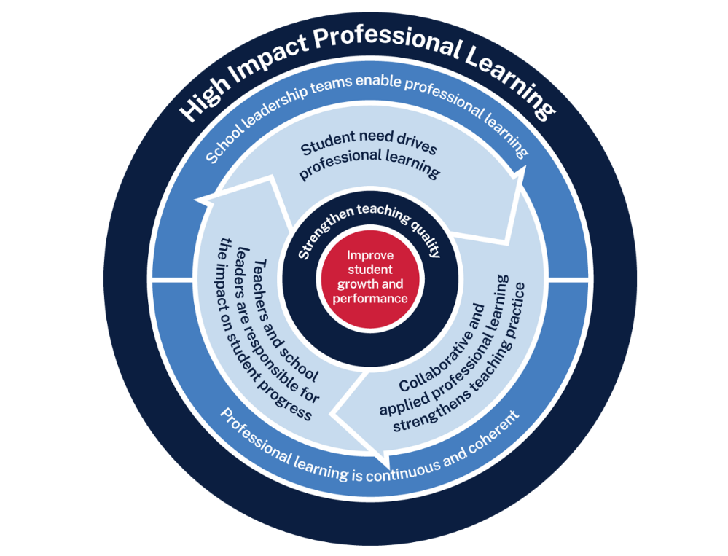
Checking for understanding professional learning
Measure baseline student data and set a goal
Use the whole-school teaching routines and, together, plan the questions they will ask
Analyse data to determine further cycles
Implement the teaching routine in the classroom and measure impact
Rehearse and give each other feedback
Notes:
Purpose: Familiarising High Impact Professional Learning model (HIPL) and how it may inform our implementation of explicit teaching.
[01:00]
Speaker notes:
The High Impact Professional Learning (HIPL) model forms the basis of this professional learning. This model has five elements.
Professional learning is driven by identified student needs
School leadership teams enable professional learning
Collaborative and applied professional learning strengthens teaching practice
Professional learning is continuous and coherent
Teachers and school leaders are responsible for the impact of professional learning on student growth and performance
The actions and steps we take to enact each of these elements will be shaped by our increasing shared understanding of check for understanding strategy and how specific check for understanding techniques can be used to optimise the learning of our students.

Slide 6
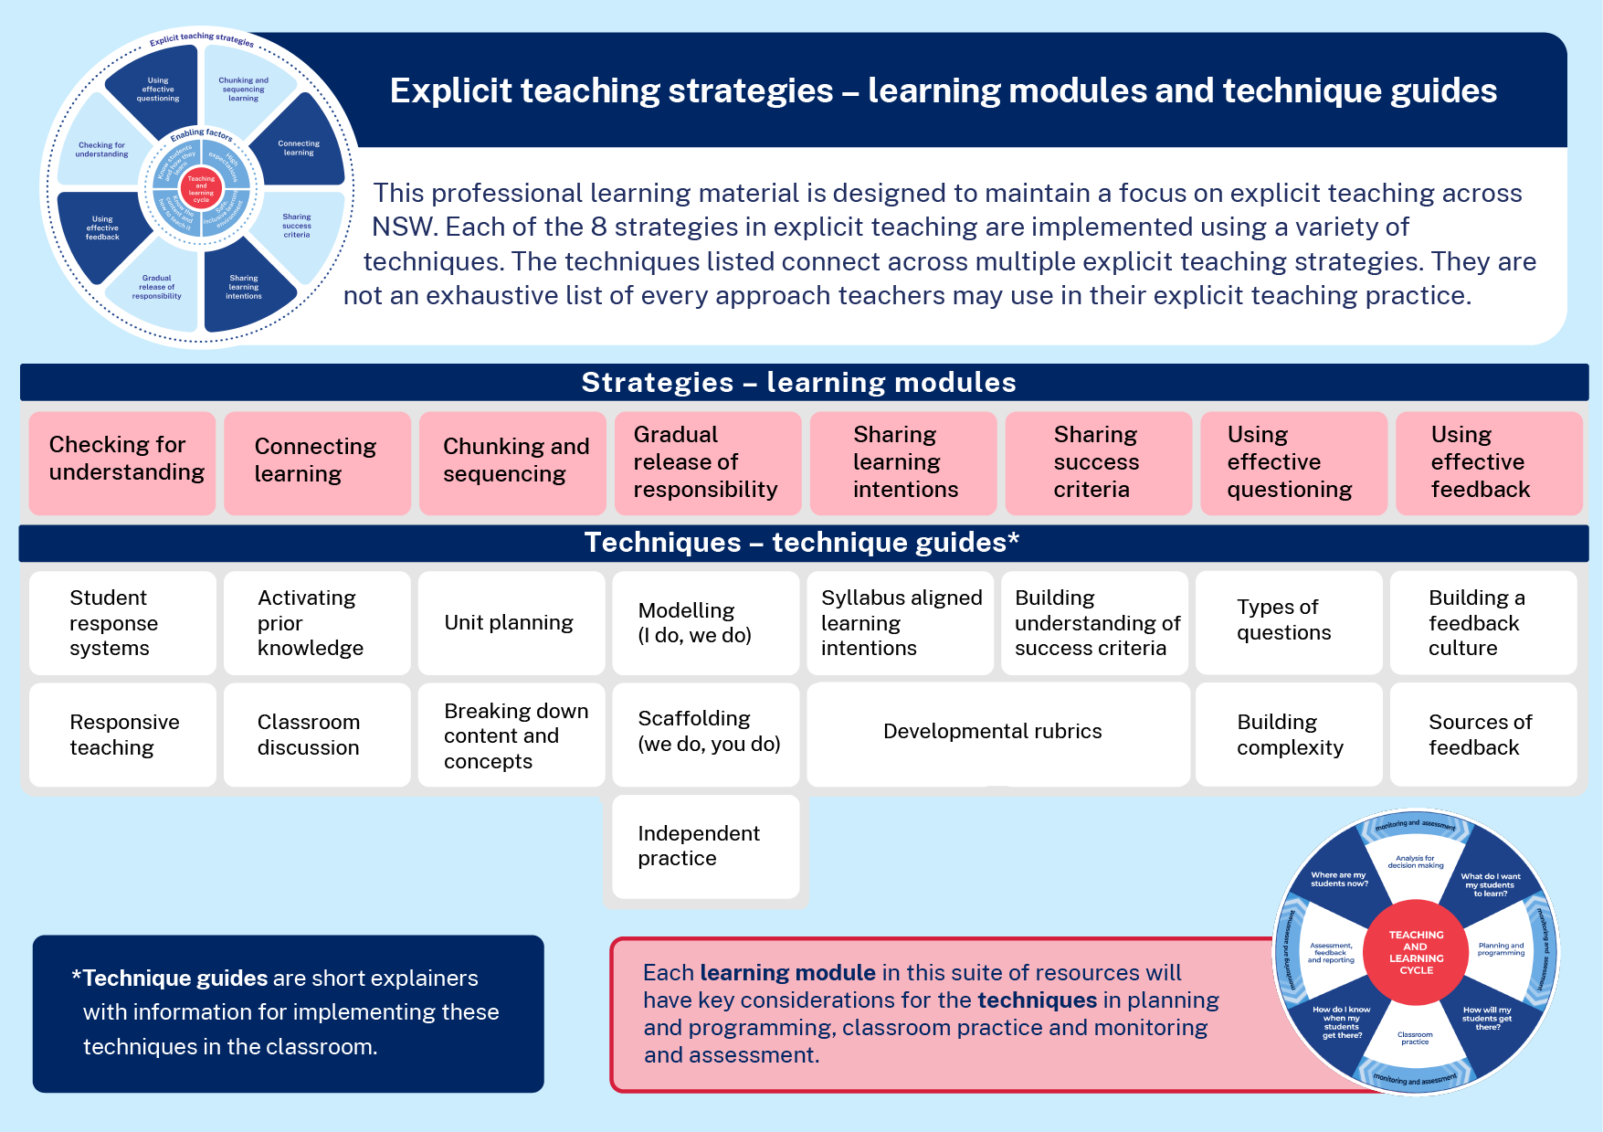
Explicit teaching strategies
Learning modules and technique guides
Notes:
Purpose: To highlight where this module fits with other current and future modules and technique guides.
[00:30]
Speaker notes:
This module looks at one of the 8 explicit teaching strategies, checking for understanding and some techniques for this strategy, student response systems and responsive teaching. These learning modules and the corresponding technique guides will have staggered release dates.

Slide 7
Understanding the strategy
Part A

Slide 8
Purpose and outcome (1)
Purpose
To understand the mechanisms of checking for understanding in the context of optimising student understanding, engagement and participation.
Outcome
We can articulate how, when and why we check for understanding.
Notes:
Purpose: Purpose and outcome of Part A
[00:30]
Speaker notes:
This strategy learning module focuses on teachers making purposeful decisions to check students’ understanding throughout lessons.
The purpose of Part A is:
To understand the mechanisms of checking for understanding in the context of optimising student understanding, engagement and participation.
Working towards the outcome that:
We can articulate how, when and why we check for understanding.

Slide 9
Key idea
Why checking for understanding is important
For students to develop a deep understanding of knowledge and skills, teachers elicit thinking from all students and support their engagement through consistent and reliable checking for understanding.
Notes:
Purpose: Key idea as we focus on checking for understanding
[00:30]
Speaker notes:
Checking for understanding is essential because it delivers immediate, relevant feedback during lessons. It allows us to correct misconceptions as they arise and helps our students build accurate schemas.

Slide 10
Initial data reflection point
A continuum of student engagement, adapted from Reimagining Student Engagement by Amy Berry. (Corwin Press)
Notes:
Purpose: Reflecting on student engagement as an early indicator.
[00:30]
Speaker notes:
Before we delve into checking for understanding, it is important to establish a baseline for where our students are now.
Amy Berry's continuum of engagement provides a model to reflect on our students’ engagement. This module focuses on only one aspect of the continuum, engaging in the activity.
Think about one class you taught today. What parts of the continuum would best describe students in your class? (Allow time for teachers to reflect and share. Recording some ideas here would be beneficial as an initial point of reflection as we focus on checking for understanding as a strategy.)
AERO’s research summary shows: “Learning requires [students’] active engagement and sustained focus to move new information from working memory to long-term memory” (AERO 2023). It also shows that "The most effective teaching practices foster a supportive learning environment and enable students to focus their attention to successfully acquire the knowledge and skills they need to be successful in their learning." (AERO 2023). One of the benefits of consistently checking for understanding is that it can help to focus our students’ attention - "Attention is the gatekeeper of learning. What we attend to is ultimately what we learn.” (McCrea 2020:17)
We will be able to refer to our early indicator observations when we evaluate our impact in Part C.
Note to presenter: There is an opportunity to use this data in Part C. This data could be collated and compared to other “school and classroom data about growth and performance.”
For example:
NAPLAN report overview accessed through Scout
https://education.nsw.gov.au/about-us/education-data-and-research/scout/training/digital-learning-centre/naplan-report-overview
NAPLAN report overview
Learn more about the NAPLAN reports in Scout.
https://education.nsw.gov.au/about-us/education-data-and-research/scout/scout-overview/apps-and-reports/naplan---doe/class-report#tabs0
Class report
The Class report shows the distribution of students’ scaled scores across domains and proficiency levels for NAPLAN 3, 5, 7 or 9.
References:
AERO (2023) How students learn best
Berry A (2020) Reimagining Student Engagement https://www.kqed.org/mindshift/61926/reimagining-student-engagement-as-a-continuum-of-learning-behaviors
McCrae P (2020) Motivated teaching (p.17)

Slide 11
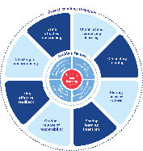
Enabling factors
Know students and how they learn
High expectations
Teachers understand how learning happens, and this informs their practice.
Students benefit from teachers holding high expectations for their learning.
Know the content and how to teach it
Safe, inclusive learning environments
Teachers know how the knowledge builds and connects to create learning that is strategic, sequenced and cumulative.
Explicit teaching both relies on, and brings about, a safe and inclusive learning environment.
Notes:
Purpose: Revisiting core knowledge
[00:30]
Speaker notes:
Let’s remind ourselves that explicit teaching is an optimal way to teach knowledge and skills that are new or complex.
There are important enabling factors for explicit teaching that relate to the technique we are focusing on. Let’s revisit them.
Note to presenter: you may wish for participants to read these to themselves
Our understanding of the how learning happens informs our practice
We know how knowledge builds across syllabuses
We hold high expectations for our students’ learning
And, explicit teaching both relies on, and brings about a safe, inclusive learning environment
Resources:
Leading explicit teaching – school-facilitated workshops 1–3 on core content and the enabling factors of explicit teaching – https://education.nsw.gov.au/teaching-and-learning/curriculum/explicit-teaching/leading-explicit-teaching
Classrooms of Possibility – https://education.nsw.gov.au/inside-the-department/teaching-and-learning/classrooms-of-possibility
Explicit instruction – implementing evidence-based teaching practices for students with disability - https://resources.education.nsw.gov.au/detail/IPR-LD230526144351
Strong Strides Together: Meeting the educational goals for Aboriginal and/or Torres Strait Islander students – https://education.nsw.gov.au/teaching-and-learning/aec/universal-resources---aboriginal-education/strong-strides-together--meeting-the-educational-goals-for-abori

Slide 12
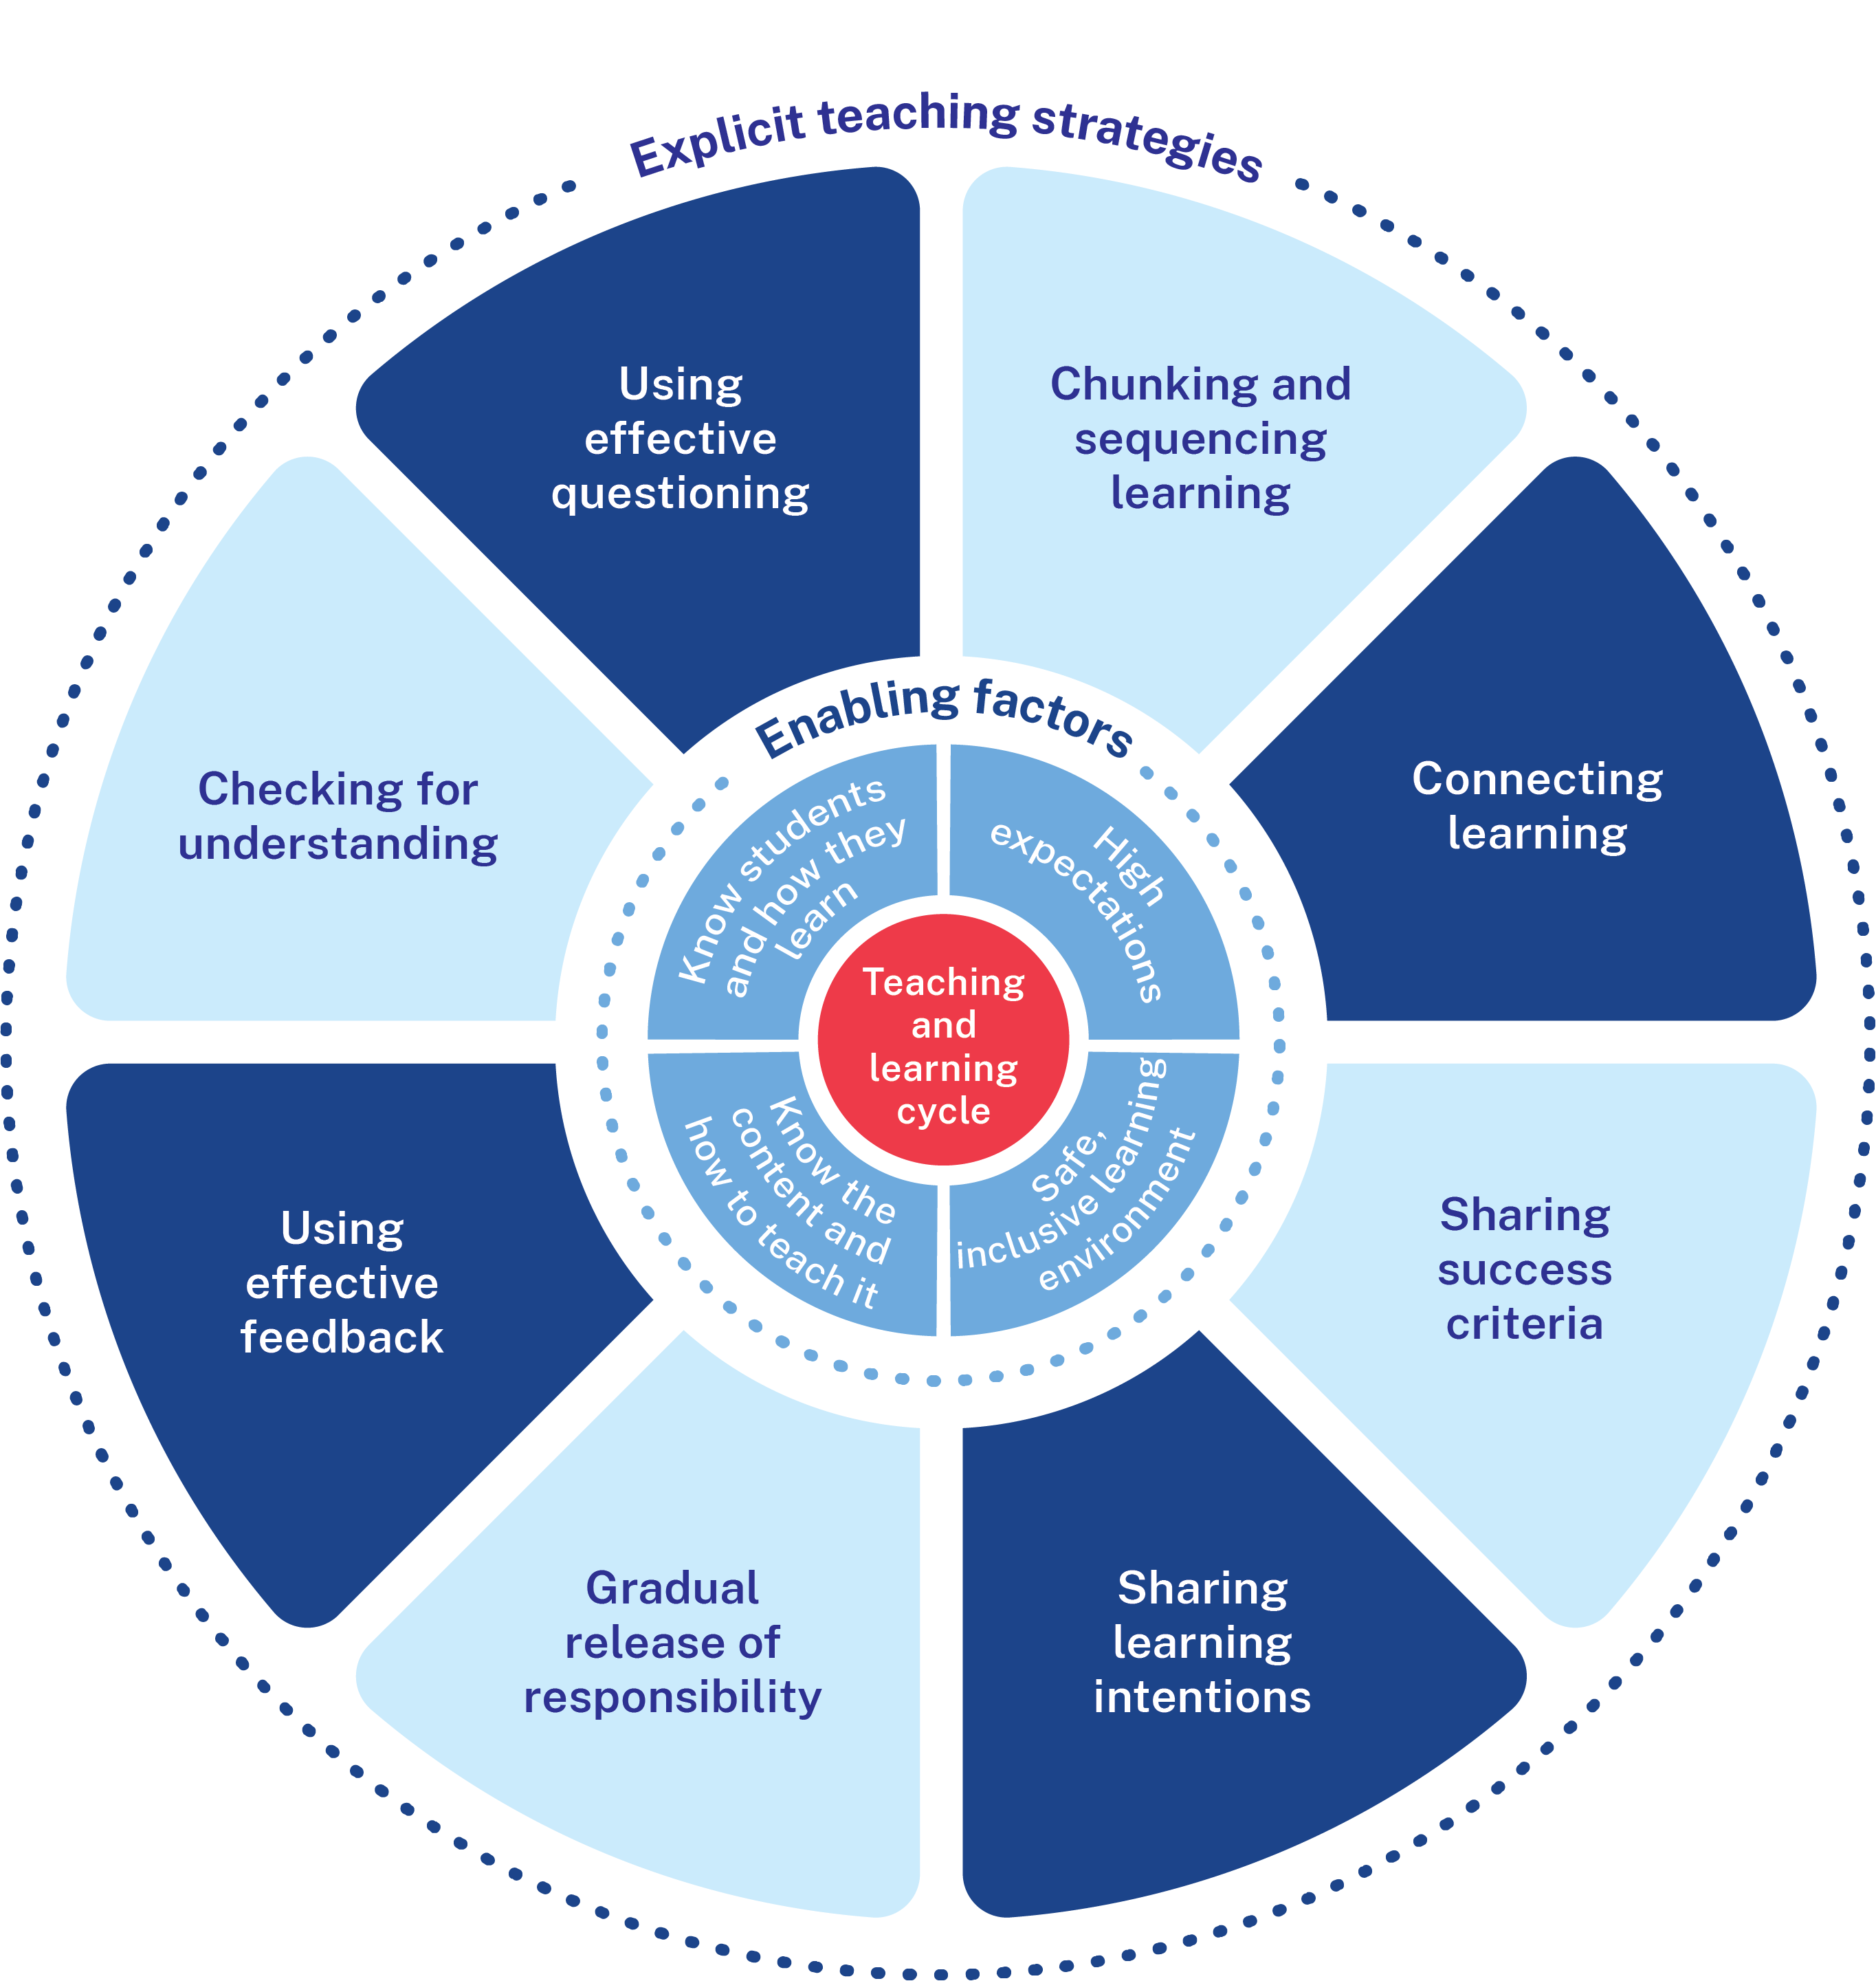
Checking for understanding (2)
Why check for understanding?
It informs teachers’ next steps in the lesson.
It elicits deeper student thinking.
It supports students’ engagement.
Notes:
Purpose: Why check for understanding is an important explicit teaching strategy.
[00:30]
Speaker notes:
Checking for understanding is an important explicit teaching strategy because it helps us to:
inform next steps in the lesson
use techniques that enable all students to think and respond
support students’ engagement in class.
Further reading:
AERO (2024) Monitor progress

Slide 13
Checking for understanding of all students
The teacher checks the understanding of all students throughout the lesson. For example:
When a choral response is used, all students say the answer out loud.
When a mini whiteboard is used all students record and show their answer.
When the teacher cold calls, all students have to think of an answer.
It is inclusive – we want to hear from every student, not just those with the right answer.¹
Notes:
Purpose: A key point about checking for understanding being inclusive
[02:00]
Speaker notes:
I’m going to explore some checking for understanding techniques on this slide. At the end of this slide, I will ask you some checking for understanding questions about it.
Checking for understanding is an inclusive practice.
The teacher checks the understanding of all students throughout the lesson not just at the beginning or the end.
I will let you read through the description for [click] choral response[wait], [click] mini whiteboards, and [click] cold call.
Techniques such as choral response and mini whiteboards can allow the teacher to quickly ascertain what all students understand. Cold calls are great to elicit thinking from every child in the classroom.
We have an important point here about inclusivity [click] when there are access considerations for students with a disability, such as a text-to-speech device, it is important for reasonable adjustments to be made to their learning to ensure access for all.
Activity:
Ask audience for a choral response to the question: Should the teacher just be checking for understanding at the end of the lesson? (Cue) (a: No)
Cold call for this question: What are 2 techniques that help a teacher quickly ascertain what ALL students understand? [select a participant at random] (a: choral response and mini whiteboards)
Cold call for this question: What is the advantage of asking the question first before cold calling on a student? [wait, then select a participant at random] (a: all students can think of an answer)
References:
1. Lemov D (October 26, 2016) Cold Call is inclusive. Teach like a champion https://teachlikeachampion.org/blog/cold-call-inclusive/

Slide 14
Students must feel safe to participate
Asking questions to assess understanding
Re-teaching when necessary, remembering that students need at least 3 exposures
Avoiding negative responses when students make mistakes or are unsure
A safe learning environment for ongoing participation and growth.
Notes:
Purpose: Creating an environment that generates ongoing participation.
[01:30]
Speaker notes:
When students don’t understand, the teacher’s reaction and response can greatly impact on students.
When students expect teachers will be annoyed if they don’t know something, it presents a barrier to their learning (Peeters 2020).
We know from the work of Nuthall (2007) that students need on average 3 exposures to information to learn it.
Teachers make the decision to correct or go back and re-teach. They consider how foundational that knowledge is for the overall schema students are developing. If it was a key piece of knowledge that students didn’t seem to grasp the first time, the teacher invests time by going back and reteaching and then again, checking for understanding.
Asking students if they understand is not often a strong indicator of their actual understanding.
References:
Nuthall G (2007) The hidden lives of learners. NZCER Press.
Peeters A (2020) Theories in use that explain adolescent help seeking and avoidance in mathematics, Journal of Educational Psychology 112(3):533-550

Slide 15
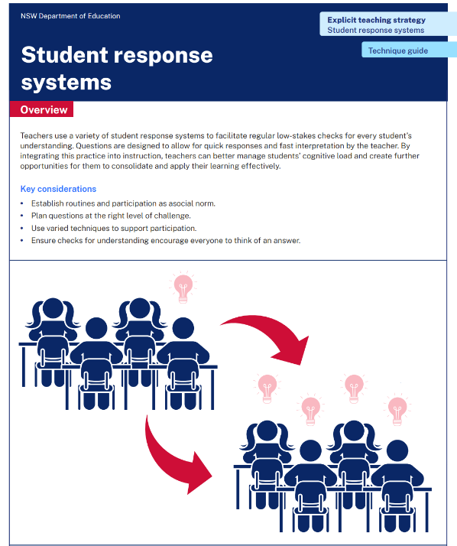
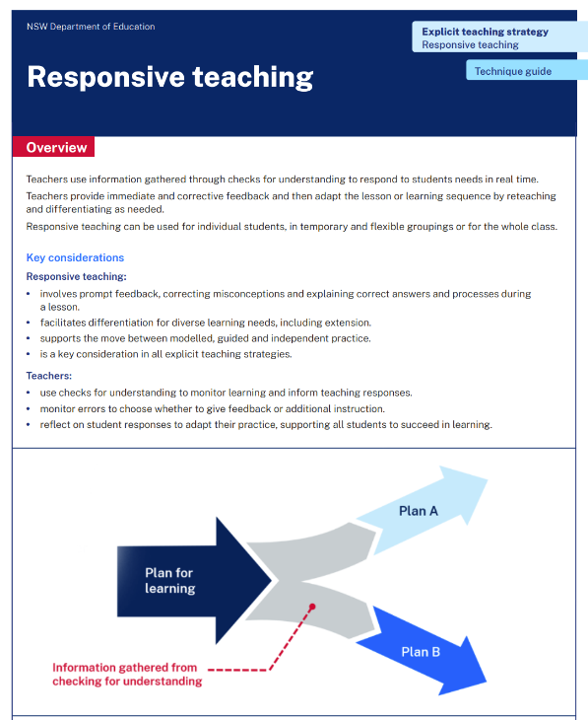
Activity 1
Connecting reading and Part A
Read or revise – 5 min
Discuss – 5 min
Identify the key points in Student response systems technique guide or the Responsive teaching technique guide.
Describe the connections between the technique guide and the learning in Part A.
Notes:
Purpose: Make connections between check for understanding resources to deepen knowledge.
[10:00]
Speaker notes:
We have had the opportunity to read [Student response systems and Responsive teaching] technique guides.
Revisit that reading and identify the key points you observed.
Discuss with your groups the connections you can make between the readings and the learning we have done in Part A so far.

Slide 16
Implementing the strategy

Slide 17
Checking for understanding and student engagement
What are the mechanisms that makes it work
Conditions for understanding
Routine
Right challenge level
Expect success
Everyone thinks of an answer
Notes:
Purpose: To summarise what makes checking for understanding effective
[00:40]
Speaker notes:
When checking for understanding:
[click] 1. establish a whole school routine so students know what to do and there is a social norm of participation.
[click] 2. plan clear questions at the right level of challenge
[click] 3. choose the right technique at the right time, so students are likely to succeed.
[click] 4. give all students thinking time
[click] when all 4 are in place, students are supported to optimise their understanding.
Reference:
Mccrea P (2020) Motivated Teaching: harnessing the science

Slide 18
The importance of all moving together
A whole-school approach
Saves learning time¹
Frees up students’ working memory²
Sets certain and consistent expectations for students³
Helps students to learn the routine more quickly when it is done in the same way across the school⁴
Fosters a strong sense of belonging⁵
Notes:
Purpose of slide: To restate why a whole school teaching routine is powerful
Speaker notes:
[00:20]
The power of whole school teaching routines:
We know that teaching routines:
save learning time
frees up students’ working memory
provide certainty and consistent expectations for students to contribute to a focused learning environment where they’re safe to participate.
Fosters a strong sense of belonging
When a group of expert teachers from across the school come together and create a whole school approach, they are far more effective than when they go it alone. This is because students learn the routine more quickly when it is done in the same way across the school.
This also fosters a strong sense of belonging.
References:
Archer A and Hughes C (2011) Explicit instruction: Effective and efficient teaching. Guilford Press.
Australian Education Research Organisation (2021) Focused classrooms: managing the classroom to maximise learning. https://www.edresearch.edu.au/resources/focused-classrooms-practice-guide/ focused-classrooms-practice-guide-full-publication
Australian Education Research Organisation (2023) Teaching routines: their role in classroom management. https://www.edresearch.edu.au/resources/teaching-routines
McCrea (2020) Motivated teaching.
McCrea (2020) Motivated teaching.
Donohoo J, Hattie J and Eells R (2018) The power of collective efficacy. Educational Leadership 75, 40-44.
Further reading:
Tharby A (May 17, 2023) We are what we do: the case for explicit and consistent school wide routines https://classteaching.wordpress.com/2023/05/17/we-are-what-we-do-the-case-for-explicit-and-consistent-school-wide-routines/

Slide 19
Planning and rehearsing (1)
The key to success
Plan
Rehearse
Feedback
Evidence for Learning (2022) Effective Professional Development, Sydney: Evidence for Learning.
Notes:
Purpose of slide: To explain the process of rehearsing
Speaker notes:
[01:10]
Planning, rehearsing and getting feedback are crucial when we are working to develop techniques for implementing strategies. When we say rehearse, we mean:
plan number of suitable questions or activities ready
deliver the instruction as if doing it in class.
then partners can provide feedback - what may need to be added, changed, enhanced or deleted?
Note to presenter: it is advisable to prepare school leaders beforehand if modelling and rehearsing are not yet established practices in the school.
Further reading on this research:
Sims, S., Fletcher-Wood, H., O’Mara-Eves, A., Cottingham, S., Stansfield, C., Van Herwegen, J., Anders, J. (2021). What are the Characteristics of Teacher Professional Development that Increase Pupil Achievement? A systematic review and meta-analysis. London: Education Endowment Foundation.
The report is available from: https://educationendowmentfoundation.org.uk/education-evidence/evidence-reviews/teacherprofessional-development-characteristics
The EEF Guidance Report Effective Professional Development is available at: https://educationendowmentfoundation.org.uk/education-evidence/guidance-reports/effectiveprofessional-development
AERO’s Classroom management practice guide – gaining all students’ attention outlines how teachers should script and rehearse and use a checklist to refine before doing it with students present. https://www.edresearch.edu.au/sites/default/files/2023-12/gaining-all-students-attention-aa.pdf

Slide 20
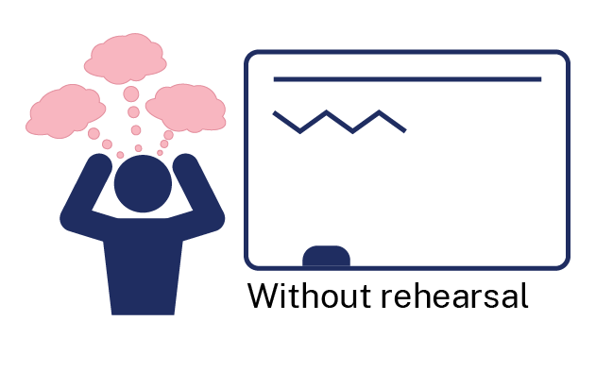
Rehearsal
Notes:
Purpose of slide: To explain why rehearsing is so important
Speaker notes:
[01:10]
Application is a real key to success in professional learning.
Why might professional learning not be applied in the classroom, despite our best intentions?
[click] Research from Evidence for Learning (2022) found that rehearsing was among the key mechanisms for success in the application of PL.
New teachers often have practices described to them – but it is much clearer to have lead teachers model the practice (out of the classroom, without students) while the observer uses prompts to reflect on what made that practice successful.
Teaching is a habit-forming practice. By necessity, teaching requires us to automate a number of behaviours. The cognitive load on teachers to introduce a new behaviour is high and so we often rely on those previously formed habits.
Rehearsal (out of the classroom, without students) makes our PL a habit. When we try a rehearsed routine in a classroom, our cognitive load is reduced because we have one thing to think about, rather than 4 or 5.
This is why rehearsing is a key mechanism for success in professional learning.
References:
Evidence for Learning (2022) Effective Professional Development, Sydney: Evidence for Learning

Slide 21
In the next part of this module, we will work on implementing the strategies through techniques. We will have opportunity to plan and rehearse techniques when checking for understanding.
Notes:
Purpose of slide: To orient into the next part of the module.
[00:20]

Slide 22
Implementing the strategies through techniques
Part B

Slide 23
Part B instructions
Part B contains multiple techniques. To use Part B:
Select Technique A or Technique B (Slides 25–40).
Plan, rehearse and develop routines for the technique you have selected (Slide 41–46).
Notes:
Purpose of the slide: To provide instructions on using Part B of the module.
[00:20]
Note to presenter: Select a technique to focus on with a cycle of planning, rehearsing and developing routines. This will support developing sustainable routines in the school.

Slide 24
Purpose and outcome (2)
Purpose
To develop checking for understanding techniques and routines by planning, rehearsing and developing these techniques for students in our school.
Outcome
We have whole-school teaching routines for techniques to check for understanding that are ready to use in lessons.
Notes:
Purpose of slide: Purpose and outcome of Part B
Speakers notes:
[00:20]
In this part, we're going to develop checking for understanding techniques and routines; and have our first attempt at creating our own whole school teaching routines for checking for understanding techniques

Slide 25
student response systems
Technique A

Slide 26
How does it work? (1)
Student response systems
Facilitate regular low-stakes checks for every student’s understanding
Include quick responses with fast interpretation by the teacher
Manage cognitive load for students
Create opportunities for students to consolidate and apply their learning
Notes:
Purpose: How student response systems work
Speaker notes:
[00:30]
Teachers use a variety of student response systems to facilitate regular low-stakes checks for every student's understanding. Questions are designed to allow for quick responses and fast interpretation by the teacher. By integrating this practice into instruction, teachers can better manage students' cognitive load and create further opportunities for them to consolidate and apply their learning effectively.
Making Data-Driven Decisions: The teacher should decide whether to move forward or revisit the content based on the students’ responses, making the decision quickly to keep the lesson on track.

Slide 27
Key considerations (1)
Student response systems
Establish routines and participation as a social norm
Plan questions at the right level of challenge
Use varied techniques to support participation
Ensure checks for understanding encourage everyone to think of an answer.
Notes:
Purpose: Key considerations for student response systems Speaker notes:
[02:00]
Read points on the slide together. Provide some time to discuss each point. Suggested
1. Create predictable routines
“Establishing consistent routines helps students focus on learning rather than on what’s expected of them.”
2. Use varied methods
“The response system should be matched to the intention of its use.”
3. Check frequently
“Frequent checks allow for immediate adjustments, ensuring students stay on track.”
4. Connect with the learning intentions and success criteria
“Align responses with learning goals to keep activities purposeful and outcomes clear.”
5. Checks for understanding occur while learning is happening, not at the end of the lesson
“Real-time checks prevent misunderstandings from accumulating and allow for in-the-moment support.”
6. Understanding is optimised when students are engaged
“Active engagement is key to ensuring students fully grasp and retain the material.”

Slide 28
Response cards
What it is and how to use it
Notes:
Purpose of slide: Response cards as a student response system
Speaker notes:
[01:00]
Use when:
checking for understanding of key content
questions test specific knowledge
Considerations:
establish norms, such as a signal, so that all students respond at the same time
cards are readily accessible materials such as signs, cards, or items
Response cards are one way in which we can check for understanding of all students in a way that is not reliant upon their language skills. This allows for universal access.
To use these cards to check for understanding successfully requires the teachers to craft questions and/or statements that test specific knowledge.
For example, the ABCD cards are optimal when they are statements that include:
key misconception
accurate answer
nearly accurate answer
wrong answer
Careful crafting of the statement ensures that all students need to think to answer, however, the ABCD removes the pressure of using writing to express their ideas. The same principles of design applies when using techniques like hand gestures. This type of check for understanding technique would be maximised by the use of a hinge question, or a useful precursor to a 'hinge question'
True or False, and Yes or No, can easily be differentiated. Restricting statements to straightforward definitions, for example, can allow students to build schema around metalanguage. Whereas, statements that include elaboration or reasoning will require students to use higher-order thinking.
Response cards establish a foundation from which the student can then move to elaborating their thinking in way that is accessible for them. (Eg: Classroom discussion)
Resources
https://education.nsw.gov.au/inside-the-department/teaching-and-learning/curriculum/school-development-day-curriculum-implementation/curriculum-implementation-professional-learning-sessions/effective-multiple-choice-assessment-to-inform-teaching
Response cards – Implementing evidence-based teaching practices for students with disability - https://resources.education.nsw.gov.au/detail/IPR-LD230602164447

Slide 29
Gesture voting
What it is and how to use it
Thumbs up, thumbs down
Gesture voting
Notes:
Purpose: Gesture voting as a student response system
Speaker notes:
[01:00]
Use when:
checking for understanding of key content
questions are a selected response, such as multiple choice, yes or no, or agree or disagree
Considerations:
establish norms, such as a signal, so that all students respond at the same time
Identify where students are physically required to place their gesture
The same principles of high-quality question and statement design apply when we use techniques that allow students to show their understanding through gesture.
It is important to recognise the distinct feature of gesture voting is that it is highly and instantly visible to all learners. Gestures can be contagious and be copied. To ensure their success:
Maintain the imposition of thinking time
Consider ways in which students may be restricted from seeing other students' answers. Such as: answer with eyes closed, answer in front of chest, backs to their group.

Slide 30
Mini whiteboards
What it is and how to use it
All students record their answers individually and then show them to the teacher at the same time.
The teacher can quickly see incorrect answers and respond.
Record individually
Teacher checks answers and responds
Show teacher at the same time
Notes:
Purpose: Mini whiteboards as a student response system
Speakers notes:
[01:00]
Use when:
content is increasingly familiar
response requires either short answer or diagram
Considerations:
establish norms, such as a gesture or phrase, to signal when and how students will show their boards
feedback provided for an incorrect answer maintains student safety
Mini whiteboards allow the teacher to see everyone’s individual understanding.
In this technique:
All students write their answers individually and then show them to the teacher at the same time.
The teacher can quickly see incorrect answers and respond.
Mini whiteboards are perceived as medium risk because although students record an individual response, without consulting peers, the answer is only shared with the teacher. Whiteboards also allow for answers to be changed or rubbed out/erased. If an answer is not correct, it is not permanent!
Optional Activity:
Presenter shows a video of mini whiteboard use such as this one:
Teaching & Learning at Sedgehill Academy - Mini Whiteboards (1:11) https://www.youtube.com/watch?v=YpRX5dhbm7U
Participants write down an example of a suitable simple mini whiteboard question and share it with the person next to them, explaining why that question would be effective in their context.
Note to presenter: you may choose to select some pairs to share to the whole group

Slide 31
Example routine
Mini-whiteboards
Record your answer
Hover your whiteboard
When I say, ‘chin it’, hold your whiteboard up
Wait for feedback
Erase and get ready for the next question
Notes:
Purpose of slide: To illustrate how a teaching routine for mini whiteboards should be.
Speaker notes:
[01:00]
This is an example of a whole school whiteboard teaching routine. There needs to be very specific detail in the routine. The detail is intended to ensure the class keeps going at an engaging pace and there isn’t opportunity for misunderstanding of the routine to interfere with the check for understanding of the knowledge being learned.
Record your answer: Once you’ve heard the question, write your answer clearly on your whiteboard to show your thinking.
Hover your whiteboard: When you are ready hover your board so it is facing your desk.
When I say ‘chin it', hold your whiteboard up under your chin. I’ll take a quick look at everyone’s answers to see how we’re doing.
Wait for feedback: After I’ve checked your answers, I’ll give you some feedback or ask a few students to share their responses. If you need to make changes, I’ll let you know.
Erase and get ready for the next question: Once we’ve discussed the answers, you can erase your whiteboard and get ready for the next question.
Remember, this is a way for us to see how we’re all doing with the lesson. Don’t worry about making mistakes – it’s a chance to learn and improve together.
Optional Activity:
Presenter shows a video of mini whiteboard use such as this one:
Teaching & Learning at Sedgehill Academy - Mini Whiteboards (1:11) https://www.youtube.com/watch?v=YpRX5dhbm7U
Participants write down an example of a suitable simple mini whiteboard question and share it with the person next to them, explaining why that question would be effective in their context.
Note to presenter: you may choose to select some pairs to share to the whole group

Slide 32
Cold calling
What it is and how to use it
The teacher asks questions that elicit thinking from everyone, calling on a non-volunteer to answer.
Pose the question
Pause
Select a student to answer
Examples:
‘What sound can the letter c make? [pause] Mary?'​
'How many protons and neutrons does the average carbon atom have? [pause] Wei?'​
'How do we know this? [pause] Jose?'​
'How could we explain this? [pause] Annisa, we could explain this by…?'​
Notes:
Purpose: Cold calling as a student response system
Speaker notes:
[01:00]
Use when:
it is fair to expect the students know an answer. Either students have built knowledge and confidence in the content, or they have just learnt it.
Considerations:
work towards establishing norms
provide a scaffolded sentence starter
elicit students’ reasoning
facilitate a Think, Pair, Share first
A ‘cold call’ is a question that is posed first and then a student is selected to answer.
The key to success is the pause – and the random selection of a student to respond.
If the student is selected first, before the question is asked, only that student needs to attend to the question.
When the question is posed first and the teacher pauses to give ‘wait time’, this allows all students to attend to the question.
Research shows that increasing the wait time after questioning improves the number and quality of the responses. 3 seconds for a lower-order question and as much as 10 seconds or more for a higher-order question (Bianchini, 2008)
It is best for students to answer cold call questions in full sentences. This helps students to articulate their understanding before writing it down.
Cold calling may be perceived by students as higher risk as answers are shared verbally with the whole class. The questions may also require students to provide a more lengthy or detailed response.
Fostering a positive classroom culture where students feel safe to participate is important. Establishing a cold calling routine can help to maintain a safe, inclusive learning environment where students see mistakes as learning opportunities. When routines are taught to students and used consistently it reduces perceived risk students may have (AERO 2023).
Activity:
Participants create an example of a suitable simple cold call question and share with the person next to them, explaining why that question would be effective in their context.
References:
Bianchini J (2008) Mary Budd Rowe: A Storyteller of Science. Cultural Studies of Science Education. 3. 799-810. 10.1007/s11422-008-9132-y.
Stahl R J (1994) Using" Think-Time" and" Wait-Time" Skillfully in the Classroom, ERIC Digest, Chicago

Slide 33
Choral response
What it is and how to use it
All students say the answer out loud at the same time.
The teacher may cue the students to answer the question together with something like a hand gesture
Examples:
'Count with me in fives – 5, 10 , 15, 20…'
'What is the phoneme?' 'sh'
'What is our first safety rule in the kitchen?'
'Every map needs a boarder, title, orientation, legend and…'
'A positive charge and a negative charge will…'
Notes:
Purpose: Choral response as a student response system
Speaker notes:
[01:00]
Use when:
learning is new
answers are short and the same
Considerations:
establish norms, such as a signal, so that all students respond at the same time
Another way to checking for understanding is via choral response.
Primary school teachers may be more familiar with choral response routines than secondary teachers.
Secondary settings also benefit from this technique as it gives all students the chance to verbalise responses.
Choral response is when all students say the answer out loud at the same time.
Integrating visual or hand cues with choral response routines can support all learners.
These visual prompts help students understand the expected format of their responses, reducing confusion and improving the quality of feedback.
Some examples of choral response include:
[click] “Count with me in 5's - 5, 10 , 15, 20…”
[click] “What is the phoneme?" “sh”
[click] “What is our first safety rule in the kitchen?”
[click] “Every map needs a boarder, title, orientation, legend and…”
[click] “A positive charge and a negative charge will…”
Choral response has a perceived lower risk because all students are responding together and the answers are usually scaffolded.
Optional Activity:
Presenter shows a video of a choral response such as this one:
Choral Response (4:21) - https://www.youtube.com/watch?v=eKkR0EpvrcM
Participants create an example of a suitable simple choral response question and share with the person next to them, explaining why that question would be effective in their context. For example, a secondary Science teacher may use this approach when introducing students to the periodic table.
Note to presenter: you may choose to select some pairs to share with the whole group

Slide 34
Responsive teaching
Technique B

Slide 35
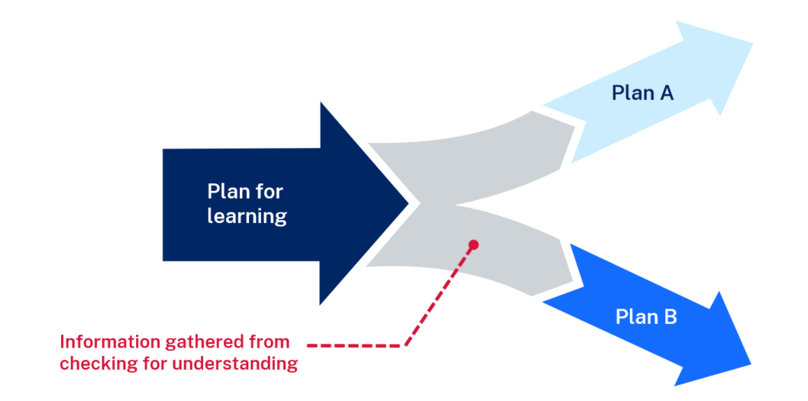
How does it work? (2)
Responsive teaching
It provides information for the teacher to make instructional decisions about where to go next in the learning.
It is the actions taken by the teacher after they have checked for understanding.
Notes:
Purpose: Explaining how responsive teaching works
Speaker notes:
[01:00]
Responsive teaching occurs when teachers use information gathered through checks for understanding to respond to student needs in real-time. The teacher provides immediate and corrective feedback. When lessons have planned checks for understanding throughout, teachers can then adapt the lessoning, by reteaching and differentiating when needed.
After each check for understanding the teacher makes a data-driven decision; whether to move forward or revisit the content based on the students’ responses. This decision is made quickly to keep the lesson on track.

Slide 36
Key considerations (2)
Responsive teaching
Responsive teaching presumes that misunderstandings and misconceptions are expected and normal in learning.
The teacher does not move on unless most of the class demonstrates understanding.
Responsive teaching requires decisions about feedback and corrections.
Feedback is immediate to prevent misunderstandings being consolidated.
Responsive teaching supports differentiated teaching and learning.
1. Rosenshine, B. (2012). Principles of instruction: Research-based strategies that all teachers should know. American Educator, 36(1), 12–39.
Notes:
Purpose: Key considerations for responsive teaching
Speaker notes:
[01:00]
Responsive teaching is a key consideration across all explicit teaching strategies. Responsive teaching involves prompt verbal feedback, correcting misconceptions and explaining correct answers and processes. Checks for understanding are used to monitor learning and inform teaching responses while learning is happening, not at the end of the lesson (AERO 2023). It facilitates differentiation for diverse learning needs, including extension. Responsive teaching supports the move between modelled, guided and independent practice. Teachers also reflect on student responses to adapt their practice, supporting all students to succeed in learning.

Slide 37
Checking for understanding (3)
Student response systems
Response cards
Gesture voting
Choral response
Mini whiteboards
Cold calling
Notes:
Purpose: Revise student response systems to check for understanding
Speaker notes:
[01:00]
Checking for understanding should be designed to allow quick responses and fast interpretation by the teacher, typically within two minutes for students to respond and 30 seconds for the teacher to evaluate.
Teachers facilitate regular low-stakes checks for understanding, ensuring a response from every student. It’s crucial to ensure that every student responds to the hinge question to get an accurate assessment of the entire class’s understanding.

Slide 38
Misconceptions
Planning for responsive teaching
Identify misconceptions
Correct misconceptions
Check for understanding and re-teach later, if needed
Notes:
Purpose: To understand the role of misconception in building learning
Speaker notes:
[01:00]
Misconceptions can be identified by the teacher both before and during the lesson. Teachers can anticipate common misconceptions based on their subject knowledge before the lesson. They can also identify misconceptions during a lesson, based on student responses and checks for understanding.
Taking time to pre-empt and identify misconceptions is important. It allows teachers to understand the accuracy or inaccuracy of knowledge students are using to develop their schema.
Teachers can do this by:
[Click] identifying common misconceptions about the concept/content to assess the validity of students' prior knowledge. Students make assumptions and wrong connections which can compromise their knowledge
[Click] correcting the misconception by explaining WHY the misconception is INCORRECT.
explaining the correct answer.
[Click] providing an opportunity later in the lesson to check for understanding on the correction of the misconception, then re-teach if needed.
References:
Madgwick H (14 July 2021) EEF Blog: ECF– Exploring the Evidence: Prior knowledge and pupil misconceptions – https://educationendowmentfoundation.org.uk/news/eef-blog-ecf-exploring-the-evidence-prior-knowledge-and-pupil-misconceptions

Slide 39
Re-teaching
Enabling motivation and participation
When a student has an incorrect answer (or doesn’t know):
Call on other students to offer an answer
Decide when it's best to correct the answer or re-teach
When re-teaching, extra scaffolding can be used to break down the concepts further and support understanding.
Notes:
Purpose: To help teachers set up an environment that is conducive to students’ ongoing participation
Speaker notes:
[02:00]
We have already learned that students need on average 3 exposures to information to learn it.¹
During checks for understanding, teachers decide whether to correct or go back and re-teach. They consider how foundational that knowledge is for the overall schema students are developing. If students don’t demonstrate understanding of key knowledge the teacher goes back and reteaches.
When a student gets it wrong or doesn’t know, move to other students. Decide when it’s best to provide the correct answer or to re-teach. Teachers check for understanding, looking for a high success rate (80%) for students². When a high success rate isn't achieved, re-teaching the concept in different ways, such as with whole-group or small group instruction or thinking aloud through the concept with more frequent questioning. You might consider using EduChat to help prepare questions to check for understanding. Ask EduChat what some common misconceptions are about a topic to help predict incorrect answers.
How teachers react to a misconception or incorrect answer directly impacts a student's willingness to continue engaging in learning. Establishing routines and expectations for classroom participation are necessary to create inclusive learning environments, where misconceptions are welcome, and students feel safe to learn.
References:
1.Nuthall G (2007) The hidden lives of learners. NZCER Press.
2. Rosenshine, B. (2012) ‘Principles of instruction: Research-based strategies that all teachers should know,’ American Educator, 36(1), 12–39.
Further reading and resources:
NSW Department of Education, Task Analytic Instruction, https://resources.education.nsw.gov.au/detail/IPR-LD230602165734 Hub Resources - Universal Resource Hub
NSW EduChat https://chat.education.nsw.gov.au/ft/#/chat
AERO – Monitor progress
If students don’t know how to answer a question, offer supportive guidance rather than allowing them to pass and moving on. Instead, you could establish a routine approach to moving on and circling back later to a student who is struggling. Support students to keep thinking and trying without singling them out in a way that might feel unsafe or unsupportive. Scaffolding questions with cues and prompts can make questions seem less intimidating. Simplifying the question to a multiple-choice format with 2 options can also help students attempt a response.

Slide 40
Extending
Creating optimal challenge
Options for extending learning:
Apply new skills and knowledge to a different context.
Justify and communicate thinking in a variety of ways for different audiences.
Unpack thinking at a deeper level to provide reasoning.
Use visual representations to summarise information and explain complex relationships.
Notes:
Purpose: Consider how checking for understanding can inform opportunities to extend student learning.
Speaker notes:
[2:00]
If consistent checking for understanding shows that students have deep knowledge, some options to extend their learning are:
applying new skills and knowledge to a different context
justifying thinking when given a provocative question and communicating it in a variety of ways for different audiences
unpacking thinking at a deeper level, demanding justification of reason and thought
using visual representations to summarise information and explain complex relationships.
All students, including HPGE students, require dynamic and responsive adjustments informed by ongoing checks for understanding. Extension is only considered once students have demonstrated a consolidated understanding of key knowledge and skills.
If consistent checks for understanding reveal students are ready for extension, you may consider using the differentiation adjustment tool.
Differentiation Adjustment Tool – https://education.nsw.gov.au/teaching-and-learning/high-potential-and-gifted-education/supporting-educators/implement/differentiation-adjustment-strategies

Slide 41
Planning, rehearsing and developing routines

Slide 42
A whole school approach
What it is
Teachers create an agreed teaching routine to use checking for understanding techniques.
Teachers use the right teaching routine for the right purpose.
What it isn't
Our school decides only to use cold calling for checking for understanding.
In our school one teacher uses popsicle sticks to select a student to answer but another teacher selects from volunteers.
Notes:
Purpose of slide: Whole school approach
Speaker notes:
[1:00]
What is a whole-school approach? It is ideal to have a number of whole school teaching routines that teachers can choose from to implement for the right purpose at the right time.
For example: the teacher decides today’s lesson would be suitable for the mini whiteboards for checking for understanding. They use the school’s agreed procedure to administer this learning routine.
[click] What it’s not, [click] we aren’t just doing one teaching routine every time. [click] And we want to avoid teachers using different teaching routines for the same thing. It isn’t effective if one teacher is doing a random selection for cold call and the next teacher allows students to opt out of participating by selecting volunteers.
So in this session your group will come up with a whole school teaching routine for one of the checking for understanding techniques.

Slide 43
Creating whole-school routines
Activity
Draft whole-school teaching routines for checking for understanding techniques.
Share the revised teaching routines.
Agree on whole-school routines for techniques.
Notes:
Note to presenter: consideration needs to be given as to how a routine is created, for example, in small groups, cross-stage or cross-faculty, etc. If working with a larger staff group, form smaller groups.
Speaker notes:
[1:00]
Today we will be doing an activity in groups to develop possible whole-school routines for checking for understanding (CFU).
In your groups, draft a consensus on a CFU routine that aligns with effective teaching practices. Remember, this should be a routine that can be applied across the school.
After drafting, the group leader will model the routine using the routine for feedback. This step is crucial as it allows the group to reflect on and refine the process based on the feedback prompts provided.
Once refined, we’ll come back together and share these routines as a whole. The goal is to adopt a cohesive approach that supports all teachers and ensures students feel confident in participating and engaging with the content.

Slide 44
Planning and rehearsing (2)
The key to success
Plan
Rehearse
Feedback
Evidence for Learning (2022) Effective Professional Development, Sydney: Evidence for Learning.
Notes:
Purpose of slide: To explain the process of rehearsing
Speaker notes:
[01:10]
Now that we have our routine, we have some time to plan, rehearse, and get feedback from each other. When we say rehearse, we mean:
[click] plan number of suitable questions or activities ready
[click] deliver the instruction as if doing it in class.
Then your partners
[click] will use the feedback prompts on the next slide to refine the teaching routine. What may need to be added, changed, enhanced or deleted?
Note to presenter: it is advisable to prepare the leaders beforehand if modelling and rehearsing are not yet established practices in the school.
Further reading on this research:
Sims, S., Fletcher-Wood, H., O’Mara-Eves, A., Cottingham, S., Stansfield, C., Van Herwegen, J., Anders, J. (2021). What are the Characteristics of Teacher Professional Development that Increase Pupil Achievement? A systematic review and meta-analysis. London: Education Endowment Foundation.
The report is available from: https://educationendowmentfoundation.org.uk/education-evidence/evidence-reviews/teacherprofessional-development-characteristics
The EEF Guidance Report Effective Professional Development is available at: https://educationendowmentfoundation.org.uk/education-evidence/guidance-reports/effectiveprofessional-development
AERO’s Classroom management practice guide – gaining all students’ attention outlines how teachers should script and rehearse and use a checklist to refine before doing it with students present. https://www.edresearch.edu.au/sites/default/files/2023-12/gaining-all-students-attention-aa.pdf

Slide 45
Rehearsal steps and feedback prompts
Feedback prompts
Did the technique elicit thinking from the whole class?
Was the teacher’s question clear and specific?
Did the teacher check for understanding on what they just taught?
Was there adequate wait time?
Would the teacher be able to check for understanding from all students with this approach?
Use your learning sequence or lesson plan to:
Select a technique to check for understanding.
Create a 'checking for understanding' question(s).
Plan your instructions for the class.
With a partner, rehearse the teaching for this 'checking for understanding’ technique.
Use the feedback and modelling from your partner to improve your approach.
Swap with your partner for their rehearsal.
Notes:
Purpose of slide: To give the steps and feedback prompts for the activity
Speaker notes:
[00:20]
Take a minute to go through the rehearsal steps and the prompts for feedback.
If you are giving feedback, we have provided a list of prompts for you to think about how the routine could be refined.
Note to presenter: this slide and the activity slide could be provided to the groups as handouts.

Slide 46
In the next part of this module, we will work on evaluating our approach to implementing the strategies through techniques
Notes:
Speaker notes:
[00:20]
Note to presenter: Select a technique to focus on with a cycle of planning, rehearsing and developing routines. This will support developing sustainable routines in the school.

Slide 47
Evaluating a whole-school approach
Part C

Slide 48
Purpose and outcome (3)
Purpose
To apply effective professional development structures, reflect on and evaluate our implementation of an explicit teaching technique.
Outcome
Refine the whole-school practices of checking for understanding and plan for future success and activities.
Notes:
Purpose of slide: Purpose and outcome of Part C
Speakers notes:
[00:20]
In this part, the focus is on reflection and evaluation. We will consider the early indicators of success and use this to plan for evaluation of longer-term impact. There is also a good opportunity to refine the routines we are developing as a whole school in line with what is working in classroom presently.

Slide 49
Evaluating impact on students

Slide 50
Measuring success
What should our early measures of impact be?
Short term
Increased engagement
Increased ability to articulate the lesson’s learning intention(s) and success criteria
Longer term
Increased understanding
Increased learning
Student data indicates learning gains
Notes:
Purpose of slide: Measuring success
Speaker notes:
[2:00]
When we try something new in the classroom and our students experience it for the first time, it may not have the desired impact. Over time, the impact of the approach should show signs of success.

Slide 51
Data sources to measure impact
Reflecting on initial observations
Short term
Increased engagement
Increased ability to articulate the lesson’s learning intention(s) and success criteria
Longer term
Increased understanding
Increased learning
Student data indicates learning gains
A continuum of student engagement, from Reimagining Student Engagement by Amy Berry (2023)
Notes:
Purpose of slide: Reflecting on initial observations and considering long-term measures
Speaker notes:
[06:00]
In Part A, we identified the level of students’ engagement in our classrooms. This measure can be used as an indicator – where we consider the most immediate indicator of change and use this measure to track change over time.
We could choose a different measure, but it's important it is proximal to the teaching. It should be an immediately observable/collectable indicator of change in students’ knowledge, skills, motivation, self-belief, or teacher practice. This information of what is successful helps us plan for longer term outcomes.
Activity:
What observations can you make about checking for understanding techniques in the classroom?
What observations can be made about what has been successful so far while we’ve focused on checking for understanding in classrooms?
How will we measure longer term outcomes?
How can we scale our success by refining and building the techniques and routines we’ve been developing?
Note to presenter: You may wish to display the data from the first session if it was collected.
Further reading on High Impact Professional Learning:
High Impact Professional Learning
References:
Berry A (2020) Reimagining Student Engagement https://www.kqed.org/mindshift/61926/reimagining-student-engagement-as-a-continuum-of-learning-behaviors
McCrae P (2020) Motivated teaching (p.17)

Slide 52
School Excellence Framework
Explicit teaching in NSW Public Schools
‘School-wide explicit teaching approaches incorporate modelled, guided and independent practice.
Teachers consider students’ cognitive load and employ explicit teaching strategies to optimise learning progress of students across the full range of abilities. Effective methods are identified, promoted and modelled, and students’ learning improvement is monitored, demonstrating growth.’
School Excellence Framework, Teaching Domain (p 11)
52
Notes:
Purpose of slide: Aligning the practice to the SEFv3 – suggested for school leadership team
Speaker notes:​
[06:00]
​
Linking to longer term outcomes, the SEF is an excellent way to measure whole-school impact over time.
Checking for understanding relates to themes from the SEFv3​
​
For example, in the teaching domain, under the element of effective classroom management, this practice aligns with the descriptors for the theme of explicit teaching and classroom management.
Activity:
Access and identify key features from delivering, sustaining and growing and excelling for the explicit teaching theme.
Access and identify key features from delivering, sustaining and growing and excelling for the classroom management theme.
Describe how our classrooms would look, feel and sound if we were to move to 'sustaining and growing' or move to 'excelling'
Discussion points:
In ‘sustaining and growing’ the practice looks like a whole school approach to positive classroom management.
This extends to learning routines in ‘excelling’, where there are consistent school-wide approaches to learning routines that enable student engagement. ​
​

Slide 53
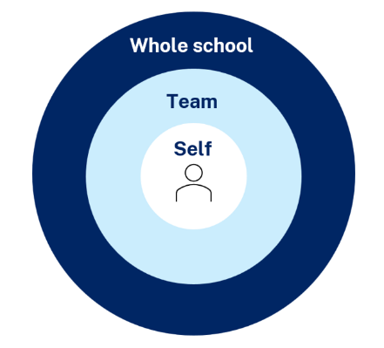
Maintaining a whole school approach
Using data
Video observation and reflection
Peer observation and feedback
Teacher and student survey
Growth in assessment data
Notes:
Purpose of slide: collating and using data - suggested for school leadership team
Speaker notes:
[05:00]
Evaluating data is a way we can consider the extent to which we are being effective in achieving long term goals. Data can be collected from many perspectives, including individual teachers and students, teams and whole school. Data can include a range of things, such as observational/instructional rounds, student work samples (such as exit tickets), student self-reports, teacher reflections and assessments. Data can be quantitative and qualitative.
Reflecting on data helps us consider how efficient and effective we are being in achieving our instructional goals. It also provides key insights to inform the next steps of professional learning and whole school strategic planning.
Activity:
What data have we accessed so far and what have we learnt?
How can we select and measure data over time to consider our impact?
Further reading:
More information about using data to evaluate the curriculum aligned to the School Excellence Framework LECI: Module 5: Using data to effectively evaluate the curriculum AC01087

Slide 54
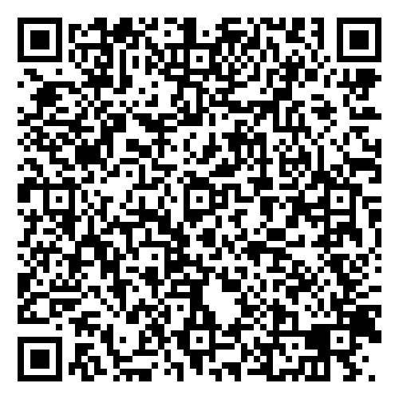
Feedback
Please complete the Checking for understanding learning module survey to help us improve future professional learning and provide further support.
Contact us
ContactCurriculumReform@det.nsw.edu.au

Slide 55
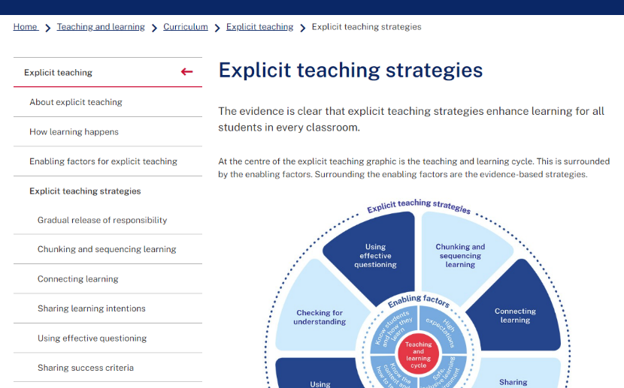
Explicit teaching strategies and resources
More information is available about:
​explicit teaching
how learning happens
the enabling factors
the explicit teaching strategies
https://education.nsw.gov.au/teaching-and-learning/curriculum/explicit-teaching
Notes:
Purpose of slide: Next steps
Speaker notes:
[0:40]
The evidence on explicit teaching is clear, it shows us how important it is to align our teaching pedagogy with how learning occurs. Ongoing information to support this is available on the department's website.
This includes information about the enabling factors, how learning happens and the explicit teaching strategies. The website will continue to be updated as new resources are released in future. https://education.nsw.gov.au/teaching-and-learning/curriculum/explicit-teaching

Slide 56
Further reading
AERO (2024) Foundational classroom management resources handbook, AERO, accessed 4 October 2024.
NSW Department of Education (CESE) Guide to evidence-based models of collaborative inquiry, NSW Department of Education, accessed 4 October 2024.
NSW Department of Education (2024) What is high impact professional learning?, NSW Department of Education, accessed 4 October 2024.
Powerful Learning (28 January 2024) Reimagining Student Engagement with Dr. Amy Berry, Powerful Learning Podcast, YouTube, accessed 4 October 2024.
Timperley H, Parr J and Bertanees C (2009) Promoting professional inquiry for improved outcomes for students in NEW Zealand. Professional Development in Education, 35(2) 227-245.
Tips for Teachers (14 December 2022) ‘Check for understanding - tips for teachers’[video], YouTube, accessed 12 September 2024.

Slide 57
Reference list (1)
This presentation contains NSW Curriculum and syllabus content. The NSW Curriculum is developed by the NSW Education Standards Authority. This content is prepared by NESA for and on behalf of the Crown in the right of the State of New South Wales. The material is protected by Crown copyright.
Please refer to the NESA Copyright Disclaimer for more information https://educationstandards.nsw.edu.au/wps/portal/nesa/mini-footer/copyright.
NESA holds the only official and up-to-date versions of the NSW Curriculum and syllabus documents. Please visit the NSW Education Standards Authority (NESA) website https://educationstandards.nsw.edu.au/wps/portal/nesa/home and the NSW Curriculum website https://curriculum.nsw.edu.au.
Archer A and Hughes C (2011) Explicit instruction: Effective and efficient teaching. Guilford Press.
Australian Education Research Organisation (AERO) (2021) Focused classrooms: managing the classroom to maximise learning, Australian Education Research Organisation, accessed 12 September 2024.
Australian Education Research Organisation (AERO) (2023) How students learn best: An overview of the evidence, Australian Education Research Organisation, accessed 12 September 2024.
Australian Education Research Organisation (AERO) (2024) Monitor progress, Australian Education Research Organisation, accessed 12 September 2024.
Australian Education Research Organisation (AERO) (2023) Teaching routines: their role in classroom management, Australian Education Research Organisation, accessed 12 September 2024.
Berry A (4 July 2023) Reimagining student engagement as a continuum of learning behaviors | KQED, KQED, accessed 12 September 2024.

Slide 58
Reference list (2)
Bianchini JA (4 June 2008) ‘Mary Budd Rowe: a storyteller of science’, Cultural Studies of Science Education, 3(4):799–810, doi:10.1007/s11422-008-9132-y.
Stahl R (May 1994) ‘Using "think-time" and "wait-time" skillfully in the classroom.’ [PDF], ERIC Digest, accessed 12 September 2024.
Commonwealth of Australia or Education Services Australia Ltd (1 January 2024) Grappling with engagement | Student Wellbeing Hub, Student Wellbeing Hub, accessed 12 September 2024.
Donohoo J, Hattie J and Eells R (2018) ‘The power of collective efficacy’. Educational Leadership 75, 40-44.
Evidence for Learning (2022) Effective Professional Development, Sydney: Evidence for Learning.
Harn, B, Parisi D and Stoolmiller M (2013) ‘Balancing Fidelity With Flexibility and Fit: What Do We Really Know About Fidelity of Implementation in Schools?’ Exceptional Children, 79, 181-193 10.1177/001440291307900204.
Lemov D (October 26, 2016) Cold Call is inclusive. Teach like a champion https://teachlikeachampion.org/blog/cold-call-inclusive/
McCrea P (2020) Motivated Teaching: harnessing the science of motivation to boost attention and effort in the classroom, Createspace Independent Publishing Platform.
Madgwick H (14 July 2021) EEF Blog: ECF– Exploring the Evidence: Prior knowledge and Pupil Misconceptions, Education Endowment Foundation, accessed 4 October 2024

Slide 59
Reference list (3)
Nuthall G (2007) The hidden lives of learners, New Zealand Council for Educational Research.
Peeters A, Robinson V and Rubie-Davies C (April 2020) ‘Theories in use that explain adolescent help seeking and avoidance in mathematics,’ Journal of Educational Psychology, 112(3):533–550, doi:10.1037/edu0000423.
Rosenshine, B. (2012) ‘Principles of instruction: Research-based strategies that all teachers should know,’ American Educator, 36(1), 12–39.
Sedgehill Academy (28 November 2022) ‘Teaching & learning at sedgehill academy - mini whiteboards’[video], YouTube, accessed 12 September 2024.
Wiliam D (1 September 2015) Designing great hinge questions, ASCD, 73(1).

Slide 60
Copyright
© State of New South Wales (Department of Education), 2024
The copyright material published in this resource is subject to the Copyright Act 1968 (Cth) and is owned by the NSW Department of Education or, where indicated, by a party other than the NSW Department of Education (third-party material).
Copyright material available in this resource and owned by the NSW Department of Education is licensed under a Creative Commons Attribution 4.0 International (CC BY 4.0) license.
This license allows you to share and adapt the material for any purpose, even commercially.
Attribution should be given to © State of New South Wales (Department of Education), 2024.
Material in this resource not available under a Creative Commons license:
the NSW Department of Education logo, other logos and trademark-protected material
Material owned by a third party that has been reproduced with permission. You will need to obtain permission from the third party to reuse its material.
Links to third-party material and websites
Please note that the provided (reading/viewing material/list/links/texts) are a suggestion only and implies no endorsement, by the New South Wales Department of Education, of any author, publisher, or book title. School principals and teachers are best placed to assess the suitability of resources that would complement the curriculum and reflect the needs and interests of their students.
If you use the links provided in this document to access a third-party’s website, you acknowledge that the terms of use, including licence terms set out on the third-party’s website apply to the use which may be made of the materials on that third-party website or where permitted by the Copyright Act 1968 (Cth). The department accepts no responsibility for content on third-party websites.

