Slide 1

Year 10, Term 2 – Reshaping the world
Phase 3, resource 2 – form, rhyme structure and meter – PowerPoint
Notes:
Teacher note: In this lesson, students will be explicitly taught about the form, rhyme structure and meter of ‘I wandered lonely as a cloud’ by William Wordsworth. Explicit teaching is the best way to teach students new or complex concepts or skills such as this as it provides the necessary building blocks for guided and independent practice.
The following activities are designed to accompany Phase 3, activity 6 – form, rhyme structure and meter. By explicitly teaching students about the form, rhyme structure and meter of ‘I wandered lonely as a cloud’ by William Wordsworth, students will be able to apply their new knowledge and skills to guided and independent annotations and written responses. This will help students to prepare for responding to unseen poems in their formal examination.

Slide 2
Sharing learning intentions and success criteria
Notes:
Teacher note: sharing learning intentions with students allows a teacher to effectively communicate learning goals with students. They allow students to connect new learning to existing knowledge, skills and understanding. When used with success criteria, students have a clear idea of the learning goal and how to get there. This slide should be deleted or hidden when using in a classroom setting.

Slide 3
Learning intentions and success criteria (1)
Learning intentions
We are learning to:
understand the form, rhyming structure and meter of ‘I wandered lonely as a cloud’ and how these are stylistic features of Romantic poetry.
Success criteria
I will know I am successful when I can:
[these could be co-constructed with the class or used as per the notes].
Notes:
Teacher note: clarify what students are learning and why.
Learning intentions and success criteria are best co-constructed with students. Adapt the learning intention as required and add matching success criteria.
LISC is not necessarily presented at the beginning of the lesson. Teacher needs to consider most effectual time to introduce.
LISC should be revisited during the lesson to support students' evaluation of their learning.
Success criteria should be communicated to students, so they understand what it looks like to achieve the learning intention. The success criteria breaks the learning intention into smaller, more manageable actions and show students what they must be able to do, say, make, create or perform to demonstrate their learning.
Students may achieve this at different 'levels' depending on the starting point of different students. The suggested success criteria below have been differentiated – not all students will be able to demonstrate success in each of the criteria, however, all students should be able to experience success. It is not necessary to explain this differentiation to students. Depending on the needs of your students, you may choose to remove one or more of the success criteria. For example, if you know that your students will require high levels of support, you may choose to remove the final success criteria. Conversely, if you know that your students can already recall key features of the poem’s form, there is no need to include the first success criteria.
Suggested success criteria
I will know I am successful when I can:
recall key features of the poem’s form
identify the rhyme structure of the poem
explain the difference between a poetic foot and meter and apply this knowledge to identify the meter of ‘I wandered lonely as a cloud’
make connections between the stylistic features of Romantic poetry and the context in which it was composed.

Slide 4
Connecting learning
Notes:
Teacher note: learning creates a shift from working memory to long term memory. Making connections within and across learning helps students to develop increasingly complex mental models or schemas. This helps to manage students’ cognitive load by providing context about the value and significance of the learning and connecting new learning with their prior knowledge.
Students may have previously engaged with form, rhyme structure and meter in Year 8, Term 1 – Knowing the rules to break the rules and Year 9, Term 3 – Poetic purpose. The following slides are included to briefly revise and activate students’ prior knowledge of these aspects using examples from previous units. Where required, you may like to return to these units and revisit some of the resources and activities provided.

Slide 5
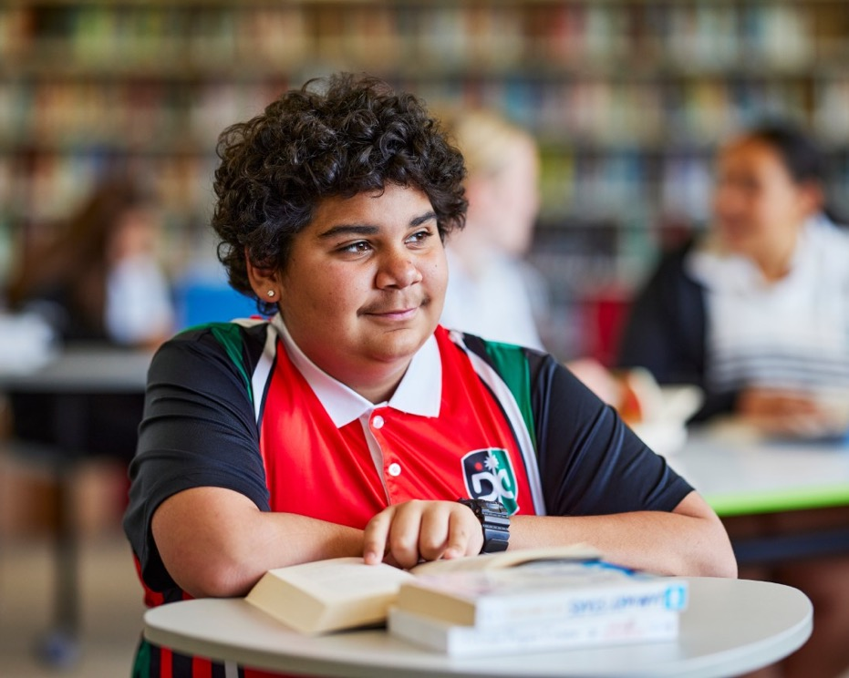
Form, rhyming structure and meter of ‘How Do I Love Thee? (Sonnet 43)’
In Year 8, Term 1 – Knowing the rules to break the rules, you may have studied ‘How Do I Love Thee? (Sonnet 43)’ by Elizabeth Browning.
It is written in the form of a Petrarchan sonnet, which focuses on the topic of love.
It is structured with an ABBAABBA CDCDCD rhyme scheme.
It uses iambic pentameter (5 da-DUMs), meaning that it ‘sounds’ like a song when read aloud.
Notes:
Teacher note: this slide is included to revise form, rhyme and meter students may have learnt about in their study of ‘How Do I Love Thee? (Sonnet 43)’ by Elizabeth Browning in Year 8, Term 1 – Knowing the rules to break the rules. Read through and discuss as a class, asking students questions to assess what they already know or remember about meter, rhyme and meter.

Slide 6
Form, rhyming structure and meter of ‘The Echoing Green’ by William Blake
In Year 8, Term 1 – Knowing the rules to break the rules, you may have studied ‘The Echoing Green’ by William Blake.
It is structured in three 10-line stanzas, a form of Blake’s own invention.
It uses an AABBCCDDEE FFGGHHIIJJ KKLLMMNNOO rhyme scheme.
It is mostly written in iambic tetrameter (4 da-DUMs), with some variations throughout.
Notes:
Teacher note: this slide is included to revise form, rhyme and meter students may have learnt about in their study of ‘The Echoing Green’ by William Blake in Year 8, Term 1 – Knowing the rules to break the rules. Read through and discuss as a class, asking students questions to assess what they already know or remember about meter, rhyme and meter.

Slide 7
Form, rhyming structure and meter of ‘The Black Rat’
In Year 9, Term 3 – Poetic purpose, you may have studied ‘The Black Rat’ by Iris Clayton.
It is written in the ballad form, which traditionally uses 10 stanzas with 4 lines in each standard.
It uses a distinct AABB rhyme scheme and a rhythm referred to as ballad meter to make it easy to remember and recite for entertainment.
Traditional ballad meter:
First and third lines of each stanza are written in tetrameter (4 feet or stresses)
Second and fourth lines are written in trimeter (3 feet or stresses)
Notes:
Teacher note: this slide is included to revise form, rhyme and meter students may have learnt about in their study of ‘The Black Rat’ by Iris Clayton in Year 9, Term 3 – Poetic purpose. Read through and discuss as a class, asking students questions to assess what they already know or remember about meter, rhyme and meter.

Slide 8
Gradual release of responsibility
Notes:
Teacher note: this slide has been used to identify the explicit teaching learning strategy and should be deleted or hidden when using in a classroom setting. The strategy of gradual release of responsibility is a flexible process moving between modelled, guided and independent teaching practice responsive to student learning. Students should be supported to move between each practice based on their capabilities and requirements. This slide should be deleted or hidden when using in a classroom setting.

Slide 9
Definition of poetic feet and meter (1)
Romantic poems share similar concerns and values. The form and structure of Romantic poems contribute to the distinctive style of the literature for the movement.
In poetry, feet are used to describe different patterns of stressed and unstressed syllables used in each line, and meter is used to describe the number of poetic feet used per line. Meter is defined by how many syllables or beats there are on each line and the pattern formed by the stressed or unstressed beats (feet).
Notes:
Teacher note: it is important that students understand essential terminology before building on their knowledge. The following slides are designed to support students in activating their prior knowledge about poetic feet and meter, which they may have already learned about in previous units or introducing them to these key concepts of poetry. These slides should be used as a reference point for students and may be referred back to throughout the unit as required. Where possible, please support students with further explanations and examples of key terms, if they are still feeling unsure.

Slide 10
Definition of poetic feet and meter (2)
For example:
an iamb – or iambic foot – is when the first syllable is stressed, followed by an unstressed syllable. It sounds like this – ‘da-DUM’. Iambic meter reflects the natural sound of the English language and is commonly used in Romantic poetry. It mimics the sound of a heartbeat.
a trochee – or trochaic foot – is when the first syllable is stressed, and the second syllable is unstressed. It sounds like this – ‘DUM-da’. A trochee is the reverse of an iamb. It mimics the sound of a galloping horse.
Notes:
Teacher note: it is important that students understand essential terminology before building on their knowledge. The following slides are designed to support students in activating their prior knowledge about poetic feet and meter, which they may have already learned about in previous units or introducing them to these key concepts of poetry. These slides should be used as a reference point for students and may be referred back to throughout the unit as required. Where possible, please support students with further explanations and examples of key terms, if they are still feeling unsure.

Slide 11
Types of meter
Monometer – 1 foot per line
Diameter – 2 feet per line
Trimeter – 3 feet per line
Tetrameter – 4 feet per line
Pentameter – 5 feet per line
Hexameter – 6 feet per line
Notes:
Teacher note: it is important that students understand essential terminology before building on their knowledge. This slide lists the different types of meter used in poetry. There is an opportunity to connect to prior learning here – in Phase 2, activity 5 – unpacking numerical prefixes in poetry students explored the connection between the prefixed and poetry metalanguage. To help students remember, note the numerical prefixes and give examples, where possible:
For example:
Mono – one, mono-rail
Di – two, dia-gonal
Tri – three, tri-angle
Tetra – four, tetra-gon
Penta – five, penta-gon
Hexa – six, hexa-gon

Slide 12
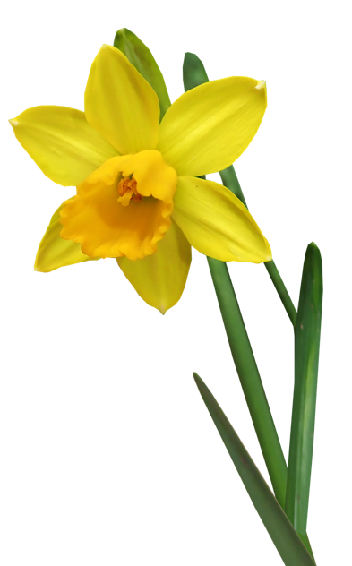
Form of ‘I wandered lonely as a cloud’
A lyric poem – a short poem with songlike qualities, used to express the poet’s thoughts and feelings
Made up of 4 sestet (6-line) stanzas
Written from first-person point of view
Primarily written in past tense as the poet remembers walking amongst the daffodils, though shifts to present tense in the final stanza
Uses everyday language to describe situations and events from ‘common life’
'Daffodil, Flower, Flower background image’ by Buntysmum is licensed under Pixabay Content License.
Notes:
Teacher note: use this slide to discuss and explain the form of ‘I wandered lonely as a cloud’. Refer students to their copy of the poem to annotate the features of form, including the sestets and shift to past tense in the final stanza.

Slide 13
Rhyming structure in ‘I wandered lonely as a cloud’
The rhyming structure refers to the pattern of rhymes within a poem. Rhyme schemes are described by assigning letters of the alphabet to matching rhymes at the end of each line. When poems are more than one stanza, a space is used to represent stanza breaks in a rhyme scheme. For example, ABAB DEDE FF.
For example, the first stanza of the poem has a rhyming structure of ABABCC.
I wandered lonely as a cloud
That floats on high o'er vales and hills,
When all at once I saw a crowd,
A host, of golden daffodils;
Beside the lake, beneath the trees,
Fluttering and dancing in the breeze.
A
B
A
B
C
C
Notes:
Teacher note: use this slide to discuss and explain the rhyming structure of ‘I wandered lonely as a cloud’. Refer students to their copy of the poem to annotate the rhyming pattern using letter coding to draw attention to the lines that rhyme. The first stanza has been modelled on this slide.

Slide 14
Meter in ‘I wandered lonely as a cloud’ (1)
Foot 1 | Foot 2 | Foot 3 | Foot 4
I wan- | dered lone- | ly as | a cloud
That floats | on high | o’er vales | and hills,
When all | at once | I saw | a crowd,
A host | of gol- | den daff- | o-dills.
In this example from the poem, you can see that each line consists of 4 iambic feet (da-DUMs). The first syllable of each foot is unstressed and the second syllable is stressed.
Since there are 4 (tetra-) feet per line, ‘I wandered lonely as a cloud’ is written in iambic tetrameter.
Notes:
Teacher note: use this slide to discuss and explain the meter of ‘I wandered lonely as a cloud’. It may be useful to revisit slide 8 to revise the definitions of poetic feet and meter.

Slide 15
Meter in ‘I wandered lonely as a cloud’ (2)
Foot 1 | Foot 2 | Foot 3 | Foot 4
Contin- | uous | as the stars | that shine
And twink- | le on | The milk- | y way
They stretched | in nev-
In this example from the poem, you can see that each line consists of 4 iambic feet (da-DUMs). The first syllable of each foot is unstressed and the second syllable is stressed.
Since there are 4 (tetra-) feet per line, ‘I wandered lonely as a cloud’ is written in iambic tetrameter.
Notes:
Teacher note: use this slide to check for understanding. Direct students to Phase 3, activity 6 – form, rhyme structure and meter where they complete a table to identify the iambic tetrameter in the second stanza of ‘I wandered lonely as a cloud’. You may move in and out of the stages of the gradual release of responsibility here. Further teacher modelling of identifying the feet within a line of poetry may be required. Students may need more guided practice. There may be movement between guided practice and modelled example before students can complete independent practice. Check for understanding from all students frequently when moving through the phases of the gradual release of responsibility.

Slide 16
Checking for understanding
Notes:
Teacher note: it is important to check that all students understand what has been taught up until this point before teaching a new concept, content or skill. You should regularly check student understanding using a variety of strategies in order to make the best instructional decisions for your class. This includes when to move between modelled, guided and independent practice. Checking for understanding requires teachers to collect responses of all students. The following slides contain quick response questions to check students’ understanding of form, rhyme structure and meter.

Slide 17
True or false – form
‘I wandered lonely as a cloud’
Using your true or false cards, respond to the following statements:
‘I wandered lonely as a cloud’ is a sonnet.
Lyric poems have songlike qualities and usually explore a poet’s thoughts and feelings about a topic.
Sestets are made up of 6 lines.
‘I wandered lonely as a cloud’ is written in first person.
Wordsworth uses formal, academic language throughout the poem.
‘I wandered lonely as a cloud’ is structured in 4 stanzas.
Notes:
Teacher note: Checking for understanding requires teachers to collect responses of all students. Using true or false cards, you can clearly identify if students are confident with form of ‘I wandered lonely as a cloud’. It is important to check that all students understand before teaching moving on to new content, concepts or skills. You should regularly check student understanding using a variety of strategies in order to make the best instructional decisions for your class. This includes when to move between modelled, guided and independent practice.
Discuss the answers with the class, explaining why the false statements are incorrect.
Answers:
False – it is not a sonnet.
True
Tue
True
False – Wordsworth uses everyday language to engage an everyday audience.
True

Slide 18
Quick response – rhyme structure
‘I wandered lonely as a cloud’
Using mini whiteboards or ABCD cards, select the correct rhyme scheme for the second stanza of ‘I wandered lonely as a cloud’ displayed on the right. Remember that the first stanza is ABABCC:
ABABAB
DEDEFF
AB AB CC
DDEEFF
Continuous as the stars that shine
And twinkle on the milky way,
They stretched in never-ending line
Along the margin of a bay:
Ten thousand saw I at a glance,
Tossing their heads in sprightly dance.
Notes:
Teacher note: checking for understanding requires teachers to collect responses of all students. Using true or false cards, you can clearly identify if students are confident with the rhyme structure of ‘I wandered lonely as a cloud’. It is important to check that all students understand before moving on to new content, concepts or skills. You should regularly check student understanding using a variety of strategies in order to make the best instructional decisions for your class. This includes when to move between modelled, guided and independent practice.
Discuss the answer with the class, explaining why b) is the correct answer.
Answer: b) DEDEFF – as it is the second stanza of the poem. The other options are incorrect because it does not follow an ABABAB (a) or DDEEFF (d) rhyme scheme, nor is it separated into couplets (c).

Slide 19
True or false – meter
‘I wandered lonely as a cloud’
Using your true or false cards, respond to the following statements:
A poetic foot refers to the number of syllables in a line.
Meter describes the type and number of feet per line.
Syllables are either stressed or unstressed.
An iamb sounds like galloping horses.
There are six feet per line in a tetrameter.
Notes:
Teacher note: checking for understanding requires teachers to collect responses of all students. Using true or false cards, you can clearly identify if students are confident with the meter of ‘I wandered lonely as a cloud’. It is important to check that all students understand before moving on to new content, concepts or skills. You should regularly check student understanding using a variety of strategies in order to make the best instructional decisions for your class. This includes when to move between modelled, guided and independent practice.
Discuss the answers with the class, explaining why the false statements are incorrect.
Answers:
False – it refers to the pattern of stressed and unstressed syllables
True
True
False – iambic feet sound like a heartbeat. Trochaic feet sound like galloping horses.
False – there are four feet in a tetrameter.

Slide 20
Returning to the learning intentions and success criteria
Notes:
Teacher note: the learning intention should be referred back to throughout the lesson to check for understanding, provide feedback to students and for students to monitor their progress towards achieving their learning goal. Returning to the learning intention and success criteria at the end of the lesson is an important part of the learning process. It allows students to reflect on their learning, while allowing the teacher the opportunity to formatively assess students’ knowledge and understanding from the lesson. Teachers could use a quick response strategy such as traffic lights or thumbs up/thumbs down to check for understanding for each of the success criteria.

Slide 21
Learning intentions and success criteria (2)
Learning intentions
We are learning to:
understand the form, rhyming structure and meter of ‘I wandered lonely as a cloud’ and how these are stylistic features of Romantic poetry.
Success criteria
I will know I am successful when I can:
[these could be co-constructed with the class or used as per the notes].
Notes:
Teacher note: returning to the learning intention and success criteria allows for students to reflect on what they have learnt, while checking for understanding. If individual whiteboards are available, have students indicate the success criteria that they have achieved by writing 1, 2 or 3 on them. Otherwise, consider using the 3-finger system – 1 finger for level 1, 2 fingers for level 2, 3 fingers for level 3 – or traffic lights – green for understands and can apply without help, yellow for understands but still needs help to apply, red for needs help to understand.
Suggested success criteria
I will know I am successful when I can:
recall key features of the poem’s form
identify the rhyme structure of the poem
explain the difference between a poetic foot and meter and apply this knowledge to identify the meter of ‘I wandered lonely as a cloud’
make connections between the stylistic features of Romantic poetry and the context in which it was composed.

Slide 22
References
This presentation contains NSW Curriculum and syllabus content. The NSW Curriculum is developed by the NSW Education Standards Authority. This content is prepared by NESA for and on behalf of the Crown in the right of the State of New South Wales. The material is protected by Crown copyright.
Please refer to the NESA Copyright Disclaimer for more information https://educationstandards.nsw.edu.au/wps/portal/nesa/mini-footer/copyright.
NESA holds the only official and up-to-date versions of the NSW Curriculum and syllabus documents. Please visit the NSW Education Standards Authority (NESA) website https://educationstandards.nsw.edu.au/wps/portal/nesa/home and the NSW Curriculum website https://curriculum.nsw.edu.au.
AERO (Australian Education Research Organisation) (2024) Explain learning objectives External link, AERO, accessed 16 April 2024.
English K–10 Syllabus © NSW Education Standards Authority (NESA) for and on behalf of the Crown in right of the State of New South Wales, 2022.
Buntysmum (2018) 'Daffodil, Flower, Flower background image' [image], Buntysmum, Pixabay website, accessed 21 May 2024.
Griffin P (2018) Assessment for teaching, Cambridge University Press.
Wordsworth W (1807) ‘I wandered lonely as a cloud’ in Moods of my own Mind. A version of this is available at Project Gutenberg. This work is in the public domain.

Slide 23
Copyright
© State of New South Wales (Department of Education), 2024
The copyright material published in this resource is subject to the Copyright Act 1968 (Cth) and is owned by the NSW Department of Education or, where indicated, by a party other than the NSW Department of Education (third-party material).
Copyright material available in this resource and owned by the NSW Department of Education is licensed under a Creative Commons Attribution 4.0 International (CC BY 4.0) license.
This license allows you to share and adapt the material for any purpose, even commercially.
Attribution should be given to © State of New South Wales (Department of Education), 2024.
Material in this resource not available under a Creative Commons license:
the NSW Department of Education logo, other logos and trademark-protected material
Material owned by a third party that has been reproduced with permission. You will need to obtain permission from the third party to reuse its material.
Links to third-party material and websites
Please note that the provided (reading/viewing material/list/links/texts) are a suggestion only and implies no endorsement, by the New South Wales Department of Education, of any author, publisher, or book title. School principals and teachers are best placed to assess the suitability of resources that would complement the curriculum and reflect the needs and interests of their students.
If you use the links provided in this document to access a third-party’s website, you acknowledge that the terms of use, including licence terms set out on the third-party’s website apply to the use which may be made of the materials on that third-party website or where permitted by the Copyright Act 1968 (Cth). The department accepts no responsibility for content on third-party websites.

