Slide 1
Year 10, Term 3 – Shakespeare retold
NSW Department of Education
Phase 2, resource 3 – Shakespeare's genres
Shakespeare's genres
Notes:
Teacher note: this resource is designed to support Phase 2, sequence 2.

Slide 2
Sharing learning intentions and success criteria
NSW Department of Education
Notes:
Teacher note: this slide has been used to identify the Explicit teaching learning strategy and should be deleted or hidden when using in a classroom setting. Sharing learning intentions allows a teacher to effectively communicate learning goals with students. They allow students to connect new learning to existing knowledge, skills and understanding. When used with success criteria students have a clear idea of the learning goal and how to get there (AERO 2024). The sample success criteria are aligned to the syllabus. They break the learning intention into smaller and more manageable actions. They show students what they must do, say, make, create or perform to demonstrate their learning (Griffin 2018). These have been left blank with suggestions provided in the notes to allow for the co-construction of success criteria that reflects student need. When co-constructing with students, teachers use their expertise to guide student thinking, and often model and use exemplars to show students what success 'looks like'.

Slide 3
Learning intentions and success criteria
Learning intention
We are learning to:
understand who Shakespeare is and the influence he has had on the literary canon.
Success criteria
I will know I am successful when I can:
[these could be co-constructed with the class or used as per the notes].
Notes:
Teacher note: the intention of this PowerPoint is to develop an understanding of the features of the 3 key genres Shakespeare's plays are commonly classified as.
Use this slide to clarify what students are learning and why.
Learning intentions and success criteria are best co-constructed with students. Adapt the learning intention as required and add matching success criteria.
LISC is not necessarily presented at the beginning of the lesson. Teacher needs to consider most effectual time to introduce.
LISC should be revisited during the lesson to support students' evaluation of their learning.
Success criteria should be communicated to students, so they understand what it looks like to achieve the learning intention. The success criteria breaks the learning intention into smaller, more manageable actions and shows students what they must be able to do, say, make, create or perform to demonstrate their learning.
Students may achieve this at different 'levels' depending on the starting point of different students. The suggested success criteria below have been differentiated – not all students will be able to demonstrate success in each of the criteria, however, all students should be able to experience success. It is not necessary to explain this differentiation to students. Depending on the needs of your students, you may choose to remove one or more of the success criteria.
Suggested success criteria:
I will know I am successful when I can:
identify Shakespeare’s key literary genres
identify the features of the 3 main genres.

Slide 4
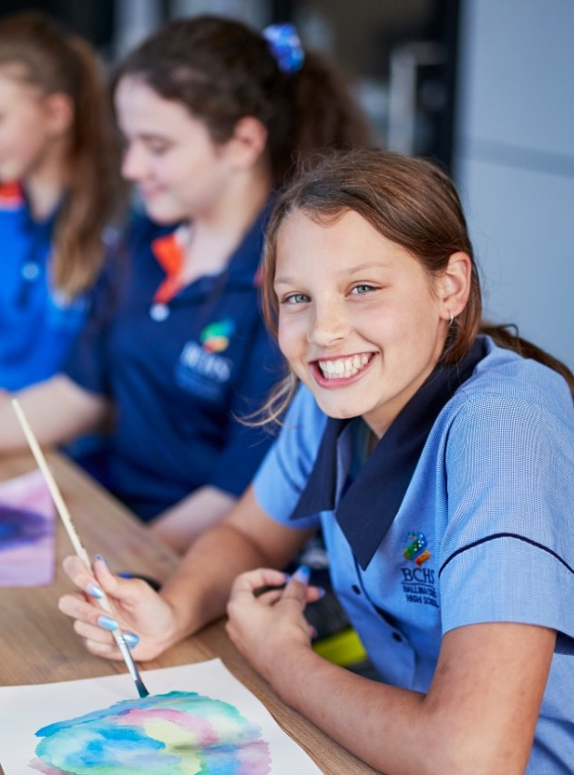
Do now
NSW Department of Education
Check for understanding
What do you know about the types of plays Shakespeare wrote?
Two minutes to recall and list in your English books
Notes:
Teacher note: give students 2 minutes to jot down any knowledge they have about the types of plays Shakespeare wrote. Some prompts you could provide them with are:
What are some of the common features of Shakespeare's plays?
Think about any Shakespearean plays you know of, what happens in them?
Discuss with students what they know about the features of Shakespeare's plays.

Slide 5
Shakespeare's genres
Shakespeare wrote in 3 key genres:
Histories
Comedies
Tragedies.
Notes:
Teacher note: William Shakespeare's plays are generally categorised as 3 key genres – histories, comedies and tragedies. The focus of this program is The Tragedy of Romeo and Juliet, but we will also look at the features of the historical and comedic plays Shakespeare created.
For this exercise and keeping in mind this is the first time Shakespeare has been taught in the English Curriculum Team's scope and sequence, the problem plays are not covered in this program.

Slide 6
Histories
2 minute writing activity
What do the histories sound like they would be about?
Notes:
Teacher note: students are to take 2 minutes to hypothesise what Shakespeare's history plays are about, based only on the title of the genre and their prior knowledge.

Slide 7
Shakespeare's histories
The historical plays:
cover English history from the 12th to 16th centuries
focused on a king who reigned during this time
were works of imagination, loosely based on real events
give insight into political processes
show us what life was like throughout all classes of society
could still contain elements of comedy and tragedy.
Some of Shakespeare's histories include Henry IV Part 1 and Part 2, Richard III.
Notes:
Teacher note: Shakespeare wrote 10 histories. Each explored the reign of an English king who lived between the 12th and 16th centuries. While based on events that took place, it is important to remember that these plays were works of fiction. The histories give audiences insight into the political processes of the times, as well as letting them see what life was like for different social classes, ranging from the poor to the monarch.
While they are identified as histories, comedies and tragedies, Shakespeare would include elements of other genres in his plays.

Slide 8
Comedies
Share with a partner
What would the key features of a Shakespearean comedy have been?
Notes:
Teacher note: teacher can prompt the students' consideration of the features of a Shakespearean comedy by asking what they know about the genre, what they think Shakespeare's comedies may have been about. Would Shakespearean society have found the same things as us funny?
Students share their ideas with a partner and can feedback to class.

Slide 9
Shakespeare's comedies
The comedies:
are not a comedy as we understand the word
are full of wordplay
feature disguises and mistaken identities
have very confusing plots
still feature death, loss, tragedy.
Some Shakespearean comedies are: All's Well That Ends Well, As You Like It, Twelfth Night.
Notes:
Teacher note: a Shakespearean comedy was quite different to the modern understanding of the genre.
A play featured lots of wordplay, such as puns and thinly veiled insults. Common features of comedies included mistaken identity and disguises, such as Twelfth Night where a young woman dresses as a man and is thought to be her twin brother. It was partly the mistaken identity and disguises that contributed to the confusing plots of these plays.
Although they were supposed to be light-hearted, Shakespeare's comedies regularly featured death and tragedy.

Slide 10
Tragedies
2 minute write
What do you expect of a tragedy?
Notes:
Teacher note: give students 2 minutes to jot down all the things they would expect to see in a play classified as a tragedy.

Slide 11
Shakespeare's tragedies
The tragedies:
focus on the fall of a nobleman, the protagonist
explore the consequences of the protagonist's mistake
feature a high death toll
show how the death of the hero helps restore order to the world in which they lived
feature a tragic waste of life.
Some Shakespearean tragedies are Hamlet and Othello.
Notes:
Teacher note: Shakespearean tragedies explored the downfall of the protagonist, often someone of high social standing. The genre explores what happens when the main character makes a mistake. There is a high death toll in tragedies, with order only being restored to the world in which they lived with the death of the protagonist.

Slide 12
Checking for understanding
NSW Department of Education
Exit ticket
Notes:
Teacher note: as a short check for understanding, ask students to complete the questions on the following slide. Follow up with any clarification as required.

Slide 13
Exit ticket
Complete the following questions in your English workbook
What are the 3 main categories of Shakespearean plays?
What is one problem you can identify in the classification system?
If you were to watch a tragedy, what would you expect to happen?
Notes:
Teacher note: students are to answer the questions in their workbooks.

Slide 14
References
This presentation contains NSW Curriculum and syllabus content. The NSW Curriculum is developed by the NSW Education Standards Authority. This content is prepared by NESA for and on behalf of the Crown in the right of the State of New South Wales. The material is protected by Crown copyright.
Please refer to the NESA Copyright Disclaimer for more information https://educationstandards.nsw.edu.au/wps/portal/nesa/mini-footer/copyright.
NESA holds the only official and up-to-date versions of the NSW Curriculum and syllabus documents. Please visit the NSW Education Standards Authority (NESA) website https://educationstandards.nsw.edu.au/wps/portal/nesa/home and the NSW Curriculum website https://curriculum.nsw.edu.au.
English K–10 Syllabus © NSW Education Standards Authority (NESA) for and on behalf of the Crown in right of the State of New South Wales, 2022.
Australian Education Research Organisation (AERO) (2024) Practice guide: Explain learning objectives [529 KB], AERO website, accessed 28 August 2024.
Griffin, P (ed) (2018) Assessment for Teaching, 2nd edn, Cambridge University Press, Melbourne.
No Sweat Shakespeare (n.d.) Shakespeare's Play Types, No Sweat Shakespeare website, accessed 15 July 2024.
Notes:
Teacher note: this slide contains references for this resource.

Slide 15
Copyright
© State of New South Wales (Department of Education), 2024
The copyright material published in this resource is subject to the Copyright Act 1968 (Cth) and is owned by the NSW Department of Education or, where indicated, by a party other than the NSW Department of Education (third-party material).
Copyright material available in this resource and owned by the NSW Department of Education is licensed under a Creative Commons Attribution 4.0 International (CC BY 4.0) license.
This license allows you to share and adapt the material for any purpose, even commercially.
Attribution should be given to © State of New South Wales (Department of Education), 2024.
Material in this resource not available under a Creative Commons licence:
the NSW Department of Education logo, other logos and trademark-protected material
Material owned by a third party that has been reproduced with permission. You will need to obtain permission from the third party to reuse its material.
Links to third-party material and websites
Please note that the provided (reading/viewing material/list/links/texts) are a suggestion only and implies no endorsement, by the New South Wales Department of Education, of any author, publisher, or book title. School principals and teachers are best placed to assess the suitability of resources that would complement the curriculum and reflect the needs and interests of their students.
If you use the links provided in this document to access a third party’s website, you acknowledge that the terms of use, including license terms set out on the third-party’s website apply to the use which may be made of the materials on that third-party website or where permitted by the Copyright Act 1968 (Cth). The department accepts no responsibility for content on third-party websites.

