Slide 1

Year 10, Term 2 – Reshaping the world
Phase 1, resource 1 – ideas and values of Romanticism
Notes:
Teacher note: in this lesson, students will be explicitly taught about the key values and ideas of the Romantic period. Explicit teaching is the best way to teach students new or complex concepts or skills such as this as it provides the necessary building blocks for guided and independent practice.
The following activities will begin to build students’ understanding of the context of the Romantic movement. This understanding with be developed and consolidated in Phase 2, resource 1a – the context of the Romantic movement and Phase 2, activity 1 – Romanticism concept map, so that students develop the necessary knowledge and understanding of the context of Romanticism, while also developing the required skills to note-take and summarise extended texts later in the program.

Slide 2
Sharing learning intentions and success criteria
Notes:
Teacher note: this slide has been used to identify the Explicit teaching learning strategy and should be deleted or hidden when using in a classroom setting. Sharing learning intentions allows a teacher to effectively communicate learning goals with students. They allow students to connect new learning to existing knowledge, skills and understanding. When used with success criteria students have a clear idea of the learning goal and how to get there (AERO 2024a). The sample success criteria are aligned to the syllabus. They break the learning intention into smaller and more manageable actions. They show students what they must do, say, make, create or perform to demonstrate their learning (Griffin 2018). These have been left blank with suggestions provided in the notes to allow for the co-construction of success criteria that reflects student need. When co-constructing with students, teachers use their expertise to guide student thinking, and often model and use exemplars to show students what success 'looks like'.

Slide 3
Learning intentions and success criteria (1)
Learning intentions
We are learning to:
understand the values and ideas of the Romantic period.
Success criteria
I will know I am successful when I can:
[these could be co-constructed with the class or used as per the notes].
Notes:
Teacher note: clarify what students are learning and why.
Learning intentions and success criteria are best co-constructed with students. Adapt the learning intention as required and add matching success criteria.
LISC is not necessarily presented at the beginning of the lesson. Teacher needs to consider most effectual time to introduce.
LISC should be revisited during the lesson to support students' evaluation of their learning.
Success criteria should be communicated to students, so they understand what it looks like to achieve the learning intention. The success criteria breaks the learning intention into smaller, more manageable actions and show students what they must be able to do, say, make, create or perform to demonstrate their learning.
Students may achieve this at different 'levels' depending on the starting point of different students. The suggested success criteria below have been differentiated – not all students will be able to demonstrate success in each of the criteria, however, all students should be able to experience success. It is not necessary to explain this differentiation to students. Depending on the needs of your students, you may choose to remove one or more of the success criteria. For example, if you know that your students will require high levels of support, you may choose to remove the final success criteria. Conversely, if you know that your students already understand Romanticism, there is no need to include the first success criteria.
Suggested success criteria:
I will know I am successful when I can:
define Romanticism
identify Romantic values and ideas used by key figures from the time
predict key ideas, images and motifs used in Romantic texts.

Slide 4
Connecting learning
Notes:
Teacher note: this slide has been used to identify the explicit teaching learning strategy and should be deleted or hidden when used in a classroom setting. The strategy of connecting learning involves making connections within and across learning. In this example, students are connecting the new learning to their prior learning about Romanticism when it was introduced in Year 8, Term 1 – Knowing the rules to break the rules in Phase 4 activity 3 – Romanticism: movement and style and Phase 4, activity 4 – check your understanding of Romanticism.
Teachers actively support students to make connections within and across knowledge, skills and understanding as well as to prior learning experiences. Learning is a change to long term memory. Long term memory is a network of overlapping information with many connections (AERO 2024a), which are called schemas (CESE 2017).
Activate students’ prior knowledge by completing a class brainstorm on the aspects of Romanticism that students can recall or by using one the suggested strategies on the Digital Learning Selector. https://app.education.nsw.gov.au/digital-learning-selector/LearningActivity/Card/562?clearCache=de919492-eb8c-f89b-3cf0-dfd0984cf5db

Slide 5

What is Romanticism?
A cultural, artistic and literary movement
Swept through Europe during late 18th and early 19th centuries
A period of cultural and artistic rebellion against the Enlightenment (1685 to 1815) which was the movement that preceded Romanticism
Celebrated emotion, imagination, nature and individualism
‘Landscape, mountains, cloudy image’ by Edouhoekstra is licensed under Pixabay Content License.
Notes:
Teacher note: Romanticism is a cultural, artistic and literary movement that swept through Europe during the late 18th and early 19th centuries. The key values and ideas of Romanticism are explored in the following slides.
The information on slides 5 to 7 can be used to create questions to check for understanding. Consider quick-response questions at the end of this series of slides such as:
True or false – Romanticism was a period of rebellion (true)
True or false – Romanticism celebrated reason and logic (false – it celebrated emotion, imagination, nature and individualism).

Slide 6
Enlightenment versus Romanticism
A shift in values
Enlightenment | Romanticism
Values common to the Enlightenment include: strict rules rationalism industrialisation urbanisation mechanisation logic and reason. | Values common to the Romantic era include: emotion imagination nature individualism personal expression creativity Innovation.
Notes:
Teacher note: some of the terms on this slide may require explanation and discussion. Encourage students to predict the meaning of unfamiliar words by breaking the words down and drawing on their knowledge and familiarity with parts of the word. For example, where have students heard and how have they used the term ‘industrial’ before? What might ‘industrialisation’ mean? Students can also infer the meaning of the words by understanding the opposing values. For example, students may be able to infer that ‘rationalism’ is unlike the values common to Romanticism and so may infer that it refers to thinking and reasoning rather than emotion.
Rationalism – the practice of basing opinions and actions on reason and knowledge rather than religious beliefs or emotional response
Industrialisation – economic movement away from agriculture towards large-scale industries, technology and urban growth
Urbanisation – increase of the proportion of people living in urban areas – a movement away from rural areas
Mechanisation – replacing humans with machines to increase productivity and efficiency
Individualism – a social and political philosophy that celebrates the moral worth and rights of the individual over the collective.
Student note: Romanticism is a cultural, artistic and literary movement that swept through Europe during the late 18th and early 19th centuries. It marked a distinct shift in values from the Enlightenment, which was the movement prior to Romanticism. This slide shows some of the key differences between the 2 movements.

Slide 7
Checking for understanding
Notes:
Teacher note: this slide has been used to identify the explicit teaching learning strategy of using effective questioning and should be deleted or hidden when using in a classroom setting. If students cannot adequately respond to this type of question, they should be provided with either whole class instruction in another delivery mode or example, or if only some students are lacking confidence, they could be assisted individually when the class move on to the next stage of learning.
Teachers analyse the information they collect to make evidence-based instructional decisions. This includes when to move between modelled, guided and independent practice.
Checking understanding requires teachers to collect the responses of all students (Wiliam 2014).

Slide 8

Enlightenment versus Romanticism (1)
While the Enlightenment valued _________________, Romanticism believed that _________________________.
‘Bloody Moon’ by Altınay Dinç is licensed under Unsplash License.
Notes:
Teacher note: to check for understanding, have students fill in the blanks in this sentence. They could display their responses on a mini whiteboard or the teacher could select a range of students to contribute their responses. Responses may include:
‘While the Enlightenment valued industrialisation, Romanticism believed that humans needed to reconnect with nature.’
‘While the Enlightenment valued strict rules, Romanticism believed that personal expression was of greater importance.’
Student note: complete the sentence on the slide by filling in the gaps with what you know about the Enlightenment and Romantic periods.

Slide 9
Enlightenment versus Romanticism (2)
While the Enlightenment valued logic and reason, Romanticism believed that the imagination had the power to transcend reality and access deeper truths about the world.
‘Bloody Moon’ by Altınay Dinç is licensed under Unsplash License.
Notes:
Student note: there are many correct ways to complete the previous activity. How does your sentence compare with the one on the slide?

Slide 10
Key figures
Notes:
Teacher note: Romanticism is a cultural, artistic and literary movement that swept through Europe during the late 18th and early 19th centuries. Some of the key figures of this time are explored on the following slides. As you read through the following slides, call out or ask students to identify the main ideas that come through the poets’ works, individually and collectively – for example, their interest in surreal, dreamlike representations of nature and interest in the ‘ordinary’.
Student note: we are going to get to know some of the key figures of the Romantic movement – you may have heard of these writers before. As we discuss them, take note of their interests and inspiration for their work.

Slide 11
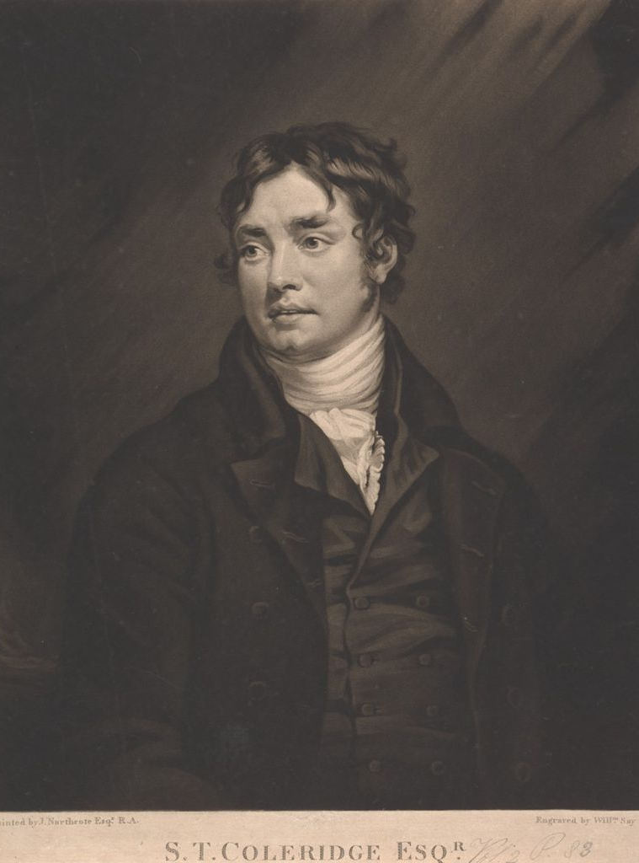
Samuel Taylor Coleridge
1772–1834
One of the most influential Romantic poets
Best known for ‘The Rime of the Ancient Mariner’, ‘Christabel’ and ‘Kubla Khan’
Depicted exotic landscapes and mythical elements to create a surreal and dreamlike atmosphere in his writing
Developed a natural, conversational style that influenced other Romantic writers at the time
Image: William Say (n.d.) Samuel Taylor Coleridge [photograph], Yale Center for British Art, Paul Mellon Collection, © public domain.
Notes:
Teacher note: Samuel Taylor Coleridge was one of the key figures of this time. ‘Exotic landscapes’ often included features such as mountains, rivers, gardens and caves. In ‘Kubla Khan’, Coleridge describes a place called Xanadu, which was built by a powerful ruler named Kubla Khan, as a fantastical and dreamlike place that captures the imagination.

Slide 12
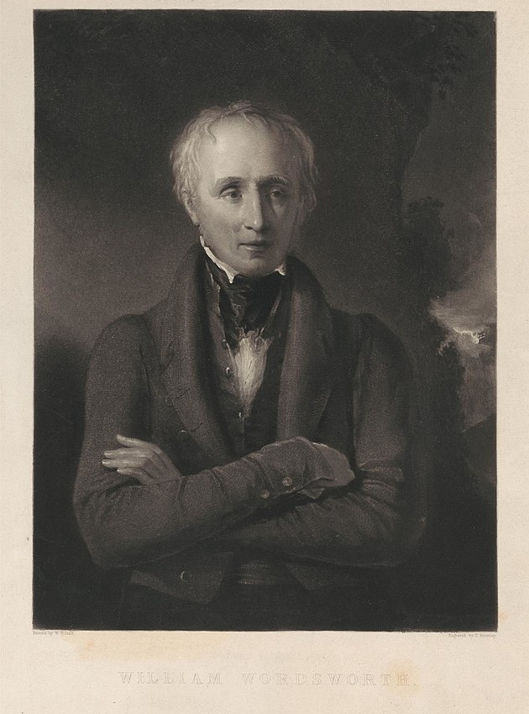
William Wordsworth
1770–1850
A prominent poet of the Romantic period
Work emphasised the unique experiences, thoughts and emotions of the individual
Had a particular interest ‘ordinary’ people rather than on the aristocracy and monarchy
Most famous works include ‘I Wandered Lonely as a Cloud’
Image: James Bromley (1832) William Wordsworth [photograph], Yale Center for British Art; Yale University Art Gallery Collection © public domain.
Notes:
Teacher note: William Wordsworth was one of the key figures of this time. ‘Ordinary’ people included people with common occupations such as chimney sweeps or mariners, or the everyday experiences of ‘ordinary’ people such as children.

Slide 13
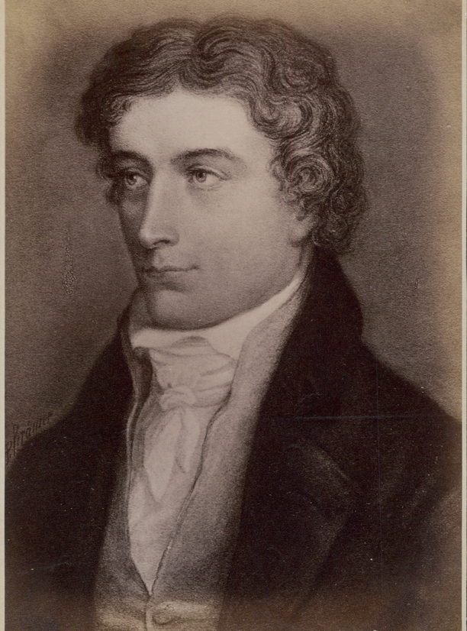
John Keats
1795–1821
Saw nature as a source of beauty and inspiration
Accentuated poetry with extreme emotion and natural imagery
Deeply preoccupied with themes of beauty, nature and mortality
Most famous works include ‘Ode to a Nightingale’, ‘Ode on a Grecian Urn’, ‘To Autumn’ and ‘Bright Star’
Died of tuberculosis at the age of 25
Image: JOHN KEATS (London, October 31, 1975 – Rome, February 23, 1821) by AldrianMimi is licensed under CC BY 4.0.
Notes:
Teacher note: John Keats was one of the key figures of this time. By 1821, he had not achieved widespread fame or recognition for his work, and he faced many financial difficulties and literary criticism during his lifetime. It was only in the years following his death that Keats’ work began to gain popularity and appreciation, and his friends, including Percy Bysshe Shelley – another famous romantic poet – played a crucial role in preserving and promoting his poetry.

Slide 14
Values and ideas of the Romantic period
Notes:
Teacher note: this section of the PowerPoint should prepare students for Phase1, activity 3 – making predictions as they deepen their understanding of Romantic ideas and values and how these might be reflected in Romantic texts.

Slide 15
Conventions in texts from the Romantic movement
A convention is ‘a way in which something is usually done’. In English, conventions are the features that we expect from certain types of texts. For example, we may expect:
poetry to rhyme
comedies to be funny
fairytales to have happy endings.
Values and ideas can be considered conventional such as the celebration of the natural world found in Romantic poetry. Romantic poetry also conforms to stylistic conventions such as rigid rhyme and rhythm structures, religious allusion and the use of symbolism.
Notes:
Teacher note: the following slide includes a list of common conventions found in Romantic texts, including the key values and ideas. A definition of convention has also been provided on this slide, so that students can make connections with their prior knowledge of this term. You may also like to lead a class discussion about some other types of conventions or expectations we have of certain text types, such as horror, mystery or speculative fiction (previously studied in Year 9, Term 4). Ask students to consider why some composers might choose to deliberately ignore pre-existing conventions. How do we feel when poems don’t rhyme, comedies make us cry or fairytales end badly?

Slide 16
Values and ideas of the Romantic movement
Common conventions used in Romantic texts
Emphasis on religion and/or spirituality
A heightened focus on emotions
The impact and rejection of the Industrial Revolution and French Revolution
Celebration of nature and the imagination
Search for truth
Reminiscence about the past
An interest in ordinary people
Notes:
Teacher note: you may like to animate this slide so that the bullet points appear one by one.

Slide 17
What might this look like?
Brainstorm some ideas, images or motifs you might expect to see in Romantic texts
Values and ideas | How this might be represented in Romantic texts
Emphasis on religion and/or spirituality
A heightened focus on emotions
The impact and rejection of the Industrial Revolution and French Revolution
Celebration of nature and the imagination
Search for truth
Reminiscence about the past
An interest in ordinary people
Notes:
Teacher note: this slide includes a list of values and ideas of Romantic texts. The table allows students space to brainstorm ideas, images or motifs that they might expect to see in Romantic texts, given what they now know about its key values and ideas, and some of the key ideas or images used by poets such as Coleridge, Wordsworth and Keats. Depending on students’ prior knowledge and understanding, you may complete this table together as a class, in small groups, pairs or individually, using Phase 2, resource 1 – the context of the Romantic movement for further context and support. Students can copy notes from the slide into their English workbooks.

Slide 18
Returning to the learning intentions and success criteria
Notes:
Teacher note: the teacher should use success criteria throughout the lesson. They can be used to check for understanding and to support students to reflect on their progress towards achieving the learning intention.

Slide 19
Learning intentions and success criteria (2)
Learning intentions
We are learning to:
understand the values and ideas of the Romantic period.
Success criteria
I will know I am successful when I can:
[these could be co-constructed with the class or used as per the notes].
Notes:
Teacher note: returning to the learning intention and success criteria allows for students to reflect on what they have learned, while checking for understanding. If individual whiteboards are available, have students indicate the success criteria that they have achieved by writing 1, 2 or 3 on them. Otherwise, consider using the three-finger system – 1 finger for level 1, 2 fingers for level 2, 3 fingers for level 3 – or traffic lights – green for understands and can apply without help, yellow for understands but still needs help to apply, red for needs help to understand.
Suggested success criteria:
I will know I am successful when I can:
define Romanticism
identify Romantic values and ideas used by key figures from the time
predict key ideas, images and motifs used in Romantic texts.

Slide 20
References
This presentation contains NSW Curriculum and syllabus content. The NSW Curriculum is developed by the NSW Education Standards Authority. This content is prepared by NESA for and on behalf of the Crown in the right of the State of New South Wales. The material is protected by Crown copyright.
Please refer to the NESA Copyright Disclaimer for more information https://educationstandards.nsw.edu.au/wps/portal/nesa/mini-footer/copyright.
NESA holds the only official and up-to-date versions of the NSW Curriculum and syllabus documents. Please visit the NSW Education Standards Authority (NESA) website https://educationstandards.nsw.edu.au/wps/portal/nesa/home and the NSW Curriculum website https://curriculum.nsw.edu.au.
English K–10 Syllabus © NSW Education Standards Authority (NESA) for and on behalf of the Crown in right of the State of New South Wales, 2022.
AERO (Australian Education Research Organisation) (2024a) Explain learning objectives, AERO website, accessed 16 April 2024.
AERO (Australian Education Research Organisation) (2024b) Why explicit instruction works, AERO website, accessed 16 April 2024.
AldrianMimi (2022) JOHN KEATS (London, October 31, 1795 – Rome, February 23, 1821), Wikimedia Commons website, accessed 7 May 2024.
Black P and Wiliam D (2018) ‘Classroom assessment and pedagogy’, Assessment in Education Principles Policy and Practice, 25(1):1–25.
CESE (Centre for Education Statistics and Evaluation) (2017) Cognitive load theory: Research that teachers really need to understand, NSW Department of Education, accessed 16 April 2024.
Bromley J (1832) William Wordsworth, Yale Centre for British Art; Yale University Art Gallery Collection, accessed 7 May 2024.
Dinc A (2018) Bloody Moon, Unsplash website, accessed 7 May 2024.
Notes:
Teacher note: this slide includes a reference list for information and images used in this presentation.

Slide 21
References (2)
Edohoekstra (2020) Landscape, mountains, cloudy image, Pixabay website, accessed 6 May 2024.
Say W (n.d.) Samuel Taylor Coleridge, Yale Centre for British Art, Paul Mellon Collection, accessed 7 May 2024.
Notes:
Teacher note: this slide includes a reference list for information and images used in this presentation.

Slide 22
Copyright
© State of New South Wales (Department of Education), 2024
The copyright material published in this resource is subject to the Copyright Act 1968 (Cth) and is owned by the NSW Department of Education or, where indicated, by a party other than the NSW Department of Education (third-party material).
Copyright material available in this resource and owned by the NSW Department of Education is licensed under a Creative Commons Attribution 4.0 International (CC BY 4.0) license.
This license allows you to share and adapt the material for any purpose, even commercially.
Attribution should be given to © State of New South Wales (Department of Education), 2024.
Material in this resource not available under a Creative Commons license:
the NSW Department of Education logo, other logos and trademark-protected material
Material owned by a third party that has been reproduced with permission. You will need to obtain permission from the third party to reuse its material.
Links to third-party material and websites
Please note that the provided (reading/viewing material/list/links/texts) are a suggestion only and implies no endorsement, by the New South Wales Department of Education, of any author, publisher, or book title. School principals and teachers are best placed to assess the suitability of resources that would complement the curriculum and reflect the needs and interests of their students.
If you use the links provided in this document to access a third-party’s website, you acknowledge that the terms of use, including licence terms set out on the third-party’s website apply to the use which may be made of the materials on that third-party website or where permitted by the Copyright Act 1968 (Cth). The department accepts no responsibility for content on third-party websites.

