Slide 1
Instructions for use
This resource is not a teaching and learning program. It should be used in conjunction with ‘Representation of life experiences’ – Year 9, Term 1.
Classroom teachers are encouraged to add and adapt slides as required to meet the needs of their students.
Save a copy of the file to make changes to the slide deck. Go to File > Download a Copy (this downloads a copy to the computer to edit in the PowerPoint app).
To convert the PowerPoint to Google Slides
  Upload the file into Google Drive and open it.
  Go to File > Save as Google Slides.
  (Note – conversion may cause formatting changes in the slides.)

Slide 2
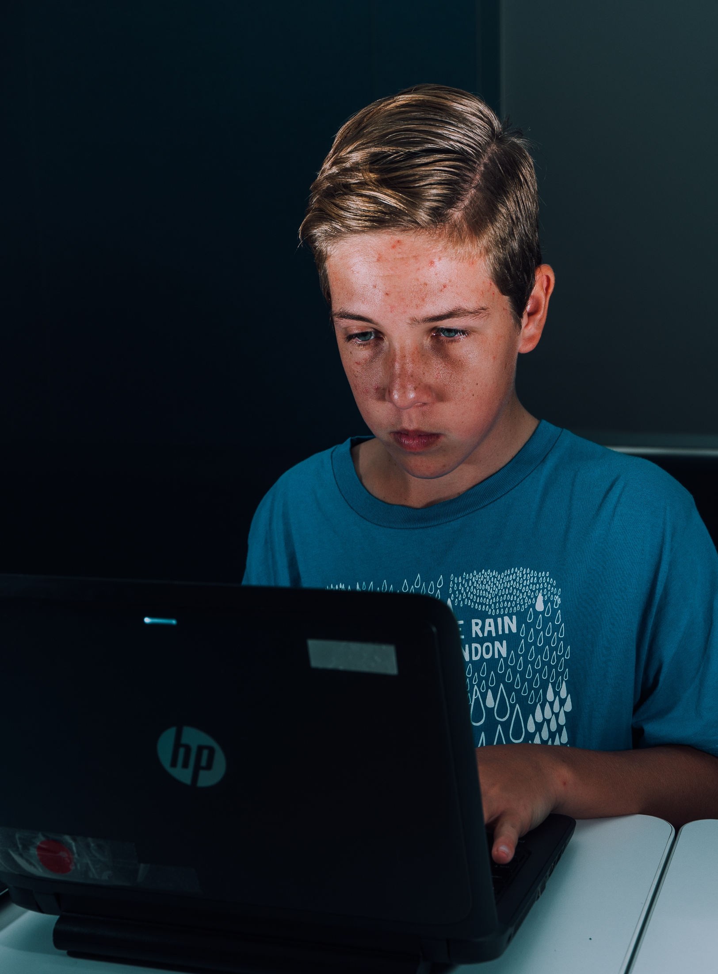
Phase 4 – text annotations – Smith
Stage 5 – 9.1
‘Representation of life experiences – Year 9
Term 1

Slide 3
Sharing learning intentions and success criteria
Notes:
Teacher note: this slide has been used to identify the explicit teaching learning strategies sharing learning intentions and sharing success criteria. This slide should be deleted or hidden when using in a classroom setting.
Sharing learning intentions allows a teacher to effectively communicate the learning goal with students. They allow students to connect new learning to existing knowledge, skills and understanding.
When used with success criteria, students have a clear idea of the learning goal and how to get there (AERO 2024).
The sample learning intentions and success criteria on slide 13 are aligned to the syllabus. The success criteria break the learning intention into smaller and more manageable actions. They show students what they must do, say, make, create or perform to demonstrate their learning (Griffin 2018).
Success criteria are communicated to students in ways they understand. Teachers use their expertise to guide student thinking, and often model and use exemplars to show students what success 'looks like
For more information, see ⁠AITSL or the NSW Department of Education explicit teaching strategies, ⁠Sharing learning intentions and ⁠Sharing success criteria

Slide 4
Learning intentions and success criteria
We are learning to
understand the purpose and effect of using anaphora in writing
understand the language feature of allusion and its effect
identify the effectiveness of using language features to express a specific purpose
We can
[insert success criteria].
Notes:
Notes for teachers:
Adapt the provided learning intentions and success criteria (LISC), in line with the syllabus, as required to suit the needs of your students.
LISC is usually shared first or early in the lesson and is explained by the teacher who checks for understanding.
LISC is referred to regularly to check for understanding, provide feedback or as a self-assessment tool (Wiliam and Leahy 2015).
Learning intentions and success criteria can be supported by exemplars, such as 'What A Good One Looks Like' (WAGOLL) or exemplars to demonstrate success criteria (Clarke 2021)
For more information on sharing learning intentions and success criteria, see Sharing learning intentions and success criteria – technique guide
For more information on planning learning intentions and success criteria, see Planning syllabus-aligned learning intentions and success criteria– technique guide

Slide 5
‘Stories Matter’ by Freya Smith (1)

Slide 6
Text complexity
‘Stories Matter’ by Freya Smith
Text requirement | Text complexity | Annotation and overview
The text helps meet the Text requirements for English 7–10 as it is taken from a writing competition. It is award-winning (quality literature) and written by a young Australian author. The story is representative of popular, social and cultural perspectives. | EN5-RVL-01 requires students to use a range of personal, creative and critical strategies to engage with complex texts. This text has elements of a moderately complex text as per the NLLP (V3) Text Complexity scale. The word ‘story’ is one with ‘multiple connotations or meanings’ and these multiple connotations are explored in this text. Rhetorical and literary devices are used throughout and the ideas are ‘presented with significant details or elaboration’. | This is a prose poem about story. It aims to challenge the existing ‘narrative’ about the texts that are ascribed literary value. This is a thought-provoking text that uses anaphora in order to challenge the reader and their thinking about Western notions of the literary canon.
Notes:
Teacher note: this information summarises the text complexity of the model text.

Slide 7
‘Stories Matter’ by Freya Smith (2)
License information
Freya Smith, ‘Stories Matter’, Hobart City High School (Year 9/10 category winner, 2022)
Reproduced and made available for copying and communication by NSW Department of Education for its educational purposes with the permission of Freya Smith, Hobart City High School. Accessed 25 March 2023.

Slide 8
Deeping connections with the use of anaphora

Slide 9
Language feature focus – anaphora
What are the origins of the word and how can we remember its meaning?
Language features help a composer convey their ideas, line of arguments or emotions to an audience. They are a part of the writer’s ‘toolbox’ and help to the composer to shape meaning in their text. Anaphora is a language feature writers use to impact their audiences.
Phase 4, activity 3 – exploring the term ‘anaphora’
Research the definition of the term and its word history.
Write a definition in your own words.
Create a symbolic representation of the word.
Leveling-up your learning Etymology is the correct term for ‘word history’. It refers to the word’s development over history and is interesting because it examines how words are transferred from one language to another! This is why you may find similarities between English and other Western languages, such as French.
Notes:
Teacher note: this activity introduces the language feature of anaphora and is designed to work alongside Phase 4, activity 3 – exploring the term ‘anaphora’ . This slide and activity allows students to examine the origins of the word and create a symbolic representation to assist them to remember the meaning of the word.
Anaphora is defined as:
Grammar – a word or phrase that references an earlier word or phrase.
Rhetoric – the intentional repetition of a word or phrase at the beginning of several clauses, sentences, stanzas or paragraphs.
(NESA 2022)

Slide 10
Deepening our understanding of anaphora
How can we build on our understanding of this language feature?
The best way to further develop our understanding of anaphora is to identify its use in a text. Together, let’s examine how this language feature has been used in Core text 3 – ‘Stories Matter’ by Freya Smith by completing a purposeful class annotation of the text.
We will now annotate a section of the text together.
Re-read the first 2 stanzas of the text.
Can you identify any examples of anaphora?
Notes:
Teacher note: this slide has been designed to prepare students for purposeful annotation of the text.
Students should make initial identification of examples of anaphora if possible.
The teacher should model how to identify anaphora in the next 2 slides by using the think aloud strategy.

Slide 11
Core text 3 – ‘Stories Matter’ by Freya Smith (1)
Text annotations
The rare freedom of a story.
Whether it begins with Once Upon a Time,
And has pages that smell like a comforting kind of old,
Or the furiously typed words written of the world, and fed to us from paragraphs of hopelessness.
Or maybe the letter which you received this very morning, in your mailbox
Or even the chatter you heard from passers by
But which is more real?
All, or maybe none.
A story can be born from your imagination,
Or it can grow from the truth you hold so tightly
A story can be spoken
Or written
Or drawn
Or signed
Or grown
It can be anything you want it to be,
It's a story, it can be as real as you care to believe.
Notes:
Teacher note: these are purposeful annotations of anaphora in this text – use a think-aloud strategy to explain how you decided these were examples of anaphora.
For example, read the text aloud. Stop at the end and comment on the fact that the word ‘or’ is used repeatedly. Identify that this serves as an example of anaphora. This repetition emphasises the various forms and origins of stories, highlighting their diversity and flexibility. The repetition invites readers to consider the vast possibilities and inclusivity of storytelling.

Slide 12
Core text 2 – ‘Stories Matter’ by Freya Smith (1)
Text annotations
Over a hundred million books have been written,
Hundreds of those, I believe, have swirled and shaped the person I am today.
These strangers' stories mould and influence everyone.
We learn from their mistakes,
And cry for their heartbreak.
We travel with them through fearsome jungles,
And slay dragons with our shiny swords.
We meet eccentric friends,
And lose more than we can count.
We climb the height of a princess' tower,
And diminish evil from the kingdom that surrounds her.
And now I make my own mistakes,
And learn from them.
I cry my own tears,
And travel through lively cities.
And although I've never truly slayed a dragon,
It's a story I'm prepared to tell.
Notes:
Teacher note: continue using a think-aloud for this section of the text.
The repetition of ‘and’ is also anaphora. This repetition creates a rhythm and emphasises the connection between different actions and emotions related to storytelling. This language feature reinforces the diverse and universal nature of stories, drawing attention to the shared human experiences they reflect.

Slide 13
Independent practice (1)
Purposeful annotations of anaphora
Complete purposeful annotations for anaphora for the remainder of the text.
Notes:
Teacher note: students should now complete purposeful annotations independently or with a partner.

Slide 14
Responding to a text
Writing activity
In Core text 3 – ‘Stories Matter’ by Freya Smith, anaphora is used to emphasise particular ideas, create rhythm, and engage the audience.
Respond to the following statement about how anaphora is used in ‘Stories Matter’
Stories can be grounded in a diverse range of experiences. No one person’s story is more important than another.
Notes:
Teacher note: students should consolidate their understanding of the importance of stories by responding to the statement on the screen.
Sample response:
The author has drawn from a broad range of issues to emphasise the importance of representing those issues in the stories we tell. By placing these issues in the same grouping as ‘Of poverty’ and ‘Of Kings and Queens’, the author seeks to level the playing field and reinforces her idea that all stories matter and no single story should be privileged over another.

Slide 15
Deeping connections with the use of allusion

Slide 16
Language feature focus – allusion
What are the origins of the word and how can we remember its meaning?
As we determined earlier, language features are a part of the writer’s ‘toolbox’ and help a composer shape meaning in their text. Allusion is another language feature composers use to impact their audiences.
Phase 4, activity 4 – exploring the term ‘allusion’
Research the definition of the term and its word history.
Write a definition in your own words.
Create a symbolic representation of the word.
Can you recall the correct term for ‘word history’?
Etymology is the correct term for ‘word history’. It refers to the word’s development over history and examines how words are transferred from one language to another!
Notes:
Teacher note: this activity introduces the language feature of anaphora and is designed to work alongside Phase 4, activity 4 – exploring the term ‘allusion’.
This slide and activity allows students to examine the origins of the word and create a symbolic representation to assist them to remember the meaning of the word.
Allusion is defined as:
A deliberate and implicit reference to a person or event, or a work of art which draws on knowledge and experiences shared by the composer and responder.
(NESA 2024)

Slide 17
Allusion definition
An allusion is a figure of speech which refers to a famous person, a well-known text, a time period, a historical event or even an iconic character from a well-known story.
Allusions help authors to contextualise a story and draw from the readers prior knowledge, association, and imagination.
Example
If I say chocolate is my ‘Achilles’ heel’, I am alluding to the one weakness of Achilles. This suggests that I can resist everything, except for chocolate!
Notes:
Teacher note: this is an explanation of allusion. You may need to explore this a little deeper with your students. You could do this by having students explore the story of Achilles using Britannica (2025) https://www.britannica.com/topic/Achilles-Greek-mythology
.

Slide 18
Deepening our understanding of allusion (1)
How can we build on our understanding of this language feature?
The best way to further develop our understanding of allusion is to identify its use in a text. Together, let’s examine how this language feature has been used in Core text 3 – ‘Stories Matter’ by Freya Smith by completing a purposeful class annotation of the text.
We will now annotate a section of the text together.
Re-read the first stanza of the text.
Can you identify any examples of allusion?
Notes:
Teacher note: this slide has been designed to prepare students for purposeful annotation of the text.
Students should make initial identification of examples of allusion if possible.
The teacher should model how to identify allusion on the next slide by using the think-aloud strategy.

Slide 19
Core text 3 – ‘Stories Matter’ by Freya Smith (2)
The rare freedom of a story.
Whether it begins with Once Upon a Time,
And has pages that smell like a comforting kind of old,
Or the furiously typed words written of the world, and fed to us from paragraphs of hopelessness.
Or maybe the letter which you received this very morning, in your mailbox
Or even the chatter you heard from passers by
But which is more real?
All, or maybe none.
A story can be born from your imagination,
Or it can grow from the truth you hold so tightly
A story can be spoken
Or written
Or drawn
Or signed
Or grown
It can be anything you want it to be,
It's a story, it can be as real as you care to believe.
Notes:
Teacher note: these are purposeful annotation of the featured language features of this text – use a think-aloud strategy to explain how you decided this was an example of allusion.
For example, read the text aloud. Stop at the end and comment on the fact that the text contains the use of ‘Once Upon a Time’. Talk about how this is an allusion to the traditional beginning of fairy tales, and how it evokes a universal familiarity of storytelling.

Slide 20
Independent practice (2)
Purposeful annotations of allusion
Complete purposeful annotations for allusion for the remainder of the text.
Notes:
Teacher note: students should now complete purposeful annotations independently or with a partner.

Slide 21
Deepening our understanding of allusion (2)
Exploring allusion in Core text 3 – ‘Stories Matter’ by Freya Smith
Class discussion – how does allusion allow the responder to make connections with other significant texts or ideas?
Notes:
Teacher note: guide students through a discussion of how allusion is used in the text to allow the responder to make connections with other significant texts or ideas.

Slide 22
Text annotations for teacher use
Notes:
Teacher note: the following annotations have been provided to support teachers.

Slide 23
Key for purposeful annotations
Core text 2 – ‘Stories Matter’ by Freya Smith
Anaphora
Allusion
Notes:
Additional teacher notes on Core text 3 – ‘Stories Matter’ by Freya Smith:
You might like to share with students the following information:
The author alludes to our history of telling stories through fairy tale - her purpose in doing so is to draw our attention to the stories we know, value and trust and how these stories shape who we are and what we understand about our world.
The author acknowledges that some stories are privileged over others and sends a strong message that all stories matter!
Freya Smith goes on to use anaphora in a distinctive way to reinforce her thematic concern. One could argue that it almost sounds like a speech in places.

Slide 24
Core text 2 – ‘Stories Matter’ by Freya Smith (2)
The rare freedom of a story.
Whether it begins with Once Upon a Time,
And has pages that smell like a comforting kind of old,
Or the furiously typed words written of the world, and fed to us from paragraphs of hopelessness.
Or maybe the letter which you received this very morning, in your mailbox
Or even the chatter you heard from passers by
But which is more real?
All, or maybe none.
A story can be born from your imagination,
Or it can grow from the truth you hold so tightly
A story can be spoken
Or written
Or drawn
Or signed
Or grown
It can be anything you want it to be,
It's a story, it can be as real as you care to believe.
Notes:
Teacher note: these are purposeful annotation of the featured language features of this text.
The text contains the repeated use of the word ‘Or’ which serves as an example of anaphora. This repetition emphasises the various forms and origins of stories, highlighting their diversity and flexibility. The repetition invites readers to consider the vast possibilities and inclusivity of storytelling.
‘Once Upon a Time’ – an allusion to the traditional beginning of fairy tales, evoking the universal familiarity of storytelling.

Slide 25
Core text 2 – ‘Stories Matter’ by Freya Smith (3)
Over a hundred million books have been written,
Hundreds of those, I believe, have swirled and shaped the person I am today.
These strangers' stories mould and influence everyone.
We learn from their mistakes,
And cry for their heartbreak.
We travel with them through fearsome jungles,
And slay dragons with our shiny swords.
We meet eccentric friends,
And lose more than we can count.
We climb the height of a princess' tower,
And diminish evil from the kingdom that surrounds her.
And now I make my own mistakes,
And learn from them.
I cry my own tears,
And travel through lively cities.
And although I've never truly slayed a dragon,
It's a story I'm prepared to tell.
Notes:
Teacher note: these are purposeful annotation of the featured language features of this text.
The repetition of ‘and’ is also anaphora. This repetition creates a rhythm and emphasises the connection between different actions and emotions related to storytelling. This language feature reinforces the diverse and universal nature of stories, drawing attention to the shared human experiences they reflect.
‘Slay dragons with our shiny swords’ – an allusion to medieval fantasy tales or myths involving heroic quests, symbolizing courage and overcoming challenges.
‘The height of a princess' tower’ – an allusion to classic fairy tales like Rapunzel or Sleeping Beauty, referencing stories of rescue and romance.

Slide 26
Core text 2 – ‘Stories Matter’ by Freya Smith (4)
These stories matter.
The first ever handwritten letter was said to be sent in 500BC,
I wonder what story was told in the secrets of those words?
Over time, letters began to flourish,
They became signed, sealed and stamped,
Little envelopes of stories and feelings,
Awaiting their arrival to be torn open and fawned over for days.
Stories would grow like roots from an apple tree,
'Have you heard?' They would say
And parade the stories they had read earlier that morning,
New ones would grow, and change,
Working their way through the hands of many,
And then, they would be found years later
Maybe in a dusty draw in the attic of a very old house
The discoverer would sing the stories here and there
Of the one small letter that had made it so very far.
Notes:
Teacher note: these are purposeful annotation of the featured language features of this text.
‘The first ever handwritten letter was said to be sent in 500BC’ – an allusion to the historical origins of written communication, anchoring the power of stories in a historical context.
Please note that ‘draw’ has been spelled incorrectly by the composer. It should be ‘’drawer’. It has been included here as per the licensed version.

Slide 27
Core text 2 – ‘Stories Matter’ by Freya Smith (5)
These stories matter.
History is a rather marvelous thing,
That one small word, contains so many exceptional stories.
Stories of war
Stories of protest
Stories of discrimination
Of poverty
Of Kings and Queens
Of pyramids
Of sailors
Of violence
Of leaders.
Stories that have been the very foundation for the world we live in,
Whether we have learnt from them or not.
The stories of history have left a mark, not just the events, or places, or actions.
But the people, and the stories they wrote for themselves.
Notes:
Teacher note: these are purposeful annotation of the featured language features of this text.
The repetition of ‘stories of’ shortened to ‘of’ is used similarly to the first stanza of this text. This repetition expands the idea that stories are vast and can be about many things.
‘Stories of war ... Protest ... Discrimination ... Poverty ... Kings and Queens ... Pyramids ... Sailors ... Violence ... Leaders’ – these are allusions to major historical events and figures, such as wars, social movements, ancient civilisations, and leadership struggles, encapsulating the broad scope of history.

Slide 28
Core text 2 – ‘Stories Matter’ by Freya Smith (6)
These stories matter.
This is my story, of what matters to me.
You too have a story
It is strong
It is wanted
It is rich and beautiful
But what makes a story even more powerful?
Everyone has one to tell.
Notes:
Teacher note: these are purposeful annotation of the featured language features of this text.
Here, the repetition of ‘it is’ creates a final conclusion about the value of stories through this high modal phrase.

Slide 29
References
This presentation contains NSW Curriculum and syllabus content. The NSW Curriculum is developed by the NSW Education Standards Authority. This content is prepared by NESA for and on behalf of the Crown in the right of the State of New South Wales. The material is protected by Crown copyright.
Please refer to the NESA Copyright Disclaimer for more information https://educationstandards.nsw.edu.au/wps/portal/nesa/mini-footer/copyright.
NESA holds the only official and up-to-date versions of the NSW Curriculum and syllabus documents. Please visit the NSW Education Standards Authority (NESA) website https://educationstandards.nsw.edu.au/wps/portal/nesa/home and the NSW Curriculum website https://curriculum.nsw.edu.au.
English K–10 Syllabus © NSW Education Standards Authority (NESA) for and on behalf of the Crown in right of the State of New South Wales, 2022.
AERO (Australian Education Research Organisation) (2024a) Explain learning objectives, AERO website, accessed 16 April 2024.
---- (2024b) Why explicit instruction works, AERO website, accessed 16 April 2024.
Britannica (2025) Achilles Britannica website, accessed 16 January 2025.
Emily Fries, ‘Monsters and Mice’, James Ruse Agricultural High School (Shortlist, Year 9/10 category, 2021) Reproduced and made available for copying and communication by NSW Department of Education for its educational purposes with the permission of Emily Fries, James Ruse Agricultural High School. Accessed 25 March 2023.
NSW Education Standards Authority (NESA) (2024) Glossary, NESA website, accessed 2 December 2024.
State of New South Wales (Department of Education) (2024a) ‘Explicit teaching strategies’, Explicit teaching, NSW Department of Education website, accessed 27 May 2024.

Slide 30
Copyright
© State of New South Wales (Department of Education), 2024
The copyright material published in this resource is subject to the Copyright Act 1968 (Cth) and is owned by the NSW Department of Education or, where indicated, by a party other than the NSW Department of Education (third-party material).
Copyright material available in this resource and owned by the NSW Department of Education is licensed under a Creative Commons Attribution 4.0 International (CC BY 4.0) licence.
This licence allows you to share and adapt the material for any purpose, even commercially.
Attribution should be given to © State of New South Wales (Department of Education), 2024.
Material in this resource not available under a Creative Commons licence:
the NSW Department of Education logo, other logos and trademark-protected material
Material owned by a third party that has been reproduced with permission. You will need to obtain permission from the third party to reuse its material.
Links to third-party material and websites
Please note that the provided (reading/viewing material/list/links/texts) are a suggestion only and implies no endorsement, by the New South Wales Department of Education, of any author, publisher, or book title. School principals and teachers are best placed to assess the suitability of resources that would complement the curriculum and reflect the needs and interests of their students.
If you use the links provided in this document to access a third party’s website, you acknowledge that the terms of use, including licence terms set out on the third-party’s website apply to the use which may be made of the materials on that third-party website or where permitted by the Copyright Act 1968 (Cth). The department accepts no responsibility for content on third-party websites.

