Slide 1
Speak the speech
Sample speech – audio file and listening activity
Notes:
Teacher instructions
This student work sample and audio file are not standalone resources. They have been designed for use by teachers in connection to the program ‘Speak the speech’ and the accompanying resources, including the teaching and learning program, resource booklet and sample assessment task notification.
All resources connected with this sample can be found on the department’s webpage, Planning, programming and assessing English 7-10: https://education.nsw.gov.au/teaching-and-learning/curriculum/english/planning-programming-and-assessing-english-7-10

Slide 2
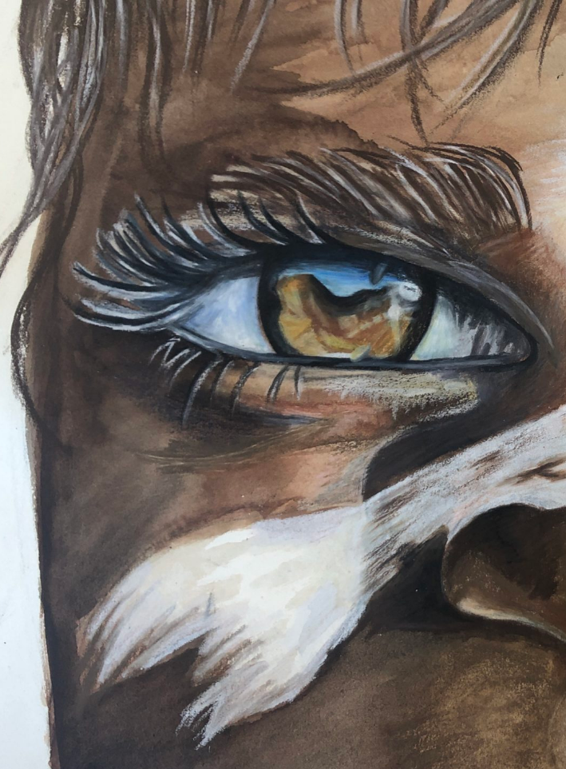
Acknowledgement of Country
We recognise the Ongoing Custodians of the lands and waterways where we work and live. We pay respect to Elders past and present as ongoing teachers of knowledge, songlines and stories.
We strive to ensure every Aboriginal and Torres Strait Islander learner in NSW achieves their potential through education.
‘Ochre Eyes’ created by Lilianna from Winmalee High School on Darug Country as part of 2020 Schools Reconciliation Challenge.

Slide 3
Supporting effective peer editing – activity structure
Oral storytelling is dead
Read over the vocal variation rehearsal strategies in Phase 6, resource 9 - rehearsal strategies, taking note of how using your voice can create engagement and interest in your audience.
Listen to the student sample of the unrehearsed speech ‘Oral storytelling is dead’ by John.
While you are listening, use Phase 4, activity 8 – feedback templates to note areas for improvement.
Take notes individually during the speech, recording both strengths and weaknesses of the content and delivery of the speech.
Reflection – how would you improve this speech if you were the speaker? Write a list of 3 areas for improvement and 3 areas that worked well.

Slide 4
First attempt before peer feedback – speaker: John – part 1
Oral storytelling is dead
Listen to the student sample.
While listening, use Phase 4, activity 8 – feedback templates and note areas for improvement.
Record strengths and weaknesses in relation to the delivery of the speech.

Slide 5
First attempt before peer feedback – speaker: John – part 2
Oral storytelling is dead
Reflection – how would you improve this speech if you were the speaker?
Identify 3 areas for improvement and 3 areas that worked well.

Slide 6
Rehearsal strategies
Overview
If you want to deliver an effective speech, you must rehearse. Rehearsing your speech will give you authority on your topic and will allow you to feel more confident in your delivery.
When rehearsing, use these 3 strategies.
Practise
Vocal variation
Body language

Slide 7
1. Practise
Rehearsal strategies
Practise in front of the mirror.
Video yourself on your phone – play it back and look for particular delivery elements.
Rehearse in front of your family and friends.
Time your speech to make sure it is long enough.
Know your speech so you could extemporise if required.

Slide 8
2. Vocal variation
Rehearsal strategies
Project your voice – make sure you are loud enough.
Vary your vocal variety – use different tone, pause, pitch and pace.
Stress important words.
Use appropriate passion in your vocal delivery.

Slide 9
3. Body language
Rehearsal strategies
Maintain eye contact with the audience.
Use appropriate facial expressions.
Use hand gestures to strengthen points.
Use appropriate body language.
For this particular speech sample, you will not be able to observe the delivery; however, you should consider the types of delivery techniques you could use.

Slide 10
Rehearsed speech
Oral storytelling is dead
Listen to the student sample of the speech ‘Oral storytelling is dead’ after it has been rehearsed.
Look back over Phase 4, activity 8 – feedback templates that you completed previously. Has any of your feedback been incorporated? What could still be improved? Voice projection? Vocal variety? Word stress? Emotive delivery?
Reflection – how would you incorporate body language into this speech to complement the delivery?

Slide 11
Second attempt after rehearsal and peer feedback – speaker: John
Oral storytelling is dead
Listen to the rehearsed student sample.
Look back over Phase 4, activity 8 – feedback templates and reflect: has any of your feedback been incorporated? What could still be improved (voice projection, vocal variety, word stress or emotive delivery)?
Reflection – how would you incorporate body language into this speech to complement the delivery?

Slide 12
What next…
Speak the speech
Refer to the ‘Steps for success’ in the sample assessment notification. In addition, a range of activities and resources have been created to support the creation of the assessment speech:
Phase 6, resource 1 – evidence-based practice in assessment procedures
Phase 6, resource 2 – task forms and features
Phase 6, resource 6 – the research process
Phase 6, resource 8 – using palm cards
Phase 6, resource 10 – structured rehearsal strategy
Phase 6, activity 1 – research guiding questions
Phase 6, activity 2 – what’s your line of argument?
Phase 4, activity 8 – feedback templates

Slide 13
References
This presentation contains NSW Curriculum and syllabus content. The NSW Curriculum is developed by the NSW Education Standards Authority. This content is prepared by NESA for and on behalf of the Crown in the right of the State of New South Wales. The material is protected by Crown copyright.
Please refer to the NESA Copyright Disclaimer for more information https://educationstandards.nsw.edu.au/wps/portal/nesa/mini-footer/copyright.
NESA holds the only official and up-to-date versions of the NSW Curriculum and syllabus documents. Please visit the NSW Education Standards Authority (NESA) website https://educationstandards.nsw.edu.au/wps/portal/nesa/home and the NSW Curriculum website https://curriculum.nsw.edu.au.

Slide 14
Copyright
© State of New South Wales (Department of Education), 2024
The copyright material published in this resource is subject to the Copyright Act 1968 (Cth) and is owned by the NSW Department of Education or, where indicated, by a party other than the NSW Department of Education (third-party material).
Copyright material available in this resource and owned by the NSW Department of Education is licensed under a Creative Commons Attribution 4.0 International (CC BY 4.0) licence.
This licence allows you to share and adapt the material for any purpose, even commercially.
Attribution should be given to © State of New South Wales (Department of Education), 2023.
Material in this resource not available under a Creative Commons licence:
the NSW Department of Education logo, other logos and trademark-protected material
material owned by a third party that has been reproduced with permission. You will need to obtain permission from the third party to reuse its material.
Links to third-party material and websites
Please note that the provided (reading/viewing material/list/links/texts) are a suggestion only and implies no endorsement, by the New South Wales Department of Education, of any author, publisher, or book title. School principals and teachers are best placed to assess the suitability of resources that would complement the curriculum and reflect the needs and interests of their students.
If you use the links provided in this document to access a third-party's website, you acknowledge that the terms of use, including licence terms set out on the third-party's website apply to the use which may be made of the materials on that third-party website or where permitted by the Copyright Act 1968 (Cth). The department accepts no responsibility for content on third-party websites.

