Slide 1
Instructions for use
This resource is not a teaching and learning program. It should be used in conjunction with ‘Knowing the rules to break the rules’ – Year 8, Term 1.
Classroom teachers are encouraged to add and adapt slides as required to meet the needs of their students.
Save a copy of the file to make changes to the slide deck. Go to File > Download a Copy (this downloads a copy to the computer to edit in the PowerPoint app).
To convert the PowerPoint to Google Slides:
Upload the file into Google Drive and open it.
Go to File > Save as Google Slides.
(Note – conversion may cause formatting changes in the slides.)

Slide 2
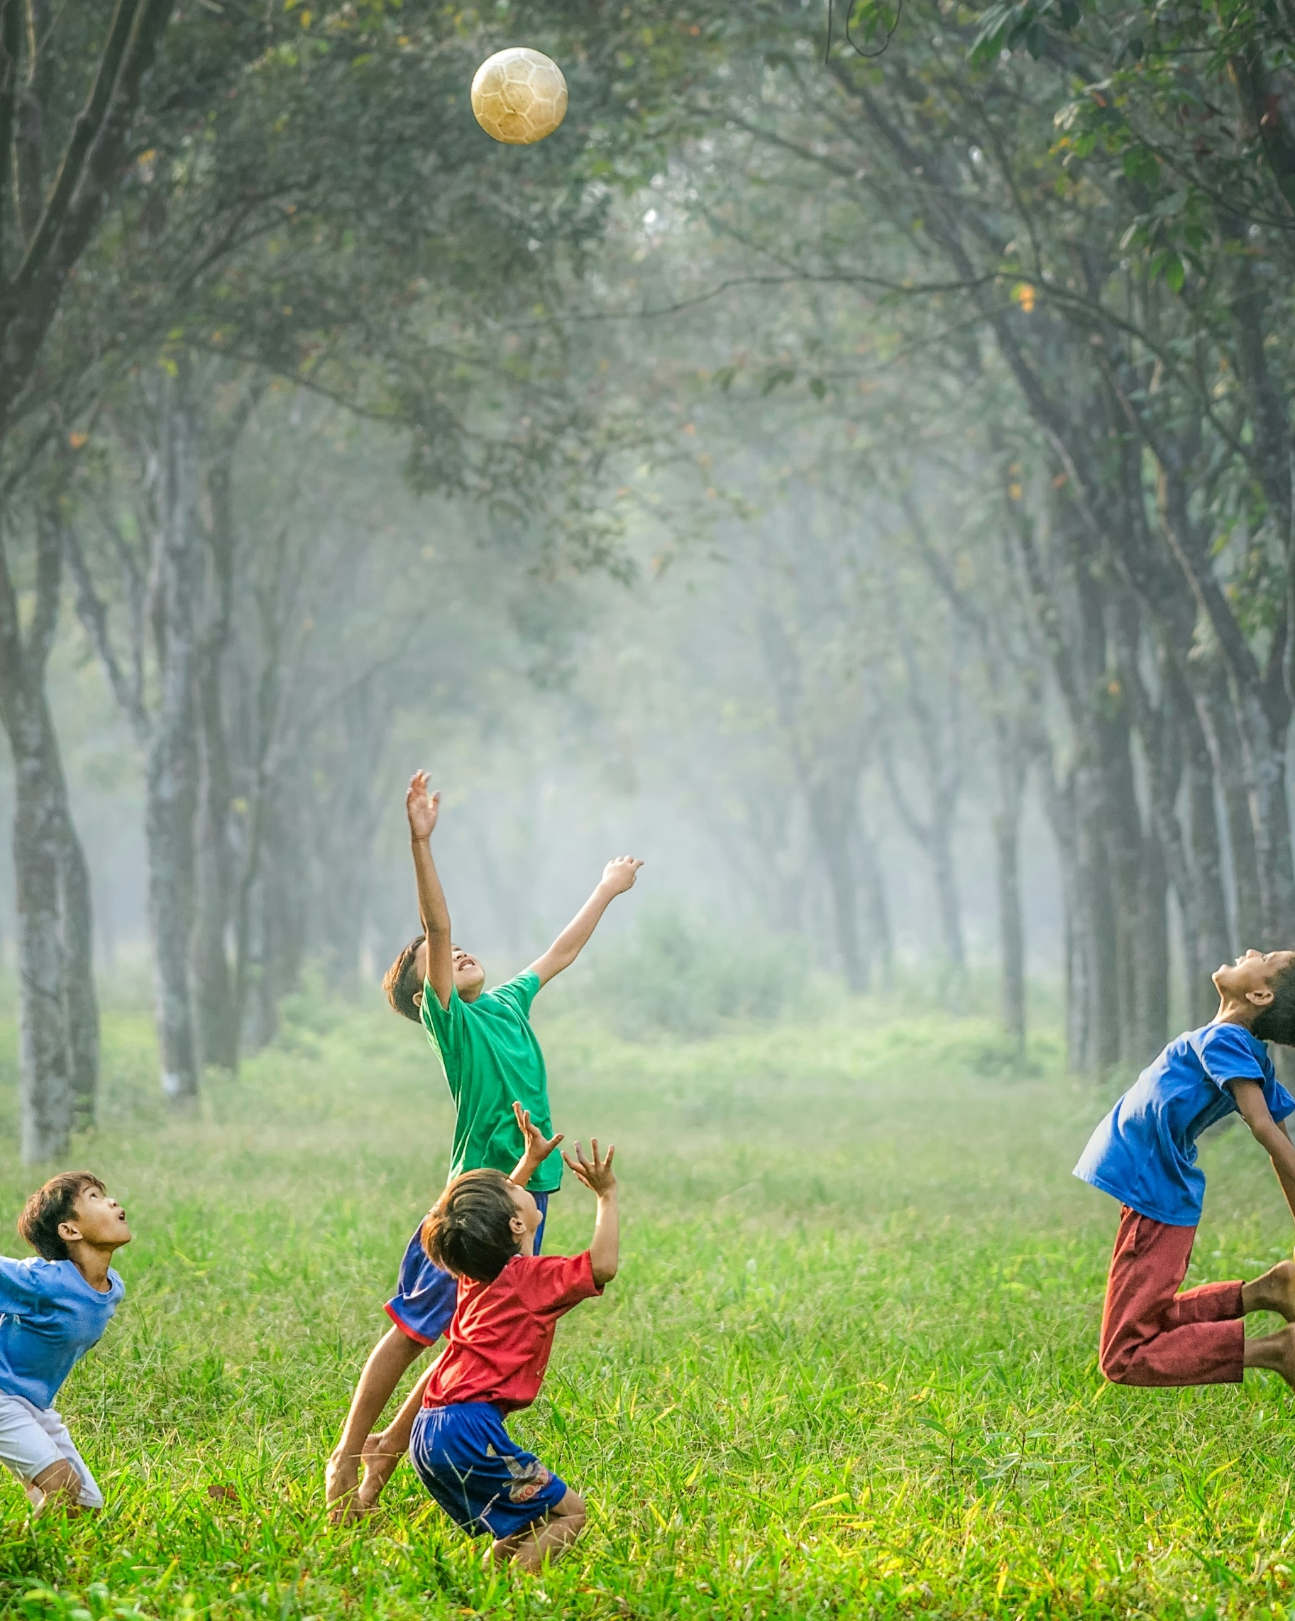
Text annotations – ‘The Echoing Green’ – Blake – 8.1
Stage 4 – 8.1
‘Knowing the rules to break the rules’ – Year 8, Term 1 ’
Photo by Robert Collins on Unsplash

Slide 3
Licence agreement details
Core text 4 – poem
‘The Echoing Green’ by William Blake (1789), from Songs of Innocence
A version of this is available at Project Gutenberg. This work is in the public domain.
Notes:
Teacher note: licence agreement details.

Slide 4
Text complexity details
This poem contains a range of markers which align to the complex level of the Text complexity scale as per the National Literacy Learning Progression (NLLP) (V3) in that it provides students opportunities to engage with a poetic text with complex levels of meaning or subtlety. It contains multi-clause sentences with varying syntax structures, non-literal descriptive details, and context specific symbolism.
This text helps meet the text requirements for English 7–10 as it contributes to a collection of poetry, and forms part of a range of fiction and non-fiction texts that are widely regarded as quality literature.
Notes:
Teacher note:
This slide is for teacher reference only.
The text complexity details are drawn from the table in the Core texts booklet where this text can be found.
Highlighted in red on this slide are the areas of focus within a grammar in context approach.
It contains multi-clause sentences with varying syntax structures, non-literal descriptive details, and context specific symbolism.
A study of this text will allow for the development of reading skills, the appreciation of the development of poetic forms, and the ways in which composers use language features as a form of expression.
An understanding of this poem will support students to understand how the ‘rules’ of poetry are established, then how later composers respond to them.

Slide 5
Sharing learning intentions and success criteria
Notes:
Teacher note: this slide has been used to identify the explicit teaching strategies sharing learning intentions and sharing success criteria. This slide could be deleted or hidden when using this content in a classroom setting. Alternatively, the teacher could discuss the educational benefit of the process of sharing learning intentions and success criteria and discussing the significance of this learning process.
Sharing learning intentions allows a teacher to effectively communicate the learning goal with students. They allow students to connect new learning to existing knowledge, skills and understanding.
When learning intentions are used with success criteria, students have a clear idea of the learning goal and how to get there (AERO 2024).
The success criteria break the learning intention into smaller and more manageable actions. They show students what they must do, say, make, create or perform to demonstrate their learning (Griffin 2018).
Success criteria are communicated to students in ways they understand. Teachers use their expertise to guide student thinking and often model and use exemplars to show students what success 'looks like’ (DoE 2025).
The sample learning intentions and success criteria (LISC) on the following slide are aligned to the syllabus.
When designing LISC for students working above or below stage level, or towards Life Skills outcomes, draw on the collaborative curriculum planning process to ensure LISC is differentiated and aligned with the relevant syllabus outcomes.
For more information, see:
AITSL: https://www.aitsl.edu.au/docs/default-source/feedback/aitsl-learning-intentions-and-success-criteria-strategy.pdf?sfvrsn=382dec3c_2
Sharing learning intentions: https://education.nsw.gov.au/teaching-and-learning/curriculum/explicit-teaching/explicit-teaching-strategies/sharing-learning-intentions
Sharing success criteria: https://education.nsw.gov.au/teaching-and-learning/curriculum/explicit-teaching/explicit-teaching-strategies/sharing-success-criteria
Collaborative curriculum planning: https://educationstandards.nsw.edu.au/wps/portal/nesa/k-10/diversity-in-learning/special-education/collaborative-curriculum-planning

Slide 6
Learning intentions and success criteria
We are learning to:
understand the context, form and literary value of a Romantic poem
develop their researching, analysing and poetry annotation skills
be able to explain the conventions within a Romantic poem
be able to follow the conventions to experiment with writing a Romantic poem.
We can:
[classroom teacher to insert co-constructed success criteria]
[classroom teacher to insert co-constructed success criteria]
[classroom teacher to insert co-constructed success criteria].
Notes:
Teacher note: adapt the provided learning intention and below sample success criteria, as required, to suit the needs of your students.
Identify the language forms and features of the poem
Interpret the intended meaning of the poem.
LISC is usually shared first or early in the lesson and is explained by the teacher who checks for understanding (DoE 2025).
LISC is referred to regularly to check for understanding, provide feedback or as a self-assessment tool (Wiliam and Leahy 2015).
Learning intentions and success criteria can be supported by exemplars, such as 'What A Good One Looks Like' (WAGOLL) or exemplars to demonstrate success criteria (Clarke 2021).
For more information, see:
Sharing learning intentions and success criteria: https://education.nsw.gov.au/content/dam/main-education/documents/teaching-and-learning/curriculum/explicit-teaching/explicit-teaching-technique-guide-lisc-sharing.pdf
Planning learning intentions and success criteria: https://education.nsw.gov.au/content/dam/main-education/documents/teaching-and-learning/curriculum/explicit-teaching/explicit-teaching-technique-guide-lisc-planning.pdf

Slide 7
Language and vocabulary
Notes:
Teacher note: this section of the PowerPoint is used with Phase 4, sequence 1 - playing by the rules – ‘The Echoing Green’ by William Blake.

Slide 8
The Echoing Green – Metalanguage
Natural imagery: descriptive language that uses elements from nature, such as plants, animals, and landscapes, to create pictures or feelings in the reader’s mind.
Alliteration: the repetition of the same consonant sound at the beginning of closely connected words to create a rhythmic or emphasised effect.
Emotive language: words or phrases that are used to evoke strong feelings or emotional responses from the reader.
Sensory language: descriptive language that appeals to the five senses (sight, sound, smell, taste, touch) to make a text more vivid and engaging.
Symbolism: the use of objects, characters, or actions to represent deeper meanings or ideas beyond their literal sense.
Contrast: the use of opposing or different ideas, images, or words to highlight differences and create emphasis.
Simile: a way of describing something by comparing it to something else using ‘like’ or ‘as’ to suggest a similarity.
Rhyme scheme: the pattern of rhymes at the end of lines in a poem, often identified using letters to show which lines rhyme (e.g., ABAB).
Notes:
Teacher note: present these poetic terms as tools students will use to analyse the poem. Have students record definitions in their workbooks as part of the build your own glossary activity.

Slide 9
The Echoing Green – Vocabulary
Arise: Rise.
Make the happy skies: the skies are happy to see the sun and the start of the day.
Our sports shall be seen: people see / watch children playing on the green.
Echoing Green: a village common space where children gather to play and people gather to relax.
Does laugh away care: enjoying watching children play and is carefree.
In our youth time: when they were children.
Weary: feeling of tiredness.
Descend: move downwards.
Our sports have an end: games and playtime have finished.
Like birds in their nest: a simile for the children nestling in their mother’s laps, being compared to baby birds getting ready for bed (nest).
Darkening green: sunlight is fading into evening and night.
Notes:
Teacher note:
This vocabulary preparation supports students' comprehension of the poem while building their understanding of archaic and poetic language.
Teachers should emphasise how vocabulary choices contribute to the poem's pastoral and nostalgic tone.
Consider creating a word wall grouping terms by theme or function.
The vocabulary selections support understanding of both literal and figurative meaning.
Note that some terms ("arise," "descend") have both literal and metaphorical meanings that students should explore.
Activities
Guide students through these content-specific words they'll encounter in the poem.
Have students identify connections between words to build understanding of the poem's themes before reading.
This vocabulary foundation will support comprehension.

Slide 10
First reading and discussion
Notes:
Teacher note: this section of the PowerPoint is used with Phase 2, sequence 1 - introduction to vocabulary and context.

Slide 11
The Echoing Green (1)
William Blake
The sun does arise,
And make happy the skies;
The merry bells ring
To welcome the spring;
The skylark and thrush,
The birds of the bush,
Sing louder around
To the bell's cheerful sound,
While our sports shall be seen
On the Echoing Green.
Notes:
Teacher note: this first encounter with ‘The Echoing Green’ supports students' initial comprehension while building connections to previously studied poetry.
Key points for class discussion:
The poem's natural imagery and pastoral setting
The contrast between youth and age
The role of memory and nostalgia
Structural differences from Barrett Browning's sonnet
The use of repetition and rhyme
Activities
Lead a reading of the poem's three stanzas
Have students track the progression from dawn to dusk
Create a visual timeline of events in the poem
Identify shifts in mood across stanzas
Compare with ‘How Do I Love Thee?’ structure and style
Mark key transitions in the text
Guide paired discussion of first impressions

Slide 12
The Echoing Green (2)
William Blake
Old John with white hair,
Does laugh away care,
Sitting under the oak,
Among the old folk.
They laugh at our play,
And soon they all say:
"Such, such were the joys
When we all, girls and boys,
In our youth time were seen
On the Echoing Green."
Notes:
Teacher note: allow students to read the text or model the reading of poetry to the class.

Slide 13
The Echoing Green (3)
William Blake
Till the little ones, weary,
No more can be merry;
The sun does descend,
And our sports have an end.
Round the laps of their mothers
Many sisters and brothers,
Like birds in their nest,
Are ready for rest,
And sport no more seen
On the darkening Green.
Notes:
Teacher note: allow students to read the text or model the reading of poetry to the class.

Slide 14
Language forms and features of the poem
Notes:
Teacher note: this section of the PowerPoint is used with Phase 4, sequence 1 - playing by the rules – ‘The Echoing Green’ by William Blake.

Slide 15
The Echoing Green
The Echoing Green – Imagery
The sun does arise,
And make happy the skies;
The merry bells ring
To welcome the spring;
The skylark and thrush,
The birds of the bush,
Sing louder around
To the bell's cheerful sound,
While our sports shall be seen
On the Echoing Green.
Imagery is created through the effective use of figurative language devices. It appeals to our five senses. In this excerpt from the poem, Blake has created both visual imagery (eyesight) and auditory imagery (hearing), both of which give us a greater understanding of the environment that he was writing about.
The sun does arise,
And make happy the skies;
The merry bells ring
To welcome the spring;
The skylark and thrush,
The birds of the bush,
Sing louder around
To the bell's cheerful sound,
While our sports shall be seen
On the Echoing Green.
The sun does arise,
And make happy the skies;
The merry bells ring
To welcome the spring;
The skylark and thrush,
The birds of the bush,
Sing louder around
To the bell's cheerful sound,
While our sports shall be seen
On the Echoing Green.
Analysing the creation of imagery in this excerpt of the poem:
The first line opens with a sunrise. What colours do you associate with dawn? Compare or contrast with the colours you associate with sunset.
Create a new third and fourth line that add to Blake’s depiction of a sunrise. Include the colours you have mentioned above that you associate with dawn.
Why has Blake used words that have positive connotations in his creation of auditory imagery?
‘Echoing’ – does this create auditory imagery for the reader?
Notes:
Teacher note: this analysis of imagery supports students' understanding of how sensory language creates meaning. Teachers should use the gradual release of responsibility model when teaching imagery identification.
Activities
Guide students in identifying visual and auditory imagery
Create a sensory mapping of dawn vs. sunset imagery
Analyse the effect of positive connotations
Compare nature imagery across stanzas
Discuss how imagery creates atmosphere
Practise annotating imagery examples

Slide 16
The Echoing Green – Assonance and alliteration
The sun does arise,
And make happy the skies;
The merry bells ring
To welcome the spring;
The skylark and thrush,
The birds of the bush,
Sing louder around
To the bell's cheerful sound,
While our sports shall be seen
On the Echoing Green.
The alliteration of the ‘s’ sound and the assonance of the ‘ou’ sound adds to the poem’s musicality, transporting us into the Echoing Green’s lively atmosphere! Identify these examples in the poem and note their effect.
In this first part of the poem, Blake has made the Echoing Green sound like it is a place that would bring about a positive experience. He has created a positive atmosphere through his creation of imagery and use of sound devices.
Activity: pretend you are a member of Romantic-era society and have just read this poem. Write a short letter to your friend telling them about the poem and why Blake has convinced you that the two of you must visit this lively place. You must identify at least one technique and one example from this excerpt to support your case.
Notes:
Teacher note: support students to complete the activities on the slide.
Activities
Guide students in identifying 's' sounds (alliteration) and 'ou' sounds (assonance)
Colour-code different sound patterns in the poem
Practice reading aloud to hear musical effects
Use think-pair-share to discuss sound effects
Create a list of sound devices and their impacts
Draft a Romantic-era letter incorporating techniques

Slide 17
The Echoing Green – Symbolism
Old John with white hair,
Does laugh away care,
Sitting under the oak,
Among the old folk.
They laugh at our play,
And soon they all say:
"Such, such were the joys
When we all, girls and boys,
In our youth time were seen
On the Echoing Green."
As evident from the previous slide, with the references to sunrise and “the birds of the bush”, Blake has placed emphasis on nature in this poem. He references an oak tree in this excerpt from the poem, with these trees symbol of longevity, strength and endurance, highlighting the Echoing Green’s importance to the community.
If you weren’t already relaxed enough from just thinking about sitting in the shade of an old oak tree, note that Blake also uses rhyme to add the poem’s musicality. Along with sound devices, rhyme helps us imagine the relaxing atmosphere enjoyed by those visiting the Echoing Green in the 1800s.
Notes:
Teacher note:
Understanding symbolism helps students recognise how figurative language deepens meaning.
Teachers should scaffold symbol analysis from concrete to abstract interpretations.
Consider creating a class symbol chart linking images to meanings.
Activities
Identify natural symbols in the poem
Analyse the oak tree's symbolic significance
Explore how symbolism creates deeper meaning
Create visual representations of key symbols

Slide 18
The Echoing Green – Direct speech and inclusive language
Activity instructions:
Ensure you have an annotation tool (for example, highlighters).
Locate and highlight in this excerpt Blake’s use of direct speech and his use of inclusive (first-person) language. Annotate why you think he might have chosen to use these language features.
Can you identify more examples of inclusive language in the rest poem?
Old John with white hair,
Does laugh away care,
Sitting under the oak,
Among the old folk.
They laugh at our play,
And soon they all say:
"Such, such were the joys
When we all, girls and boys,
In our youth time were seen
On the Echoing Green."
Old John with white hair,
Does laugh away care,
Sitting under the oak,
Among the old folk.
They laugh at our play,
And soon they all say:
"Such, such were the joys
When we all, girls and boys,
In our youth time were seen
On the Echoing Green."
We can also see in this excerpt that Blake also uses third-person language. He refers to ‘Old John’ and the old folk as ‘they’. In the excerpt on the next slide, he refers to ‘the little ones’. Along with his inclusion of direct speech, this language emphasises that the poem is reflective of other people’s nostalgic memories of the Echoing Green, not just the composer’s experience.
Nostalgia: feelings of happiness and sadness that come from remembering something from the past.
Notes:
Teacher note: support students to complete the activities on the slide.
Activities
Highlight examples of different narrative perspectives
Analyse the effect of inclusive pronouns
Identify instances of direct speech
Discuss how language choices create community
Examine the role of nostalgia
Practise annotating language features

Slide 19
The Echoing Green – Nouns and similes
Till the little ones, weary,
No more can be merry;
The sun does descend,
And our sports have an end.
Round the laps of their mothers
Many sisters and brothers,
Like birds in their nest,
Are ready for rest,
And sport no more seen
On the darkening Green.
Blake uses nouns in this excerpt to highlight the familial bonds as people leave the community of the Green back to their own homes. The family roles of mothers and children, as well as ‘little ones’ and ‘old folk’ symbolise the communal nature and love for this natural space.
Let’s not forget the power of imagery, which Blake has created throughout the entire poem. In this last excerpt, he revisits the natural imagery of the day’s end by drawing our attention to the sun setting and green darkening.
Can you spot the simile in this excerpt? Why is its use by Blake effective in shaping meaning in the poem? Annotate your copy of the poem with this information.
Notes:
Teacher note: support students to complete the activities on the slide.
Activities
Identify and categorize nouns
Analyse the bird's nest simile
Explore familial imagery
Discuss how word choices create meaning

Slide 20
References
This presentation contains NSW Curriculum and syllabus content. The NSW Curriculum is developed by the NSW Education Standards Authority. This content is prepared by NESA for and on behalf of the Crown in the right of the State of New South Wales. The material is protected by Crown copyright.
Please refer to the NESA Copyright Disclaimer for more information https://educationstandards.nsw.edu.au/wps/portal/nesa/mini-footer/copyright.
NESA holds the only official and up-to-date versions of the NSW Curriculum and syllabus documents. Please visit the NSW Education Standards Authority (NESA) website https://educationstandards.nsw.edu.au/wps/portal/nesa/home and the NSW Curriculum website https://curriculum.nsw.edu.au.
English K-10 © Syllabus NSW Education Standards Authority (NESA) for and on behalf of the Crown in right of the State of New South Wales, 2022.
Australian Education Research Organisation (AERO) (2024a) Explain learning objectives, AERO, accessed 16 April 2024.
AERO (Australian Education Research Organisation) (2024b) Why explicit instruction works, AERO website, accessed 16 April 2024.
Black P and Wiliam D (2018) ‘Classroom assessment and pedagogy’, Assessment in Education Principles Policy and Practice, 25(1):1–25.
CESE (Centre for Education Statistics and Evaluation) (2017) Cognitive load theory: Research that teachers really need to understand, NSW Department of Education, accessed 16 April 2024.
Clarke S (2014) Outstanding formative assessment: culture and practice, Hodder Education, Great Britain.
Clarke S, Timperley H, Hattie J (2003) Unlocking formative assessment: Practical strategies for enhancing students’ learning in the primary and intermediate classroom, Hodder Moa Beckett, Auckland NZ, 2003.
Griffin P (2018) Assessment for teaching, Cambridge University Press.
State of New South Wales (Department of Education) (2024.) Explicit teaching strategies, NSW Department of Education website, accessed 5 April 2024.
State of New South Wales (Department of Education) (2024) the Explicit teaching – Driving learning and engagement, Centre for Education Statistics and Evaluation website, accessed 5 April 2024.
State of New South Wales (Department of Education) (n.d.) Digital Learning Selector, NSW Department of Education website, accessed 5 April 2024.
Wiliam D (2014) ‘The right questions, the right way ’, Educational Leadership, 71(6).

Slide 21
Copyright
© State of New South Wales (Department of Education), 2025
The copyright material published in this resource is subject to the Copyright Act 1968 (Cth) and is owned by the NSW Department of Education or, where indicated, by a party other than the NSW Department of Education (third-party material).
Copyright material available in this resource and owned by the NSW Department of Education is licensed under a Creative Commons Attribution 4.0 International (CC BY 4.0) license.
This license allows you to share and adapt the material for any purpose, even commercially.
Attribution should be given to © State of New South Wales (Department of Education), 2025.
Material in this resource not available under a Creative Commons license:
the NSW Department of Education logo, other logos and trademark-protected material
Material owned by a third party that has been reproduced with permission. You will need to obtain permission from the third party to reuse its material.
Links to third-party material and websites
Please note that the provided (reading/viewing material/list/links/texts) are a suggestion only and implies no endorsement, by the New South Wales Department of Education, of any author, publisher, or book title. School principals and teachers are best placed to assess the suitability of resources that would complement the curriculum and reflect the needs and interests of their students.
If you use the links provided in this document to access a third party’s website, you acknowledge that the terms of use, including licence terms set out on the third-party’s website apply to the use which may be made of the materials on that third-party website or where permitted by the Copyright Act 1968 (Cth). The department accepts no responsibility for content on third-party websites.

