Slide 1
Instructions for use
This resource is not a teaching and learning program. It should be used in conjunction with (Insert unit name and link).
Classroom teachers are encouraged to add and adapt slides as required to meet the needs of their students.
Save a copy of the file to make changes to the slide deck. Go to File > Download a Copy (this downloads a copy to the computer to edit in the PowerPoint app).
To convert the PowerPoint to Google Slides:
Upload the file into Google Drive and open it.
Go to File > Save as Google Slides.
(Note – conversion may cause formatting changes in the slides.)

Slide 2
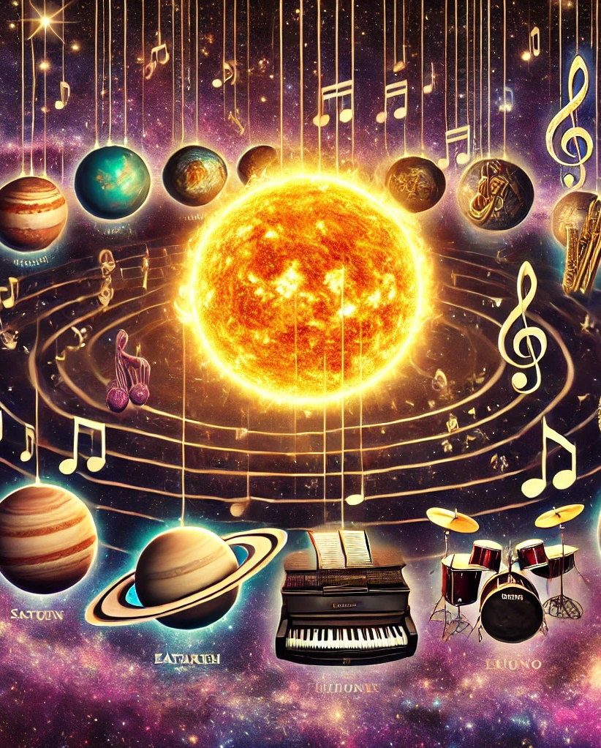
Music of our solar system
Music – Stage 5
PowerPoint
This work has been generated using artificial intelligence. Any copyright subsisting in this work is owned by © State of New South Wales (Department of Education) 2025.

Slide 3
Lesson sequence overview
1
‘Mars’ from The Planets – Holst
4
‘Jupiter’ Symphony No. 41 in C major K. 551 – Mozart
2
‘Imperial March’ from Star Wars – Williams
5
Assessment task planning and submission
3
‘Eternity’ from The Brightest Star in the Night – Macens
Notes:
Teacher notes:
Click lesson numbers to go to specific lessons
Interactive features can be viewed in slide show
Notes for vendors [to be removed after slide deck creation]:
Create hyperlinks to dividers that match lesson numbers by
Right click on the number>edit link>select slide in deck to connect to

Slide 4
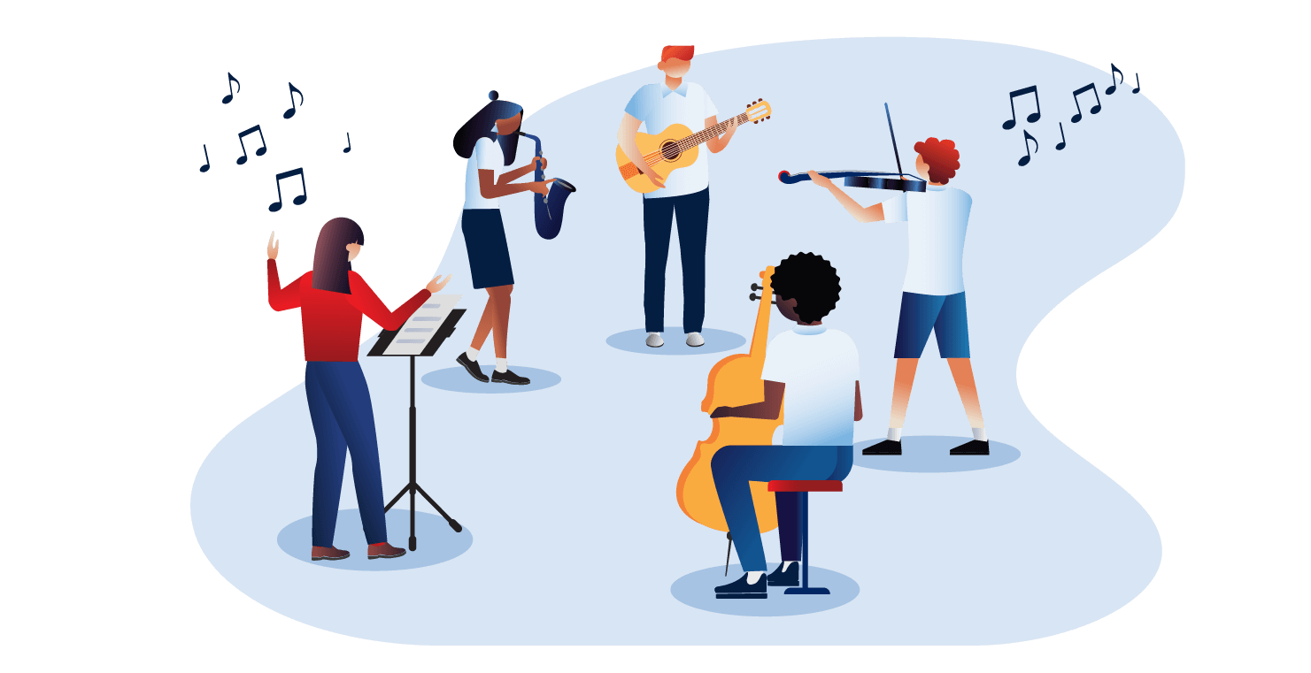
Learning sequence 1 'Mars' from The Planets – Holst

Slide 5
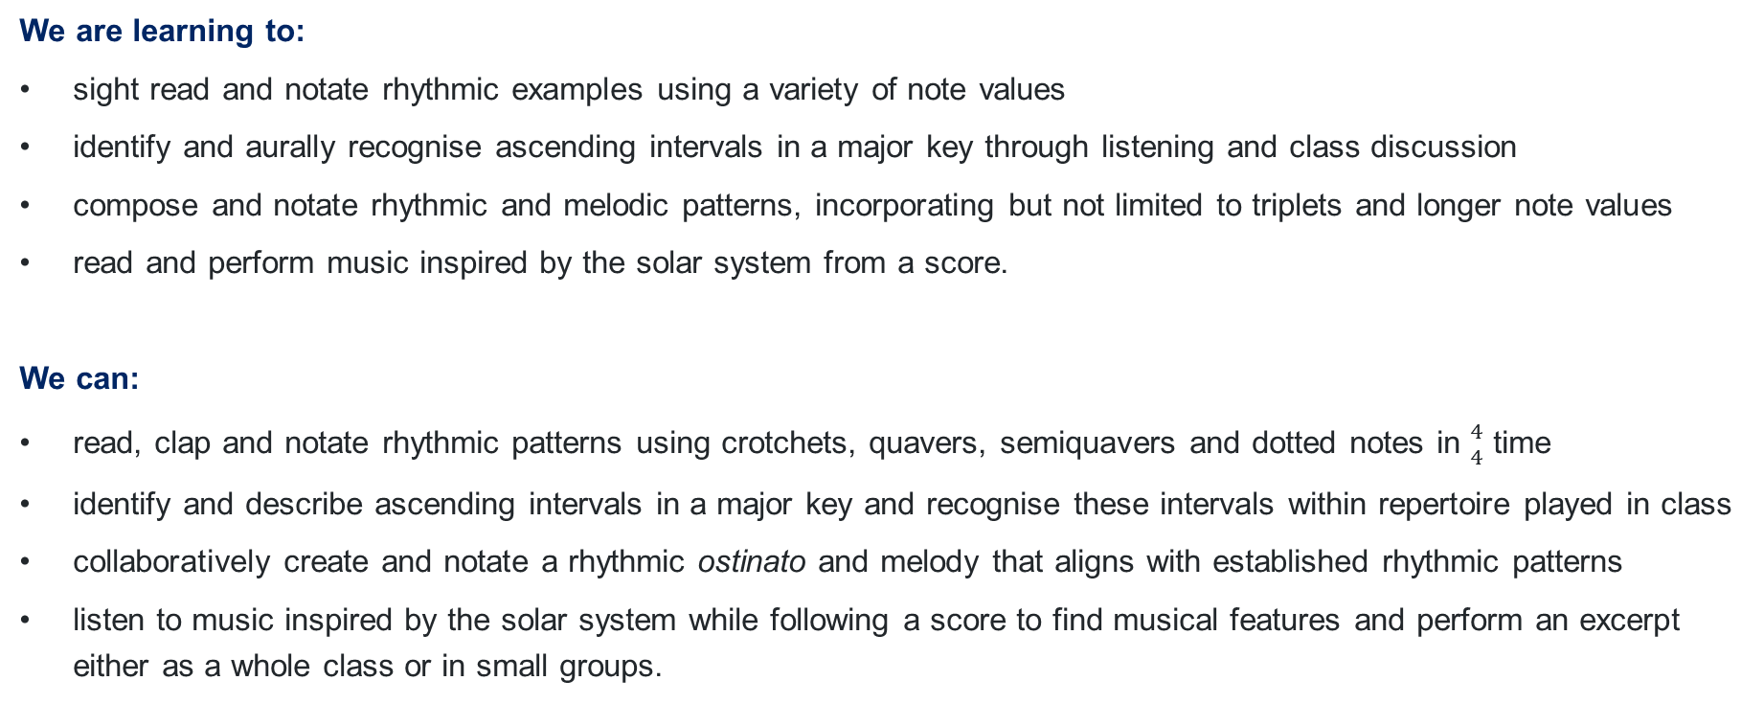
Learning intentions and success criteria – learning sequence 1
We are learning to:
sight read and notate rhythmic examples using a variety of note values
identify and aurally recognise ascending intervals in a major key through listening and class discussion
compose and notate rhythmic and melodic patterns, incorporating but not limited to triplets and longer note values
read and perform music inspired by the solar system from a score.
We can:
read, clap and notate rhythmic patterns using crotchets, quavers, semiquavers and dotted notes in ${4 \atop 4}$ time
identify and describe ascending intervals in a major key and recognise these intervals within repertoire played in class
collaboratively create and notate a rhythmic ostinato and melody that aligns with established rhythmic patterns
listen to music inspired by the solar system while following a score to find musical features and perform an excerpt either as a whole class or in small groups.
Notes:
Notes for teachers:
Learning intentions and success criteria are best co-constructed with students. Adapt the learning intention as required and add matching success criteria.
For more information See ⁠AITSL or the NSW Department of Education explicit teaching strategies, ⁠Sharing learning intentions and ⁠Sharing success criteria
LISC is not necessarily presented at the beginning of the lesson. Teacher needs to consider most effectual time to introduce
LISC should be revisited during the lesson to support students' evaluation of their learning

Slide 6











Activity 1.1 – rhythmic sight reading (1)
2-bar examples
${4 \atop 4}$
${4 \atop 4}$

Slide 7












Activity 1.1 – rhythmic sight reading (2)
4-bar examples
${4 \atop 4}$
${4 \atop 4}$

Slide 8
Activity 1.1 – activating prior knowledge for intervals
Ascending in a major key
Interval | Song
Unison | Jingle bells (0:00 - 0:02)
2nd | Happy birthday (0:00 - 0:01) Silent night (0:08 - 0:10)
3rd | Oh when the saints go marching in (0:09 - 0:10) For he's a jolly good fellow (0:00 - 0:03)
4th | Australian national anthem (0:13 - 0:15) Amazing grace (0:05 - 0:07) Auld lang syne (0:00 - 0:04)
5th | Twinkle, twinkle (0:00 - 0:02) ABC song (0:05 - 0:10)
6th | Dashing through the snow (jingle bells) (0:09 - 0:10) My bonnie lies over the ocean (0:09 - 0:11)
7th | Take on me (0:54 - 0:56)
8ve | Somewhere over the rainbow (0:00 - 0:03)
An interval is the distance between 2 notes.
We can use well known songs to identify each interval using our listening skills.
Sing the opening two notes of each of these songs.
Then consider the distance between the two notes – this is the interval.
Sing the two notes again, but instead of singing the song lyrics, sing the interval name, for example major second.
Once you can remember these intervals, have your teacher test your knowledge by playing intervals for you to work out on your own.

Slide 9
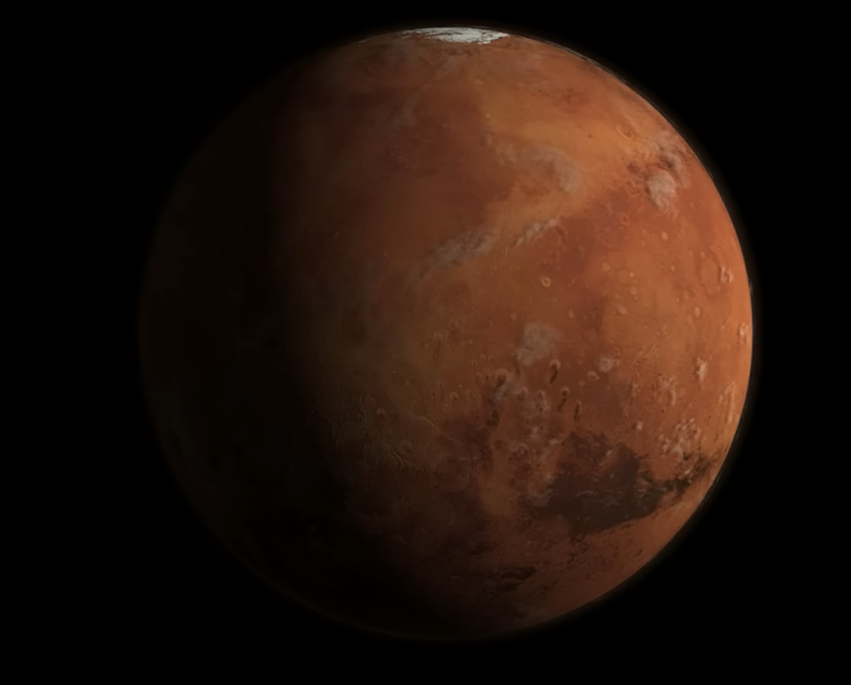
Activity 1.1 – what is the common ascending interval?
Listening
Identify the 2 common intervals in the first
minute of Holst’s ‘Mars’ from The Planets
Hint:
Graphic notation of interval
Graphic notation of interval (note: identify the interval between the first 2 notes only)
Answers:
1. Unison. 2. 5th.
HDclassical (2010) Gustav Holst – Mars (7:08) [video] accessed 21 January 2025
Notes:
Note - colour coding activity slides
Blue - listening
Pink - composition
Green - performance

Slide 10
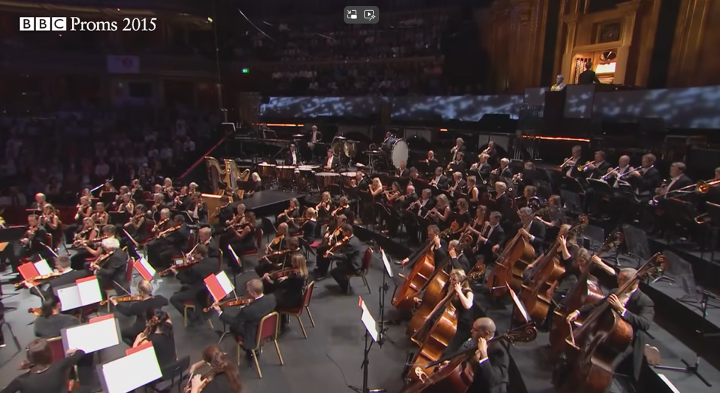
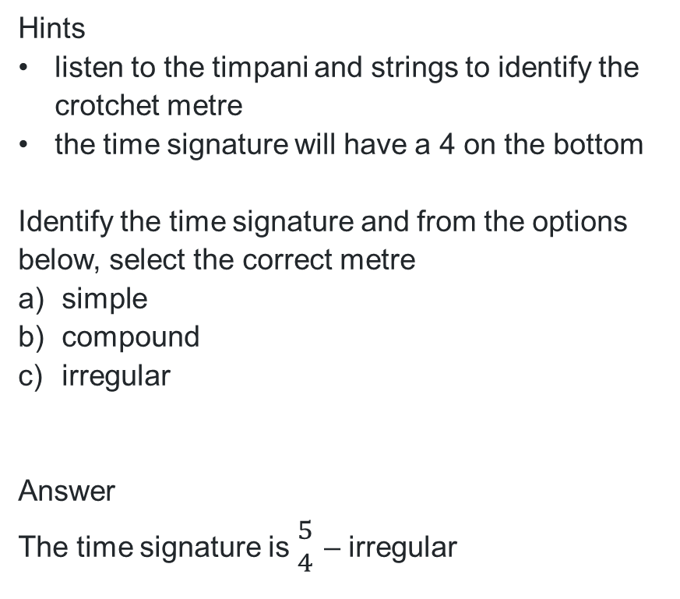
Activity 1.2 – what is the time signature?
Listening
Hints
listen to the timpani and strings to identify the crotchet metre
the time signature will have a 4 on the bottom
Identify the time signature and from the options below, select the correct metre
simple
compound
irregular
Answer
The time signature is ${5 \atop 4}$ – irregular
BBC (2015) Holst: The Planets, 'Mars' – BBC Proms (6:57) [video] accessed 22 January 2025

Slide 11

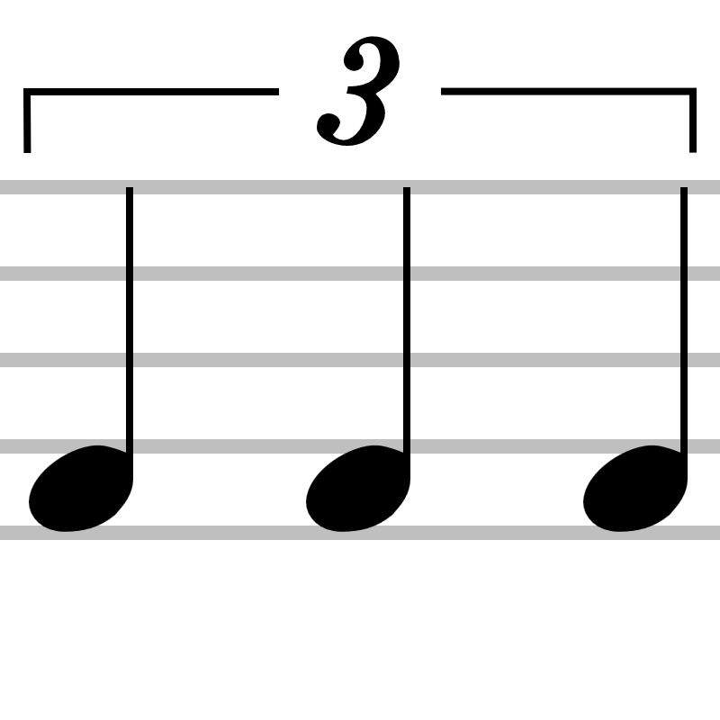

Activity 1.2 – musical terms
Triplet – 3 notes played in the time of 2
Example
Ostinato – a repeated pattern
Example

Slide 12

Activity 1.2 – 'Mars' ostinato
Opening ostinato from 'Mars' by Holst
Image created in Sibelius

Slide 13
Activity 1.2 – safety in the music classroom (1)
Show respect for your classmates, your teacher and the music classroom equipment.
Return instruments and equipment (including leads, adaptors, pedals) to the right place.
Take care when using instruments to avoid accidents and damage. Report any damage immediately to your teacher.
Consider safe volume levels when rehearsing and think about others around you.
Always do a warm-up and/or technical work before rehearsing a performance piece.
Position your music and/or ensemble members to ensure correct posture both in rehearsal and performance.

Slide 14
Activity 1.2 – safety in the music classroom (2)
Cover any trip hazards, including cords.
Explore different ways to play. For example, adjust volume or pitch controls or select different modes or effects instead of playing forcefully.
Be considerate of class members with sound sensitivity.
Practice safety when packing away. For example, turn off the instrument before unplugging and switch off power points before pulling out plugs.

Slide 15
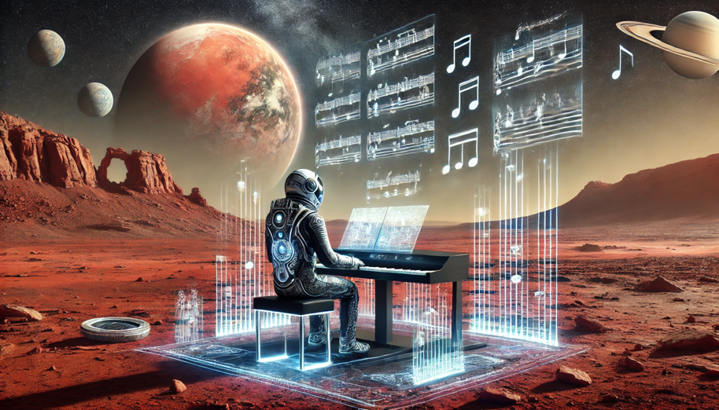
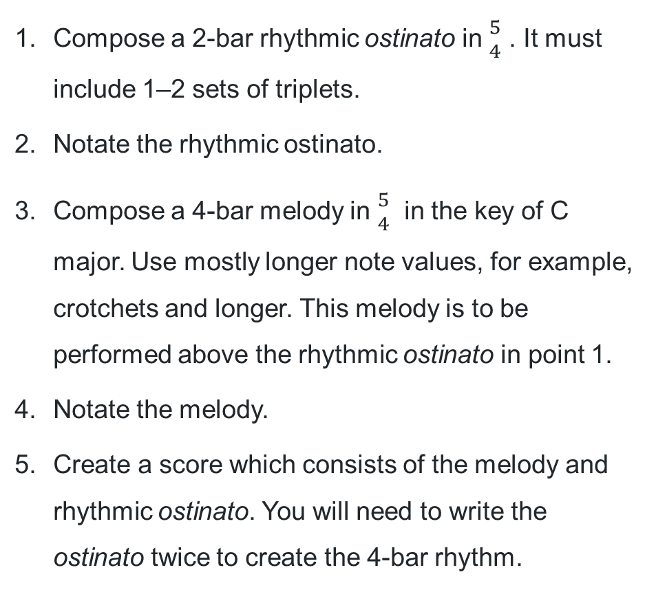
Activity 1.2 – composition activity
Compose a 2-bar rhythmic ostinato in ${5 \atop 4}$ . It must include 1–2 sets of triplets.
Notate the rhythmic ostinato.
Compose a 4-bar melody in ${5 \atop 4}$ in the key of C major. Use mostly longer note values, for example, crotchets and longer. This melody is to be performed above the rhythmic ostinato in point 1.
Notate the melody.
Create a score which consists of the melody and rhythmic ostinato. You will need to write the ostinato twice to create the 4-bar rhythm.
This work has been generated using artificial intelligence. Any copyright subsisting in this work is owned by © State of New South Wales (Department of Education) 2025.

Slide 16
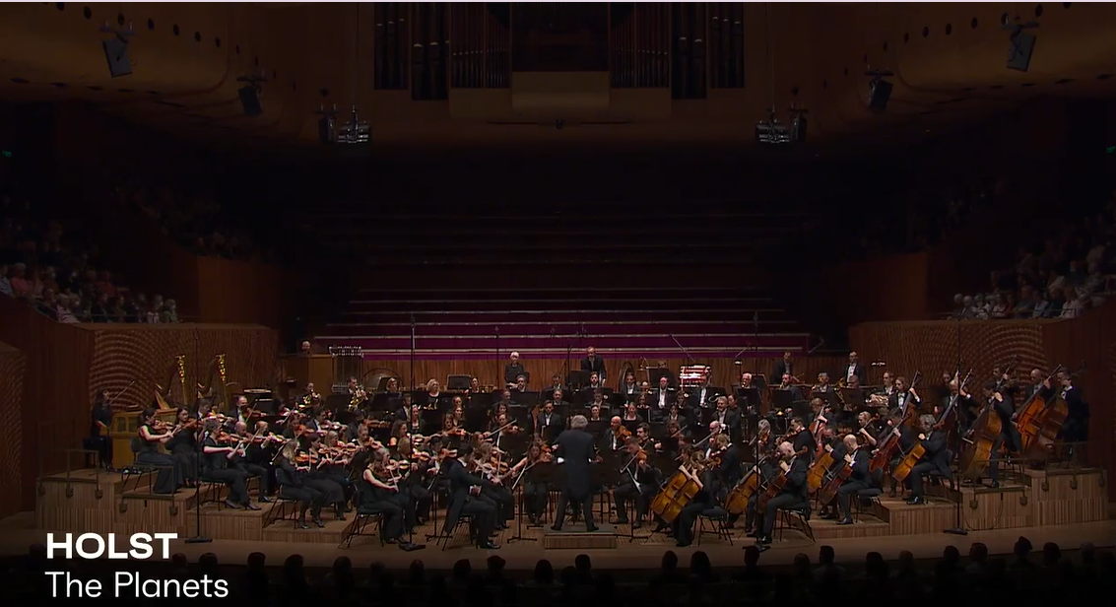
Activity 1.3 –‘Mars’ from The Planets – Gustav Holst
Listen to the first 40 bars of 'Mars' (0:00 – 1:42)
Sydney Symphony Orchestra (2022) Gustav Holst – Mars (53:56) [video] accessed 23 January 2025

Slide 17

Learning sequence 2 'Imperial March' from Star Wars – Williams

Slide 18
Learning intentions and success criteria – learning sequence 2
We are learning to:
understand and identify the musical device – leitmotif
compare musical elements from different repertoire
evaluate and articulate our observations on the mood of different musical pieces
compose and perform a ternary form piece using compositional devices.
We can:
discuss and provide examples of leitmotif in ‘Imperial March’ and articulate its role in the repertoire
complete a comparison table detailing the similarities and differences in musical elements between ‘Imperial March’ and ‘Mars’
write and share a 1–2 paragraph evaluation comparing the moods of ‘Imperial March’ and ‘Mars’ supported by musical evidence with our peers
collaboratively create and perform a 24-bar composition that includes contrasting sections using compositional devices.
Notes:
Notes for teachers:
Learning intentions and success criteria are best co-constructed with students. Adapt the learning intention as required and add matching success criteria.
For more information See ⁠AITSL or the NSW Department of Education explicit teaching strategies, ⁠Sharing learning intentions and ⁠Sharing success criteria
LISC is not necessarily presented at the beginning of the lesson. Teacher needs to consider most effectual time to introduce
LISC should be revisited during the lesson to support students' evaluation of their learning

Slide 19

Activity 2.1 – ‘Imperial March’ from Star Wars – Williams (1)
Leitmotif – a recurring theme that is usually associated with a particular person, place or idea.
In ‘Imperial March’ this particular person/character is Darth Vader, the piece is often referred to as Darth Vader’s theme. The leitmotif is used to evoke fear, but when played softly or slowly reflects Darth Vader’s internal conflict or demise.

Slide 20
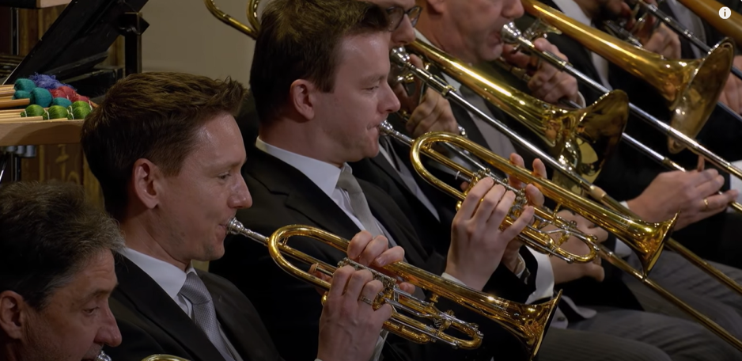
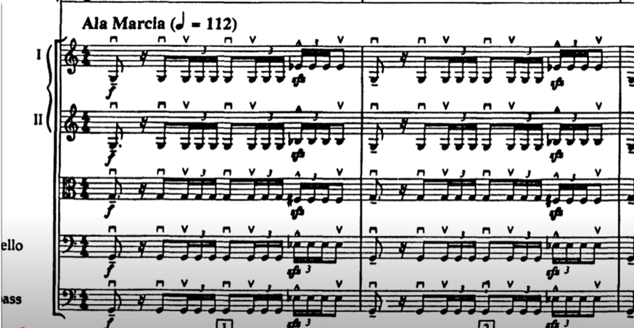
Activity 2.1 – ‘Imperial March’ from Star Wars –Williams (2)
Deutsche Grammophon – DG (2020)
John Williams & Vienna Philharmonic – Williams: Imperial March (from "Star Wars") (3:49)
[video] accessed 23 January 2025
Classical Scores (2015) John Williams – Star Wars Imperial March (with score) (3:03)
[video] accessed 23 January 2025

Slide 21
Activity 2.1 – ‘Mars’ from The Planets – Holst
HDclassical (2010) Gustav Holst – Mars (7:08) [video] accessed 21 January 2025

Slide 22
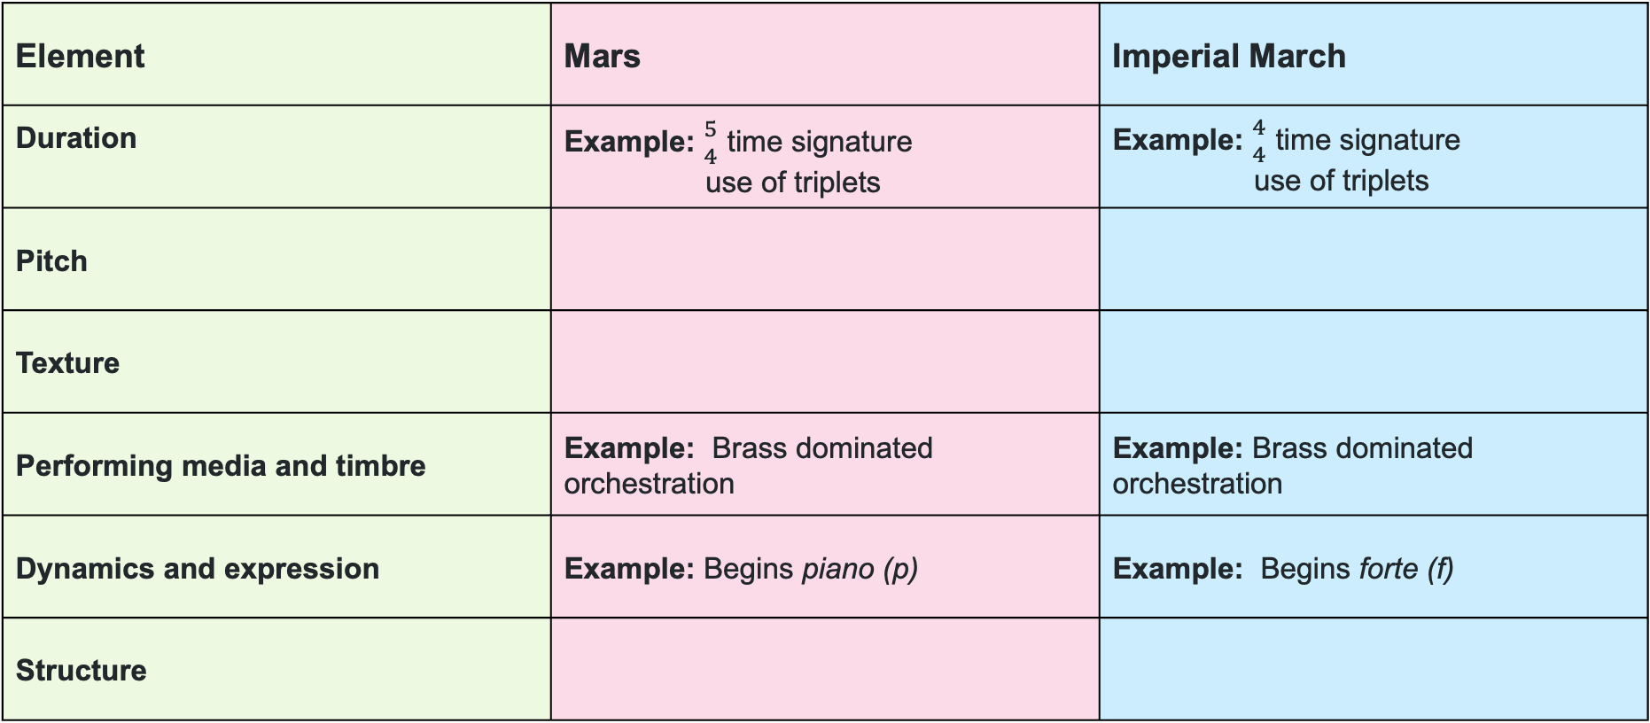
Activity 2.1 – compare ‘Mars’ with ‘Imperial March’
Element | Mars | Imperial March
Duration | Example: ${5 \atop 4}$ time signature use of triplets | Example: ${4 \atop 4}$ time signature use of triplets
Pitch
Texture
Performing media and timbre | Example: Brass dominated orchestration | Example: Brass dominated orchestration
Dynamics and expression | Example: Begins piano (p) | Example: Begins forte (f)
Structure

Slide 23
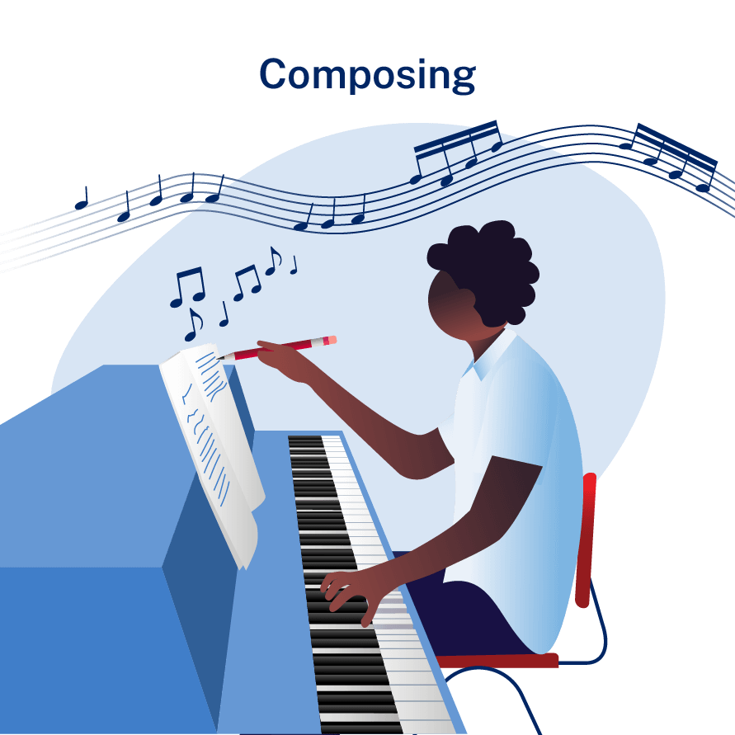
Activity 2.2 – compositional devices
Motif – a short musical idea
Leitmotif – a short recurring musical phrase associated with a person, place or situation
Imitation – where a musical idea is repeated and shared between parts/instruments
Augmentation – the lengthening of note values
Diminution – the shortening of note values
Fragmentation – the use of fragments or parts of a motif/theme

Slide 24

Activity 2.2 – composition and performance activity
Overview
Using the given ostinato rhythmic pattern and leitmotif, compose and perform a 24–bar ternary form piece resembling the musical qualities of ‘Mars’ and/or ‘Imperial March’.
The ostinato can be rhythmic or pitched. If pitched, use chords I, IV and V.
When extending the leitmotif idea, consider compositional devices such as augmentation, diminution, fragmentation and imitation.
The key is G minor, and the composition/performance must include contrasting dynamics.
This work has been generated using artificial intelligence. Any copyright subsisting in this work is owned by © State of New South Wales (Department of Education) 2025.

Slide 25
Activity 2.2 – composition and performance
Lesson 1 of 4
In lesson 1
Move into pairs or groups of 4.
Compose and complete section A (Bars 1–8) of the ternary form composition.
Use the given leitmotif and ostinato rhythmic patterns and extend the ideas using compositional devices such as augmentation, fragmentation, imitation and diminution.
Remember to include dynamics.
Rehearse section A.
This work has been generated using artificial intelligence. Any copyright subsisting in this work is owned by © State of New South Wales (Department of Education) 2025.

Slide 26
Activity 2.3 – composition and performance
Lesson 2 of 4
In lesson 2
Compose and complete section B (Bars 9–16) of the ternary form composition. This section should be contrasting to section A.
Use the given leitmotif and ostinato rhythmic patterns and look at ways to create contrast. For example, augmentation/diminution of note values, change in dynamics and change of mood.
Rehearse section B, then rehearse whole piece in ternary form. Section A, Section B and the return of Section A.
This work has been generated using artificial intelligence. Any copyright subsisting in this work is owned by © State of New South Wales (Department of Education) 2025.

Slide 27
Activity 2.4 – composition and performance
Lesson 3 of 4
In lesson 3
Finalise your ternary form composition in the style of ‘Mars’ and/or ‘Imperial March’.
Rehearse ready to perform to class next lesson.
This work has been generated using artificial intelligence. Any copyright subsisting in this work is owned by © State of New South Wales (Department of Education) 2025.

Slide 28
Activity 2.5 – performance etiquette
As a performer and an audience member
Performer
Move to the performance space and face the audience.
Ensure that you have eye contact with the other members of your group.
Wait until the audience is settled and quiet.
Remain focused throughout the performance, even if you lose your place.
If you lose your place, don’t giggle or pull faces, focus on joining back in with the rest of the group.
Appreciate the applause from the audience. Take a bow.
Audience member
Respect the performer(s) by not talking or moving during their performance.
Applause only – show the performer(s) your appreciation by applauding. No whistling or calling out.
If you arrive to class late or need to leave, do not enter or exit during a performance, wait until the performance is over.
Outside a school setting, remember to have your mobile phone switched off and put it in your bag/pocket.

Slide 29
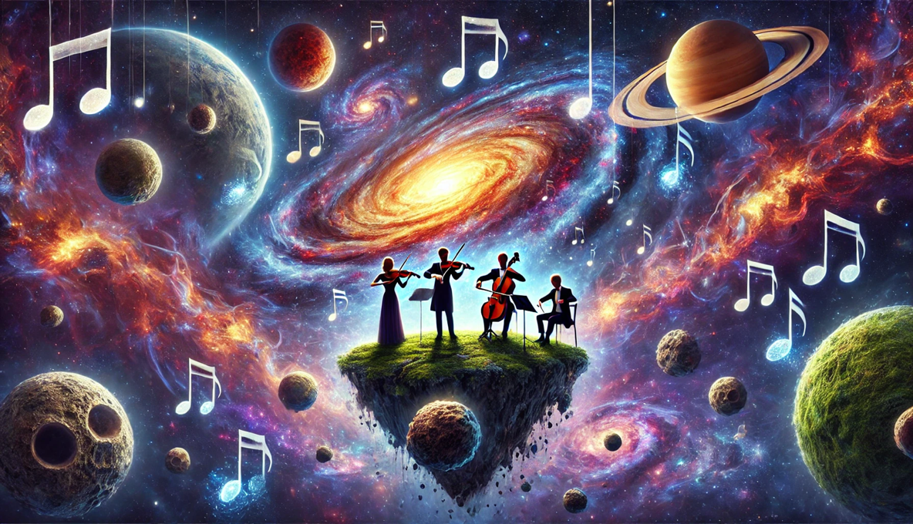
Activity 2.5 – composition and performance
Lesson 4 of 4
In lesson 4
Perform ‘Mars’ and/or ‘Imperial March’ style composition to the class
This work has been generated using artificial intelligence. Any copyright subsisting in this work is owned by © State of New South Wales (Department of Education) 2025.

Slide 30
Learning sequence 3 'Eternity' from The Brightest Star in the Night – Macens

Slide 31
Learning intentions and success criteria – learning sequence 3
We are learning to:
aurally recognise and notate rhythmic and melodic patterns
identify and discuss various musical metres and articulations
analyse and discuss the musical features and composer and performer perspectives
prepare and present a comparison of repertoire studied in class and own choice.
We can:
accurately notate a 4-bar rhythm dictations and 2-bar melodic dictations
define simple and compound metres, articulate the expression tenuto and apply these concepts in our clapping and singing activities
identify recurring motifs and patterns in the score and discuss composer and performer perspectives and how these features relate to Music of our solar system
outline the main musical features and comparison of 2 pieces representing our solar system in a written or viva voce format.
Notes:
Notes for teachers:
Learning intentions and success criteria are best co-constructed with students. Adapt the learning intention as required and add matching success criteria.
For more information See ⁠AITSL or the NSW Department of Education explicit teaching strategies, ⁠Sharing learning intentions and ⁠Sharing success criteria
LISC is not necessarily presented at the beginning of the lesson. Teacher needs to consider most effectual time to introduce
LISC should be revisited during the lesson to support students' evaluation of their learning

Slide 32
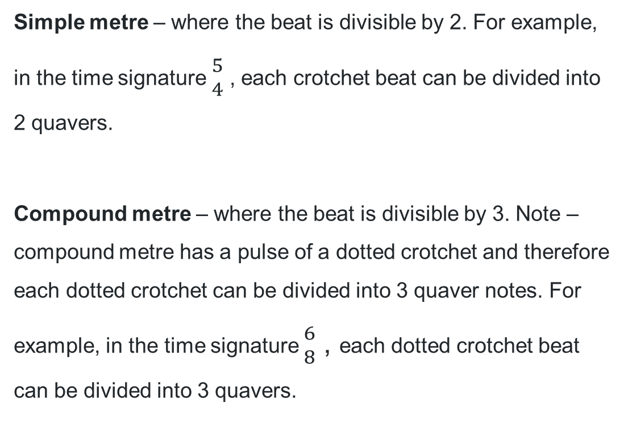
Activity 3.1 – musical terms (1)
Simple metre – where the beat is divisible by 2. For example, in the time signature ${5 \atop 4}$ , each crotchet beat can be divided into 2 quavers.
Compound metre – where the beat is divisible by 3. Note – compound metre has a pulse of a dotted crotchet and therefore each dotted crotchet can be divided into 3 quaver notes. For example, in the time signature ${6 \atop 8}$ , each dotted crotchet beat can be divided into 3 quavers.

Slide 33
Activity 3.1 – musical terms (2)
Mixed metre – where the metre or the time signature changes within a piece of music. This could appear a few times in a piece or could be evident every couple of bars.
Complex metre – an unusual or irregular metre that does not fall under duple, triple or quadruple time.

Slide 34
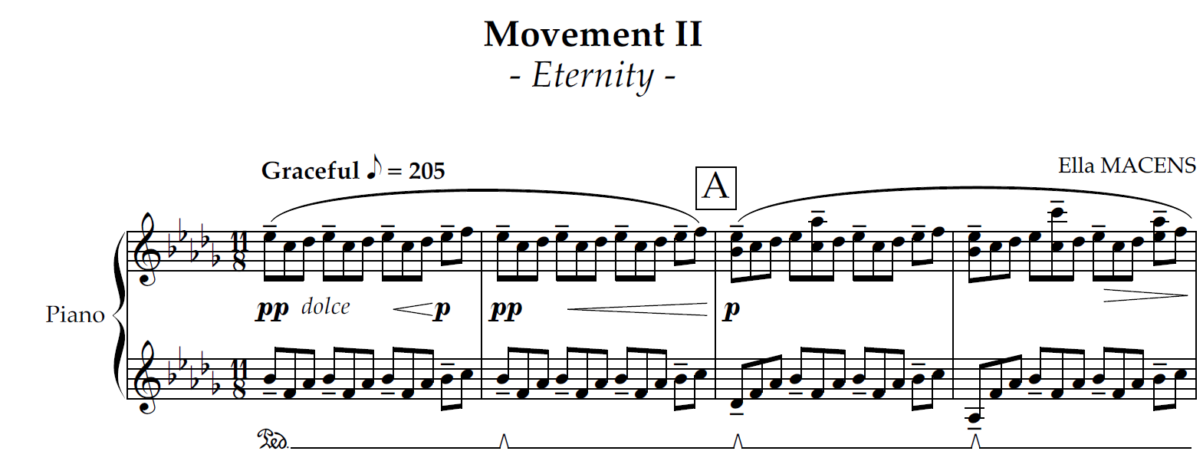
Activity 3.1 – Movement II ‘Eternity’ from The Brightest Star in the Night – Ella Macens bars 1 – 4 (piano)

Slide 35

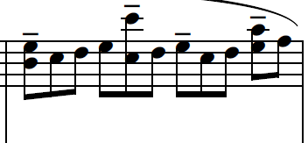
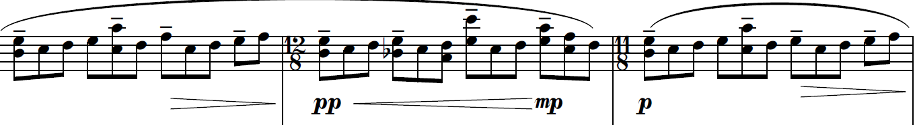
Activity 3.1 – Movement II ‘Eternity’ from The Brightest Star in the Night – Ella Macens bars 8 – 11 (treble piano)

Slide 36
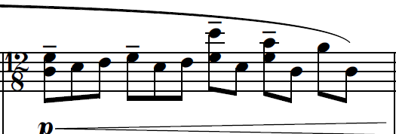
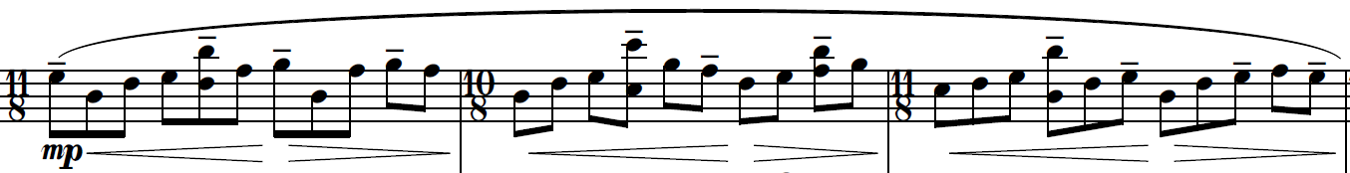
Activity 3.1 – Movement II ‘Eternity’ from The Brightest Star in the Night – Ella Macens bars 50 – 53 (treble piano)

Slide 37
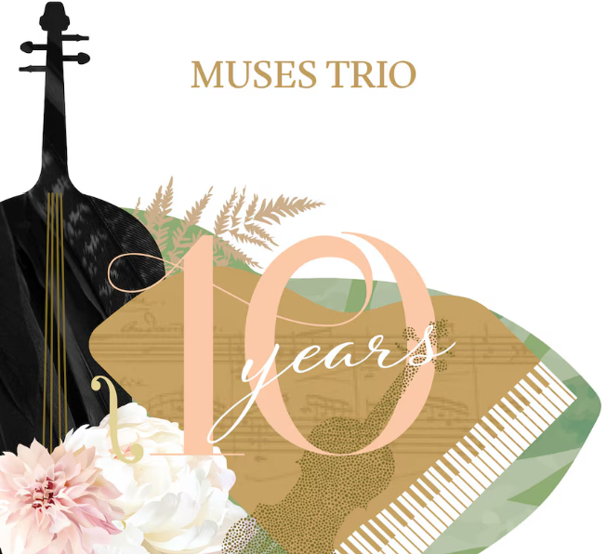
Activity 3.1 – Movement II ‘Eternity’ from The Brightest Star in the Sky – Macens
Release – Topic (7 March 2024) Ella Macens – ‘II, Eternity’ from The Brightest Star in the Night (0:00–6:04) [video] accessed 4 March 2025

Slide 38

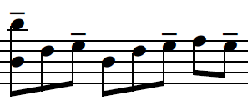
Activity 3.1 – musical terms (3)
Tenuto – a note or chord that is held for its full value. It is indicated by a short horizontal line above or below the notehead.
Tenuto example from 'Eternity' by Ella Macens

Slide 39
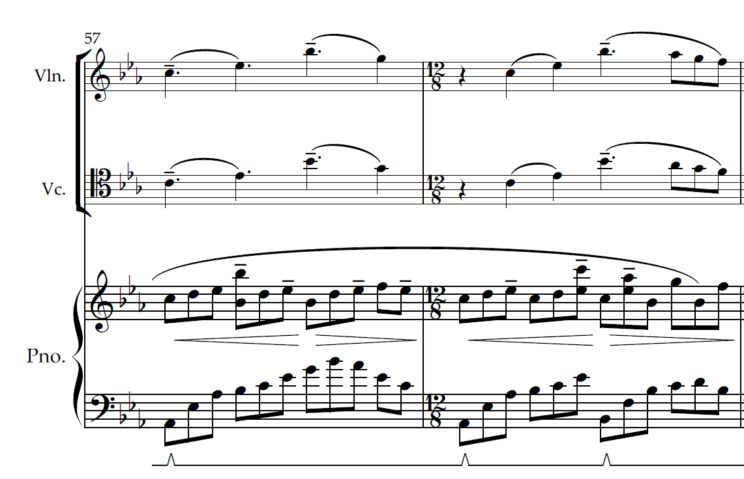
Activity 3.1 – Movement II ‘Eternity’ from The Brightest Star in the Night – Macens bars 57 – 58 (Violin, cello and piano)

Slide 40

Activity 3.2 – podcast featuring Macens and Muses Trio
Perspective through 'Eternity'
Darwin Gomez (2015), Ella Macens bio [image] accessed 10 March 2025

Slide 41
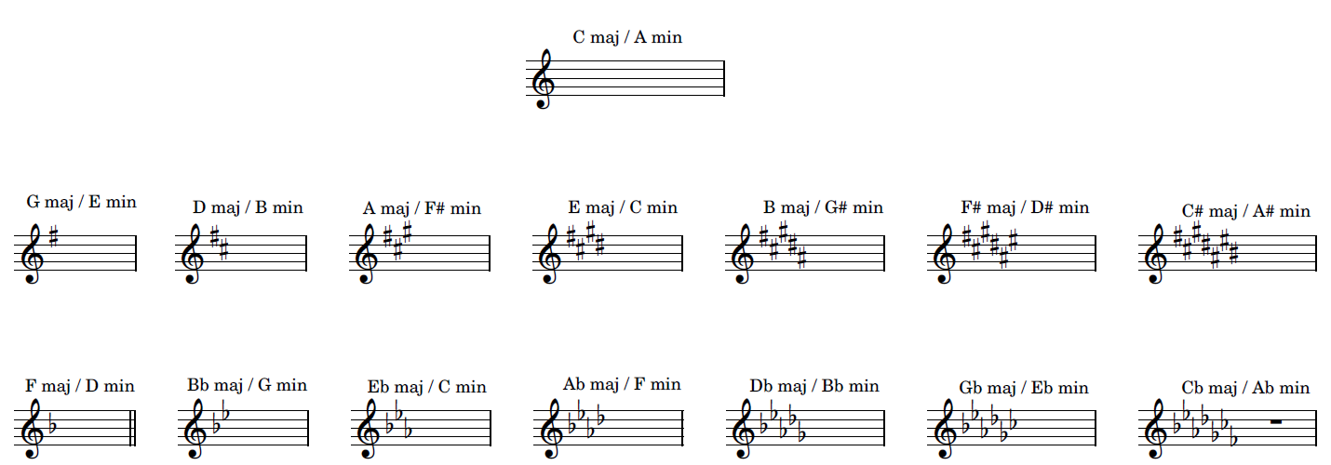
Activity 3.2 – key signatures
Created in Sibelius

Slide 42




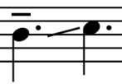
Activity 3.3 – string techniques (1)
Technique | Notation | Definition
Arco |  | Playing with the bow (the default technique for most orchestral string instruments).
Artificial harmonics |  | A player fully presses down a string with one finger while lightly touching the same string with another finger at a specific point. This controlled touch divides the string’s vibration, creating a soft, flute-like tone.
Ascending rolled arpeggio |  | The notes of a chord are played sequentially from the lowest to the highest pitch rather than simultaneously
Double stopping |  | Playing two notes at the same time by bowing or plucking across 2 strings.
Glissando or portamento |  | A smooth transition between 2 notes by sliding the finger along the string
All images created in Sibelius

Slide 43





Activity 3.3 – string techniques (2)
Technique | Notation | Definition
Ord. (Ordinario) |  | Return to the normal way of playing after a special technique.
Pizz. (Pizzicato) |  | Plucking the string with a finger instead of using the bow.
Sul tasto |  | Bowing over the fingerboard to create a soft, airy sound
Trill |  | Rapid alternation between 2 adjacent notes
Triple stopping |  | Playing 3 notes at the same time by bowing or plucking across three strings.
All images created in Sibelius

Slide 44

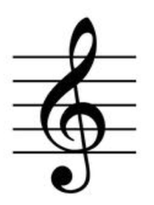
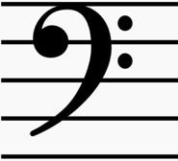
Activity 3.3 – cello clefs
Bass clef
The bass clef, or F clef, indicates lower pitches in music. The clef's two dots are positioned around the fourth line of the staff, which represents the note F. Middle C is located on the first ledger line above the staff.
Tenor clef
The tenor clef is a musical symbol indicating low-mid range pitches. It places the note middle C on the fourth line of the staff, aiding in reading music for tenor voices or instruments.
Treble clef
The treble clef, or G clef, indicates higher pitches in music, curling around the second line of the staff, which represents the note G. Middle C is located on the first ledger line below the staff.
All images created in Sibelius

Slide 45
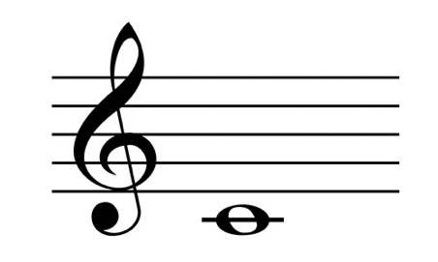
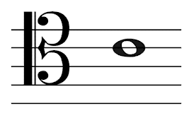
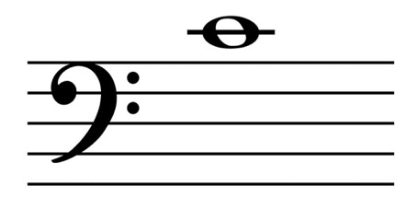
Activity 3.3 – tips for clef transposition
Work out where middle C would be in both clefs.
Find out how many lines up or down you need to move the music to move from middle C in the original clef to middle C in the new clef.
Count the same number of lines or spaces up or down from the first note in the original and write the first note in the new clef.
Continue with the remaining notes.

Slide 46

Activity 3.4 – perspective through 'Eternity' excerpt
“the little … melodic line … in the right hand, it's still the same ostinato and same time signature, but there's a few different points of emphasis and a few pitches being added there that start to create … a new melody that's just kind of woven itself out of that tapestry of the ostinato”
– Ella Macens – ‘Perspectives through 'Eternity'’ podcast
This work has been generated using artificial intelligence. Any copyright subsisting in this work is owned by © State of New South Wales (Department of Education) 2025.

Slide 47

Activity 3.4 – composition/improvisation
Learn the opening pattern – start by practicing the 2-bar ostinato individually. Aim to play this pattern fluently four times in a row.
Create your melody – once you can play the ostinato smoothly, try changing some of the notes in the pattern. Add tenuto marks to these notes to create a melody that works with the continuous quavers, similar to what Ella did in her piece.
Explore note placement – think about where you change the notes. Do they fall on the strong beats of the quaver groupings, or do you create interest by using syncopation?
Analyse the pitch relationships – when selecting which notes to change, consider the intervals between them. Do they create a smooth, flowing melody, or is it more disjointed when played on its own?
Transcribe your work – finally, write down your 8-bar composition either by hand on manuscript paper or by using music notation software.
This work has been generated using artificial intelligence. Any copyright subsisting in this work is owned by © State of New South Wales (Department of Education) 2025.

Slide 48
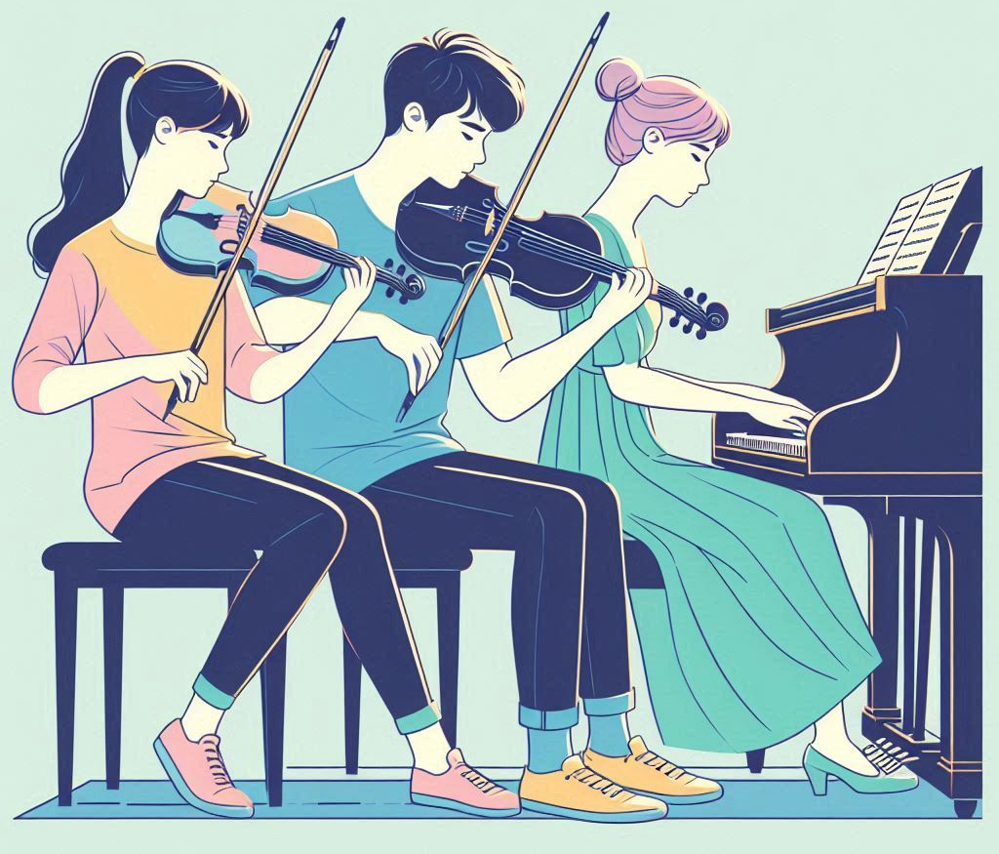
Activity 3.6 – performance
In small chamber groups, rehearse figures G to J. Things to consider:
use a metronome to keep the quaver pulse
listen to the piece several times to internalise the music
treat the interplay between the violin and cello parts as a conversation
integrate the dynamics and expression markings that will bring the music to life
This work has been generated using artificial intelligence. Any copyright subsisting in this work is owned by © State of New South Wales (Department of Education) 2025.

Slide 49
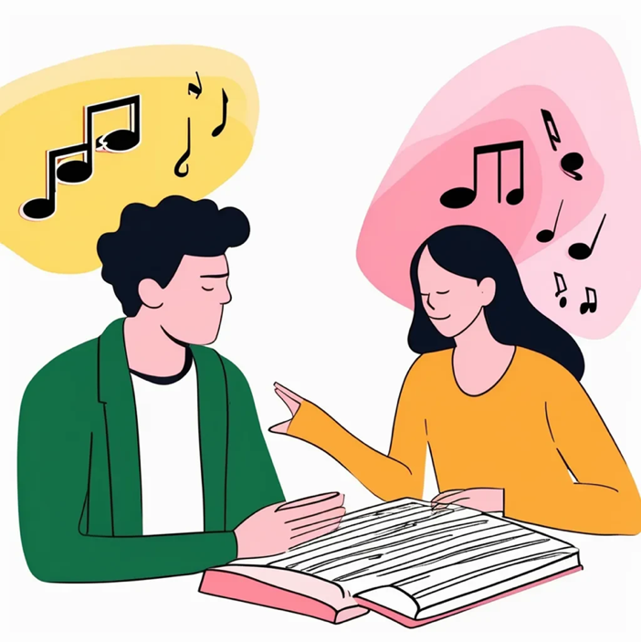
Activity 3.7 – viva voce
A viva voce is an examination where questions are asked and answered orally instead of through written responses. In the context of music, it involves a two-way discussion between the examiner and the student, during which the student demonstrates their understanding of the elements of music related to the topics and/or pieces studied.
This work has been generated using artificial intelligence. Any copyright subsisting in this work is owned by © State of New South Wales (Department of Education) 2025.

Slide 50

Activity 3.7 – sample viva voce questions
Before you play this excerpt, could you explain what we need to listen for?
How does this show …?
What is the role of …?
Can you explain the use of …?
How does the use of … compare in the two works?
Can you expand further on …?
This work has been generated using artificial intelligence. Any copyright subsisting in this work is owned by © State of New South Wales (Department of Education) 2025.

Slide 51
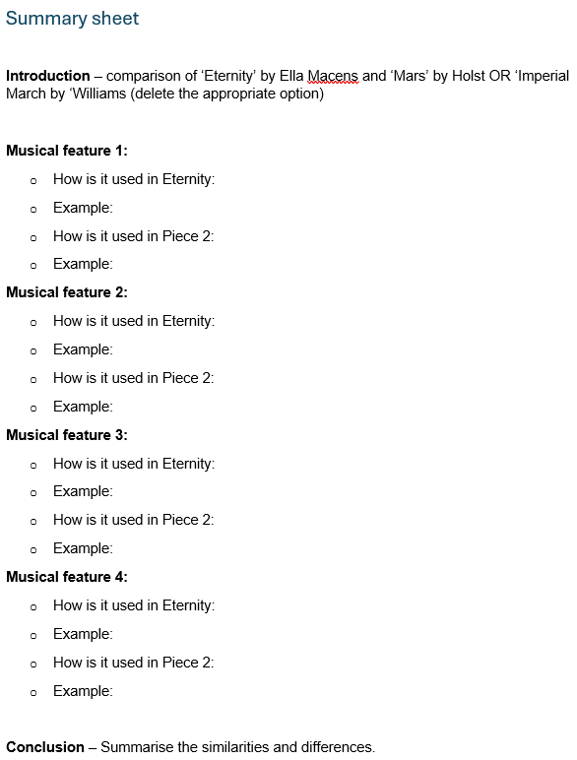
Activity 3.7 – viva voce summary sheet
The viva voce summary sheet should:
guide the discussion
include clear and important points
focus on musical features/elements of music
be succinct
give consideration for the timing for each point to be discussed/demonstrated.

Slide 52

Activity 3.7 – viva voce comparison activity (1)
Overview
You will work individually or in small groups to prepare a 5-minute viva voce presentation in which you will compare the piece 'Eternity' with either 'Mars' or the 'Imperial March'.
This work has been generated using artificial intelligence. Any copyright subsisting in this work is owned by © State of New South Wales (Department of Education) 2025.

Slide 53
Activity 3.7 – viva voce comparison activity (2)
Lesson 1 of 2
In lesson 1
Identify main features – compare the 2 pieces by identifying the main features that are similar and those that are different. Aim to discuss 4 points covering a range of elements of music.
Demonstrate features – for each feature, identify how you can demonstrate it. Consider using:
annotated score excerpts (highlight specific sections)
sound recordings (play short segments of the pieces)
live performances (you can even clap a rhythmic pattern or sing an interval to illustrate your point).
Structure your discussion – organise your ideas in a logical order to facilitate smooth discussion during your presentation. Consider which points will flow best into each other.

Slide 54

Activity 3.8 – viva voce comparison activity (3)
Lesson 2 of 2
In lesson 2
Create a summary sheet – develop a summary sheet that outlines the structure of your discussion. This should serve as a reference for both you and your teacher during your discussion.
Practice your presentation – rehearse your viva voce with a friend or peer. This will help you refine your delivery and timing.
Present to your teacher – present your viva voce to your teacher, ensuring you cover all points clearly and concisely within the 5-minute timeframe. Be prepared to answer any questions they may have about your comparisons!
This work has been generated using artificial intelligence. Any copyright subsisting in this work is owned by © State of New South Wales (Department of Education) 2025.

Slide 55
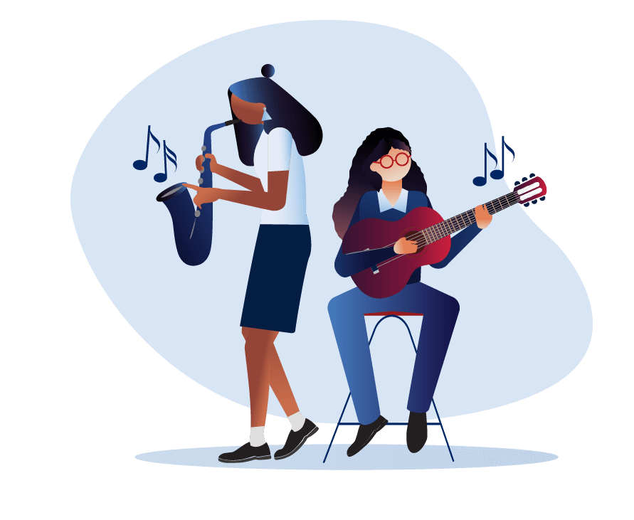
Learning sequence 4 'Jupiter' from Symphony No. 40 – Mozart

Slide 56
Learning intentions and success criteria – learning sequence 4
We are learning to:
read and interpret orchestral scores
identify and explain key musical features of a Classical period symphony
understand how Mozart uses structure on a micro and macro level to organise musical material
apply musical features of repertoire studied to a theme and variation composition.
We can:
accurately read and interpret orchestral scores, including identifying features such as cadences, chords and the alto clef
identify and articulate the key musical features in ‘Jupiter’, including cadences and modulation
identify and describe the structural components of ‘Jupiter’, including thematic development and the use of different forms
compose and notate in a theme and variations form based on a motif from ‘Jupiter’ integrating features of different repertoire studied.
Notes:
Notes for teachers:
Learning intentions and success criteria are best co-constructed with students. Adapt the learning intention as required and add matching success criteria.
For more information See ⁠AITSL or the NSW Department of Education explicit teaching strategies, ⁠Sharing learning intentions and ⁠Sharing success criteria
LISC is not necessarily presented at the beginning of the lesson. Teacher needs to consider most effectual time to introduce
LISC should be revisited during the lesson to support students' evaluation of their learning

Slide 57
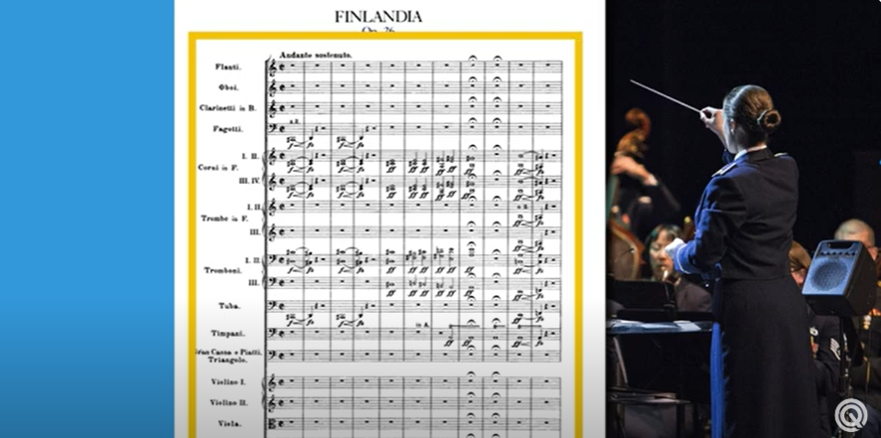
Activity 4.1 – how to read music scores
Odd Quartet (2019) How To Read Music Scores – Music Theory Crash Course (04:30) [video] accessed 6 March 2025

Slide 58
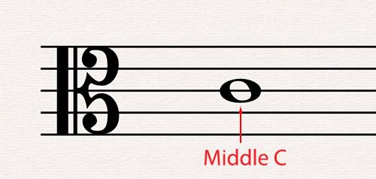
Activity 4.1 – alto clef
An alto clef is a type of musical clef used primarily for instruments that play in the alto range, such as the viola. The alto clef is characterised by the placement of the middle line of the staff, which represents the note middle C.

Slide 59
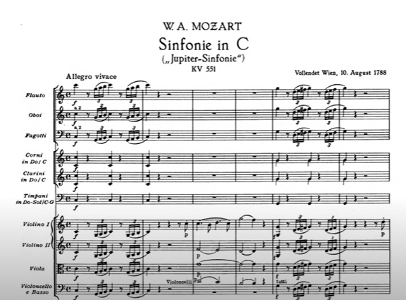
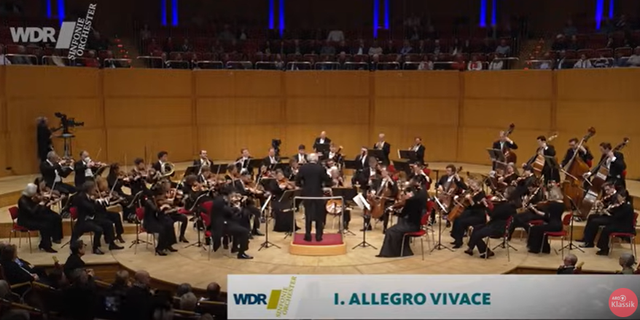
Activity 4.1 – 'Jupiter' movement 1 – Mozart
Danish National Chamber Orchestra (2023) Mozart: Symphony No. 41 in C major, K. 551
“Jupiter” (with score) (34:50) [video] accessed 6 January 2025
ARD Klassik (2025) Mozart: Symphony No. 41 | Adam Fischer | WDR Symphony Orchestra
(39:57) [video] accessed 6 January 2025

Slide 60
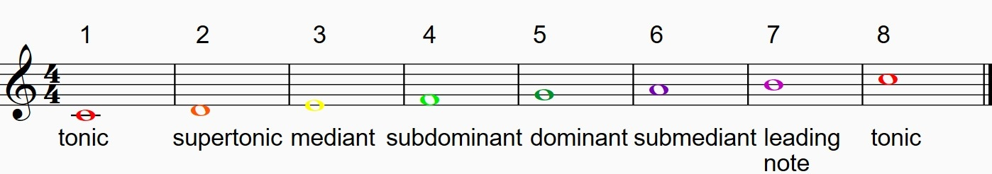
Activity 4.1 – scale degree names and numbers
Note: the colour–coding used above is for boomwhackers.

Slide 61

Activity 4.1 – musical term
Cadence – a sequence of chords that brings a phrase, section, or piece of music to a close, serving as a point of rest or resolution.
Some cadences on the other hand, can create a sense of suspension or expectation, encouraging the music to continue.

Slide 62
Activity 4.1 – types of cadences
What do I know? | What do I want to know? | What have I learned? | How can I learn more?
This involves a progression from the dominant chord (V) to the tonic chord (I), creating a strong sense of resolution and closure. | Known as the 'Amen Cadence', it typically moves from the subdominant chord (IV) to the tonic (I), providing a softer resolution that often feels more reflective. | This cadence typically involves a progression from chord (I) to the dominant chord (V), creating a sense of suspense or expectation, as it does not provide a complete resolution and often leads to further musical development. | This occurs when a progression leads to the dominant chord (V) but instead of resolving to the tonic (I), it resolves to a different chord, often the submediant (vi). This creates a surprising turn and delays the expected resolution.
Perfect
V – I
Plagal
IV – 1
Imperfect
I – V
Interrupted
V – vi

Slide 63
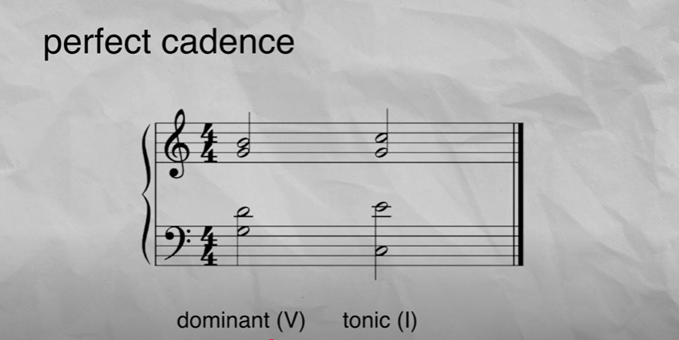
Activity 4.1 – cadences
David Hartley (2021) Musical Cadences: Explained! (4:06) [video] accessed 6 January 2025

Slide 64

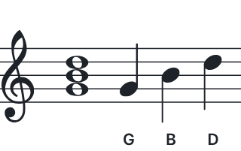
Activity 4.1 – reading chords on a score
D
G and B
G and B
G major chord
D
D
D, D and B
D

Slide 65
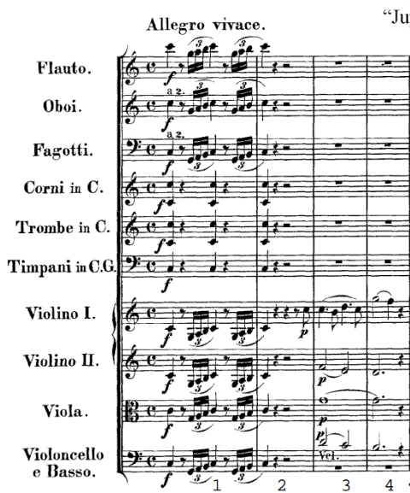
Activity 4.1 – analysing a cadence (1)
To work out this chord, we use the notes:
C from the violin 1
E from the violin II
G from viola
C from cello
These are the notes of a C major chord
To work out this chord, we use the notes:
G from the violin 1
D from the violin II
G from viola
B from cello
These are the notes of a G major chord

Slide 66
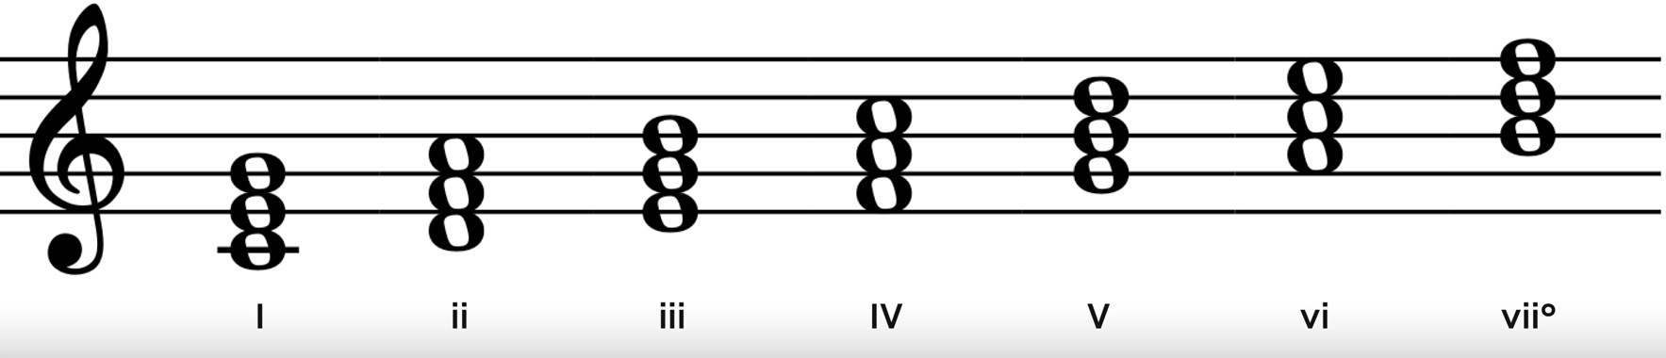
Activity 4.1 – analysing a cadence (2)
Our next step is to work out what chord numbers these are.
The music is in C Major.
1st chord
2nd chord

Slide 67
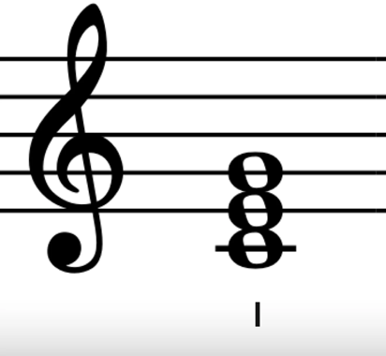
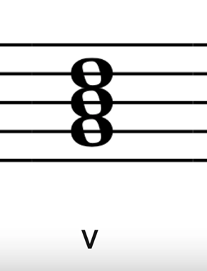
Activity 4.1 – analysing a cadence (3)
Our last step is to work out which cadence is chord I - V
Imperfect cadence

Slide 68
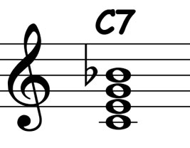
Activity 4.1 – major minor 7 chord
Commonly referred to as a "dominant 7 chord," is a type of seventh chord that consists of four notes:
Root: The base note of the chord.
Major third: The note that is 4 semitones above the root.
Perfect fifth: The note that is 7 semitones above the root.
Minor seventh: The note that is 10 semitones above the root (or 2 semitones below the octave).

Slide 69
Activity 4.1 – musical terms
Antecedent phrase – a musical idea that precedes a consequent phrase, establishing a question-and-answer relationship. It typically consists of the first part of a phrase, often 2 bars long, where the first 2 bars create a musical thought, and the next 2 measures respond to it, contributing to tension and resolution in the composition.
Consequent phrase – the part that follows an antecedent phrase, completing the musical idea. It responds to the question posed by the antecedent, often providing a sense of resolution or closure. Typically, a consequent phrase will balance the antecedent.

Slide 70
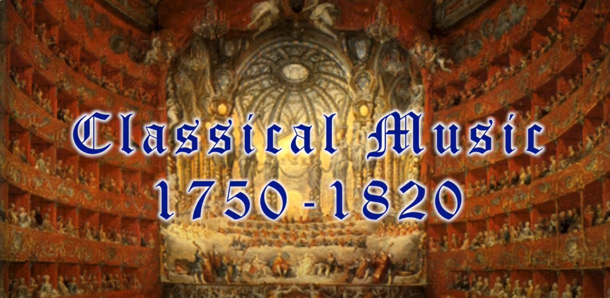
Activity 4.2 – the Classical period
Spark Music (2019) Classical Music (6:40) [video] accessed 13 March 2025

Slide 71
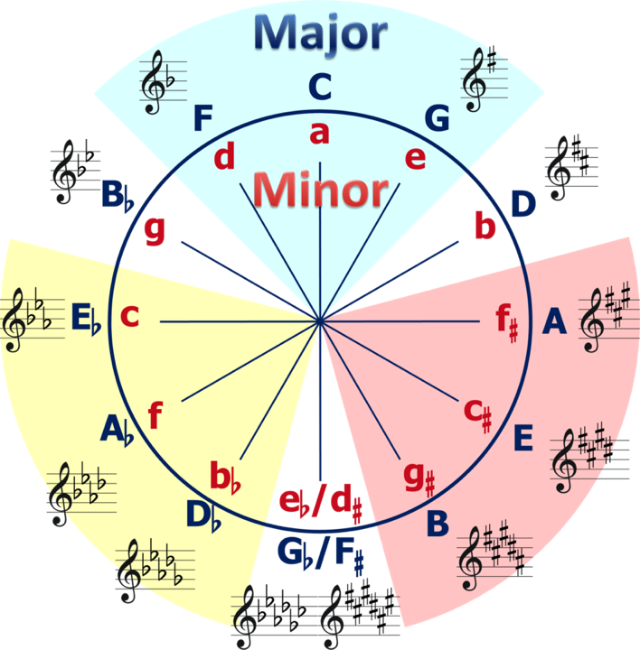
Activity 4.2 – circle of fifths
The circle of fifths is a visual tool that organizes the 12 keys in Western music based on their relationships through perfect fifths. It helps musicians understand key signatures, chord progressions, and modulation.
How it works:
Starting from C major (no sharps or flats), each move clockwise goes up by a perfect fifth and adds one sharp to the key signature.
Each move counterclockwise goes up by a perfect fourth and adds one flat to the key signature.
Circle–of–Fifths english–notation by Manuela on Wikimedia commons

Slide 72
Activity 4.2 – musical terms
Modulation – when a piece of music changes from one key to another. It helps keep music interesting, adds emotion, and creates movement.

Slide 73
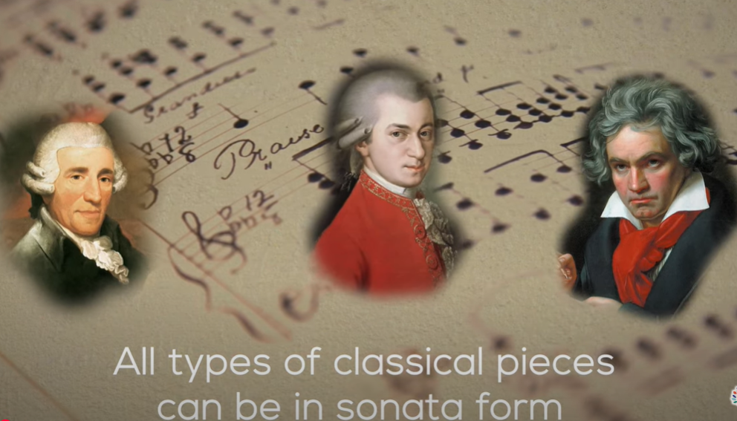
Activity 4.2 – sonata form
Liberty Park Music (2017) What is Sonata Form? | Learn the structure of sonata form | music theory video (5:07) [video]
accessed 7 March 2025

Slide 74


Activity 4.2 – establishing the key
Look at the key signature – check the beginning of the piece for the key signature, which is indicated with sharps or flats.
Identify the tonic note – the tonic is the first note of the scale associated with the key. For example, in C major, the tonic is C.
Examine the opening and closing chords – analyse the first and last chords of the piece or section. Often, the piece will start and end on the tonic chord, reinforcing the key.
Look for cadences – identify cadences within the music. A perfect cadence (V-I) will often confirm the key, especially if it resolves to the tonic chord.
Analyse melodic content – examine the melody for notes that appear frequently. Accidentals can help to establish if the key is different to the one indicated by the key signature.

Slide 75
Activity 4.3 – intervals (1)
Ascending minor and tritone
What is the difference between a major and a minor interval?
The difference lies in the distance between the notes, measured in semitones (half steps).
A major interval is slightly larger than a minor interval and has a brighter, more uplifting sound.
A minor interval is smaller than a major interval by one semitone and has a darker, more sombre quality.
Note – major and minor intervals only occur for the 2nd, 3rd, 6th and 7th intervals.
4th, 5th and 8ve intervals are known as perfect intervals because they are the same for both major and minor keys.
Tritone – an interval that has a distance of 3 tones or 6 semitones. For example – F to B. It can also be referred to as an augmented 4th or diminished 5th.
Augmented 4th – larger than a perfect 4th by a semitone. An augmented 4th has a distance of 6 semitones and is also known as a tritone.
Diminished 5th – smaller than a perfect 5th by a semitone. A diminished 5th has a distance of 6 semitones and is also known as a tritone.

Slide 76
Activity 4.3 – intervals (2)
Ascending minor and tritone
An interval is the distance between 2 notes. We can use well known songs to identify each interval using our listening skills.
Interval | Song
minor 2nd | Chromatic scale (0:43–0:47) Jaws Theme (0:31–0:40)
minor 3rd | Greensleeves (0:00 - 0:01) Brahms’ Lullaby (0:00 - 0:01) Smoke on the Water – Deep Purple (0:00 - 0:07)
tritone/ augmented 4th/ diminished 5th | The Simpsons Theme (0:07 – 0:14) Maria from West Side Story (0:00 - 0:01) Purple Haze – Jimi Hendrix (0:20–0:51)
minor 6th | The Entertainer (0:11–0:14) We Are Young – fun (on the word “fire”) (1:00–1:06)
minor 7th | Somewhere – West Side Story (0:42–0:50) Away in a Manger (The little Lord Jesus) (0:15–0:19)

Slide 77

Activity 4.3 – musical terms (1)
Rhythmic devices (1)
Syncopation – a rhythmic device where emphasis is placed on weak beats or between beats.
Cross rhythms – rhythmic patterns where 2 or more contrasting rhythms are played simultaneously. Typically, one rhythm is based on a different beat division than the other, such as one part playing in triplets (3 beats) while another plays in duplets (2 beats). For example,

Slide 78

Activity 4.3 – musical terms (2)
Example 1 – the quaver groupings switch between 3's and 2's resulting in the feeling of alternating bars of 2 and 3 beats.
Rhythmic devices (2)
Hemiola – a rhythmic device where there is a feeling of 2 against 3. It often involves contrasting rhythms, such as 2 bars of triple metre fitting into one bar of duple metre or where accents are placed altering the metric emphasis from 2 to 3 or vice versa.
1 + a 2 + a 1+ 2+ 3+ 1 + a 2 + a 1+ 2+ 3+
Excerpt from 'America' by Bernstein
Example 2 – the beats are grouped in 2's, despite the triple time signature making it feel like the excerpt is in a duple metre.
1 + 2 3 + 1 2 + 3

Slide 79

Activity 4.4 – musical terms
Macro structure – the overall structure of a piece, breaking it into sections
Minuet and trio form – a musical structure commonly used in Classical music. It typically consists of three main sections:
Minuet (A): usually in ${3 \atop 4}$ time and has a graceful, dance-like character. The minuet is typically composed of two contrasting themes, each repeated.
Trio (B): contrasts with the minuet and often features a lighter texture or a different key. Like the minuet, the trio also includes two themes that are repeated.
Minuet (A): After the trio, the original minuet is repeated to conclude the piece.

Slide 80
Activity 4.6 – musical terms (1)
Fugue – a composition that involves 2 or more instruments playing the same theme in a way that interweaves and overlaps. It starts with one part presenting the main theme, and then other parts enter one by one, each repeating the theme in a different key or at a different time.
Stretto – a technique where the instruments enter with the main theme one after the other in quick succession, closer together than in the earlier parts of the piece. Generally used in the context of a fugue.

Slide 81
Activity 4.6 – musical terms (2)
Inverted melody (inversion) – An inverted melody is when you take a melody and flip it upside down. This means that if the original melody goes up to a higher note or down to a lower note, the inverted melody does the opposite.
For example, if the original melody starts on a note, goes up a step, and then down a step, the inverted melody would start on the same note but go down a step first and then up a step. The distances between the notes stay the same, but the direction changes.

Slide 82

Activity 4.6 – musical terms (3)
Counterpoint – a technique that involves combining 2 or more melodies in a way that they sound good together. Each melody, or 'voice', is independent and has its own distinct rhythm and pitch, but they are written so that when played together, they create harmony.

Slide 83

Activity 4.6 – thematic development
‘Jupiter’, Movement 4
Richard Atkinson (2016) Magnificent Counterpoint in the Finale of Mozart's Jupiter Symphony (14:26) [video] accessed 17 March 2025

Slide 84
Activity 4.6 – musical terms (4)
Theme and Variations – a musical form where a main theme is presented first, and then that theme is changed or altered in various ways. Variations can change the melody slightly, alter the rhythm, change the harmony, or even modify the instrumentation. Each variation keeps some elements of the original theme but adds new ideas to make it sound different.

Slide 85

Activity 4.6 – Twelve Variations on “Ah vous dirai-je, Maman”
Twinkle, twinkle little star variations
Pianoplayer002 (2009) ‘Twelve Variations on “Ah vous dirai-je, Maman”’ (Twinkle Twinkle Little Star Variations) (7:50)
[video] accessed 17 March 2025

Slide 86

Activity 4.6 – composition activity (1)
Overview
Compose a theme and variations based on motif 1 from ‘Jupiter’ Movement 1:
use motif 1 as your theme
consider the musical features of the other works you have studied in this unit
compose 1 or more variations in the style of works from the unit
optional: compose a short coda
This work has been generated using artificial intelligence. Any copyright subsisting in this work is owned by © State of New South Wales (Department of Education) 2025.

Slide 87

Activity 4.6 – composition activity (2)
Lesson 1 of 2
In lesson 1:
Select 2 instruments or a keyboard as the performing media for your composition. You will need to have one instrument/hand to perform the melody and one instrument/hand to provide accompaniment.
Set up a score with the selected performing media using the time signature ${4 \atop 4}$.
Notate motif 1 in the opening 4 bars in both parts. You may write them in unison or in unison at the octave.
Revisit ‘Mars’, ‘Imperial March’ and ‘Eternity’ listening to sections of the works and refamiliarising yourself with the musical features.
This work has been generated using artificial intelligence. Any copyright subsisting in this work is owned by © State of New South Wales (Department of Education) 2025.

Slide 88

Activity 4.7 – composition activity
Lesson 2 of 2
In lesson 2:
Use the musical features of one of ‘Mars’, ‘Imperial March’, ‘Eternity’ or ‘Jupiter’ to compose an 8-bar variation of motif 1.
If time, compose one or more additional variations inspired by other pieces in the unit.
Optional: compose a short coda to complete the composition.
Share your composition with the class.
Mars | Imperial March | Eternity | Jupiter
ostinato ${5 \atop 4}$ time signature dissonance use of triplets | driving, militaristic rhythms chromaticism minor tonality march–like feel | mixed metre complex metre ostinato melody emerging from a continuous quaver texture | balanced phrases contrasting dynamics modulations to related key areas fugal/ canonic entries

Slide 89

Learning sequence 5 assessment planning and submission

Slide 90
Learning intentions and success criteria – learning sequence 5
We are learning to:
analyse and compare 2 pieces of music that reflect our solar system
conduct research on a piece of music not studied in class, focusing on its connection to the solar system and the elements of music
prepare a presentation or written submission that effectively communicates our analysis and findings.
We can:
complete an analysis table for piece 1 and piece 2, demonstrating our understanding of the elements of music
create a bibliography that accurately lists all sources used in our research
present our findings clearly in either a written submission or a viva voce, including a comparison of the 2 pieces and relevant listening examples.
Notes:
Notes for teachers:
Learning intentions and success criteria are best co-constructed with students. Adapt the learning intention as required and add matching success criteria.
For more information See ⁠AITSL or the NSW Department of Education explicit teaching strategies, ⁠Sharing learning intentions and ⁠Sharing success criteria
LISC is not necessarily presented at the beginning of the lesson. Teacher needs to consider most effectual time to introduce
LISC should be revisited during the lesson to support students' evaluation of their learning

Slide 91

Assessment task notification (1)

Slide 92

Assessment task notification (2)

Slide 93


Assessment task notification (3)

Slide 94

Assessment task notification (4)

Slide 95


Assessment task notification (5)

Slide 96
References
This presentation contains NSW Curriculum and syllabus content. The NSW Curriculum is developed by the NSW Education Standards Authority. This content is prepared by NESA for and on behalf of the Crown in the right of the State of New South Wales. The material is protected by Crown copyright.
Please refer to the NESA Copyright Disclaimer for more information https://educationstandards.nsw.edu.au/wps/portal/nesa/mini-footer/copyright.
NESA holds the only official and up-to-date versions of the NSW Curriculum and syllabus documents. Please visit the NSW Education Standards Authority (NESA) website https://educationstandards.nsw.edu.au/wps/portal/nesa/home and the NSW Curriculum website https://curriculum.nsw.edu.au.
Music 7–10 Syllabus © NSW Education Standards Authority (NESA) for and on behalf of the Crown in right of the State of New South Wales, 2024.
12tone (4 May 2019) Understanding Purple Haze (11:06) [video] accessed 7 April 2025
a-ha (7 January 2010) Take on me (Official Video) (4:03) [video] accessed 3 April 2025
ARD Klassik (18 January 2025) Mozart: Symphony No. 41 | Adam Fischer | WDR Symphony Orchestra (39:57) [video] accessed 6 January 2025
Bagpipe Master (9 March 2016) Amazing grace – Bagpipe Master (2:30) [video] accessed 3 April 2025
BBC (1 August 2015) Holst: The Planets, 'Mars' – BBC Proms (6:57) [video] accessed 22 January 2025
Bxhija (22 February 2015) Jingle Bells Chorus (Lyrics) (0:22) [video] accessed 3 April 2025
C Piano (28 January 2023) Greensleeves (Easy Piano, Piano Tutorial) Sheet [video] accessed 7 April 2025
Cedarmont kids (24 February 2023) When the Saints Go Marching In (1:34) [video] accessed 3 April 2025
Charles Szabo (16 June 2017) For he's a jolly good fellow which/that nobody can deny words lyrics text sing along Birthday song (0:29) [video] accessed 3 April 2025
Children Love To Sing (4 July 2023) Twinkle, Twinke Little Star with Lyrics Nursey Rhymes for Kids (2:09) [video] accessed 7 April 2025

Slide 97
References (2)
Choral Scholars of University College Dublin (28 November 2020) Auld lang syne – The Choral Scholars of University College Dublin (3:50) [video] accessed 7 April 2025
Classical Scores (18 July 2015) John Williams – Star Wars Imperial March (with score) (3:03) [video] accessed 23 January 2025
Christmas Songs and Carols – Love to Sing (22 December 2011) Away in a Manger with Lyrics | Christmas Carol & Song (1:59) [video] accessed 3 April 2025
Christmas Songs and Carols – Love to Sing (29 October 2015) Jingle Bells with Lyrics | Christmas Songs HD | Christmas Songs and Carols (1:45) [video] accessed 3 April 2025
Danish National Chamber Orchestra (24 June 2023) Mozart: Symphony No. 41 in C major, K. 551 “Jupiter” (with score) (34:50) [video] accessed 6 January 2025
Darwin Gomez (2015), Ella Macens bio [image] accessed 10 March 2025
David Hartley (19 January 2021) Musical Cadences: Explained! (4:06) [video] accessed 6 January 2025
Deep Purple Official (2 March 2024) Deep Purple – Snoke On the Water (Official Music Video) (6:14) [video] accessed 7 April 2025
Deutsche Grammophon – DG (4 May 2020) John Williams & Vienna Philharmonic – Williams: Imperial March (from "Star Wars") (3:49) [video] accessed 23 January 2025
DisneyMusicVEVO (9 December 2021) Rita Moreno – Somewhere (From West Side Story/Audio Only) (3:15)
HDclassical (7 October 2010) Gustav Holst – Mars (7:08) [video] accessed 21 January 2025
HectorJW2007 (15 July 2011) John Williams: Theme from Jaws (Boston Pops) (3:04) [video] accessed 7 April 2025
Highland Saga – Celtic Folk, Rock & Pop Music (27 August 2021) My Bonnie is over the Ocean | Highland Sage | [Official Video] (3:25) [video] accessed 3 April 2025

Slide 98
References (3)
Howard State School (25 May 2021) Newest Advance Australia Fair 2021 Lyric Video with Vocals (1:51) [video] accessed 3 April 2025
Fueled By Ramen (5 November 2011) Fun.: We Are Young ft. Janelle Monae (ACOUSTIC) (4:35)
isisip (23 November 2011) Silent night lyrics – Christmas carol – Christmas song 2011 – piano and voice music (3:00) [video] accessed 3 April 2025
Jerry Loves Music (31 December 2021) West Side Story Song Maria using A Tritone – Song Analysis (6:05) [video] accessed 7 April 2025
Johannes Brahms – Topic (9 November 2014) Brahms’ Lullaby (1:57) [video] accessed 7 April 2025
Liberty Park Music (17 November 2017) What is Sonata Form? | Learn the structure of sonata form | music theory video (5:07) [video] accessed 7 March 2025
Manuela on Wikimedia Commons (2015) Circle of Fifths [image] accessed 10 March 2025
Martine Carlsen (1 April 2018) Happy birthday played by The Musical Mice – on the recorder (0:25) [video] accessed 3 April 2025
Mega Fun Kids Songs & Nursery Rhymes (20 December 2017) ABC Song | Learn ABC Alphabet for Children | Education ABC Nursery Rhymes (8:10) [video] accessed 3 April 2025
Movieclips (27 May 2011) Somewhere Over the Rainbow – The Wizard of Oz (1/8) Movie CLIP (1939) HD (2:42) [video] accessed 3 April 2025
Muses Trio (7 March 2024) Ella Macens – ‘II, Eternity’ from The Brightest Star in the Night (6:04) [video] accessed 4 March 2025
MusicTheoryAcademy (20 September 2022) Chromatic Scale – What is it? (5:24) [video] accessed 7 April 2025
Odd Quartet (19 July 2019) How To Read Music Scores – Music Theory Crash Course (4:30) [video] accessed 6 March 2025

Slide 99
References (4)
Pianoplayer002 (31 August 2009) ‘Twelve Variations on “Ah vous dirai-je, Maman”’ (Twinkle Twinkle Little Star Variations) (7:50) [video] accessed 17 March 2025
Richard Atkinson (3 August 2016) Magnificent Counterpoint in the Finale of Mozart's Jupiter Symphony (14:26) [video] accessed 17 March 2025
Spark Music (25 March 2019) Classical Music (6:40) [video] accessed 13 March 2025
Steven (11 November 2016) The Simpsons Opening Credits and Theme Song (1:40) [video] accessed 7 April 2025
Sydney Symphony Orchestra (7 December 2022) Gustav Holst – Mars (53:56) [video] accessed 23 January 2025
Toms Mucenieks (2 April 2019) Steven (11 November 2016) Scott Joplin – The Entertainer (4:03) [video] accessed 7 April 2025

Slide 100
Copyright
© State of New South Wales (Department of Education), 2025
The copyright material published in this resource is subject to the Copyright Act 1968 (Cth) and is owned by the NSW Department of Education or, where indicated, by a party other than the NSW Department of Education (third-party material).
Copyright material available in this resource and owned by the NSW Department of Education is licensed under a Creative Commons Attribution 4.0 International (CC BY 4.0) license.
This license allows you to share and adapt the material for any purpose, even commercially.
Attribution should be given to © State of New South Wales (Department of Education), 2025.
Material in this resource not available under a Creative Commons license:
the NSW Department of Education logo, other logos and trademark-protected material
Material owned by a third party that has been reproduced with permission. You will need to obtain permission from the third party to reuse its material.
Links to third-party material and websites
Please note that the provided (reading/viewing material/list/links/texts) are a suggestion only and implies no endorsement, by the New South Wales Department of Education, of any author, publisher, or book title. School principals and teachers are best placed to assess the suitability of resources that would complement the curriculum and reflect the needs and interests of their students.
If you use the links provided in this document to access a third-party’s website, you acknowledge that the terms of use, including licence terms set out on the third-party’s website apply to the use which may be made of the materials on that third-party website or where permitted by the Copyright Act 1968 (Cth). The department accepts no responsibility for content on third-party websites.

