Slide 1
Instructions for use
This resource is not a teaching and learning program. It should be used in conjunction with (Insert unit name and link).
Classroom teachers are encouraged to add and adapt slides as required to meet the needs of their students.
Save a copy of the file to make changes to the slide deck. Go to File > Download a Copy (this downloads a copy to the computer to edit in the PowerPoint app).
To convert the PowerPoint to Google Slides:
  Upload the file into Google Drive and open it.
  Go to File > Save as Google Slides.
  (Note – conversion may cause formatting changes in the slides.)

Slide 2

Australian perspectives
Music – Stage 5
PowerPoint

Slide 3
Lessons
1
'Scar' – Missy Higgins
5
Depth study – getting started
2
'Where' – Kate Miller-Heidke
6
Further exploration of Australian music
3
'Bedouin song' – Lior
7
Depth study
4
Assessment preparation and presentation
Notes:
Teacher notes:
Click lesson numbers to go to specific lessons
Interactive features can be viewed in slide show
Notes for vendors [to be removed after slide deck creation]:
Create hyperlinks to dividers that match lesson numbers by
Right click on the number>edit link>select slide in deck to connect to

Slide 4
Learning sequence 1 – ‘Scar’ – Missy Higgins

Slide 5
Learning intentions and success criteria – LS 1
We are learning to
analyse and interpret the meanings of song lyrics while adhering to ethical standards in music use.
analyse and discuss the elements of music using musical terminology.
perform syncopated rhythms with bass and chordal accompaniment, improving rhythmic accuracy, ensemble skills, and overall performance confidence.
We can
articulate the themes and emotions expressed in the song lyrics, while demonstrating an understanding of ethical considerations in music use.
accurately identify and describe the elements of music using appropriate musical terminology.
demonstrate confident performance techniques, refined rhythmic understanding, and strong ensemble skills.
Notes:
Notes for teachers:
Learning intentions and success criteria are best co-constructed with students. Adapt the learning intention as required and add matching success criteria.
For more information See ⁠AITSL or the NSW Department of Education explicit teaching strategies, ⁠Sharing learning intentions and ⁠Sharing success criteria
LISC is not necessarily presented at the beginning of the lesson. Teacher needs to consider most effectual time to introduce
LISC should be revisited during the lesson to support students' evaluation of their learning

Slide 6
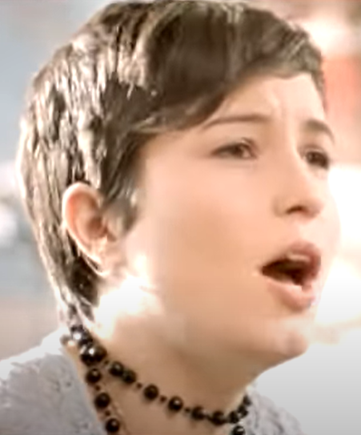
Activity 1.1 – 'Scar' – Missy Higgins – listening and performing
The lyrics of 'Scar' explore Missy’s experiences with the music industry attempting to mold her into their ideal, often at the expense of her true self.
The metaphor of a ‘triangle trying to squeeze through a circle’ symbolises the struggle of not conforming to the expectations of others.
missyhiggins (27 October 2009) Missy Higgins – Scar (Official Video) (3:31) [video], missy higgins, YouTube, accessed 13 May 2025

Slide 7
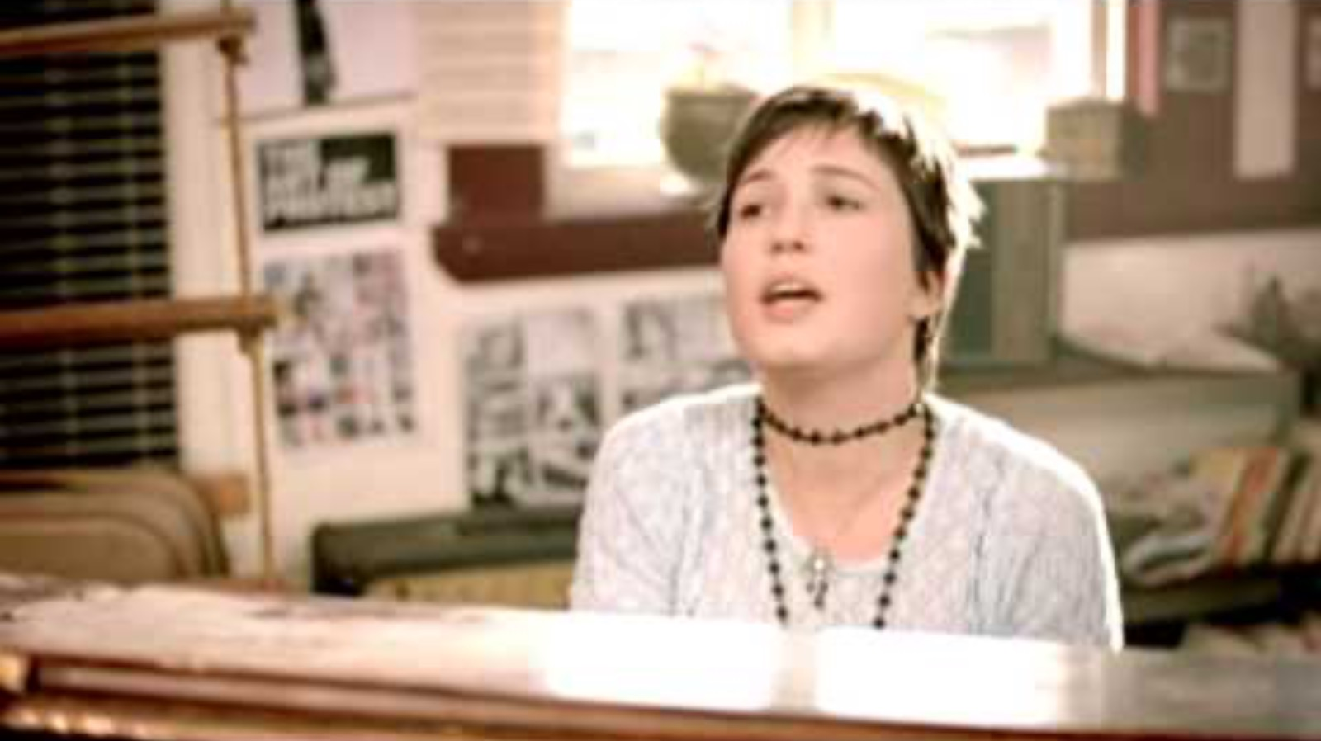
Video – Missy Higgins – Scar (Official Video)
Notes:
Video link - https://www.youtube.com/watch?v=XPK2FmoA1Bc

Slide 8

Activity 1.1 – 'Scar' – Missy Higgins – listening (1)
What is the time signature of this piece?
What is the tempo of this piece?

Slide 9

Activity 1.1 – 'Scar' – Missy Higgins – performing (1)
Verse – straight rhythm drum exercise
1 | 2 | 3 | 4
X | X |  | X
1 | 2 | 3 | 4
X | X |  | X

Slide 10
Activity 1.1 – 'Scar' – Missy Higgins – listening (2)
The melodic line of this piece uses an anacrusis and syncopation.
Define anacrusis and identify one lyric that is on the anacrusis.
Define syncopation.

Slide 11






Activity 1.1 – 'Scar' – Missy Higgins – performing (2)
Verse – straight rhythm drum exercise with syncopated lyrics
1 | 2 | 3 | 4
X | X |  | X
a card, | a bar | of soap | and a
He left
1 | 2 | 3 | 4
X | X |  | X
scrub-bing bru - | sh next | to a note | that said
  Words and music by Melissa Higgins and Kevin Griffin © Copyright Mushroom Music Publishing Pty Ltd and Tentative Music Inc Print Rights for Mushroom Music Publishing Pty Ltd administered in Australia and New Zealand By Hal Leonard Australia Pty Ltd ABN 13 085 333 713 www.halleonard.com.au Used By Permission. All Rights Reserved. Unauthorised Reproduction is illegal. "Scar" Words and Music by Kevin Griffin & Missy Higgins © Alfred Publishing Co.Inc. on behalf of Warner Chappell Music Pty Ltd used by permission of Australian Music Examinations Board Ltd.

Slide 12
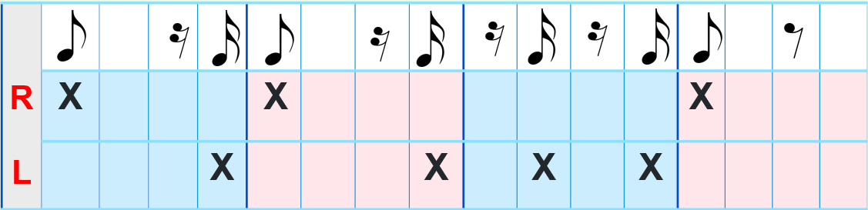

Activity 1.1 – 'Scar' – Missy Higgins – performing (3)
Verse – syncopated drum pattern
1 2 3 4
  Words and music by Melissa Higgins and Kevin Griffin © Copyright Mushroom Music Publishing Pty Ltd and Tentative Music Inc Print Rights for Mushroom Music Publishing Pty Ltd administered in Australia and New Zealand By Hal Leonard Australia Pty Ltd ABN 13 085 333 713 www.halleonard.com.au Used By Permission. All Rights Reserved. Unauthorised Reproduction is illegal. "Scar" Words and Music by Kevin Griffin & Missy Higgins © Alfred Publishing Co.Inc. on behalf of Warner Chappell Music Pty Ltd used by permission of Australian Music Examinations Board Ltd.

Slide 13




Activity 1.1 – 'Scar' – Missy Higgins – performing (4)
Verse – straight rhythm drum exercise, syncopated lyrics and syncopated drum pattern
1 2 3 4
Drum pattern
Rhythm exercise | X |  |  |  | X |  |  |  |  |  |  |  | X
 |  |  |  | X |  |  |  | X |  | X |  | X
Straight rhythm | X |  |  |  | X |  |  |  |  |  |  |  | X
Lyrics He left |  |  | a | card |  |  | a | bar |  |  | of | soap |  |  | and | a
 | scrub | bing |  | bru- | sh |  | next |  | to | a |  | note |  | that | said
  Words and music by Melissa Higgins and Kevin Griffin © Copyright Mushroom Music Publishing Pty Ltd and Tentative Music Inc Print Rights for Mushroom Music Publishing Pty Ltd administered in Australia and New Zealand By Hal Leonard Australia Pty Ltd ABN 13 085 333 713 www.halleonard.com.au Used By Permission. All Rights Reserved. Unauthorised Reproduction is illegal. "Scar" Words and Music by Kevin Griffin & Missy Higgins © Alfred Publishing Co.Inc. on behalf of Warner Chappell Music Pty Ltd used by permission of Australian Music Examinations Board Ltd.

Slide 14

Activity 1.1 – 'Scar' – Missy Higgins – listening (3)
The bass line of this piece uses a 2-bar bass ostinato
Define ostinato.
What effect does the bass ostinato have on:
the beat
the harmony

Slide 15
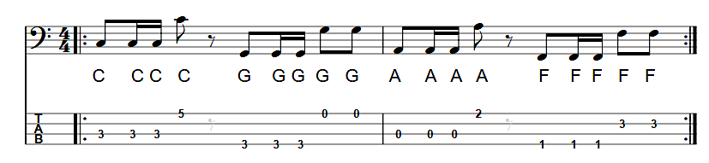
Activity 1.1 – 'Scar' – Missy Higgins – performing (5)
Verse – bass line
Note: for an easier version – remove the notes on beat 3
  Words and music by Melissa Higgins and Kevin Griffin © Copyright Mushroom Music Publishing Pty Ltd and Tentative Music Inc Print Rights for Mushroom Music Publishing Pty Ltd administered in Australia and New Zealand By Hal Leonard Australia Pty Ltd ABN 13 085 333 713 www.halleonard.com.au Used By Permission. All Rights Reserved. Unauthorised Reproduction is illegal. "Scar" Words and Music by Kevin Griffin & Missy Higgins © Alfred Publishing Co.Inc. on behalf of Warner Chappell Music Pty Ltd used by permission of Australian Music Examinations Board Ltd.

Slide 16
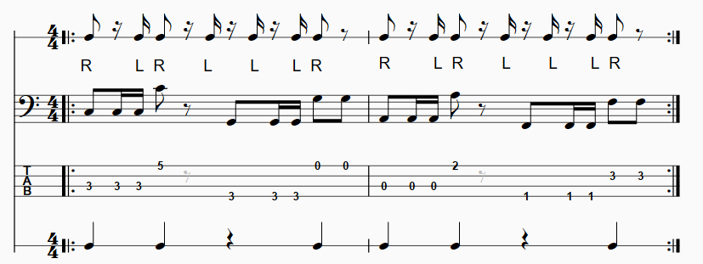
Activity 1.1 – 'Scar' – Missy Higgins – performing (6)
Verse – straight rhythm exercise, syncopated lyrics and drum pattern and bass line
Syncopated lyrics Verse only
He left a card, a bar of soap and a scrubbing brush next to a note that said 'use these down to your bones' And before I knew I had shiny skin, and it felt easy being clean like him I thought ‘this one knows better than I do’
  Words and music by Melissa Higgins and Kevin Griffin © Copyright Mushroom Music Publishing Pty Ltd and Tentative Music Inc Print Rights for Mushroom Music Publishing Pty Ltd administered in Australia and New Zealand By Hal Leonard Australia Pty Ltd ABN 13 085 333 713 www.halleonard.com.au Used By Permission. All Rights Reserved. Unauthorised Reproduction is illegal. "Scar" Words and Music by Kevin Griffin & Missy Higgins © Alfred Publishing Co.Inc. on behalf of Warner Chappell Music Pty Ltd used by permission of Australian Music Examinations Board Ltd.

Slide 17
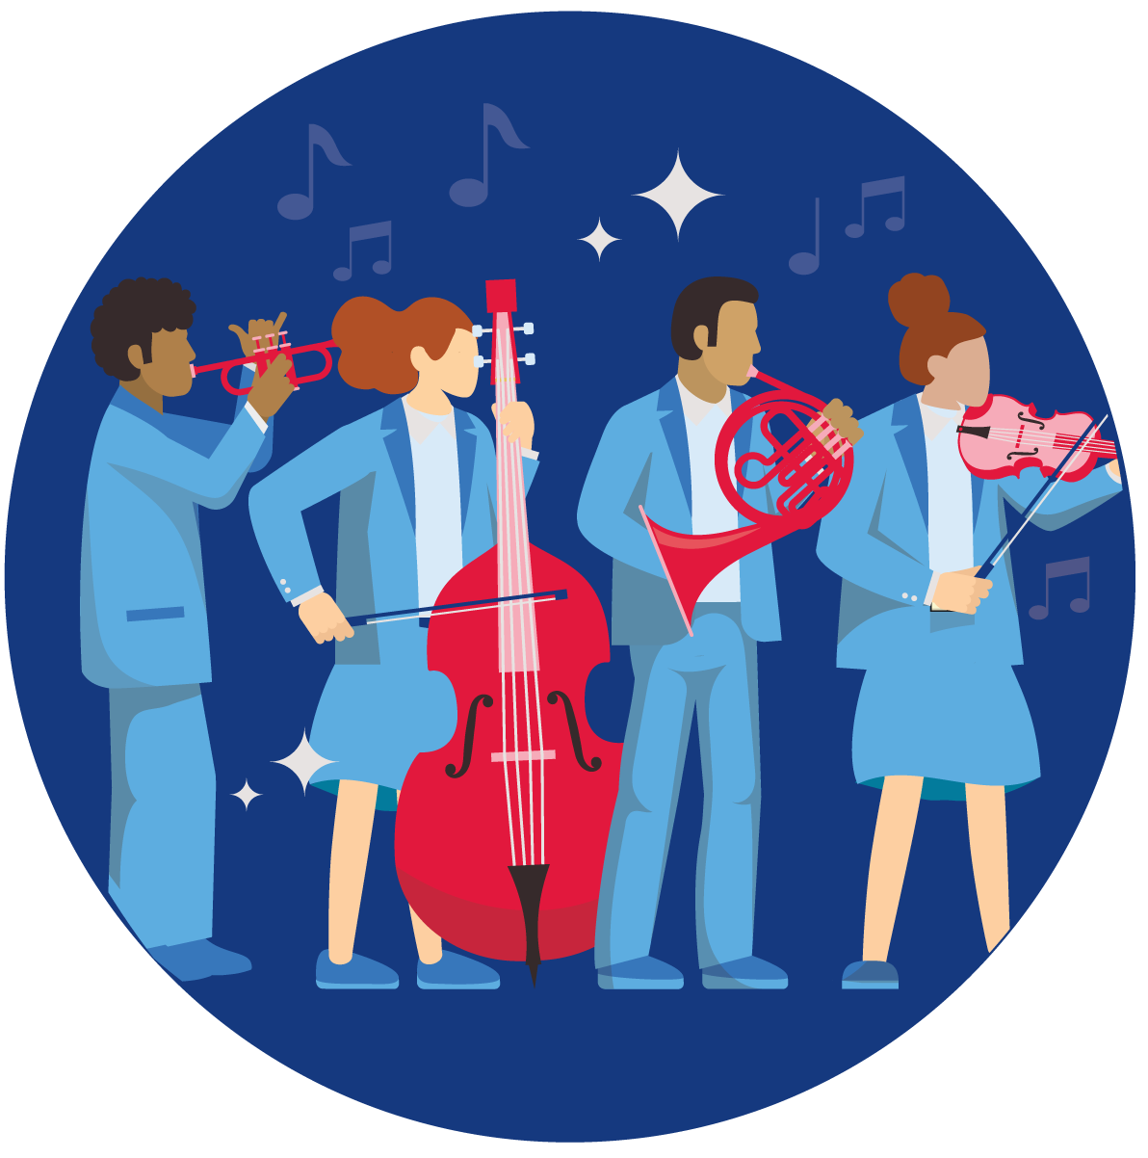
Activity 1.1 – 'Scar' – Missy Higgins – listening (4)
List the performing media in this piece

Slide 18

Activity 1.1 – 'Scar' – Missy Higgins – listening (5)
Use the following chart to outline the structure of this piece.
Structure | Total bars
Intro | 4 bars
Verse 1
Outro (extended chorus) | 16 bars

Slide 19

Activity 1.2 – 'Scar' – Missy Higgins – listening and performing continued
Music protocols
Missy Higgins is a respected Australian artist who values protocols and authenticity in the music industry.
Points for us to consider:
Where to source sheet music
The use of AI
Understand copyright and licensing
ABC Perth and Mark Gibson (23 August 2024) Missy Higgins says governments need to do more to protect musicians from AI (2:41) [website] accessed 13 May 2025
Notes:
Video link - https://www.abc.net.au/listen/programs/perth-breakfast/missy-higgins-calls-for-more-ai-protection/104261024

Slide 20
Activity 1.2 – 'Scar' – Missy Higgins (1)
Protocols relating to performances – points to remember
Music scores
I must use scores that are approved from licenced sites
I must check the copyright before sharing or posting
I must not use images, videos or music I do not have permission to use
Identity
I must always give proper credit (composer, arranger, performers)
I must not claim work that is not mine
I must respect how people want to be identified (or not identified)
Performance
I must check the copyright before sharing recordings
I must get the permission of my school before posting performances
I understand fair use – class vs sharing

Slide 21
Activity 1.2 – 'Scar' – Missy Higgins (2)
Protocols relating to performances
  The NSW Department of Education has paid for licensing for the use of the score ‘Scar’ for NSW Department of Education teachers and students only.
  Score distribution permissions for the NSW Department of Education are limited to 500 copies across the state. One printed copy per school.
  Individuals and organisations outside the department must seek the composer’s permission to use the score.
  The following rights must be published on all created material:
  Words and music by Melissa Higgins and Kevin Griffin
  © Copyright Mushroom Music Publishing Pty Ltd and Tentative Music Inc
  Print Rights for Mushroom Music Publishing Pty Ltd administered in Australia and New Zealand
  By Hal Leonard Australia Pty Ltd ABN 13 085 333 713 www.halleonard.com.au
  Used By Permission. All Rights Reserved. Unauthorised Reproduction is Illegal
  "Scar" Words and Music by Kevin Griffin & Missy Higgins © Alfred Publishing Co.Inc. on behalf of Warner Chappell Music Pty Ltd used by permission of Australian Music Examinations Board Ltd.
  Note – this score is licensed by 2 companies with each company holding a 50% ownership; Mushroom Music Publishing Pty Ltd and Warner Chappell Music Pty Ltd.

Slide 22
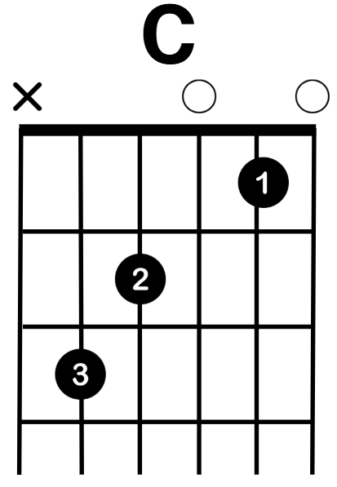
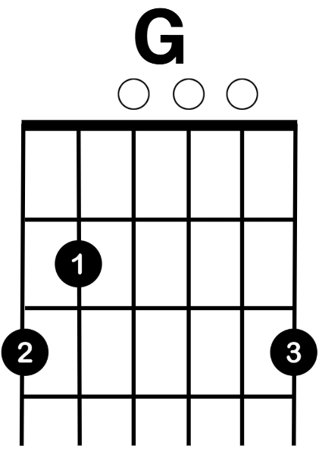
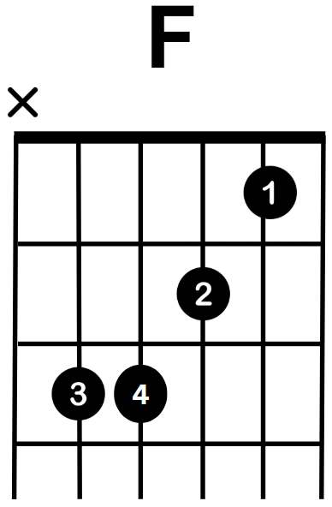
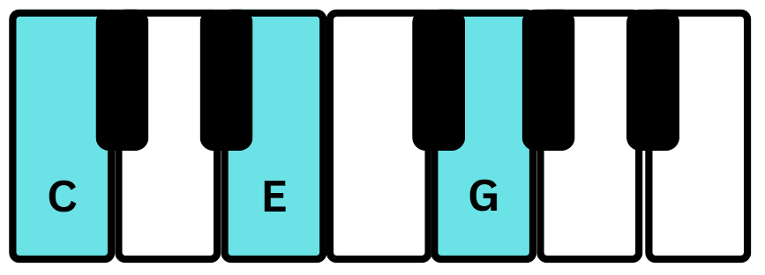
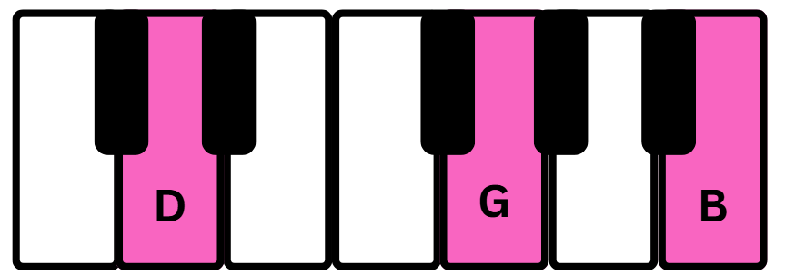
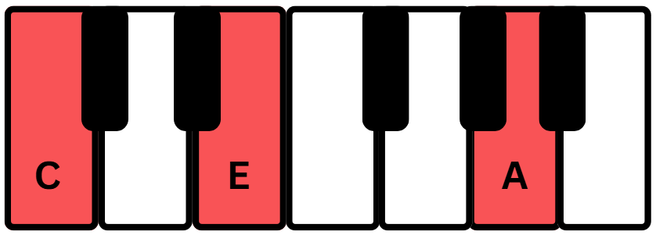
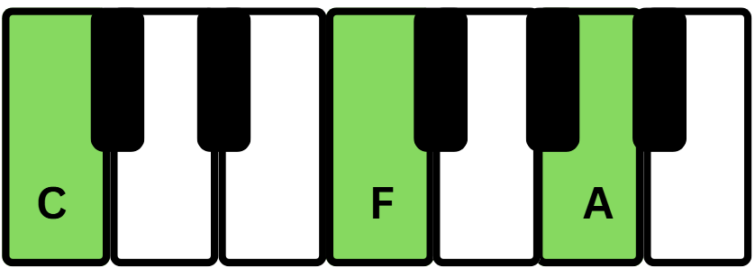
Activity 1.2 – 'Scar' – Missy Higgins – performing (1)
Introduction and verse chords
Play each chord as a minim.
C | G | Am | F
C, E, G | G, B, D | A, C, E | F, A, C
  Words and music by Melissa Higgins and Kevin Griffin © Copyright Mushroom Music Publishing Pty Ltd and Tentative Music Inc Print Rights for Mushroom Music Publishing Pty Ltd administered in Australia and New Zealand By Hal Leonard Australia Pty Ltd ABN 13 085 333 713 www.halleonard.com.au Used By Permission. All Rights Reserved. Unauthorised Reproduction is illegal. "Scar" Words and Music by Kevin Griffin & Missy Higgins © Alfred Publishing Co.Inc. on behalf of Warner Chappell Music Pty Ltd used by permission of Australian Music Examinations Board Ltd.

Slide 23
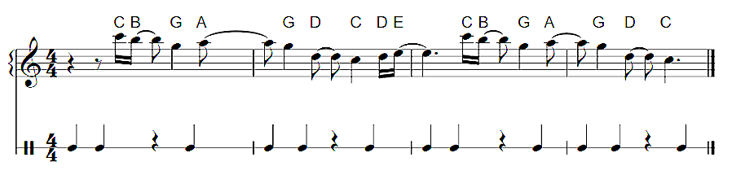
Activity 1.2 – 'Scar' – Missy Higgins – performing (2)
Introduction piano riff
Backing track – slow
Backing track – at tempo
represents the beat
  Words and music by Melissa Higgins and Kevin Griffin © Copyright Mushroom Music Publishing Pty Ltd and Tentative Music Inc Print Rights for Mushroom Music Publishing Pty Ltd administered in Australia and New Zealand By Hal Leonard Australia Pty Ltd ABN 13 085 333 713 www.halleonard.com.au Used By Permission. All Rights Reserved. Unauthorised Reproduction is illegal. "Scar" Words and Music by Kevin Griffin & Missy Higgins © Alfred Publishing Co.Inc. on behalf of Warner Chappell Music Pty Ltd used by permission of Australian Music Examinations Board Ltd.

Slide 24
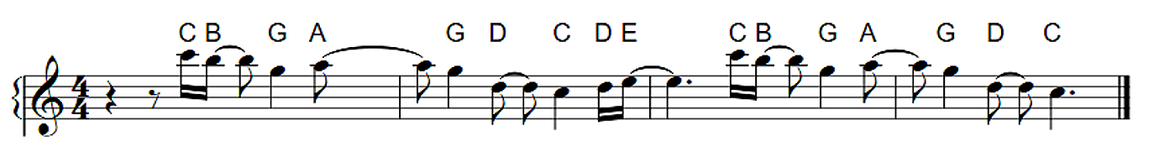


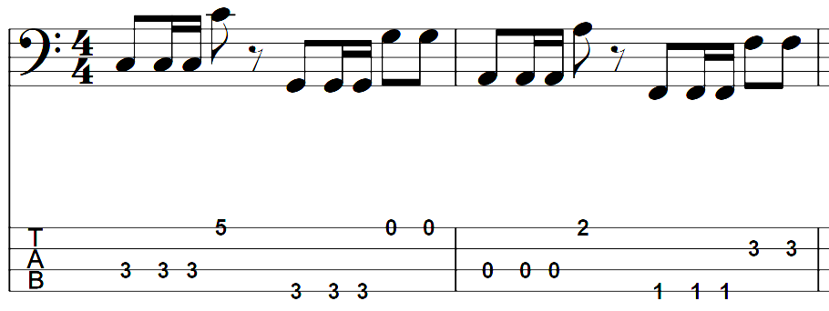
Activity 1.2 – 'Scar' – Missy Higgins – performing (3)
Introduction and verse
Syncopated lyrics Verse only
He left a card, a bar of soap and a scrubbing brush next to a note that said 'use these down to your bones' And before I knew I had shiny skin, and it felt easy being clean like him I thought ‘this one knows better than I do’
Piano riff
Intro only
Drum pattern and straight rhythm drum exercise
Intro and verse
Chords
Intro and verse
C, G, Am, F
Bass line
Intro and verse
  Words and music by Melissa Higgins and Kevin Griffin © Copyright Mushroom Music Publishing Pty Ltd and Tentative Music Inc Print Rights for Mushroom Music Publishing Pty Ltd administered in Australia and New Zealand By Hal Leonard Australia Pty Ltd ABN 13 085 333 713 www.halleonard.com.au Used By Permission. All Rights Reserved. Unauthorised Reproduction is illegal. "Scar" Words and Music by Kevin Griffin & Missy Higgins © Alfred Publishing Co.Inc. on behalf of Warner Chappell Music Pty Ltd used by permission of Australian Music Examinations Board Ltd.

Slide 25
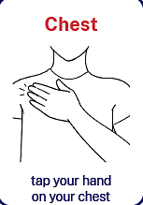
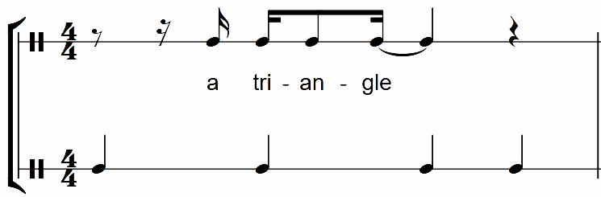
Activity 1.2 – 'Scar' – Missy Higgins – performing (4)
Pre-chorus – lyrics
lyrics Pre–chorus
A triangle trying to squeeze through a circle, He tried to cut me so I’d fit Now does that sound …
1 | 2 | 3 | 4
X | X |  | X
Backing track – slow
Backing track – at tempo
  Words and music by Melissa Higgins and Kevin Griffin © Copyright Mushroom Music Publishing Pty Ltd and Tentative Music Inc Print Rights for Mushroom Music Publishing Pty Ltd administered in Australia and New Zealand By Hal Leonard Australia Pty Ltd ABN 13 085 333 713 www.halleonard.com.au Used By Permission. All Rights Reserved. Unauthorised Reproduction is illegal. "Scar" Words and Music by Kevin Griffin & Missy Higgins © Alfred Publishing Co.Inc. on behalf of Warner Chappell Music Pty Ltd used by permission of Australian Music Examinations Board Ltd.

Slide 26

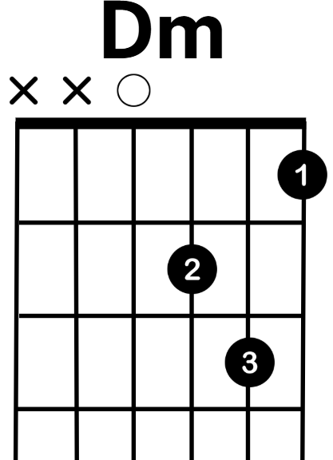
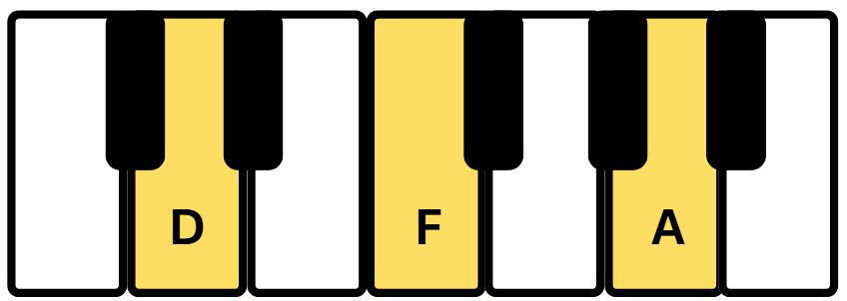
Activity 1.2 – 'Scar' – Missy Higgins – performing (5)
Pre-chorus – chords and lyrics
Dm | Dm | F | G
D, F, A | D, F, A | F, A, C | G,B,D
lyrics Pre–chorus
A triangle trying to squeeze through a circle, He tried to cut me so I’d fit Now does that sound …
Play each
chord as
a minim.
Backing track
Backing track with vocals
  Words and music by Melissa Higgins and Kevin Griffin © Copyright Mushroom Music Publishing Pty Ltd and Tentative Music Inc Print Rights for Mushroom Music Publishing Pty Ltd administered in Australia and New Zealand By Hal Leonard Australia Pty Ltd ABN 13 085 333 713 www.halleonard.com.au Used By Permission. All Rights Reserved. Unauthorised Reproduction is illegal. "Scar" Words and Music by Kevin Griffin & Missy Higgins © Alfred Publishing Co.Inc. on behalf of Warner Chappell Music Pty Ltd used by permission of Australian Music Examinations Board Ltd.
26

Slide 27
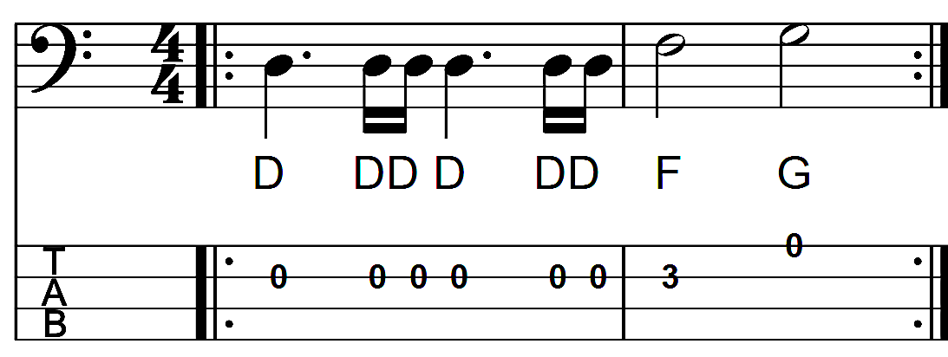
Activity 1.2 – 'Scar' – Missy Higgins – performing (6)
Pre-chorus – bass line and lyrics
Each chord is played for two beats
lyrics Pre–chorus
A triangle trying to squeeze through a circle, He tried to cut me so I’d fit Now does that sound …
Backing track
Backing track with vocals
  Words and music by Melissa Higgins and Kevin Griffin © Copyright Mushroom Music Publishing Pty Ltd and Tentative Music Inc Print Rights for Mushroom Music Publishing Pty Ltd administered in Australia and New Zealand By Hal Leonard Australia Pty Ltd ABN 13 085 333 713 www.halleonard.com.au Used By Permission. All Rights Reserved. Unauthorised Reproduction is illegal. "Scar" Words and Music by Kevin Griffin & Missy Higgins © Alfred Publishing Co.Inc. on behalf of Warner Chappell Music Pty Ltd used by permission of Australian Music Examinations Board Ltd.

Slide 28
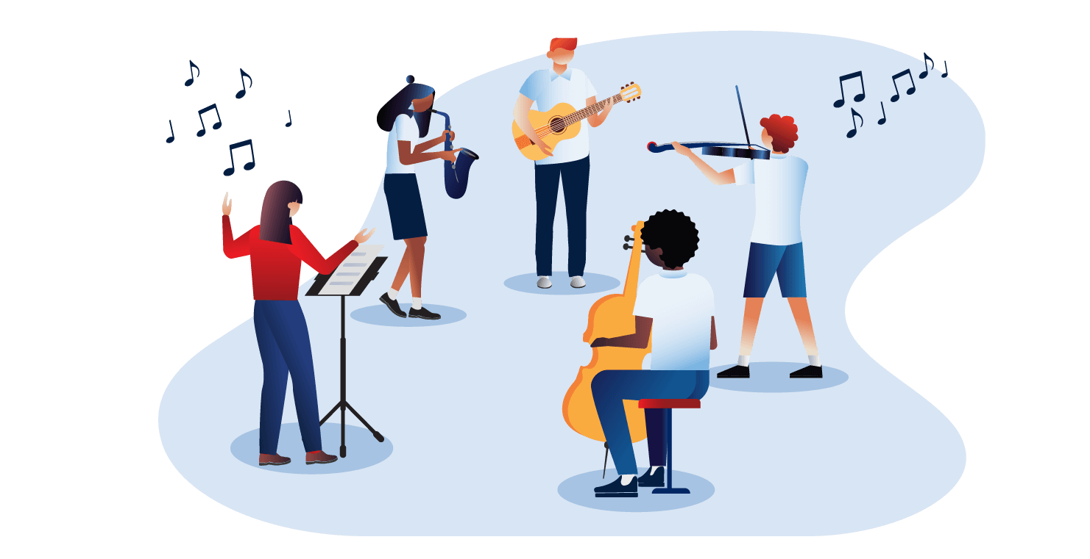
Activity 1.2 – 'Scar' – Missy Higgins – performing (7)
Introduction, verse and pre-chorus
Syncopated lyrics Verse only
He left a card, a bar of soap and a scrubbing brush next to a note that said 'use these down to your bones’ And before I knew I had shiny skin, and it felt easy being clean like him I thought ‘this one knows better than I do’
lyrics Pre–chorus
A triangle trying to squeeze through a circle, He tried to cut me so I’d fit Now does that sound …
  Words and music by Melissa Higgins and Kevin Griffin © Copyright Mushroom Music Publishing Pty Ltd and Tentative Music Inc Print Rights for Mushroom Music Publishing Pty Ltd administered in Australia and New Zealand By Hal Leonard Australia Pty Ltd ABN 13 085 333 713 www.halleonard.com.au Used By Permission. All Rights Reserved. Unauthorised Reproduction is illegal. "Scar" Words and Music by Kevin Griffin & Missy Higgins © Alfred Publishing Co.Inc. on behalf of Warner Chappell Music Pty Ltd used by permission of Australian Music Examinations Board Ltd.

Slide 29
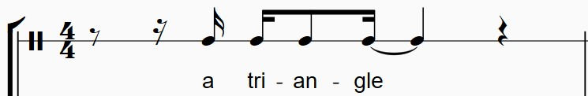
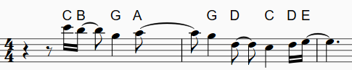

Activity 1.2 – 'Scar' – Missy Higgins – performing (8)
'Scar' musical rhythm game
As a class, play the musical rhythm game on the next slide.
Tips to help you:
start the rhythm game standing
do the action when you hear the rhythm
Sit on your chair
One hand on your head,
other hand on your nose
Stand on one leg
Hands on your shoulders
to prepare for the next rhythm, return to the standing position as soon as each rhythm is completed
  Words and music by Melissa Higgins and Kevin Griffin © Copyright Mushroom Music Publishing Pty Ltd and Tentative Music Inc Print Rights for Mushroom Music Publishing Pty Ltd administered in Australia and New Zealand By Hal Leonard Australia Pty Ltd ABN 13 085 333 713 www.halleonard.com.au Used By Permission. All Rights Reserved. Unauthorised Reproduction is illegal. "Scar" Words and Music by Kevin Griffin & Missy Higgins © Alfred Publishing Co.Inc. on behalf of Warner Chappell Music Pty Ltd used by permission of Australian Music Examinations Board Ltd.

Slide 30
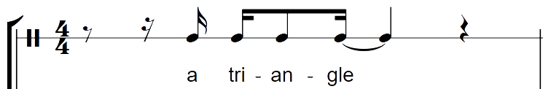
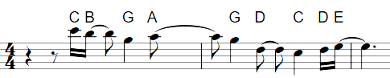


Activity 1.2 – 'Scar' – Missy Higgins – performing (9)
'Scar' musical rhythm game
Sit on your chair
One hand on your head,
other hand on your nose
Stand on one leg
Hands on your shoulders
  Words and music by Melissa Higgins and Kevin Griffin © Copyright Mushroom Music Publishing Pty Ltd and Tentative Music Inc Print Rights for Mushroom Music Publishing Pty Ltd administered in Australia and New Zealand By Hal Leonard Australia Pty Ltd ABN 13 085 333 713 www.halleonard.com.au Used By Permission. All Rights Reserved. Unauthorised Reproduction is illegal. "Scar" Words and Music by Kevin Griffin & Missy Higgins © Alfred Publishing Co.Inc. on behalf of Warner Chappell Music Pty Ltd used by permission of Australian Music Examinations Board Ltd.

Slide 31
Activity 1.3 – ‘Scar’ – performing (1)
Performance space, production and staging
How you arrange a performance space – where you stand, how you set-up instruments, lighting and production, can change the way your music is heard and felt.
Let's try some configurations to see what performance space arrangement works best for communicating your music to your audience.
Group 1 | Group 2 | Group 3 | Group 4
Stand close together in a semi–circle | Face different directions | Stand in a straight line (use guitar straps) | Perform sitting down (no guitar straps)

Slide 32
Activity 1.3 – ‘Scar’ – performing (2)
Performance space, production and staging
What do you consider for the musical success of an ensemble when making decisions about performance space, staging and production?
Balance | Settings | Volume | Equipment | Formation
Is the melodic line heard over the rhythmic and harmonic lines? | Have the sound production settings you require for amplification or sound production been decided upon and checked? | Have you considered the size of the space when deciding on the volume of your performance? | Do all ensemble members have all the equipment they require? Is the equipment all in working order? | How will your ensemble arrange themselves in the space so they can communicate with other ensemble members and engage with the audience?

Slide 33
Activity 1.3 – ‘Scar’ – performing (3)
Optional activity
In small groups or as a class, learn and perform the full version of ‘Scar’.
The printed score is on the following slides.
Note – the licensing and copyright information on the right hand side of this slide.
  The NSW Department of Education has paid for licensing for the use of the score ‘Scar’ for NSW Department of Education teachers and students only.
  Score distribution permissions for the NSW Department of Education are limited to 500 copies across the state. One printed copy per school.
  Individuals and organisations outside the department must seek the composer’s permission to use the score.
  The following rights must be published on all created material:
  Words and music by Melissa Higgins and Kevin Griffin © Copyright Mushroom Music Publishing Pty Ltd and
  Tentative Music Inc Print Rights for Mushroom Music Publishing Pty Ltd administered in Australia and New Zealand
  By Hal Leonard Australia Pty Ltd ABN 13 085 333 713 www.halleonard.com.au Used By Permission. All Rights Reserved.
  Unauthorised Reproduction is Illegal.
  "Scar" Words and Music by Kevin Griffin & Missy Higgins © Alfred Publishing Co.Inc. on behalf of Warner Chappell Music Pty Ltd used by permission of Australian Music Examinations Board Ltd.
  Words and music by Melissa Higgins and Kevin Griffin © Copyright Mushroom Music Publishing Pty Ltd and Tentative Music Inc Print Rights for Mushroom Music Publishing Pty Ltd administered in Australia and New Zealand By Hal Leonard Australia Pty Ltd ABN 13 085 333 713 www.halleonard.com.au Used By Permission. All Rights Reserved. Unauthorised Reproduction is illegal. "Scar" Words and Music by Kevin Griffin & Missy Higgins © Alfred Publishing Co.Inc. on behalf of Warner Chappell Music Pty Ltd used by permission of Australian Music Examinations Board Ltd.

Slide 34
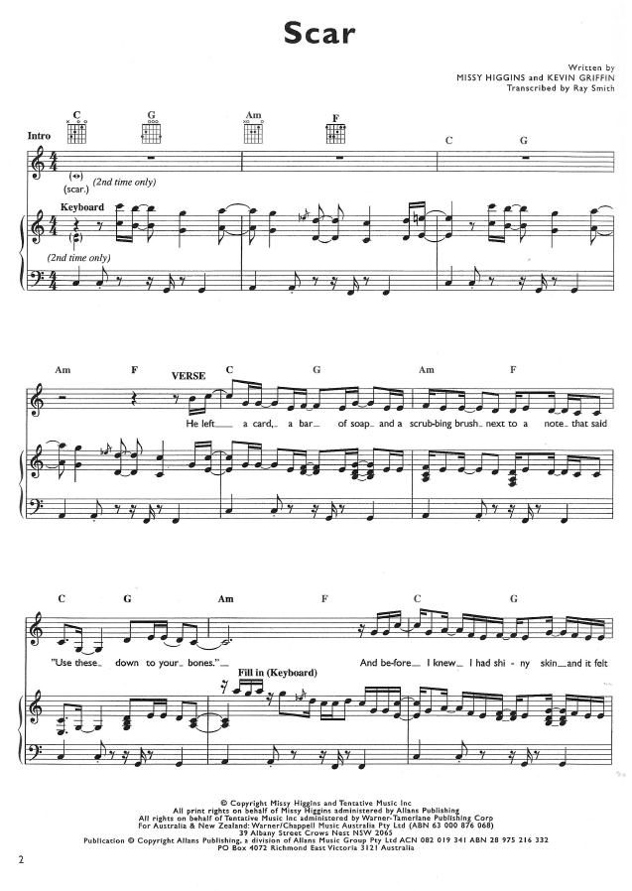
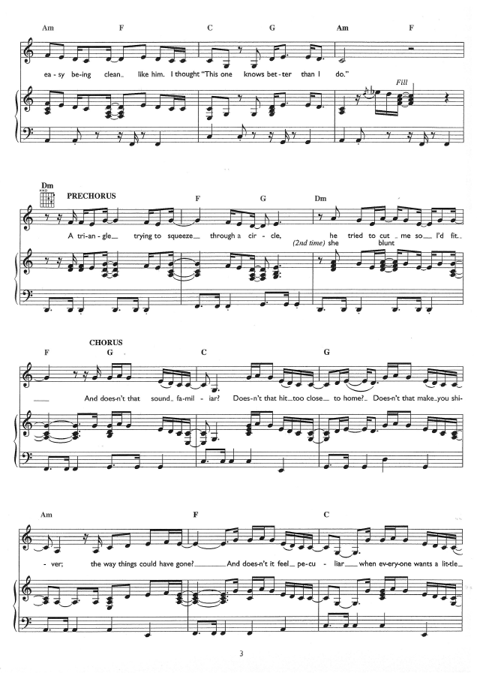
‘Scar’ score (1)

Slide 35
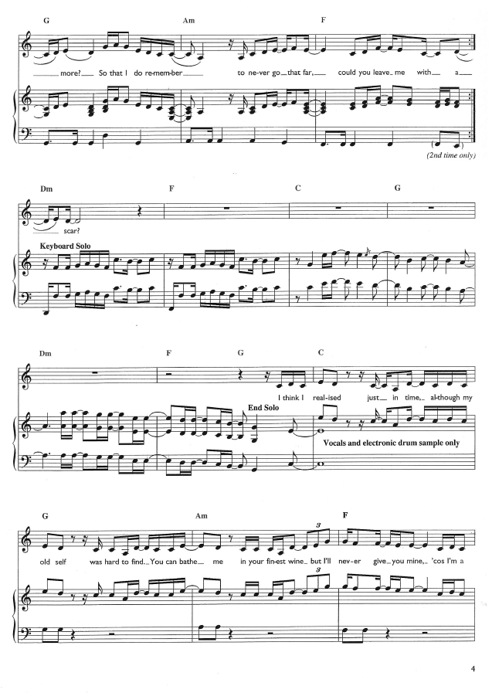
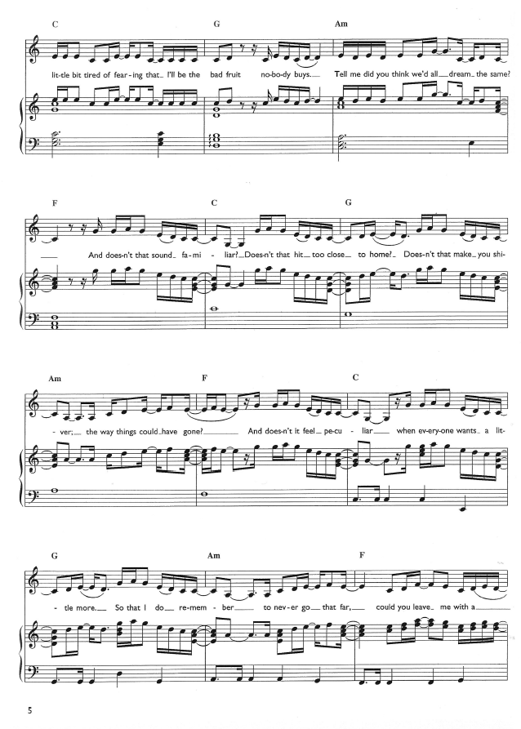
‘Scar’ score (2)

Slide 36
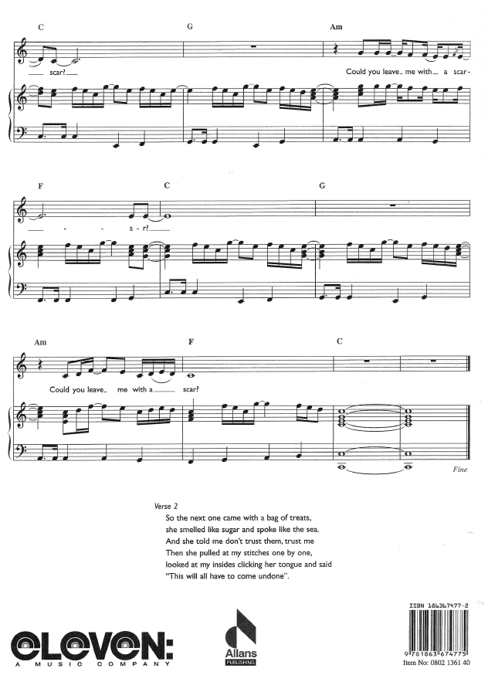

‘Scar’ score (3)

Slide 37

Activity 1.3 – 'Scar' – Missy Higgins – performing (4)
Perform
Reflect

Slide 38
Activity 1.4 – Assessment task (1)
The beginning steps to success
Task description
Perform a piece of music by an Australian composer or artist. The performance can be presented as a soloist or as an ensemble. If performing in an ensemble, each member's part must be clear. A backing track can be used with the performed part removed from the recording.
Prepare and present an introduction to the performance that outlines how the performance reflects the stylistic features and cultural, historical and/or social context.
Note - Explicit lyrics are not to be performed. Spotify identifies songs with explicit lyrics with 'Explicit' or 'E' tags.

Slide 39
Activity 1.4 – Assessment task (2)
The beginning steps to success
Submission details
Formative check-in opportunities
This task is to be presented in class. Your teacher will guide you to select the best submission format for the introduction from the list below:
verbally present and submit a written introduction
verbally present the introduction
submit a hard or electronic copy of the introduction
The recommendation for the introduction length is 1-2 minutes or for a submitted introduction, ½-1 page.
Week 1 – inform your teacher of the piece you plan to perform and whether it is as a soloist or an ensemble member.
Week 3 – teacher will check-in with your progress during the rehearsal lesson.
Week 4 – teacher will check-in with your progress during the rehearsal lesson.
Week 4 – in the second rehearsal lesson, submit a draft copy of your introduction to your teacher.
Week 5 – reflect on the feedback provided on the draft copy of your introduction and check-in with your teacher for final feedback on your performance in the lessons before you present to the class.

Slide 40
Activity 1.4 – Assessment task (3)
The beginning steps to success
What I need to do | Some ways I can do this
Choose the style of music I would like to perform. Choose an Australian composer/artist and select a piece of music they have written to perform | Consider Australian composers/artists that I have studied in class throughout the year Consider an Australian composer/artist that I best resonate with
Identify the publishing company that owns the copyright/publishing rights to the song and the year it was copyrighted | Written on the sheet music Google search
Research the stylistic characteristics of my chosen piece | Find articles, websites or books about my piece that helps me understand the style. Pay attention to how the author uses musical language, like the elements of music, and take notes
Identify any interesting facts about my piece that give social and cultural context | Find articles, websites or books about my piece that helps me to identify interesting facts like social and cultural context. Take notes Interview or question relatives or neighbours that have firsthand experience with the culture of my chosen piece

Slide 41
Learning sequence 2 – ‘Where’ from 'The Rabbits' – Kate Miller-Heidke

Slide 42
Learning intentions and success criteria – LS 2
We are learning to
understand the background information of the book and opera ‘The Rabbits’ and the musical message of the song ‘Where’.
develop our vocal skills and sing the song ‘Where’ using correct vocal techniques and experimentation with tempo variations.
understand and apply techniques of transposition in music.
We can
identify key themes and accurately define and demonstrate tempo markings such as grave, largo, andante, and others.
perform vocal warm-ups and sing the opening pre-chorus phrase accurately in different tempos, applying these skills to sing the ‘Where’.
transpose the bass and melody lines from the score of ‘Where’ and perform the arrangement on appropriate instruments.
Notes:
Notes for teachers:
Learning intentions and success criteria are best co-constructed with students. Adapt the learning intention as required and add matching success criteria.
For more information See ⁠AITSL or the NSW Department of Education explicit teaching strategies, ⁠Sharing learning intentions and ⁠Sharing success criteria
LISC is not necessarily presented at the beginning of the lesson. Teacher needs to consider most effectual time to introduce
LISC should be revisited during the lesson to support students' evaluation of their learning

Slide 43
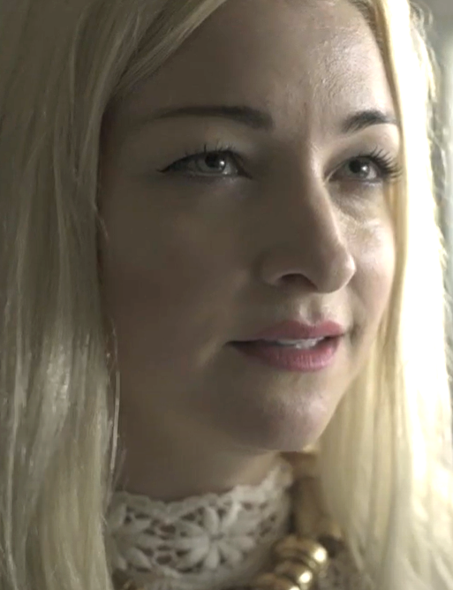
Activity 2.1 – ‘Where’ – Kate Miller-Heidke – listening (1)
‘The Rabbits’ is a children’s book written by John Marsden and illustrated by Shaun Tan and is an allegory for the colonisation of Australia. It depicts the adverse effects that colonisation had on our First Nations people due to the European settlement. Issues surrounding conflict, the stolen generation, industrialisation and its effect on the environment, and loss of Aboriginal culture are addressed in the powerful text and imagery. The book is written from the First Nation’s point of view where they are portrayed as marsupials and the invaders are depicted as rabbits.
In 2015, it was reimagined as an opera, by Australian vocalist and composer Kate Miller-Heidke and writer Lally Katz and produced by Opera Australia.
Opera Australia (6 August 2015) Kate Miller–Heidke performs 'Where?' from The Rabbits (5:00) [video], Opera Australia, YouTube, accessed 19 May 2025

Slide 44
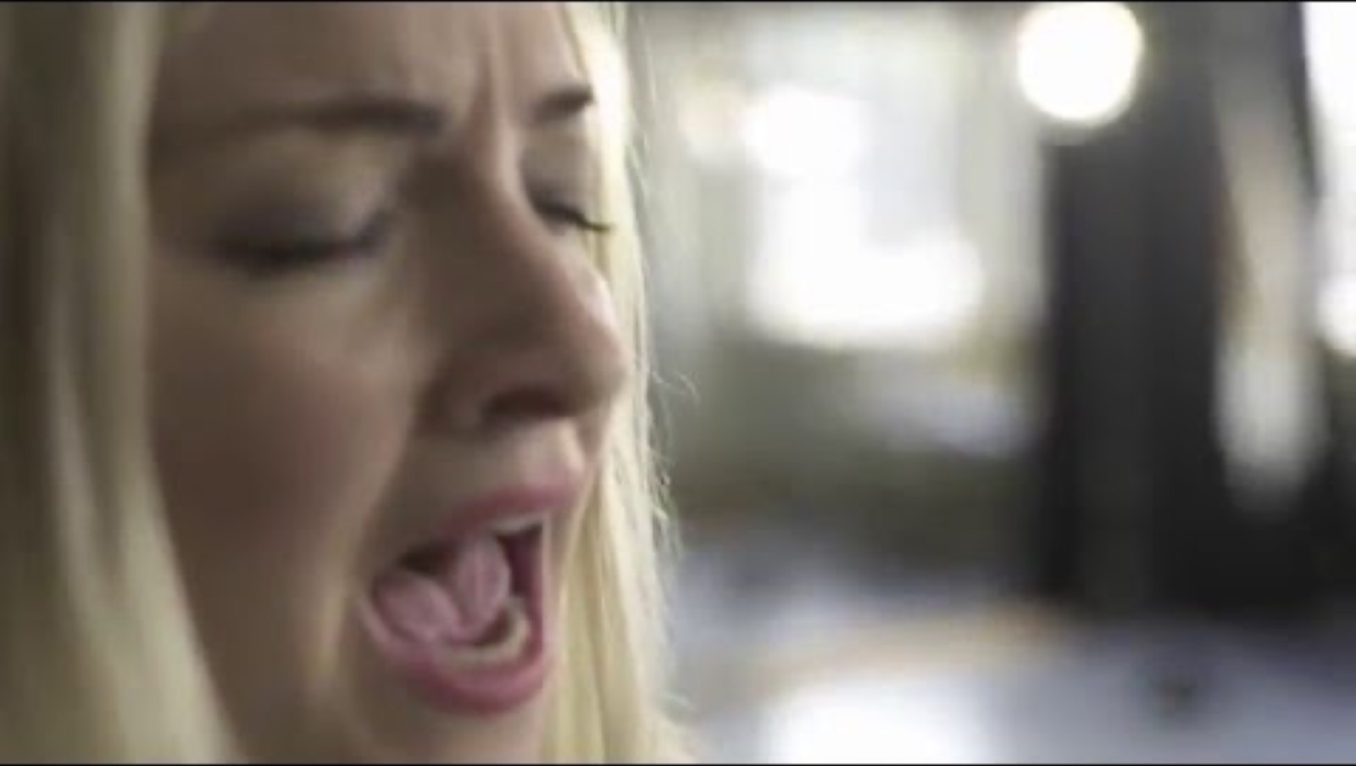
Video – Kate Miller – Heidke performs 'Where?' from The Rabbits
Notes:
Video link - https://www.youtube.com/watch?v=ZL7v4YFowSE

Slide 45
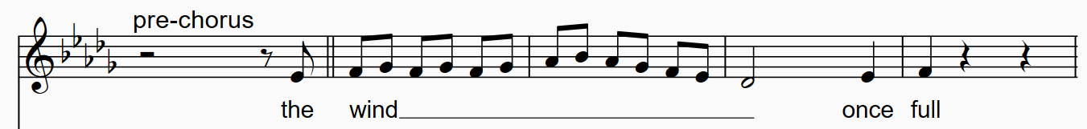
Activity 2.1 – ‘Where’ – Kate Miller-Heidke – performing (1)
Opening pre-chorus phrase vocal warm-up
‘vvvvvvvv’
‘purr’ rolled tongue
‘nnnngggg’
‘zzzzzzzz’
‘bubbles’ lip trills
spoken lyrics
Words and music by Kate Miller-Heidke, John Marsden and Lally Katz © Copyright Sony Music Publishing (Australia) Pty Ltd/ Kate Miller-Heidke, John Marsden and Lally Katz Print Rights for Kate Miller-Heidke administered in Australia and New Zealand By Hal Leonard Australia Pty Ltd ABN 13 085 333 713 www.halleonard.com.au Used By Permission. All Rights Reserved. Unauthorised Reproduction is Illegal.

Slide 46

Activity 2.1 – ‘Where’ – Kate Miller-Heidke – performing (2)
Opening pre-chorus phrase warm-up
Allegretto
= 112
Words and music by Kate Miller-Heidke, John Marsden and Lally Katz © Copyright Sony Music Publishing (Australia) Pty Ltd/ Kate Miller-Heidke, John Marsden and Lally Katz Print Rights for Kate Miller-Heidke administered in Australia and New Zealand By Hal Leonard Australia Pty Ltd ABN 13 085 333 713 www.halleonard.com.au Used By Permission. All Rights Reserved. Unauthorised Reproduction is Illegal.

Slide 47
Activity 2.1 – ‘Where’ – Kate Miller-Heidke (1)
Tempo
‘Where’
Slow
Fast
Grave
Adagio
Moderato
Allegro
Prestissimo
Largo
Andante
Allegretto
Presto

Slide 48
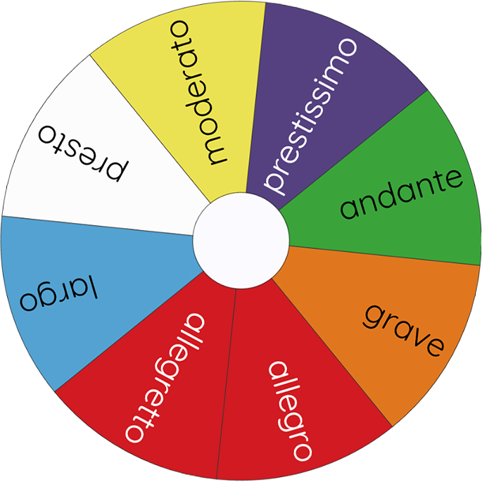
Activity 2.1 – ‘Where’ – Kate Miller-Heidke (2)
Spin the wheel [website], accessed 12 May 2025

Slide 49
Activity 2.1 – ‘Where’ – Kate Miller-Heidke – performing (3)
Opening pre-chorus phrase
Grave
Largo
Adagio
Andante
Moderato
Allegretto
Allegro
Presto
Prestissimo
Words and music by Kate Miller-Heidke, John Marsden and Lally Katz © Copyright Sony Music Publishing (Australia) Pty Ltd/ Kate Miller-Heidke, John Marsden and Lally Katz Print Rights for Kate Miller-Heidke administered in Australia and New Zealand By Hal Leonard Australia Pty Ltd ABN 13 085 333 713 www.halleonard.com.au Used By Permission. All Rights Reserved. Unauthorised Reproduction is Illegal.

Slide 50
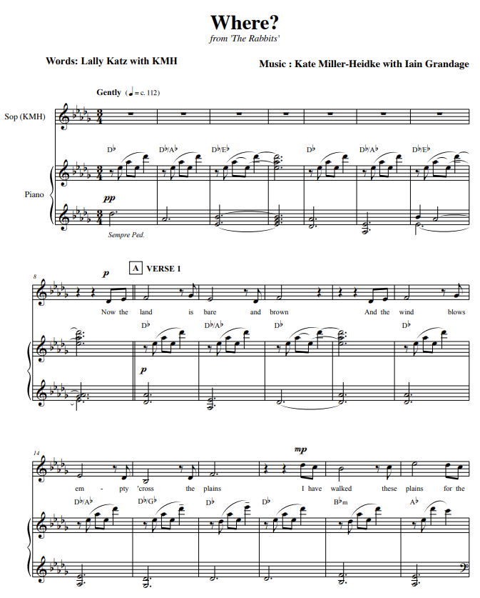
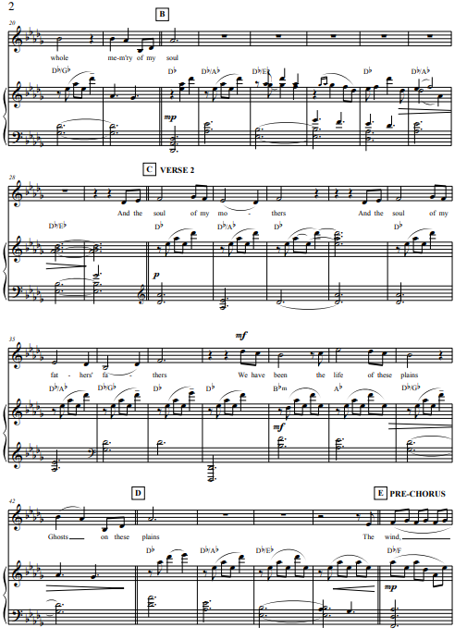
Activity 2.1 – ‘Where’ – Kate Miller-Heidke – performing (4)
Words and music by Kate Miller-Heidke, John Marsden and Lally Katz © Copyright Sony Music Publishing (Australia) Pty Ltd/ Kate Miller-Heidke, John Marsden and Lally Katz Print Rights for Kate Miller-Heidke administered in Australia and New Zealand By Hal Leonard Australia Pty Ltd ABN 13 085 333 713 www.halleonard.com.au Used By Permission. All Rights Reserved. Unauthorised Reproduction is Illegal.

Slide 51
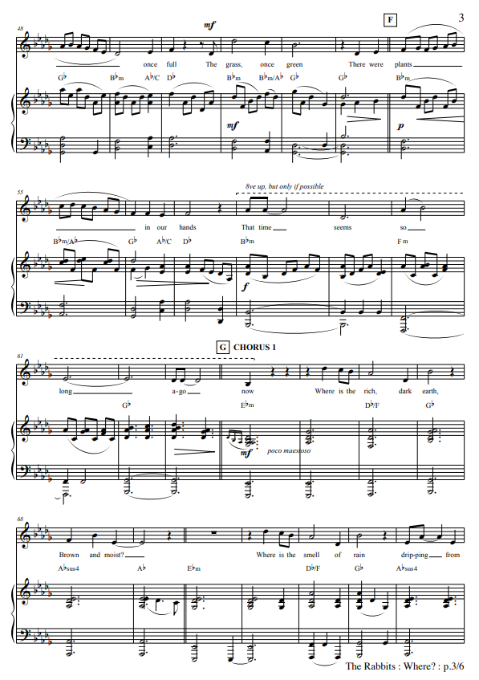
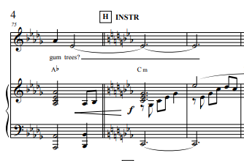
Activity 2.1 – ‘Where’ – Kate Miller-Heidke – performing (5)
Words and music by Kate Miller-Heidke, John Marsden and Lally Katz © Copyright Sony Music Publishing (Australia) Pty Ltd/ Kate Miller-Heidke, John Marsden and Lally Katz Print Rights for Kate Miller-Heidke administered in Australia and New Zealand By Hal Leonard Australia Pty Ltd ABN 13 085 333 713 www.halleonard.com.au Used By Permission. All Rights Reserved. Unauthorised Reproduction is Illegal.

Slide 52
Activity 2.1 – ‘Where’ – Kate Miller-Heidke
Whose perspective is the
song written from?
Who needs saving?
Think, pair, share
Who are the mothers
and the fathers?
Who are the rabbits?
Why do you think the songwriters chose rabbits as a symbol?

Slide 53
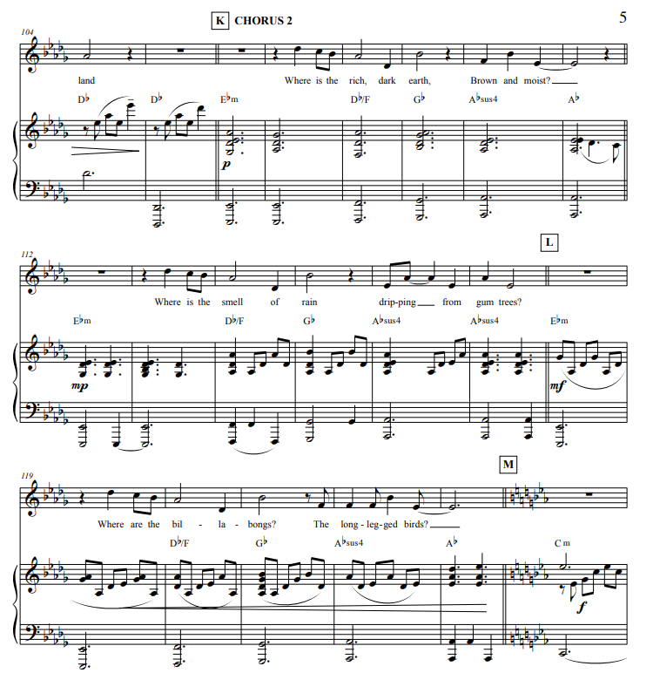
Activity 2.2 – ‘Where’ – Kate Miller-Heidke – listening (1)
Chorus 2 score reading
List the chords used in chorus 2.
What is the effect of the very low left hand piano octave notes?
In bars 112, 117 and 123, the piano right hand uses dotted crotchets. What does this do to the rhythmic pulse of the piece?
What does this symbol mean in bar 108 – Db/F
Look at the first 3 phrases of the melody line for chorus 2. Outline one observation about this melody.
Words and music by Kate Miller-Heidke, John Marsden and Lally Katz © Copyright Sony Music Publishing (Australia) Pty Ltd/ Kate Miller-Heidke, John Marsden and Lally Katz Print Rights for Kate Miller-Heidke administered in Australia and New Zealand By Hal Leonard Australia Pty Ltd ABN 13 085 333 713 www.halleonard.com.au Used By Permission. All Rights Reserved. Unauthorised Reproduction is Illegal.

Slide 54
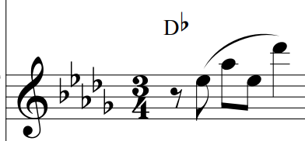
Activity 2.2 – ‘Where’ – Kate Miller-Heidke
Verse
There is a strong sense of Db major in this section.
The treble accompaniment motif is played throughout the verses.
Chorus
In the choruses, variety is achieved through the greater variation of the chords.
At the end of chorus 2, there is a modulation.

Slide 55
Activity 2.2 – ‘Where’ – Kate Miller-Heidke – performing (1)
Chorus 2
‘Where is the rich dark earth,
brown and moist?
Where is the smell of the rain
dripping from the gum trees?
Where are the billabongs?
The long-legged birds?’
Words and music by Kate Miller-Heidke, John Marsden and Lally Katz © Copyright Sony Music Publishing (Australia) Pty Ltd/ Kate Miller-Heidke, John Marsden and Lally Katz Print Rights for Kate Miller-Heidke administered in Australia and New Zealand By Hal Leonard Australia Pty Ltd ABN 13 085 333 713 www.halleonard.com.au Used By Permission. All Rights Reserved. Unauthorised Reproduction is Illegal.

Slide 56
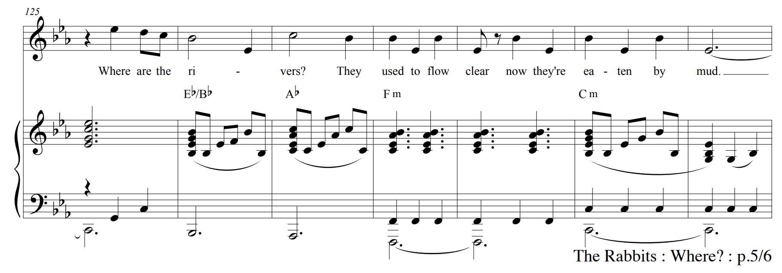
Activity 2.2 – ‘Where’ – Kate Miller-Heidke – listening (2)
Chorus 2 score reading
The music modulates to a new key in the final phrase of chorus 2
How many notes higher than the beginning of chorus 2 is the melody of this final phrase?
What effect does this modulation add to the piece?
Words and music by Kate Miller-Heidke, John Marsden and Lally Katz © Copyright Sony Music Publishing (Australia) Pty Ltd/ Kate Miller-Heidke, John Marsden and Lally Katz Print Rights for Kate Miller-Heidke administered in Australia and New Zealand By Hal Leonard Australia Pty Ltd ABN 13 085 333 713 www.halleonard.com.au Used By Permission. All Rights Reserved. Unauthorised Reproduction is Illegal.

Slide 57
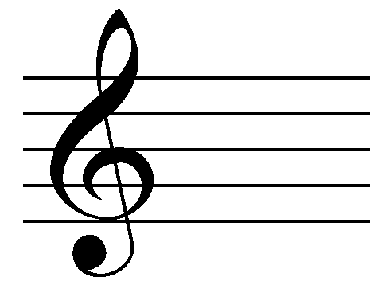
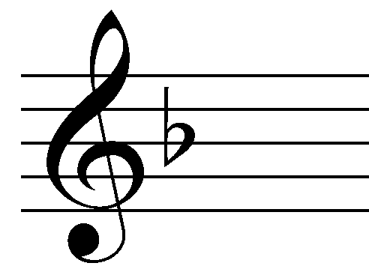
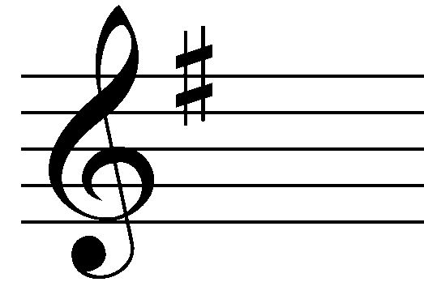
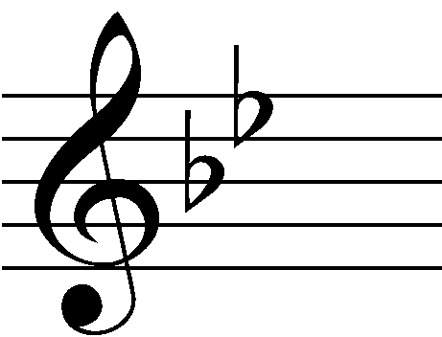
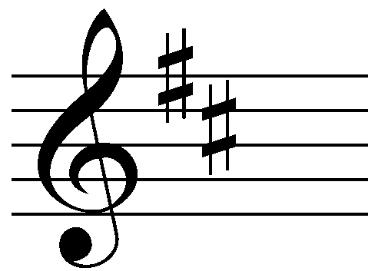
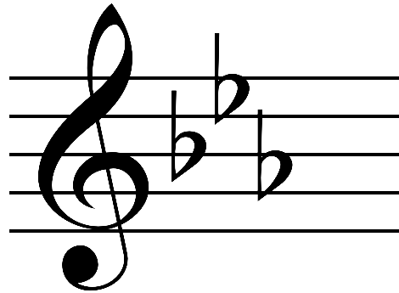
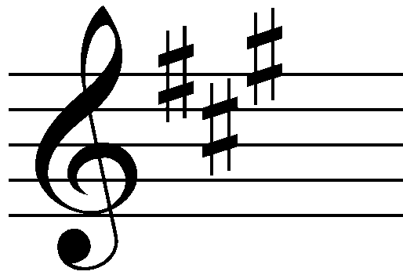
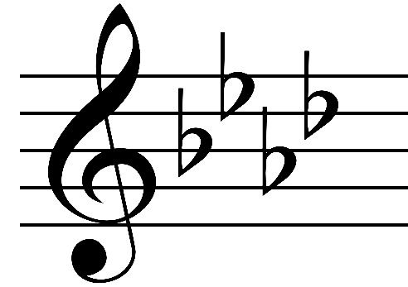







Activity 2.2 – ‘Where’ – Kate Miller-Heidke (1)
Circle of fifths
Notes:
An image of a wheel that is broken into segments. Each segment contains a keysignature written in the treble clef

Slide 58
Activity 2.2 – ‘Where’ – Kate Miller-Heidke (2)
Circle of fifths – answers
C major
A minor
F major
D minor
G major
E minor
Bb major
G minor
D major
B minor
Eb major
C minor
A major
F# minor
Ab major
F minor
E major
C# minor
C#/Db
major
A#/Bb minor
B/Cb major
G#/Ab
minor
F#/Gb major
D#/Eb minor
Notes:
An image of a wheel that is broken into segments. Each segment contains a key signature written in the treble clef. The major and minor keys are listed for each of the key signatures.

Slide 59
Activity 2.2 – ‘Where’ – Kate Miller-Heidke – arranging (1)
Transposition
Transposition is to move the notes of a piece up or down in pitch while keeping the distance between the notes the same.

Slide 60


Activity 2.2 – ‘Where’ – Kate Miller-Heidke – arranging (2)
Transposition tools
You may like to use one of the transposition tools to assist you.
Transposition wheel – the outside letters are the original key, the inside letters the key you are transposing to.
Transposition wheel
Keyboard – move the original note down ½ a step to the transposed note. It is the closest note to the left, regardless of whether it is a black or white note.
Keyboard diagram

Slide 61


Activity 2.2 – ‘Where’ – Kate Miller-Heidke – arranging (3)
Transposition – verse 1 bass notes
Original key
Transposed key

Slide 62


Activity 2.2 – ‘Where’ – Kate Miller-Heidke – arranging (4)
Transposition – verse 1 treble notes
Original key
Transposed key

Slide 63

Activity 2.2 – ‘Where’ – Kate Miller-Heidke – arranging (5)
Transposition – answer

Slide 64
Activity 2.2 – ‘Where’ – Kate Miller-Heidke – arranging and performing
Perform the transposition – treble and bass lines

Slide 65
3-2-1 things I learned today
List 3 things you learned today:
3
1.
2.
3.
List 2 questions you have about these things:
2
1.
2.
Give 1 reason why it’s important to learn about these things:
1
1.

Slide 66
Learning sequence 3 – ‘Bedouin song’ – Lior

Slide 67
Learning intentions and success criteria – LS 3
We are learning to
listen to and examine the musical elements in Lior’s ‘Bedouin Song’ through score reading and guided questions.
develop and apply vocal techniques, while rehearsing and performing music.
compose and perform an original 16-bar piece that explores themes of identity and belonging.
We can
analyse and interpret the musical elements by accurately responding to score reading and listening questions.
apply vocal techniques to perform music with musical expression, dynamics and a personal style.
collaboratively compose, rehearse, and perform a 16-bar piece.
Notes:
Notes for teachers:
Learning intentions and success criteria are best co-constructed with students. Adapt the learning intention as required and add matching success criteria.
For more information See ⁠AITSL or the NSW Department of Education explicit teaching strategies, ⁠Sharing learning intentions and ⁠Sharing success criteria
LISC is not necessarily presented at the beginning of the lesson. Teacher needs to consider most effectual time to introduce
LISC should be revisited during the lesson to support students' evaluation of their learning

Slide 68

Activity 3.1 – ‘Bedouin song’ – Lior – listening and score reading (1)
Lior discusses his childhood
List one point that Lior remembers about his life in Israel (0:48 – 1:02).
What is Lior’s view of Australia (1:44 – 2:04)?
Why did his parents decide to move to Australia (2:04 – 2:34)?
Outline Lior’s first musical experiences (4:41 – 5:03)?
Why did Lior want to be good at music (5:03 – 5:32)?
FaceCulture (14 July 2011) Lior interview – Lior Attar (part 1) (5:37) [video], FaceCulture, YouTube, accessed 20 May 2025

Slide 69

Video – Lior interview – Lior Attar (part 1)
Notes:
Video link - https://www.youtube.com/watch?v=RuF2iJ79kyI

Slide 70

Activity 3.1 – ‘Bedouin song’ – Lior – listening (2)
Lior’s 'Bedouin Song' is a poetic piece that delves into themes of identity, displacement, and belonging. The song uses the figure of the Bedouin – a nomadic Arab people traditionally living in the desert regions of the Middle East – as a metaphor for a broader human experience. Lior, an Australian singer-songwriter of Israeli descent, often weaves elements of his Jewish heritage into his music.
‘This song was inspired by time I spent with Bedouins – the wandering people of the desert – and the way they embraced the transience of life, challenging my ideas about the meaning of home’.
Lior Sunday 16 February 2025 (Lior 2025)
liormusic (14 February 2025) LIOR – Bedouin Song (Live Performance) (3:14) [video], liormusic, YouTube, accessed 20 May 2025

Slide 71

Video – LIOR – Bedouin Song (Live Performance)
Notes:
Video link - https://www.youtube.com/watch?v=nqhO8EziCYw

Slide 72
Activity 3.1 – ‘Bedouin song’ – Lior – listening and score reading (1)
Make a chart to demonstrate the structure of this piece.
You can use a table format or a flow chart

Slide 73
Activity 3.1 – ‘Bedouin song’ – Lior – listening and score reading (2)
List the performing media of this song.
Using one word, identify the timbre of the introduction of this piece (guitar 0:00 – 0:08).
Lior sings in falsetto at the beginning of this piece.
    What is falsetto?
    Write one word to describe the timbre of Lior’s voice

Slide 74
Activity 3.1 – ‘Bedouin song’ – Lior – listening and score reading (3)
Use one word to identify the pitch movement of the accompaniment in the introduction.
Draw a graphic representation of the pitch movement in bars 1 and 2.
Identify the highest and lowest melodic note in the melody in the verse (range).
Is the melodic range of this verse:
a) wide or b) narrow

Slide 75

Activity 3.1 – ‘Bedouin song’ – Lior – listening and score reading (4)
Describe a change in the pre-chorus in:
a) harmony b) melody
A melisma (or vocal run) is a technique where a single syllable of text is sung while moving between several different notes in succession.
Find 3 melismas in ‘Bedouin song’ (identify the bar number or the syllable Lior is singing).
The final chord in this piece is arpeggiated.
By looking at the score, define arpeggiated.

Slide 76


Activity 3.1 – ‘Bedouin song’ – Lior – vocal exercises
Vocal warmups can help to:
  protect the voice
  improve breath control
  increase vocal flexibility
  enhance resonance & vocal timbre
1
2
Good techniques include:
  start gently
  consistent practice
  use proper posture and breath support
  focus on relaxation and stay hydrated
Cheryl Porter Vocal Coach (23 October 2023) VOCAL AGILITY Exercise DUET w/Vocal Coach Cheryl Porter (2:28) [video], Cheryl Porter Vocal Coach, YouTube, accessed 20 May 2025
@thisisshari (4 April 2023) 'How To Develop and Strengthen Your Falsetto Singing Voice... (0:58)’ [video], @thisisshari, YouTube, accessed 24 March 2025.
Notes:
Video 1 - https://www.youtube.com/shorts/sA3D_ByDzVc

Slide 77

Video – Vocal Agility Exercise Duet with Vocal Coach Cheryl Porter
Notes:
Video 2 - https://www.youtube.com/watch?v=NO3Iw6bvYsQ

Slide 78

Activity 3.2 – ‘Bedouin song’ – Lior – listening and score reading (1)
Identify an Italian tempo term for this piece:
= c. 47 (freely)
What difference do you notice between the note values of the guitar and melody in the pre-chorus? List one observation and the bar number it occurs.
What do these rhythmic differences in the guitar and vocal part add to the pre-chorus?

Slide 79



Activity 3.2 – ‘Bedouin song’ – Lior
${6 \atop 8}$time signature
Amplified Warmups (29 March 2022) Rhythm tutorial: how to count 6/8 (2:26) [video], Amplified Warmups, YouTube, accessed 20 May 2025

Slide 80






Activity 3.2 – ‘Bedouin song’ – Lior – listening and score reading (2)
Notes | Values represented in quaver beats
 | 1 quaver beat
Outline the value of the notes in the chart.

Slide 81

Activity 3.2 – ‘Bedouin song’ – Lior – listening and score reading (3)
Identify the term that describes the texture of this piece:
polyphonic
homophonic
monophonic
Write one sentence to describe the texture

Slide 82

Activity 3.2 – ‘Bedouin song’ – Lior – listening and score reading (4)
Lior uses an expressive tool called rubato,
where he varies the tempo
to add musical expression.
Identify one place where Lior speeds up the tempo in this piece (accelerando).
Identify one place where Lior slows the tempo down of this piece (ritardando).

Slide 83
Activity 3.2 – ‘Bedouin song’ – Lior – listening and score reading (5)
Ornamentation is important in this piece.
Identify 3 examples of ornamentation and discuss the effect these ornaments have on the piece.
Ornamentation | Symbol | Effect

Slide 84
Activity 3.2 – ‘Bedouin song’ – Lior – listening and score reading (6)
The score for this piece does not have dynamic markings. If you were to perform this piece:
Where would you use dynamics to communicate your personal interpretation?
How and where would you add expression? Consider the following sections:
verse
intro
chorus
Self-reflection
Consider your performance assessment and your own use of dynamics and expression.

Slide 85


Activity 3.2 – ‘Bedouin song’ – Lior – listening
Lior and Joseph Tawadros Bedouin song
Joseph Tawadros is an Australian Egyptian oud virtuoso, composer, and musical producer. He is widely recognised as one of the leading players of the oud (a traditional Arabic string instrument), blending classical Arabic music with Western and contemporary influences.
What does the performing media of the orchestra accompaniment add to the piece?
How is the oud played and what does the inclusion of this instrument add to the piece?
liormusic (5 July 2016) Lior - Bedouin Song - with the Sydney Symphony Orchestra feat. Joseph Tawadros (4:24) [video], liormusic, YouTube, accessed 21 May 2025

Slide 86

Video – Lior – Bedouin Song – with the Sydney Symphony Orchestra feat. Joseph Tawadros
Notes:
Video link - https://www.youtube.com/watch?v=JoGRitVm_rw

Slide 87
Activity 3.2 – ‘Bedouin song’ – Lior
Personal style in performance assessment task
Self-reflection
Consider your performance assessment and how dynamics and expression will be explored to demonstrate personal style.
Group discussion
Discuss, share, collaborate and explore your
personal style decisions for your performance
assessment task with the group.

Slide 88
Activity 3.3 –Assessment task (1)
Planning to write the introduction
Task description
Prepare and present an introduction to the performance that outlines how the performance reflects the stylistic features and cultural and/or social context.

Slide 89
Activity 3.3 –Assessment task (2)
Writing the introduction
What is the title and composer of my performance piece?
Are there any interesting facts about my piece that give social and cultural context?
What style or genre is my performance piece?
What are some stylistic considerations I have considered for when I perform my piece?
What is my personal connection to my interpretation of my performance piece?

Slide 90
Activity 3.3 – Assessment task (3)
More steps to success
What I need to do | Some ways I can do this
Rehearse my chosen Australian piece | As a soloist, spend time learning and refining the pitch and rhythm As an ensemble member: spend time learning and refining the pitch and rhythm of my part rehearse with the ensemble and pay particular attention to rhythmic unity, textural layers and balance
Consider what stylistic considerations I want to include in my interpretation of the piece | Do I want to make changes to the structure of my performance piece? If yes, what are they? Do I want to include dynamics and expression that are not included on the music? If yes, what and where? Do I want to consider making changes to the performance piece through any other of the elements of music? If yes, what are they and how will I make changes? Write these decisions onto the music

Slide 91
Activity 3.4 – ‘Bedouin song’ – Lior – composing and performing (1)
What is meant by connection to land and heritage, identity and belonging?
Connection to land and heritage
The Bedouin culture is tied to the land they roam, and they live a nomadic lifestyle which is their sense of identity. In ‘Bedouin song’, Lior invoked this idea of a deep, almost spiritual connection to the earth and one’s roots. The longing for home and the sense of exile or displacement resonates throughout the song.
Themes of freedom and movement whilst needing to belong
The Bedouins are nomadic – which can give them a unique kind of freedom, yet also a form of instability. The song explores the tension between the freedom of movement as well as loneliness or uncertainty. Many people feel like outsiders, whether due to geography, culture, or personal circumstances, and 'Bedouin song' taps into that feeling of searching for a place or a community to call one’s own.
Searching for identity
Much of Lior’s work deals with the journey of self-discovery. The song symbolises seeking your place in the world and struggling to find a sense of belonging whilst staying true to your culture and identity.

Slide 92



Activity 3.4 – ‘Bedouin song’ – Lior – composing and performing (2)
What is meant by connection to land and heritage, identity and belonging?
Word cloud using Canva
log in to Canva, select the option – create a new design. You can choose a template design and customise.
using the left sidebar, use the search bar to look for ‘word cloud’.
click on the ‘text’ tab on the left sidebar to choose text style and then type the words you want to include in the word cloud. You may need to use various size fonts, style, colour according to your preference.
manually position the words in a cloud-like format and change background colour or shapes if you choose to.
click the ‘share’ button at the top right corner and select ‘download’ and then choose your preferred file format and download the design.
open the downloaded file to ensure everything looks as expected.
Image generated using Canva for Education and shared in
Accordance with Canva’s Product Terms.

Slide 93


Activity 3.4 – ‘Bedouin song’ – Lior – composing and performing (2)
16 bar composition
Section A –
G major (G, B, D)
Section B –
C (C, E, G), D (D, F#, A), Em (E, G, B),
End on G (G, B, D)

Slide 94


Activity 3.4 – ‘Bedouin song’ – Lior – composing and performing (3)
Section A – only use G chord (G, B, D) broken chord
Bar 1 | Bar 2 | Bar 3 | Bar 4
Bar 5 | Bar 6 | Bar 7 | Bar 8
Example only

Slide 95


Activity 3.4 – ‘Bedouin song’ – Lior – composing and performing (4)
Section B – use block chords C, D, Em, and end on G
Bar 9 | Bar 10 | Bar 11 | Bar 12
Bar 13 | Bar 14 | Bar 15 | Bar 16
Example only

Slide 96


Activity 3.4 – ‘Bedouin song’ – Lior – composing and performing (5)
G major
G, B, D
Melodic phrases
Phrase 1
Phrase 2
Lior (n.d.) A selection of sheet music and TABS [website], accessed 30 June 2025

Slide 97

Activity 3.4 – ‘Bedouin song’ – Lior – composing and performing (6)
Group presentations
Present
Perform
Reflect

Slide 98
Learning sequence 4 – Assessment preparation and presentation

Slide 99
Learning intentions and success criteria – LS 4
We are learning to
develop performance skills by rehearsing a self–chosen Australian piece individually or in an ensemble
craft an effective introduction that provides context about the chosen Australian piece
understand the assessment criteria to meet the expectations outlined for each grade.
We can
demonstrate improvement in performing by engaging in consistent rehearsals and applying the ‘Steps to success’ strategies
submit a draft of our introduction to the teacher and effectively incorporate their feedback in the final version.
articulate the 3 outcomes that will be assessed and explain the expectations for each grade in our own words.
Notes:
Notes for teachers:
Learning intentions and success criteria are best co-constructed with students. Adapt the learning intention as required and add matching success criteria.
For more information See ⁠AITSL or the NSW Department of Education explicit teaching strategies, ⁠Sharing learning intentions and ⁠Sharing success criteria
LISC is not necessarily presented at the beginning of the lesson. Teacher needs to consider most effectual time to introduce
LISC should be revisited during the lesson to support students' evaluation of their learning

Slide 100
Activity 4.1 – Assessment preparation (1)
More steps to success
What I need to do | Some ways I can do this
Consider what stylistic considerations I want to include in my interpretation of the piece | Do I want to make changes to the structure of my performance piece? If yes, what are they? Do I want to include dynamics and expression that are not included on the music? If yes, what and where? Do I want to consider making changes to the performance piece through any other of the elements of music? If yes, what are they and how will I make changes? Write these decisions onto the music
Rehearse my interpretation of the piece | Include my stylistic and interpretation decisions that I have written on the music when rehearsing for the performance and refine
Identify what my personal connection is to the piece and how I have interpreted this piece for my performance | Why do I personally feel connected to this piece? What changes have I made that makes my interpretation of the piece unique and more meaningful or connected for me?

Slide 101
Activity 4.1 – Assessment preparation (2)
More steps to success
What I need to do | Some ways I can do this
Write my introduction to my performance by Week 4 | Using all of the information I have gathered in the previous ‘Steps to success’, write the introduction part of the assessment task Submit my introduction to the teacher in Week 4 to get feedback before I present it in Week 5
Think about where I/my ensemble will position myself/ourselves in the room to perform | As a soloist – Will I face the audience? Will I be standing or sitting? As an ensemble member – Will I be standing or sitting? Do I have a good line of view with all the members of my ensemble? Can the audience see all members of my ensemble?
Get feedback on my performance | During Weeks 3 to 5, ask the teacher to listen to my performance and ask for feedback
Present my introduction and performance | Know the due date in Week 5 as outlined by my teacher Come prepared with my music and completed introduction on the due date

Slide 102
Activity 4.2 – Assessment preparation (3)
Assessment rubric
Outcomes | A | B | C | D | E
MU5-PER-01 performs repertoire with stylistic awareness and musical expression | I can demonstrate outstanding delivery of stylistic features, interpretation and musical expression in my chosen Australian piece performance. | I can demonstrate a strong delivery of stylistic features and musical expression in my chosen Australian piece performance. | I can demonstrate a competent delivery of stylistic features and musical expression in my chosen Australian piece performance, with some inconsistencies. | I can demonstrate some stylistic features and musical expression in my chosen Australian piece performance, with some loss of fluency and accuracy. | I can perform my chosen Australian piece with limited awareness of style or musical expression. I perform with frequent hesitations.

Slide 103
Activity 4.2 – Assessment preparation (4)
Assessment rubric
Outcomes | A | B | C | D | E
MU5-PER-02 manipulates and combines the elements of music in performance to communicate musical ideas | I can make highly effective musical decisions when combining and manipulating the elements of music to successfully communicate my own personal interpretation in the performance. | I can make effective musical decisions when combining and manipulating the elements of music to communicate my personal interpretation in the performance. | I can make musical decisions when combining and manipulating the elements of music to communicate a personal interpretation for the performance. | I can make musical decisions when combining and/or manipulating some of the elements of music to communicate a developing interpretation of the piece. | I attempt to make some musical decisions about using the elements of music in performance when considering an interpretation of the piece.

Slide 104
Activity 4.2 – Assessment preparation (5)
Assessment rubric
Outcomes | A | B | C | D | E
MU5-LIS-01 uses listening skills to analyse music in relation to stylistic, cultural, historical and social contexts | I can present a detailed and perceptive introduction that makes strong links between my performance and the stylistic, cultural, historical and social context of the piece. | I can present a detailed introduction that clearly links my performance to the stylistic, cultural, historical and social context of the piece. | I can present an introduction that makes links between my performance and the stylistic, cultural, historical and social context of the piece. | I can present an introduction that identifies the stylistic, cultural, historical and/or social context of the piece. | I can present an introduction that attempts to broadly identify the context of the piece.

Slide 105
Activity 4.1 – 4.4 Assessment preparation (1)
Protocols and responsibilities for working safely and respectfully with others
Show respect for your classmates, your teacher and the music classroom equipment.
Return instruments and equipment (including leads, adaptors, pedals) to the right place.
Take care when using instruments to avoid accidents and damage. Report any damage immediately to your teacher.
Consider safe volume levels when rehearsing and think about others around you.
Always do a warm-up and/or technical work before rehearsing a performance piece.
Position your music and/or ensemble members to ensure correct posture both in rehearsal and performance.
105

Slide 106
Activity 4.1 – 4.4 Assessment preparation (2)
Protocols and responsibilities for working safely and respectfully with others
Cover any trip hazards, including cords.
Explore different ways to play. For example, adjust volume or pitch controls or select different modes or effects instead of playing forcefully.
Be considerate of class members with sound sensitivity.
Practice safety when packing away. For example, turn off the instrument before unplugging and switch off power points before pulling out plugs.
Make sure each class member has equal opportunity to the rehearsal space and equipment
Follow teacher instructions
106

Slide 107
Learning sequence 5 – Depth study – getting started

Slide 108
Learning intentions and success criteria – LS 5
We are learning to
define what a depth study in music is and understand its purpose
plan and organise a product that answers the depth study driving question
We can
collaboratively define a depth study and share our findings with the class
identify key elements from the Music 7–10 syllabus regarding depth studies
document our ideas and plans for our product using the provided worksheets
complete and submit on time a depth study proposal, planner
if working in a group, a group norms contract.
Notes:
Notes for teachers:
Learning intentions and success criteria are best co-constructed with students. Adapt the learning intention as required and add matching success criteria.
For more information See ⁠AITSL or the NSW Department of Education explicit teaching strategies, ⁠Sharing learning intentions and ⁠Sharing success criteria
LISC is not necessarily presented at the beginning of the lesson. Teacher needs to consider most effectual time to introduce
LISC should be revisited during the lesson to support students' evaluation of their learning

Slide 109
Activity 5.1 – Depth study – getting started (1)
NESA Music 7–10 Syllabus (2024)
Guidelines
8 to 10 hours of class time is recommended
A music depth study may include:
Depth study​
Students are required to undertake a depth study in Stage 5. Students draw on content studied in class, and apply knowledge, understanding and skills in an area of individual interest. Depth studies may be completed individually or collaboratively. Students may choose to specialise in one or more of the focus areas: Performing, Listening and Composing.​
Performing
A live performance and supporting material
A recorded performance and supporting material
Leading or directing an ensemble and documenting the process of musical preparation
An investigative presentation of a piece of music, incorporating live performance
Listening
A live or recorded presentation of a musical investigation
A musical investigation presented as a viva voce
A musical investigation presented in written and/or multimodal form
Composing
An arrangement of an existing song or piece and documentation of the development process
An original composition and documentation of the process
A collection of short compositions linked to the work of other songwriters or composers
Music 7–10 syllabus © NSW Education Standards Authority (NESA) for and on behalf of the Crown in right of the State of New South Wales, 2024

Slide 110
Activity 5.1 – Depth study – getting started (2)
Limitations to consider
Resources
Access to musical instruments and technology may not be available every lesson.
If working in a group
Consider the size of the group. The more people in the group that harder it is to coordinate.
Time
You only have 7 lessons for independent work on your depth study
An interesting fact: your teacher will not direct you; you need to manage your time and project development. For the depth study your teacher takes on the supportive role of the facilitator but does not manage your project.

Slide 111
Activity 5.1 – Depth study – getting started (3)
Consider the possibilities
You can choose to focus your depth study on EITHER:
performing OR
listening OR
composing OR
more than one of the focus areas
You can explore a musical area of passion that you have not been able to in school time before
1
2
You get to choose what you create and present in the final lesson
3

Slide 112
Activity 5.1 – Depth study – getting started (4)
The driving question
How does my perspective of Australia shape my music?

Slide 113
Activity 5.1 – Depth study – getting started (5)
What else do I need to consider?
?
?
?
What product will I create?
What will I need to create that product?
How can my product answer the driving question?
How will I present my product to the class in the final lesson?

Slide 114
Activity 5.1 – Depth study – getting started (6)
Examples of how to answer the driving question with a product
Arrange a personal interpretation of an Australian composition or piece using scales and rhythms influenced by your cultural heritage
How does my perspective of Australia shape my music?
Compile a playlist of Australian songs that reflect personal perspective on Australia (for example, political, cultural, emotional) and provide written or spoken analysis explaining why each song was chosen
Perform a piece by an Australian artist that resonates with your identity or values. Add expression that reflects your personal connection with the music and its meaning
Write an original song with lyrics that reflect your thoughts on Australian identity
Create a listening journal or podcast that explores how music from different Australian communities (for example, Aboriginal and/or Torres Strait Islander, ethnic, Deaf/hearing impaired or LGBTQIA+) reflects varied perspectives
Create a performance that reflects imagery and/or sounds of Australia (for example, combining music elements to create a composition that depicts a waterfall, or sounds of nature) with styles from my cultural heritage or personal preference

Slide 115


Activity 5.2 (1)
Project proposal
Writing a project proposal helps clarify your goals, organise your ideas and create a clear plan for success. Use the depth study proposal template
at the example

Slide 116
Activity 5.2 (2)
Depth study planner
Planning tool
Week | Lesson 1 | Lesson 2 | Lesson 3
Week 6 | What is a depth study? Branching and planning questions | Project proposal Depth study planner Group norms contract Submit this lesson | This is not a depth study lesson
Week 7 | This is not a depth study lesson | This is not a depth study lesson | This is not a depth study lesson
Week 8 | This is not a depth study lesson | Independent lesson What do I want to achieve this lesson? | *Facilitator check-in What do I want to achieve this lesson?
Week 9 | *Facilitator check-in What do I want to achieve this lesson? | *Facilitator check-in What do I want to achieve this lesson? | *Facilitator check-in What do I want to achieve this lesson?
Week 10 | Present product for peer feedback | Finish and refine product | Submit or present product
Planning is very important to make sure you finish your product on time.
Set yourself goals for each lesson.

Slide 117

Activity 5.2 (3)
Group norms – only required if working in a group
Working in a group can be challenging. It is important to set some guidelines to ensure that each member is working equitably.

Slide 118
Learning sequence 6 – Further exploration of Australian music

Slide 119
Learning intentions and success criteria – LS 6
We are learning to
revise and identify the 6 elements of music through active listening, score reading, observation and comparison.
explore and articulate aspects of personal and cultural identity in music through group discussion and presentation.
clap, create and sequentially perform using body percussion, rhythms, voice, rap, primary chords, rhythm sections and ostinatos.
understand the significance of protest songs and apply this knowledge by researching current issues
We can
discuss the elements of music through active listening.
discuss and present ideas that reflect aspects of identity expressed through music.
create and perform using clapping, body percussion, voice, rap, primary chords, rhythm section patterns, and ostinatos.
understand the purpose and impact of protest songs and research current Australian social and political issues suitable for protest song themes.
Notes:
Notes for teachers:
Learning intentions and success criteria are best co-constructed with students. Adapt the learning intention as required and add matching success criteria.
For more information See ⁠AITSL or the NSW Department of Education explicit teaching strategies, ⁠Sharing learning intentions and ⁠Sharing success criteria
LISC is not necessarily presented at the beginning of the lesson. Teacher needs to consider most effectual time to introduce
LISC should be revisited during the lesson to support students' evaluation of their learning

Slide 120
Activity 6.1 – Elements of music revision
Performing media and timbre
Dynamics and expression
Elements of music
Pitch
Duration
Structure
Texture

Slide 121

Activity 6.1 – ‘Wish You Well’ – Bernard Fanning – listening (1)
‘Wish You Well’ is a song that expresses a message of positivity and encouragement, particularly in the face of life's challenges after a relationship breakup. Bernard Fanning is best known as the lead singer and songwriter of the hugely successful Australian rock band Powderfinger. Formed in Brisbane in 1989, Powderfinger became one of Australia's most beloved and influential rock bands. After Powderfinger disbanded in 2010, Fanning pursued a successful solo career and he composed ‘Wish You Well’ in 2020, and it was released as a single in 2021.
Bernard Fanning (17 November 2006) Bernard Fanning – Wish You Well (2:28) [video], Universal Music Australia, YouTube, accessed 25 June 2025

Slide 122

Video – Bernard Fanning – Wish You Well
Notes:
Video link - https://www.youtube.com/watch?v=JYlyghmTSIU

Slide 123
Activity 6.1 – ‘Wish You Well’ – Bernard Fanning –listening (2)
Elements of music – revision
Pitch | Duration | Performing media and timbre | Texture | Dynamics and expression | Structure

Slide 124

Activity 6.1 – ‘Wish You Well’ – Baker Boy featuring Bernard Fanning – listening (1)
The song ‘Wish You Well’ by Baker Boy and Bernard Fanning is a powerful and heartfelt collaboration that merges two distinct Australian musical influences: Baker Boy’s Aboriginal heritage and charismatic rap style with Fanning’s reflective, emotive songwriting, creating a musical dialogue between two generations of Australian music.
Baker Boy (17 August 2022) Baker Boy – Wish You Well (Official Video) ft. Bernard Fanning (3:11) [video], Baker Boy, YouTube, accessed 30 June 2025

Slide 125

Video – Baker Boy – Wish You Well (Official Video) ft. Bernard Fanning
Notes:
Video link - https://www.youtube.com/watch?v=Wh0lbSvLLH0

Slide 126
Activity 6.1 – ‘Wish You Well’ – Baker Boy featuring Bernard Fanning – listening (2)
Comparison – unity and contrast
Bernard Fanning
Baker Boy ft. Bernard Fanning
Musical observations –
Bernard Fanning’s version
Musical observations that are the same in both songs
Musical observations –
Baker Boy ft. Bernard Fanning’s version

Slide 127
Activity 6.1 – ‘Wish You Well’ – Baker Boy featuring Bernard Fanning – listening (3)
Who?
Where?
‘Who’ is playing/making the musical observation I have identified?
‘Who’ am I discussing?
‘Where’ in the song is the musical observation?
What?
How?
‘How’ is my musical observation being used?
‘How’ does the musical observation ‘affect’ the piece?
‘What’ do I hear?
‘What' element of music am I referring to by this terminology?

Slide 128
Activity 6.1 – ‘Wish You Well’ – Baker Boy featuring Bernard Fanning – listening (4)
Unity and contrast chart
Musical observations | Who/what/where? Wish You Well | How? Sentence starter suggestions
Unity |  | This adds … This creates … This brings … This combines …
Contrast |  | This brings … This introduces … This adds … This changes …

Slide 129


Activity 6.1 – ‘Wish You Well’ – Bernard Fanning – listening (3)
2-bar riff – rhythmic dictation
A musical feature of 'Wish You Well' is the consistent rhythmic and harmonic riff.
A 2-bar rhythmic dictation, similar in its repetitive nature to 'Wish You Well', will be played 4 times for you to notate. There will be a 4-beat count in.
${4 \atop 4}$
First playing – short break
Second playing – 5 second break
Third playing – 10 second break
Fourth playing – 10 second break
Click to reveal answer

Slide 130

Activity 6.1 – ‘Wish You Well’ – Bernard Fanning – listening (4)
Listen to the opening of 'Wish You Well' and notate the 2-bar rhythmic riff.
Hint: it is in ${4 \atop 4}$ time signature and uses syncopation.
Bernard Fanning (17 November 2006) Bernard Fanning – Wish You Well (2:28) [video], Universal Music Australia, YouTube, accessed 25 June 2025

Slide 131
Video – Bernard Fanning – Wish You Well (2)

Slide 132
Activity 6.1 – ‘Wish You Well’ – Bernard Fanning
Primary chords in D major
Roman numeral | I | IV | V
Chord | D | G | A
Notes | D, F♯, A | G, B, D | A, C♯, E

Slide 133
Activity 6.1 – ‘Wish You Well’ – Bernard Fanning –performing
2-bar riff using primary chords in D major
D G A G
D D A D

Slide 134
Activity 6.1 – ‘Wish You Well’ – Bernard Fanning – composing and performing (1)
Create a 2-bar riff using the primary chords – D major – class composition
Primary chords used in ‘Wish You Well’
I – D
IV – G
V – A
Create a 2-bar riff using the primary chords and inspiration from 2-bar rhythms you have listened to in class
Begin your 2-bar riff with D chord and end with an A followed by D chord
Only use the primary chords

Slide 135
Activity 6.1 – ‘Wish You Well’ – Bernard Fanning – composing and performing (2)
Create rap lyrics for 2-bar riff – class composition
Create a short, catchy, rap–style phrase to fit with the 2-bar riff
Perform the riff and phrase lyrics together to make a class composition

Slide 136

Activity 6.2 – Baker Boy – identity through composing and performing (1)
Baker Boy – Language and Culture
Growing up in a remote community, Baker Boy faced many challenges and used these to:
shape his musical journey
express his experiences through music
advocate for his Community
show his musical message to the world
NITV (16 October 2018) Baker Boy 'Feel the power of my blackness' (3:26) [video], NITV, YouTube, accessed 30 June 2025

Slide 137

Video - Baker Boy 'Feel the power of my blackness’
Notes:
https://www.youtube.com/watch?v=a0xvVoQ-wVI

Slide 138
Activity 6.2 – Baker Boy – identity through composing and performing (2)
Who is Baker Boy?
Where is he from?
How does Baker Boy include Culture in his music?
What influences Baker Boy?
What is the effect of Baker Boy’s music on the listener?

Slide 139
Activity 6.2 – Baker Boy – identity through composing and performing (3)
Rap is a musical genre and a vocal style where the artist rhythmically speaks, or chants rhymed lyrics.
Verse – class rap
1)
I’m a reflection of the struggle and the fight,
A mix of history, vision, and light.
Got my roots in the past, but my dreams in the sky,
I’m a journey, a story, watch me rise, watch me fly.
3)
I’m made of all the pieces they said wouldn’t fit,
Every scar, every story, every ounce of grit.
I’m the heartbeat of a dream that never fades,
A mix of the past and the moves I’ve made.
suggested
lyrics
2)
I’m the whispers of my ancestors,
the voices in my mind,
Every step I take, I’m leaving traces behind.
A canvas full of memories, yet fun in my sight,
I’m rewriting the story, defining my light.
4)
I’m the sum of every choice I ever made,
The quiet and the loud, the night and the day.
I’m the lessons, the growth, the battles I fight,
A vision unfolding, I’m owning my light.

Slide 140

Activity 6.2 – Baker Boy – identity through composing and performing (4)
Baker Boy recreates ‘Marryuna’
‘Marryuna’ is a word from the Yolŋu Language (Northern Territory of Australia). The term 'Marryuna' translates to dance.
Yolŋu Language and English lyrics – Marryuna
Red Bull Music (2 December 2020) Baker Boy recreates 'Marryuna' | Red Bull Key Ingredients (5:30) [video], Red Bull Music, YouTube, accessed 30 June 2025

Slide 141

Video –
Notes:
https://www.youtube.com/watch?v=uMsn3VGn5vM

Slide 142


Activity 6.2 – Baker Boy – identity through composing and performing (5)
Rhythmic ostinato patterns

Slide 143
Activity 6.2 – Baker Boy – identity through composing and performing (6)
Rap with rhythmic ostinato
Verse – class rap
Ostinato layered accompaniment

Slide 144
Activity 6.2 – Baker Boy – identity through composing and performing (7)
Final stages
Perform
Reflect

Slide 145
Activity 6.3 – Murrgumurrgu – James Henry – listening (1)
Translations from Yuwaalaraay
Murrgumurrgu
Ibis
Ngiyarrmanha
there they walking
binaal
happy/peaceful
gungan ganugu, yuul gayarragilanha
water and food they
are looking for
Dharriwaa-ngunda
Narran Lakes

Slide 146


Activity 6.3 – Murrgumurrgu – James Henry – listening (2)
Language and pronunciation
James Henry (2 June 2025) Murrgumurrgu Pronounciations (10:14) [video], James Henry, unlisted YouTube, accessed 16 June 2025
Notes:
Video link - https://www.youtube.com/watch?v=1_u3GYziGaw

Slide 147


Activity 6.3 – ‘Murrgumurrgu’ – James Henry
Additive rhythms
Additive rhythms break a time signature down into smaller groups of time of different durations.
Additive rhythms can add rhythmic complexity and possibilities.
Additive rhythms can create an asymetrical and/or irregular feel that assists with leaning into a more speech-like rhythm.
For example, in Murrgumurrgu:
the 10 quavers are broken into groups of 3, then 3, then 4
the 14 quavers are broken into groups of 3, then 3, then 4 and 4

Slide 148



Activity 6.3 – ‘Murrgumurrgu’ – performing (1)
Body percussion
slow
at tempo
Speak the lyrics

Slide 149

Activity 6.3 – ‘Murrgumurrgu’ – performing (2)
Pitch and lyrics
slow
at tempo

Slide 150

Activity 6.4 – ‘Murrgumurrgu’ – James Henry
Score reading
Bar number | Name | Symbol | Definition
Example: 3 | Octave clef |  | When the 8 is at the bottom of the clef, it means to play or sing an octave (8 notes) lower than notated

Slide 151

Activity 6.5 – ‘First Nation’ –
Midnight Oil – listening (1)
Protest song
Midnight Oil are an Australian rock band composed of Peter Garrett (vocals, harmonica), Rob Hirst (drums), Jim Moginie (guitar, keyboard) and Martin Rotsey (guitar) which formed in 1972. The band's music often broaches political subjects, and they have lent their support to multiple causes.
This song is a protest song; a song associated with a movement for social change and comes from the album ‘Makaratta Project’ by Midnight Oil which can be considered to be a protest album.
Protest songs allow musicians to raise awareness, challenge injustice and inspire social change.
Midnight Oil (25 September 2020) Midnight Oil – First Nation (feat. Jessica Mauboy & Tasman Keith) [Official Video] (4:55) [video], Midnight Oil, YouTube, accessed 30 June 2025

Slide 152

Video – Midnight Oil – First Nation (feat. Jessica Mauboy & Tasman Keith)

Slide 153
Activity 6.5 – ‘First Nation’ – Midnight Oil – listening (2)
Song meaning
List the artists that sing this song
What is the song about?
How does this song make you feel? Happy/sad/angry/hopeful
What words or lines stood out to you in this song? Why are these words important?
Why is the song called ‘First Nation?’

Slide 154


Activity 6.5 – ‘First Nation’ – Midnight Oil – listening (3)
Elements of music – verse 1 and 2 (0:00 – 1:19)
Is the pulse of this song strong or weak? How do you know if the pulse is strong or weak?
What is the tempo of this piece?
The time signature of this piece is ${6 \atop 4}$ . Write out the first bar of the drum pattern.

Slide 155
Activity 6.5 – ‘First Nation’ – Midnight Oil – listening (4)
Elements of music – verse 1 and 2 (0:00 – 1:19)
Name the instrument (performing media) that is playing with the drumkit at the beginning of the piece in the introduction (0:00 – 0:11).
Identify:
a) how it is being played
b) a word to describe the timbre of this instrument
c) the note values this instrument is playing
Draw a graphic score of the pitch pattern of the backing vocals (‘do, do, do, do, do, do, do’)
Compare the main vocals with the backing vocals for the following:
a) timbre
b) register
c) rhythmic note values (word bank – ostinato, syncopation, long/short, repetition)

Slide 156


Activity 6.5 – ‘First Nation’ – Midnight Oil – listening (5)
Elements of music – verse 1 and 2 (0:00 – 1:19)
Use the rhythm below to notate the pitch of the bass line ostinato in this piece:
Starting note

Slide 157
Activity 6.5 – ‘First Nation’ – Midnight Oil – listening (6)
Elements of music – pre–chorus (1:19 – 1:31)
What happens to the time signature in the bridge before the chorus (‘out loud’)?
Write one sentence to describe the melodic line in the bridge.
Both the main vocals and backing vocals sing this bridge. What is different about their pitch?
What happens to the texture of the song in the bridge?
Identify one element of music and write one sentence referring to how the drums use this element to add excitement in the bridge.
Name the dynamic and expression marking that gradually occurs throughout the bridge.

Slide 158
Activity 6.5 – ‘First Nation’ – Midnight Oil – listening (7)
Elements of music – chorus (1:31 – 1:47)
What dynamic marking is used in the chorus of this song?
Identify 3 instruments (performing media) in the chorus and use a word to describe their timbre.
Performing media | Timbre
What effect does the vocal ‘growl’ at the end of the chorus create?

Slide 159
Activity 6.5 – ‘First Nation’ – Midnight Oil – listening (8)
Elements of music – rap section (1:47 – 2:14)
Use one word to describe the timbre of the rap.
There is a slight echo (call and response) at the end of each rap phrase. Write 2 points about this echo (‘response’).
Does the performing role of the drums and bass riff change (variety) or stay the same (unity) in this section?
There is a high–pitched electronic keyboard in this section. What effect does this high–pitched electronic keyboard create?

Slide 160
Activity 6.6 – ‘First Nation’ – Midnight Oil
Group research task
Current Australian issue to write a protest song about
What is the issue about?
Why did you choose this issue to discuss?
Think of a rhyming chorus lyric you could use for a protest song that fits the Australian issue you identified
Why is this a problem?
What style of song would you write to address this issue?
What needs to change?
Who is affected by the issue?

Slide 161
Learning sequence 7 – Depth study

Slide 162
Learning intentions and success criteria – LS 7
We are learning to
manage our time effectively while working independently on our depth study, ensuring we meet our goals and deadlines.
effectively plan and prepare for facilitator meetings by formulating relevant questions and identifying draft components of our products to share.
develop and refine our depth study products based on feedback received from peers and facilitators.
create and complete a depth study product that effectively answers the driving question
We can
set clear goals for each lesson and adjust our planner to ensure we stay on track and manage our time effectively during independent work sessions.
create a list of targeted questions for our facilitator meetings and outline the draft components we will present during these sessions.
use the warm and cool feedback sentence starters to give meaningful feedback to our peers and reflect on how their suggestions can be integrated into our own work.
document and reflect on the feedback received from peers and facilitators in our student booklet to improve our depth study products.
finalise our depth study product ensuring it is complete, ready for presentation and demonstrates a clear resolution to the driving question
Notes:
Notes for teachers:
Learning intentions and success criteria are best co-constructed with students. Adapt the learning intention as required and add matching success criteria.
For more information See ⁠AITSL or the NSW Department of Education explicit teaching strategies, ⁠Sharing learning intentions and ⁠Sharing success criteria
LISC is not necessarily presented at the beginning of the lesson. Teacher needs to consider most effectual time to introduce
LISC should be revisited during the lesson to support students' evaluation of their learning

Slide 163
Activity 7.6 – Peer feedback (1)
Be considerate, be specific, be helpful
Sharing your product can be scary. When providing feedback, be considerate of your peer’s feelings.
It is a privilege to provide feedback on a peer’s piece of work. Be helpful when making suggestions for improvement. Use questions like –‘Have you thought about?’
When providing feedback,
be specific. ‘I like the way you have matched the minor key of the composition to the despairing words in the lyrics.

Slide 164
Activity 7.6 – Peer feedback (2)
Warm and cool feedback
Warm feedback starters
I really liked how you …
It was effective when you …
One strength of your work is …
This part was clear and engaging …
Your use of __ stood out because …
Cool feedback starters
Have you considered…?
I was a little confused by …
It might help to …
One thing you could work on is …
It might be helpful to clarify …

Slide 165
Activity 7.6 – Peer feedback (3)
Reflecting on feedback
Peer feedback reflection
Date:
What warm feedback did I receive?
What cool feedback did I receive?
What feedback do I want to action and how will I do that?

Slide 166
Appendix

Slide 167

Activity – Bluey – listening (1)
Bluey episode – ‘BBQ’
There are many different types of music used in television shows which may include:
teaser – a musical cue or piece of music that scores a preview scene or segment before the main title sequence or theme song.
theme song – an opening or closing song that is associated with a TV show.
underscore (background music) – music that is played in the background, often behind dialogue. It often sets the mood or atmosphere of the scene.
bumper – a bumper is a musical transition consisting of a short musical piece that signals a change of scene.
tracking – the use of pre-recorded music used in a TV show that was not originally created for the show.
diegetic music – this is music that is happening within the scene itself. For example, music being played in a nightclub etc.
mickey mousing – this is music that exactly matches the movement onscreen and is often found in cartoons.
highlight – music that specifically highlights a character or item within the scene.
foley sounds – everyday sound effects.
end credits – music that is played behind the end credits.
Brumm J (Series Director) (2018) ‘BBQ’ [television program], Bluey, (season 1, episode 7), ABC, Brisbane.

Slide 168

Activity – Bluey – listening (2)
Bluey is an Australian animated TV show that centres around the life of a 6-year-old Blue Heeler puppy named Bluey, her younger sister, Bingo, and their family. The show is set in a suburban Australian community and reflects our Australian culture to the world through humour, Australian animals, family fun and our environment. It is a light–hearted snapshot into all things Australian.
Bluey – Topic (5 November 2020) Bluey Theme Tune (Extended) (1:06) [video], Crimson, YouTube, accessed 30 June 2025

Slide 169

Video – Bluey Theme Tune (Extended)
Notes:
Video link - https://www.youtube.com/watch?v=SyJxF1ZWpA0

Slide 170

Activity – Bluey score reading
Bluey class arrangement score
List 3 ways the composer creates a happy mood in the piece.
Identify the bar numbers and instrument/s where you see the following:
  Syncopation
  rhythmic unison
  an expression marking (include the Italian term in your answer)
What is the effect of the ${5 \atop 4}$ time signature change in the last bar?
Define the ${5 \atop 4}$ time signature of the final bar.

Slide 171

Activity – Bluey – performing (1)
Bluey rhythm section

Slide 172

Activity – Bluey – performing (2)
Bluey rhythm section and bass line

Slide 173

Activity – Bluey – performing (3)
Bluey class arrangement
Backing track without melody
Backing track
with melody

Slide 174
References (1)
This presentation contains NSW Curriculum and syllabus content. The NSW Curriculum is developed by the NSW Education Standards Authority. This content is prepared by NESA for and on behalf of the Crown in the right of the State of New South Wales. The material is protected by Crown copyright.
Please refer to the NESA Copyright Disclaimer for more information https://educationstandards.nsw.edu.au/wps/portal/nesa/mini-footer/copyright.
NESA holds the only official and up-to-date versions of the NSW Curriculum and syllabus documents. Please visit the NSW Education Standards Authority (NESA) website https://educationstandards.nsw.edu.au/wps/portal/nesa/home and the NSW Curriculum website https://curriculum.nsw.edu.au.
Music 7–10 © Syllabus NSW Education Standards Authority (NESA) for and on behalf of the Crown in right of the State of New South Wales, 2024.
@thisisshari (4 April 2023) 'How To Develop and Strengthen Your Falsetto Singing Voice... [video], @thisisshari, YouTube, accessed 24 March 2025.
ABC Perth and Mark Gibson (23 August 2024) Missy Higgins says governments need to do more to protect musicians from AI [website], accessed 13 May 2025
Amplified Warmups (29 March 2022) Rhythm tutorial: how to count 6/8 [video], Amplified Warmups, YouTube, accessed 20 May 2025
Baker Boy (17 August 2022) Baker Boy – Wish You Well (Official Video) ft. Bernard Fanning [video], Baker Boy, YouTube, accessed 30 June 2025
Baker Boy (2025) Marryuna [website], accessed 30 June 2025
Bernard Fanning (17 November 2006) Bernard Fanning – Wish You Well [video], Universal Music Australia, YouTube, accessed 25 June 2025
Bluey – Topic (5 November 2020) Bluey Theme Tune (Extended) [video] [video], Crimson, YouTube, accessed 30 June 2025

Slide 175
References (2)
This presentation contains NSW Curriculum and syllabus content. The NSW Curriculum is developed by the NSW Education Standards Authority. This content is prepared by NESA for and on behalf of the Crown in the right of the State of New South Wales. The material is protected by Crown copyright.
Please refer to the NESA Copyright Disclaimer for more information https://educationstandards.nsw.edu.au/wps/portal/nesa/mini-footer/copyright.
NESA holds the only official and up-to-date versions of the NSW Curriculum and syllabus documents. Please visit the NSW Education Standards Authority (NESA) website https://educationstandards.nsw.edu.au/wps/portal/nesa/home and the NSW Curriculum website https://curriculum.nsw.edu.au.
Brumm J (Series Director) (2018) ‘BBQ’ [television program], Bluey, (season 1, episode 7), ABC, Brisbane.
Canva (2025) Canva for Education [website], accessed 13 August 2025
Cheryl Porter Vocal Coach (23 October 2023) VOCAL AGILITY Exercise DUET w/Vocal Coach Cheryl Porter [video], Cheryl Porter Vocal Coach, YouTube, accessed 20 May 2025
FaceCulture (14 July 2011) Lior interview – Lior Attar (part 1) [video], FaceCulture, YouTube, accessed 20 May 2025
James Henry (2 June 2025) Murrgumurrgu Pronounciations [video], James Henry, unlisted YouTube, accessed 16 June 2025
Lior (n.d.) A selection of sheet music and TABS [website], accessed 30 June 2025
liormusic (14 February 2025) LIOR – Bedouin Song (Live Performance) [video], liormusic, YouTube, accessed 20 May 2025

Slide 176
References (3)
This presentation contains NSW Curriculum and syllabus content. The NSW Curriculum is developed by the NSW Education Standards Authority. This content is prepared by NESA for and on behalf of the Crown in the right of the State of New South Wales. The material is protected by Crown copyright.
Please refer to the NESA Copyright Disclaimer for more information https://educationstandards.nsw.edu.au/wps/portal/nesa/mini-footer/copyright.
NESA holds the only official and up-to-date versions of the NSW Curriculum and syllabus documents. Please visit the NSW Education Standards Authority (NESA) website https://educationstandards.nsw.edu.au/wps/portal/nesa/home and the NSW Curriculum website https://curriculum.nsw.edu.au.
liormusic (5 July 2016) Lior - Bedouin Song - with the Sydney Symphony Orchestra feat. Joseph Tawadros [video], liormusic, YouTube, accessed 21 May 2025
Midnight Oil (25 September 2020) Midnight Oil – First Nation (feat. Jessica Mauboy & Tasman Keith) [Official Video] [video], Midnight Oil, YouTube, accessed 30 June 2025
missyhiggins (27 October 2009) Missy Higgins – Scar (Official Video) [video], missy higgins, YouTube, accessed 13 May 2025
NITV (16 October 2018) Baker Boy 'Feel the power of my blackness' [video], NITV, YouTube, accessed 30 June 2025
Opera Australia (6 August 2015) Kate Miller–Heidke performs 'Where?' from The Rabbits [video], Opera Australia, YouTube, accessed 19 May 2025
Red Bull Music (2 December 2020) Baker Boy recreates 'Marryuna' | Red Bull Key Ingredients [video], Red Bull Music, YouTube, accessed 30 June 2025
Spin the Wheel (n.d.) Spin the wheel [website], accessed 12 May 2025

Slide 177
Copyright
© State of New South Wales (Department of Education), 2025
The copyright material published in this resource is subject to the Copyright Act 1968 (Cth) and is owned by the NSW Department of Education or, where indicated, by a party other than the NSW Department of Education (third-party material).
Copyright material available in this resource and owned by the NSW Department of Education is licensed under a Creative Commons Attribution 4.0 International (CC BY 4.0) license.
This license allows you to share and adapt the material for any purpose, even commercially.
Attribution should be given to © State of New South Wales (Department of Education), 2025.
Material in this resource not available under a Creative Commons license:
the NSW Department of Education logo, other logos and trademark-protected material
Material owned by a third party that has been reproduced with permission. You will need to obtain permission from the third party to reuse its material.
Links to third-party material and websites
Please note that the provided (reading/viewing material/list/links/texts) are a suggestion only and implies no endorsement, by the New South Wales Department of Education, of any author, publisher, or book title. School principals and teachers are best placed to assess the suitability of resources that would complement the curriculum and reflect the needs and interests of their students.
If you use the links provided in this document to access a third-party’s website, you acknowledge that the terms of use, including licence terms set out on the third-party’s website apply to the use which may be made of the materials on that third-party website or where permitted by the Copyright Act 1968 (Cth). The department accepts no responsibility for content on third-party websites.

