Slide 1
Instructions for use
This resource is not a teaching and learning program. It should be used in conjunction with the Stage 5 (Year 9) – ‘What moves you?’ sample unit and assessment available on the Planning, programming and assessing dance 7–10 (2023) webpage. It is intended to support a primarily practical approach to teaching composition.
Classroom teachers are encouraged to add and adapt slides as required to meet the needs of their students.
Save a copy of the file to make changes to the slide deck. Go to File > Download a Copy (this downloads a copy to the computer to edit in the PowerPoint app).
To convert the PowerPoint to Google Slides:
Upload the file into Google Drive and open it.
Go to File > Save as Google Slides.
(Note – conversion may cause formatting changes in the slides.)

Slide 2
What moves you?
Stage 5 dance
Composition
Notes:
Image from collabaro

Slide 3
Learning sequences
1
Introduction to choreographic practice
2
Generating personalised movement
3
From idea to intent
4
Structuring motifs and phrases
Notes:
Teacher notes:
Click lesson numbers to go to specific lessons
Interactive features can be viewed in slide show
Notes for vendors [to be removed after slide deck creation]:
Create hyperlinks to dividers that match lesson numbers by
Right click on the number>edit link>select slide in deck to connect to

Slide 4
Learning sequence 1 – introduction to choreographic practice

Slide 5
Learning intentions and success criteria (1)
We are learning to
know about protocols and responsibilities of working safely and respectfully with others in composition
understand the ethics and conventions of choreographic practice including plagiarism and misappropriation
create a safe composition classroom.
I can
identify how to work safely and respectfully with others including gaining and/or denying consent, making valuable contributions, valuing opinions, being considerate of other’s thoughts and feelings
explore my own personalised movement using a range of stimulus
contribute to a safe composition classroom through positive engagement.
Notes:
Notes for teachers:
Learning intentions and success are best co-constructed with students. Adapt the learning intention as required and add matching success criteria.
For more information See ⁠AITSL or the NSW Department of Education explicit teaching strategies, ⁠Sharing learning intentions and ⁠Sharing success criteria
LISC is not necessarily presented at the beginning of the lesson. Teacher needs to consider most effectual time to introduce
LISC should be revisited during the lesson to support students' evaluation of their learning

Slide 6
1.1 – working safely in composition
Discussion
How can we work safely and respectfully in dance composition?
Notes:
Notes for teachers:
The poster can be used to drive discussion about what safe and respectful behaviour looks, sounds and feels like in composition.

Slide 7
1.3 – exit ticket
A positive success or highlight
Something you are looking forward to
A challenge experienced

Slide 8
1.4 – What is choreographic practice?
Personal reflection scaffold
Respond to the following questions using a scale of 1 to 10.
How familiar are you with the word ‘composition’ related to dance? (1 – least familiar, 10 – most familiar)
Have you ever created a dance before? (1 – never, 10 – all the time)
How do you feel about dance composition? (1 – dreading it, 10 – so excited)
Ways to reflect | Examples
Verbally | have a discussion audio record your own personal reflection
Written | write a paragraph draw a mind map
Multimodal | draw a picture with written annotation perform your response.
1
2
3
4
5
6
7
8
9
10

Slide 9
1.5 – Think Pair Share – plagiarism and misappropriation
Topic: plagiarism and misappropriation in dance
Name:
Partner:
Think
Pair
Share

Slide 10
1.6 – the composition process diary
As we work through our composition lessons you will use your process diary as a tool to document and reflect on your learning.
Your process diary may include written notes, drawings, annotations, responses to questions, images and other tasks given by the teacher.
1
Introduction to choreographic practice
Documentation of learning and planning for group composition
2
Generating personalised movement
Reflection activities
3
From idea to intent
4
Structuring motifs and phrases

Slide 11
Learning sequence 2 – generating personalised movement

Slide 12
Learning intentions and success criteria (2)
We are learning to
know about stimulus in dance
understand how stimulus can be used to inspire ideas and movement
use stimulus to generate personalised, symbolic movement to communicate an idea.
I can
define and explain how stimuli can be used in dance
experiment with a range of stimuli to develop personalised, symbolic movement to communicate ideas.
Notes:
Notes for teachers:
Learning intentions and success are best co-constructed with students. Adapt the learning intention as required and add matching success criteria.
For more information See ⁠AITSL or the NSW Department of Education explicit teaching strategies, ⁠Sharing learning intentions and ⁠Sharing success criteria
LISC is not necessarily presented at the beginning of the lesson. Teacher needs to consider most effectual time to introduce
LISC should be revisited during the lesson to support students' evaluation of their learning

Slide 13
2.1a – stimulus concept map
Visual
Ideational
Auditory
Chair
Kinaesthetic
Tactile

Slide 14
2.1b – sample chair as a stimulus spider map
Regal, upright movement
Angular shapes show confidence
Angular and direct pathways can show authority and decision making
Sustained dynamics to show control
Chair as a throne
Medium to high levels to show high status
Open shapes show poise
Regular and even tempo to show power
Gestures to the head to show a crown

Slide 15
2.1c – chair as a stimulus spider map
Chair

Slide 16
2.2a – exploring abstraction
NESA defines abstraction as ‘the process of generating movement that is symbolic, or changing movement from being representational to symbolic.’
(NESA 2023)
Representational
Pure mime
Mostly representational
Fairly representational
Mostly symbolic
Abstraction exists on a continuum from literal (or representational) to symbolic.
Nearly unrecognisable representation
Symbolic
Adapted from Blom L and Chaplin L (1982) The intimate act of choreography, University of Pittsburgh.

Slide 17
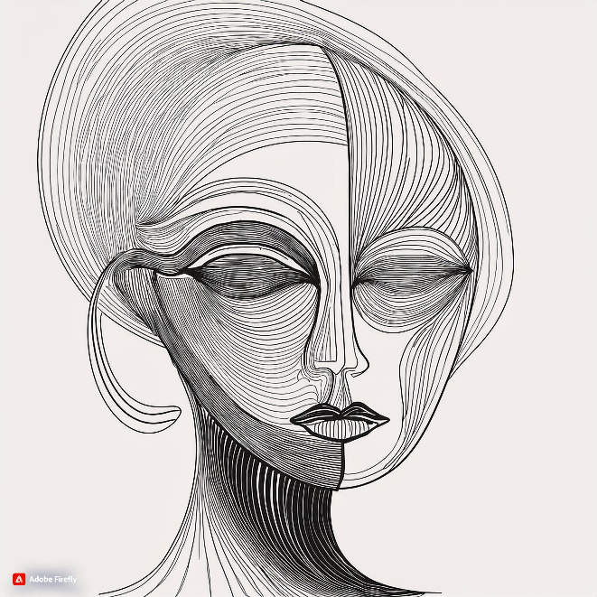
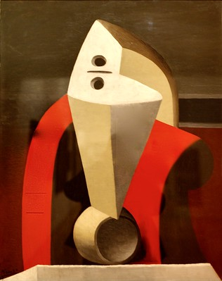
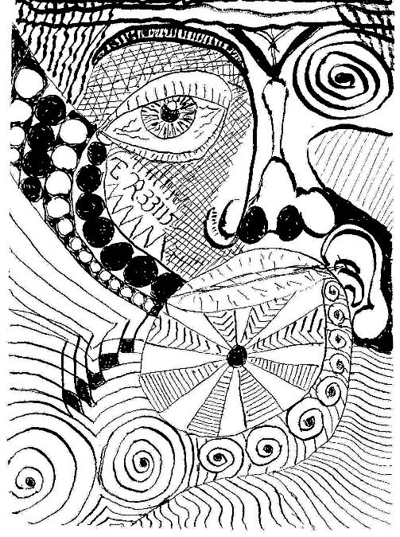
2.2b – exploring abstraction visually (1)
Instructions – sort the face images on slides 23 to 25 from most realistic to most abstract
Image generated using Adobe Firefly and used in accordance with Generative AI User Guidelines.
‘Femme dans un fauteuil (Métamorphose) (1929) - Pablo
Picasso (1881 - 1973)’ by Pedro Ribeiro Simões is licensed
under CC BY 2.0.
‘Zenface’ by Eric.Ray is licensed under CC BY 2.0.

Slide 18
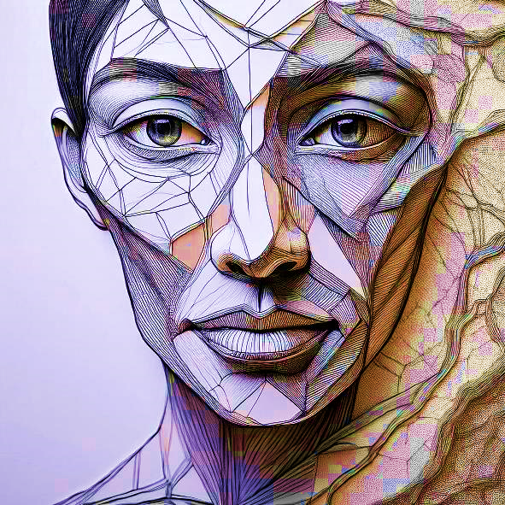
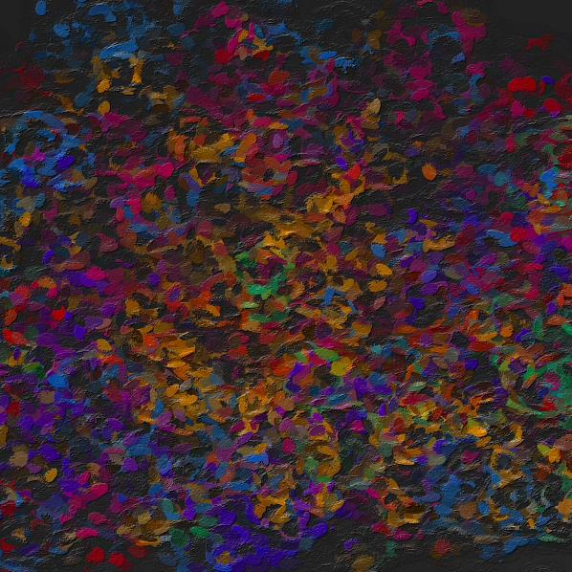
2.2b – exploring abstraction visually (2)
Instructions – sort the face images on slides 23 to 25 from most realistic to most abstract
Image generated using Adobe Firefly and used in accordance with Generative AI User Guidelines.
'Dab dab dab’ by readerwalker is licensed under CC BY-NC-SA 2.0.
'Fine art/Fashion' by NinderryStudios is licensed under CC BY-SA 2.0.

Slide 19
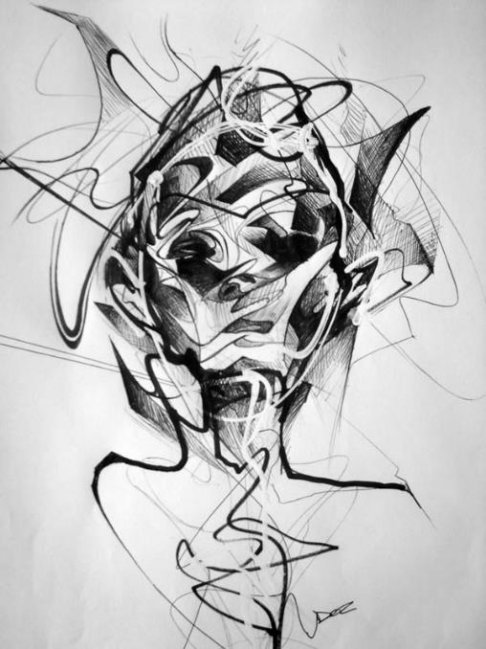
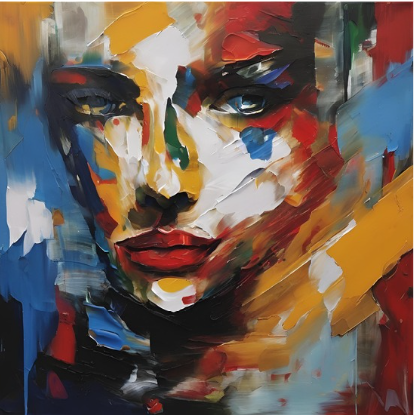
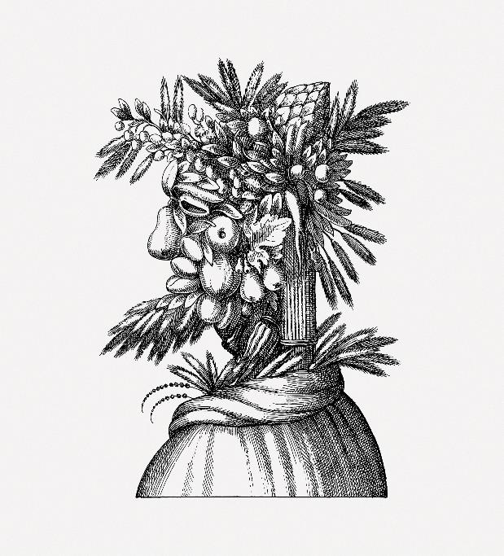
2.2b – exploring abstraction visually (3)
Instructions – sort the face images on slides 23 to 25 from most realistic to most abstract
'Abstract Face Sketch’ by Danny O’Connor is licensed under CC BY-NC-SA 2.0.
Image generated using Canva and used in accordance with the Acceptable Use Policy.
'Giuseppe Arcimboldo fruit face art' is licensed under CC0 1.0.

Slide 20
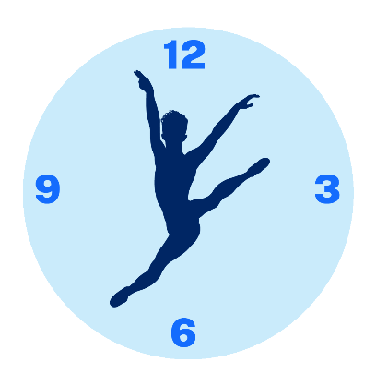
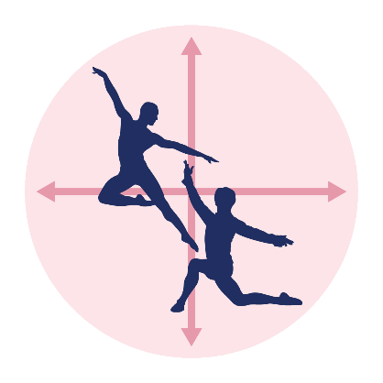
2.2c – exploring abstraction through movement
Tempo
Select an everyday movement action:
Brushing your teeth
Checking the time on your watch
Trying to fall asleep
Putting on shoes
Stillness
Duration
Dimension
Direction
Level
Time
Space

Slide 21
2.2d – reflection – 3-2-1 things I learned today
List 3 things you learned today about abstraction:
3
1.
2.
3.
List 2 questions you have about abstraction:
2
1.
2.
Give one reason why it’s important to learn about abstraction in composition:
1
1.

Slide 22
2.3a – exploring space through visual stimulus
Consider the following in the image:
shapes
lines
colours
emotions
textures
ideas
what is the figure looking at?
where is the figure going?
In small groups, brainstorm ideas in response to the visual stimulus.
Select an idea and create 3 shapes in response using shape, level, direction and/or dimension.
Move and connect your 3 shapes considering pathway and the floor pattern to communicate your idea.
Image generated using Canva and used in accordance with the Acceptable Use Policy.
Notes:
Notes for teachers:

Slide 23
2.3b – exploring space through visual stimulus
Consider the following in the image:
shapes
lines
colours
emotions
textures
ideas
what could the figure be feeling?
what could the figure be thinking?
In small groups, brainstorm ideas in response to the visual stimulus.
Select an idea and create 3 shapes in response using shape, level, direction and/or dimension.
Move and connect your 3 shapes considering pathway and the floor pattern to communicate your idea.
Image generated using Canva and used in accordance with the Acceptable Use Policy.
Notes:
Notes for teachers:

Slide 24
2.3c – exploring space through visual stimulus
Consider the following in the image:
shapes
lines
colours
emotions
textures
ideas
how many faces can you see?
why are the faces painted in this way?
In small groups, brainstorm ideas in response to the visual stimulus.
Select an idea and create 3 shapes in response using shape, level, direction and/or dimension.
Move and connect your 3 shapes considering pathway and the floor pattern to communicate your idea.
Image generated using Canva and used in accordance with the Acceptable Use Policy.
Notes:
Notes for teachers:

Slide 25
2.3d – visual stimulus concept map
Idea #1
Idea #2
Idea #3
Idea #4
Identify the stimulus

Slide 26
2.3e – reflection (1)
Shape 1 is communicating (insert specific idea) by (describe how using the language of space)
Shape 2 is communicating (insert specific idea) by (describe how using the language of space)
Shape 3 is communicating (insert specific idea) by (describe how using the language of space)
Insert sketch/image of shape 1
Insert sketch/image of shape 2
Insert sketch/image of shape 3

Slide 27
2.3e – reflection (2)
Idea(s) from the visual stimuli
The components of space we explored in our phrase were (highlight or circle):
shape, level, direction, dimension, pathways,
floor patterns, stage space
Choose one component you highlighted and describe in one sentence how you used it to communicate the idea.
The components of space we explored in the transitions between our 3 shapes were (highlight or circle):
shape, level, direction, dimension, pathways,
floor patterns, stage space
Choose one component you highlighted and describe in one sentence how you used it to communicate the idea.

Slide 28
2.4a – exploring time and dynamics through auditory stimuli (1)
Soundscapes
‘Fireplace with crackling sounds’ by RonKoster2023 (1:59)
‘Electronic Whale Synth’ by Prettysleepy (1:00)
‘Acceleration’ by Alban_Gogh (0:35)
‘Old Machine’ by Alban_Gosh (1:00)
‘Funk’ by NRA-LAB (1:41)
‘tension’ by gradient 12345678 (2:30)
Notes:
Notes for teachers:
* Sample soundscapes and music that can be used or adapted

Slide 29
2.4b – exploring time and dynamics through auditory stimuli (2)
Music
‘Jazzy Frenchy’ by Benjamin Tissot (1:44)
‘The Duel’ by Benjamin Tissot (1:58)
‘Hope’ by Hugo Dujarin (1:53)
‘Against all Odds’ by Nick Petrov (2:37)
‘Struol’ by BesteMu-NoCopyrightMu (1:15)
‘Holiday Paradise’ by FASSouds (2:15)
Notes:
Notes for teachers:
* Sample soundscapes and music that can be used or adapted

Slide 30
2.4c – reflection
Describe an example of how you used tempo and accents in your phrase of movement.
1. Tempo
2. Accents
Identify 2 dynamic qualities you explored.
1.
2.
List 3 things you have learned using an auditory stimulus in composition.
1.
2.
3.

Slide 31
2.5a – exploring the elements of dance through ideational stimulus
Our idea to explore from the ideational stimulus of the Greek myth of Icarus is:
Space
Dynamics
Time

Slide 32
2.5b – 3-2-1 things I learned this week
List 3 things you learned this week about composition.
3
1.
2.
3.
List 2 questions you have about composition.
2
1.
2.
Give one reason why it’s important to learn about composition in dance.
1
1.

Slide 33
Learning sequence 3 – from idea to intent

Slide 34
Learning intentions and success criteria (3)
We are learning to
consider achievable ideas for dance composition
understand that ideas can be derived from stimulus
collaborate to generate ideas and movement for dance composition.
I can
identify an achievable idea for a dance composition
explore stimuli to select appropriate ideas and movement for a dance composition
collaborate to develop a clear statement of intent for a dance composition.
Notes:
Notes for teachers:
Learning intentions and success are best co-constructed with students. Adapt the learning intention as required and add matching success criteria.
For more information See ⁠AITSL or the NSW Department of Education explicit teaching strategies, ⁠Sharing learning intentions and ⁠Sharing success criteria
LISC is not necessarily presented at the beginning of the lesson. Teacher needs to consider most effectual time to introduce
LISC should be revisited during the lesson to support students' evaluation of their learning

Slide 35
3.1 – dance to communicate meaning
Use of theatrical elements (music, costume and/or lighting)
Use of space
What is the dance about?
Use of time
Use of dynamics

Slide 36
3.3a – What moves you? assessment task
Part A – composition
This group task is an opportunity for you to collaborate and devise new movement using more than one dancer. Your teacher will provide you with stimulus material(s) and a selection of music for your group to choose from. Your composition must:
be between 1 minute and 1 minute, 30 seconds in length
have a clear intent that has been developed from the stimulus
use the elements of dance to generate phrases of movement in a personal style
develop and manipulate motif(s) to create phrases of movement
structure phrases to support the communication of the intent.
Note – you will be marked individually on the group composition.

Slide 37
3.3b – What moves you? assessment task
Part B – process diary
The process diary is your opportunity to individually document and reflect on your process of creating the group composition. Your teacher will guide you to select the best format for your process diary. You will complete reflective responses about how your group:
explored stimuli to generate your ideas, intent and movement
used the elements of dance to develop motif(s)
manipulated your motif(s) using the elements of dance to create and structure phrases of movement
used creative problem-solving to overcome challenges.

Slide 38
3.3c – What moves you? assessment task
Part B – process diary submission options
Your process diary could be submitted in the following ways:
in your dance workbook – identify the pages and activities relevant to the process diary task
in digital format – such as a google doc that may include photos and images or blog
verbal discussion – share and discuss your reflective responses from throughout the process. Your teacher may ask questions to clarify your responses.

Slide 39
3.3d – steps to success
What moves you? – assessment task
What I need to do | Ways I can do this
Prepare for, participate and contribute to composition lessons | Come to class prepared to create movement, including bringing appropriate dance attire Try my best to participate fully in all lessons Contribute ideas to the class and to my group
Explore and experiment using a range of stimuli to generate ideas and intent | Brainstorm ideas from a range of stimuli Conduct further research and find other stimuli if necessary Make graphic organisers with ideas Select and refine ideas from the graphic organiser into a clear statement of intent for the composition
Create personalised movement using a range of stimuli to communicate ideas and intent | Improvise using a range of stimulus using the elements of dance Use abstraction to explore personalised movement Select and refine movement choices to support the ideas and intent
Develop a relevant motif(s) for the idea and intent | Identify key/signature word(s) from the stimuli to explore for your motif Experiment with the elements of dance to develop motif(s) that support the ideas and intent Select and refine the most relevant components of the elements of dance to generate motif(s) which clearly support the ideas and intent

Slide 40
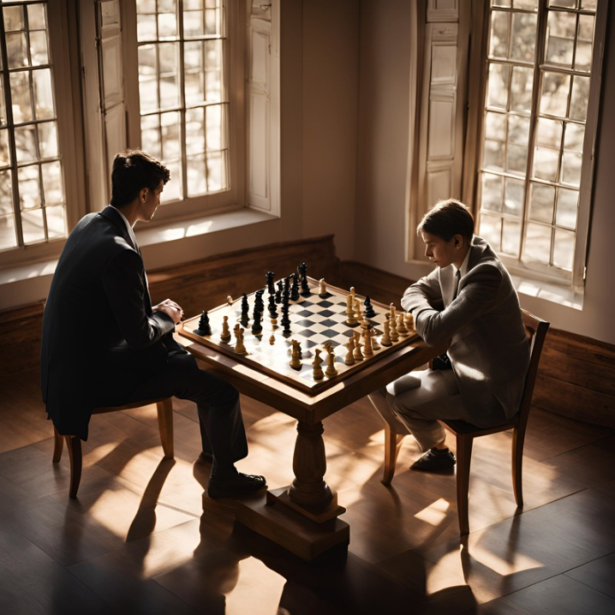
3.4a – stimuli for assessment
Sample 1
Images generated using Canva and used in accordance with the Acceptable Use Policy.

Slide 41
3.4b – stimuli for assessment
Sample 2
Images generated using Canva and used in accordance with the Acceptable Use Policy.

Slide 42
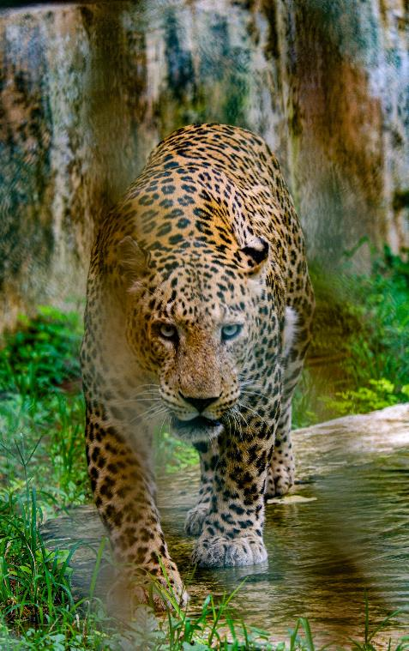
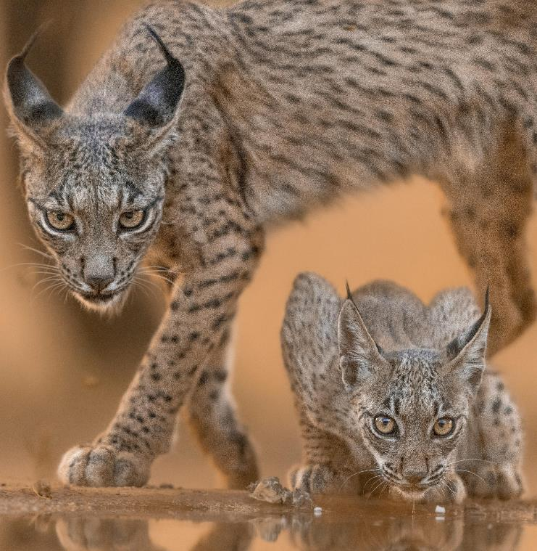
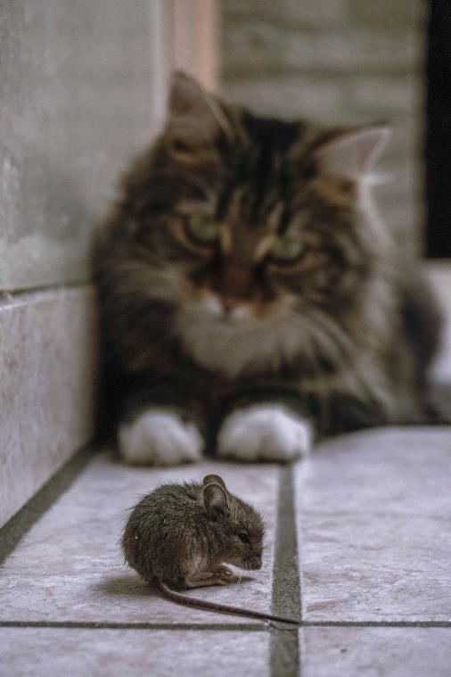
3.4c – stimuli for assessment
Sample 3
'Leopard Walking at the Zoo' by Ekam Juneja is licensed under the under the Pexels License.
'Iberian Lynx and Cub in Spanish Wilderness’ by Bharath Kumar Venkatesh Mihailova is licensed under the Pexels License.
'Shallow Focus Photo of a Rat Stared Down’ by a Cat by Katherine Mihailova is licensed under the Pexels License.

Slide 43
3.5 – movement as research
Parameters for collaborative improvisation using your group stimulus idea
Develop 3 shapes using varying levels and relationships between bodies (for example, close, far, towards, away) to communicate your idea.
Devise a locomotor transition from shape 1 to shape 2.
Devise a slow, purposeful movement for one dancer while the others remain in stillness in shape 2.
Devise locomotor movement to travel from shape 2 to 3, with a different use of tempo.
Decide whether to finish in shape 3 or return to shape 1 in a creative way.
Perform your movement phrase for the teacher or another group for feedback.

Slide 44
3.6a – adding music, moving from ideas to intent
Completing the following:
1
1
Listen
Listen
Individually document your ideas, thoughts and feelings.
2
Evaluate
Individually evaluate how the music may support your intent and record your thoughts.
3
Select
As a group, discuss each of the pieces and make a group decision to select one music track.
4
Brainstorm
As a group, find and plan for opportunities in the music to complement the use of the elements of dance.
5
Improvise and refine
As a group, improvise and refine movement using your music, intent and ideas for use of the elements of dance.

Slide 45
3.6b – adding music, moving from ideas to intent
Music samples to choose from include the following:
‘Evolution’ by Benjamin Tissot (2:45)
‘Fragments of Sunlight’ by Nick Petrov (2:33)
‘Echo of Sadness’ by TURNIQUE (2:19)
‘Adventure’ by Benjamin Tissot (2:59)
‘Slow Life’ by Benjamin Lazzarus (3:57)
‘Event Horizon’ by Lunar Years (2:36)

Slide 46
3.6c – adding music, moving from ideas to intent
Group brainstorm and planning scaffold
The intent of our dance is:
Beginning
Middle
End
Description of the music:
Description of the music:
Description of the music:
Elements of dance we could use:
Elements of dance we could use:
Elements of dance we could use:
Relevance to the intent:
Relevance to the intent:
Relevance to the intent:

Slide 47
3.8a – formative check-in opportunity 1
Proposal of intent
Your group will present a verbal and/or written proposal of your intent and explain how you have used stimuli to generate ideas. Your teacher and peers will provide feedback on the proposed intent including whether it is clear, achievable and/or suggest ways to further explore and refine the idea and intent. Ways to receive feedback and reflect may include combinations of physical, verbal or written responses.

Slide 48
3.8b – guide for your composition proposal
Outline of the intent:
For example, to demonstrate the physical impact of the changing of seasons on an oak tree.
Ways you can add to your proposal:
show and discuss your original brainstorm from first accessing the stimulus
demonstrate shapes or movement phrases you have developed during your movement as research phase
explain how space, time and dynamics could be used and manipulated across more than one body to communicate your intent
play selected music and discuss the relationship between the idea and the music.

Slide 49
Learning sequence 4 – structuring motifs and phrases

Slide 50
Learning intentions and success criteria (4)
We are learning to
know about compositional structure including motif and phrase
understand how compositional structures can support the communication of ideas and intent
manipulate the elements of dance to generate motif(s) and phrases.
I can
identify compositional structures including motif(s) and phrases
experiment with compositional structures to communicate an intent in a group composition
develop and refine the use of the elements of dance, motif(s) and phrase to communicate intent in a group composition.
Notes:
Notes for teachers:
Learning intentions and success are best co-constructed with students. Adapt the learning intention as required and add matching success criteria.
For more information See ⁠AITSL or the NSW Department of Education explicit teaching strategies, ⁠Sharing learning intentions and ⁠Sharing success criteria
LISC is not necessarily presented at the beginning of the lesson. Teacher needs to consider most effectual time to introduce
LISC should be revisited during the lesson to support students' evaluation of their learning

Slide 51
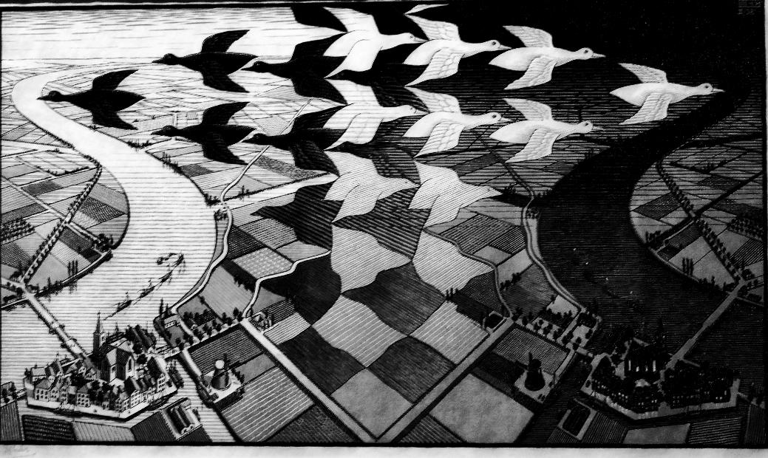
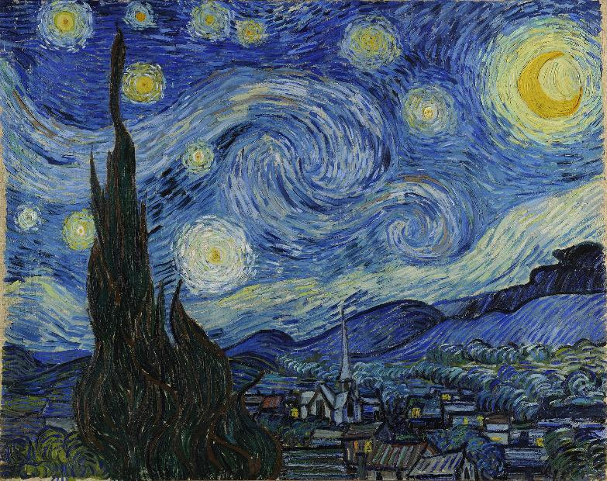
4.1b – What is a motif?
Visual art examples
'Day and night (1938) - Maurits Cornelis Escher (1898 - 1972)' by Pedro Ribeiro Simões is licensed under CC BY 2.0.
'The Starry Night’ by Vincent van Gogh (1853–1890) on Wikimedia is available in the Public Domain.

Slide 52
4.1c – What is a motif?
Music examples
Beethoven, Symphony 5, 1st movement (7:37)
14 Motifs, Themes, and Analysis of Time Inception Theme song (9:34)

Slide 53
4.1d – What is a motif?
Dance examples
Access one or more video samples of motif in a dance work and discuss the following questions:
What movement(s) or components of the elements of dance do you see repeated throughout?
Can you identify the motif(s)? How would you describe it?
What do you think this motif(s) means? Why?
How have you seen the motif(s) being manipulated in different ways? Consider the elements of dance.
Falling Angels choreographed by Jiří Kylián (15:31)
MOTH Bangarra Dance Theatre Education Resource (4:45)
[EXTRAIT] IN YOUR ROOMS by Hofesh Shechter (3:03)

Slide 54
4.3 – What is a phrase?
NESA defines phrase as ‘the fundamental unit of structure in dance. It consists of a series of movements linked by thematic intent which has a beginning, middle and end.’
(NESA 2023)
A phrase is like a sentence.
A phrase makes a clear statement about something and has a beginning, middle and end.
Sentences vary in length depending on what is required to be communicated to the reader. So do phrases in a dance work.

Slide 55
4.5 – formative check-in opportunity 2
Evaluate motifs in progress
Your group will review video footage of a phrase of movement from your composition. Individually, you will evaluate and reflect on the motif(s) developed and the clarity of the intent in relation to choices in either space, or time/dynamics using the prompt 'How has (select space or time/dynamics) been manipulated to communicate the intent?'. For example, the exploration of motif through stage space, direction, level and floor pattern.
You will document the feedback in your process diary and present your feedback to the group.
As a group, you will experiment applying the feedback to further refine the phrase.

Slide 56
4.6 – piecing it all together
Experiment with the order of your phrases using the timeline below.
Start
End

Slide 57
4.7 – formative check-in opportunity 3
Demonstrate phrases for feedback
Your group will demonstrate 2 phrases of movement to another group for feedback. One phrase should be selected from the beginning and the other from the end of the composition.
The group verbally explains the choices of the elements of dance to manipulate motif(s) and phrases to communicate the intent.
Peer feedback should reflect on strengths and opportunities to communicate the intent through the elements of dance, motif(s) and phrases.

Slide 58
4.8a – presenting your composition
Prompts for written or verbal explanation
The stimulus for our dance composition was….
The intent of our dance is….
We have ‘x’ motif(s) (these could be demonstrated one at a time with a description of how and why the elements of dance have been used)
Components of space that are important to communicating our intent include…
Components of time that are important to communicating our intent include….
The use of dynamics that are important to communicating our intent include…

Slide 59
4.8b – reflection
Using an example from your composition, explain how space can be used to communicate ideas and intent.
Using an example from your composition, explain how time and dynamics can be used to communicate ideas and intent.
Using an example from your composition, explain how a motif can be manipulated to develop a phrase of movement.
In your composition group, consider these 3 prompts when watching a digital recording of your dance composition.
Your group can present your responses to the class in written, verbal or multimodal formats.

Slide 60
Glossary (1)
Term | Definition
Abstraction | The process of generating movement that is symbolic, or changing movement from being representational to symbolic.
Dynamics | The release of energy, weight and/or force over a period of time to create movement qualities.
Generating movement | A process that begins with stimulus, idea and intent, and is developed through improvisation, abstraction, selection and refinement.
Intent | The purpose or message a choreographer or performer aims to communicate.
Improvise | Generate spontaneous movement in response to a stimulus.
Misappropriation | The act of stealing something that you have been trusted to take care of and using it for yourself.
Motif | A thematic device. A distinctive, recognisable movement or pattern of movements that introduces and develops the idea and intent in a dance phrase and work.

Slide 61
Glossary (2)
Term | Definition
Personalised movement vocabulary | Individualised movements created in response to a stimulus or task that are free from misappropriation and communicate the intent.
Phrase | The fundamental unit of structure in dance. It consists of a series of movements linked by thematic intent which has a beginning, middle and end.
Plagiarism | The process or practice of using another person's ideas or work and pretending that it is your own.
Sequence | A series of kinaesthetically linked dance movements not necessarily based on a compositional idea and intent.
Space | The components of space including shape, level, direction, dimension, pathways, floor patterns and stage space.
Stimulus | The starting point for ideas and/or generating movement.
Structure | Part of the forming process in composition and choreography. There are 2 main parts; organising the movement; and organising the dance.

Slide 62
Glossary (3)
Term | Definition
The elements of dance | Space, time and dynamics.
Time | The components of time including metre, rhythm, accent, tempo, duration and stillness.

Slide 63
Glossary (4)
The elements of dance – definitions and examples
The Elements of dance – definitions and examples resource can be used to support this unit.

Slide 64
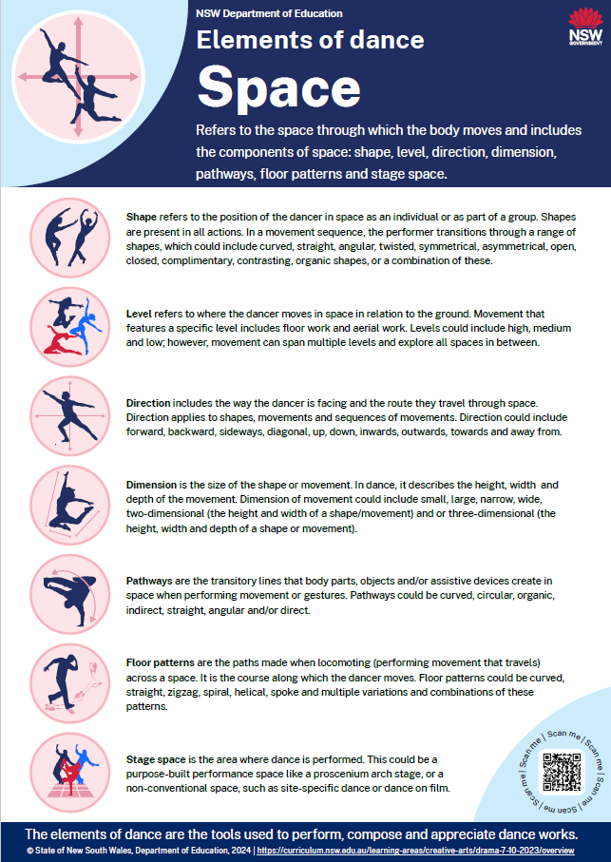
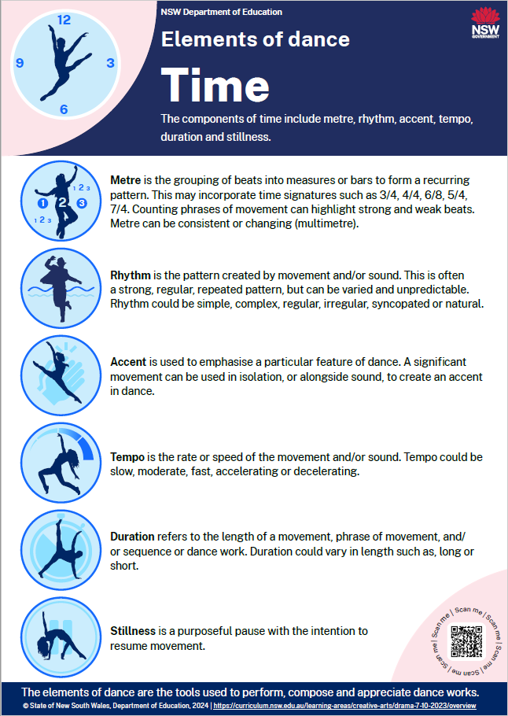
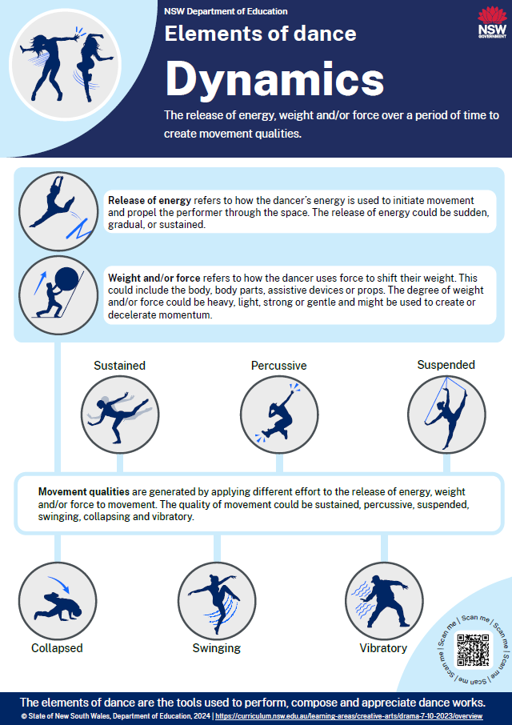
Glossary (5)
The elements of dance – posters

Slide 65
References (1)
This presentation contains NSW Curriculum and syllabus content. The NSW Curriculum is developed by the NSW Education Standards Authority. This content is prepared by NESA for and on behalf of the Crown in the right of the State of New South Wales. The material is protected by Crown copyright.
Please refer to the NESA Copyright Disclaimer for more information https://educationstandards.nsw.edu.au/wps/portal/nesa/mini-footer/copyright.
NESA holds the only official and up-to-date versions of the NSW Curriculum and syllabus documents. Please visit the NSW Education Standards Authority (NESA) website https://educationstandards.nsw.edu.au/wps/portal/nesa/home and the NSW Curriculum website https://curriculum.nsw.edu.au.
Dance 7–10 (2023) © Syllabus NSW Education Standards Authority (NESA) for and on behalf of the Crown in right of the State of New South Wales, 2023.
Bangarra Dance Theatre (27 August 2013) 'MOTH Bangarra Dance Theatre Education Resource' [video], Bangarra Dance Theatre, YouTube, accessed 25 October 2024.
BesteMu-NoCopyrightMu (2022) 'Struol’ [sound effect], BesteMu-NoCopyrightMu, Pixabay.
Blom L and Chaplin L (1982) The Intimate Act of Choreography, University of Pittsburgh Press, Pittsburgh, PA.
Cambridge University Press & Assessment 2024 plagiarism, Cambridge Advanced Learner's Dictionary & Thesaurus website, accessed 25 October 2024.
Cambridge University Press & Assessment 2024, misappropriation, Cambridge Advanced Learner's Dictionary & Thesaurus website, accessed 25 October 2024.
Dujarin H (n.d.) 'Hope' [soundtrack], Hugo Dujardin, Bensound.
FASSouds (2024) 'Holiday Paradise – Fun Tropical Beach Music’ [sound effect], FASSouds, Pixabay.

Slide 66
References (2)
Gogh A (2024) 'Acceleration’ [sound effect], Alban_Gogh, Pixabay.
Gogh A (2024) ‘Old Machine’ [sound effect], Alban_Gogh, Pixabay.
Gradient 12345678 (2023) 'Tension’ [sound effect], Gradient 12345678, Pixabay.
Kumar G (15 August 2018) 14 Motifs, Themes, and Analysis of Time Inception Theme song, ganesh kumar, YouTube, accessed 24 October 2024.
Kylián J (1996) 'Falling Angels' [video], Numeridanse, accessed 25 October 2024.
Lazzarus B (n.d.) 'Slow life’ [soundtrack], Lazzarus B, BenSound.
NESA (NSW Education Standards Authority) (2023) ‘Dance 7–10 Syllabus: Glossary’, Resources, NESA website, accessed 24 October 2024.
NRA-LAB (2024) 'Funk’ [sound effect], NRA-LAB, Pixabay.
Opéra national de Paris (25 March 2022), '[EXTRAIT] IN YOUR ROOMS by Hofesh Shechter' [video], Hofesh Shechter, YouTube, accessed 25 October 2024.
Petrov N (n.d.) 'Against All Odds’ [soundtrack], Nick Petrov, Bensound.
Petrov N (n.d.) 'Fragments Of Sunlight' [soundtrack], Nick Petrov, Bensound.

Slide 67
References (3)
Prettysleepy (2021) 'Electronic Whale Synth by Prettysleepy’ [sound effect], Prettysleepy, Pixabay.
RonKoster2023 (2023) 'Fireplace with crackling sounds’ [sound effect], RonKoster2023, Pixabay.
smalin (15 July 2009) 'Beethoven, Symphony 5, 1st movement' [video], smalin, YouTube, accessed 24 October 2024. Tissot B (n.d.) 'Adventure’ [soundtrack], Benjamin Tissot, Bensound. Tissot B (n.d.) 'Evolution’ [soundtrack], Benjamin Tissot, Bensound.
Tissot B (n.d.) 'Jazzy Frenchy' [soundtrack], Benjamin Tissot, Bensound.
Tissot B (n.d.) 'The Duel' [soundtrack], Benjamin Tissot, Bensound. TURNIQUE (n.d.) Echo of 'Echo of Sadness’ [soundtrack], TURNIQUE, Bensound.

Slide 68
Copyright
© State of New South Wales (Department of Education), 2024
The copyright material published in this resource is subject to the Copyright Act 1968 (Cth) and is owned by the NSW Department of Education or, where indicated, by a party other than the NSW Department of Education (third-party material).
Copyright material available in this resource and owned by the NSW Department of Education is licensed under a Creative Commons Attribution 4.0 International (CC BY 4.0) license.
This license allows you to share and adapt the material for any purpose, even commercially.
Attribution should be given to © State of New South Wales (Department of Education), 2024.
Material in this resource not available under a Creative Commons license:
the NSW Department of Education logo, other logos and trademark-protected material
Material owned by a third party that has been reproduced with permission. You will need to obtain permission from the third party to reuse its material.
Links to third-party material and websites
Please note that the provided (reading/viewing material/list/links/texts) are a suggestion only and implies no endorsement, by the New South Wales Department of Education, of any author, publisher, or book title. School principals and teachers are best placed to assess the suitability of resources that would complement the curriculum and reflect the needs and interests of their students.
If you use the links provided in this document to access a third-party’s website, you acknowledge that the terms of use, including licence terms set out on the third-party’s website apply to the use which may be made of the materials on that third-party website or where permitted by the Copyright Act 1968 (Cth). The department accepts no responsibility for content on third-party websites.

