Slide 1
Instructions for use
This resource is not a teaching and learning program. It should be used in conjunction with the Music Stage 4 sample unit ‘Sound lab’, found on the Planning, programming and assessing music 7–10 (2024) webpage.
Classroom teachers are encouraged to add and adapt slides as required to meet the needs of their students.
Save a copy of the file to make changes to the slide deck. Go to File > Download a Copy (this downloads a copy to the computer to edit in the PowerPoint app).
To convert the PowerPoint to Google Slides:
  Upload the file into Google Drive and open it.
  Go to File > Save as Google Slides.
  (Note: conversion may cause formatting changes in the slides.)

Slide 2

Sound lab
Stage 4 music

Slide 3
Lessons
1
6
Keyboard performance continued
Sound and layers
2
7
Layering with vocals
Electronic layering
3
8
Roles of layers of sound in electronic music
Rehearse and refine
4
9
The symphonic spectrum
Creating music
5
10
Keyboard performance
Composition assessment
Notes:
Teacher notes:
Click lesson numbers to go to specific lessons.
Interactive features can be viewed in slide show.

Slide 4
Learning sequence 1 – sound and layers

Slide 5
Learning intentions and success criteria – learning sequence 1
We are learning to:
know and define how layers of sound create texture in music
understand and identify different textures in music through critical listening
create different texture types through performing, composing and notating.
We can:
explain and define how layers of sound create texture in music
identify different texture types in music through listening
apply and demonstrate different texture types through performing, composing and notating.
Notes:
Notes for teachers:
Learning intentions and success criteria are best co-constructed with students. Adapt the learning intention as required and add matching success criteria.
For more information see ⁠AITSL or the NSW Department of Education explicit teaching strategies, ⁠Sharing learning intentions and ⁠Sharing success criteria.
LISC is not necessarily presented at the beginning of the lesson. Teacher needs to consider most effectual time to introduce.
LISC should be revisited during the lesson to support students' evaluation of their learning.

Slide 6
Activity 1.1 – What is sound? What is music?
In pairs or small groups, complete a Venn diagram to define: What is sound? What is music? Discuss the answers as a class.
Sound
Music
Features similar to both sound and music
Features of sound
Features of music

Slide 7
Activity 1.2 – classroom soundscape
Listening
In silence, listen to the sounds of the classroom for approximately 30 seconds. As you listen, consider the following questions:
What sounds can you hear?
How many layers can you hear?
How loud or soft are they?
Are the sounds continuous or intermittent?
Are the sounds natural or manmade?
Document and create a symbol for each sound. Graphically notate the sound scape of the classroom environment. An example is given on the next slide.

Slide 8
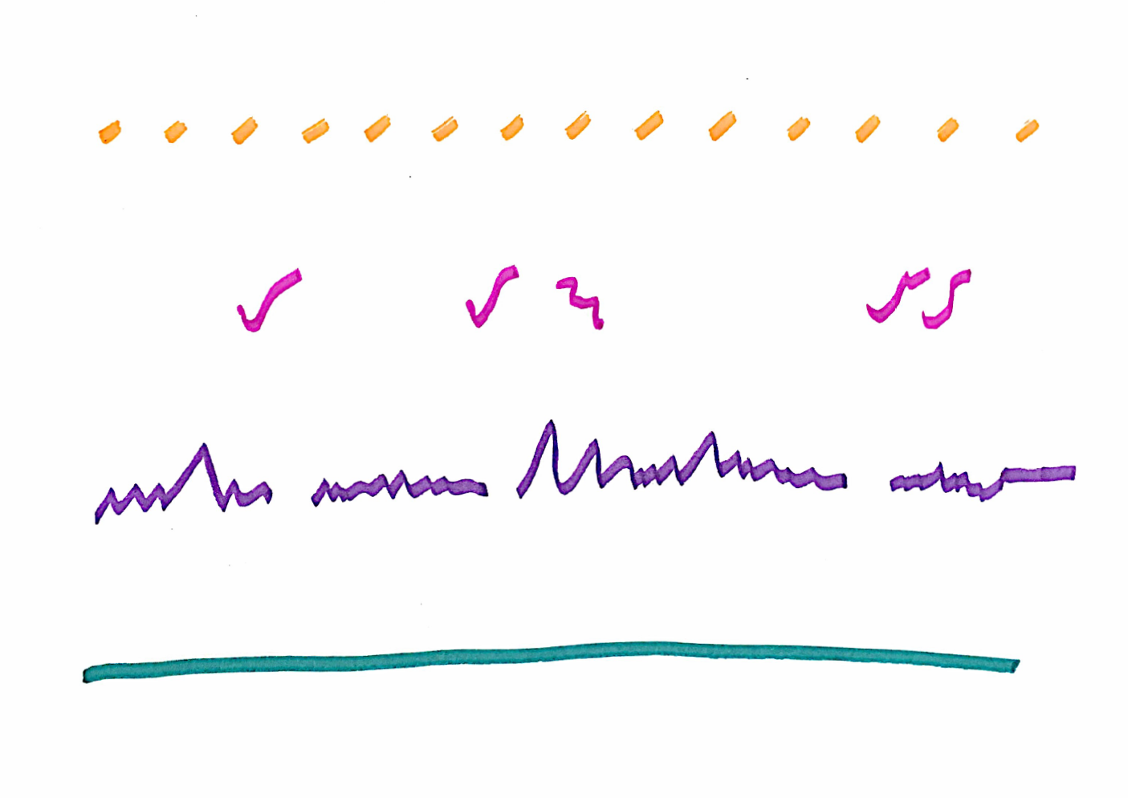




Classroom soundscape
Graphic score example
Key
Sound | Symbol
Fan ticking
Birds outside
Teacher talking down the hall
Classroom chatter down the hall

Slide 9
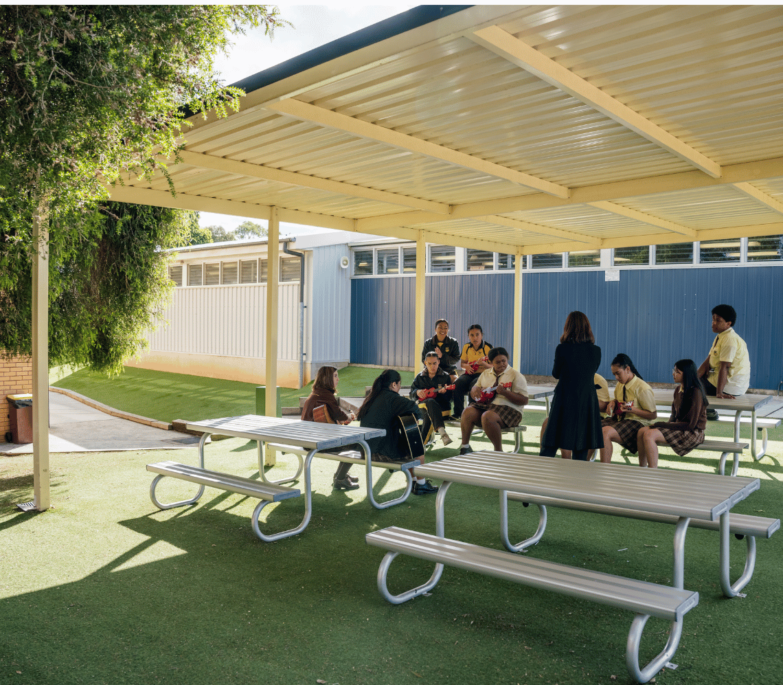
Activity 1.3 – soundwalk (1)
Listening
As a class, go outside into a natural environment and find a place to sit away from your peers. Listen carefully to your surroundings for one minute. Document the sounds you hear. Repeat the process as described in the previous activity, creating a symbol for each sound and notating the sound scape of the natural environment.
Return to the classroom once complete.

Slide 10
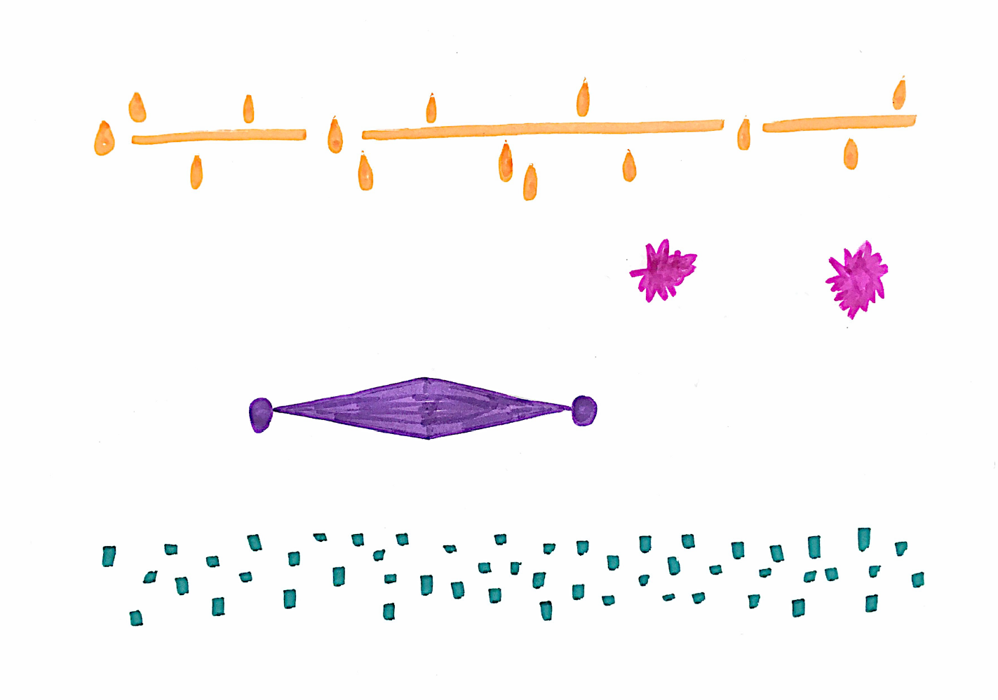



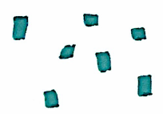
Soundwalk – connecting to Country
Graphic score example
Key
Sound | Symbol
Kookaburra
Drainpipe
Plane rumbling overhead
Rain

Slide 11
Activity 1.3 – soundwalk (2)
Performing
In small groups, use the graphic score you created to reimagine your soundscape as a performance, using classroom objects or instruments. Locate items in the classroom to represent each sound. Interpret, play and arrange each other’s works in your group for the classroom objects or instruments.
Choose one work from your group and rehearse and refine the work to perform for the class.
Reflection questions
How did you choose which instruments would represent the sounds you heard outside?
What material(s) is each instrument made from? For example, wood, metal, plastic, strings.
How did you create the sound on the instrument? For example, hit, scrape, pluck, blow.

Slide 12

Activity 1.4 – layering rhythm and pitch
Composing, listening and performing
Each small group is given an envelope of 4-bar rhythmic and melodic phrases which can be played on an instrument of your choice or allocated by your teacher. Experiment with different combinations of sound by layering them on top of each other, using some or all of the phrases. In music, we refer to the way layers of sound are combined in a piece of music as texture.
Use the following prompts to experiment with organising the phrases:
Can you create a thin texture?
Can you create a thick texture?
Can you create a sequence which changes from a thin to thick texture?
Choose one combination that you have explored to perform to the class.

Slide 13



















Activity 1.5 – rhythm clock 1
$$12$$
$$11$$
$$1$$
Composing, listening and performing
$$10$$
$$2$$
A rhythm clock is a pattern of 12 rhythms arranged in a circle like the hours on a clock. It can be used to perform a piece of music. As a class, perform one of the rhythm clocks in unison on percussion instruments. Split the class into 2 with half of the class performing the rhythms clockwise while the other half plays anti-clockwise simultaneously.
$$9$$
time
$$3$$
$$8$$
$$4$$
$$7$$
$$5$$
$$6$$

Slide 14























Activity 1.5 – rhythm clock 2
$$12$$
$$11$$
$$1$$
Composing, listening and performing
$$10$$
$$2$$
$$9$$
time
$$3$$
$$8$$
$$4$$
$$7$$
$$5$$
$$6$$

Slide 15














Activity 1.5 – rhythm clock 3
$$12$$
$$11$$
$$1$$
Composing, listening and performing
$$10$$
$$2$$
$$9$$
time
$$3$$
$$8$$
$$4$$
$$7$$
$$5$$
$$6$$

Slide 16
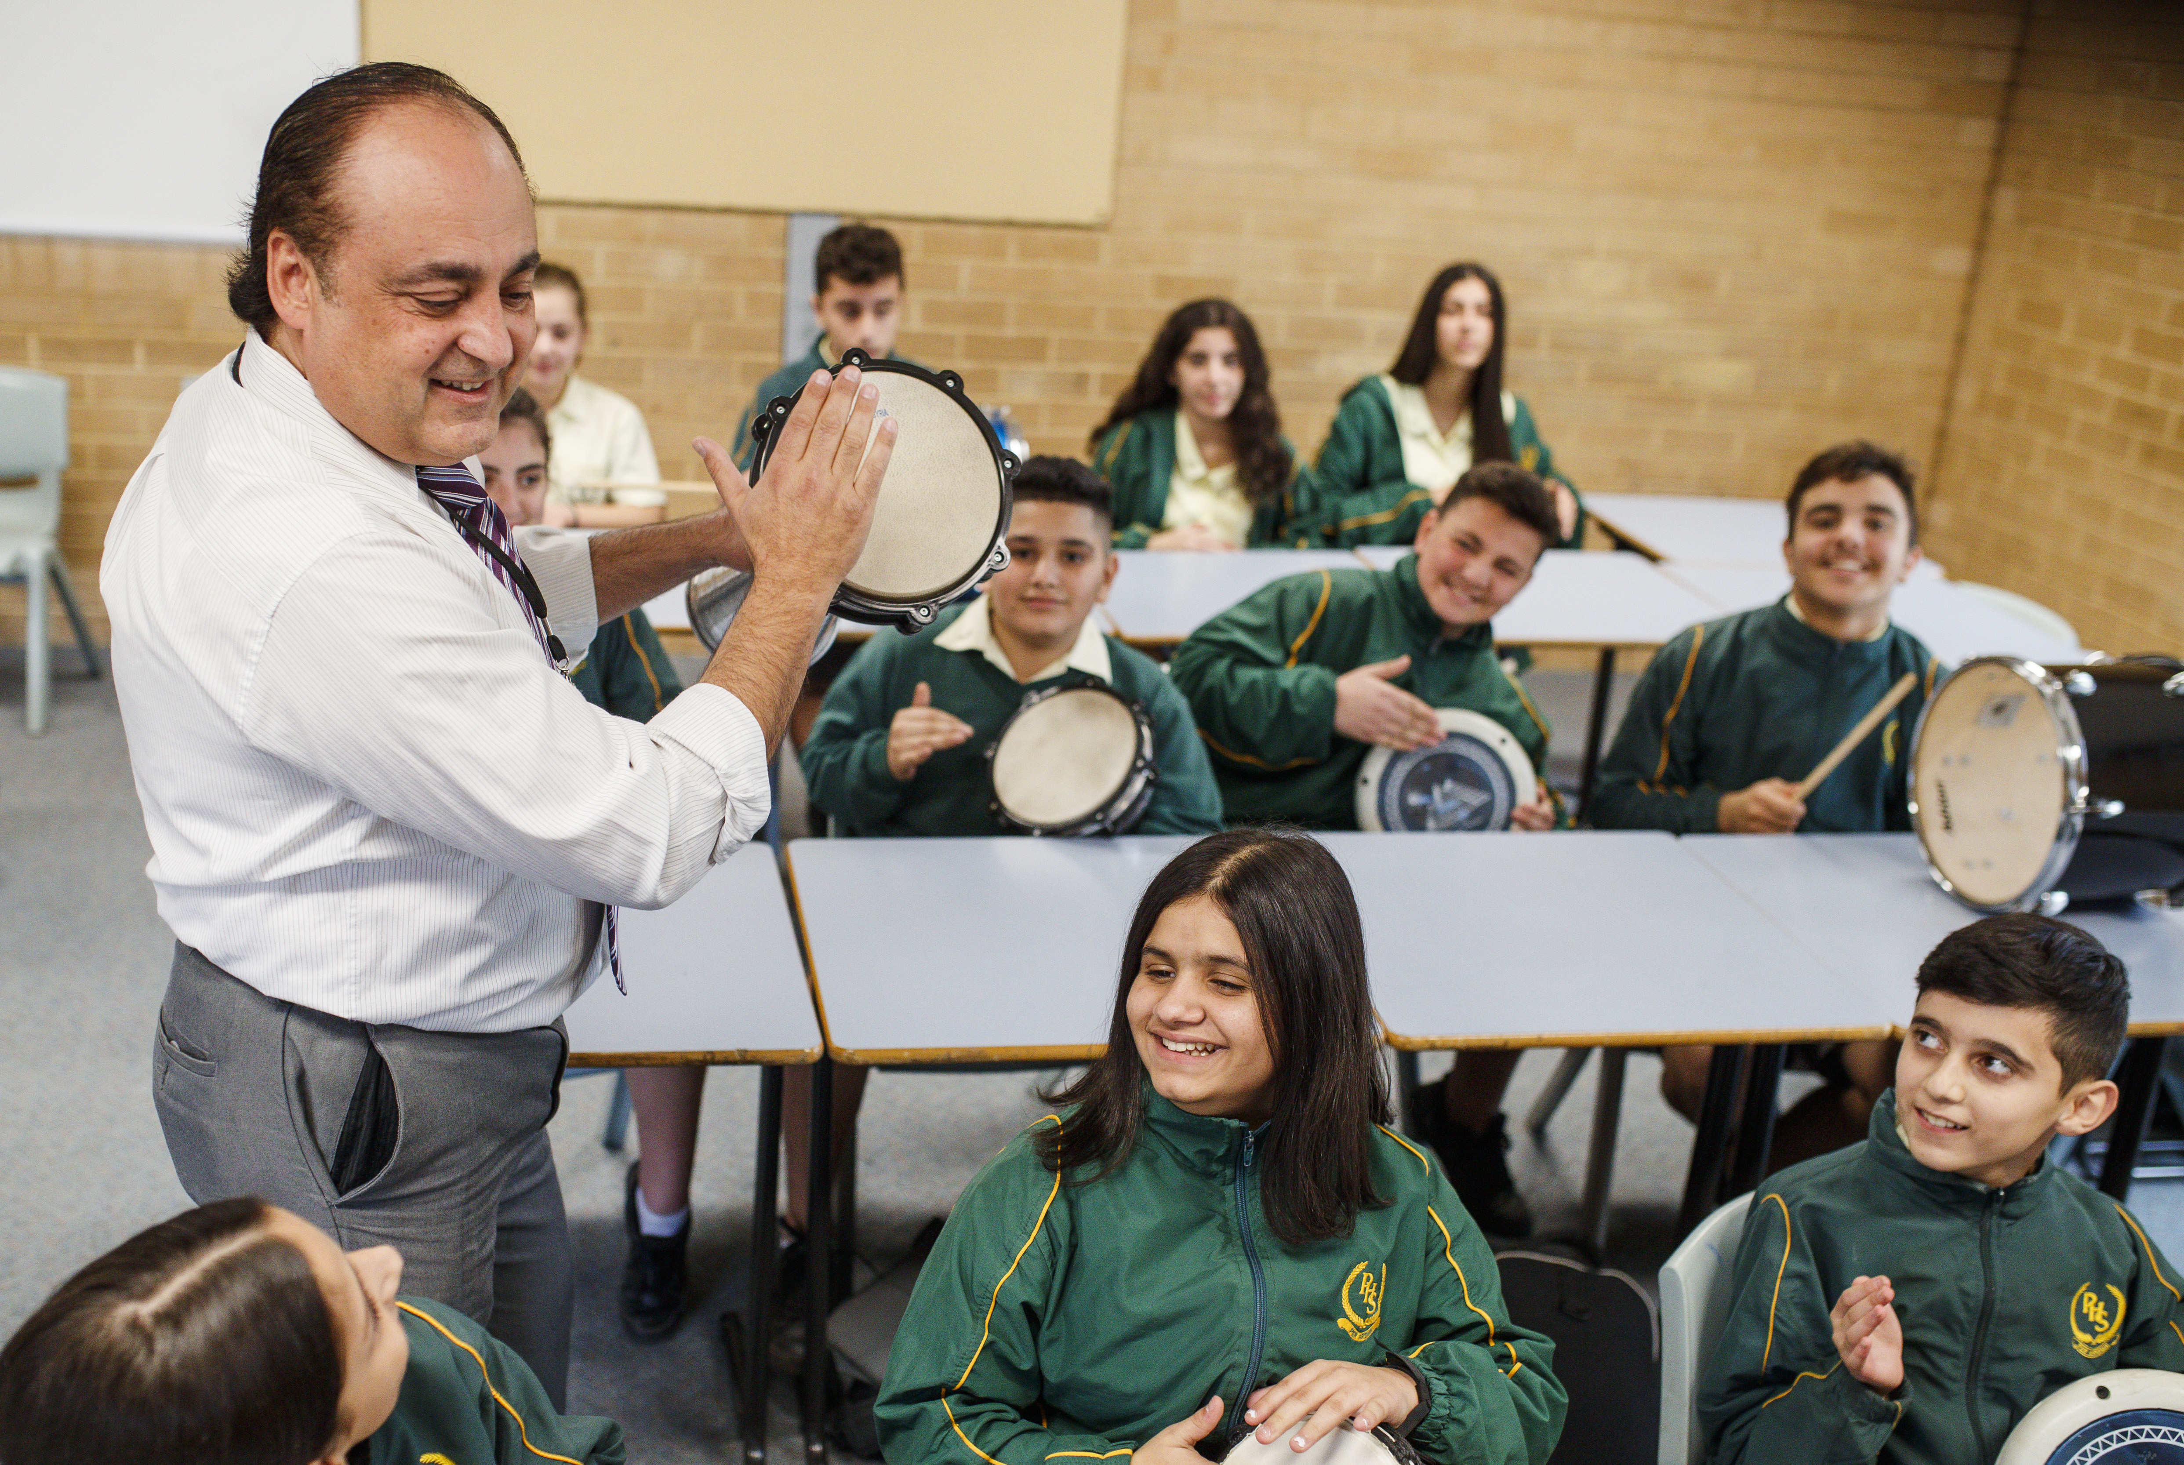
Activity 1.5 – rhythm clocks
Composing, listening and performing
Experiment with layering the parts in different ways by splitting the class into groups. For example, half of the class starts at number one, and the second half of the class begins when the first group reaches the number 3 on the rhythm clock (similar to a round). Experiment with splitting the class up into even smaller groups.
Reflection questions
How did you make the texture thinner?
How did the texture become thicker?
How did the number of layers affect the density of the sound?

Slide 17
Learning sequence 2 – layering with vocals

Slide 18
Learning intentions and success criteria – learning sequence 2
We are learning to:
know the music terminology to describe different types of texture
understand how layers of sound contribute to density
demonstrate layers of sound through singing and notating.
We can:
name and define the types of texture used in music using music terminology
explain how layers of sound contribute to density
perform simple vocal exercises and rounds that demonstrate layers of sound and document these using notation.
Notes:
Notes for teachers:
Learning intentions and success criteria are best co-constructed with students. Adapt the learning intention as required and add matching success criteria.
For more information see ⁠AITSL or the NSW Department of Education explicit teaching strategies, ⁠Sharing learning intentions and ⁠Sharing success criteria.
LISC is not necessarily presented at the beginning of the lesson. Teacher needs to consider most effectual time to introduce.
LISC should be revisited during the lesson to support students' evaluation of their learning.

Slide 19
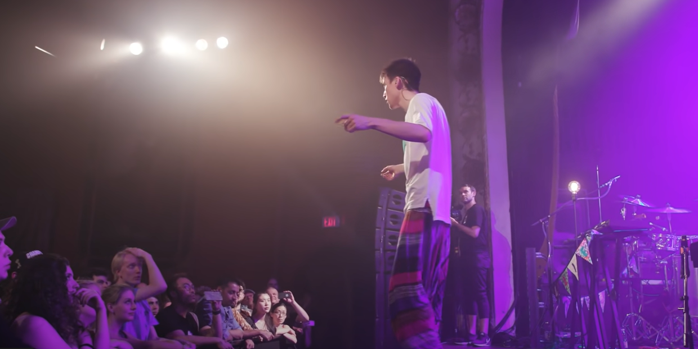

Activity 2.1 – audience choir (1)
Listening
Access the video and consider the following questions:
How many layers of sound can you identify?
Describe the density of the texture. Was it thick or thin and why?
Did the parts ascend (go up) or descend (go down) or both?
Did the parts move in mainly steps or leaps?
Jacob Collier Harmonises The Audience [Toronto] (2:36)

Slide 20
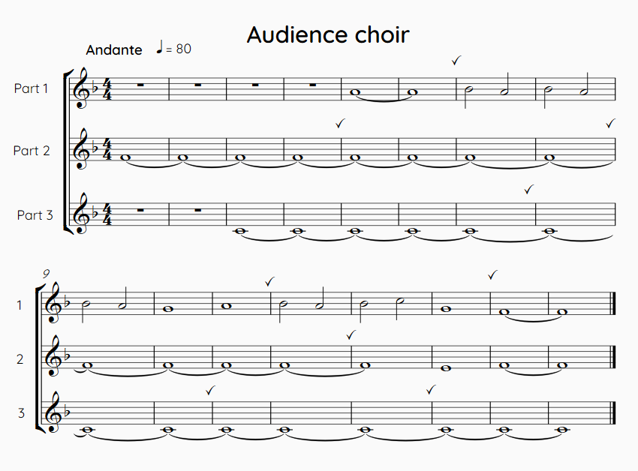
Activity 2.1 – audience choir (2)
Performing
Perform your own ‘audience choir’ as a class by either following along with the video or using the ‘Audience choir’ score provided. (This is not Jacob Collier’s piece, but it is similar.)
Using graphic notation, notate the contour and layering of the upper vocal part for a section of the excerpt.
Extension: notate the pitch of the upper vocal part on the treble clef stave.

Slide 21
Types of texture
Monophonic, homophonic and polyphonic
A round is where multiple voices sing the same melody but begin at different times. When the round begins, only one melody is performed. This is called monophonic texture. As other parts enter, this creates a polyphonic texture. A polyphonic texture is when 2 or more melodies are played at the same time. A homophonic texture is when one melody is performed with pitched accompaniment.
Types of texture
Monophonic: when one melody is played
Homophonic: when a melody is played with harmonic accompaniment
Polyphonic: when 2 or more melodies are played

Slide 22
Learning sequence 3 – rehearse and refine

Slide 23
Learning intentions and success criteria – learning sequence 3
We are learning to:
know about safe vocal practice and technique
rehearse and refine a piece of music using listening and performing skills
use vocal technique to perform a piece of music using layers of sound.
We can:
apply safe vocal practice to demonstrate vocal technique
respond to feedback during the rehearsal process to refine performing and listening skills
sing demonstrating melodic and/or harmonic awareness.
Notes:
Notes for teachers:
Learning intentions and success criteria are best co-constructed with students. Adapt the learning intention as required and add matching success criteria.
For more information see ⁠AITSL or the NSW Department of Education explicit teaching strategies, ⁠Sharing learning intentions and ⁠Sharing success criteria.
LISC is not necessarily presented at the beginning of the lesson. Teacher needs to consider most effectual time to introduce.
LISC should be revisited during the lesson to support students' evaluation of their learning.

Slide 24
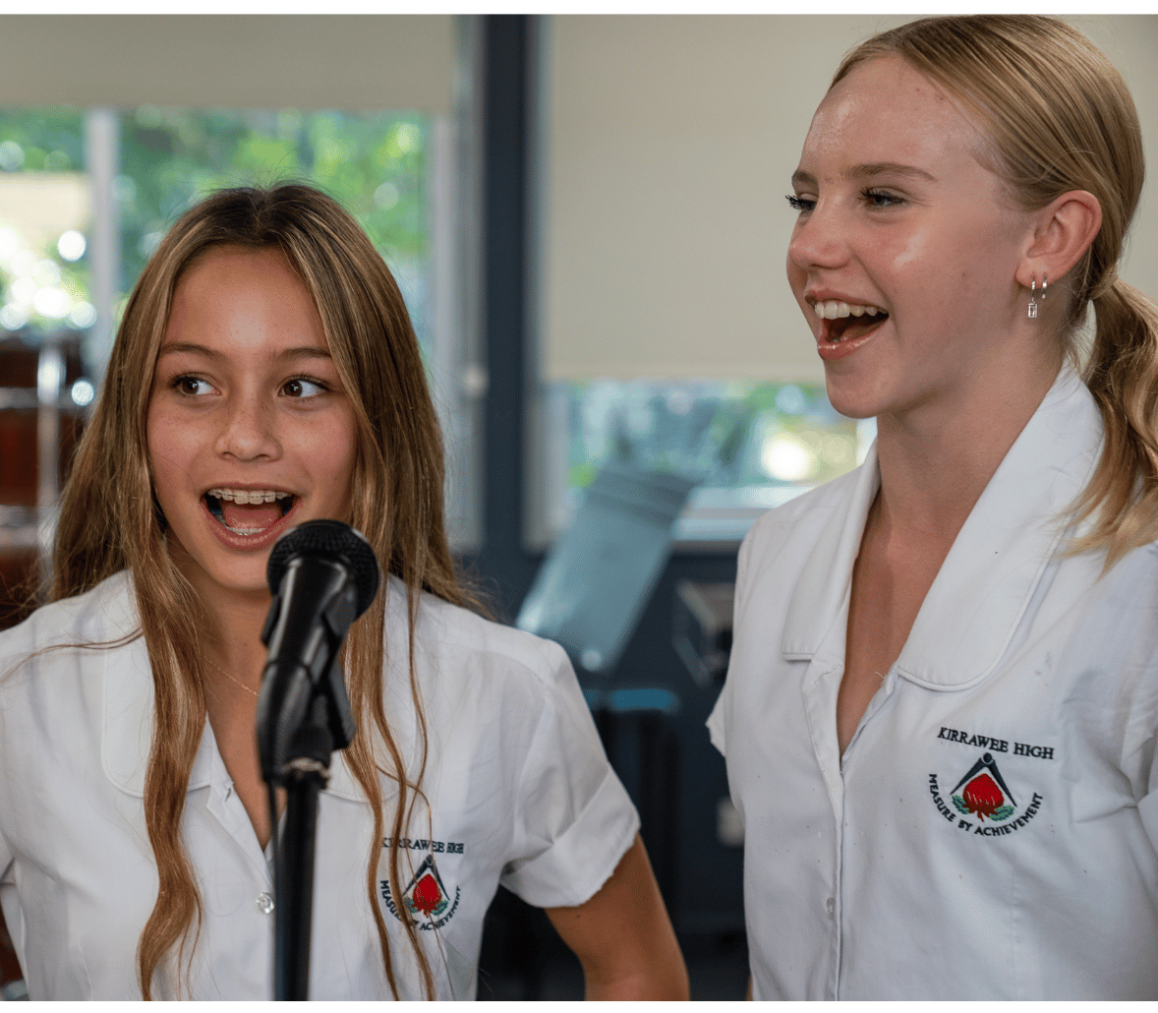
Safe vocal practice
Tips for looking after your voice
Always warm up and cool down
Stay hydrated
Have good posture when singing
Refrain from straining or yelling when singing
Rest your voice when you are sick

Slide 25
Learning sequence 4 – the symphonic spectrum

Slide 26
Learning intentions and success criteria – learning sequence 4
We are learning to:
know about the instruments used in an orchestra
understand how to describe the timbre of an instrument using music terminology
play melodies on the keyboard including those that are self-composed.
We can:
name the instruments of the orchestra and identify which orchestral family they each belong to
describe the timbre of an instrument using music terminology
perform a melody on the keyboard including one that is self-composed.
Notes:
Notes for teachers:
Learning intentions and success criteria are best co-constructed with students. Adapt the learning intention as required and add matching success criteria.
For more information see ⁠AITSL or the NSW Department of Education explicit teaching strategies, ⁠Sharing learning intentions and ⁠Sharing success criteria.
LISC is not necessarily presented at the beginning of the lesson. Teacher needs to consider most effectual time to introduce.
LISC should be revisited during the lesson to support students' evaluation of their learning.

Slide 27
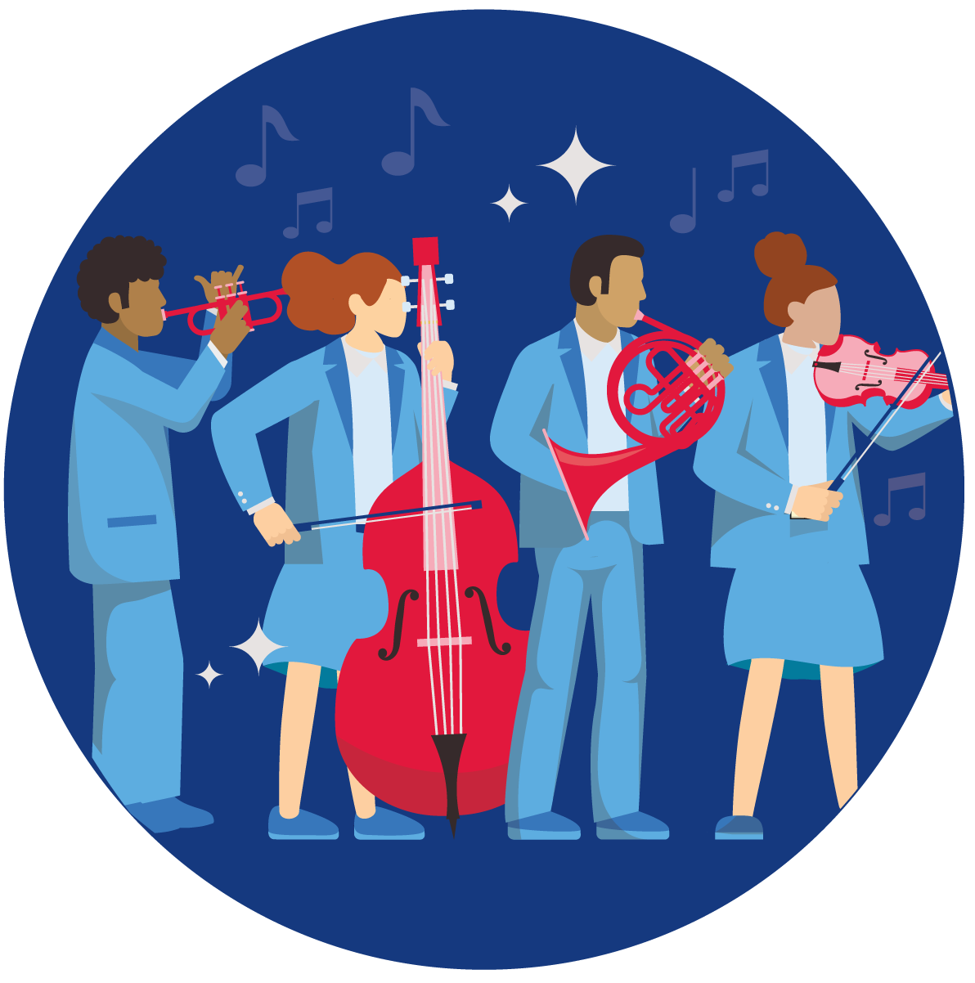
What is timbre?
Timbre refers to the distinctive quality of a sound that enables the sound sources to be identified. Through listening, we can use adjectives to describe the timbre of a sound source.

Slide 28
Activity 4.2 – introduction to keyboard
Safety protocols
It is important that we look after the instruments and keep everyone in the classroom safe during practical lessons. Please remember to:
Handle the keyboards with care. If transporting your keyboard from a storage space, use both hands to carry the instrument back to your table. Stay at your assigned keyboard for the entire class time.
Keep all cords neatly tucked away to avoid trip hazards.
Plug in your headphones but don’t pull on the headphone cords. Tension on the cord may damage the cord or cause the headphone jack input to become loose. This means the sound won’t work properly.
Ensure the volume knob is at either a soft or moderate level before you turn the keyboard on. This is to protect your hearing.
Turn the keyboard on. If it isn’t working, check that the power cord is plugged into the wall and switched on. If it is still not working, alert your teacher to come and help you.
Play the keys gently to avoid damage to the instrument.

Slide 29
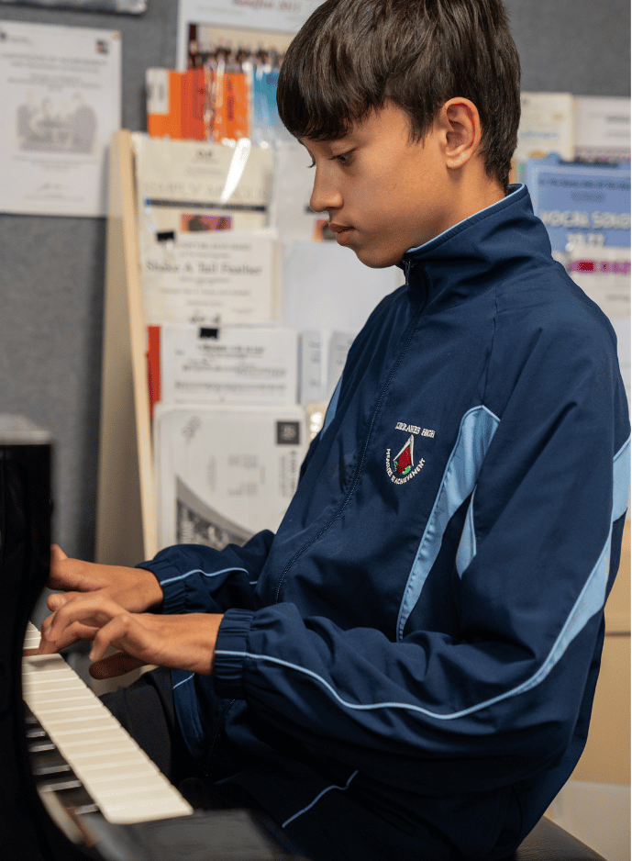
Keyboard technique
Safe instrumental practice
When playing the keyboard, it is important that you use the correct technique to allow your body to play the instrument with ease and avoid strain on your body. It is important to:
sit on a chair or stool with your feet flat on the floor and your body centred in the middle of the keyboard
position your hands softly above the keys like they are resting on a ball
ensure your wrists are not resting on the desk or keyboard
position your fingers over the keys to play the notes and press down gently.

Slide 30
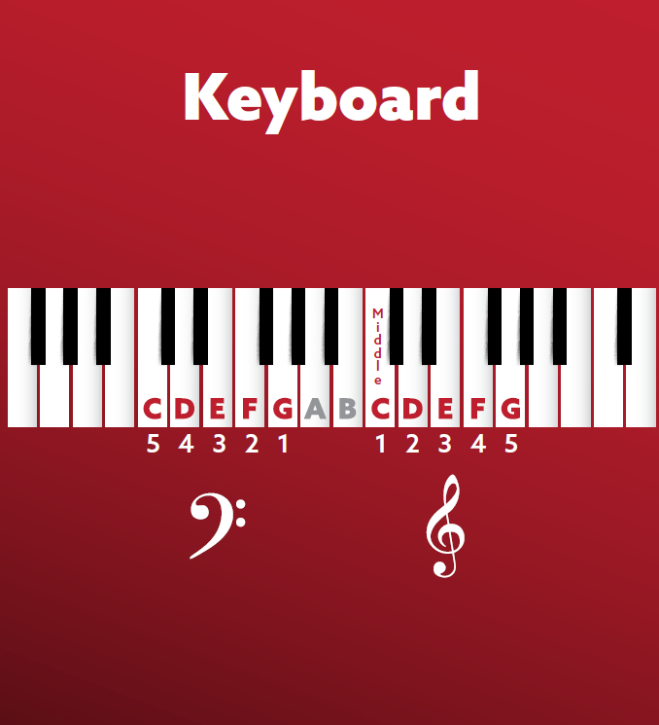
Introduction to the keyboard
The keyboard is made up of black and white keys. The white keys use the letter names of A, B, C, D, E, F, G. The black keys are the sharps or flats that relate to each note on either side of the white notes.
Sharp notes are the black notes to the right of a white note. Flat notes are the black notes to the left of a white note.

Slide 31
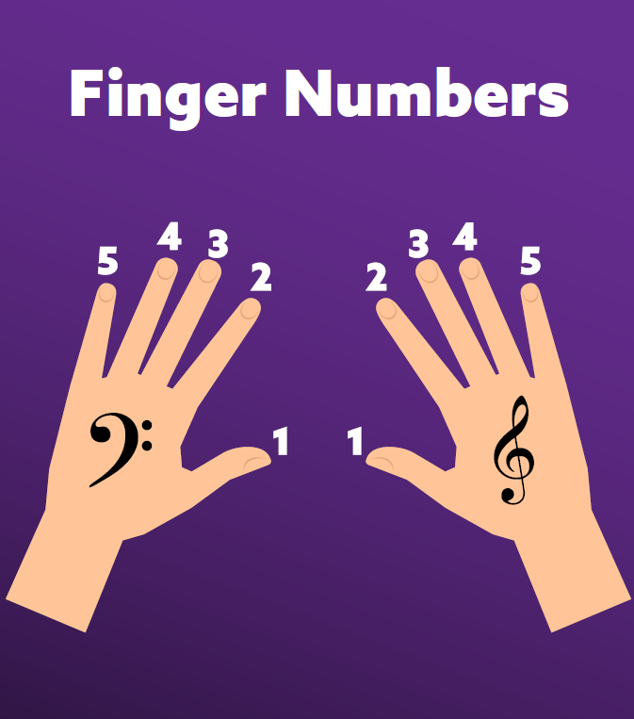
Keyboard fingering
The music you play on the keyboard uses both the treble and bass clefs. Usually the left hand (LH) plays the bass notes and the right hand (RH) plays the treble notes. The finger numbers we use to play the keyboard are 5, 4, 3, 2, 1 for the left hand and 1, 2, 3, 4, 5 for the right hand.

Slide 32
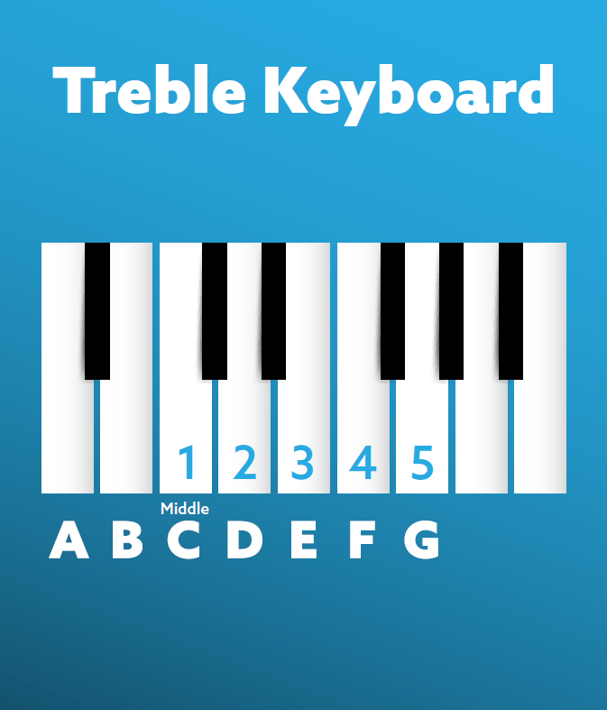
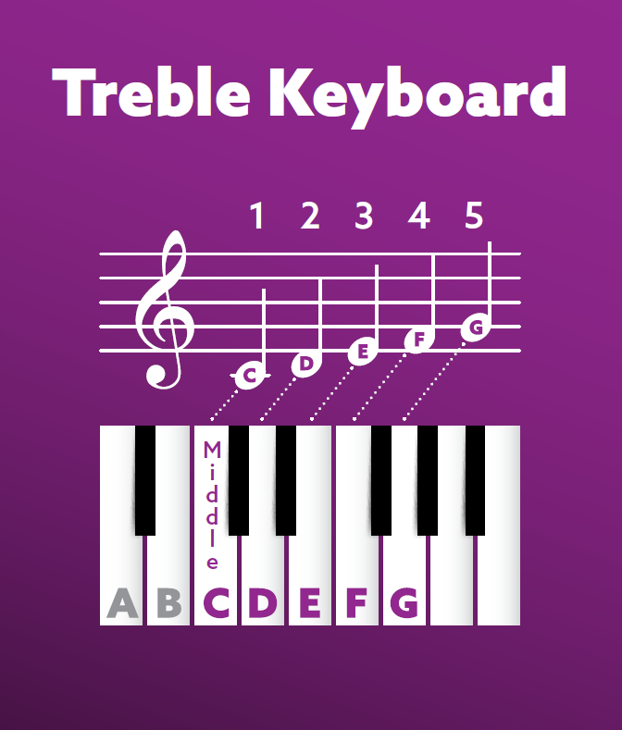
Playing in the treble clef

Slide 33
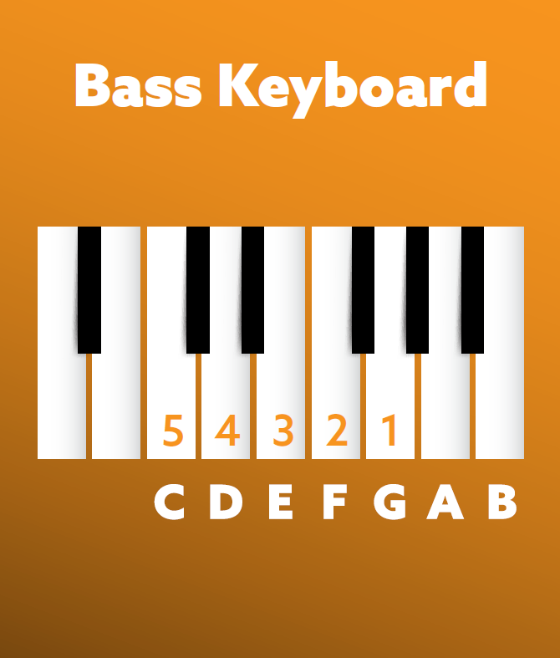
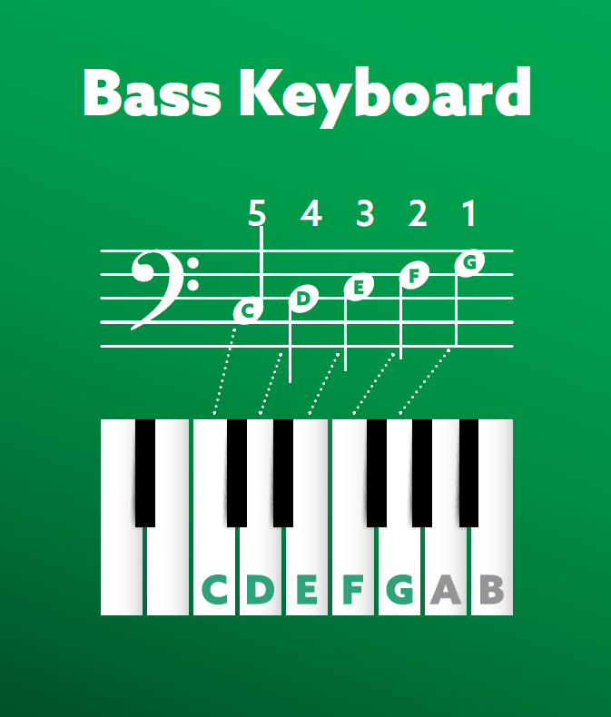
Playing in the bass clef

Slide 34
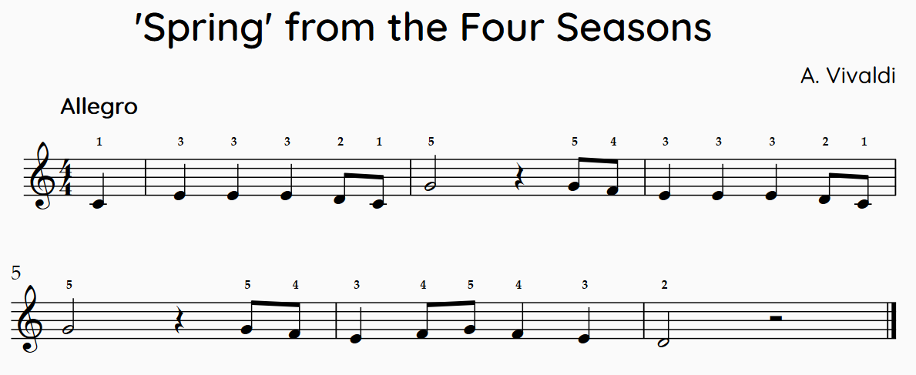
Performing (1)
Orchestral melodies
Learn to play one or more of the following melodies taken from famous orchestral pieces. Ask your teacher for an advanced version if you have had prior experience on keyboard.

Slide 35
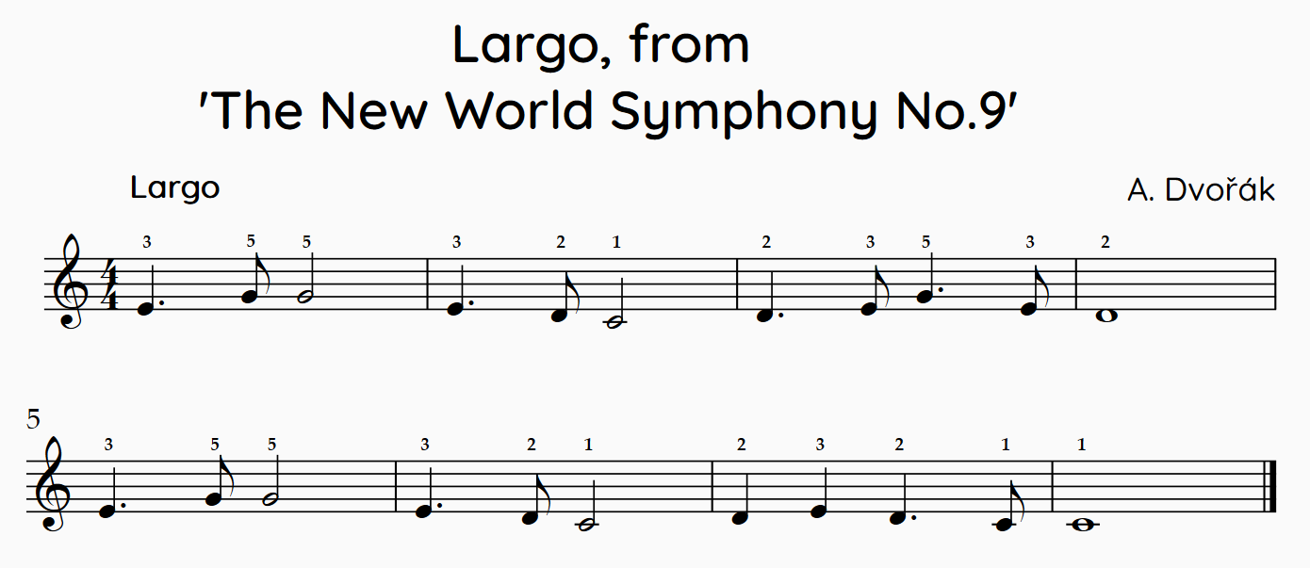
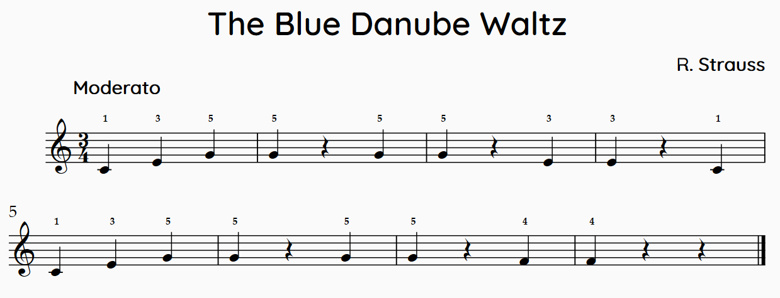
Performing (2)
Orchestral melodies

Slide 36

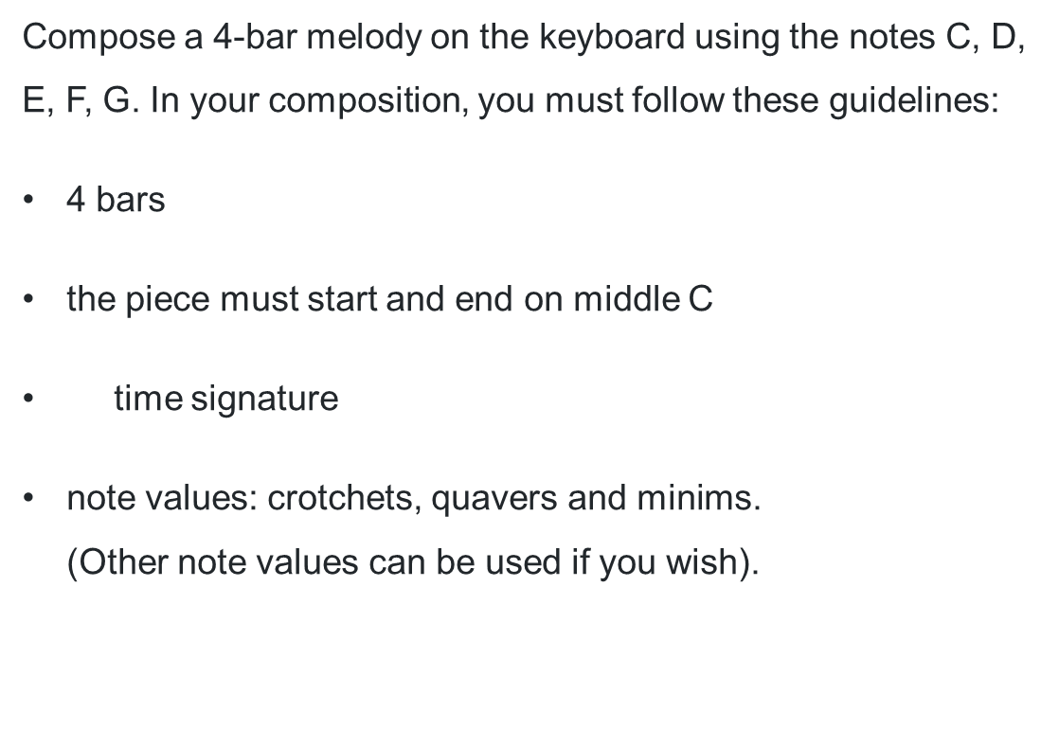
Activity 4.3 – composing a 4-bar melody
Composing
Compose a 4-bar melody on the keyboard using the notes C, D, E, F, G. In your composition, you must follow these guidelines:
4 bars
the piece must start and end on middle C
time signature
note values: crotchets, quavers and minims.
(Other note values can be used if you wish).

Slide 37
How to compose your 4-bar melody
Composing
Experiment on the keyboard by improvising on the 5 given notes starting on C. When you hear something that you like, try to play it again and write the notes down. For example: C, C, D, E, C. Continue to use this method until you are happy with your 4-bar melody. Make sure you have enough beats to make up 4 bars of time.
Pay the melody again and notate the rhythm of your melody above the notes you have written.
Alternatively, you can compose the rhythm first by experimenting with clapping rhythms and writing them down, before assigning pitches to them.
Notate your composition using notation software such as Musescore, Flat.io or Sibelius. Alternatively, you may like to hand write it using manuscript.
Perform or record your composition.

Slide 38
Learning sequence 5 – keyboard performance

Slide 39
Learning intentions and success criteria – learning sequence 5
We are learning to:
know the names of the notes in the bass clef
understand how to apply the note names to the keyboard
rehearse and refine a piece of music on the keyboard through listening, discernment and repetition.
We can:
identify and name the notes in the bass clef
demonstrate how to apply knowledge of note names to the keyboard
rehearse and refine a piece of music on the keyboard.
Notes:
Notes for teachers:
Learning intentions and success criteria are best co-constructed with students. Adapt the learning intention as required and add matching success criteria.
For more information see ⁠AITSL or the NSW Department of Education explicit teaching strategies, ⁠Sharing learning intentions and ⁠Sharing success criteria.
LISC is not necessarily presented at the beginning of the lesson. Teacher needs to consider most effectual time to introduce.
LISC should be revisited during the lesson to support students' evaluation of their learning.

Slide 40

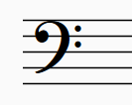

Activity 5.1 – note names in the bass clef
Mnemonics
The bass clef is used to show the low notes on the stave. It is used for low sounding instruments, as well as for the left hand of the keyboard.
The bass clef looks like this:
Notes can be positioned either on the lines or in the spaces.
Lines
Good Birds Don’t Fly Away
Spaces
All Cows Eat Grass Blissfully

Slide 41
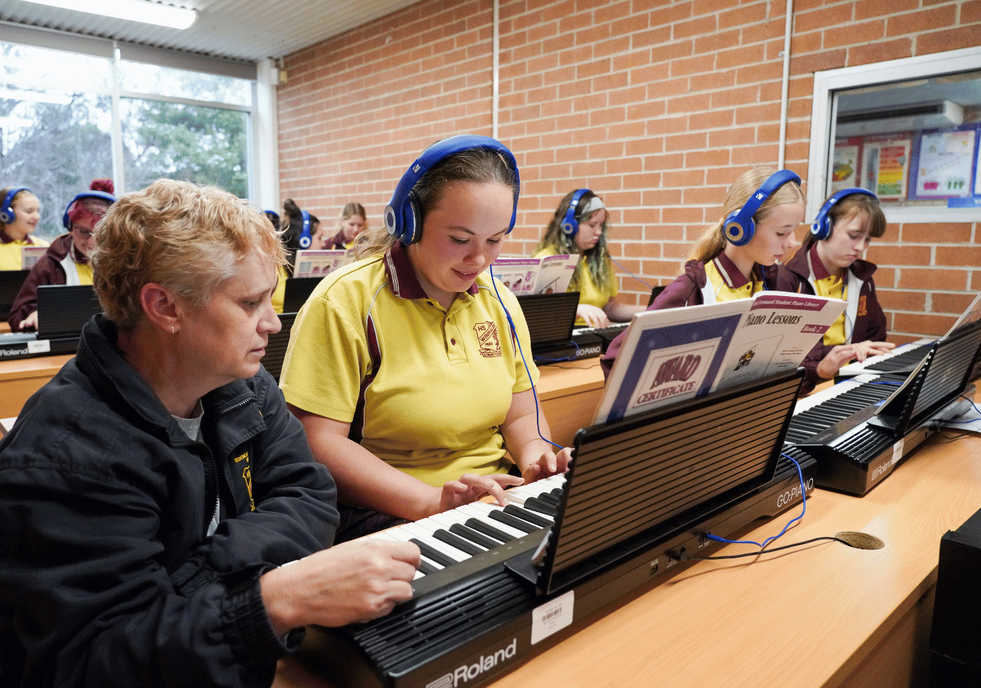
Activity 5.2 – performing orchestral melodies
Keyboard
Access the score booklet. Listen to the orchestral pieces listed below and choose one of the pieces to learn on the keyboard:
Ode to Joy – Beethoven Symphony No9 – Royal Scottish National Orchestra (4:20) (from 0:00–0:59)
Vienna Philharmonic & Zubin Mehta – Grieg: Morning Mood (Summer Night Concert) (4:08) (from 0:00–0:27)
Trumpet Voluntary (2:55) (from 0:00–1:30)
There are 3 versions of each piece to choose from, level 1, level 2 and level 3.

Slide 42
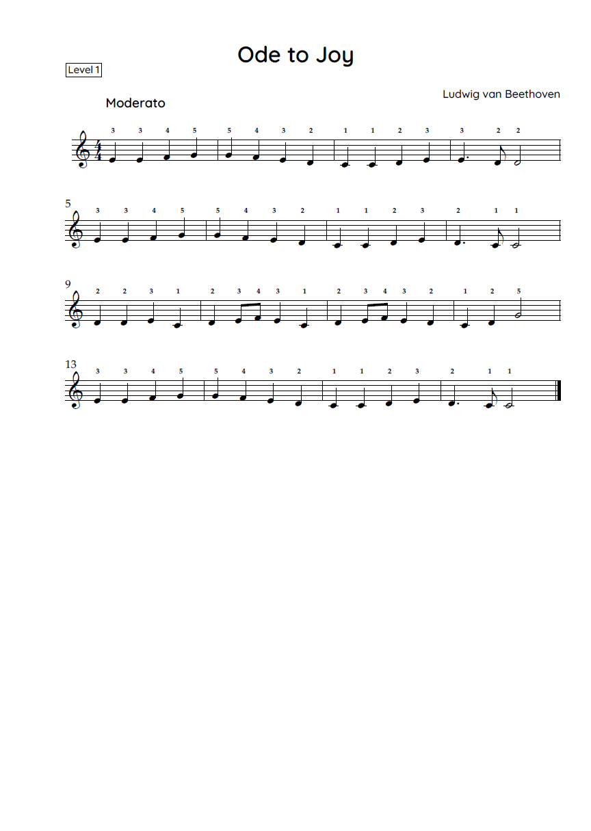
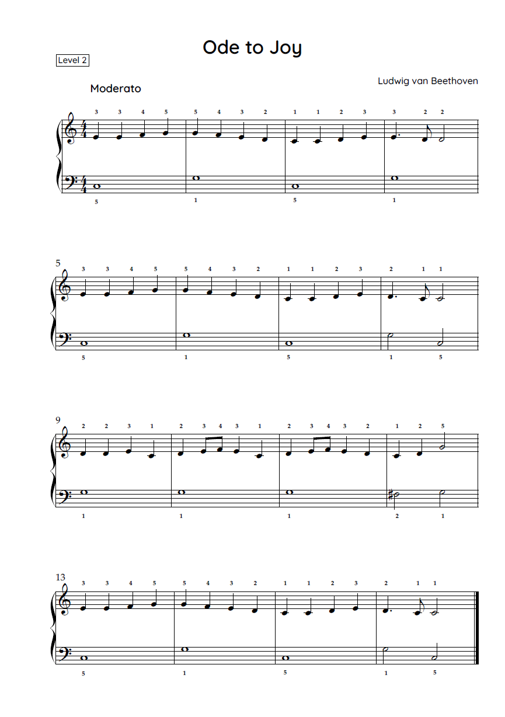
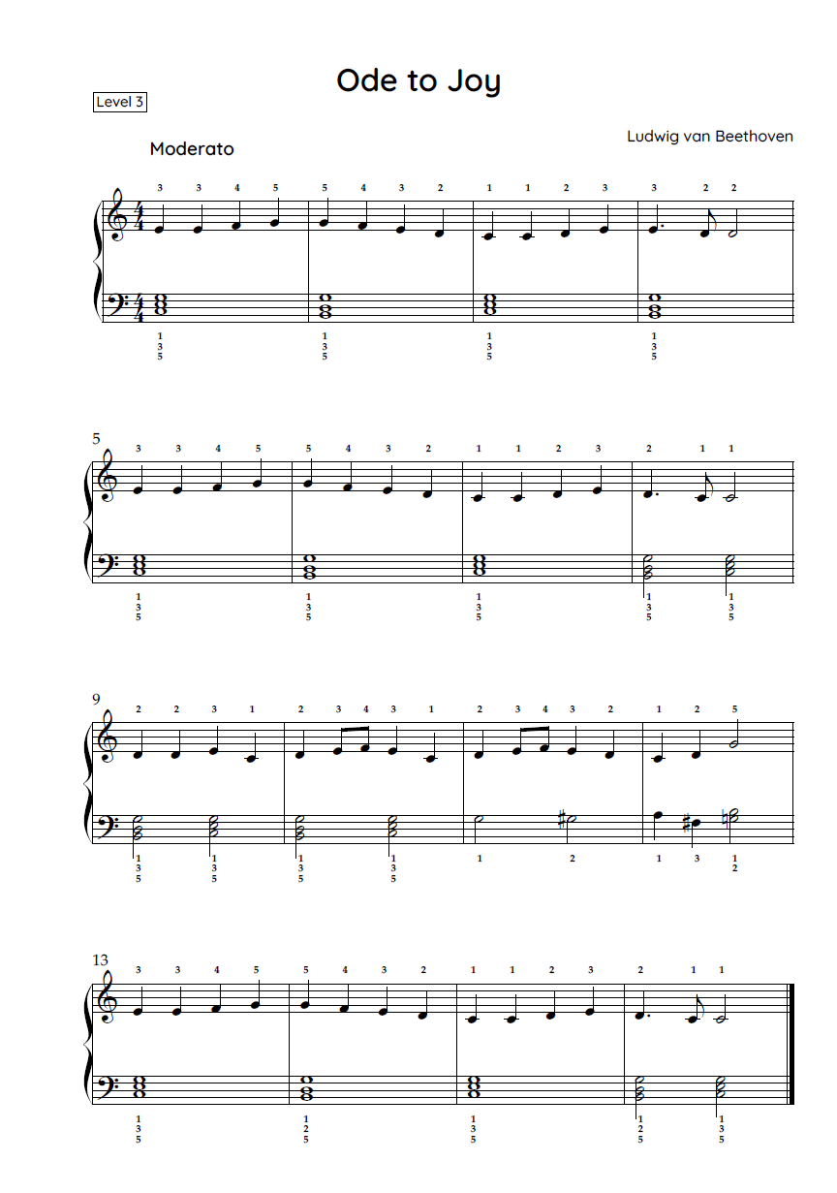
‘Ode to Joy’ by Beethoven
Keyboard

Slide 43
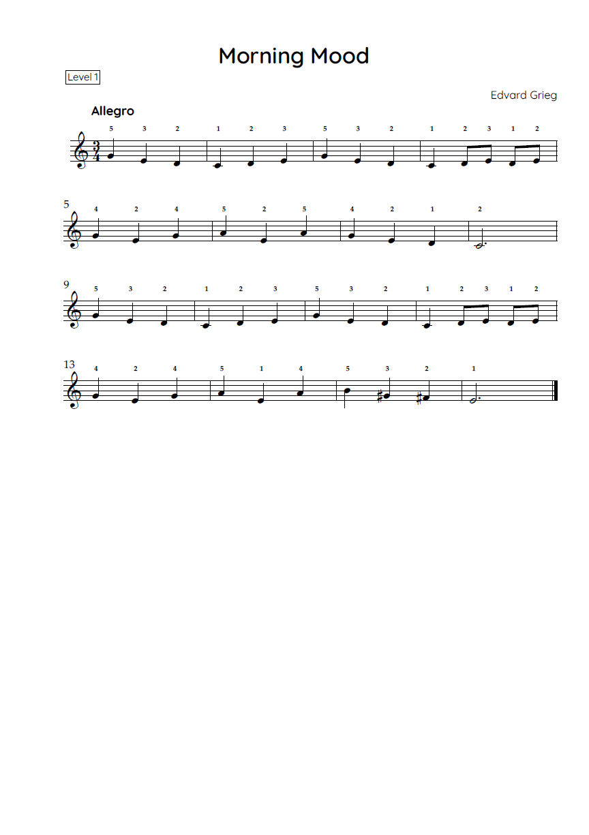
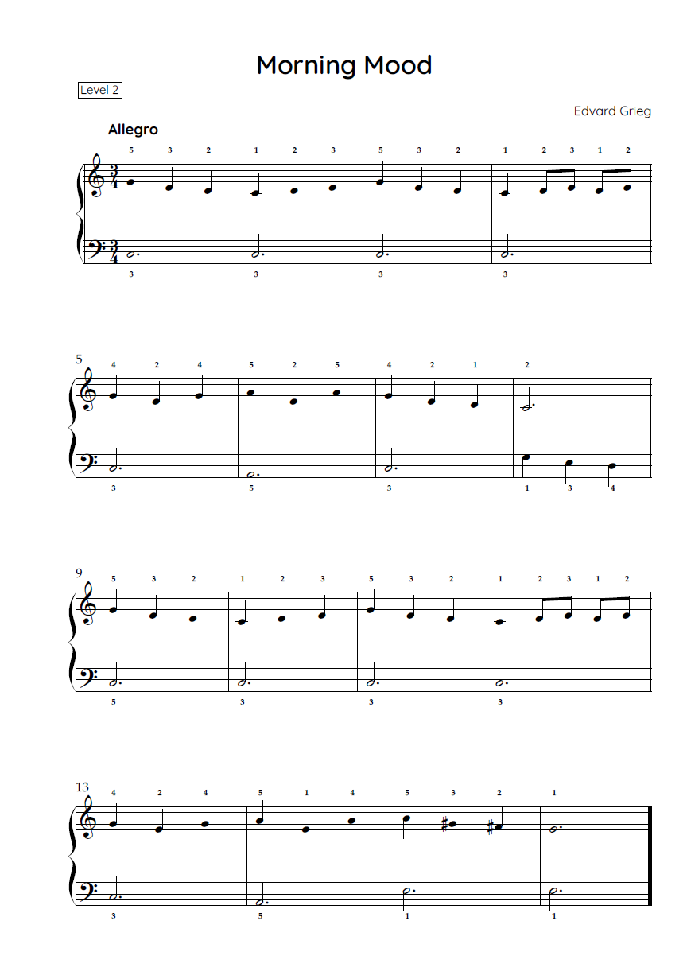
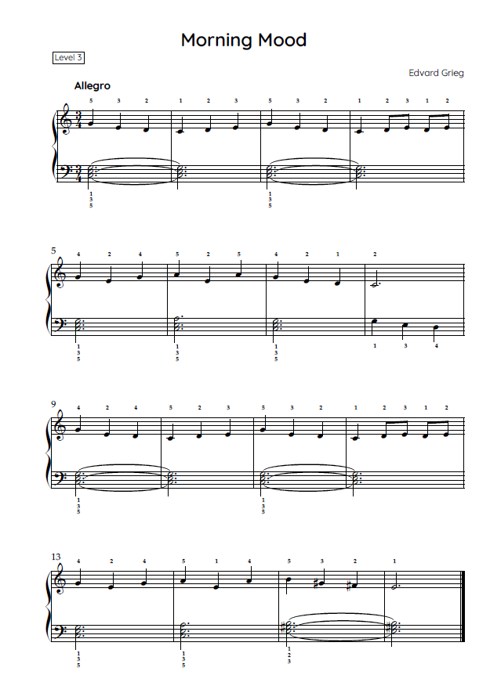
‘Morning Mood’ by Grieg
Keyboard

Slide 44
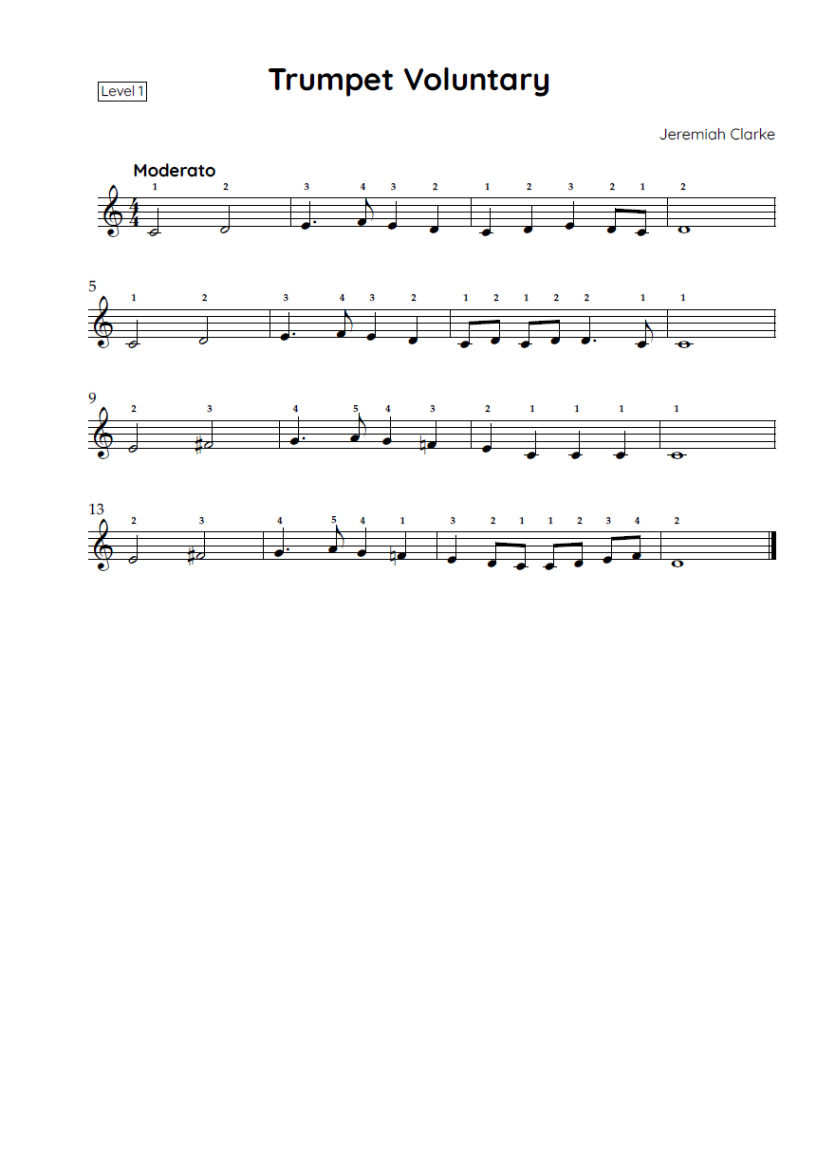
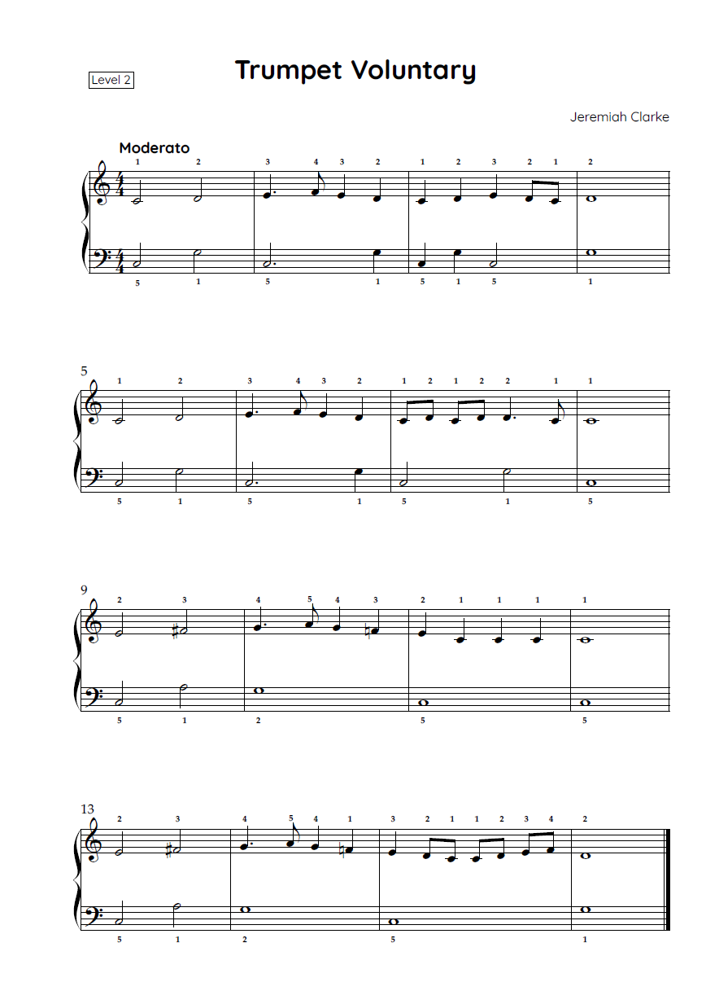
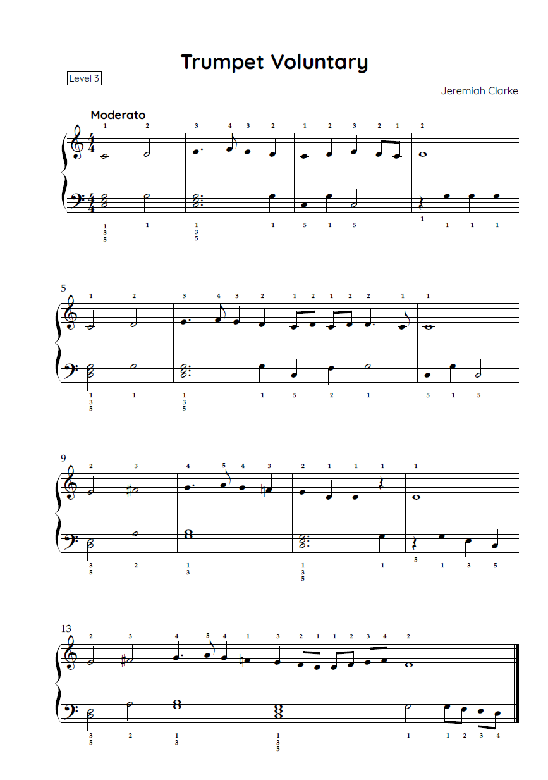
‘Trumpet Voluntary’ by Clarke
Keyboard

Slide 45
How to practise your keyboard piece
Developing instrumental skills
The teacher will demonstrate how to play the piece as you follow along with the score. Practise the piece by completing the steps below:
Listen to the piece while following the score.
Clap the rhythm of the right-hand melody while keeping a steady beat.
Play through the piece slowly.
Chunk and drill – play through the first 1 to 2 bars 5 times or until you have achieved fluency. Repeat this process with the following bars and then join the bars together.
Repeat this process with the left hand (if applicable).
Play the left hand and right hand together until fluency is achieved(if applicable).
Perform the piece to the class or record your performance for submission.

Slide 46
Learning sequence 6 – keyboard performance continued

Slide 47
Learning intentions and success criteria – learning sequence 6
We are learning to:
know the music terminology associated with the elements of music, performing media and timbre, and texture
understand how to identify the elements of music in a piece of music through listening and score reading
demonstrate understanding of the elements of music through performance.
We can:
use music language to identify and describe performing media, timbre and texture
respond to questions about the elements of music used in a piece of music
apply understanding of the elements of music to perform a piece on the keyboard.
Notes:
Notes for teachers:
Learning intentions and success criteria are best co-constructed with students. Adapt the learning intention as required and add matching success criteria.
For more information see ⁠AITSL or the NSW Department of Education explicit teaching strategies, ⁠Sharing learning intentions and ⁠Sharing success criteria.
LISC is not necessarily presented at the beginning of the lesson. Teacher needs to consider most effectual time to introduce.
LISC should be revisited during the lesson to support students' evaluation of their learning.

Slide 48
Activity 6.2 – score scavenger
Score reading
Access the score and recording of the piece you performed and highlight and label the following musical features on the score:
title
composer
treble clef and bass clef (if applicable)
time signature
tempo
note names and values such as crotchet, quaver
double barline
using a highlighter, trace over the treble clef line of the first 4 bars. Describe the contour of the melody (ascending/descending/steps/leaps/skips).

Slide 49
Activity 6.3 – listening
Performing media and timbre and texture
Access the recording of the orchestral piece you played on the keyboard. Answer these questions based on the piece you selected:
Which performing media are playing the melody?
Describe the timbre of the performing media playing the melody.
Which instrument(s) or instrument families are performing the accompaniment?
How would you describe the texture of this section? You must describe the density (thick/thin) and the type of texture (phonic).

Slide 50
Learning sequence 7 – electronic layering

Slide 51
Learning intentions and success criteria – learning sequence 7
We are learning to:
know and define the different types of texture in music and how they are created through layers
understand how to use digital technologies to create different types of texture
interpret a visual score to identify musical features in a piece of music
compare pieces of music according to the elements of music.
We can:
name and define the different types of texture in music and use digital technologies to demonstrate each type of texture
identify and describe musical features in a visual score through listening
apply understanding of the elements of music to compare 2 versions of the same piece.
Notes:
Notes for teachers:
Learning intentions and success criteria are best co-constructed with students. Adapt the learning intention as required and add matching success criteria.
For more information see ⁠AITSL or the NSW Department of Education explicit teaching strategies, ⁠Sharing learning intentions and ⁠Sharing success criteria.
LISC is not necessarily presented at the beginning of the lesson. Teacher needs to consider most effectual time to introduce.
LISC should be revisited during the lesson to support students' evaluation of their learning.

Slide 52
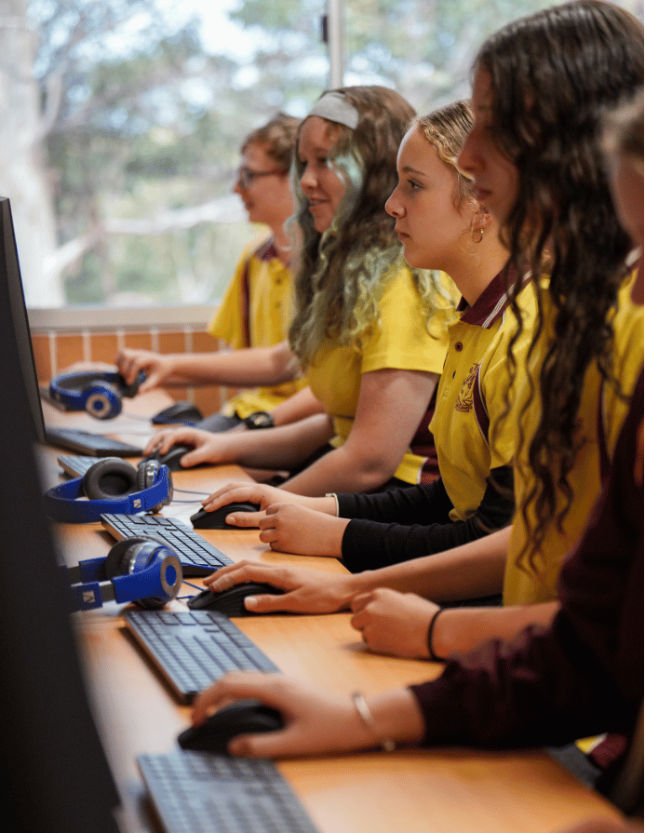

Activity 7.1 – Incredibox (1)
The aim of this activity is to create different textures using layers of sound on your device.
Access Incredibox and select Demo from the top tab. Select a version to start mixing music (it may take a minute to load).
Drag and drop each icon individually to listen to each sound. Establish which sounds are melodic, harmonic or rhythmic.
Choose one or more of the layers of sound and notate its pattern using graphic notation. For example:

Slide 53
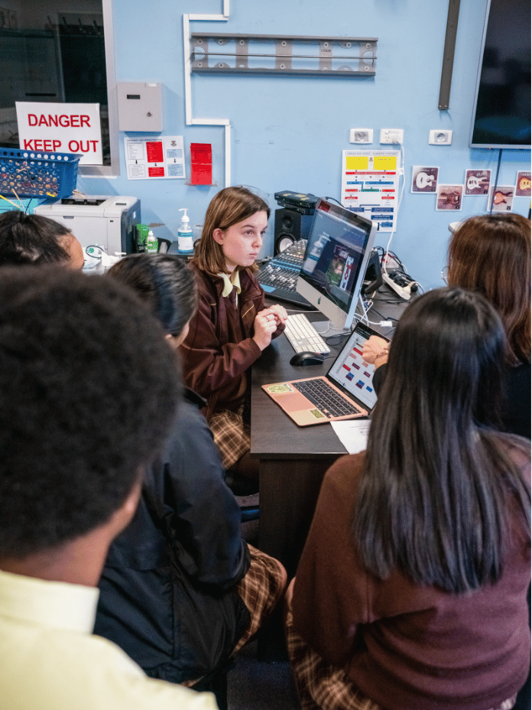
Activity 7.1 – Incredibox (2)
Experimenting and creating music
Experiment with creating the following textures:
monophonic and thin
homophonic and moderately thick
homophonic and thin
polyphonic and moderately thin
own choice.
Extension: notate one of the types of texture you created using graphic notation.
Reflection question: Which texture was your favourite combination and why?

Slide 54

Activity 7.2 – animated graphic score
‘In the Hall of the Mountain King’ by Grieg
Access the video and discuss:
Which instrument began playing the piece and how did they create the sound?
How could you tell when the melody entered? What did it sound like? What did it look like?
How were short sounds and long sounds notated on the score?
How were high notes and low notes notated on the score?
How could you tell if the texture was thick? What did it sound like? What did it look like?
Grieg, Dovregubbens hall (In the Hall of the Mountain King) (2:39)

Slide 55
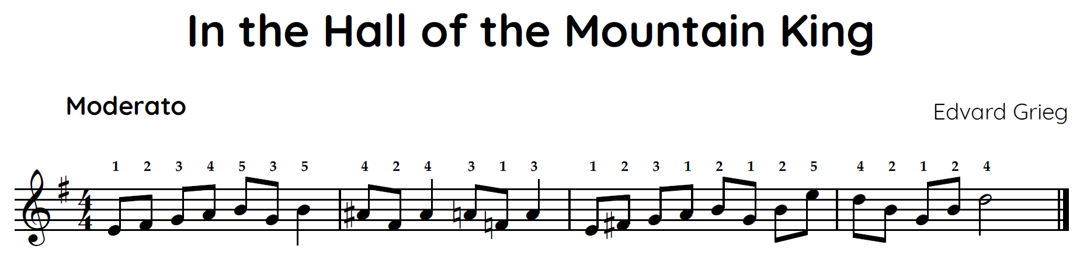
‘In the Hall of the Mountain King’
Performing
Practise the melody of ‘In the Hall of the Mountain King’ on keyboard. Perform as a class.

Slide 56
Score reading
‘In the Hall of the Mountain King’
Highlight and label these musical features on the score:
title
composer
treble clef
time signature
crotchets, quavers, minim
accidentals
double barline.

Slide 57
Activity 7.4 – comparative analysis
‘In the Hall of the Mountain King’ and ‘Hair up’
Compare Grieg’s In the Hall of the Mountain King (2:28) (from 0:00–1:04) with Justin Timberlake’s Hair up (2:58) (from 0:00–0:52) by completing the table below. Consider the elements of music such as performing media, timbre and texture.
Musical features | Grieg – ‘In the Hall of the Mountain King’ | Timberlake – ‘Hair up’
Performing media
Timbre
Texture

Slide 58
Learning sequence 8 – roles of layers of sound in electronic music

Slide 59
Learning intentions and success criteria – learning sequence 8
We are learning to:
know about the roles of performing media used in music
understand how layers are combined in electronic music to create different types of texture
demonstrate how electronic sounds can be combined using digital technologies.
We can:
name and define the role of layers of sound using music terminology
demonstrate how layers are combined using digital technologies
apply understanding of how layers are combined to create a short composition.
Notes:
Notes for teachers:
Learning intentions and success criteria are best co-constructed with students. Adapt the learning intention as required and add matching success criteria.
For more information see ⁠AITSL or the NSW Department of Education explicit teaching strategies, ⁠Sharing learning intentions and ⁠Sharing success criteria.
LISC is not necessarily presented at the beginning of the lesson. Teacher needs to consider most effectual time to introduce.
LISC should be revisited during the lesson to support students' evaluation of their learning.

Slide 60
The roles of layers of sound
Texture
The layers of sound in a piece can fulfil 3 functions:
Melodic role
Harmonic role
Rhythmic role
When the performing media provide the melody.
When the performing media provide harmony (pitch other than the melody.) For example, chords.
When the performing media provide the beat and/or accompanying rhythms.

Slide 61
Activity 8.1 – Listening
Worksheet
Access the below excerpts and identify the performing media and the role of each layer of sound in each piece as melodic, harmonic or rhythmic.
Piece | Performing media and role
Becca Hatch, Tentendo – Bass Keeps Calling (Official Video) (2:38) (from 0:00–0:34)
JVKE – this is what falling in love feels like (Official Video) (2:34) (from 0:29–0:58)
Billie Eilish – CHIHIRO (Official Music Video) (5:23) (from 0:00–0:35)
Own choice

Slide 62
Electronic music layers and roles
What is a lead?
In electronic music, any layer of sound that plays in the foreground is called a ‘lead’ and often provides the melodic role. It is usually monophonic.
What is a synth pad?
A synth pad is a sustained, pitched sound typically created using
a synthesizer. It could be a single note or chord (2 or more notes played at once). Synth pads are smooth, atmospheric sounds
that play an important role in providing the harmonic role. They sometimes fade in and out throughout a piece of music. You
could create a synth pad effect acoustically using a keyboard.
What is bass or bass synth?
In electronic music, the bass or bass synth provides the bass line, or lowest layer of the piece to give it weight and warmth. Synth bass supports the melodic, rhythmic and harmonic layers. It provides both a harmonic and sometimes rhythmic role.
What are beats?
Beats are rhythmic layers that play drum-beats and rhythms.
They provide the rhythmic role.

Slide 63
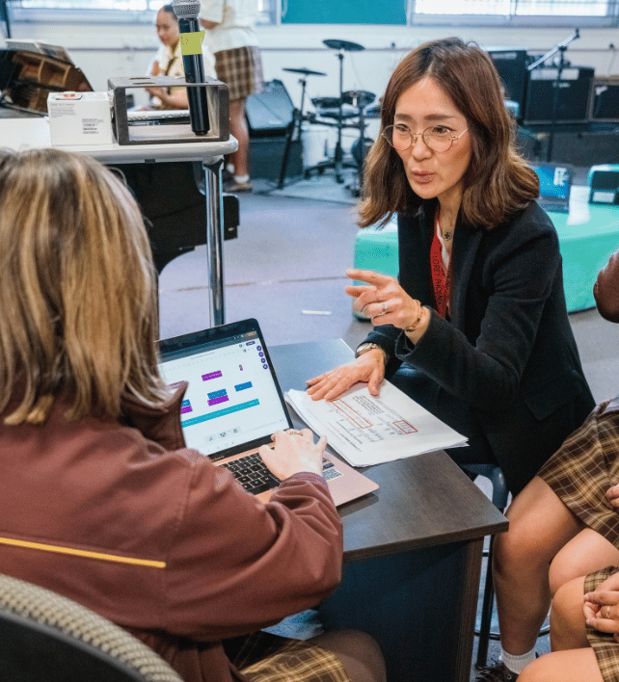
Activity 8.2 – layering lead, synth pads, beats and bass synth
Access a Digital Audio Workstation, such as BandLab For Education, and experiment with layering electronic sounds using the loops provided in the software or by creating your own. You can use the search function in BandLab to explore the different loops available and drag and drop them into the DAW. For this activity you must create a minimum of 8 bars of musical material using 4 layers of sound. The layers must consist of:
synth pad (harmonic layer)
bass synth (harmonic/rhythmic layer)
beats (rhythmic layer)
lead (melodic layer)

Slide 64
Learning sequence 9 – creating music

Slide 65
Learning intentions and success criteria – learning sequence 9
We are learning to:
understand how to combine layers of sound to create a piece of music either acoustically or using a DAW
demonstrate our understanding of texture through the creative process
document the compositional process and present a graphic score.
We can:
apply understanding of how to combine layers of sound to create a piece of music either acoustically or using a DAW
demonstrate understanding of texture through experimentation during the creative process
write about the compositional process and document a composition using a graphic score.
Notes:
Notes for teachers:
Learning intentions and success critera are best co-constructed with students. Adapt the learning intention as required and add matching success criteria.
For more information see ⁠AITSL or the NSW Department of Education explicit teaching strategies, ⁠Sharing learning intentions and ⁠Sharing success criteria.
LISC is not necessarily presented at the beginning of the lesson. Teacher needs to consider most effectual time to introduce.
LISC should be revisited during the lesson to support students' evaluation of their learning.

Slide 66
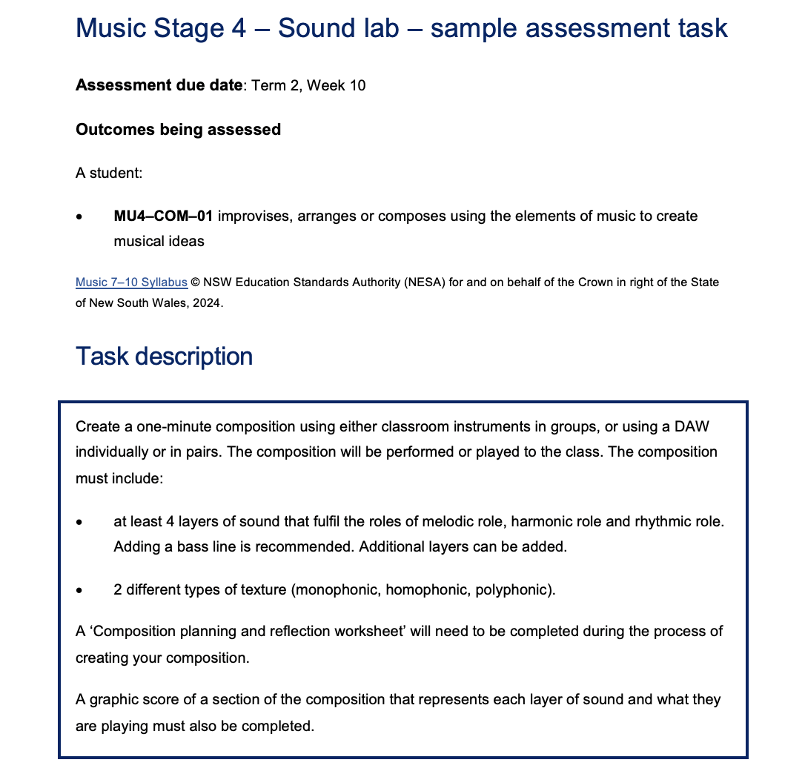
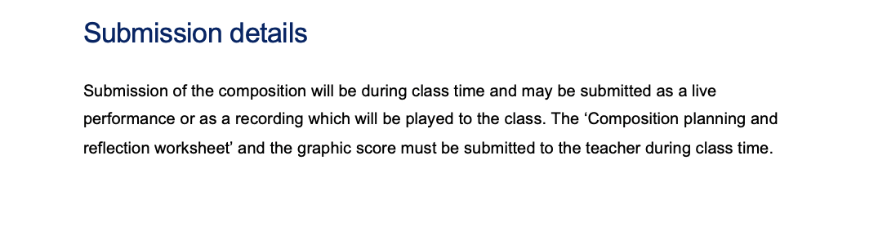
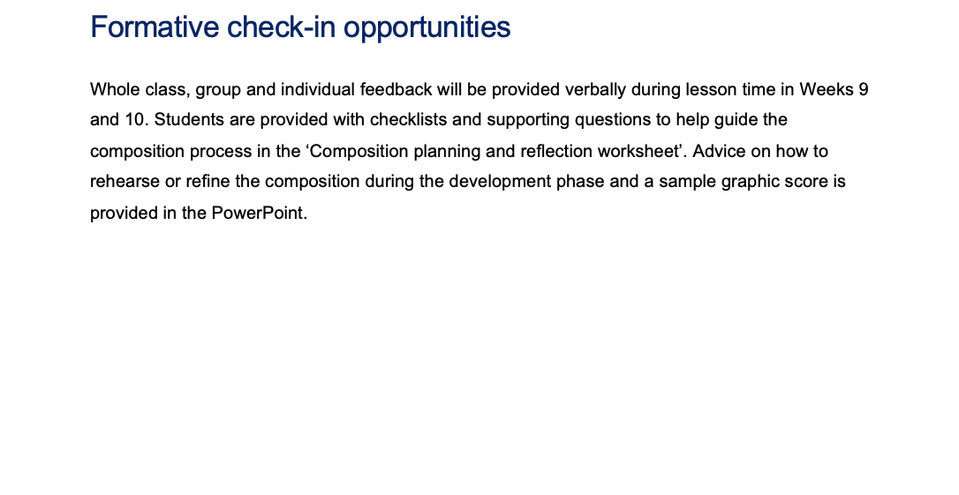
Assessment task
Sound lab – composition assessment task
Refer to the Music Stage 4 ‘Sound lab’ composition assessment task.

Slide 67
Activity 9.1 – composing with layers of sound
Assessment
In this activity, you will create a one-minute composition using either classroom instruments in groups or using a DAW individually or in pairs. Your composition will need to be performed or played to the class. A ‘Composition planning and reflection worksheet’ will need to be filled out during the process of creating your composition.
Task description
Create a one-minute composition. You must include:
at least 4 layers of sound that fulfil the roles of melodic role, harmonic role and rhythmic role. Adding a bass line is recommended. Additional layers can be added.
two different types of texture (monophonic/homophonic/polyphonic).

Slide 68
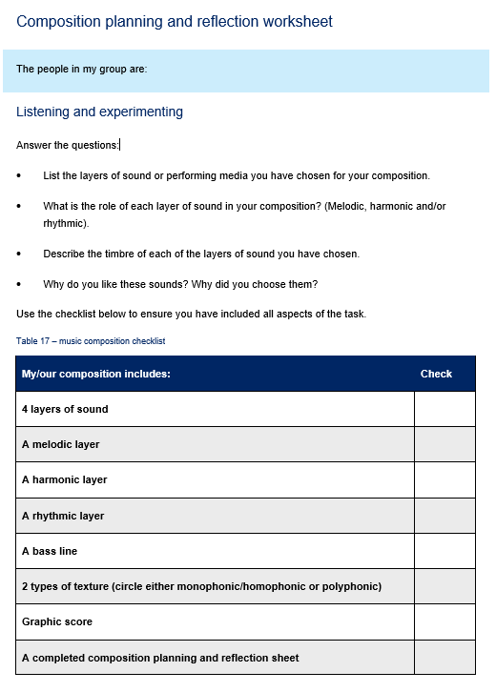
Activity 9.2 – documenting your composition
Composition planning and reflection worksheet
Access the ‘Composition planning and reflection worksheet’ and document the planning and process of your composition as it evolves.
Record your composition.
Create a graphic score of a section of your composition that represents each layer of sound and what they are playing. Consider the order of the layers on your score. The rhythmic layers should be positioned at the bottom of the score, followed by the bass line, harmonic layers and melody at the top. An example has been provided for you on the next slide.

Slide 69
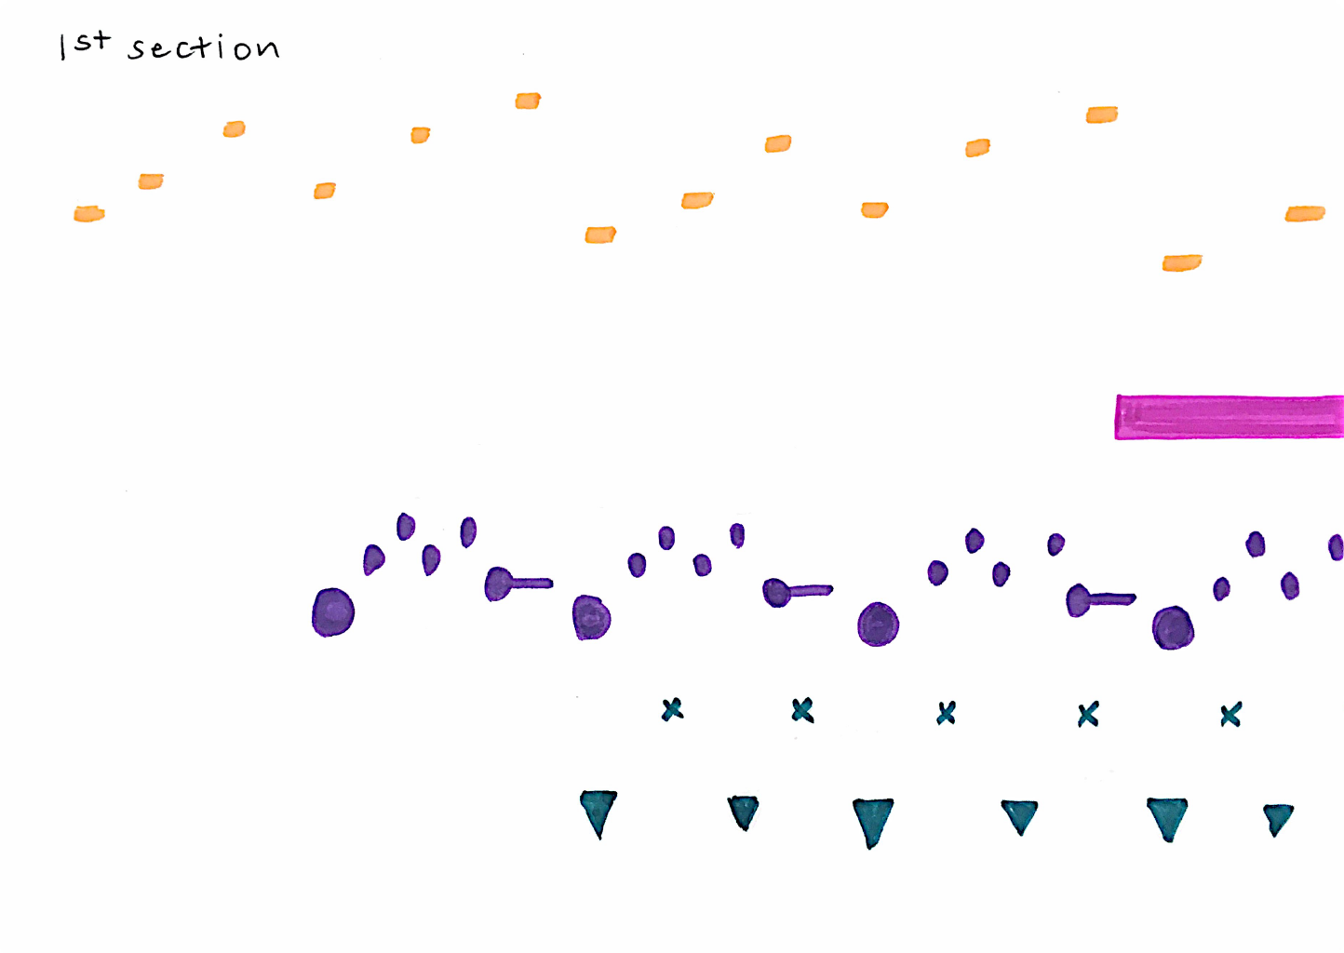


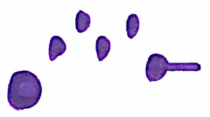

Documenting your composition
Graphic score example
Key
Sound | Symbol
Lead (melodic role)
Synth pad (harmonic role)
Bass synth (harmonic and rhythmic role)
Beats (rhythmic role)

Slide 70
Learning sequence 10 – composition assessment

Slide 71
Learning intentions and success criteria – learning sequence 10
We are learning to:
understand how to refine our composition through critical listening and evaluation
use a range of sound sources, sound production methods and timbres to compose and notate musical ideas using different textures
apply understanding of how sound can be represented through symbols using graphic notation.
We can:
identify and explain which aspects of the piece need adjustment, and describe why and how adjustments are made to a composition
create and present own musical composition that demonstrates different timbres and textures
document compositions using graphic notation.
Notes:
Notes for teachers:
Learning intentions and success criteria are best co-constructed with students. Adapt the learning intention as required and add matching success criteria.
For more information see ⁠AITSL or the NSW Department of Education explicit teaching strategies, ⁠Sharing learning intentions and ⁠Sharing success criteria.
LISC is not necessarily presented at the beginning of the lesson. Teacher needs to consider most effectual time to introduce.
LISC should be revisited during the lesson to support students' evaluation of their learning.

Slide 72
Activity 10.1 – refining the composition and graphic score
Continue to refine and rehearse (if applicable) your composition. Consider the following questions when refining your piece:
Do the sounds/performing media go together well? Do the timbres blend together?
Do the sounds you have chosen provide some contrast in timbre?
Do the layers of sound enter the piece in a logical progression?
Is there a contrast in texture in the piece? For example, thick and thin?
Are there any sections that don’t sound as successful as other sections? How could you change or develop it?
Does the ending of the piece sound like an ending? How could you make it sound like it has finished?
How do you think your piece will be perceived from the perspective of a listener or audience?
What do you like about your piece?

Slide 73
Composition checklist
Check your work
Use the checklist below to ensure you have included all aspects of the task.
My/our composition includes: | Check
4 layers of sound
A melodic layer
A harmonic layer
A rhythmic layer
A bass line
2 types of texture (either monophonic, homophonic or polyphonic)
Graphic score
A completed composition planning and reflection sheet

Slide 74



Exit ticket
What was a positive success or highlight of this unit?
What is something you are looking forward to learning more about in music?
What was a challenge experienced during this unit?

Slide 75
References (1)
This presentation contains NSW Curriculum and syllabus content. The NSW Curriculum is developed by the NSW Education Standards Authority. This content is prepared by NESA for and on behalf of the Crown in the right of the State of New South Wales. The material is protected by Crown copyright.
Please refer to the NESA Copyright Disclaimer for more information https://educationstandards.nsw.edu.au/wps/portal/nesa/mini-footer/copyright.
NESA holds the only official and up-to-date versions of the NSW Curriculum and syllabus documents. Please visit the NSW Education Standards Authority (NESA) website https://educationstandards.nsw.edu.au/wps/portal/nesa/home and the NSW Curriculum website https://curriculum.nsw.edu.au.
Music 7–10 Syllabus © Syllabus NSW Education Standards Authority (NESA) for and on behalf of the Crown in right of the State of New South Wales, 2024.
BandLab Technologies (2024) BandLab For Education [website] accessed 25 August 2024.
Collier J (17 November 2019) 'Jacob Collier Harmonises The Audience' [video], Jacob Collier, YouTube, accessed 12 August 2024.
Eilish B (7 June 2024) ‘Billie Eilish – CHIHIRO (Official Music Video)’ [video], Billie Eilish, YouTube, accessed 25 August 2024.
Hatch B (15 February 2024) 'Becca Hatch, Tentendo – Bass Keeps Calling (Official Video)' [video], Becca Hatch, YouTube, accessed 25 August 2024.
Incredibox (2023) Incredibox [website], accessed 12 August 2024.
JVKE (4 November 2021) ‘JVKE – this is what falling in love feels like (Official Video)’ [video], JVKE, YouTube, accessed 25 August 2024.
London Symphony Orchestra (1 August 2023) 'Edvard Grieg: In the Hall of the Mountain King // Nicolò Foron & London Symphony Orchestra' [video], London Symphony Orchestra, YouTube, accessed 10 September 2024.

Slide 76
References (2)
musanim (25 November 2019) 'Grieg, Dovregubbens hall (In the Hall of the Mountain King)' [video], musanim, YouTube, accessed 10 September 2024.
MuseScore BVBA (2024) Musescore [website], accessed 12 August 2024.
My Avid (2024) Sibelius [website] accessed 12 August 2024.
Royal Philharmonic Orchestra (17 August 2018) ’Trumpet Voluntary’ [video], Royal Philharmonic Orchestra, YouTube, accessed 12 August 2024.
Royal Scottish National Orchestra (15 June 2022) 'Ode to Joy – Beethoven Symphony No9 – Royal Scottish National Orchestra' [video], Royal Scottish National Orchestra, YouTube, accessed 12 August 2024.
Sony Classical (28 April 2020) Vienna Philharmonic 'Vienna Philharmonic & Zubin Mehta – Greig: Morning Mood (Summer Night Concert 2015)' [video], Sony Classical, YouTube, accessed 12 August 2024.
Timberlake J (26 December 2016) ‘Hair Up’ [video], Justin Timberlake, YouTube, accessed 25 August 2024.
Tutteo Limited (2024) Flat.io [website], accessed 12 August 2024.

Slide 77
Copyright
© State of New South Wales (Department of Education), 2024
The copyright material published in this resource is subject to the Copyright Act 1968 (Cth) and is owned by the NSW Department of Education or, where indicated, by a party other than the NSW Department of Education (third-party material).
Copyright material available in this resource and owned by the NSW Department of Education is licensed under a Creative Commons Attribution 4.0 International (CC BY 4.0) license.
This license allows you to share and adapt the material for any purpose, even commercially.
Attribution should be given to © State of New South Wales (Department of Education), 2024.
Material in this resource not available under a Creative Commons license:
the NSW Department of Education logo, other logos and trademark-protected material
Material owned by a third party that has been reproduced with permission. You will need to obtain permission from the third party to reuse its material.
Links to third-party material and websites
Please note that the provided (reading/viewing material/list/links/texts) are a suggestion only and implies no endorsement, by the New South Wales Department of Education, of any author, publisher, or book title. School principals and teachers are best placed to assess the suitability of resources that would complement the curriculum and reflect the needs and interests of their students.
If you use the links provided in this document to access a third party’s website, you acknowledge that the terms of use, including licence terms set out on the third-party’s website apply to the use which may be made of the materials on that third-party website or where permitted by the Copyright Act 1968 (Cth). The department accepts no responsibility for content on third-party websites.

