Slide 1
Creative Arts K–6 Syllabus (2024)
Familiarisation resource
Notes:
This PowerPoint resource has been developed to facilitate discussion and analysis of the aim and rationale of the new Creative Arts K-6 syllabus through the lens of some of the evidence base that has informed it.

Slide 2
Acknowledgement of Country
We recognise the Ongoing Custodians of the lands and waterways where we work and live. We pay respect to Elders past and present as ongoing teachers of knowledge, songlines and stories. We strive to ensure every Aboriginal and Torres Strait Islander learner in NSW achieves their potential through education.
‘Reflections’ created by Zara Marulanda from Blaxland High School as part of the 2021 Schools Reconciliation Challenge.

Slide 3
Quote page
The arts foster the development of creativity and the imagination, and early exposure to the arts for all children needs to be a priority in the curriculum (Ewing 2011).
A knowledge-rich curriculum creates the foundation for excellence and equity in the education system by prioritising and explicitly outlining the essential knowledge and related skills that students should be taught and develop at each stage of their schooling (AERO 2024).
Students develop cultural capital and intercultural understandings through the arts by engaging with local, national and international cultural heritages (Thomson and Hall 2023).
NESA (2024)
Notes:
The syllabus has been developed using evidence-based research that highlights the creative arts as being central to the human experience. Learning in creative arts fosters the development of creativity and imagination and establishes the foundations for lifelong engagement as cultural citizens.
The complete NESA bibliography can be accessed via the digital syllabus.

Slide 4
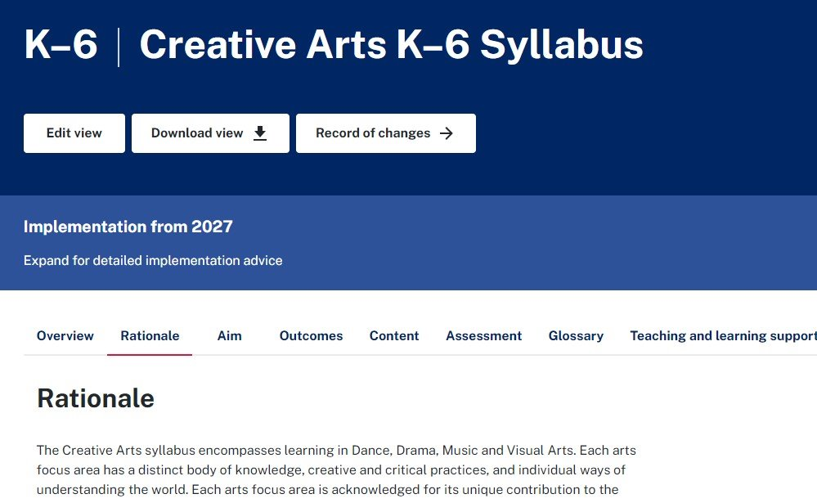
Exploring the syllabus rationale and aim
Syllabus rationale
Syllabus aim
Notes:
Professional learning opportunity:
Read through the rationale and aim of the Creative Arts K-6 Syllabus (2024). Consider how the samples from the evidence base on slide 4 are represented in the aim and rationale by recording key words and/or phrases [for example, representing ideas, communicating meaning, self-expression, creativity, cultural citizenship].
Share and explain your thinking with colleagues.

Slide 5
Reflect
Reflect on your current teaching of creative arts and how effectively it promotes creativity, curiosity, self-expression and intercultural understanding.
Consider the rationale and the aim of the Creative Arts K–6 Syllabus (2024).
What do you notice?
What does it make you think about current practice(s)?
What do you wonder?
Notes:
Use the reflective questions to guide discussion in your teams.

Slide 6
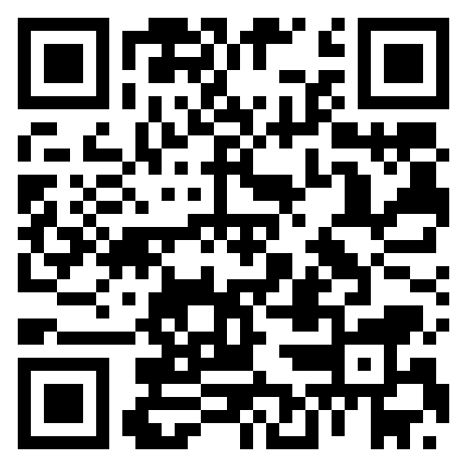
Further information and support
Familiarisation
Engage with the Creative Arts K–6 Syllabus (2024) to explore content, teaching advice and examples.
Scan the QR code to join the Primary Curriculum Statewide Staffroom and access the science and technology channel to ask questions, receive advice and updates on the release of resources.
More information
Read Creative Arts K–6 Syllabus (2024) – information for school leaders
Visit the Curriculum K–12 and Creative arts K–6 webpages.
Notes:
More information is available via these links and websites.
If you are not already a member of the Primary Curriculum Statewide Staffroom, scan the QR code to register. This provides teachers with access to the Creative Arts and Announcements channels for updates on the release of resources, advice and FAQs.

Slide 7
References
This presentation contains NSW Curriculum and syllabus content. The NSW Curriculum is developed by the NSW Education Standards Authority. This content is prepared by NESA for and on behalf of the Crown in the right of the State of New South Wales. The material is protected by Crown copyright.
Please refer to the NESA Copyright Disclaimer for more information https://educationstandards.nsw.edu.au/wps/portal/nesa/mini-footer/copyright.
NESA holds the only official and up-to-date versions of the NSW Curriculum and syllabus documents. Please visit the NSW Education Standards Authority (NESA) website https://educationstandards.nsw.edu.au/wps/portal/nesa/home and the NSW Curriculum website https://curriculum.nsw.edu.au.
Creative Arts K–6 © Syllabus NSW Education Standards Authority (NESA) for and on behalf of the Crown in right of the State of New South Wales, 2024.
AERO (Australian Education Research Organisation) (2024) A knowledge-rich approach to curriculum design, AERO website, accessed 6 March 2024. https://www.edresearch.edu.au/research/research-reports/knowledge-rich-approach-curriculum-design
Ewing R (2011) The arts and Australian education: realising potential, Australian Council for Education Research website, accessed 11 September 2024. https://research.acer.edu.au/aer/11/
Thomson P and Hall C (2023) Schools and cultural citizenship: arts education for life, 1st edn, Routledge, London, https://doi.org/10.4324/9781003093084.

Slide 8
Copyright
© State of New South Wales (Department of Education), 2024
The copyright material published in this resource is subject to the Copyright Act 1968 (Cth) and is owned by the NSW Department of Education or, where indicated, by a party other than the NSW Department of Education (third-party material).
Copyright material available in this resource and owned by the NSW Department of Education is licensed under a Creative Commons Attribution 4.0 International (CC BY 4.0) license.
This license allows you to share and adapt the material for any purpose, even commercially.
Attribution should be given to © State of New South Wales (Department of Education), 2024.
Material in this resource not available under a Creative Commons license:
the NSW Department of Education logo, other logos and trademark-protected material
Material owned by a third party that has been reproduced with permission. You will need to obtain permission from the third party to reuse its material.
Links to third-party material and websites
Please note that the provided (reading/viewing material/list/links/texts) are a suggestion only and implies no endorsement, by the New South Wales Department of Education, of any author, publisher, or book title. School principals and teachers are best placed to assess the suitability of resources that would complement the curriculum and reflect the needs and interests of their students.
If you use the links provided in this document to access a third-party’s website, you acknowledge that the terms of use, including licence terms set out on the third-party’s website apply to the use which may be made of the materials on that third-party website or where permitted by the Copyright Act 1968 (Cth). The department accepts no responsibility for content on third-party websites.

