Slide 1
Instructions for use
This resource is not a teaching and learning program. It should be used in conjunction with the Stage 5 (Year 9) ‘Crafting character– performing scripted works’ sample unit, assessment task and resources, available on the Planning, programming and assessing drama 7–10 (2023) webpage. Classroom teachers are encouraged to add and adapt slides as required to meet the needs of their students.
Save a copy of the file to make changes to the slide deck. Go to File > Download a Copy (this downloads a copy to the computer to edit in the PowerPoint app).
To convert the PowerPoint to Google Slides:
  Upload the file into Google Drive and open it.
  Go to File > Save as Google Slides.
  (Note – conversion may cause formatting changes in the slides.)

Slide 2
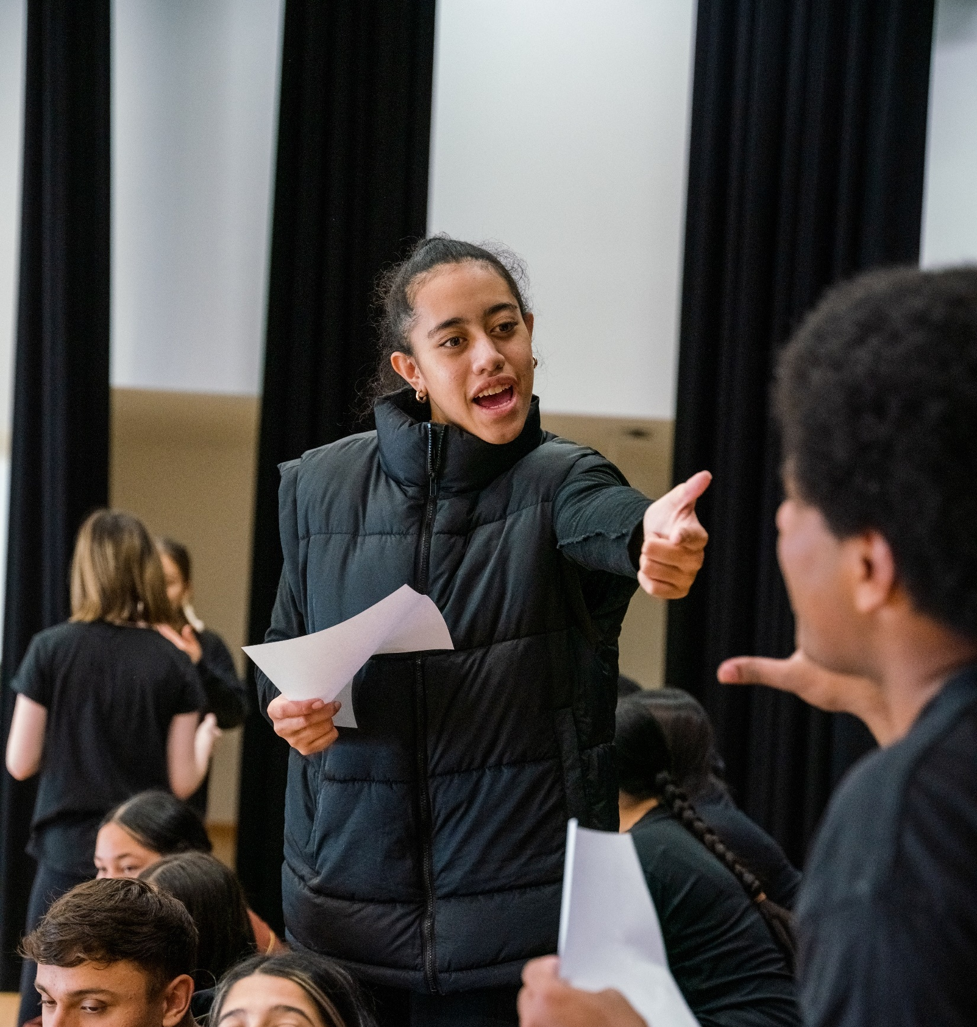
Crafting character – performing scripted works
Stage 5 drama

Slide 3

Learning sequences
1
5
Voice
Rehearse and document
2
6
Movement
Perform-share-reflect
3
Energy, dynamics and Laban’s approach to movement
4
Expression, clarity and Stanislavski’s approach to acting
Notes:
Teacher notes:
Click lesson numbers to go to specific lessons
Interactive features can be viewed in slide show

Slide 4

Learning sequence 1 –
Voice

Slide 5
Learning intentions and success criteria (1)
We are learning to interpret scripted works and use our voices to communicate characters’ identities, values and perspectives.
I can:
experiment with ways of varying and controlling my voice to convey ideas and character perspectives
interpret the identities, values and perspectives of characters presented in scripted works
explain how my creative vocal choices have shaped what the audience hears, thinks and feels about characters
follow a vocal rhythm to speak in unison with other voices.
Notes:
Notes for teachers:
Dependent on school context and student needs, teachers may use this sample LISC as a starting point for unpacking unfamiliar, subject specific terminology with students. Teachers can refer to NESA’s Glossary and Teaching and learning support downloadable documents when unpacking these terms.
Learning intentions and success are best co-constructed with students. Adapt the learning intention as required and add matching success criteria.
For more information See ⁠AITSL or the NSW Department of Education explicit teaching strategies, ⁠Sharing learning intentions and ⁠Sharing success criteria
LISC is not necessarily presented at the beginning of the lesson. Teacher needs to consider most effectual time to introduce
LISC should be revisited during the lesson to support students' evaluation of their learning

Slide 6
1.1
Vocal warm-up

Slide 7
Introduction to breath control
1.1a – vocal warm-up
Find a neutral stance: stand or sit up straight, with shoulders relaxed, and spine in alignment.
Inhale deeply: Place one hand on your chest and the other on your abdomen. Breathe in slowly through your nose, allowing your diaphragm (your belly, not your chest) to rise. Feel your abdomen expand.
Exhale slowly: breathe out through your mouth, feeling your abdomen fall. Aim for a longer exhale than inhale.
Repeat: practice this for one minute, focusing on deep, controlled breaths.
Inhale: take a deep breath, inflating your diaphragm.
Count: as you exhale, count slowly to five. Gradually increase the count as you become more comfortable.
Challenge yourself: over time, try to extend your count to 10 or more without losing your breath control.
Notes:
Teacher to call out variations to dynamics and expression (fast pace, slow pace, dramatic pause, loud, soft, high pitched, low pitched, breathy, sharp, monotone) and energy (forceful, gentle, huge, tiny, heavy, light).

Slide 8
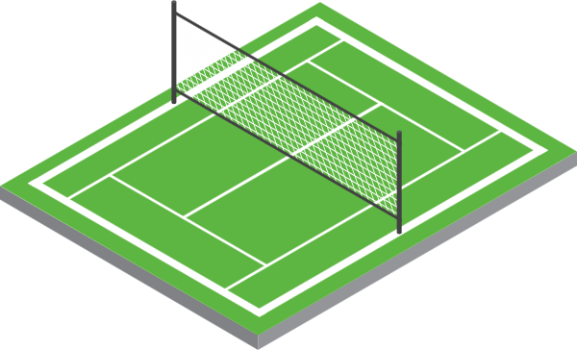
1.1b – vocal warm-up
Tennis court ‘toc’
Imagine our classroom is a tennis court.
Form pairs or groups of 4 for doubles.
Stand opposite your partner/s on the ‘court’.
Enact the physical gesture of hitting an imagined tennis ball to your partner.
Make a ‘toc’ sound as you hit the imagined ball back and forth.
Change your voice to match the dynamics , expression and energy variation that your teacher calls out.
Notes:
Teacher to call out variations to dynamics and expression (fast pace, slow pace, staccato, legato, dramatic pause, loud, soft, high pitched, low pitched, breathy, sharp, monotone) and energy (forceful, gentle, huge, tiny, heavy, light).

Slide 9
1.2
Context

Slide 10

1.2a – define
What is voice?
Voice is applied by using speech, song, other vocal utterances, sign language or augmentative and alternative communication (AAC) technologies to communicate. Voice includes:
breath, physical management and projection
speech and silence
monologue, dialogue, unison and chorus
singing
rhythm and timing
languages used by the student, such as Aboriginal English, home language(s) and dialects
accents
digital voices or voices produced by an avatar
voice in relation to role, character, language, space, sound or technologies.
Drama 7–10 Syllabus © NSW Education Standards Authority (NESA) for and on behalf of the Crown in right of the State of New South Wales, 2023.

Slide 11
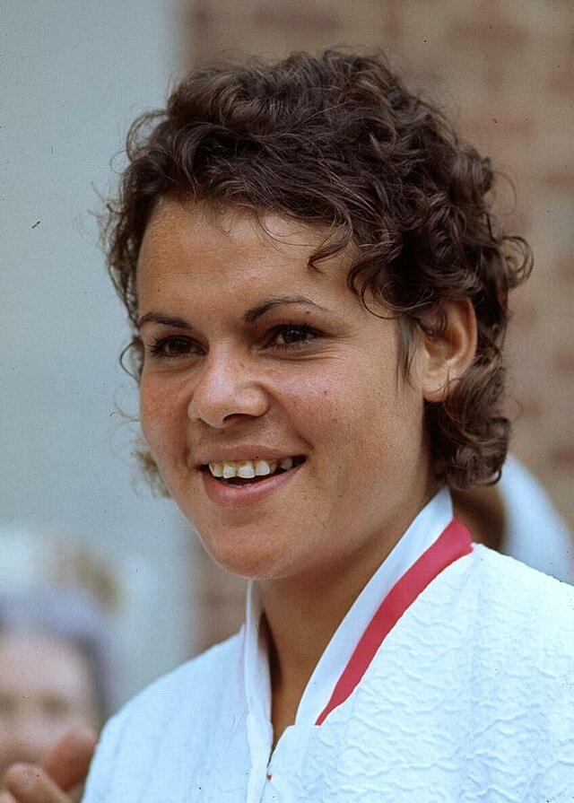
1.2b
Who am I?
I grew up in a small NSW town.
My talent was discovered when I was hitting a tennis ball against a wall with a wooden paddle.
I am a proud Wiradjuri woman who became one of Australia’s greatest tennis players.
I was the first Aboriginal woman to compete at Wimbledon.
Source: https://commons.wikimedia.org/wiki/File:Evonne_Cawley_1973.jpg

Slide 12
1.2c
Evonne Goolagong-Cawley
Tennis champion and national icon
Strong and inspiring Wiradjuri woman.
Born in 1951 in Griffith NSW playing on a clay court and went to Penrith high School where she kept training.
As an Aboriginal woman from a small regional town, she faced many challenges and widespread discrimination.
In 1971, she won her first 2 Wimbledon titles and won her final Grand Slam title in 1980, before retiring in 1983.
Sunshine Super Girl is a celebration of Evonne Goolagong-Cawley’s true story which dramatised for stage in 2020 by Yorta Yorta / Gunaikurnai theatremaker, Andrea James.
Understanding the context of a play is important as it helps us to understand the stories and perspectives shared by the characters and the playwright.

Slide 13
1.3
Voice and identity

Slide 14
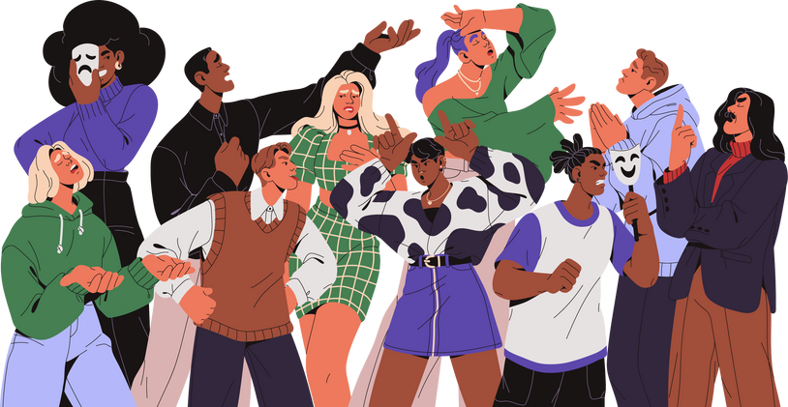
1.3a
What can a person’s voice teach us about them?

Slide 15

1.3b – thinking routine
The 3 whys
Think deeply about why sharing stories like Evonne Goolagong-Cawley’s – and hearing her voice – matters.
  Why might Evonne’s story matter to me?
  Why might it matter to the people around me?
  Why might it matter to the world?

Slide 16
1.4
Capturing perspectives through voice

Slide 17

1.4a – scripted work
Read ‘SCENE 16: THE HOLY COURT’
excerpt from Sunshine Super Girl.
As we are reading, look for clues in the dialogue which give actors hints about how the words and lines of dialogue should be delivered.

Slide 18

1.4b – thinking routine
Character motivation
Imagine yourself in the position of the character, Evonne, in this scene.
What can the character see or notice in this moment?
What does she know or believe?
What do you think she cares deeply about?
Is there anything she might be wondering or questioning?

Slide 19

1.4c – thinking routine
Now imagine you are the press.
What do they see or notice in this moment?
What do they know or believe?
What do you think they care about?
Is there anything they might be wondering or questioning?

Slide 20

1.4d – thinking routine
Here & now / There & then
What do you think the playwright, Andrea James, wanted us to see about identities, values and perspectives in Australia there & then?
How do you respond as an audience here & now engaging with this scene? What does this tell you about your own identities, values and perspectives?

Slide 21

1.4e – workshop
Let’s bring ‘SCENE 16: THE HOLY COURT’ to life on stage.
Our goal is to use voice to capture the perspective of the character, Evonne, and the values represented by the chorus of reporters in this dramatic moment.

Slide 22
1.5
Imagining the elements

Slide 23
1.5a – I do
My creative choices
Line of dialogue from Sunshine Super Girl | How I would use the dramatic elements | The effect my creative choices would have on what the audience see, think, feel or understand
“I’m the Wimbledon Freakshow” | Elements of production – lighting and sound I would put a spotlight on Evonne standing centre stage. The rest of the stage would be black and a track of laughing voices would play. | The spotlight would highlight Evonne’s horrified expression as she realises that she is an outcast at Wimbledon. The sounds of laughter coming from the darkness would imply she is being mocked by the crowd and reinforce that she is feeling alone in this moment.

Slide 24
1.5b – We do
Our creative choices
Line of dialogue from Sunshine Super Girl | How we would use the dramatic elements | The effect our creative choices would have on what the audience see, think, feel or understand
“There are 14,000 people seated around this court. Come to watch me play. There's more people here than the entire town of Barellan! More than Barellan, Griffith and West Wyalong combined!”

Slide 25
1.5c – You do
Your creative choices
Use the table to describe how you would use the elements of drama or elements of production
to enhance the identity, values and/or perspectives of the character or role you played in ‘The Holy Court’.
Line of dialogue from Sunshine Super Girl | How you would use the dramatic elements | The effect your creative choices would have on what the audience see, think, feel or understand

Slide 26
1.6
Vocal chorus

Slide 27

1.6a – scripted work
Read the first Chorus lines from Where in the World is Frank Sparrow? by Angela Betzien.
As we read, think about what you think a chorus is and why a playwright might use a chorus.

Slide 28
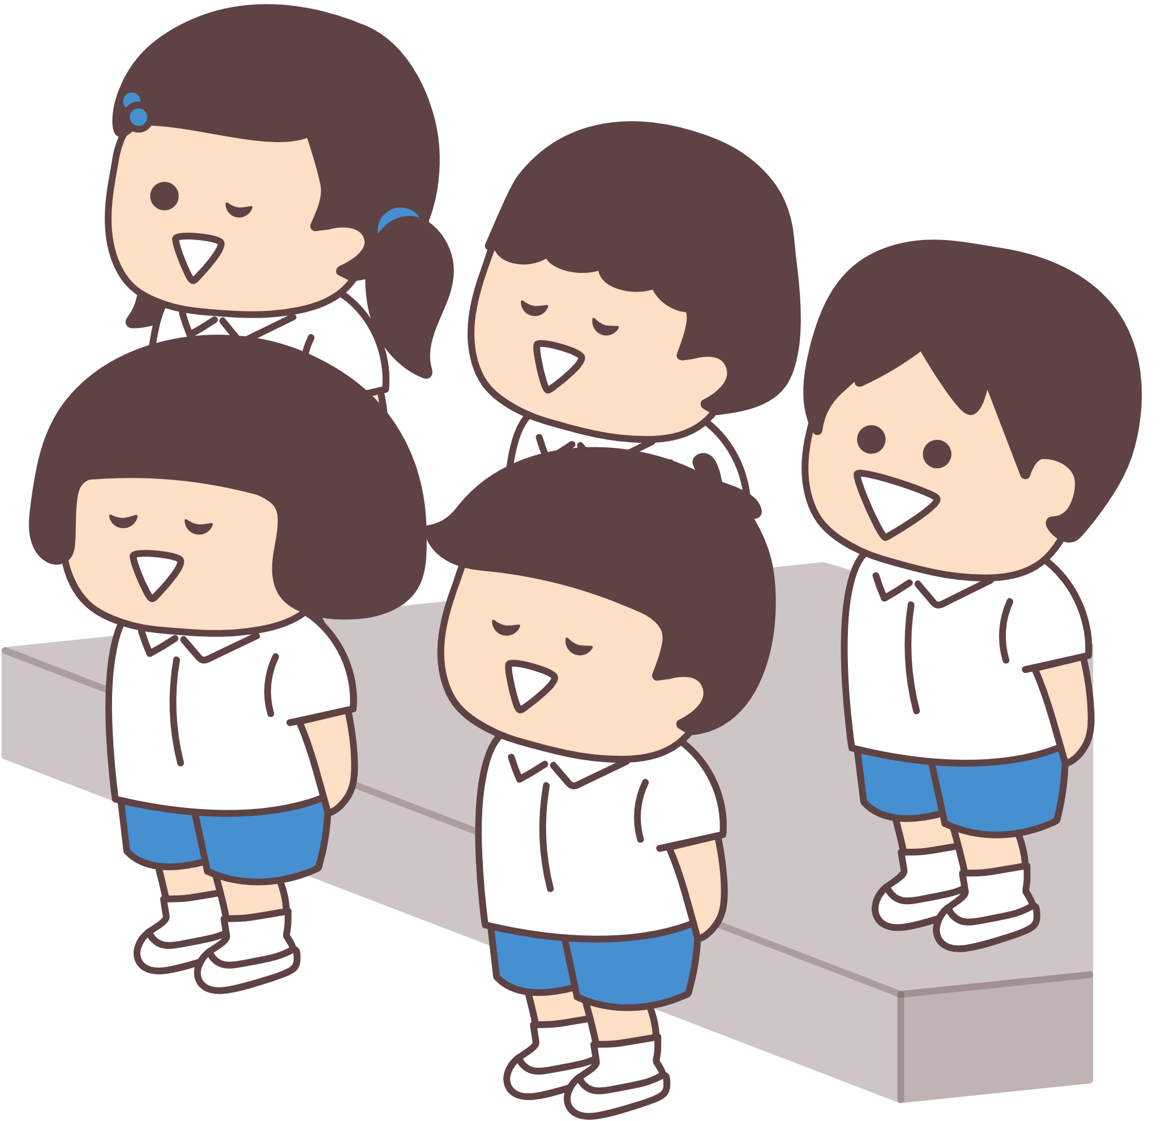
1.6b – define
What is a chorus?
In drama, a chorus is a group of performers who speak, sing or move together. They help to explain the story, give background details and draw focus to main ideas in the play.
The chorus often acts as the community’s voice, commenting on the main character’s actions and helping to shape the story.

Slide 29
1.6c – workshop
Let’s bring the Chorus excerpt to life on stage.
Our goal is to use our voices in unison with other actors and experiment with a range of vocal chorus techniques.

Slide 30
1.6d – define
Vocal chorus techniques
Make your vocal chorus more dynamic by experimenting with and incorporating some of these techniques.
read the whole excerpt in unison
speed up or slow down the pace
vary the pitch
layer the voices or gradually stagger their entry
add a delay or vocal echo
maintain a shared rhythm
create a call-and-response by speaking alternate phrases
vary the volume
add repetition
stagger the exit of voices
speak a section alone
select a phrase to say with the chorus echoing

Slide 31

1.6e – reflection
After each performance consider:
Which vocal chorus techniques were applied in the performance?
What makes you say that?

Slide 32

Learning sequence 2 –
Movement

Slide 33
Learning intentions and success criteria (2)
We are learning to interpret scripted works and select natural, heightened and abstract movements and intentionally apply them in performance.
I can:
identify and use safe processes to explore movement individually and with others
embody the differences between natural, heightened and abstract movements and apply these movements in improvisations
collaborate with my peers to create a chorus performance which includes a range of heightened and abstract movements
choreograph movements by interpreting stage directions in scripted works.
Notes:
Notes for teachers:
Dependent on school context and student needs, teachers may use this sample LISC as a starting point for unpacking unfamiliar, subject specific terminology with students. Teachers can refer to NESA’s Glossary and Teaching and learning support downloadable documents when unpacking these terms.
Learning intentions and success are best co-constructed with students. Adapt the learning intention as required and add matching success criteria.
For more information See ⁠AITSL or the NSW Department of Education explicit teaching strategies, ⁠Sharing learning intentions and ⁠Sharing success criteria
LISC is not necessarily presented at the beginning of the lesson. Teacher needs to consider most effectual time to introduce
LISC should be revisited during the lesson to support students' evaluation of their learning

Slide 34
2.1
Movement warm-up

Slide 35


2.1a – movement warm-up
3…2…1…statues!
Strike your best sneaky statue pose!
Each player takes turns making one swift move to tap an opponent’s hand or dodge a tap.
If both hands are tapped, that player is out.
The last sneaking statue standing wins.

Slide 36
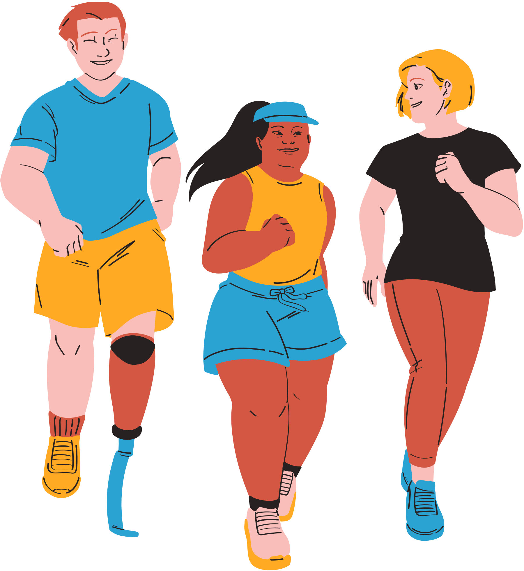
2.1b – movement warm-up
Energy walk
Walk around the room at comfortable pace.
Adapt your energy to match the energy your teacher calls out.
Adapt your energy for different everyday actions: brushing teeth, scanning groceries, mopping the floor, waving to a friend.

Slide 37

2.1c – movement warm-up
Scissors, paper, rock…with a twist
We will use our whole body.
Scissors: stand with arms in a “V” shape above your head to resemble the blades of scissors.
Paper: stand with arms straight out to your sides to replicate a flat paper surface.
Rock: curl into a ball or stand still with your body compacted to mimic a solid rock.

Slide 38
2.2
Types of movement

Slide 39
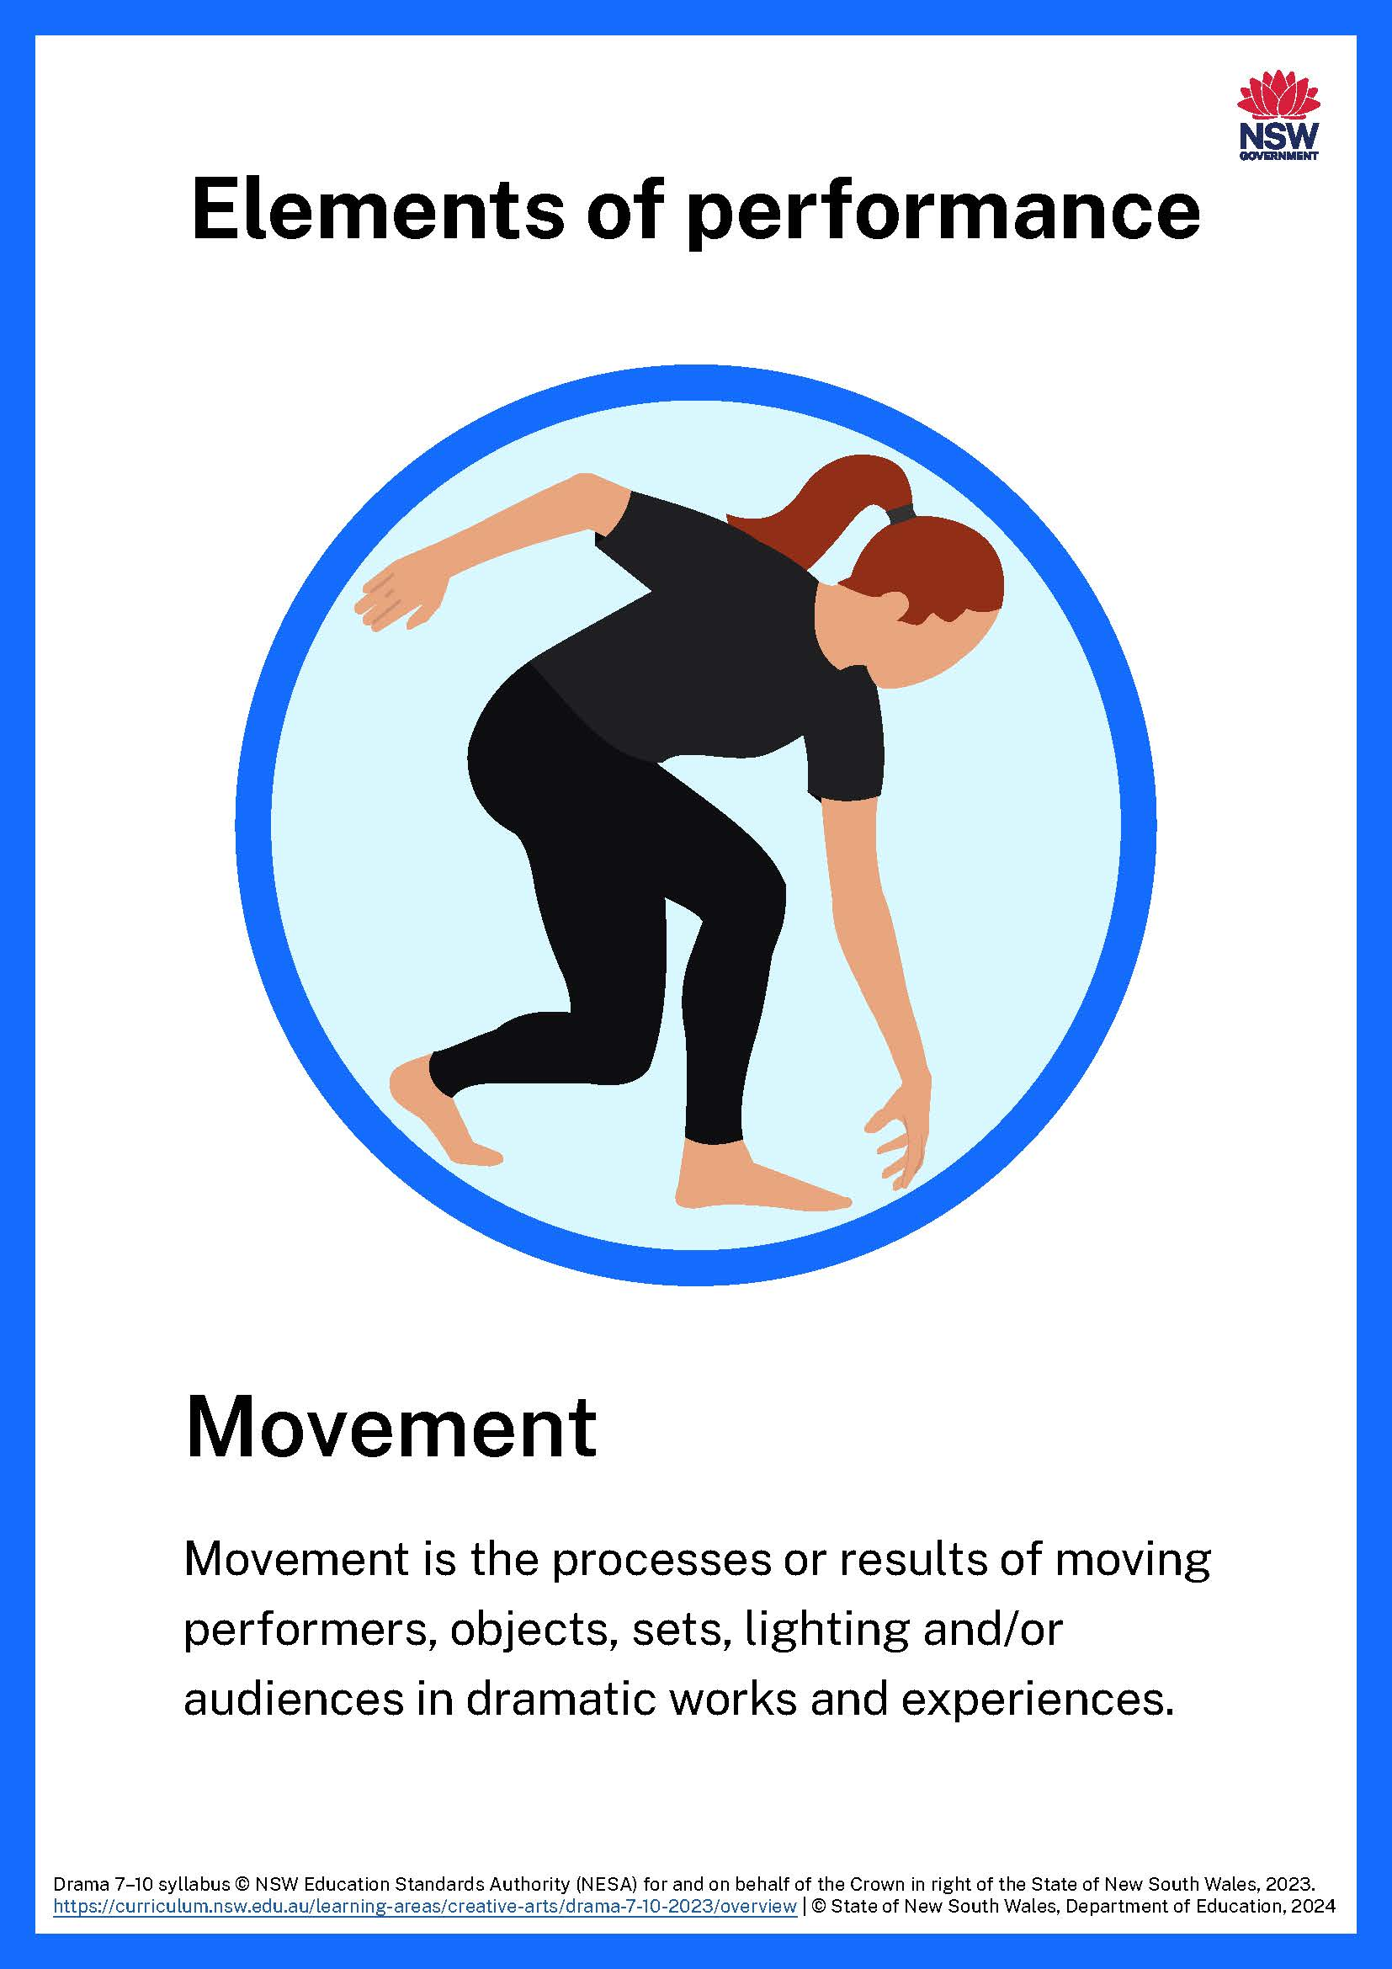
2.2a – define
What is movement?
Movement is the processes or results of moving performers, objects, sets, lighting and/or audiences in dramatic works and experiences. Movement includes:
breath and physical management
grounding techniques and neutral stance
natural movements
heightened movement
abstract movement
physical theatre
dance
puppetry
movement in relation to other elements, such as roles, characters, spaces, props, sets, lighting and technologies.
Drama 7–10 Syllabus © NSW Education Standards Authority (NESA) for and on behalf of the Crown in right of the State of New South Wales, 2023.

Slide 40
2.2b – define and embody
Natural movements
Any movement or action that we do every day.
For example, sitting on a chair, opening a door or putting on our backpacks.
Experiment with walking to and sitting on a chair, or putting on a backpack, in a natural way.

Slide 41
2.2c – define and embody
Heightened movements
An over-the-top version of the natural movement. It is still recognisable as the original movement, only the energy is exaggerated.
Repeat the original movement, but this time exaggerate it. Make it larger or much smaller, faster or slower, more intense or emotional.

Slide 42
2.2d – define and embody
Abstract movements
Shifts away from representing real life, everyday actions. Movement is broken into shapes, gestures or rhythms that do not closely resemble the original movement.
Repeat the original movement but use body shapes that are unnatural, use sudden jerking movements or create sharp angles.

Slide 43
2.2e – workshop
Let’s experiment with movement.
Our goal is to transform natural movements into heightened or abstract movements.

Slide 44
Before we begin …
2.2f – differentiation
What are some natural, everyday movements we could experiment with?

Slide 45
2.2g – reflection
Think-pair-share
Which movement type was most challenging for you as a performer?
What makes you say that?

Slide 46
2.3
Moving as a chorus

Slide 47
2.3a – scripted work
Re-read the Chorus lines from Where in the World is Frank Sparrow? by Angela Betzien.
Today you will work with your group to enhance your chorus role by adding heightened, or abstract movements.

Slide 48
2.3b – workshop
Let’s expand our chorus performance to include movement.
Our goal is incorporate heightened, or abstract movements.

Slide 49

2.3c – reflection
As an audience member, provide peer feedback to each group using the TAG strategy:
Tell them something you liked
Ask a thoughtful question
Give a positive suggestion

Slide 50
2.4
Interpreting and embodying movement from a script

Slide 51

2.4a – scripted work
Read ‘Scene 2’ from Boy Overboard by Patricia Cornelius .
Let’s explore how we might bring the stage directions to life by creating unique movements for each character.

Slide 52
2.4b – workshop
Let’s choreograph the movement in the stage directions.
Our goal is to create distinct characters with unique movements. Draw on your learning of natural exaggerated, and abstract movement.

Slide 53

2.4c – thinking routine
Headlines
Collect a sticky note
Write a headline that summarises and captures what you feel is significant or important about movement in creating scripted characters for performance.
Share your headlines with your peers, providing the story behind your choice of headline.

Slide 54


Energy, dynamics and Laban’s approach to movement
Learning sequence 3 –

Slide 55
Learning intentions and success criteria (3)
We are learning to develop and perform a character through experimentation with Laban’s approach to movement.
I can:
explore and apply energy and dynamics in movement
identify Laban’s efforts and experiment with using them in improvisation and scripted works
apply Laban’s efforts to communicate character traits interpreted from stage directions
apply and adapt Laban’s efforts to communicate dramatic action in a scripted scene.
Notes:
Notes for teachers:
Dependent on school context and student needs, teachers may use this sample LISC as a starting point for unpacking unfamiliar, subject specific terminology with students. Teachers can refer to NESA’s Glossary and Teaching and learning support downloadable documents when unpacking these terms.
Learning intentions and success are best co-constructed with students. Adapt the learning intention as required and add matching success criteria.
For more information See ⁠AITSL or the NSW Department of Education explicit teaching strategies, ⁠Sharing learning intentions and ⁠Sharing success criteria
LISC is not necessarily presented at the beginning of the lesson. Teacher needs to consider most effectual time to introduce
LISC should be revisited during the lesson to support students' evaluation of their learning

Slide 56
3.1
Warm-up

Slide 57
3.1a – define
What are energy and dynamics in voice and movement?
Energy is the intensity of action, particularly in voice or movement. Energy may also be considered in relation to other elements, such as tension and lighting.
It is useful to consider vocabulary related to volume or speed of voice and/or movement when using language to make and/or appreciate energy.
Vocabulary may include: quiet, strong, forceful, gentle, rapid, steady, heavy, light, huge, tiny, powerful or soft.
Dynamics are variations or changes, particularly in voice and/or movement. Dynamics can also be considered in relation to other elements, such as tension and sound.
It is useful to consider vocabulary related to change and continuity when using language to make and/or appreciate dynamics.
Vocabulary may include: shift, transition, transformation, contrast, increase, decrease, maintain or sustain.
Drama 7–10 Syllabus © NSW Education Standards Authority (NESA) for and on behalf of the Crown in right of the State of New South Wales, 2023.

Slide 58

3.1b – energy and dynamics warm-up
Mirror, mirror
Find a partner.
Determine who is Person A and who is Person B.
Stand opposite your partner.
Person A begins leading by moving a part of their body and Person B mirrors the movement.
Try varying the energy and dynamics of your movements as you become more confident.
Now switch so that Person B becomes the leader!

Slide 59

3.1c – energy and dynamics warm-up
Director’s cut
Imagine we are on a film set.
Nominate one person to play The Director.
Act out a scene until The Director calls ‘Cut!’.
The Director will give instructions to change the energy, dynamics or style of the performance. For example, “I want to see you transition to a fast paced, reality TV style!”
The Director calls ‘Action!’ and the scene begins again.
Now try it with a different director and different energy or dynamics!

Slide 60
3.2
Introduction to Laban’s movement analysis

Slide 61
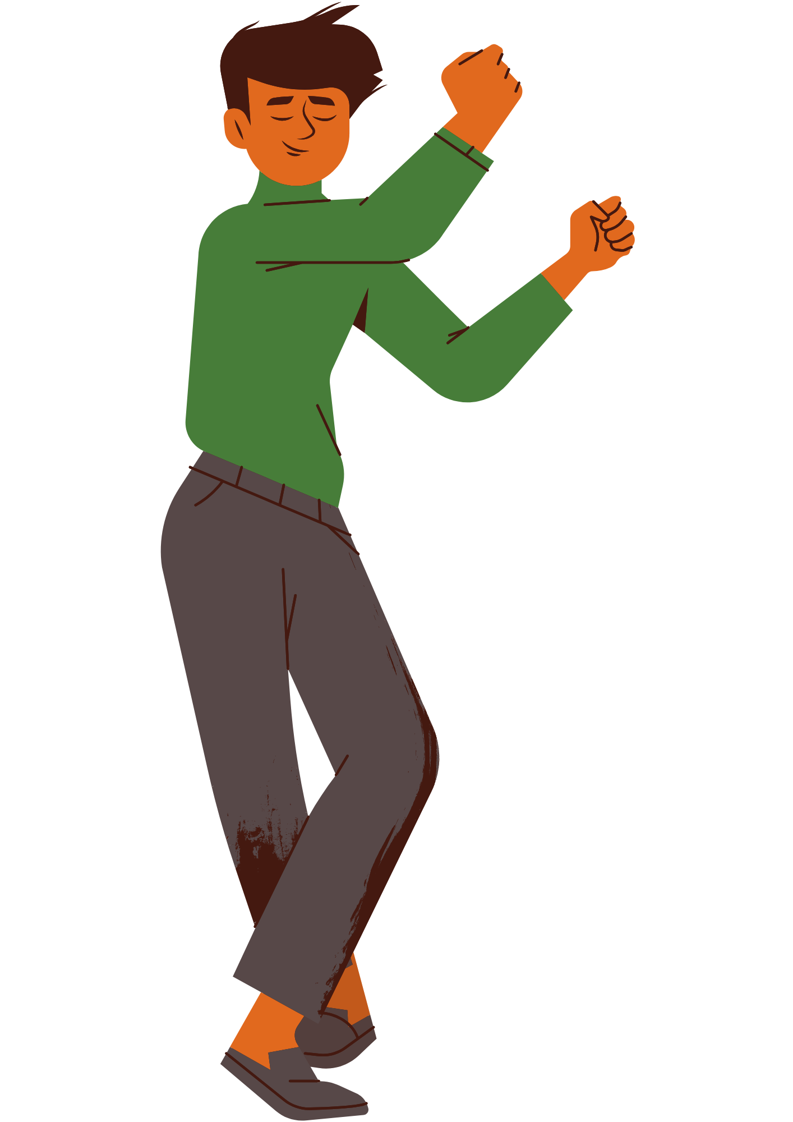
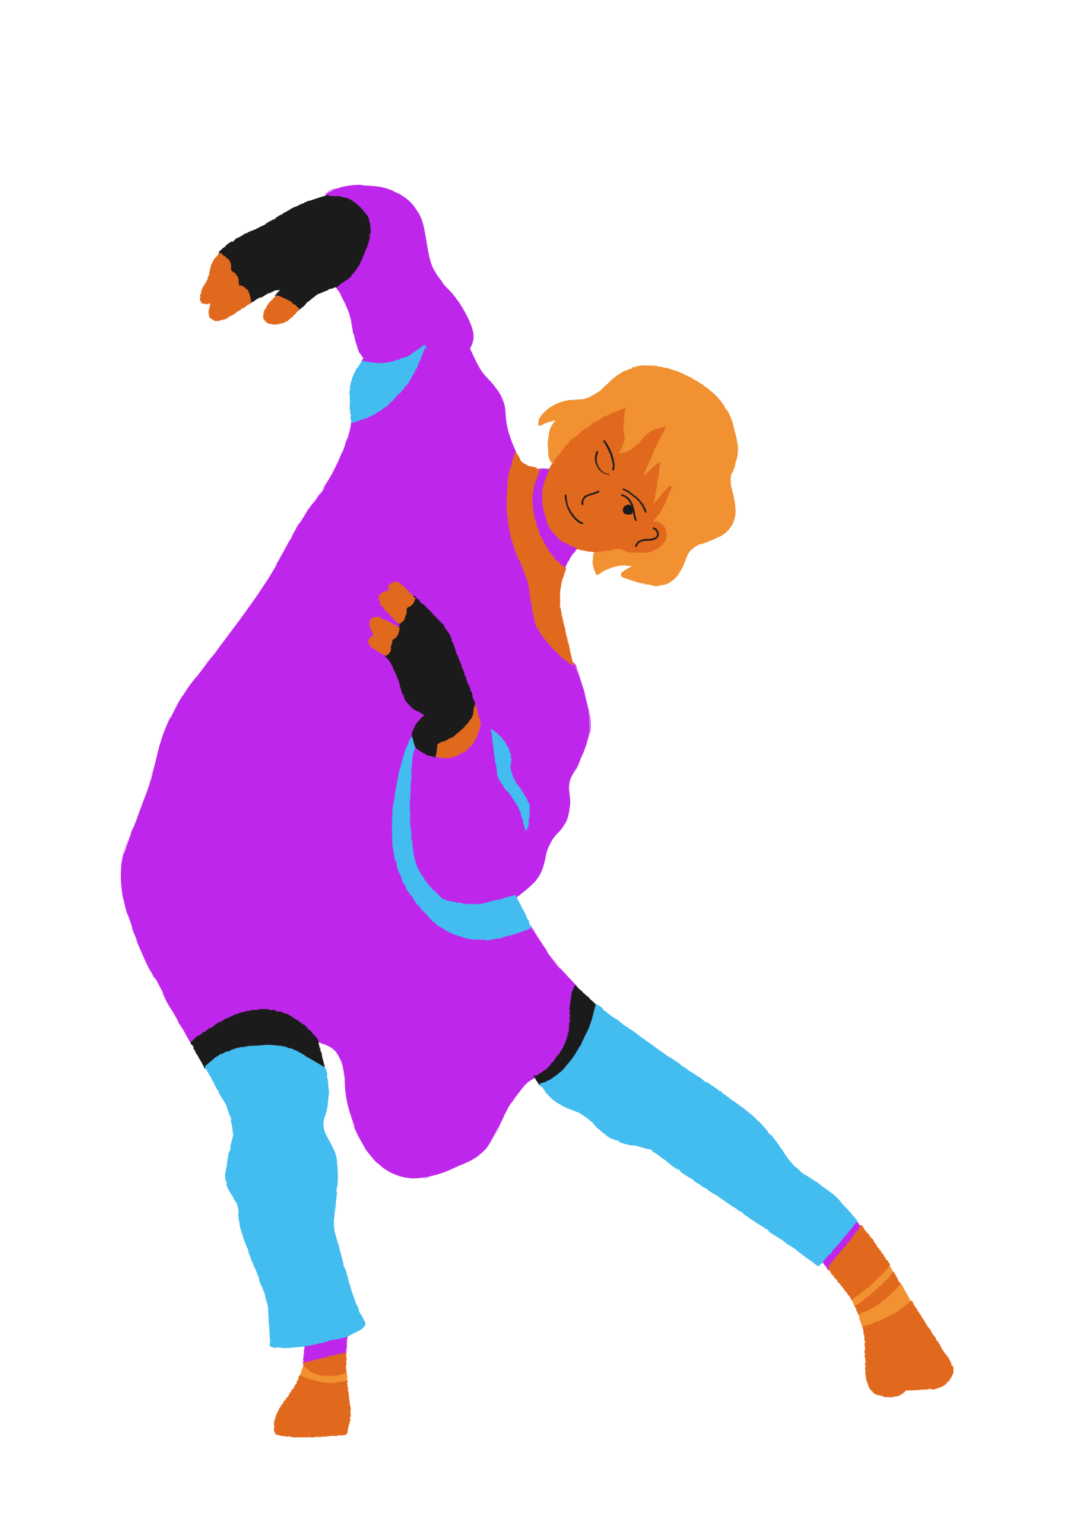
3.2a
Laban
Rudolf Von Laban was a choreographer and movement theorist who studied human motion.
He developed a system to categorise movement qualities.

Slide 62

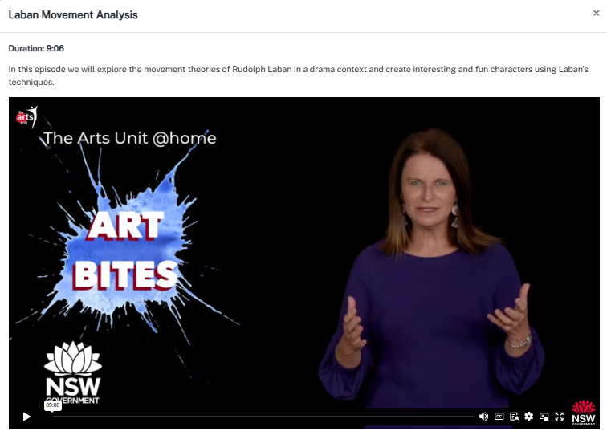
3.2b – context
Laban Movement Analysis
Notes:
Duration: 9:06
Play (00:28 – 05:15)

Slide 63
3.2c – define
Laban’s efforts
Effort | Weight | Space | Time | Energy
Punch | Heavy | Direct | Quick | Bound
Press | Heavy | Direct | Slow | Bound
Slash | Heavy | Indirect | Quick | Bound
Wring | Heavy | Indirect | Slow | Bound
Dab | Light | Direct | Quick | Free
Glide | Light | Direct | Slow | Free
Flick | Light | Indirect | Quick | Free
Float | Light | Indirect | Slow | Free

Slide 64

3.2d – define and embody
Which Laban effort would match the energy of this character?
Effort | Weight | Space | Time | Energy
Punch | Heavy | Direct | Quick | Bound
Press | Heavy | Direct | Slow | Bound
Slash | Heavy | Indirect | Quick | Bound
Wring | Heavy | Indirect | Slow | Bound
Dab | Light | Direct | Quick | Free
Glide | Light | Direct | Slow | Free
Flick | Light | Indirect | Quick | Free
Float | Light | Indirect | Slow | Free
Superhero

Slide 65

3.2e – define and embody
Which Laban effort would match the energy of this character?
Effort | Weight | Space | Time | Energy
Punch | Heavy | Direct | Quick | Bound
Press | Heavy | Direct | Slow | Bound
Slash | Heavy | Indirect | Quick | Bound
Wring | Heavy | Indirect | Slow | Bound
Dab | Light | Direct | Quick | Free
Glide | Light | Direct | Slow | Free
Flick | Light | Indirect | Quick | Free
Float | Light | Indirect | Slow | Free
Detective

Slide 66

3.2f – define and embody
Which Laban effort would match the energy of this character?
Effort | Weight | Space | Time | Energy
Punch | Heavy | Direct | Quick | Bound
Press | Heavy | Direct | Slow | Bound
Slash | Heavy | Indirect | Quick | Bound
Wring | Heavy | Indirect | Slow | Bound
Dab | Light | Direct | Quick | Free
Glide | Light | Direct | Slow | Free
Flick | Light | Indirect | Quick | Free
Float | Light | Indirect | Slow | Free
Firefighter

Slide 67

3.2g– define and embody
Which Laban effort would match the energy of this character?
Effort | Weight | Space | Time | Energy
Punch | Heavy | Direct | Quick | Bound
Press | Heavy | Direct | Slow | Bound
Slash | Heavy | Indirect | Quick | Bound
Wring | Heavy | Indirect | Slow | Bound
Dab | Light | Direct | Quick | Free
Glide | Light | Direct | Slow | Free
Flick | Light | Indirect | Quick | Free
Float | Light | Indirect | Slow | Free
Pirate

Slide 68

3.2h – define and embody
Which Laban effort would match the energy of this character?
Effort | Weight | Space | Time | Energy
Punch | Heavy | Direct | Quick | Bound
Press | Heavy | Direct | Slow | Bound
Slash | Heavy | Indirect | Quick | Bound
Wring | Heavy | Indirect | Slow | Bound
Dab | Light | Direct | Quick | Free
Glide | Light | Direct | Slow | Free
Flick | Light | Indirect | Quick | Free
Float | Light | Indirect | Slow | Free
Librarian

Slide 69
3.3
Applying effort to character

Slide 70
3.3a – thinking routine
Peel the fruit
Let’s peel back the layers of this character.
What do we know about Ernie?
Which words give us this insight?
How might this character stand?
How might this character move?
Which of Laban’s effort actions might best match this character’s energy?
How might you communicate these traits to an audience in performance?
What makes you say that?
Ernie
(F) Strong, natural leader. She's from a large family and has had to grow up fast. She is patient, warm, practical and charismatic.
Kemp J (2022) Shack, Playlab Theatre, Australia.

Slide 71
3.3b – scripted work
Your Turn!
Read the notes for your character and choose the best Laban effort to communicate their character through movement.
Mack
Jasper
Sadie
(M) Tries his very best. Something in the back of his brain holds him back and, try as he might, he can’t quite shake it. He suffers from anxiety and is more comfortable reading fantasy novels or playing boardgames than being the “hero” of a play.
(M) He marches to the beat of his own drum. He gets bullied at school by the boys and finds he is more comfortable in the company of girls. He is always being told that he is not strong, when on the inside he might just be the strongest of them all.
(F) Goodie-two-shoes but not in a bad way. Her mum’s dreams of success never panned out, so they sure as hell will with Sadie. Her hair is up in a tight dancer’s bun. She has a good heart – empathy is her strong suit.
Kemp J (2022) Shack, Playlab Theatre, Australia.

Slide 72
3.3c – scripted work
Luke
Samson
(M) A good kid. His parents are separating and their fighting is starting to take a toll on him. His way of getting through is to observe and be helpful.
(F) She’s smart, but the idea of someone knowing that about her is horrifying. It’s much easier to be dumb and blend in. Being uninformed is waaaaay cooler.
Rufus
(M) Rufus’s dad’s advice “come on son, be a man rings loud in Rufus’s ears. He’s an only child and has an inflated sense of his own power and ability. He is ill-informed and irrational but actually he's just desperate to impress.
Elliot
(F) Elliot is Jamie’s identical twin sister. She loves being a twin
Kemp J (2022) Shack, Playlab Theatre, Australia.

Slide 73
3.4
Staging script
with Laban

Slide 74
3.4a – scripted work
Divide into 2 groups and access either ‘SCENE ONE’ or ‘SCENE TWO’ from Shack by Georg Kemp.
As you read, think about how we might bring the stage directions to life by creating unique movement energy and dynamics for each character.

Slide 75
3.4b – workshop
Let’s bring a character to life on stage!
Our goal is to choose the best Laban efforts to embody each character’s energy and dynamics through movement.

Slide 76


Expression, clarity and Stanislavski’s approach to acting
Learning sequence 4 –

Slide 77
Learning intentions and success criteria (4)
We are learning to experiment with Stanislavski’s approach to acting to interpret scripted work and strengthen the expression and clarity of our performance skills.
I can:
collaborate with my peers to define and interpret Stanislavski’s approach to acting
explore expression and clarity in my voice and movement to demonstrate my character’s objectives in a scene
use Stanislavski’s approach to identify and embody the given circumstances of a scripted scene
explore ways of expressing the underlying meaning or emotion inferred through my character’s dialogue
take creative risks with my group to apply Stanislavski’s approach to characterisation and Laban’s approach to movement to a new scene.
Notes:
Notes for teachers:
Dependent on school context and student needs, teachers may use this sample LISC as a starting point for unpacking unfamiliar, subject specific terminology with students. Teachers can refer to NESA’s Glossary and Teaching and learning support downloadable documents when unpacking these terms.
Learning intentions and success are best co-constructed with students. Adapt the learning intention as required and add matching success criteria.
For more information See ⁠AITSL or the NSW Department of Education explicit teaching strategies, ⁠Sharing learning intentions and ⁠Sharing success criteria
LISC is not necessarily presented at the beginning of the lesson. Teacher needs to consider most effectual time to introduce
LISC should be revisited during the lesson to support students' evaluation of their learning

Slide 78
4.1
Warm-up

Slide 79
4.1a – define
What are expression and clarity in voice and movement?
Expression is the communication of ideas, images and emotions by the performer. It is useful to consider vocabulary related to the character’s intention or emotional quality of voice and/or movement when using language to make and/or appreciate expression. Vocabulary may include: impatient, gentle, aggressive, excited, pensive, deceptive or playful.
Clarity is clear communication in relation to intention and context, particularly in voice and movement. Clarity may also be considered in relation to other elements, such as character, language and symbol.
Drama 7–10 Syllabus © NSW Education Standards Authority (NESA) for and on behalf of the Crown in right of the State of New South Wales, 2023.

Slide 80
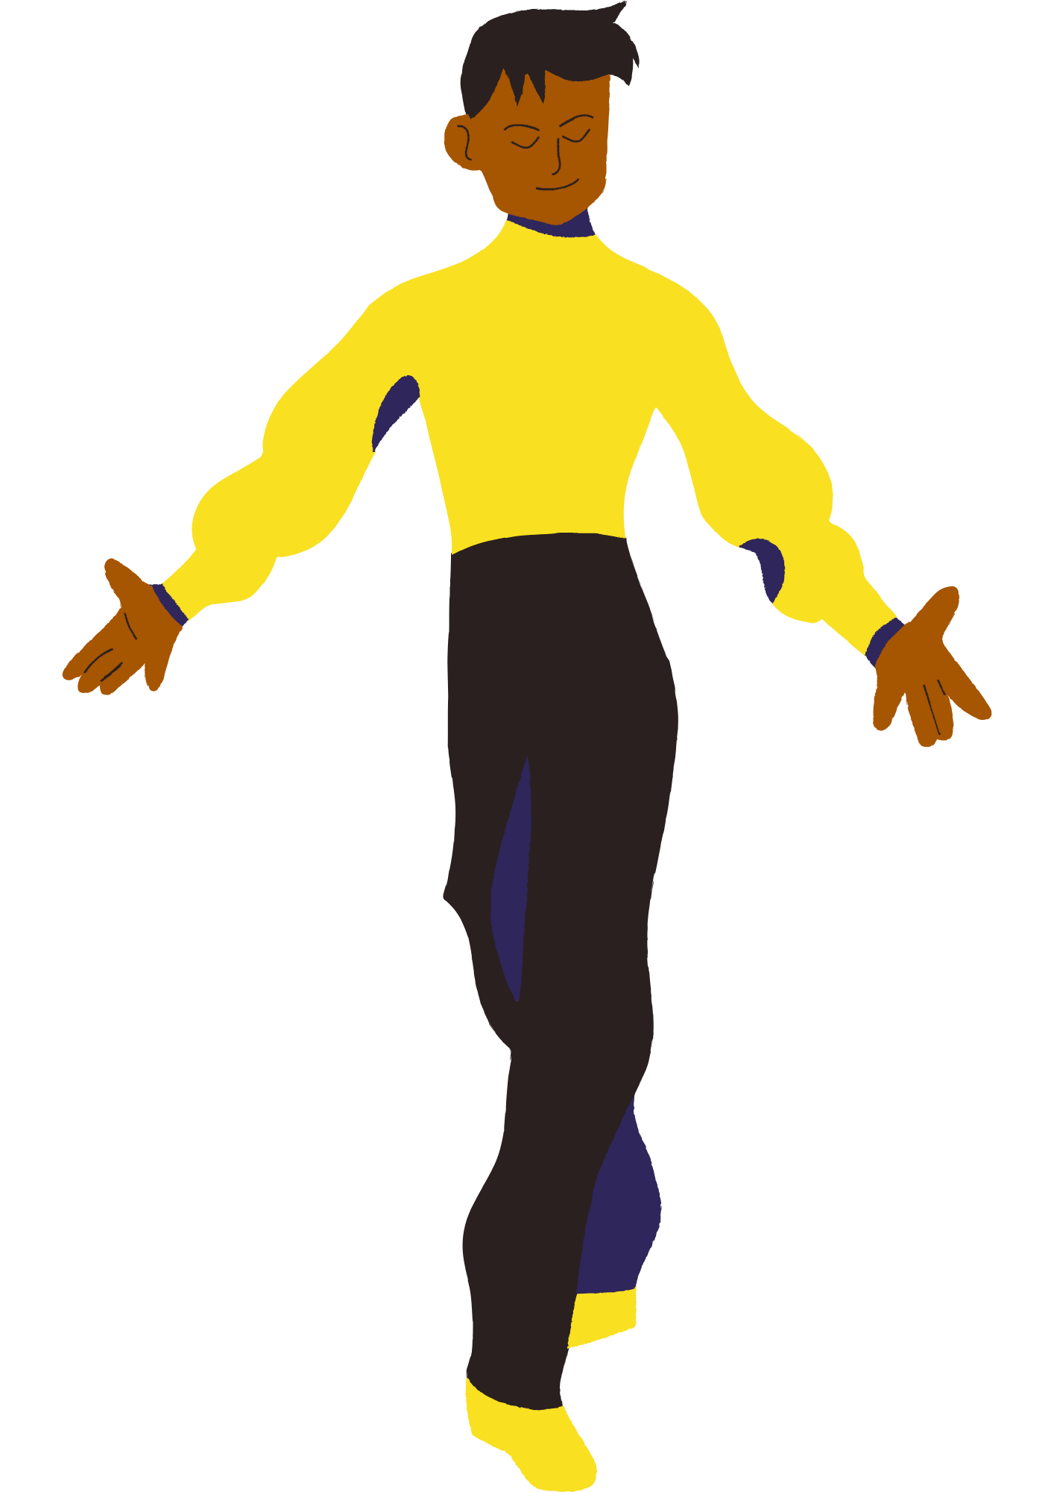
4.1b –expression and clarity warm-up
Mean what you say, say what you mean
The ocean is blue
Choose a simple phrase, such as ‘The sun is shining’ or ‘The ocean is blue’.
Inhale deeply and project your voices as you say the phrase, focusing on clarity and volume.
Next, experiment with saying the phrase at different volumes and speeds while maintaining clarity and breath control.
Play with expression by changing the emotional quality of your voices, each time your teacher calls out a new prompt.

Slide 81
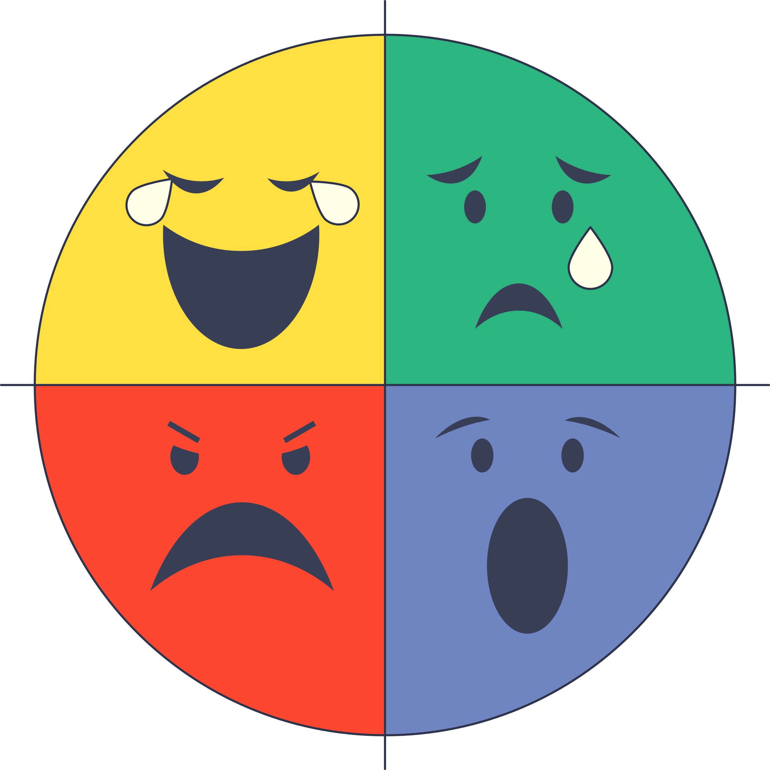
4.1c –expression and clarity warm-up
Emotion shift
Form group of 2 or 3.
Improvise a simple scene in a neutral emotion.
When your teacher calls out a new emotion, shift the expression of your voice and movement to accept the emotional offer while continuing the scene!
This time change the entire scene to match the new emotional state.

Slide 82

4.1d–expression and clarity warm-up
Living artwork
Look at the artwork.
Create a freeze frame embodying the figure/s depicted.
When the teacher points to you, bring the artwork to life with expression and clarity in voice and movement.
Now do something completely unexpected!
Notes:
Artworks to use/display for this activity could include: Beyond the Coastal Watch by Dennis Golding, The Scream by Edvard Munch, Frog Girl by Yoshitomo Nara, Oath of the Horatii by Jacques-Louis David, Displaced by Vincent Namatjira, Sunday Evening by Russel Drysdale, Unfamiliar People by Takashi Murakami, Collins St, 5pm by John Brack, Hanging Rock 1900 by Polixeni Papapetrou, La Classe de dance by Edgar Degas, Enchantments - Letter to Ludwig Leichhardt by Christian Thompson, The Potato Eaters by Vincent van Gogh or I Want to Thrive and Not Just Survive by Charlotte Allingham.

Slide 83
4.2
Introduction to Stanislavski’s approach to acting

Slide 84

4.2a – context
Stanislavski
Konstantin Stanislavski was a Russian character actor and theatre director.
He developed a system of actor training and script analysis that allowed for truth and belief in characterisation to be fundamental skills of acting.

Slide 85
4.2b – reflection
Donut
Why might being truthful and believable on stage be important for an actor?
How could truthful or believable acting impact the audience?
What choices might actors make to shape a complex and believable character?
What makes you say that?

Slide 86

4.2c
Expert jigsaw
Form groups of 4 and assign each group member a number from 1 to 4 .
Go to the station in the classroom that corresponds to your number.
Read through the information provided and take note of key points to share.
Return to your home group and take turns sharing what you learned.

Slide 87

4.2d– find and define
1
Beats and objectives
2
Subtext
Stanislavski
3
Given circumstance
4
Magic if

Slide 88
4.4
Given circumstances

Slide 89
4.4a – scripted work
Access the setting notes and ‘PROLOGUE’ from The Book of Everything adapted by Richard Tulloch
As a class, let’s analyse and uncover the given circumstances in the script.

Slide 90

4.4b – reflection
In exactly 32 words…
…explain how understanding the given circumstances can make characterisation clearer, more expressive and create greater belief in performance.
Document your answer in writing.

Slide 91
4.5
Subtext

Slide 92
4.5a – scripted work
Access ‘SCENE ONE’ from The Book of Everything.
In groups of 5, agree who will read each of the 4 character’s lines and who will read the stage directions.
Read the script excerpt with your group.
Listen for clues about what characters might be thinking or feeling beneath their spoken words.

Slide 93
4.5b – workshop
Let’s convey underlying meaning or emotions through performance.
Our goal is to convey subtext through our vocal and movement expression.

Slide 94

4.5c – reflection
Uncovering subtext
What words were spoken?
What were the thoughts or feelings beneath the words (subtext)?
Describe what you saw the actor do on stage to imply that subtext.
Clues could include dynamics, clarity, energy and expression in voice and movement.

Slide 95
4.6
Beats and objectives

Slide 96

4.6a
Objective shifts
Form pairs and improvise a scene on a boat.
Each decide on a clear objective to start the scene.
Improvise the scene, making your character’s objective clear to the audience.
When the teacher calls out a new objective, take a ‘beat’ before quickly adjusting your vocal expression and movement to match!

Slide 97
4.6b
Starting objectives
Select a clear objective for your character.
To convince the other person to stay. | To get the other person to leave. | To win an argument. | To hide a secret.
To cheer the other person up. | To impress the other person. | To avoid answering a question. | To beg for forgiveness.
To get the other person to agree with you. | To distract the other person. | To make the other person feel guilty. | To calm the other person down.
To annoy the other person. | To make the other person laugh. | To gain the other person’s trust. | To get the other person to leave something behind.

Slide 98
4.7
Demonstrating
our learning in performance

Slide 99
4.7a – scripted work
Access ‘Scene 2’
from Compass.
Let’s show what we have learned about Stanislavski’s methods by embodying a character with belief and complexity.

Slide 100
4.7b – workshop
Let’s apply Stanislavski’s methods to a performance.
Our goal is to create complexity in our portrayal of characters by exploring and embodying given circumstances, beats, objectives and subtext.

Slide 101
4.7c – thinking routine
Colour. Symbol. Image.
Annotate your script excerpt to document your creative and critical process.
Choose a colour that you feel best represents or captures your character’s original objective.
Choose a symbol that represents the objective.
Draw an image that represents the objective.
Repeat this routine to document a beat in which your character’s objective shifted.

Slide 102

Rehearse and document
Learning sequence 5 –

Slide 103
Learning intentions and success criteria (5)
We are learning to refine and rehearse our scripted performance and document our character development choices through a multimodal presentation.
I can:
unpack the requirements of the assessment task and identify the steps I need to follow to be successful
apply a range of strategies to document the planning, development and refinement of my character
use rehearsal strategies and feedback to make improvements to the creation and journey of my character.
Notes:
Notes for teachers:
Dependent on school context and student needs, teachers may use this sample LISC as a starting point for unpacking unfamiliar, subject specific terminology with students. Teachers can refer to NESA’s Glossary and Teaching and learning support downloadable documents when unpacking these terms.
Learning intentions and success are best co-constructed with students. Adapt the learning intention as required and add matching success criteria.
For more information See ⁠AITSL or the NSW Department of Education explicit teaching strategies, ⁠Sharing learning intentions and ⁠Sharing success criteria
LISC is not necessarily presented at the beginning of the lesson. Teacher needs to consider most effectual time to introduce
LISC should be revisited during the lesson to support students' evaluation of their learning

Slide 104
5.1
Warm-up

Slide 105

5.1 – movement warm-up
Find an individual space.
Think of one of Laban’s efforts to explore (light/heavy, quick/slow).
Enact your normal morning routine, embodying your chosen effort.
Focus on how your movements communicate character and objectives.
Finish with a moment of stillness. Focus and reflect on your movement choices and how these helped to create character.

Slide 106
5.2
Unpacking the task

Slide 107
5.2a – Assessment Part A
Scripted performance
This is an opportunity for you to showcase your performance skills by crafting and enacting a script excerpt you have explored in class. You can work individually or in a group to shape and perform your chosen scripted scene or moment. In your performance, you will demonstrate your ability to
apply and adapt voice, movement and embodied processes to communicate a character’s journey to the audience
select and apply the elements of drama and performance that are most appropriate to the style and conventions of your chosen script excerpt
use costume and/or props to enhance characterisation.

Slide 108
5.2b – Assessment Part B
Multimodal character analysis
This individual submission/presentation is an opportunity for you to document and share the dramatic processes and creative choices that helped you to shape intention and meaning. You need to document how you developed, refined and embodied your chosen character in Part A of this task. You will need to document how you:
interpreted the script
adopted a performance approach
used dynamics, clarity, energy and expression in voice and/or movement to create and communicate your character’s journey to the audience .
Your character analysis needs to be presented in a multimodal form, which means it needs to combine 2 or more expressive modes to communicate. These could include visual images, audio, video, written reflections and annotations, and/or embodied ideas.

Slide 109
5.2c – thinking routine
Word, phrase, sentence
As you read Part A of the task, highlight:
a word that captures your attention
a phrase that stands out as significant
a sentence that captures the core purpose of the task.
Share your word, phrase and sentence with the class.
When everyone has shared, ask yourself ‘Are there any details of the task that we have not yet captured?’
Repeat this thinking routine for Part B.

Slide 110
5.2d – modelled steps to success
Part B – multimodal character analysis
Choose your character:
Select a character from the script that you feel passionate about or intrigued by. Consider their motivations, relationships, and key moments in the scene.
Deep dive into the script:
Read the script thoroughly to understand the context and background of your character. Highlight key phrases, dramatic action, and dialogue that defines your character’s voice, movement and journey.
Interpret the character:
Analyse your character’s traits, objectives, and development throughout the script. Reflect on questions such as:
What do they want?
What challenges do they face?
How do they change from the beginning to the end?

Slide 111
5.2e – modelled steps to success
Part B – multimodal character analysis
Adopt a performance approach:
Decide on a performance style that suits your character. Consider aspects such as:
Tone of voice
Physicality and movement
Emotion and expression
Experiment with dynamics:
Practice delivering lines with varying dynamics to understand how energy and expression affect the character’s portrayal. Record yourself to assess your performance and make adjustments.

Slide 112
5.2f – modelled steps to success
Part B – multimodal character analysis
Document your process:
Throughout the rehearsal process. keep a record of all the creative choices you make when developing and embodying the character. This could include:
Notes on script interpretation
Decisions made during character development
Feedback from peers or teachers
Create a multimodal presentation:
Choose at least 2 expressive modes to present your character analysis. Possible combinations could include:
Visual images: create a mood board or character collage.
Audio: record your character’s monologue or a reflective piece about their journey.
Video: film a short performance or interpretation of a key scene.
Written reflections: annotate your script or write a reflective essay on your creative choices.

Slide 113
5.2g – guided steps to success
Part B – multimodal character analysis
Rehearse your presentation:
Gather feedback:
Finalise and present:

Slide 114
5.3
Selecting a script

Slide 115
Thinking about the 3 scripts excerpts you enjoyed the most, complete a PMI for each
5.3a
+
?
Plus
Minus
Interesting

Slide 116

Selecting your scripted scene
5.3b
1
2
3
4
5
Which scripted scene would you most like to stage?
Why do you say that?
What do you already know about it?
How do you know that?
What do you need to know about it?

Slide 117
Selecting your character
5.3c
1
2
3
4
5
Which character would you like to play?
Why do you say that?
What do you already know about them?
How do you know that?
What do you need to know about them?

Slide 118



5.3d
2
Intention
Ideas – What do you want to communicate to the audience?
[insert responses]
Response – How do you want the audience to respond?
[insert responses]
1
Interpretation
3
Creative choices
Style – What is the style of the script?
[insert responses]
Approach – What practitioner approach/es will work best?
[insert responses]
Conventions – What clues does the script give you about how to stage the scene?
[insert responses]
Elements – How could costume and/or props enhance character?
[insert responses]
Character – What is your character’s journey?
[insert responses]

Slide 119
5.4
Documenting character analysis

Slide 120


5.4a – pair-share-care
Share your draft work with a partner
When evaluating your own work, and exchanging peer feedback, think about:
Something positive – what are the strengths you see in this work?
Something constructive – what are some alternatives, next steps, or things to improve?
Peer feedback protocols:
Form pairs and review each others work using the steps below.
Be kind and constructive – focus on your peer’s strengths, and give helpful suggestions
Multimodal maker
You have 2 minutes to explain your draft and ideas to your peer.
Peer reviewer
They have 2 minutes to ask you questions about your draft.
Then they have 3 minutes to give feedback: 2 minutes of silent time to write and then one minute for verbal feedback.
Multimodal maker
You have 2 minutes to respond to the feedback and thank your classmate for their suggestions.
Document their feedback and action it as you refine your multimodal presentation.

Slide 121
5.5
Rehearsing scripted work

Slide 122
5.5a – reflection
Ladder of feedback
As an actor, share your work. As an audience member, provide peer feedback. Use the 4 steps of the feedback ladder.
Clarify – actor asks questions to gauge audience response
Value – audience offers what worked well
Concerns – audience offers what could be improved
Suggestions – audience offers how this could be achieved

Slide 123

Perform-share-reflect
Learning sequence 6 –

Slide 124
Learning intentions and success criteria (6)
We are learning to apply, share and reflect on what we have learned about crafting a character from a scripted work.
I can
apply and adapt dramatic elements and performance skills in a scripted performance
use performance skills to communicate my character to an audience and demonstrate qualities of a respectful and supportive audience member
document and analyse how my creative choices and use of dramatic elements shaped my performance of a character
reflect on the ways my understanding of character development has developed.
Notes:
Notes for teachers:
Dependent on school context and student needs, teachers may use this sample LISC as a starting point for unpacking unfamiliar, subject specific terminology with students. Teachers can refer to NESA’s Glossary and Teaching and learning support downloadable documents when unpacking these terms.
Learning intentions and success are best co-constructed with students. Adapt the learning intention as required and add matching success criteria.
For more information See ⁠AITSL or the NSW Department of Education explicit teaching strategies, ⁠Sharing learning intentions and ⁠Sharing success criteria
LISC is not necessarily presented at the beginning of the lesson. Teacher needs to consider most effectual time to introduce
LISC should be revisited during the lesson to support students' evaluation of their learning

Slide 125



6.3 – reflection A
Reflect on your experience of crafting a character and performing scripted work
A positive success or highlight
Something you are looking forward to
A challenge experienced

Slide 126
Now, I think…
6.5 – reflection B
I used to think…

Slide 127
References
This presentation contains NSW Curriculum and syllabus content. The NSW Curriculum is developed by the NSW Education Standards Authority. This content is prepared by NESA for and on behalf of the Crown in the right of the State of New South Wales. The material is protected by Crown copyright.
Please refer to the NESA Copyright Disclaimer for more information https://educationstandards.nsw.edu.au/wps/portal/nesa/mini-footer/copyright.
NESA holds the only official and up-to-date versions of the NSW Curriculum and syllabus documents. Please visit the NSW Education Standards Authority (NESA) website https://educationstandards.nsw.edu.au/wps/portal/nesa/home and the NSW Curriculum website https://curriculum.nsw.edu.au.
Drama 7-10 Syllabus © NSW Education Standards Authority (NESA) for and on behalf of the Crown in right of the State of New South Wales, 2023.
Bellamy J (2013) Compass, Playlab Theatre, Australia.
Betzien A (2012) Where in the World is Frank Sparrow?, Playlab Theatre, Australia.
Cornelius P (2007) Boy Overboard, Currency Press Sydney, Australia.
Davis J (1987) Honey Spot, Currency Press Sydney, Australia.
James A (2021) Sunshine Super Girl, Currency Press Sydney, Australia.
Kemp J (2022) Shack, Playlab Theatre, Australia.
Tulloch R (2011) The Book of Everything, Currency Press, Australia.
The Arts Unit, Art Bites – Laban Movement Analysis, NSW Department of Education website, accessed 16 June 2025.

Slide 128
Copyright
© State of New South Wales (Department of Education), 2024
The copyright material published in this resource is subject to the Copyright Act 1968 (Cth) and is owned by the NSW Department of Education or, where indicated, by a party other than the NSW Department of Education (third-party material).
Copyright material available in this resource and owned by the NSW Department of Education is licensed under a Creative Commons Attribution 4.0 International (CC BY 4.0) licence.
This licence allows you to share and adapt the material for any purpose, even commercially.
Attribution should be given to © State of New South Wales (Department of Education), 2024.
Material in this resource not available under a Creative Commons licence:
the NSW Department of Education logo, other logos and trademark-protected material
Material owned by a third party that has been reproduced with permission. You will need to obtain permission from the third party to reuse its material.
Links to third-party material and websites
Please note that the provided (reading/viewing material/list/links/texts) are a suggestion only and implies no endorsement, by the New South Wales Department of Education, of any author, publisher, or book title. School principals and teachers are best placed to assess the suitability of resources that would complement the curriculum and reflect the needs and interests of their students.
If you use the links provided in this document to access a third party’s website, you acknowledge that the terms of use, including licence terms set out on the third-party’s website apply to the use which may be made of the materials on that third-party website or where permitted by the Copyright Act 1968 (Cth). The department accepts no responsibility for content on third-party websites.

