Slide 1
Instructions for use
This resource is not a teaching and learning program. It should be used in conjunction with (Insert unit name and link).
Classroom teachers are encouraged to add and adapt slides as required to meet the needs of their students.
Save a copy of the file to make changes to the slide deck. Go to File > Download a Copy (this downloads a copy to the computer to edit in the PowerPoint app).
To convert the PowerPoint to Google Slides:
  Upload the file into Google Drive and open it.
  Go to File > Save as Google Slides.
  (Note – conversion may cause formatting changes in the slides.)

Slide 2

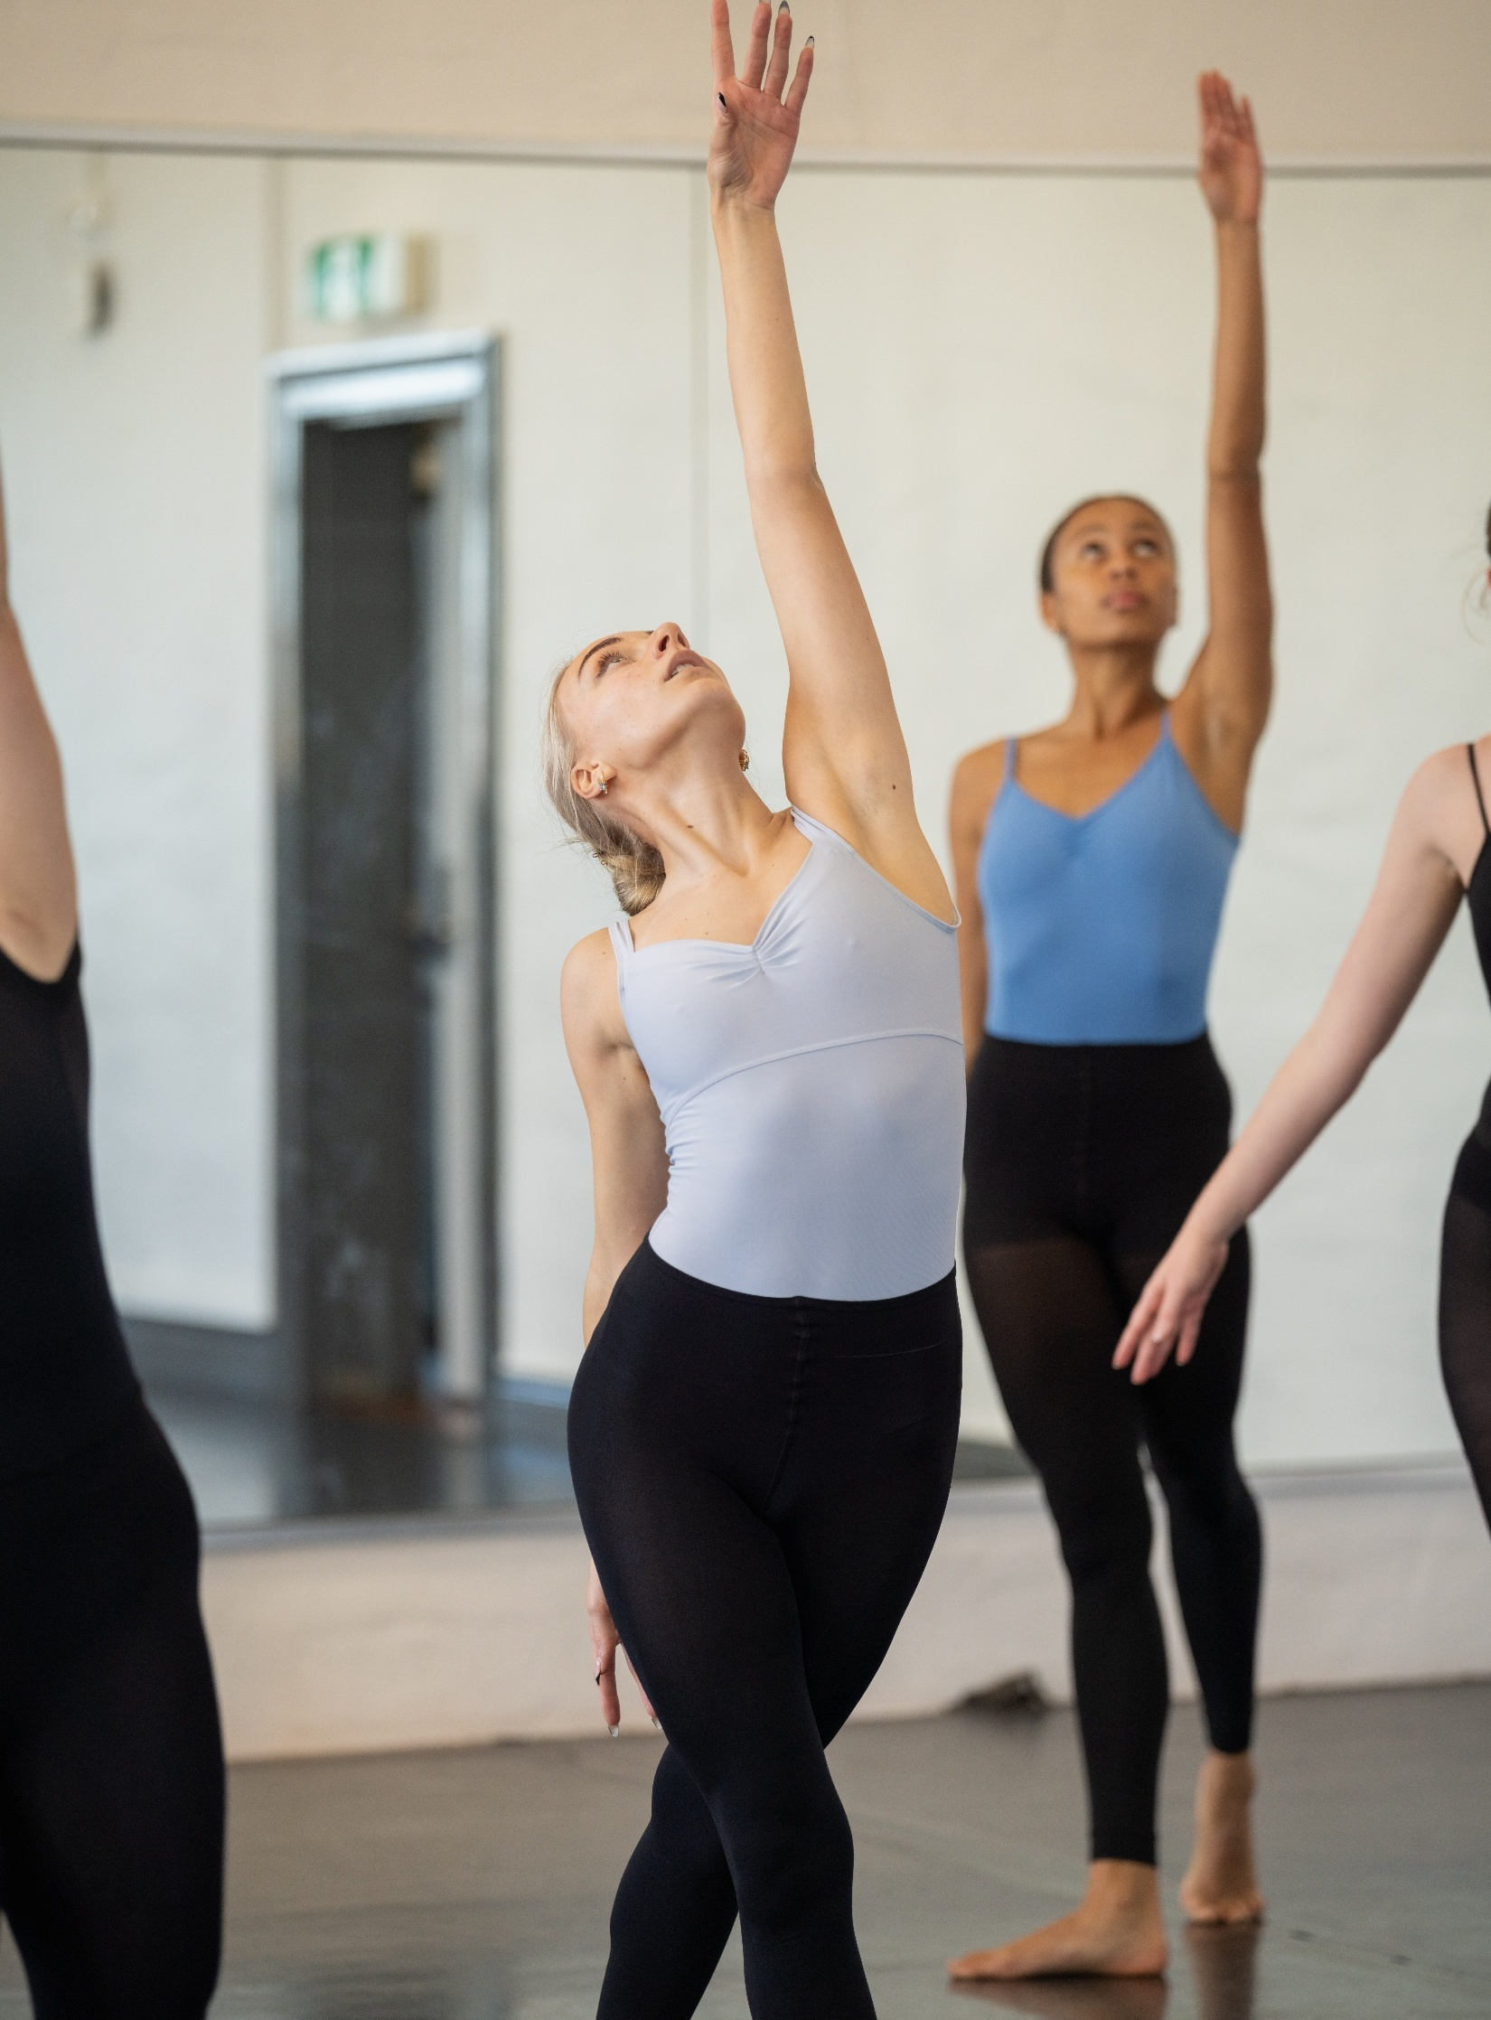
Performance
Dance – Year 11

Slide 3
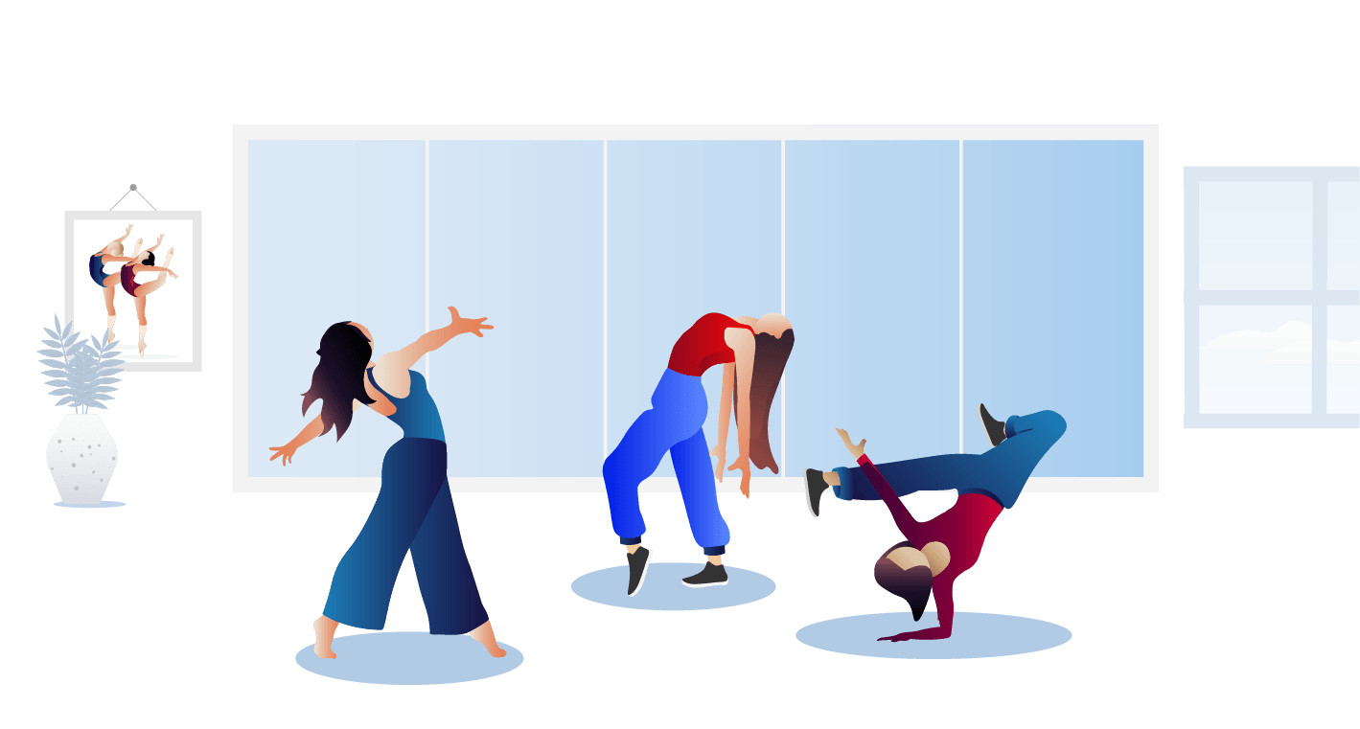
Learning sequences
1
Dance technique classes
2
Dance work 1
3
Dance work 2
Notes:
Teacher notes:
Click lesson numbers to go to specific lessons
Interactive features can be viewed in slide show
Notes for vendors [to be removed after slide deck creation]:
Create hyperlinks to dividers that match lesson numbers by
Right click on the number>edit link>select slide in deck to connect to

Slide 4
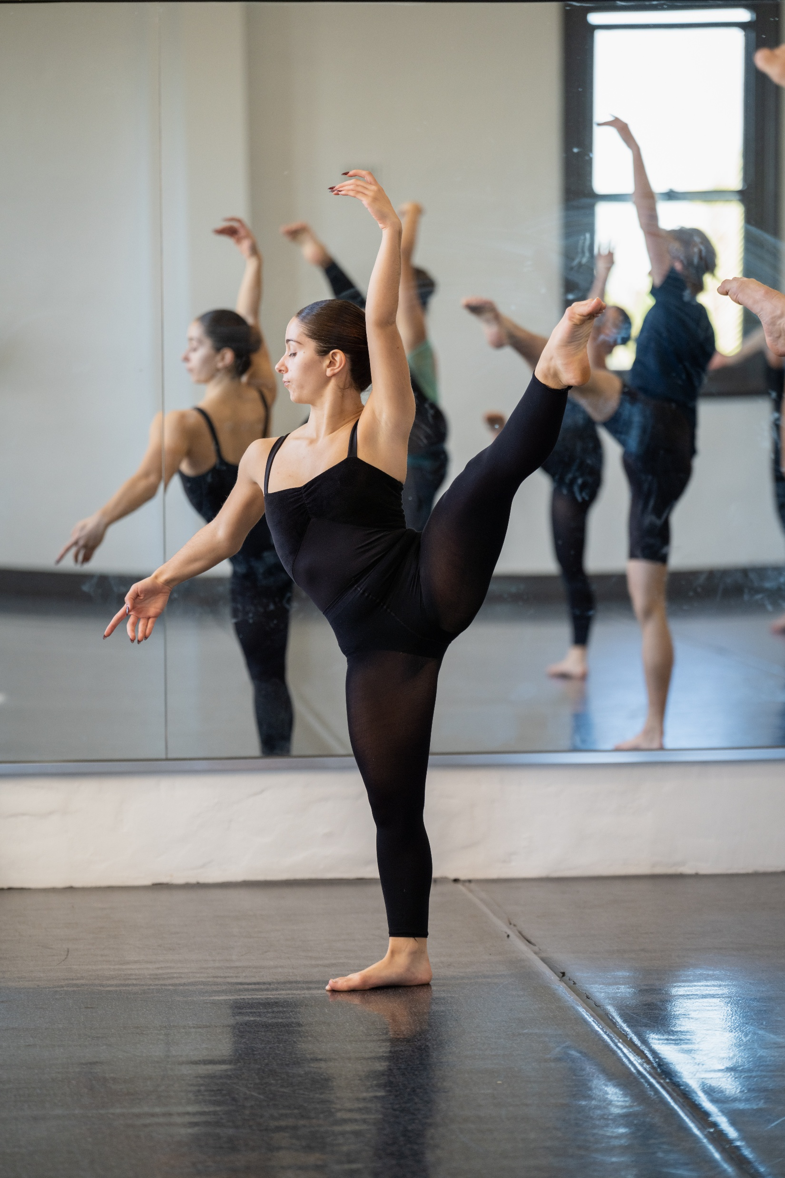
Learning sequence 1 –
Dance technique classes

Slide 5
Learning intentions and success criteria (1)
We are learning to
use dance technique, kinaesthetic awareness and the elements of dance in class exercises specific to the context of contemporary dance
use the language of performance to accurately describe and explain when demonstrating class exercises.
I can
identify and demonstrate class protocols, behaviour and responsibilities in dance classes
identify and demonstrate the stylistic characteristics of contemporary dance in class exercises
demonstrate and reflect on dance technique, kinaesthetic awareness and the manipulation of the elements of dance in dance technique classes.
Notes:
Notes for teachers:
Learning intentions and success criteria are best co-constructed with students. Adapt the learning intention as required and add matching success criteria.
For more information See ⁠AITSL or the NSW Department of Education explicit teaching strategies, ⁠Sharing learning intentions and ⁠Sharing success criteria
LISC is not necessarily presented at the beginning of the lesson. Teacher needs to consider most effectual time to introduce
LISC should be revisited during the lesson to support students' evaluation of their learning

Slide 6
Class protocols for dance technique classes
1.1a
Class protocols
Notes:
Th agreed protocols, behaviours and responsibilities may include:
being responsible and prepared for class by bringing equipment including dance clothes, appropriate footwear relative to the dance style, water bottle, note taking equipment
the storage of equipment like bags, water bottles, towels, dance clothes
procedures for getting changed into dance attire for practical classes
respectful behaviours when watching students perform exercises and dance works
the role of filming and recording within a dance class considering storage of recordings, sharing of recordings and consent for film
expectations and responsibilities of the short-term and long-term injured dancer.

Slide 7
Structure of practical dance class
1.1b
 | Definition
Warm-up | Movements and/or movement phrases designed to raise the core body temperature and bring the mind into focus for the dance activities to follow.
Centre work | Exercises performed away from the barre without any weight bearing support that continue to develop technique, alignment, control, strength, balance, flexibility, endurance, coordination, and body awareness through a greater range of space.
Travelling sequences | Combinations of dance skills that travel through the dance space that increases the complexity of dance technique whilst travelling the body through space.
Dance work | A coherent organisation of phrases and sections driven by thematic considerations that create a unified whole.
Cool-down | To bring the body back to its normal physiological level after fast, vigorous exercise or activity by gradually slowing the pace of activity or by doing gentle exercises or stretches.
Quin, E., Rafferty, S. & Tomlinson, C. (2015) Structure and Content of Individual Dance Sessions, [website], accessed 6 August 2026.
NESA (2023) Dance 7–10 Syllabus (2023) Glossary Date accessed 1 July 2026

Slide 8
The language of performance
1.2
Context
the circumstances that influence creative works, practices, practitioners and audiences
Dance technique
training that physically prepares the body to dance. It is based on safe dance practices and anatomical principles to build strength, coordination and endurance
Kinaesthetic awareness
sensing or perceiving the body’s muscles, joints and tendons while in motion or while still
Elements of dance
space, time and dynamics
Auditory elements
the auditory components of an accompaniment that include structure, temporal, dynamic and musical qualities, thematic material and lyrics
Structure
part of the forming process in composition and choreography. There are 2 main parts; organising the movement; and organising the dance
Interpretation
the individual choices made by a performer, choreographer or viewer that establish a personal perspective relative to the communication of the intent in dance works
NESA (2025) Dance 11–12 Syllabus (2025) Glossary Date accessed 1 July 2026
Notes:
Students use the language of dance performance when explaining, evaluating and critically reflecting on their performance of class exercises and dance works.
You can design opportunities to build and consolidate knowledge about key language through spaced retrieval. Revisit key language multiple times, including progressively longer gaps between retrieval to support development of long term memory. Strategies may include:
Activate prior learning of selected key terms before commencing learning that builds upon that knowledge
Print terms and definitions and cut into pieces, ask students to rearrange
Support dual coding through a combination of written and visual information through the department’s infographics and posters
Support dual coding through movement by developing movement sequences that symbolise or represent key terms as a shared gestural language developed by the class in response to written or verbal key terms and definitions
Create flash cards with the key language terms on the front and the definition/explanation on the back. Ask students to work in pairs to quiz each other on their understanding of language.
Provide flash cards as prompts for students when discussing, providing peer feedback, or personal reflection about an exercise or a phrase from the class dance work

Slide 9

Sample of context and style (1)
1.3a
Artistic context of the romantic ballet style
Intent
Stories of love and tragedy
Accompaniment
It was written with choreographers and often used a live orchestra playing classical repertoire
Technique
Soft ethereal arms, gravity defying jumps and lifts, pointe work, codified footwork and arms
Elements of dance
Mostly on a high level, with varying tempos and often applying light dynamics
Auditory elements
Accents in movement were dramatised with accents in music
Structure
Usually, a narrative in two parts exploring real and ethereal worlds
Au, S. (2024) Ballet and Modern Dance, Thames & Hudson, London.

Slide 10
Sample of context and style (2)
1.3b
Intent
Accompaniment
Technique
Elements of dance
Auditory elements
Structure
Notes:
This blank sample of the context and style slide is included should teachers wish to provide alternate samples or ask students to complete their own scaffold based on a given context and/or style as an extension activity.

Slide 11

Contexts and styles of dance
1.3c
Style: related creative works and/or practices that share distinctive conventions and/or characteristics.
Examples of different contexts
Identify examples of different
styles
Artistic
Cultural
Social
Personal
[insert responses]
NESA (2025) Dance 11–12 Syllabus (2025) Glossary Date accessed 26 August 2026
Notes:
Contexts could include artistic, social, cultural, personal, dance on film, street dancing, for social interaction, recording and archiving purposes
Styles could include romantic ballet, musical theatre, hip hop, contemporary, jazz

Slide 12
What are the characteristics of contemporary dance?
1.4
Contemporary dance is an ever-evolving style as it is reflective of the ‘now’.
It embraces innovation and can be influenced by a range of styles and contexts, particularly modern dance.
Some of the key characteristics of contemporary dance may include:
turned out and parallel positions
dancing barefoot
on and off centred
contrasting combinations of the elements of dance
grounded, floorwork and torso generated movement
emotional expression, experimentation and improvisation
blending different techniques and styles
may express themes related to cultural and/or personal identity
MasterClass (2021) What Is Contemporary Dance? A History of Contemporary Dance, [website], accessed 6 August 2026.
Notes:
Some key characteristics of contemporary dance may include
working through a range of turned out and parallel positions of the body
grounded movement, floor work, torso generated movement – inspired by Martha Graham
dancing barefoot
emotional expression
experimentation and improvisation
working on and off centre – fall and recover inspired by Doris Humphrey
influences and/or blending of different techniques and dance styles such as jazz, hip hop, ballet, modern
may include contrasting combinations of the manipulation of the elements of dance, for example suspended into percussive dynamics
may express themes related to cultural and/or personal identity.

Slide 13
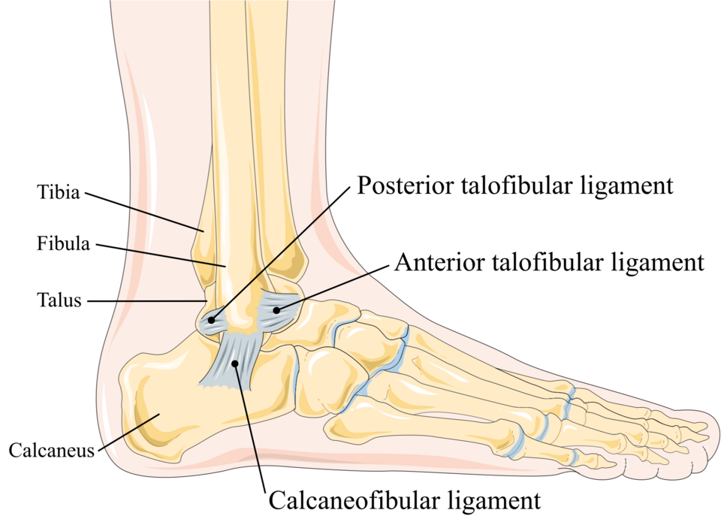
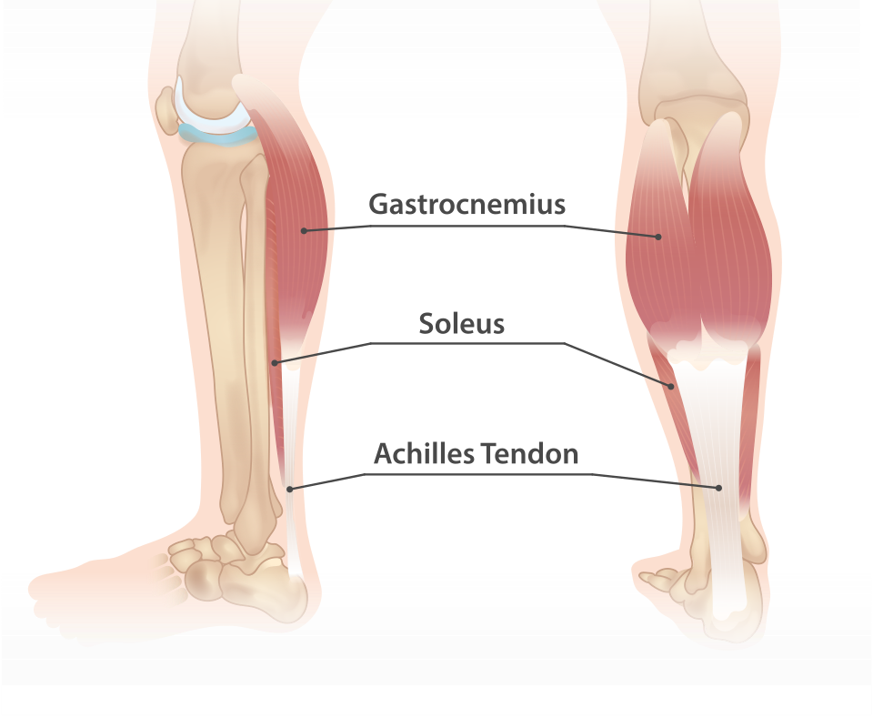
Skeletal structures, muscle groups of the ankle
1.5a
Skeletal structure | The ankle is a hinge joint. The bones that make up the ankle joint are the tibia, fibula and talus. The movements that the ankle joint can perform are plantarflexion (pointing the foot) and dorsiflexion (flexing the foot).
Muscle groups | Muscles that cause: plantarflexion include the gastrocnemius and soleus dorsiflexion include the tibialis anterior.
Lateral collateral ligament of ankle joint" by Laboratoires Servier is licensed under CC BY-SA 3.0.
Tibialis anterior
"Lower leg muscles" by InjuryMap is licensed under CC BY-SA 4.0.

Slide 14
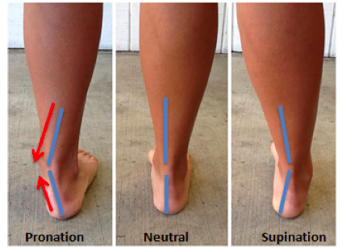
An example of safe execution (1)
1.5b
Correct alignment of the foot is maintained by avoiding unwanted pronation (rolling in) or supination (rolling out). This alignment fault can impact control in balances and the take-off and landing of jumps which can affect kinaesthetic awareness and the correct communication of the intent.
“Ankle Pronation Position” by “Ducky2315” is licensed under the Creative Commons Attribution-Share Alike 3.0 Unported license.

Slide 15
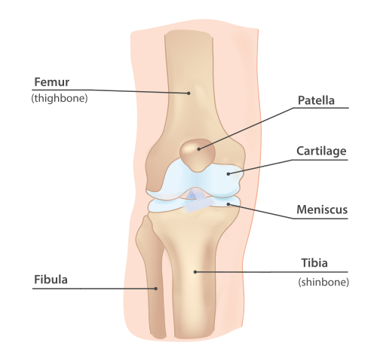
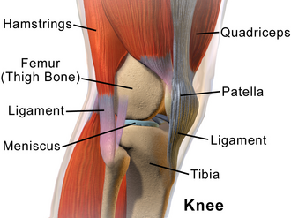
Skeletal structures, muscle groups of the knee
1.5c
Skeletal structure | The knee joint is a hinge joint. The bones that make up the knee joint are the tibia, fibula, femur and patella. The movements that the knee joint can perform are flexion (bending the knee) and extension (straightening the knee). | “Knee anatomy” by “InjuryMap” is licensed under the Creative Commons Attribution-Share Alike 4.0 International license.
Muscle groups | Muscles that cause: knee flexion include the hamstrings knee extension are the quadriceps.
Blausen 0597 KneeAnatomy Side by BruceBlaus is licensed under the Creative Commons Attribution 3.0 Unported license.

Slide 16
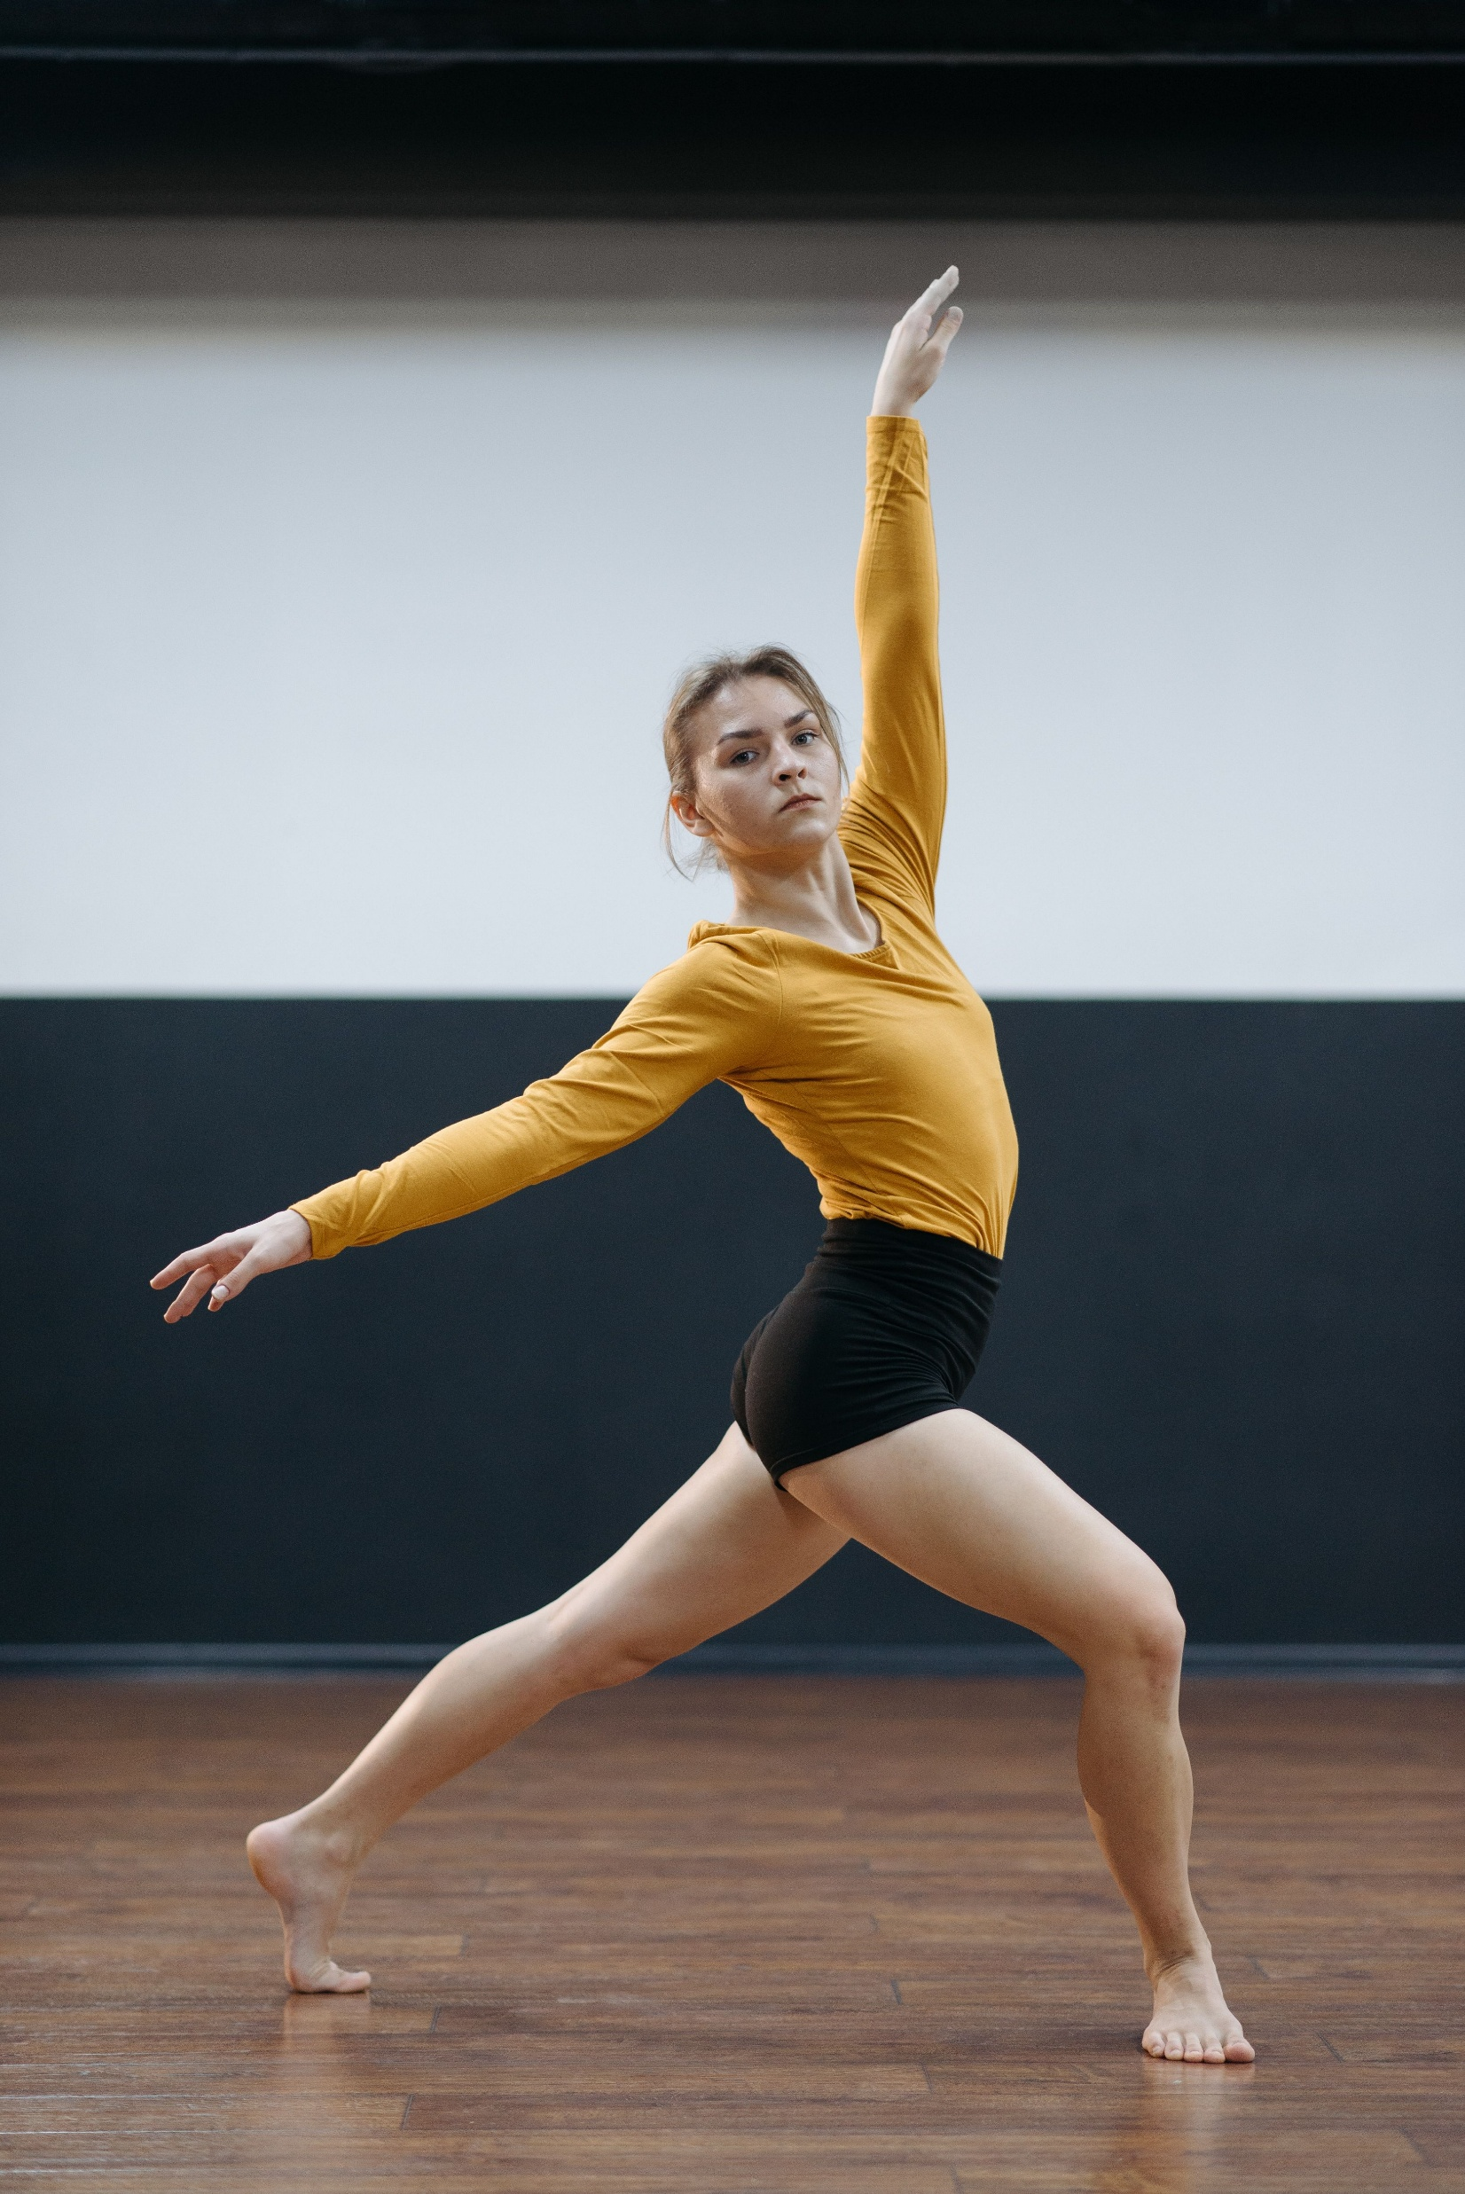
An example of safe execution (2)
1.5d
Correct alignment of the knee is maintained by avoiding unwanted rotation of the knee joint and ensuring knees are over the toes in bent knee positions. This alignment fault can impact the alignment of the leg which can affect kinaesthetic awareness and the correct communication of the intent.
Capture of a professional female dancer performing a graceful pose indoors on a wooden floor by Pavel Danilyuk is used under Pexels license.

Slide 17
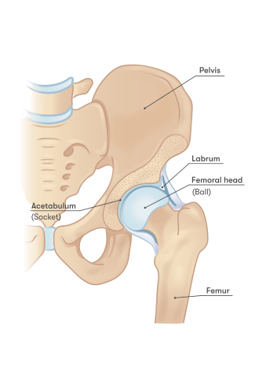
Skeletal structures of the hip
1.5e
Skeletal structure | The hip joint is a ball and socket joint. The bones that make up the hip joint are the head of the femur and the acetabulum of the pelvis. The movements that the hip joint can perform are flexion, extension, abduction, adduction, lateral rotation (turning out), medial rotation (turning in) and circumduction.
Hip anatomy by InjuryMap is
licensed under the Creative Commons Attribution-Share Alike 4.0 International license.

Slide 18
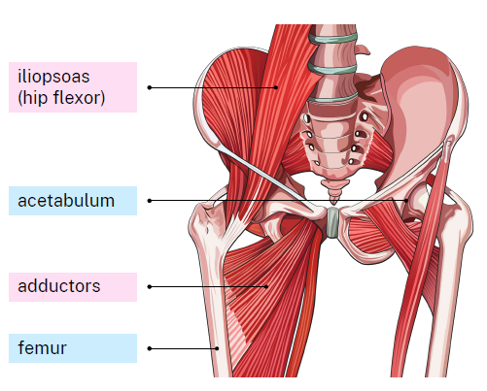
Muscle groups of the hip
1.5f
Major muscle groups
Muscles that cause:
hip flexion include the iliopsoas and quadriceps
hip extension include the gluteal muscles and hamstrings
hip abduction are the abductors
hip adduction are the adductors
lateral rotation (turning out) include the gluteal muscles and the six deep external rotators
medial rotation (turning in) include the adductors
circumduction includes a combination of the above movements and muscles.

Slide 19
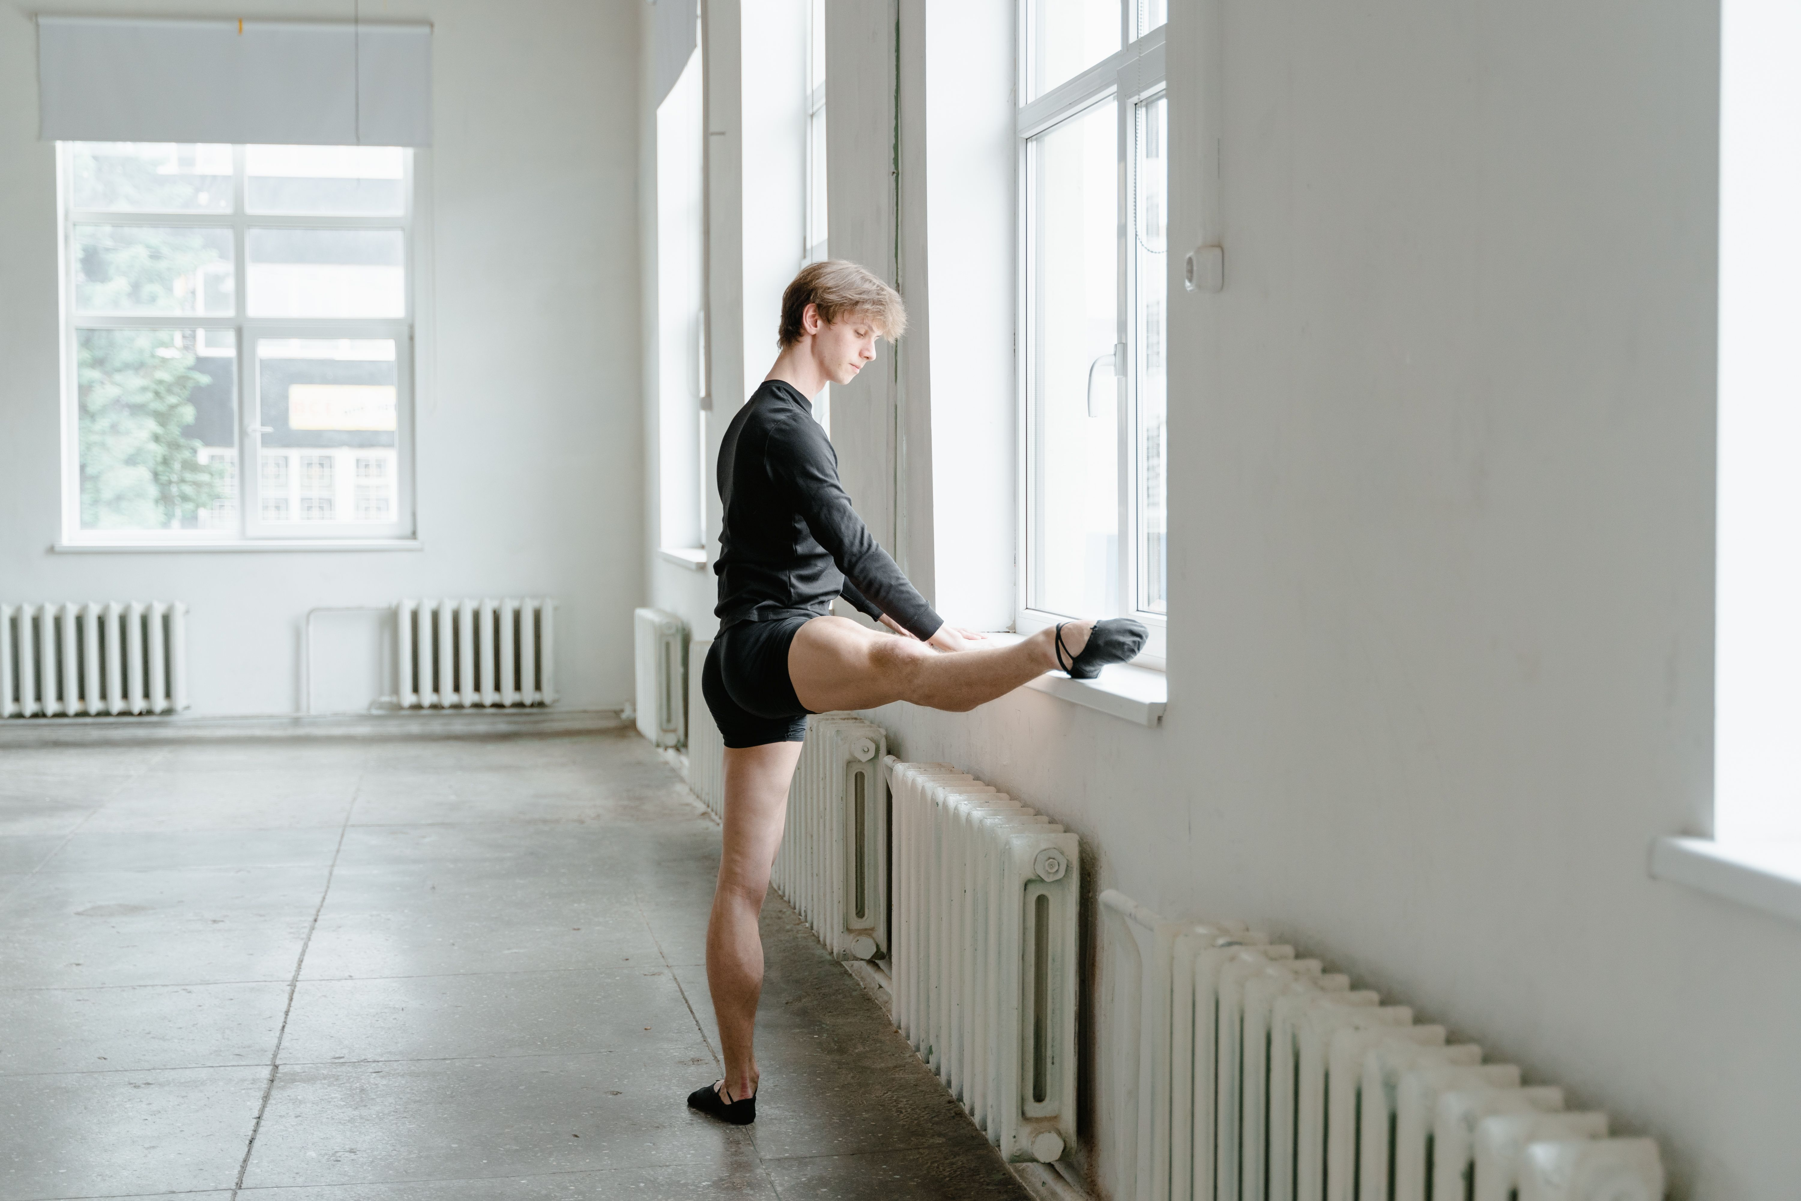
An example of safe execution (3)
1.5g
Correct alignment of the hip joint in turn out is maintained by avoiding over rotation ensuring the dancer is working safely relative to personal anatomical structure. This alignment fault can impact the alignment of the leg and the lumbar spine which can affect kinaesthetic awareness and the correct communication of the intent.
Male ballet dancer stretching beside a window in a bright ballet studio by MART PRODUCTION is used under Pexels license.
Notes:
Correct alignment of the hip joint is maintained by ensuring the dancer works within their personal anatomical structure in turned out positions and that they avoid unwanted movement of the pelvis when performing hip flexion, extension, abduction and adduction movements by engaging the abdominal and gluteal muscles.

Slide 20
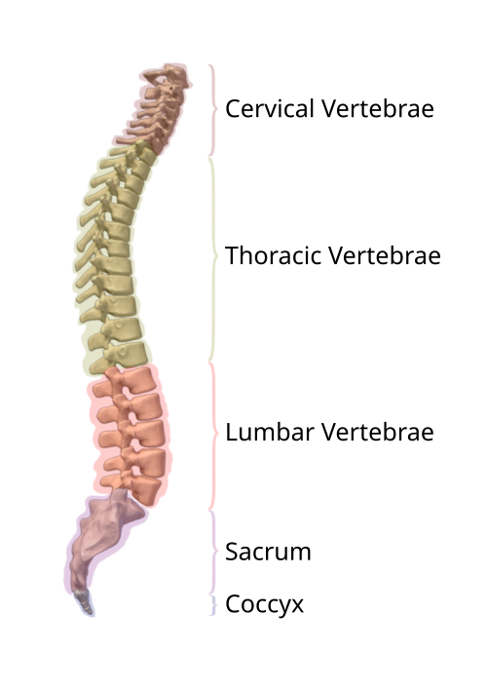
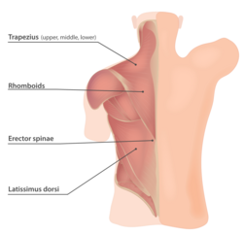
Skeletal structures, muscle groups of the spine
1.5h
Skeletal structure | The spine is made up of facet joints. The bones that make up the spine are the cervical (7), thoracic (12), lumbar (5), sacrum (part of the pelvis) and coccyx. The movements that the spine can perform include flexion, extension, rotation, lateral flexion.
Muscle groups | Muscles that cause: spine flexion include the abdominals. spine extension include the erector spinae and quadratus lumborum. rotation include the external obliques. lateral flexion include the external obliques, erector spinae and quadratus lumborum.
Segments of Vertebrae by DrJanaOfficial file is licensed under the Creative Commons Attribution-Share Alike 4.0 International license.
FiBack muscles (48605452732) by InjuryMap licensed under the Creative Commons Attribution 2.0 Generic license.
Notes:
Segments of Vertebrae by DrJanaOfficial file is licensed under the Creative Commons Attribution-Share Alike 4.0 International license.
FiBack muscles (48605452732) by InjuryMap licensed under the Creative Commons Attribution 2.0 Generic license.

Slide 21
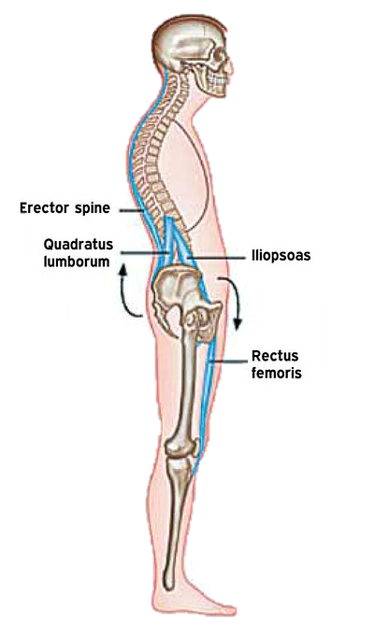
An example of safe execution(4)
1.5i
Correct alignment of the spine is maintained by engaging the abdominals to support the lumbar spine ensuring it does not have an increased curve (lumbar lordosis). This alignment fault can impact the alignment of the spine and shift the weight of the dancer too far back which can affect kinaesthetic awareness and the correct communication of the intent.
Lumbar lordosis by sportEX journals is licensed under CC BY-ND 2.0.

Slide 22
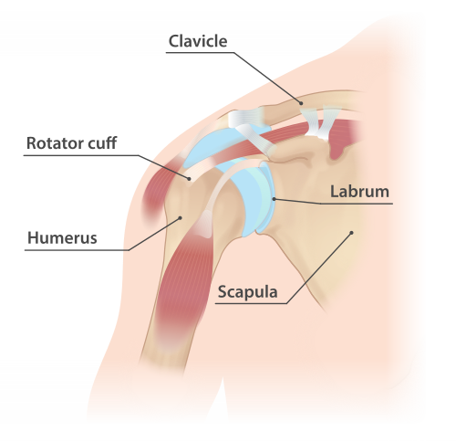
Skeletal structures of the shoulder
1.5j
Skeletal structure | The shoulder is a ball and socket type joint. The bones that make up the shoulder joint are the humerus, scapula and clavicle. The movements that the shoulder can perform are flexion, extension, abduction, adduction, internal and external rotation, and circumduction..
Shoulder anatomy by InjuryMap is licensed under the Creative Commons Attribution-Share Alike 4.0 International license.

Slide 23
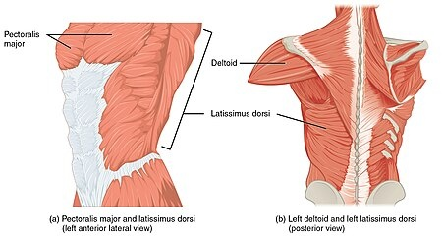
Muscle groups of the shoulder
1.5k
Muscle(s) and groups | Muscle groups that cause: shoulder flexion include the pectoral muscles and the anterior deltoid. shoulder extension include the latissimus dorsi and the posterior deltoid. shoulder abduction include the deltoid. shoulder adduction include the pectoral muscles and the latissimus dorsi Internal and external rotation and circumduction include a combination of the movements and muscles described above.
1119 Muscles that Move the Humerus by OpenStax is licensed under the Creative Commons Attribution 4.0 International license.

Slide 24
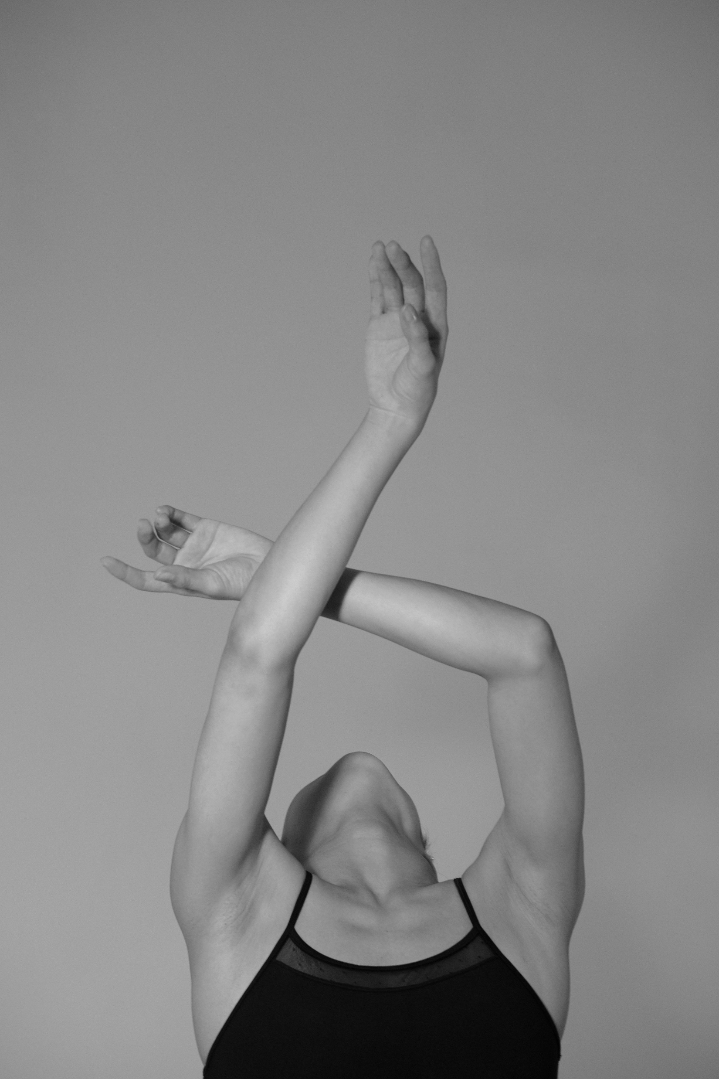
An example of safe execution (5)
1.5l
Correct alignment of the shoulders is maintained by engaging the latissimus dorsi and lower trapezius to ensure that the shoulders are not elevated causing tension in the neck. This alignment fault can affect kinaesthetic awareness and the correct communication of the intent.
A graceful dancer in a monochrome image with arms elegantly crossed above the head by Nuta Sorokina is licensed under Pexels license.

Slide 25
What is dance technique?
1.5 m
Dance technique is training that physically prepares the body to dance. It is based on safe dance practices and anatomical principles to build strength, coordination and endurance. (NESA 2025)
NESA (2025) Dance 11–12 Syllabus (2025) Glossary Date accessed 1 July 2026​

Slide 26
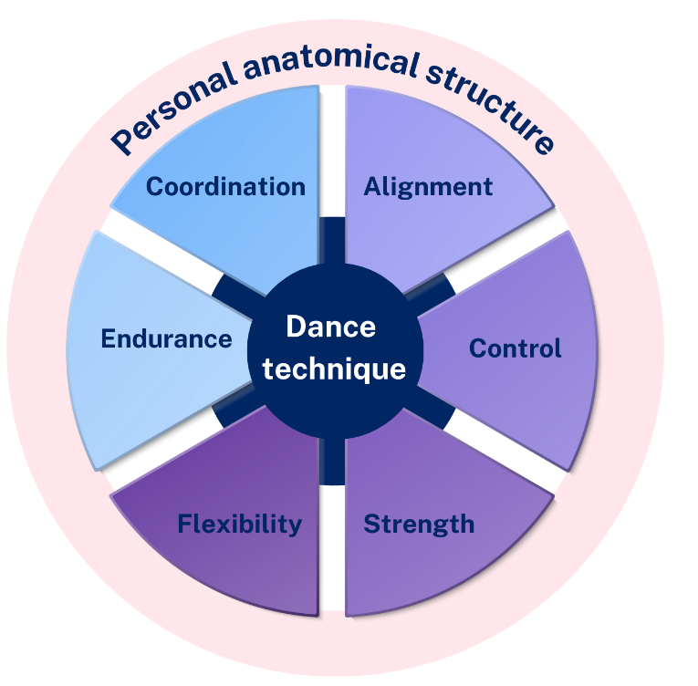
What does dance technique look like?
1.5
n
Dance technique is relative to personal anatomical structure showing the relationship between:
Alignment
Control
Strength
Flexibility
Endurance
Coordination
The performer demonstrates alignment, control, strength, flexibility, endurance and coordination simultaneously when performing movement phrases within a dance work.

Slide 27
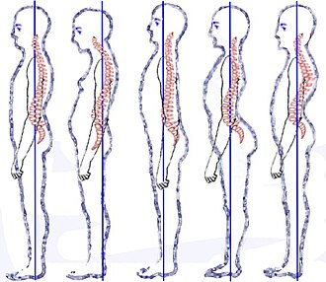
Alignment
1.5
o
Why is alignment important to the performer?
In dance alignment is an important aspect of safe dance practice.
It is the relationship of the skeleton to the line of gravity and the base of support, which makes movement more efficient and reduces the chance of injury (NESA 2025).
Correct alignment allows movement to be perform as intended.
Posture types (vertebral column) by V-Ugnivenko is licensed under CC0 1.0 Universal Public domain.

Slide 28

Control
1.5
p
Why is control important to the performer?
In dance, control is the ability to start and stop dance movements, change direction and hold correct shapes efficiently.
The ability to control dance movements prevents injury and allows the dancer to perform the movements as intended.
A dancer in a flowing white dress gracefully leans back against a minimalist background by Letycia reisi is free to use under Pexels License.

Slide 29
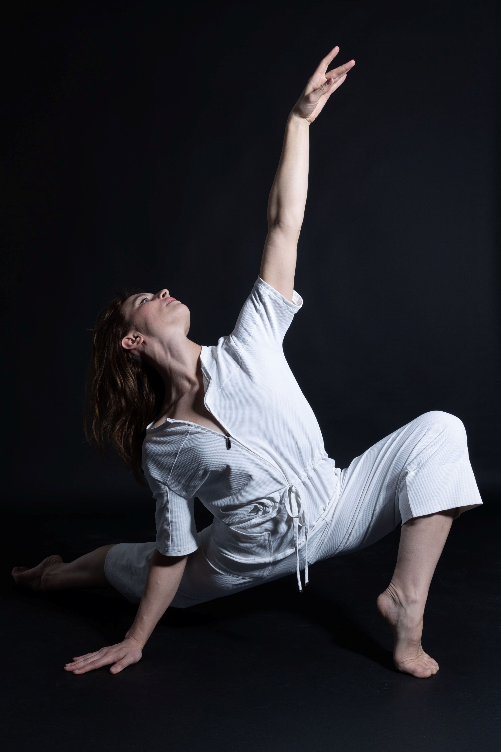
Strength
1.5
q
Why is strength important to the performer?
In dance, strength is the capacity to exert muscular force to perform dance movements with control and safety.
Strength enables the dancer to hold challenging positions, jump with power and prevent injury by supporting the joints.
Adapted from Performance Medicine: Strength Training for Dancers Accessed 1 July 2026.​
Woman dancing in a studio by Weijia MA is free to use under Pexels License.

Slide 30
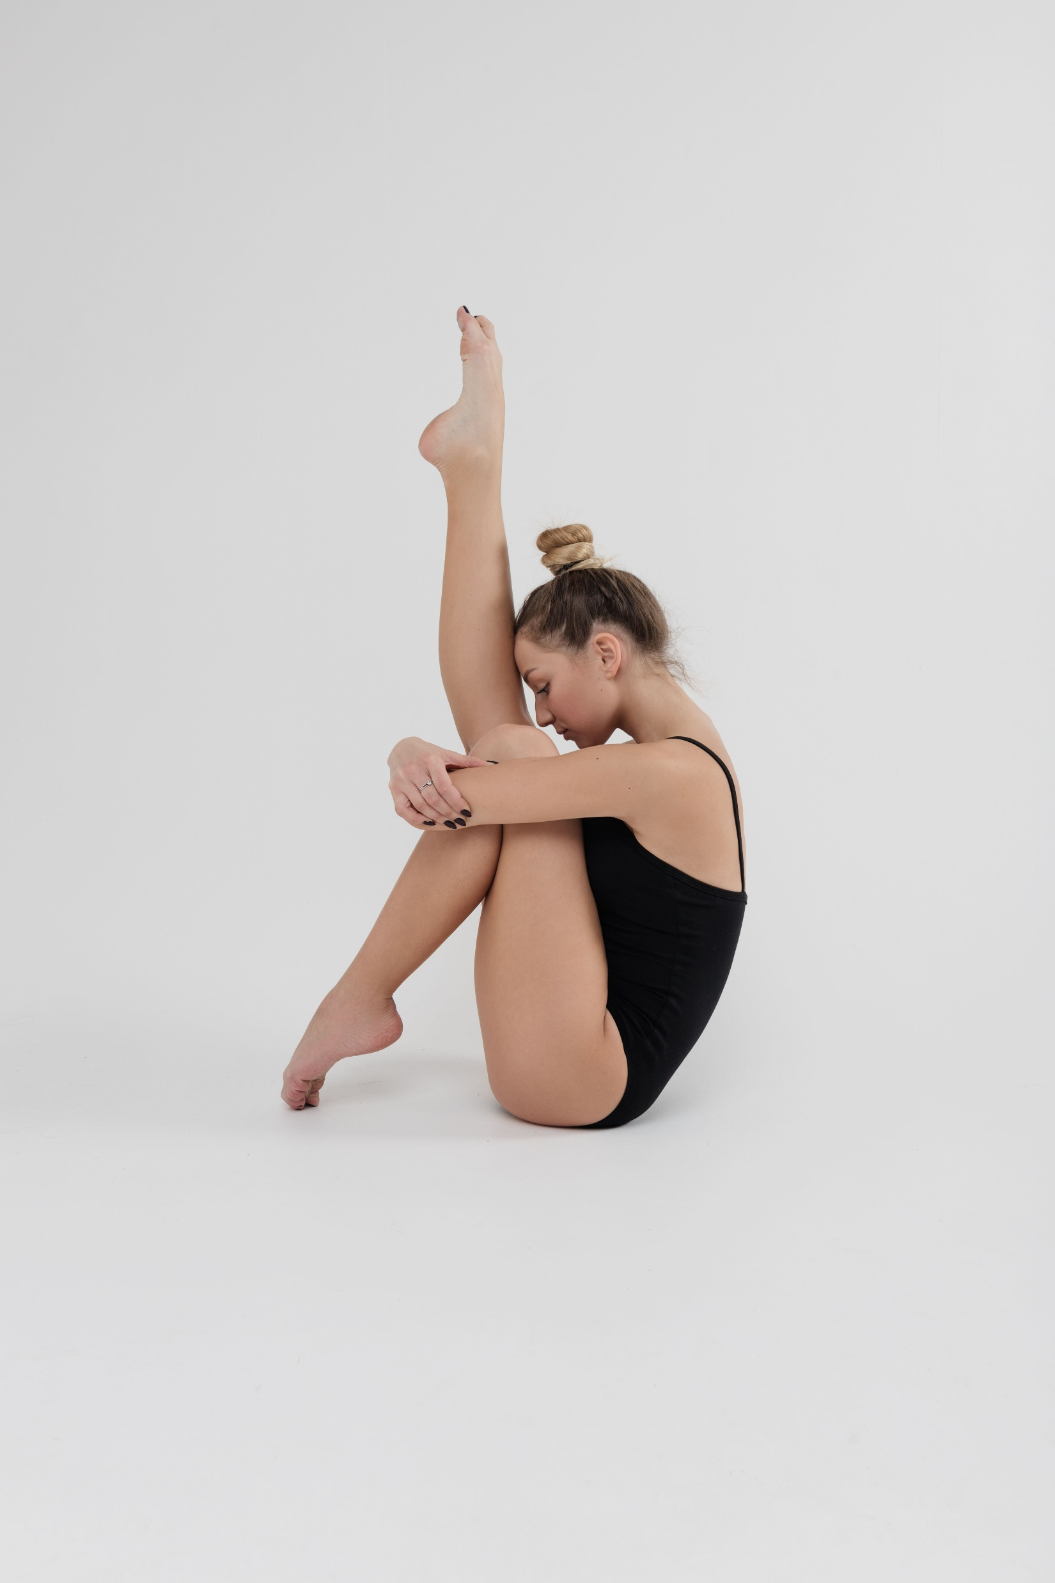
Flexibility
1.5
r
Why is flexibility important to the performer?
In dance, flexibility is the ability of muscles and joints to move through a maximum range of motion.
It is crucial for increasing joint mobility, reducing injury risk, and improving performance.
Adapted from Ausdance-Stretching rules for dancers Date accessed 1 July 2026.
A gymnast sitting on the floor by Anastasiya Gepp
is free to use under Pexels License

Slide 31
Endurance
1.5
s
Why is endurance important to the performer?
In dance, endurance is a performer’s capacity to sustain high energy cardiovascular activity over an extended period without fatigue when performing class exercises and dance works.
Dance relies heavily on anaerobic movement (stop start with a lack of oxygen).
Dancers need to train their cardiorespiratory systems (aerobic training with oxygen) to avoid fatigue when performing as fatigue can lead to an increased risk of injury.
Fatigue impacts the performer's kinaesthetic awareness and capacity to communicate the intent.
Adapted from Body Kinect- Building stamina as a dancer Date Accessed: 1 July 2026.

Slide 32
Coordination:
1.5
t
Why is coordination important to the performer?
In dance, coordination is the ability to move arms, legs, torso and head in a synchronised way to perform movements and manipulate the elements of dance as intended.
Coordination allows the dancer to control dance movements, makes movement more efficient and reduces the risk of injury.
Regular training improves coordination.
Coordination allows the dancer to concentrate on performing the movements rather than just executing them.
The Australian Ballet School (2020) A Conversation on Coordination, [website], accessed 6 August 2026.

Slide 33
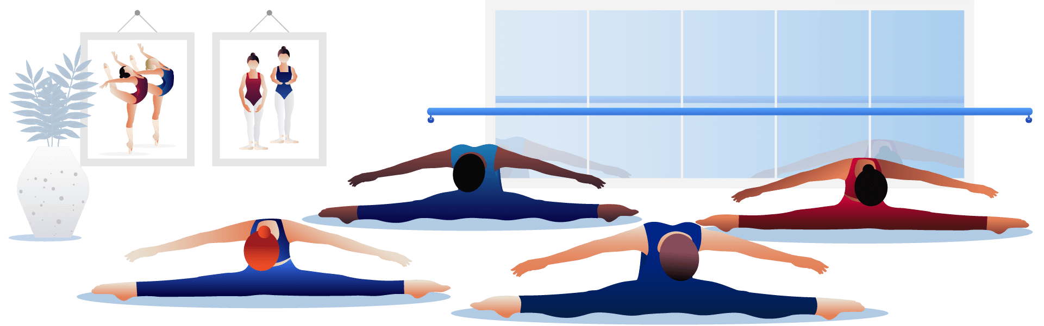
Warm-up
1.6
Check for understanding
What is the purpose of the warm-up exercise?
Can you identify the skeletal structures and major muscle groups involved in the warm-up exercise?
What considerations does the dancer need to ensure the safe execution of the warm-up exercise?
Perform a warm-up exercise then respond to the following questions.
Notes:
Exercises should explore a range of turned out and parallel positions and may include :
joint articulations, dynamic stretching activities, strength-based exercises and coordination development
a spinal roll exercise to encourage spinal joint mobility and articulation, blood flow, core and postural engagement
foot articulation exercises in both parallel and turn out at the barre (or using a weight bearing support like the back of a chair) and in the centre of the room
leg swings laying on the floor in a supine position. Leg swings at the barre in forward, backward and sideward directions
torso movements including reaching, tilting, stretching in forward, backward and sideward directions. This encourages movement of the body through its full range of motion to stretch the muscles and articulate the vertebral joints.

Slide 34
Critical reflection: centre work exercise
1.7
Strengths
1. In pairs, select a centre work exercise
2. Student A performs the exercise
3. Student B observes and provides feedback on one or more aspects of dance technique
A suggestion
Notes:
Feedback may include:
The student’s strengths – what aspects of the centre work exercise were completed well?
Provide one suggestion – how can the student continue to develop their application of dance technique?
dance technique includes:
coordination
alignment
control
strength
flexibility
endurance
relative to anatomical structure

Slide 35
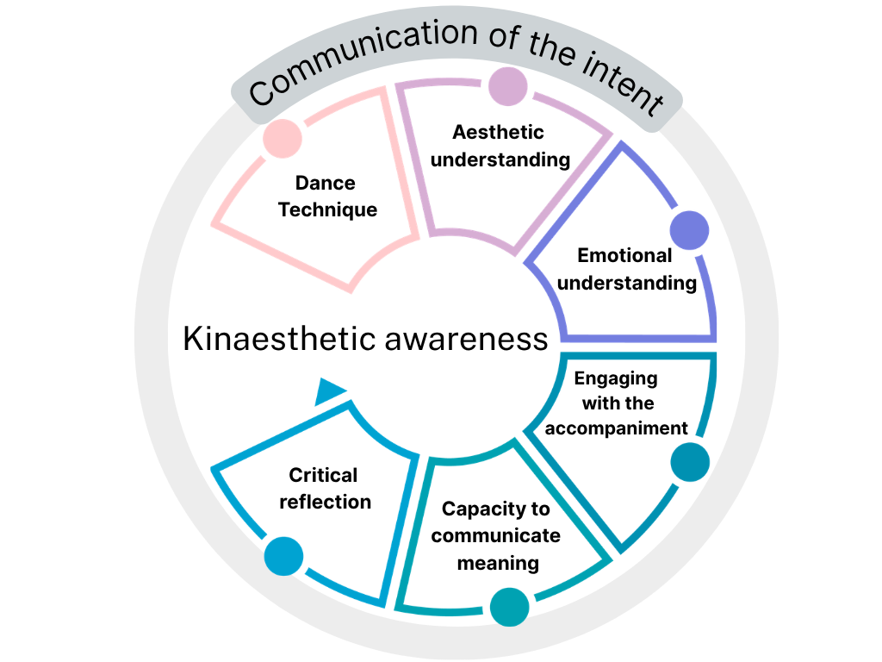
Kinaesthetic awareness
1.10
a
Arnold, P. J. (2000) ‘Aspects of the Dancer's Role in the Art of Dance’, Journal of Aesthetic Education, 34(1): 87–95, doi:https://doi.org/10.2307/3333657, accessed 6 August 2026.
Notes:
Different aspects of kinaesthetic awareness that the performer needs to have to successfully communicate the intent of the dance work. These may include:
dance technique: developing the physical capacity to execute movement as intended and value add relative to personal anatomical structure
aesthetic understanding: the ability to make the correct shapes and movements in the dance work
emotional understanding: the ability to feel what the choreographer’s intent is in shapes and movements and be able to translate this to the audience
engaging with the accompaniment: the ability to feel the music and manipulate the elements of dance and auditory elements as intended to communicate the choreographer’s intent
capacity to communicate meaning through movement: the ability to communicate meaning through the execution of choreographed abstract symbolic movements
critical reflection: the capacity to evaluate self-performance to refine the communication of intent. This can be happening in real time when learning the movement and using the mirror and corrections as feedback or by looking at recording of the performance.

Slide 36
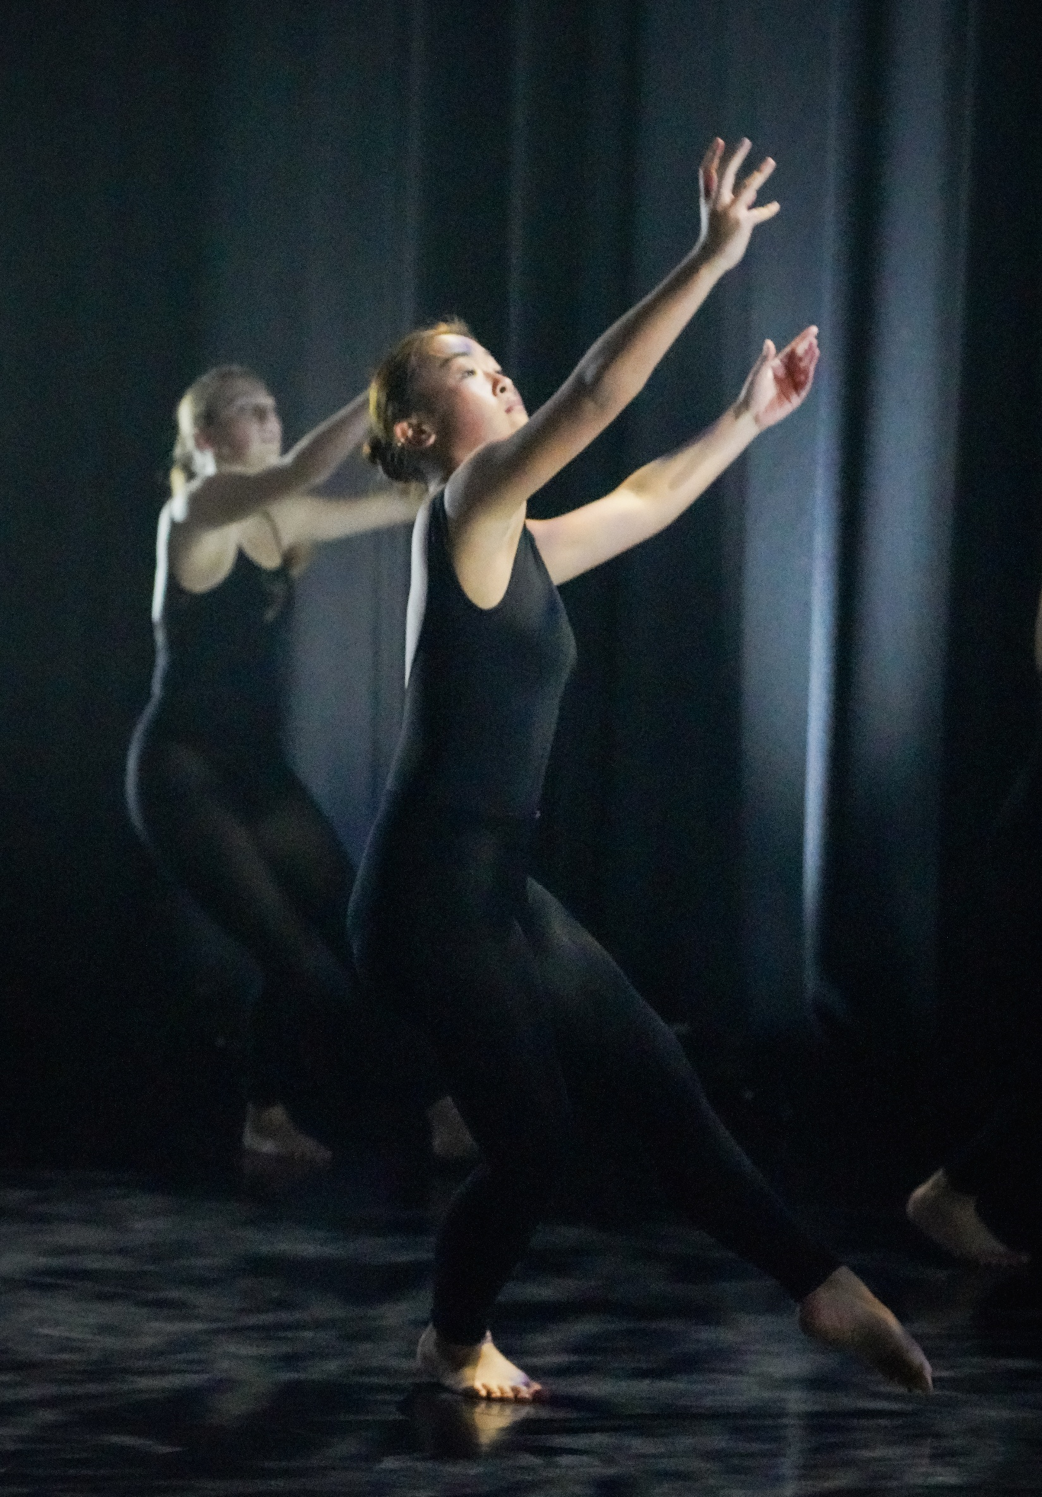
Kinaesthetic awareness – reflection
1.10
b
Demonstrate a shape or movement.
Respond to the following questions:
What are the technical requirements of this shape or movement?
Are you able to perform the shape or movement correctly/ as intended?
What does it make you feel when performing this shape? Is what you are feeling aligned with what the choreographer/teacher intended?
How could you improve your performance of the shape or movement to refine the communication?

Slide 37
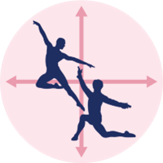
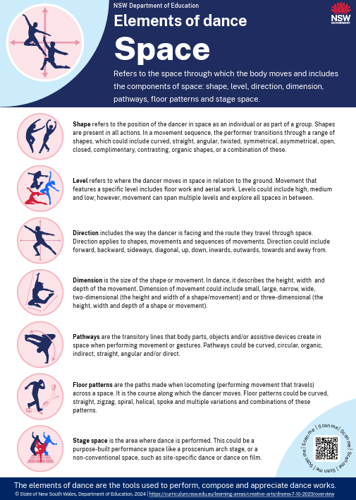
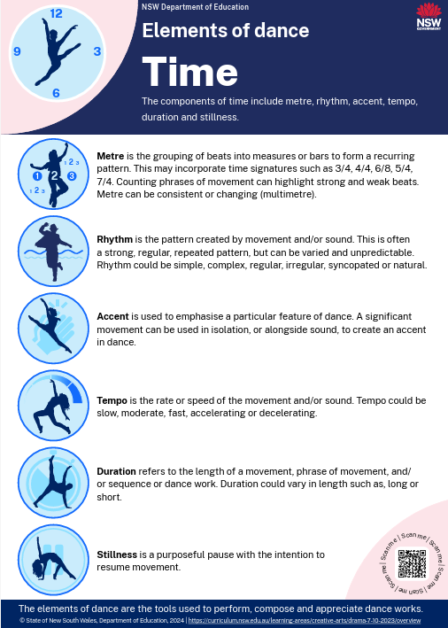
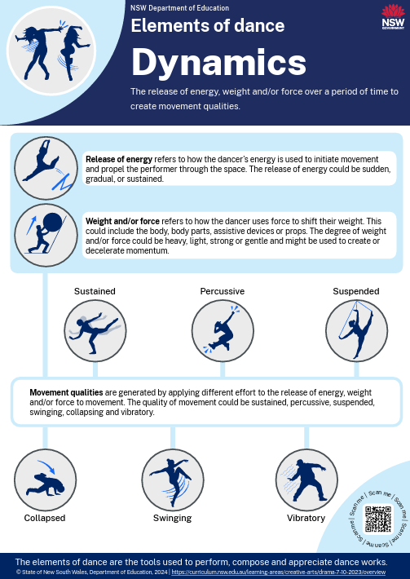
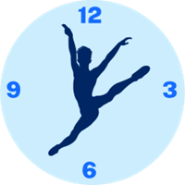

Elements of dance
1.11
NESA defines the elements of dance as ‘space, time and dynamics’
Space
Where you are moving
Time
When you are moving
Dynamics
How you are moving
Elements of dance posters
NESA (2025) Dance 11–12 Syllabus (2025) Glossary Date accessed 1 July 2026​
Notes:
Posters – Elements of dance (PDF 725 KB)
Definitions and examples –Elements of dance (DOCX 3.62 KB)

Slide 38
Manipulating the elements of dance of technique exercises – scaffold
1.12
a
What exercise did you vary?
What exercise did you vary?
What are the variations?
What exercise did you vary?
What impact do the variations have on the feel of the movement?

Slide 39
Manipulating the elements of dance of technique exercises – sample
1.12
b
What exercise did you vary?
We have chosen a foot articulation and 'tendu' exercise demonstrating both parallel and turnout positions of the leg.
What are the variations?
We chose to alter the tempo and dynamics; the new exercise has faster movements with accents on the outwards directions and upwards lift of the foot.
What impact do the variations have on the feel of the movement?
These faster tempos impact my kinaesthetic awareness as there is less time to consciously self-correct, so I am relying more heavily on the feelings of the muscles, tendons and joints in my hip, knee and ankle. I also feel a stronger connection to the musical accompaniment with correlating accents in the music and movement.

Slide 40
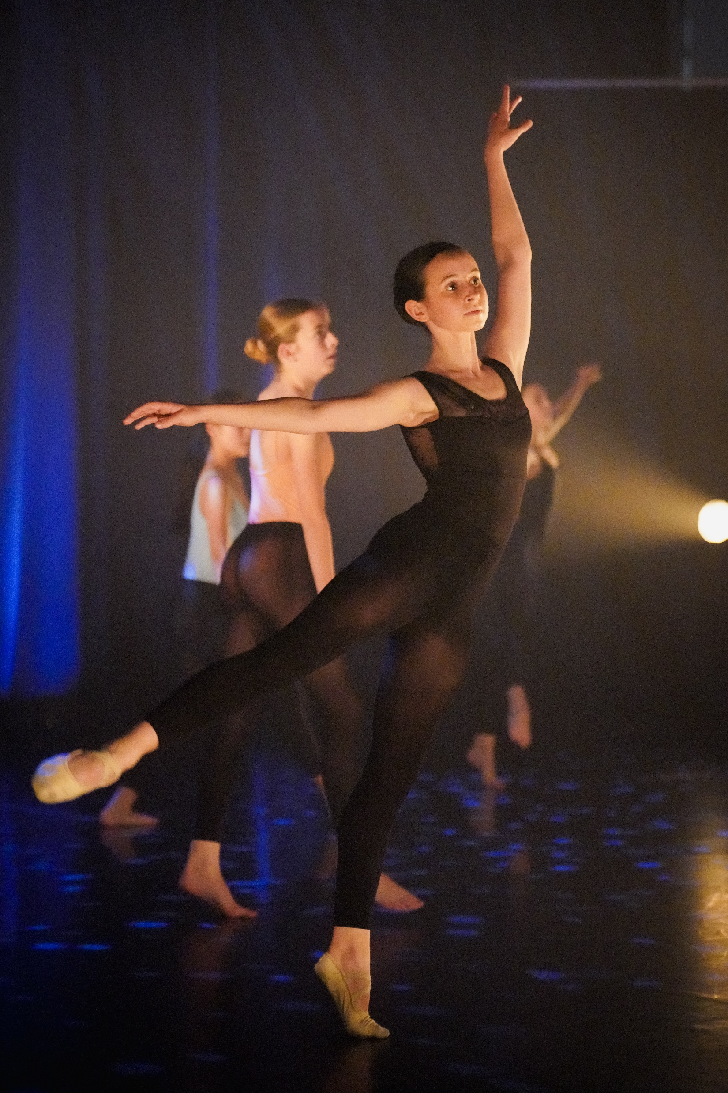
Learning sequence 2 –
Dance work 1

Slide 41
Learning intentions and success criteria (2)
We are learning to
use dance technique, kinaesthetic awareness, the elements of dance and structure to communicate a choreographer’s intent in a contemporary dance work.
I can
identify the role of the performer, the context, the choreographer’s intent and the stylistic features of the contemporary dance work
explain and demonstrate dance technique and kinaesthetic awareness to communicate the choreographer’s intent in the contemporary dance work
explain and manipulate the elements of dance to refine my personal interpretation of the contemporary dance work
perform and analyse a structured dance work.
Notes:
Notes for teachers:
Learning intentions and success criteria are best co-constructed with students. Adapt the learning intention as required and add matching success criteria.
For more information See ⁠AITSL or the NSW Department of Education explicit teaching strategies, ⁠Sharing learning intentions and ⁠Sharing success criteria
LISC is not necessarily presented at the beginning of the lesson. Teacher needs to consider most effectual time to introduce
LISC should be revisited during the lesson to support students' evaluation of their learning

Slide 42
The role of the performer
2.1
What is the role of the performer in dance technique classes?
My thoughts
My partner’s thoughts
What we will share
Notes:
Answers could include:
communicate the choreographer’s intent in dance works in different styles and contexts
the choreographer’s intent in dance works in different styles and contexts
understand and adopt performance protocols
undertake regular dance training in different styles and contexts
develop dance technique and kinaesthetic awareness
reflect critically in order to refine dance practices.

Slide 43

Context of the dance work
2.2
Artistic context
The purpose of the dance is to communicate an intent
The dance work uses abstract symbolic movement to communicate intent
The dance work is designed to be performed for an audience
Other contexts may be present such as cultural, social or personal
Notes:
The class dance work is choreographed in an artistic context, which could include, but not limited to:
the purpose of the dance work is to communicate an idea and intent
the dance work is designed to be performed for an audience
the dance work uses abstract symbolic movement to communicate the intent
other contexts may be present in the dance work for example cultural, social or personal. If exploring cultural contexts, please refer to the Teachers notes.

Slide 44
Research as stimulus
2.3a
Intent:
Notes:
This slide is for the teacher to complete to document their process of stimulus research which led to the development of the intent. The research includes the thoughts and ideas of the teacher as the choreographer considering any relevant aspects that could include any of the concepts identified below:
significant shapes or movements of the body that support the intent
written materials that the teacher engaged with to develop their idea and intent. This could be from news articles, recount texts, fictional texts,
research into events that may have impacted the development of the idea including their sources
explanations of how they generated the abstract symbolic movement ( cut this - linking it to the dancing body, the elements of dance and the structure used in the dance work).
samples of shapes, motif ideas, and phrase ideas that will be used within the dance work
descriptions of movement ideas related to the elements of dance
links between the stylistic features of contemporary dance and how they have influenced some of the movement choices within the dance work
The research is presented to students may also be in visual collages, written handouts, mood boards physical demonstrations and/or verbal modes. Then the teacher introduces the intent of the dance work and explains the stylistic features, links to the accompaniment and overview of the structure of the work.

Slide 45
Critical reflection scaffold – Dance work 1
2.3b
Title of the dance work
Context
Choreographer’s intent
Stylistic features
Details of the accompaniment
Notes:
This critical reflection scaffold can be used for Dance work 1

Slide 46
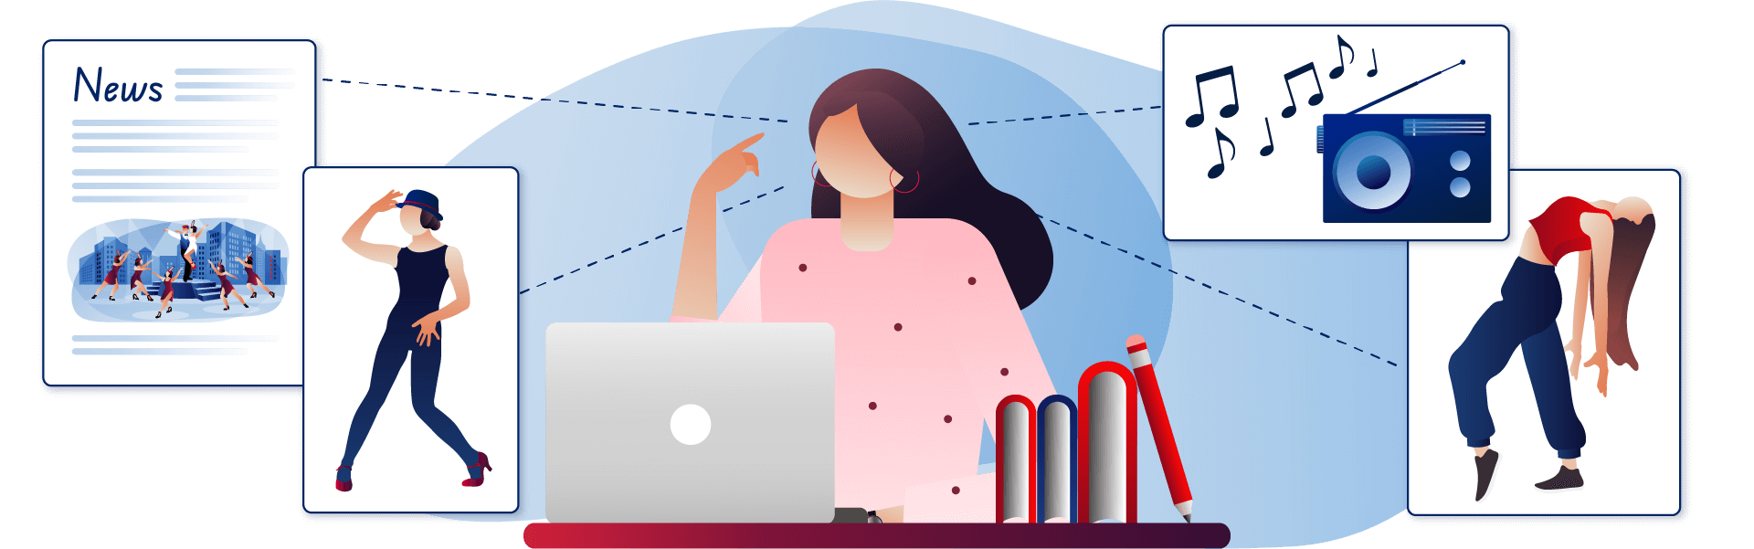
Accompaniment and auditory elements
2.4a
Accompaniment | The choreographer’s use of music, sounds, silence, vocalisations, the spoken word, percussion and body percussion as stimulus, or to accompany dance works to support the intent.
Auditory elements | The auditory components of an accompaniment that include structure, temporal, dynamic and musical qualities, thematic material and lyrics.
NESA (2025) Dance 11–12 Syllabus (2025) Glossary Date accessed 1 July 2026
Notes:
https://curriculum.nsw.edu.au/learning-areas/creative-arts/dance-11-12-2025/glossary

Slide 47

Auditory elements relative to performance activity
2.4
b
As you listen to each excerpt, answer the following questions:
What is the context of the excerpt of music?
How does the music make you feel?
Does the music make you visualise images or movements?
What is the time signature of the music?
What dynamic qualities does the music have?
Your teacher will play short excerpts of music that could be used as accompaniment for a dance work.
Notes:
Teachers may like to access mobygratis to access a range of pieces of accompaniment

Slide 48
Structure (NESA 2025)
2.5a
Term | Definition
Phrase | The fundamental unit of structure in dance. It consists of a series of movements linked by thematic intent which has a beginning, middle and end.
Transition | Transitions are connecting movements between shapes, sequences of movement, phrases and sections in dance works.
Repetition | A choreographic device where thematically significant motifs and/or phrases are repeated to reinforce their importance in the effective communication of the intent.
Variation | A choreographic device for generating new movement based on the manipulation of existing movement.
Contrast | A tool used by the choreographer to retain viewer engagement and to communicate their intent. Contrast may be achieved by manipulating the elements of dance and structural devices.
NESA (2025) Dance 11–12 Syllabus (2025) Glossary Date accessed 1 July 2026
Notes:
T

Slide 49
Structure applied to Performance
2.5b
Term | Definition
Phrase | The performer identifies the thematic intent in each phrase, and how many phrases there are in the structured dance work.
Transition | The performer identifies the transitions between shapes, sequences of movement, phrases and sections in dance works.
Repetition | The performer identifies significant motifs and/or phrases that are repeated and recognise these are important movements that they need to perform to reinforce the effective communication of the intent.
Variation | A performer identifies how variation has been used to effectively communicate the choreographer’s intent.
Contrast | A performer identifies how contrast has been used in the dance work and manipulates space, time and dynamics effectively to demonstrate the contrast and effectively communicate the choreographer’s intent.

Slide 50
What is interpretation in Performance?
2.6
When performing dance works, interpretation may include:
the performer’s application of dance technique, kinaesthetic awareness and the manipulation of elements of dance to communicate and make the choreographer’s intent visible to an audience
the individual choices made by a performer that establish a personal perspective relative to the communication of the intent in dance works
the performer connecting with the musical accompaniment, the counts, following the choreographer’s directions, making the correct shapes and movements.
the performer following the choreographer’s directions to communicate the intent
Bresnahan A (2021) ‘Interpretation in Dance Performing’, in Farinas RL & Van Camp JC (eds), The Bloomsbury Handbook of Dance and Philosophy, Bloomsbury Academic, London, pp. 139–149.
Notes:
Effective questions that the teacher can ask when teaching the dance work include:
what individual choices have you made as the performer that establish a personal perspective relative to the communication of the intent in this phrase or dance work?
how have you applied dance technique to communicate and make the choreographer’s intent visible in a phrase or dance work?
how have you applied kinaesthetic awareness to communicate and make the choreographer’s intent visible in a phrase or dance work?
how have you manipulated of elements of dance to communicate and make the choreographer’s intent visible in a phrase or dance work?
what are the choreographer’s directions that you have had to follow to communicate the intent in a phrase or dance work?
how have you connected with the musical accompaniment, the counts, following the choreographer’s directions?

Slide 51
Formative check-in opportunity (3)
2.8a
How have you used your dance technique and kinaesthetic awareness to refine your personal interpretation of the choreographer’s intent?
What went well
Areas I can improve
Strategies to improve
Characteristics of the style:
Dance technique:
Kinaesthetic awareness:
Characteristics of the style:
Dance technique:
Kinaesthetic awareness
Characteristics of the style:
Dance technique:
Kinaesthetic awareness

Slide 52
Formative check-in opportunity (3) – sample response
2.8b
What went well
Areas I can develop
Strategies to develop
Characteristics of the style:
Control of parallel and turn out
Free dynamics in torso generated movement
Held my off-centred balance.
Dance technique:
Strength and correct alignment through the supporting leg and hip which helped the torso be able to reach to the floor to show the intent in the balance.
Kinaesthetic awareness:
The height of my jump occurred at the same time as the accent in the music showing joy.
Characteristics of the style:
More grounded movement.
Dance technique:
Flexibility of the hamstrings to extend and reach my working leg in the kick to achieve the reaching intent.
Kinaesthetic awareness:
I feel like I need to emotionally connect with the intent more in the kick.
Characteristics of the style:
Connect with the floor and drop the pelvis to achieve grounded movement.
Dance technique:
Working through dynamic stretches of the hamstrings to increase the range of motion in the kick so that it ‘reaches’ more.
Kinaesthetic awareness:
Reflect and analyse the accompaniment at the time of the kick to try and emotionally connect the two.

Slide 53
Preparing for the submitted analysis (1)
2.10
c
Context
Dance technique
Kinaesthetic awareness
Intent:
Elements of dance
Auditory elements
Structure
Interpretation

Slide 54
Preparing for the submitted analysis (2)
2.10
d
Formative check-in opportunity 4
Intent of the dance work:
What is the context of the dance work?
How have you demonstrated dance technique and kinaesthetic awareness to communicate the choreographer’s intent?
Notes:
What is the context of the dance work?
This could include an explanation of artistic context, style, accompaniment, intent and any relevant contextual influences such as cultural, social or personal
How have you demonstrated dance technique and kinaesthetic awareness to communicate the choreographer’s intent?
This could include an analysis of the student’s application of alignment, control, strength, flexibility, endurance or coordination relative to personal anatomical structure to communicate the choreographer’s intent

Slide 55
Preparing for the submitted analysis (3)
2.10
e
Formative check-in opportunity 4
Intent of the dance work:
How have you manipulated the elements of dance to interpret and communicate the choreographer’s intent?
How have you used your knowledge of the structure of the choreography to refine your interpretation and communication of the intent?
Notes:
How have you manipulated the elements of dance to demonstrate the stylistic features in the dance work?
This could include an analysis of the student’s manipulation of space, time and dynamics to demonstrate the stylistic features of the contemporary dance work
How have you used your knowledge of the structure of the choreography to refine your interpretation and communication of the intent?
This could include how your knowledge of phrases, sequencing, transitions, repetition, variation or contrast has assisted you to communicate the choreographer's intent as intended.

Slide 56
Preparing for the submitted analysis (4)
2.10
f
Formative check-in opportunity 4
Intent of the dance work:
What am I doing well?
What areas do I need to further develop?
Notes:
What am I doing well?
What areas do I need to further develop?

Slide 57
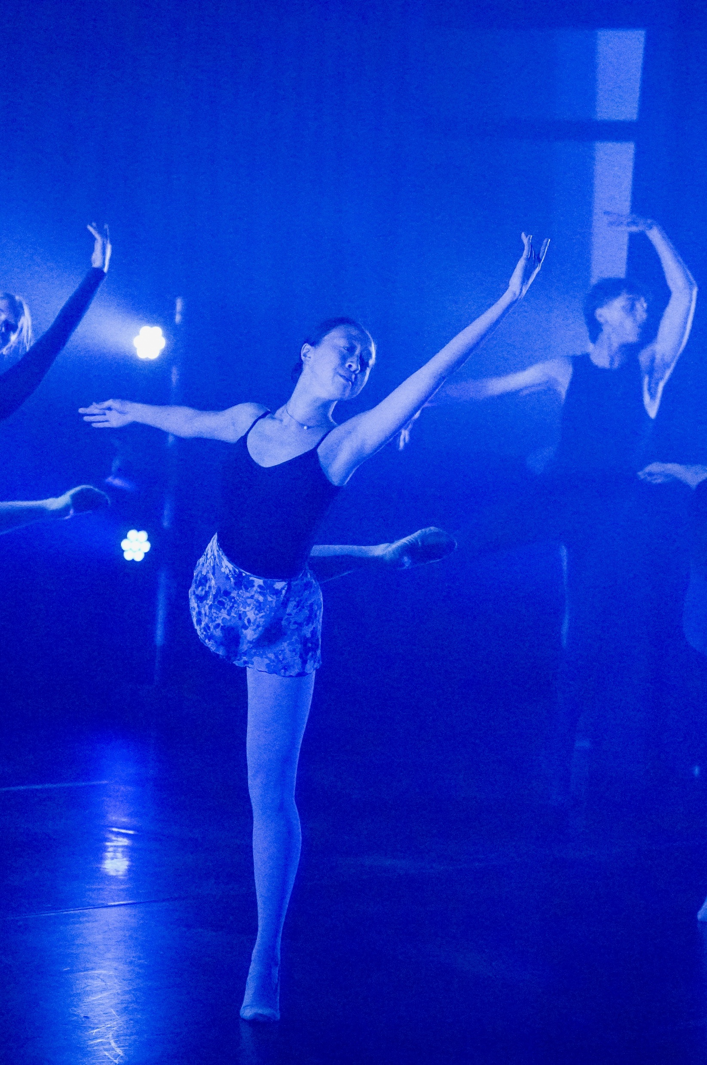
Learning sequence 3 –
Dance work 2

Slide 58
Learning intentions and success criteria (3)
We are learning to
use safe dance practice, dance technique, kinaesthetic awareness, elements of dance and structure to communicate a choreographer’s intent in a contrasting dance style.
I can
identify the context of the dance work
listen to the accompaniment of the dance work and make links between the accompaniment, structure and the choreographer’s intent
demonstrate the stylistic features of the contrasting dance style
perform a dance work demonstrating safe dance practice, dance technique, kinaesthetic awareness, elements of dance and structure to communicate the choreographer’s intent.
Notes:
Notes for teachers:
Learning intentions and success criteria are best co-constructed with students. Adapt the learning intention as required and add matching success criteria.
For more information See ⁠AITSL or the NSW Department of Education explicit teaching strategies, ⁠Sharing learning intentions and ⁠Sharing success criteria
LISC is not necessarily presented at the beginning of the lesson. Teacher needs to consider most effectual time to introduce
LISC should be revisited during the lesson to support students' evaluation of their learning

Slide 59

Critical reflection scaffold – Dance work 2
3.1
Title of the dance work
Context
Choreographer’s intent
Stylistic features
Details of the accompaniment

Slide 60
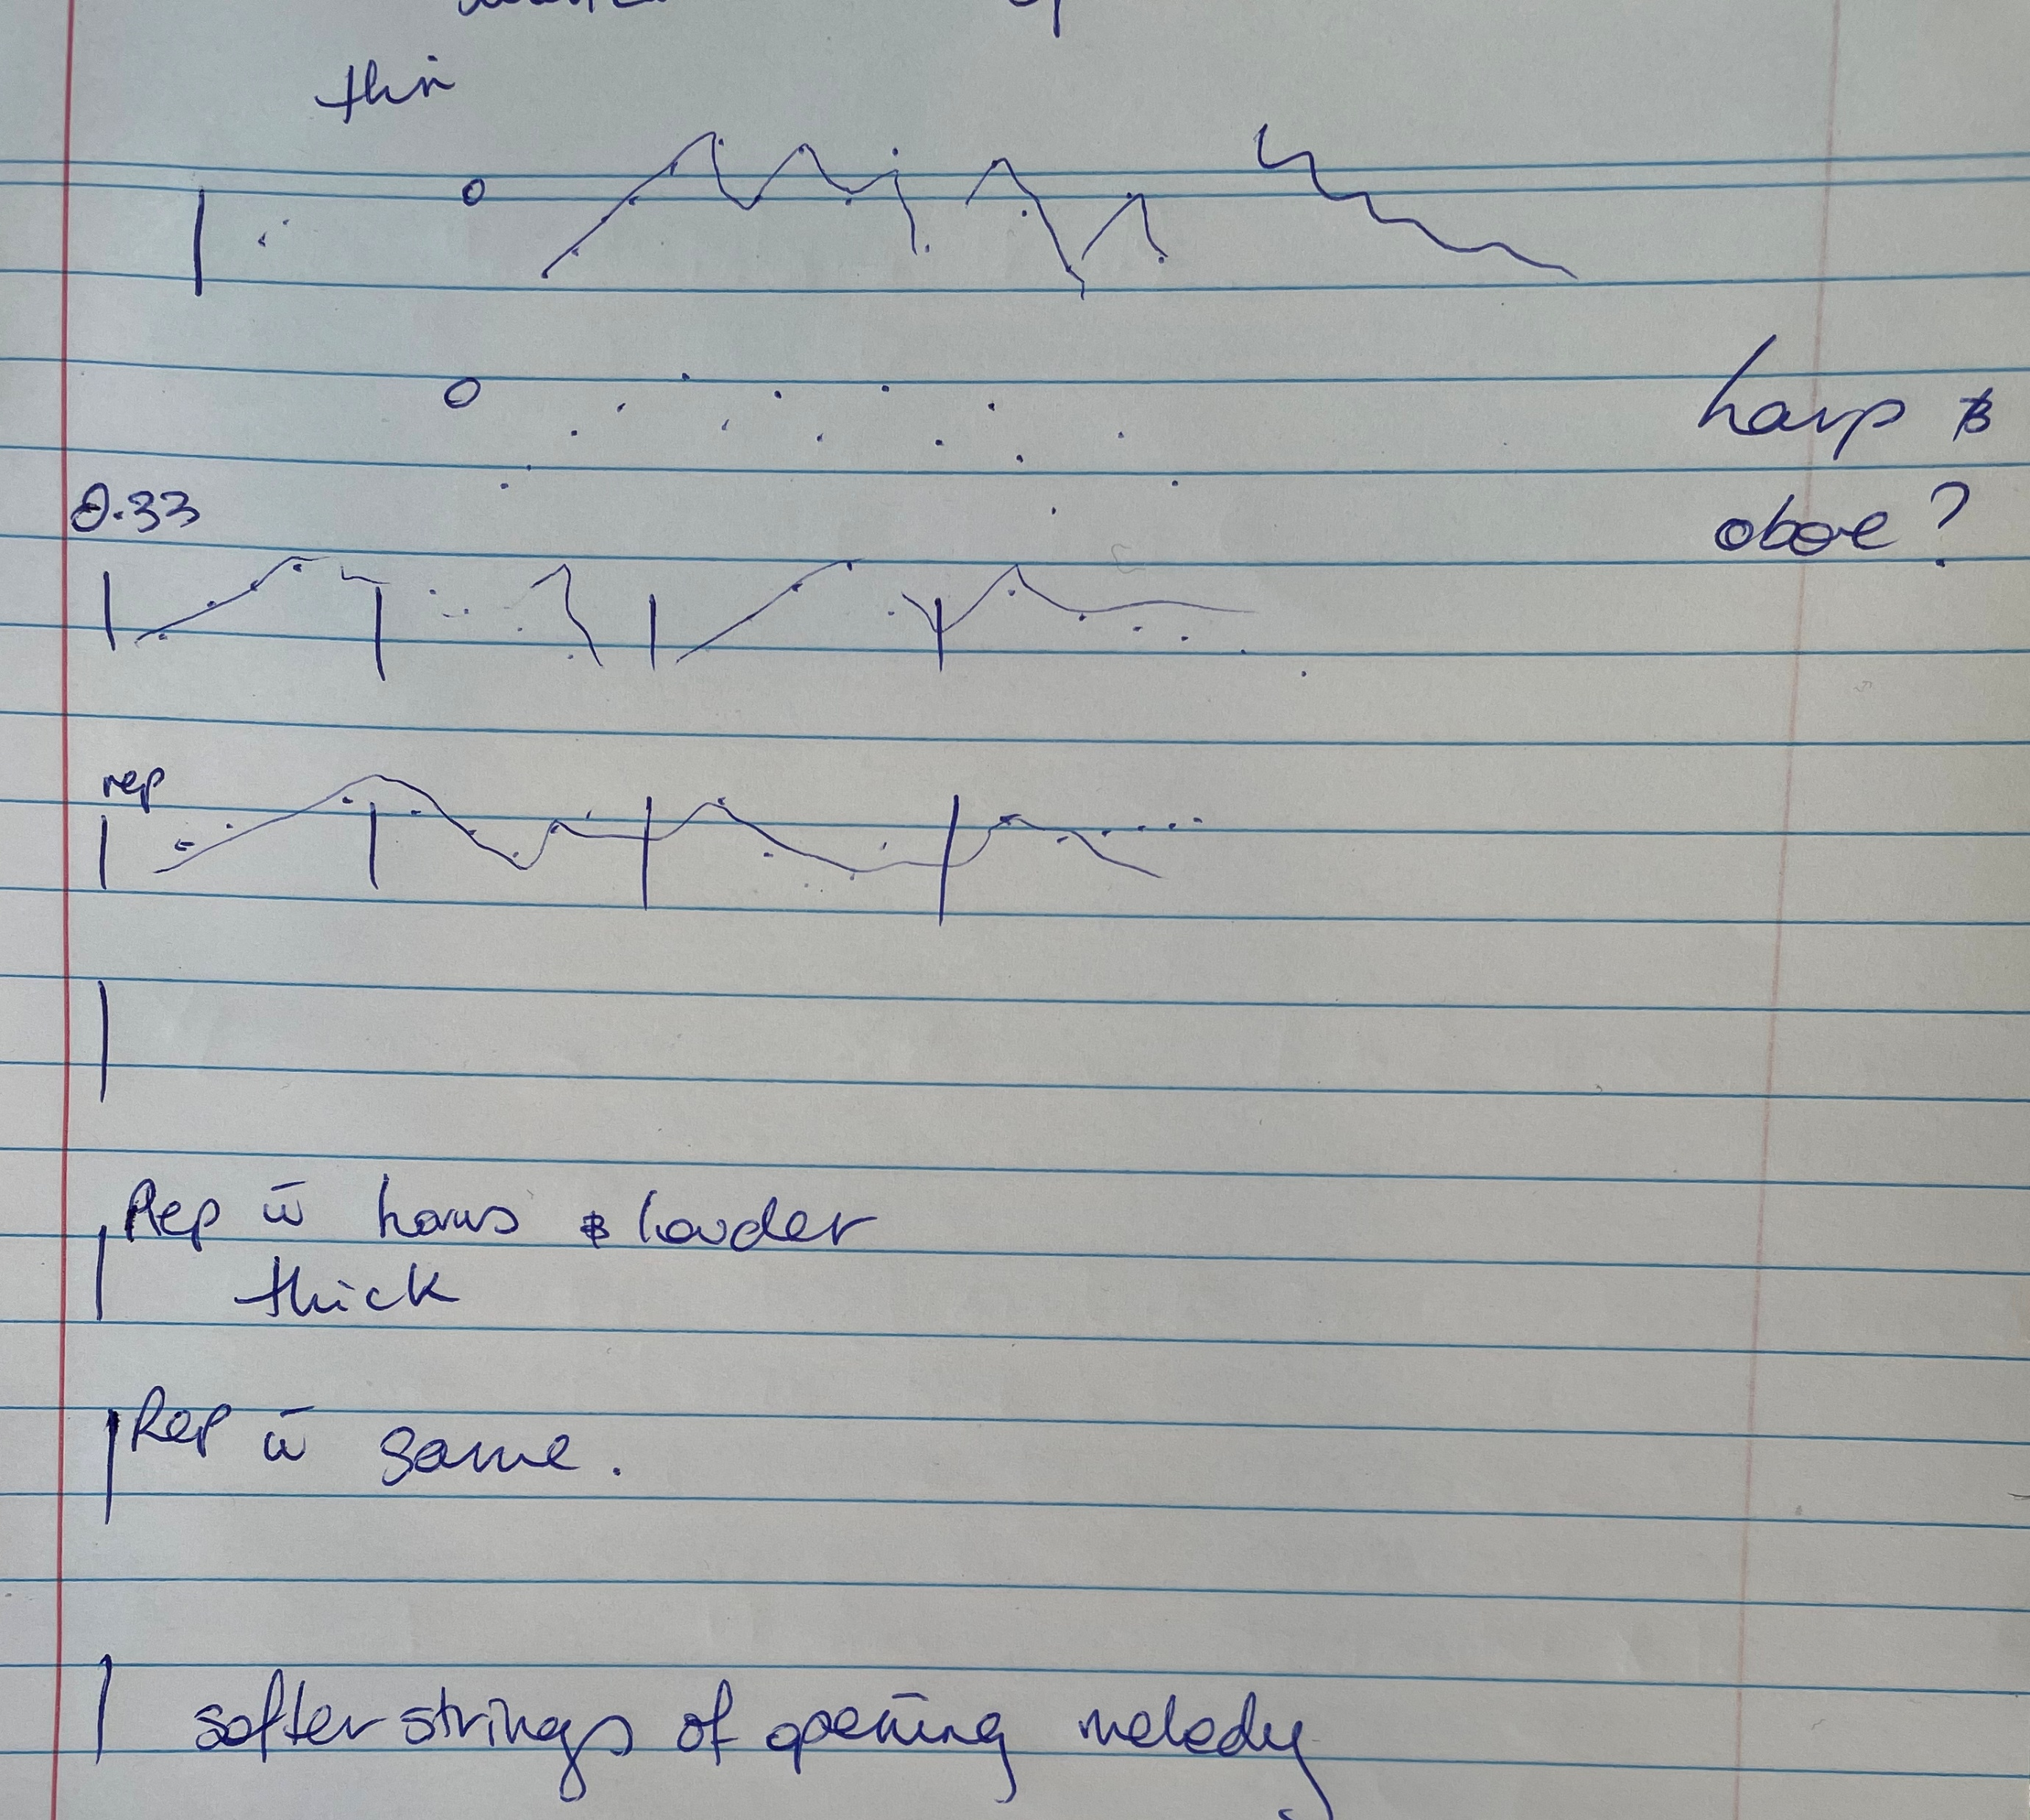
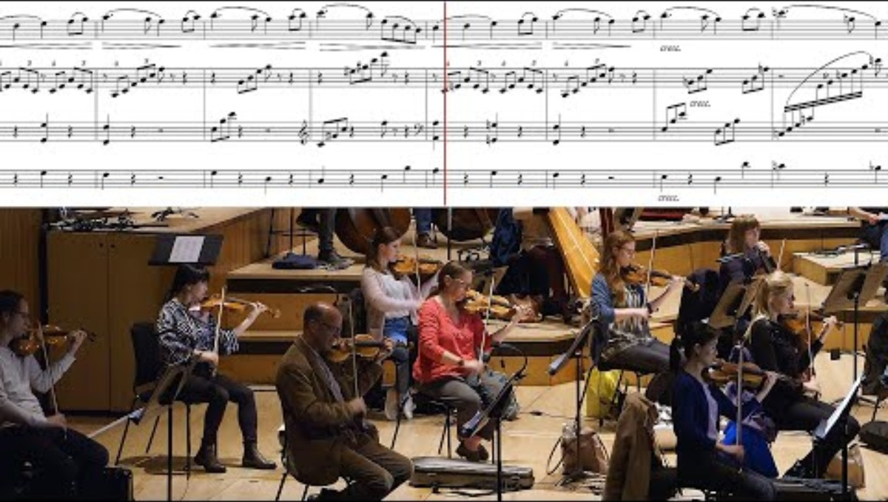
Mapping music (1)
3.3a
Sample 1
Develop a way of identifying and unpacking the auditory elements of the accompaniment. Here is a small sample of what it could look like.
Listen to the following track and see if you can read along to the musical cues.
Swan Lake: Act II – 10. Scene – London Philharmonic Orchestra (2:57)
Notes:
Tchaikovsky's Swan Lake, Op 20, Act 2: No 10, Scene. Moderato: Swan Theme

Slide 61

Accompaniment mapping for the dance work (1)
3.3b
Title
Document the title, artist and duration of the accompaniment.
Listen to the accompaniment for your dance work
Develop your own unique style of accompaniment mapping.
Answer the questions on the following slide.
Artist
Duration

Slide 62
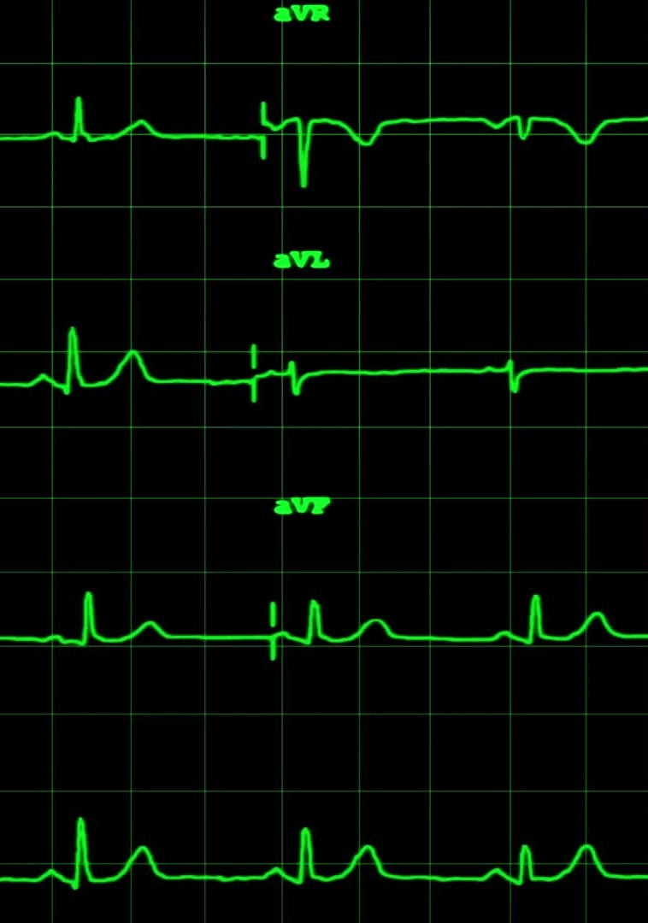
Accompaniment mapping for the dance work (2)
3.3b
How many beats are there in each bar of music (3, 4, 5, 7, 8).
Does the music sound thin or think, light or heavy?
Can you hear any accents in the music, if yes, when do they occur?
Describe the speed of the music and identify any changes that occur
Can you hear changes in the accompaniment that might indicate the start of a new phrase?
Describe the mood and atmosphere of the accompaniment.
What do the lyrics (if any) mean within the context of the song?
Notes:
The teacher recommends some possible symbols to use to help students to map the accompaniment including some of the suggested ideas below:
dots and/or dashes for chords and bars
lines or dashes to delineate the time signatures and bars within the music
upward and downward lines identifying pitch changes
squiggles or thin lines to suggest musical qualities
‘rep’ for any repetition..

Slide 63
Critical reflection on the Dance work 2
3.4
Context
Dance technique
Kinaesthetic awareness
Intent:
Elements of dance
Auditory elements
Structure
Interpretation

Slide 64
Comparison scaffold
3.6
 | Dance work 1 | Dance work 2
Context
Stylistic features
Technique requirements
Kinaesthetic awareness
Elements of dance
Structure

Slide 65
References (1)
This presentation contains NSW Curriculum and syllabus content. The NSW Curriculum is developed by the NSW Education Standards Authority. This content is prepared by NESA for and on behalf of the Crown in the right of the State of New South Wales. The material is protected by Crown copyright.
Please refer to the NESA Copyright Disclaimer for more information https://www.nsw.gov.au/education-and-training/nesa/copyright.
NESA holds the only official and up-to-date versions of the NSW Curriculum and syllabus documents. Please visit NESA https://www.nsw.gov.au/education-and-training/nesa and NSW Curriculum https://curriculum.nsw.edu.au.
Arnold, P. J. (2000) ‘Aspects of the Dancer's Role in the Art of Dance’, Journal of Aesthetic Education, 34(1): 87–95, doi:10.2307/3333657, accessed 6 August 2026.
Au, S. (2024) Ballet and Modern Dance, 5th edn, Thames & Hudson, London.
Ausdance (n.d.) Stretching Rules for Dancers, [website], accessed 1 July 2026.
Body Kinect (n.d.) Building Stamina as a Dancer: Beyond Running the Routine Over and Over Again, [website], accessed 1 July 2026.
Bresnahan A (2021) ‘Interpretation in Dance Performing’, in Farinas RL & Van Camp JC (eds), The Bloomsbury Handbook of Dance and Philosophy, Bloomsbury Academic, London, pp. 139–149.
Dance Year 11–12 © Syllabus NSW Education Standards Authority (NESA) for and on behalf of the Crown in right of the State of New South Wales, 2025.
MasterClass (2021) What Is Contemporary Dance? A History of Contemporary Dance, [website], accessed 6 August 2026.
NSW Education Standards Authority (NESA) (2025) Dance Year 11–12 Syllabus, [website].

Slide 66
References (2)
NESA (2023) Dance 7–10 Syllabus (2023) Glossary Date accessed 1 July 2026.
Performance Medicine (n.d.) Strength Training for Dancers, [website], accessed 1 July 2026.
London Philharmonic Orchestra (21 May 2021) ‘Swan Lake: Act II – 10. Scene – London Philharmonic Orchestra’ [video], London Philharmonic Orchestra, YouTube website, accessed 7 August 2026.
Quin, E., Rafferty, S. & Tomlinson, C. (2015) Structure and Content of Individual Dance Sessions, [website], accessed 6 August 2026.
The Australian Ballet School (2020) A Conversation on Coordination, [website], accessed 6 August 2026.

Slide 67
Copyright
© State of New South Wales (Department of Education), 2026
The copyright material published in this resource is subject to the Copyright Act 1968 (Cth) and is owned by the NSW Department of Education or, where indicated, by a party other than the NSW Department of Education (third-party material).
Copyright material available in this resource and owned by the NSW Department of Education is licensed under a Creative Commons Attribution 4.0 International (CC BY 4.0) license.
This license allows you to share and adapt the material for any purpose, even commercially.
Attribution should be given to © State of New South Wales (Department of Education), 2026.
Material in this resource not available under a Creative Commons license:
the NSW Department of Education logo, other logos and trademark-protected material
Material owned by a third party that has been reproduced with permission. You will need to obtain permission from the third party to reuse its material.
Links to third-party material and websites
Please note that the provided (reading/viewing material/list/links/texts) are a suggestion only and implies no endorsement, by the New South Wales Department of Education, of any author, publisher, or book title. School principals and teachers are best placed to assess the suitability of resources that would complement the curriculum and reflect the needs and interests of their students.
If you use the links provided in this document to access a third-party’s website, you acknowledge that the terms of use, including licence terms set out on the third-party’s website apply to the use which may be made of the materials on that third-party website or where permitted by the Copyright Act 1968 (Cth). The department accepts no responsibility for content on third-party websites.

