Slide 1

CHPS sample units: from planning to practice
Stage 2
October 2025
Notes:
1. Purpose: Title slide
Time: 1 minute
Presenter notes:
Welcome to Term 4 Professional Learning on CHPS sample units: From planning to practice.
[NEXT SLIDE]

Slide 2

Acknowledgement of Country
We recognise the Ongoing Custodians of the lands and waterways where we work and live. We pay respect to Elders past and present as ongoing teachers of knowledge, songlines and stories. We strive to ensure every Aboriginal and Torres Strait Islander learner in NSW achieves their potential through education.
Artwork © Kayleb Waters, Gomeroi artist and Cultural mentor 2025. This image represents Aboriginal Cultures. “This symbol is represented by a hand stencil painted in caves, showing our enduring connection to Country and story.”​
Notes:
2. Purpose: Acknowledgement of Country
Time: 2 minutes
Presenter notes:
I acknowledge the Traditional Custodians of the many lands we are joining from today across New South Wales. I am presenting today from Awabakal Country, and I pay my respects to Elders past and present and extend that respect to all Aboriginal and Torres Strait Islander colleagues with us today.
As we engage in this professional learning focused on curriculum and teaching practice, we are reminded that the NSW syllabuses strengthen the inclusion of Aboriginal histories, cultures and perspectives. This is not only an educational requirement—it is a responsibility. It invites us to teach in ways that honour truth, embed cultural integrity, and recognise the diversity of Aboriginal Nations across NSW.
Today is also a reminder that deepening our understanding of Aboriginal content is not a single lesson or unit—it is a commitment to practice. It requires ongoing learning, respectful collaboration with local communities, and ensuring that Aboriginal perspectives are embedded meaningfully, not as a token, but as a thread woven throughout learning. May we continue to walk together, listen deeply, and create classrooms where every student sees themselves and their culture respected and valued.
[NEXT SLIDE]

Slide 3
Australian Professional Standards for Teachers
Standard descriptors
6.2 – Engage in professional learning and improve practice
6.2.2 – Participate in learning to update knowledge and practice, targeted to professional needs and school and/or system priorities
6.3 – Engage with colleagues and improve practice
6.3.2 – Contribute to collegial discussions and apply constructive feedback from colleagues to improve professional knowledge and practice
Notes:
3. Purpose: To outline the teaching standards addressed in this professional learning.
Time: 30 seconds
Presenter notes:
On the slide you will see the Australian Professional Standards for Teachers that today’s professional learning will be addressing.
[NEXT SLIDE]

Slide 4





Purpose
Outcomes
By the end of this workshop, participants will:
The purpose of this session is to understand the common lesson structure of CHPS sample units and plan effectively for next steps in 2026.
preview the sample units prior to release
develop a clear understanding of what is required for 2026 readiness at year and stage level
deepen their understanding of unit and lesson structures
identify practical next steps for successful syllabus implementation at their school.
Notes:
4. Purpose: To introduce the purpose and outcomes for the workshop.
Time: 2 minutes
Presenter notes:
On the screen are the purpose and outcomes of the session. I will give you time to read these.
Today’s professional learning previews sample units across the four key learning areas, with a focus on the common lesson structure designed to support effective teaching and learning. The session will unpack how key unit features guide our planning for assessment and differentiation, ensuring all students’ needs are met. There will also be a focus on classroom readiness for Term 1, 2026.
For multi-age settings, implementation of the new syllabuses can be deferred until they are mandatory in 2027. Early adoption is possible, though supporting resources may be limited. Primary Curriculum acknowledge the unique challenges of multi-age settings and will provide ongoing communication and support to assist with planning and syllabus implementation.
[NEXT SLIDE]

Slide 5

Agenda
Item
Introduction and Acknowledgement of Country Common lesson structures across the four key learning areas
Human Society and its Environment unit spotlight Science and Technology unit spotlight
Break (10 minutes)
Creative arts unit spotlight Personal Development, Health and Physical Education unit spotlight Reflection activity
Gap analysis
Resources Conclusion, survey and close
Notes:
5. Purpose: To outline the agenda for the professional learning.
Time: 30 seconds
Presenter notes:
On this slide, you will see today’s agenda.
[NEXT SLIDE]

Slide 6

Activity
Feedback
Have you reviewed any of the sample English and mathematics units released?
Are you currently implementing any aspects of the new CHPS syllabuses, or do you plan to do so soon?
Have you ever thought about how the Department develops these sample units?
Notes:
6. Purpose: To engage with participants through questioning and reaction buttons.
Time: 5 minutes
Presenter notes:
To begin our session, I’d like to get a sense of where everyone is at, in relation to the new CHPS syllabuses.
[CLICK] Have you reviewed any of the sample English and mathematics units released?
[CLICK] Are you currently implementing any aspects of the new syllabus, or do you plan to do so soon?
[CLICK] Have you ever thought about how the Department develops these sample units?
[NEXT SLIDE]

Slide 7

Common lesson structures across the four key learning areas
Notes:
7. Purpose: To preview commonalities in CHPS units.
Time: 10 seconds
Presenter notes:
To begin the session will explore common lesson structures across the four key learning areas to show you their consistent look and feel and explain how the key sample unit features support explicit teaching, assessment and differentiation.
[NEXT SLIDE]

Slide 8

3 pillars of resource development
CHPS Sample Units
Evidence based principles
Purposeful design
Practical classroom support
Notes:
8. Purpose: To reinforce the 3 pillars of resource development.
Time: 2 minutes
Presenter notes:
When the Primary Curriculum team talk about the design of CHPS sample units, it is important to understand that everything created is grounded in three key pillars: evidence-based principles, purposeful design, and practical classroom support. These pillars guide the work from initial concept through to final delivery, ensuring high quality, impactful, and genuinely useful resources for teachers and students.
First pillar is evidence-based principles.
This means every resource is informed by current research, best practice, and data on what works in improving student learning. Developers engage with educational research and curriculum policy, so the work aligns with system priorities and supports consistent, high-quality teaching. By embedding evidence from the outset.
Second pillar is purposeful design.
This is about intentionality designing resources with a clear purpose, logical structure, and strong alignment to syllabus outcomes and learning progressions. The focus is on clarity, accessibility, and coherence so that teachers can easily see how each part connects to the bigger picture.
Third pillar is practical classroom support.
Teachers need resources they can confidently pick up and use. The materials are created to be adaptable and supportive of diverse learners. Built in are clear instructions, scaffolds, differentiation suggestions, and assessment checkpoints so teachers can focus on teaching rather than creating resources from scratch.
[NEXT SLIDE]

Slide 9
Why consistency matters
CHPS Sample Units
Creative arts
HSIE
PDHPE
Science and Technology
Notes:
9. Purpose: To explain why consistency matters across the CHPS units
Time: 1 minute
Presenter notes:
Let’s take a moment to set the scene and explain why consistency across these units is so important. The sample units play a central role in supporting schools as we move toward the 2027 mandatory implementation of the new syllabuses. They have been designed to reflect the new syllabuses and provide leaders and teachers with practical, high-quality resources they can confidently use in classrooms.
The CHPS sample units are directly aligned with the Department’s scope and sequences, and NESA’s whole-school plan. This alignment provides clarity, prevents duplication, and helps reduce workload.
The CHPS sample units are designed to engage students, support teachers, and promote consistent, high-quality learning experiences that support explicit teaching, assessment and differentiation.
[NEXT SLIDE]

Slide 10


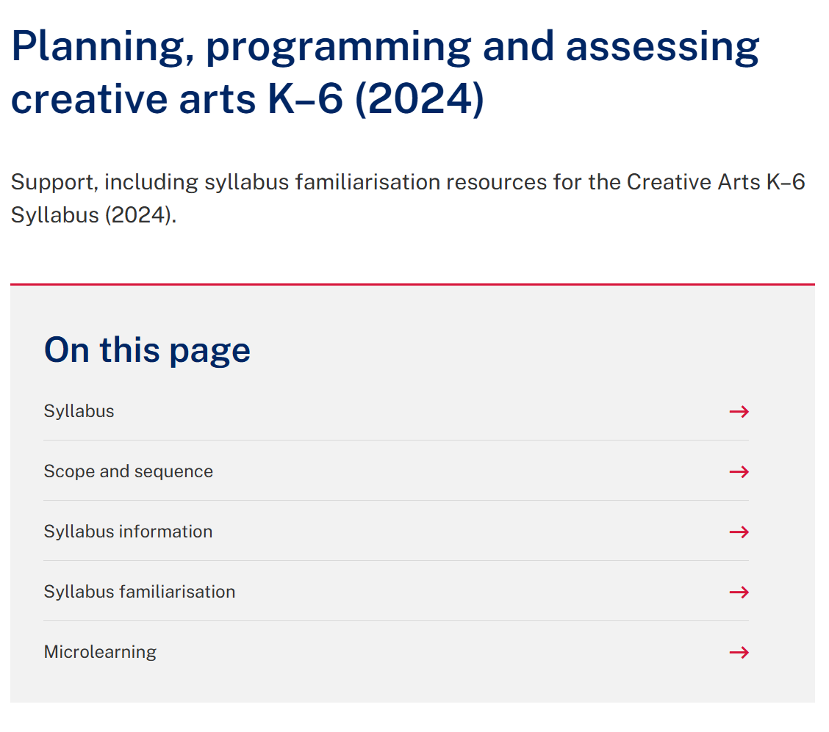
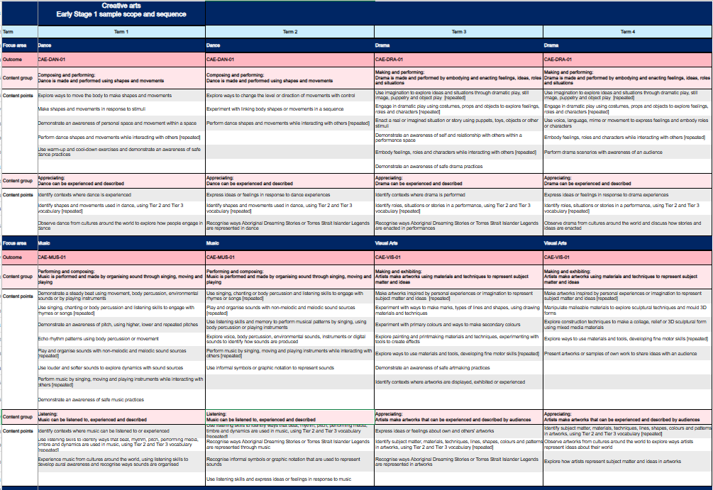
Scope and sequences
CHPS Sample Units
Notes:
10. Purpose: To highlight where to access DoE CHPS scope and sequences
Time: 30 seconds
Presenter notes:
This slide highlights where you can access the Department’s scope and sequences. You can find them by following these breadcrumbs. We have used a creative arts example on screen.
If you would like to explore scope and sequences further, the Term 3 microlearning professional learning has a focus on scope and sequences and you can access the recording and resources on demand.
[NEXT SLIDE]

Slide 11
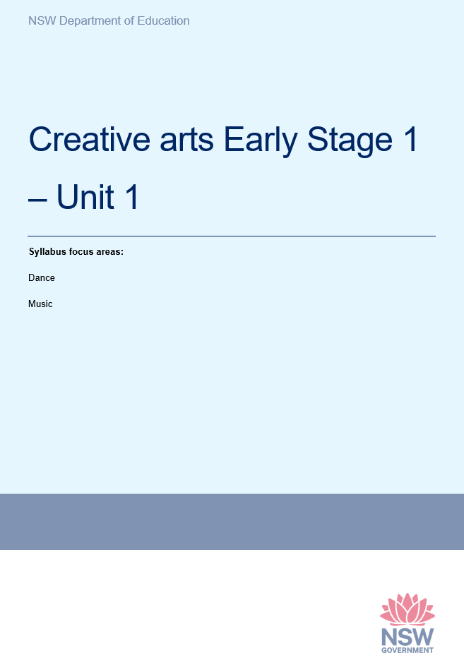
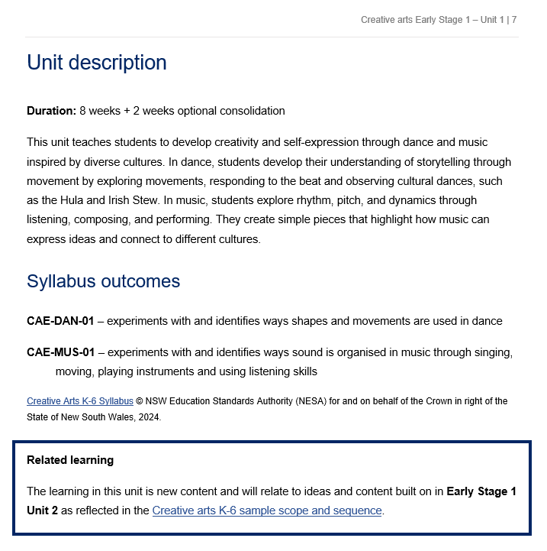
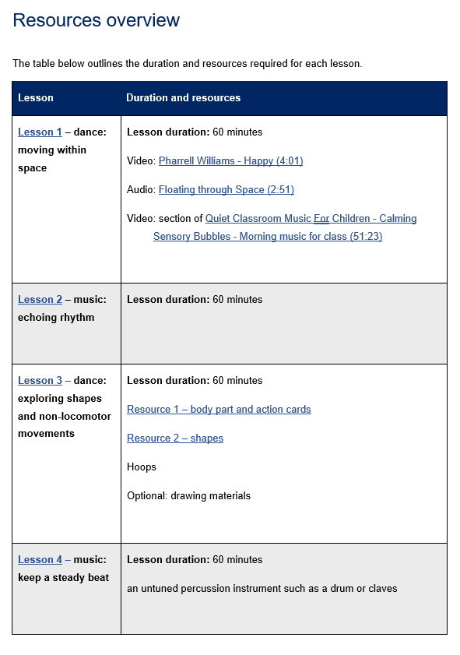
Unit and lesson structure
CHPS Sample Units
Notes:
11. Purpose: To unpack the unit and lesson structure
Time: 2 minutes
Presenter notes:
The CHPS sample units are designed as a flexible framework, just one example of how programming might look. Schools are encouraged to adapt them to suit their own context and student needs.
Each unit uses the same template, giving a consistent look and feel across all key learning areas. On page one, you’ll see the identified syllabus, stage, unit number, and focus areas.
Every unit begins with a clear description that outlines the duration of the lesson, the focus of learning, and how students will build knowledge and skills.
Related learning is highlighted to demonstrate possible connections to relevant prior learning.
Syllabus outcomes are clearly identified, ensuring every lesson is grounded in syllabus content.
Each unit also includes a resources overview, and lessons are structured as two 60-minute sessions per week, aligning with NESA’s suggested time allocation for CHPS key learning areas. This design streamlines planning, keeps expectations clear, and ensures a consistent experience for teachers and students. The resources overview makes preparation simple, everything is listed in one place, from videos and audio tracks to physical materials like hoops, percussion instruments, or action cards. This not only supports smooth planning but also helps schools plan for and manage resourcing across each term.
[NEXT SLIDE]

Slide 12
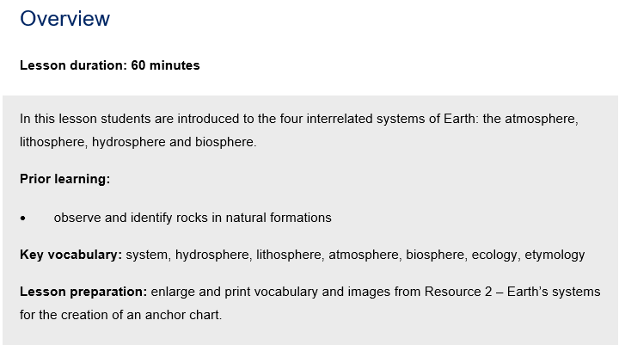
Key features of the lesson structure (1)
Overview
Science and Technology – Stage 2 – Unit 1
Notes:
12. Purpose: To unpacking Beginning the lesson
Time: 30 seconds
Presenter notes:
Each lesson in the CHPS sample units follows the same structure, ensuring consistency across all KLAs. We begin with an overview that provides a short description of the learning and identifies the prior learning the lesson builds on. This prior learning isn’t necessarily specific content points but is aligned to the syllabus content. The overview also lists the key vocabulary to be taught and highlights any preparation required.
Each lesson is 60 minutes in duration
[NEXT SLIDE]

Slide 13
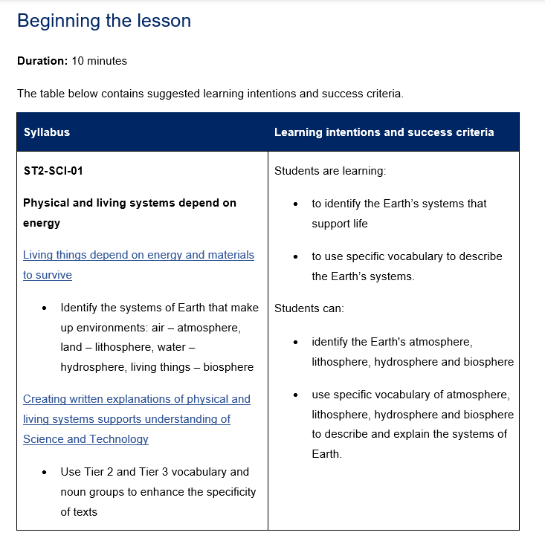
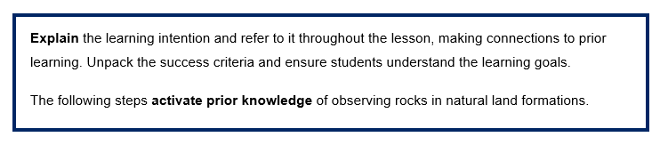
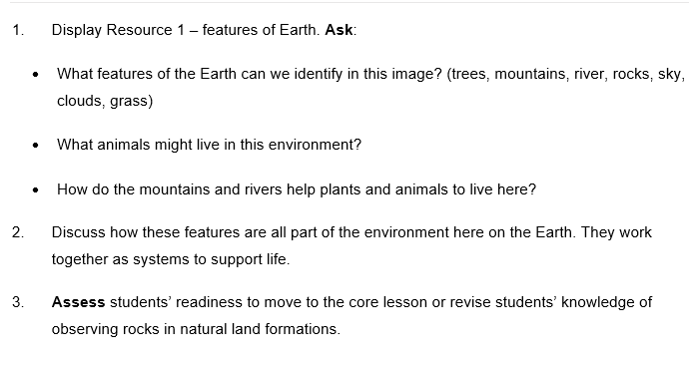
Key features of the lesson structure (2)
Beginning the lesson
Science and Technology – Stage 2 – Unit 1
Notes:
13. Purpose: To unpack Beginning the lesson
Time: 1 minute
Presenter notes:
The beginning of each lesson is usually 10 minutes duration. You will notice explicit teaching strategies embedded in the units. The learning intention and success criteria are so students know exactly what they’re working towards and how they’ll know they’ve achieved it. Making this visible is a key part of explicit teaching, it removes the guesswork and gives learning a clear purpose. This also includes activate prior knowledge. Here the focus is on students retrieving what they already know, not on reteaching content. This approach hooks into their existing schema, to prepare them for the new learning in the core lesson.
Right from the start, explicit teaching is modelled, being clear about the destination and deliberately connecting the lesson to what students bring with them.
[NEXT SLIDE]

Slide 14
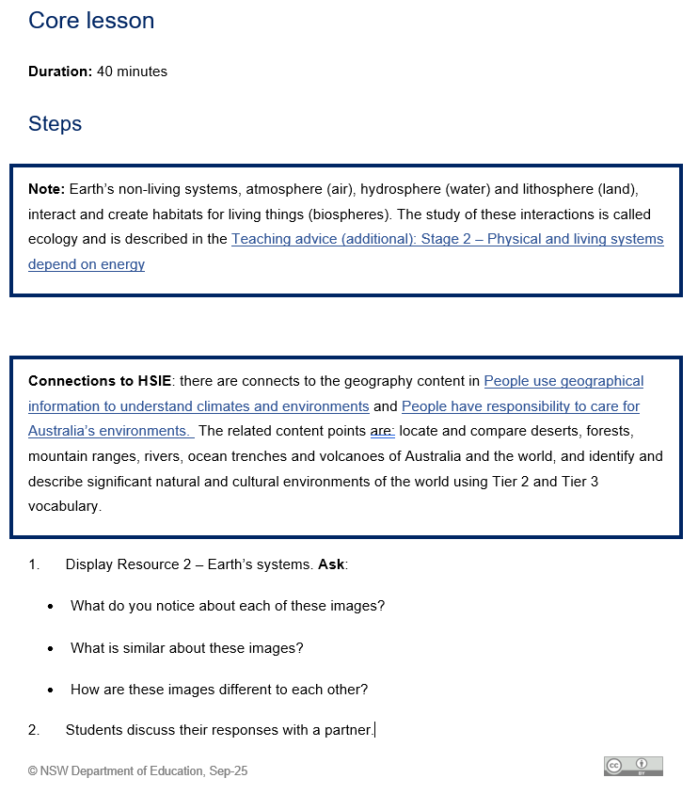
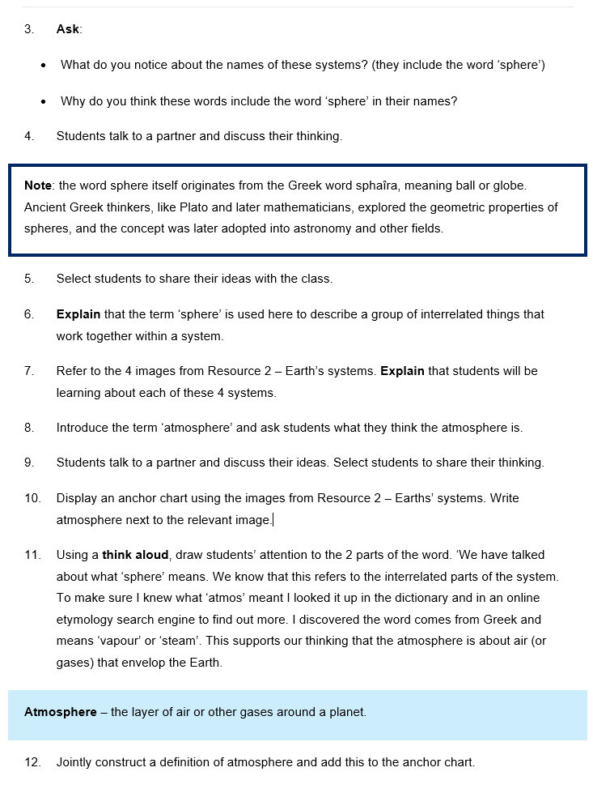
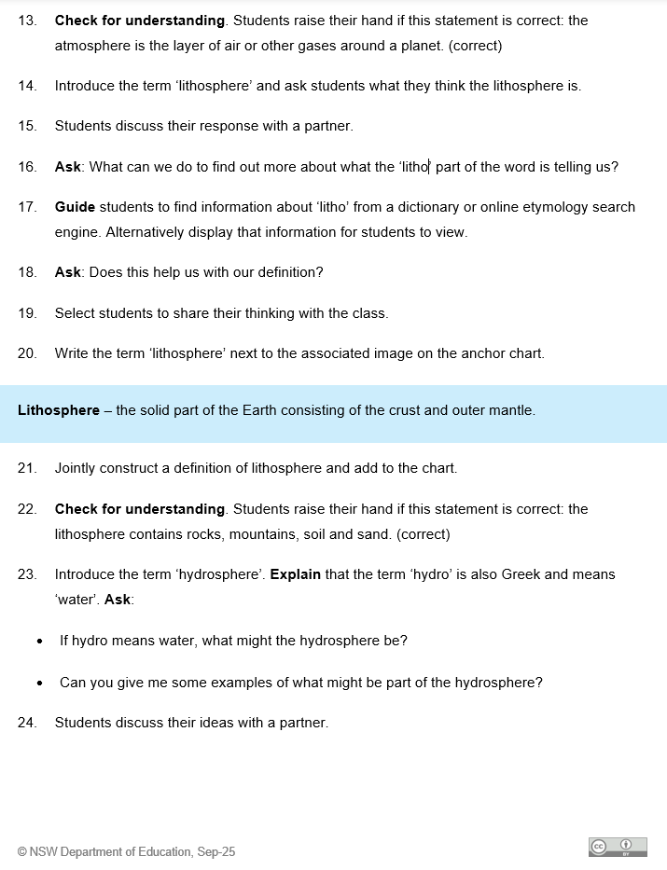
Key features of the lesson structure (3)
Core lesson
Science and Technology – Stage 2 – Unit 1
Notes:
14. Purpose: To unpack the core lesson
Time: 1 minute 30 seconds
Presenter notes:
The core lesson is planned for around 40 minutes. You will notice more explicit teaching strategies embedded here. Teachers begin by explaining and modelling the new knowledge or skill. Then students move into guided practice before working more independently, this is the Gradual Release of Responsibility in action.
The activities are tightly aligned to the learning intention. They are sequenced from simple to complex, scaffolds are gradually removed, and extension opportunities are built in, so every student is challenged at the right level.
Throughout the core lesson, teachers use checks for understanding such as questioning, response systems, or observation to monitor learning progress. These checks for understanding drive timely feedback, helping teachers adjust pace, identify areas that require re-teaching and are connected to the success criteria.
While explicit teaching strategies are central, they are balanced with a variety of other high-quality practices of collaborative learning, use of real-world contexts, inclusion of diverse backgrounds and abilities, and multimodal resources.
[NEXT SLIDE]

Slide 15
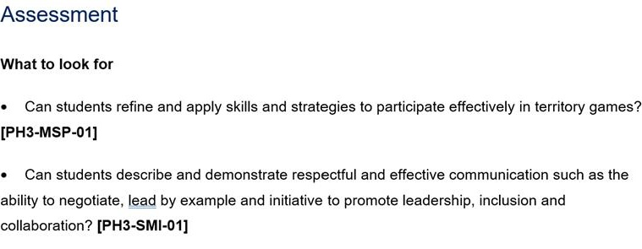
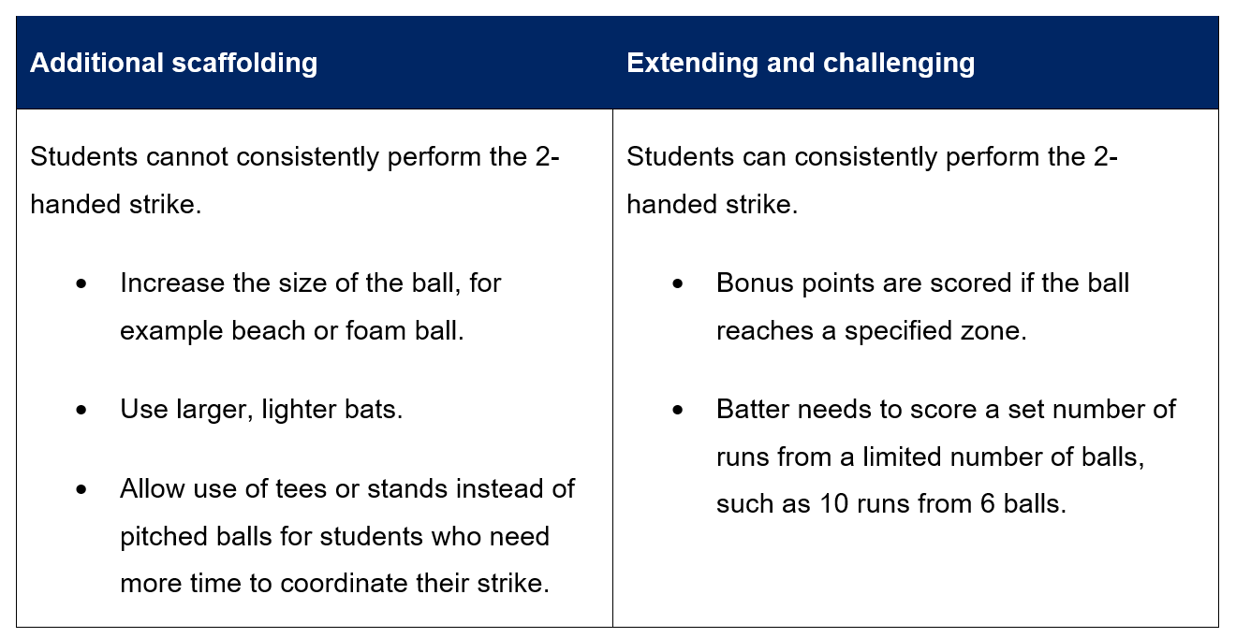
Key features of the lesson structure (4)
Differentiation and Assessment
PDHPE Stage 3 – Unit 1
Notes:
15. Purpose: To unpack differentiation and assessment
Time: 2 minutes
Presenter notes:
Each lesson includes a differentiation table to help teachers plan for the full range of learners in their classrooms. It provides practical examples of additional scaffolds for students who need more support, as well as extension strategies for those ready to be challenged. All adjustments are anchored to the same learning intention and success criteria. This means students may take different pathways, but everyone is working towards the same goal. The table helps teachers anticipate needs in advance, promotes inclusive practice, and ensures high expectations are maintained for every student.
Assessment is also embedded in every lesson, always tied directly to the learning intention, success criteria, and syllabus outcomes. The ‘What to look for’ section gives teachers clear guidance on the observable evidence that shows whether students are meeting the learning intention. For example, in this lesson teachers are looking at whether students can describe strategies to enhance road safety decision making, and whether they can explain actions and messaging for staying safe.
By aligning assessment with the success criteria, we take the guesswork out of checking progress. Teachers know exactly what evidence to gather, and students understand what success looks like. Importantly, this doesn’t add extra workload, assessment is built into the flow of the lesson and doubles as a check for understanding to guide next steps.
[NEXT SLIDE]

Slide 16
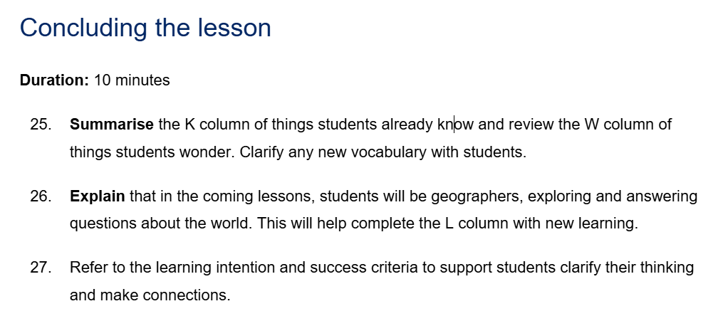
Key features of the lesson structure (5)
Concluding the lesson
HSIE Stage 1 – Unit 1
Notes:
16. Purpose: To unpack the key features of the lesson structure within the CHPS units: Concluding the lesson
Time: 1 minute
Presenter notes:
The conclusion of each lesson is approximately 10 minutes and provides an intentional wrap up of the learning. This phase is about revisiting the learning intention and success criteria, so students are reminded of the purpose of the lesson and what they’ve achieved. It allows them to reflect on how the activities connected to the learning, and to make sense of the knowledge and skills they’ve developed. There is no new content introduced here and no formal check for understanding — it’s simply about clarifying, reinforcing, and closing the loop so students leave the lesson with a clear picture of their progress.
[NEXT SLIDE]

Slide 17
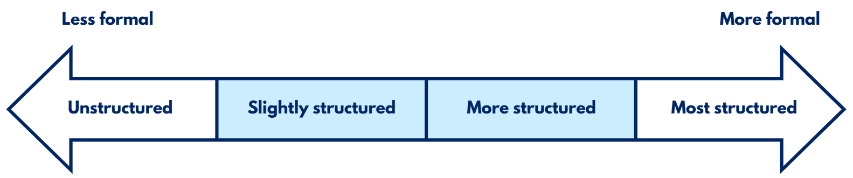
Optional assessments
Opportunities for real-time feedback
Optional assessment: Creative arts Early Stage 1 – Unit 1 – Lesson 5
Observe students during the movement stations activity to assess students’ ability to:
travel from one station to another using locomotor movements
create dance steps
This task provides evidence of student learning aligned to the success criteria. It assesses students’ ability to explore and make shapes and movements with their bodies.
Optional assessments help identify gaps in student learning and misconceptions.
They guide teaching decisions by providing a way to check student understanding at the lesson level and plan the next steps in teaching.
Notes:
17. Purpose: To unpack optional assessments
Time: 2 minutes
Presenter notes:
Each lesson contains optional assessments. These are provided as a flexible tool for assessing student understanding of key content from the lesson.
[CLICK] A benefits of these assessments is that they help identify the gaps in student learning and misconceptions that can occur during a lesson. This is valuable in ensuring that all students grasp essential concepts before new learning is introduced.
[CLICK] They guide teaching decisions. By using these assessments, teachers can gain real-time insights into student understanding and use that information to adjust instruction, provide targeted support, or extend learning. The optional assessments serve as a practical way to check comprehension at the lesson level and plan the next steps in teaching.
Optional assessments offer a range of approaches, from informal methods like planned observations and targeted questioning to identify misconceptions, to more formal tasks such as evaluating student work samples using predetermined criteria.
They are designed to be a flexible, optional resource, available for use when and where they are needed and are a tool to support your teaching.
[NEXT SLIDE]

Slide 18
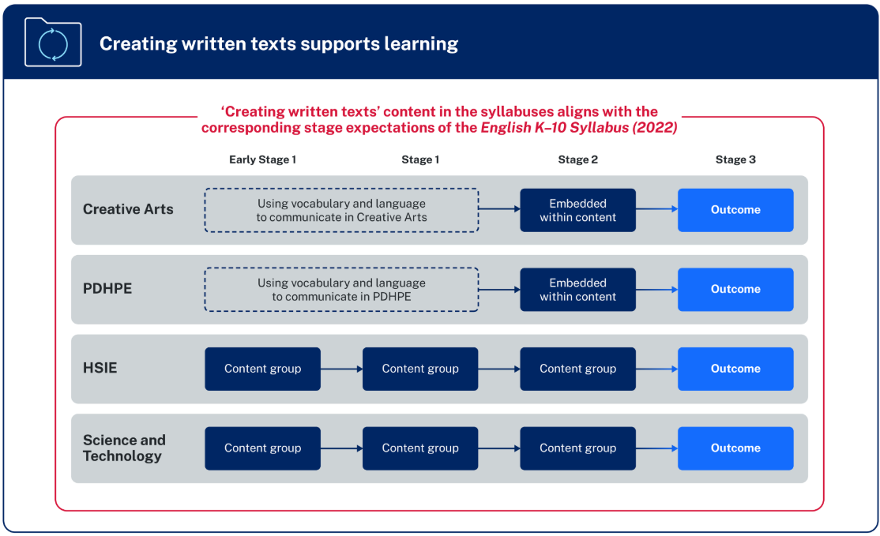
Creating written texts in CHPS K–6
“Creating written texts is a way of organising thoughts, explaining thinking and making connections within and across learning areas. The learning areas provide meaningful content for writing beyond the subject of English.” – NESA
Notes:
18. Purpose: To explore the creating written texts connection across CHPS syllabuses.
Time: 1 min
Presenter notes:
NESA’s diagram provides an overview of the organisation of content for Creating written texts is included in all CHPS syllabuses:
in Early Stage 1 and Stage 1, the focus in PDHPE and Creative arts is on developing students’ subject-specific vocabulary to support communicating. In HSIE and Science and technology there are individual content groups.
in Stage 2, for PDHPE and Creative arts opportunities are embedded within the content for students to create written texts. In HSIE and Science and technology there is an individual content group.
in Stage 3, there is a dedicated creating written texts outcome for all CHPS key learning areas with specific subject content.
NESA highlights that various methods of transcription may be employed, and a student’s preferred communication form(s) should be considered when teaching writing.
[CLICK] NESA states, “Creating written texts is a way of organising thoughts, explaining thinking and making connections within and across learning areas. The learning areas provide meaningful content for writing beyond the subject of English.”
[NEXT SLIDE]

Slide 19

Creating written text
PDHPE Stage 3 Unit 1
Activity:
Create a mind map to determine who or what was an influence on their personal wellbeing and how it impacted them.
Reflect on individual mind map
Use a combination of simple, compound and complex sentences to record reflections.
PH3-CWT-01
creating written texts supports understanding of health, safety and wellbeing
PH3-IHW-01
changes and factors can promote a positive identity
Notes:
19. Purpose: To highlight how CWT is embedded meaningfully in CHPS.
Time: 1 minute
Presenter notes:
Take a moment to review the PDHPE example on the screen.
This example demonstrates how creating written texts is effectively integrated into the PDHPE curriculum to enhance students' understanding of health, safety, and wellbeing. By engaging in the activity of creating a mind map, students reflect on influences affecting their personal wellbeing, promoting self-awareness and positive identity development. The task encourages the use of varied sentence structures, supporting literacy skills alongside personal development. This integrated approach helps students articulate their thoughts clearly while connecting literacy with key health concepts. It exemplifies how writing activities can deepen learning across key learning areas by combining content knowledge with essential communication skills..
[NEXT SLIDE]

Slide 20













Behind the scenes developing the sample units
… with students at the centre of all decisions
Syllabus is the starting point
Deep content knowledge
Enjoyment and engagement
Pedagogy and practices
Collaboration
Stakeholder consultation
Notes:
20. Purpose: To explain how CHPS units are designed with students at the centre of all decision making.
Time: 2 minutes
Presenter notes:
With students at the centre of all decisions, [CLICK] planning started with the NESA syllabus and Teaching Advice, ensuring fidelity to the syllabus rationale, intent and extensive evidence-base to shape decisions.
[CLICK] Teachers with deep content knowledge can explain concepts clearly, chunk learning effectively, differentiate with purpose, and respond confidently to key teaching moments. The sample units build this expertise by highlighting misconceptions, identifying essential vocabulary, practical tools, and expert advice.
[CLICK] Engagement is non-negotiable - the design for students to be in-task, more than just on-task: thinking deeply, doing the work, and feeling positive about learning.
[CLICK] The pedagogy and practices within the sample units are anchored in the Explicit Teaching in NSW Public Schools statement and research-informed practices tailored to each key learning area.
[CLICK] The sample units have been a collaborative build and
[CLICK] Consultation with stakeholders ensured shared understandings and inclusive approaches. These partnerships ensure that the sample units are comprehensive, culturally responsive, and aligned with best practices to support diverse student needs and enhance learning outcomes.
[NEXT SLIDE]

Slide 21

Roadmap of a CHPS unit across 13 weeks
Quality assurance
Design stage
Consult phase
Develop stage
Review stage
Digital stage
KLA Advisors map syllabus expectations from the scope and sequence into a 16-lesson sequence + 4 consolidation lessons.
Coordinators and Leader review and refine the sequence through rigorous feedback.
Quality assurance
Consultation and collaboration occurs stakeholder groups, including Aboriginal Education Advisors, Road Safety, Respectful Relationships and Effective Teaching Practices team.
Quality assurance
Writing pods develop the lessons into a sequenced unit.
Embed explicit teaching strategies, quality resources and assessment into every lesson – supported by SMEs.
Quality assurance
KLA Advisors review and provide extensive feedback for refinement.
Coordinators and Leader review for endorsement and approval.
Consultation loop is closed on the final lessons.
Quality assurance
Final checks:
Reviewed by an Editorial team
Checked by Website team.
Communication plan to feature in the Staff Noticeboard.
Quality assurance
Notes:
21. Purpose: To unpack the roadmap of CHPS unit design and quality-assurance.
Time: 2 minutes
Presenter notes:
This slide outlines the 13-week roadmap for every CHPS unit, with quality assurance built in at every stage.
It starts at the design stage, key learning advisors, subject matter specialists map syllabus expectations from the DoE scope and sequence into a 16-lesson sequence, plus four optional consolidation lessons. Coordinators and leaders then refine the sequence.
Next is the consult phase, where we test the draft with key stakeholder groups, including Aboriginal Education, Multicultural, Respectful Relationships, Road Safety, Effective Teaching Practices, and others, to ensure intent and inclusivity.
In the develop stage, writing pods build the full sequence, embedding explicit teaching, high-quality resources, and assessment in every lesson.
In the review stage key learning advisors provide detailed feedback, followed by coordinator and leader endorsement, and close the consultation loop on the final lessons.
Finally, in the digital stage, editorial and website checks are completed, and communications go out, so the unit appears on the Staff Noticeboard.
Through this pipeline, Primary Curriculum are delivering 114 units—over 2,200 lessons—ready to support the mandatory CHPS implementation in 2027.
[NEXT SLIDE]

Slide 22

Activity
Key similarities and differences
What similarities to the way you plan now can you see in the sample units?
What differences to the way you plan now can you see in the sample units?
Notes:
22. Purpose: To provide time for participants to reflect on the key similarities and differences to how they already program with the new CHPS sample units.
Time: 5 minutes
Presenter notes:
Now you have viewed the features of the sample units for CHPS I would like you to consider the questions on the slide.
What similarities to the way you plan now can you see in the sample units?
What differences to the way you plan now can you see in the sample units?
[NEXT SLIDE]

Slide 23

Unit Preview
Notes:
23. Purpose: To introduce the walkthrough of Unit 1 and Unit 5 for each stage and each KLA
Time: 30 seconds
Presenter notes:
This session is designed to a look at what will be in the first unit for each year.
Each KLA will be sharing the outcomes and content that these units will cover.
[NEXT SLIDE]

Slide 24
Human Society and its Environment (HSIE) – unit 1
Unit 1
Notes:
24. Purpose: To provide an overview of unit 1
Time: 10 seconds
Presenter notes:
Let's look at Stage 2 Human Society and its Environment Unit 1.
[NEXT SLIDE]

Slide 25

HSIE – unit 1 overview
In Unit 1, students:
learn about climate zones around the world in relation to the equator and poles
compare climate zones in Australia
analyse seasonal rainfall patterns
representing data in column graphs
Notes:
25. Purpose: To provide an overview of the unit
Time: 20 seconds
Presenter notes:
In Unit 1, students learn about climate zones around the world in relation to the equator and poles. Students compare climate zones in Australia and analyse seasonal rainfall patterns, representing data in column graphs. Students also locate and compare key geographical features in Australia and the world using grid and relief maps along with compass directions.
[NEXT SLIDE]

Slide 26

HSIE – unit 1 syllabus outcomes
Focus Area: Geographical information is used to understand the world
HS2-GEO-01
explains how people care for Australia’s environments and participate in Australian society, using geographical information.
Notes:
26. Purpose: To outline the outcomes and content in the unit
Time: 45 seconds
Presenter notes:
The focus area for Unit 1 is 'Geographical information is used to understand the world.’ The outcome is displayed on screen.
[NEXT SLIDE]

Slide 27
HSIE – unit 1 syllabus content
Content Group: People use geographical information to understand climates and environments
Identify polar, continental, temperate, tropical and dry climate zones in the world in relation to the equator and poles
Identify and compare climate zones in Australia using choropleth maps showing temperature, humidity and vegetation
Compare seasonal rainfall in places in Australia and display data in column graphs
Locate and compare deserts, forests, mountain ranges, rivers, ocean trenches and volcanoes of Australia and the world using grid and relief maps and compass directions north, south, east and west
Notes:
27. Purpose: To outline the outcomes and content in the unit
Time: 45 seconds
Presenter notes:
The content group people use geographical information to understand climates and environments is the focus for this unit. I will pause now to let you read the 4 content points the unit covers.
We will now look at skill development.
[NEXT SLIDE]

Slide 28

HSIE – unit 1 skill development
In this unit, students learn and apply geographical skills by:
using maps to identify and interpret a variety of features such as climate zones and ocean trenches.
locating and comparing places around the world using a variety of maps and compass directions.
examining and discussing climate zones around the world using the Koppen Climate Classification system.
using a variety maps to make inferences, identify patterns, draw conclusions and connect ideas.
representing and interpreting data using tables and column graphs.
Notes:
28. Purpose: To outline the skills students learn and apply during the unit.
Time: 20 seconds
Presenter notes:
Throughout the unit, students are provided with opportunities to learn and apply geographical skills whilst learning about the content.
In Stage 2 Unit 1, students:
Identify climate zones across the world and within Australia
Learn about a variety of different types of maps, including relief maps, grid maps and choropleth maps
Use maps to identify patterns, make inferences and draw conclusions about climate
Use tables and column graphs to represent and interpret data
[NEXT SLIDE]

Slide 29
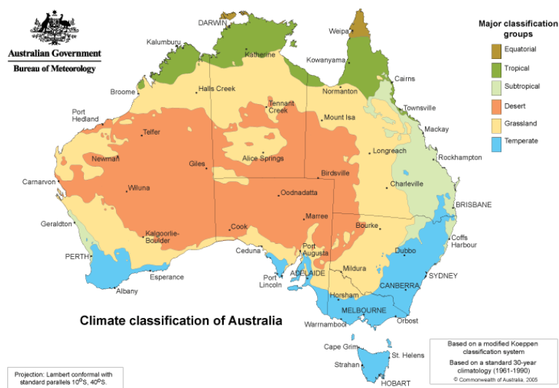
HSIE – unit 1 spotlight (1)
Choropleth maps
Students interpret a variety of choropleth maps and draw conclusions about climate zones.
Image sourced from NESA 2024 (HSIE Syllabus: Stage 2 Teaching Advice)
Notes:
29. Purpose: To highlight activities within the unit
Time: 25 seconds
Presenter notes:
A new and interesting element of this unit is the opportunity to learn about a variety of different maps, including the choropleth map. A choropleth map uses colours to show information on a map. Students are introduced to the Koppen Climate Classification system, which classifies the worlds climates into 5 main categories – tropical, desert, temperate, continental and polar. Using this type of map, students develop skills in identifying climate zones around the world and their relationship to the equator and poles.
[NEXT SLIDE]

Slide 30
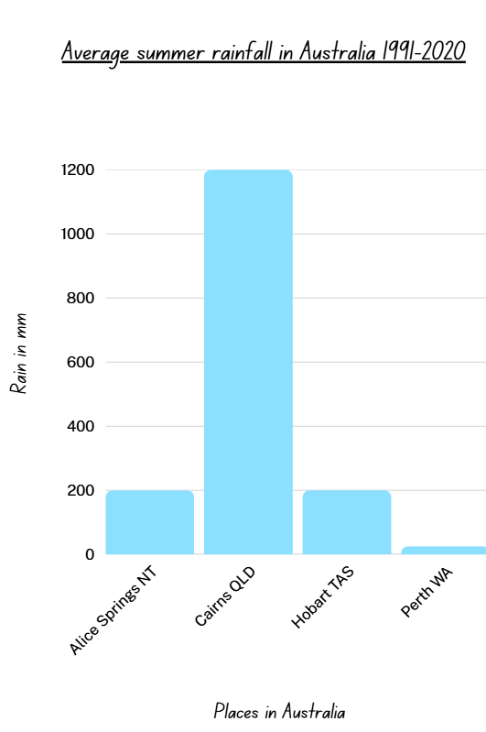
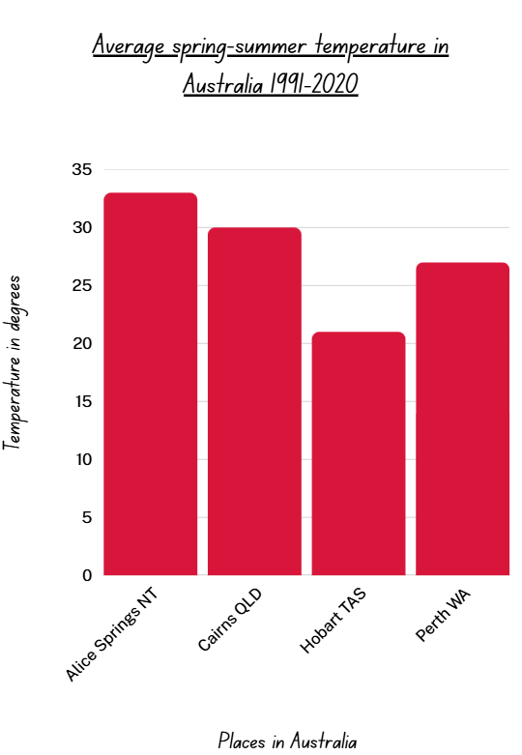
HSIE – unit 1 spotlight (2)
Column graphs
Students compare information in choropleth maps with data in column graphs to connect ideas and draw conclusions .
Climate classification map sourced from NESA 2024 (HSIE Syllabus: Stage 2 Teaching Advice)
Notes:
30. Purpose: To highlight activities within the unit
Time: 20 seconds
Presenter notes:
Another interesting element to this unit is its connection to mathematics. Students will engage with a variety of data, including rainfall and vegetation distribution, using choropleth maps. They will then learn how to use tables and column graphs to represent this data. Using column graphs, they will interpret data to draw conclusions and connect ideas.
[NEXT SLIDE]

Slide 31
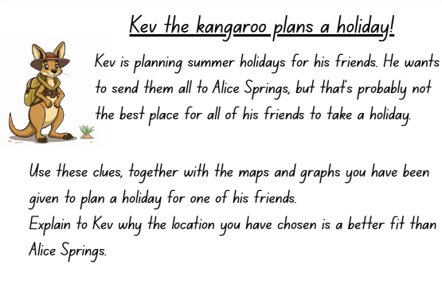
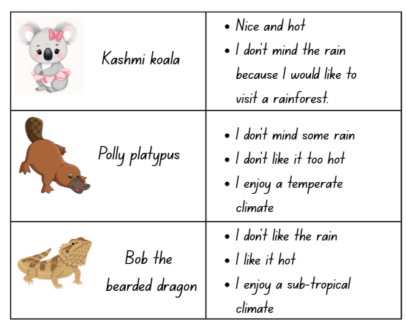
HSIE – unit 1 spotlight (3)
Using maps and data
Students use a variety of maps and data to plan a holiday for a group of friends.
Notes:
31. Purpose: To highlight activities within the unit
Time: 1 minute 25 seconds
Presenter notes:
Students will need to use a variety of maps and data during the unit.
Learning to be a geographer requires the ability to connect the skills we have learned to solve problems. Using the choropleth map and column graphs we saw on the previous slides, students are provided with a fun scenario that enables them to connect their learning. By using the information provided to Kev the kangaroo from his mates, students are required to find the best holiday location for each friend and explain to Kev why his idea of them all going to Alice Springs is probably not the best idea. What a fun and engaging way to assess student understanding!
[NEXT SLIDE]

Slide 32
Human Society and its Environment (HSIE) – unit 5
Unit 5
Notes:
31. Purpose: To introduce Stage 2 Unit 5.
Time: 5 seconds
Presenter notes:
We will now look at the second unit being released for Stage 2.
[NEXT SLIDE]

Slide 33

HSIE – unit 5 overview
In Unit 5, students:
explore how places are organised for different purposes
compare conservation and sustainability goals
learn about the management of reserved lands in New South Wales
identify waste minimisation strategies
investigate sustainable food practices of Aboriginal and Torres Strait Islander peoples.
Notes:
33. Purpose: To provide an overview of the unit
Time: 20 seconds
Presenter notes:
In Unit 5, students explore how places are organised for different purposes and compare conservation and sustainability goals. Students learn about the management of reserved lands in New South Wales, identify waste minimisation strategies and investigate sustainable food practices of Aboriginal and Torres Strait Islander peoples.
[NEXT SLIDE]

Slide 34

HSIE – unit 5 syllabus outcomes
Focus Area: Geographical information is used to understand the world
HS2-ACH-01
describes Aboriginal Peoples’ obligations to Country, Culture and Community
HS2-GEO-01
explains how people care for Australia’s environments and participate in Australian society, using geographical information.
Notes:
34. Purpose: To outline the outcomes and content in the unit.
Time: 30 seconds
Presenter notes:
Unit 5 covers the focus area 'Geographical information is used to understand the world.'
There are 2 outcomes covered:
As in unit 1 the same geography outcome is addressed. This is because there is only one geography outcome per stage. This unit also addresses the Aboriginal Cultures and Histories outcome displayed on the screen. .
[NEXT SLIDE]

Slide 35
HSIE – Unit 5 syllabus content (1)
Content Group: Aboriginal People's use and care for the environment sustainably.
Identify and use appropriate terminology when sharing Knowledges about Country
Describe how Aboriginal Peoples sustainably use the resources of Country
Notes:
35. Purpose: To outline the outcomes and content in the unit.
Time: 30 seconds
Presenter notes:
There are 2 content groups covered in Unit 5. The first is Aboriginal People's use and care for the environment sustainably.
There are 2 content points addressed in Unit 5 which are:
Identify and use appropriate terminology when sharing Knowledges about Country
Describe how Aboriginal Peoples sustainably use the resources of Country
[NEXT SLIDE]

Slide 36
HSIE – Unit 5 syllabus content (2)
Content Group: People have responsibility to care for Australia's environments.
Observe and describe ways people organise places into spaces for different purposes
Compare the objectives of managing places for conservation and managing places for sustainability
Describe how reserved lands are managed in New South Wales at Mungo National Park, Kosciuszko National Park, Wollemi National Park and Barrington Tops National Park
Identify strategies that minimise waste and make the most of resources to sustain environments
Investigate Aboriginal and Torres Strait Islander food practices that are sustainable
Notes:
36. Purpose: To outline the outcomes and content in the unit.
Time: 1 minute
Presenter notes:
The second content group covered in Unit 5 are People have responsibility to care for Australia's environments.
I'll give you a moment to read through the 5 content points on your screen.
Thank you, we will now have a closer look at the Aboriginal Cultures and Histories content.
[NEXT SLIDE]

Slide 37

Aboriginal Cultures and Histories content
All HSIE units, which cover ACH content, are written in consultation with Department of Education Aboriginal Education Advisors.
In adapting and implementing the units, schools are encouraged to:
involve local Aboriginal Communities and/or appropriate Knowledge Holders
use Aboriginal and/or Torres Strait Islander-authored or endorsed publications
read the principles and protocols relating to teaching and learning about Aboriginal and/or Torres Strait Islander histories and Cultures and the involvement of local Aboriginal Communities
Refer to the Australian Institute of Aboriginal and Torres Strait Islander Studies (AIATSIS) Guide to evaluating and selecting education resources when selecting appropriate resources.
Artwork © Kayleb Waters, Gomeroi artist and Cultural mentor 2025.
​
This image represents Community (families, parents, Aunts, Uncles, Elders, schools, teachers, LAECGs, LALCs)
“This symbol is expressed through people sitting together in one place, showing unity, responsibility, love, and respect.”
Notes:
37. Purpose: To explain the requirements for schools in relation to Aboriginal Cultures and Histories content.
Time: 40 seconds
Presenter notes:
All HSIE units, which cover Aboriginal Cultures and Histories content, are written in consultation with Department of Education Aboriginal Education Advisors.
When planning and programming content relating to Aboriginal and/or Torres Strait Islander histories and Cultures, teachers are encouraged to:
involve local Aboriginal Communities and/or appropriate Knowledge Holders in determining suitable resources
use Aboriginal and/or Torres Strait Islander-authored or endorsed publications.
read the principles and protocols relating to teaching and learning about Aboriginal and/or Torres Strait Islander histories and Cultures and the involvement of local Aboriginal Communities.
The Australian Institute of Aboriginal and Torres Strait Islander Studies (AIATSIS) Guide to evaluating and selecting education resources has been developed to assist teachers in selecting appropriate resources for teaching about Aboriginal and Torres Strait Islander histories, Cultures and Languages respectfully and effectively.
Both of these links will be placed into the Q & A for you now.
[NEXT SLIDE]

Slide 38
HSIE – unit 5 skill development
In this unit, students learn and apply geographical skills by:
observing the ways places and spaces are organised
describing the organisation of places
identifying sustainable food practices of Aboriginal and Torres Strait Islander Peoples
identifying waste management strategies
comparing the objectives of managing environments
comparing the strategies used to manage environments
describing the management of National Parks.
Notes:
38. Purpose: To outline the skills students learn and apply during the unit
Time: 40 seconds
Presenter notes:
Throughout this unit, students are provided with opportunities to learn and apply geographical skills whilst learning about the content.
Unit 5, students:
observe and describe places and spaces through a geographical lens
identify sustainable food practices of Aboriginal and Torres Strait Islander Peoples
identify sustainable practices, such as waste management
make comparisons between conservation and sustainability, making connections to learn about land management, and
investigate and describe the management of reserved areas such as National Parks
[NEXT SLIDE]

Slide 39
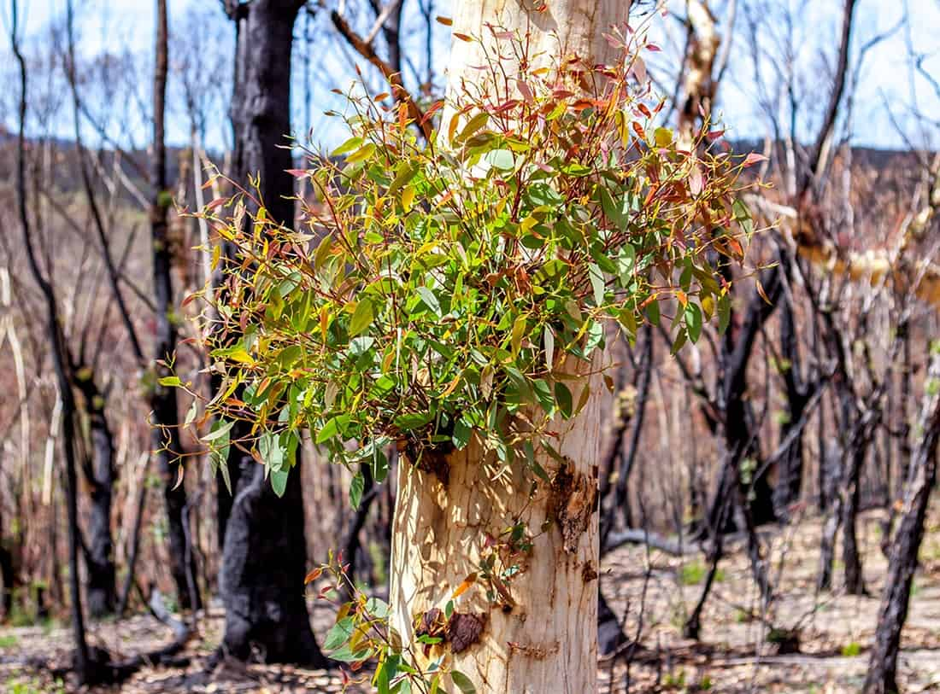

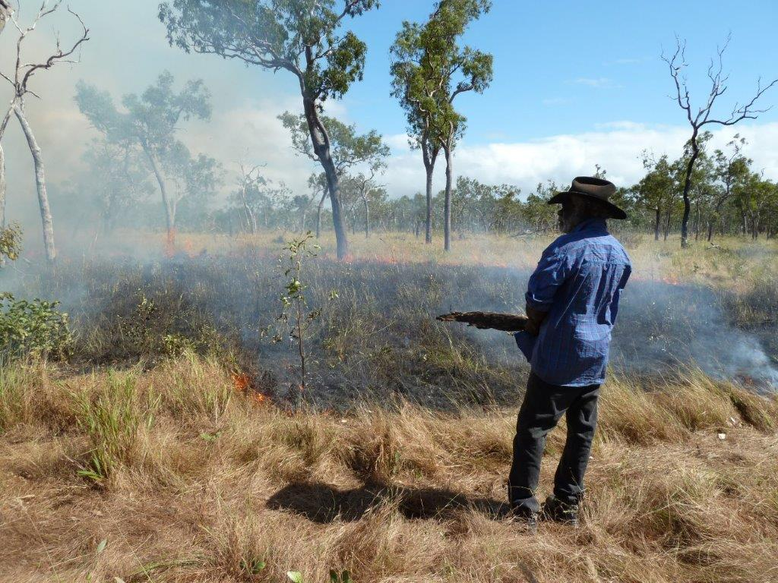
HSIE – unit 5 spotlight (1)
Sustainable Aboriginal and Torres Strait Islander food practices
Students explore fire management as a key feature of sustainable agriculture for Aboriginal Peoples.
They learn how its use manages the landscape to enhance the production of native grains and other low-growing foods.
Students discover that selective and controlled burning of the land promotes the natural growth of native plants.
A tree with new growth following a fire. Credit DCCEEW
A burning tree. Credit DCCEEW
Aboriginal rangers in a post-fire Australian landscape in Cape York.. Credit DCCEEW
NSW Environment. (n.d.). Aboriginal fire management and cultural burning. Retrieved September 25, 2025, from https://www.environment.nsw.gov.au/topics/animals-and-plants/nsw-koala-country/koalas-and-aboriginal-culture/traditional-ecological-knowledge/aboriginal-fire-management-and-cultural-burning
Notes:
39. Purpose: To highlight activities within the unit
Time: 45 seconds
Presenter notes:
As part of this unit, students learn how Aboriginal Peoples have sustainably used the resources of Country for thousands of years. They investigate examples of Aboriginal food practices that are sustainable. Students explore how these practices are connected to seasons and Country, and how they ensure resources are cared for. Students connect principles of Aboriginal sustainable use of Country with modern strategies that minimise waste and make the most of resources.
Students will learn that Aboriginal fire management is a key feature of sustainable agriculture. Selective and controlled burning of the land promotes the natural growth of native plants.
Students will investigate how sustainable fire management practices used by Aboriginal Peoples also supports the hunting of animal species by attracting animals to new plant growth.
[NEXT SLIDE]

Slide 40
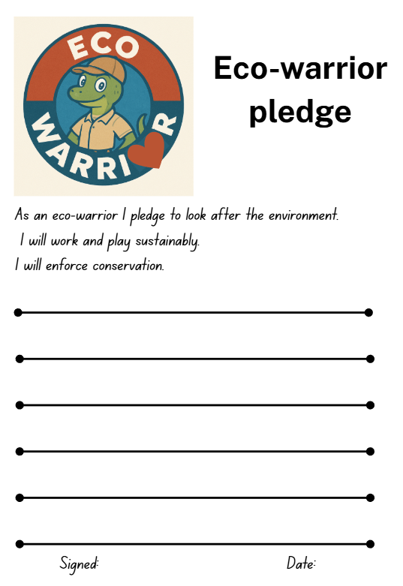
HSIE – unit 5 spotlight (2)
Students develop a deep understanding of their responsibility to care for environments by:
investigating sustainability and conservation practices to determine the purpose of management strategies
building knowledge about reserved lands such as National Parks
developing their own eco-warrior pledge to help protect Australia's environments.
Notes:
40. Purpose: To highlight activities within the unit
Time: 30 seconds
Presenter notes:
To further develop their skills as geographers, students will apply their knowledge of sustainability, conservation and land management to develop their own pledge to protect the environment. In doing so, students are connecting their learning through the development of a set of promises that reflect their knowledge and understanding, whilst embedding their clear acknowledgement of their responsibility to care for places. The development of the eco-warrior pledge helps assess the depth of understanding students have regarding their obligation to care for Country.
[NEXT SLIDE]

Slide 41

HSIE – unit 5 reflection
What excites you about these units?
What changes did you notice which you will need to make some considerations about or do some preparation for?
What is still circling that you need some further clarification on?
Notes:
41. Purpose: To reflect on the units presented and take notes.
Time: 5 minutes
Presenter notes:
We would like to give you some time now to reflect on what you have seen, make some notes and start to think about what this could look like in your school context.
In your participant workbook you will find the reflection section and a heading for each Key Learning Area.
You will have 5minutes to add some notes.
Pause 5 minutes
We will be referring to this activity again after each Key Learning Area unit walkthrough.
[NEXT SLIDE]

Slide 42
Science and technology
Unit 1
Notes:
42. Purpose: To introduce the science and technology sample units
Time: 10 seconds
Presenter notes:
Let’s shift our focus now to science and technology, and a preview of Unit 1.
[NEXT SLIDE]

Slide 43
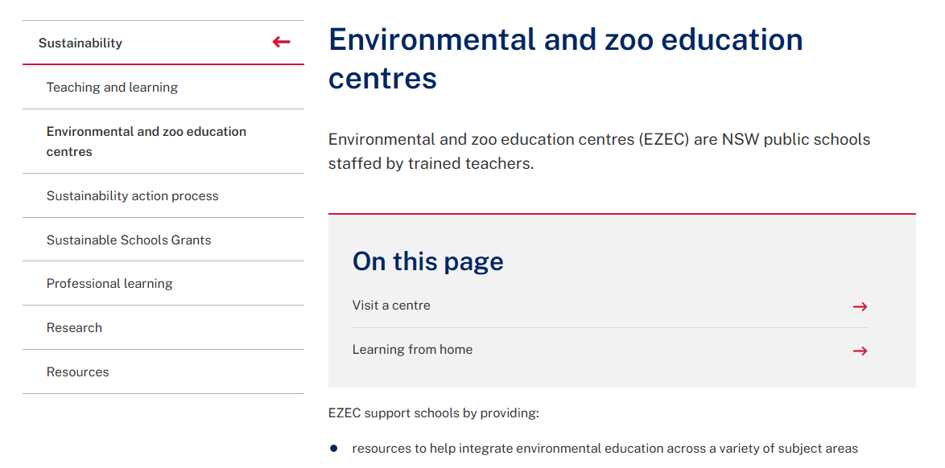

Science and technology – unit 1 overview
This unit explores:
how living things depend on each other, Earth’s systems, and energy to survive
the relationship between habitats, ecosystems, and environments
food chains by making, acting out and representing feeding relationships
how to conduct and document fair tests by examining how changes in soil, water, and light affect plant growth
how to represent and share results digitally
a local habitat
Aboriginal and/or Torres Strait Islander Peoples’ practices support habitats to survive.
Notes:
43. Purpose: To provide an overview of the unit
Time: 2 minutes
Presenter notes:
This unit marks the start of a student’s science and technology journey in Stage 2.
The unit provides opportunities for students to understand how living things depend on the Earth’s systems, energy and each other to survive.
[CLICK] Students learn about and model the atmosphere, lithosphere, hydrosphere and biosphere.
[CLICK] They investigate the relationship between habitats, ecosystems, and environments.
[CLICK] Students explore how food chains can represent energy flow in systems
[CLICK] Students begin to conduct fair tests in a way that builds on questioning, observation skills and an understanding of cause and effect learned in Early Stage 1 and Stage 1.
[CLICK] Students continue to create written texts that support their science learning and use digital tools to represent data and to collaborate.
[CLICK] During the unit students visit a local habitat. This could be somewhere on the school grounds or close by.
[CLICK] One of the Environmental and Zoo Education Centres could be an option as well. EZECs are NSW public schools staffed by trained teachers. Search for EZECs to find the list of the centres.
[CLICK] The unit also presents opportunities to connect and consolidate HSIE content about Aboriginal cultural burning practices. The specific science focus relates to how Aboriginal and/or Torres Strait Islander Peoples’ practices support habitats to survive. Consider the connections you have to your local Elders and Knowledge holders and how this could help to contextualise learning to your local area.
[NEXT SLIDE]
Image credit: Canva Education. 2025. Images via Canva. https://www.canva.com/ accessed 30 September 2025.

Slide 44
Science and technology – unit 1 syllabus outcomes
Focus area: Physical and living systems depend on energy
ST2-SCI-01 uses information to investigate the solar system and the effects of energy on living, physical and geological systems
ST2-PQU-01 poses questions to create fair tests that investigate the effects of energy on living things and physical systems
ST2-DAT-01 uses and interprets data to describe patterns and relationships
Focus area: Design processes and digital systems are used to create solutions
ST2-DDT-02 designs and uses algorithms, represents data and uses digital systems for a purpose
Notes:
44. Purpose: To outline the outcomes and content in the unit.
Time: 30 seconds
Presenter notes:
The science focus area for the whole of Stage 2 is Physical and living systems depend on energy. It is important to keep the wording of each focus area front of mind as we unpack the content of the Stage 2 sample units.
The outcomes are multi-faceted, so we have underlined the aspects covered in this unit.
The Stage 2 Technologies focus area is Design processes and digital systems are used to create solutions.
I'll give you a moment to read through the outcomes covered in this unit which appear on your screen.
[NEXT SLIDE]

Slide 45
Science and technology – unit 1 syllabus content (1)
Content Group: Living things depend on energy and materials to survive
Identify the systems of Earth that make up environments: air – atmosphere, land – lithosphere, water – hydrosphere, living things – biosphere
Describe how the needs of living things are provided by the atmosphere, hydrosphere and lithosphere
Describe the relationship between habitat, ecosystem and environment
Observe and describe living and non-living things in a habitat
Pose questions to conduct fair tests to determine the effects of soil, water and light energy on plants
Describe how Aboriginal and/or Torres Strait Islander Peoples’ practices support habitats to survive
Describe the transfer of energy between plants and animals using food chains, Tier 2 and Tier 3 vocabulary
Describe ways in which plants and animals depend on each other for survival
Notes:
45. Purpose: To outline the outcomes and content in the unit.
Time: 40 seconds
Presenter notes:
As it is still early in the students Stage 2 learning journey, students may only demonstrate achievement of relevant parts of an outcome. We have bolded the content point beginning with ‘Pose questions to conduct fair tests’ as we will elaborate on that content and related outcome shortly. I will pause for you to read the on screen content.
[NEXT SLIDE]

Slide 46

Science and technology – unit 1 syllabus content (2)
Content Group: Digital systems can be created and controlled
Use core features of common digital tools to locate, select, store and retrieve relevant information
Use core features of common digital tools to share content, plan tasks and collaborate safely following an agreed code of conduct
Notes:
46. Purpose: To outline the outcomes and content in the unit.
Time: 20 seconds
Presenter notes:
The Technologies content points for this unit have been set out.
This unit includes digital content but there is no design content. Digital tools are integrated to support student observations and representation of data.
Just a reminder that in science and technology, there is no requirement for an equal allocation of time between science and technology.
These content points are interwoven in the unit with the science content. They do not stand alone.
Again, you will notice that there is no design content for this sample unit.
[NEXT SLIDE]

Slide 47
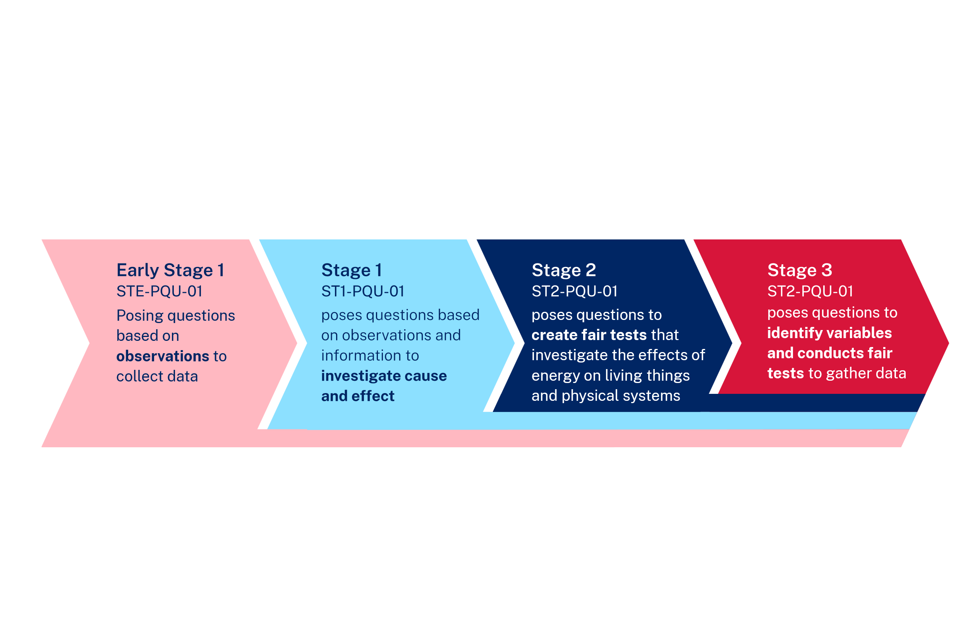
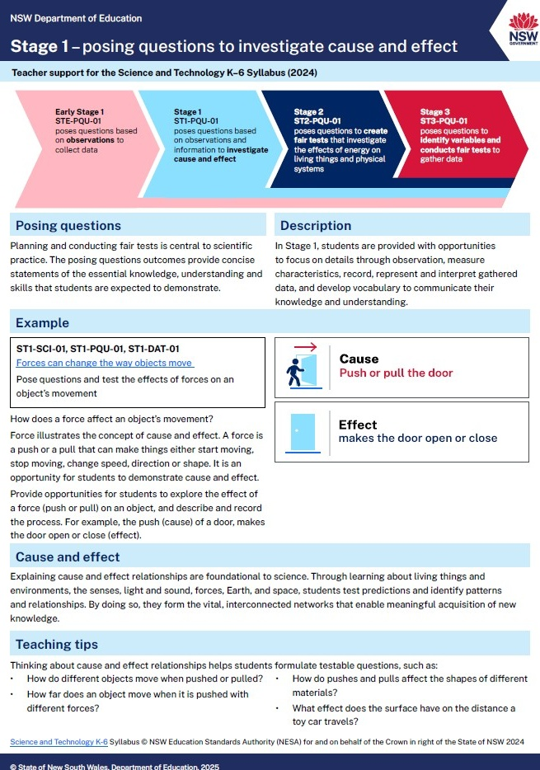
Posing Questions (PQU)
Support document
ST1-PQU-01
poses questions to investigate cause and effect
Notes:
47. Purpose: To explain teacher support for posing questions outcomes.
Time: 2 minutes 30 seconds
Presenter notes:
New to the 2024 Science and Technology syllabus for each stage are posing questions outcomes.
For Stage 2 the outcome is: poses questions to create fair tests that investigate the effects of energy on living things and physical systems
Right from the beginning of Early Stage 1 students are developing their questioning, observation and data analysis skills in a sequenced and cumulative way. This learning supports the introduction of Working Scientifically outcomes in Stage 4.
To supplement the syllabus teaching advice, the department has created an information document for posing questions. This will be published on the department’s website.
The advice has one page per stage, providing background information, examples and teaching tips relevant for each stage of learning.
For Stage 2 Unit 1, students are posing questions to create fair tests that investigate the effects of energy on living things.
[NEXT SLIDE]
https://www.menti.com/alod1akmgb8y

Slide 48
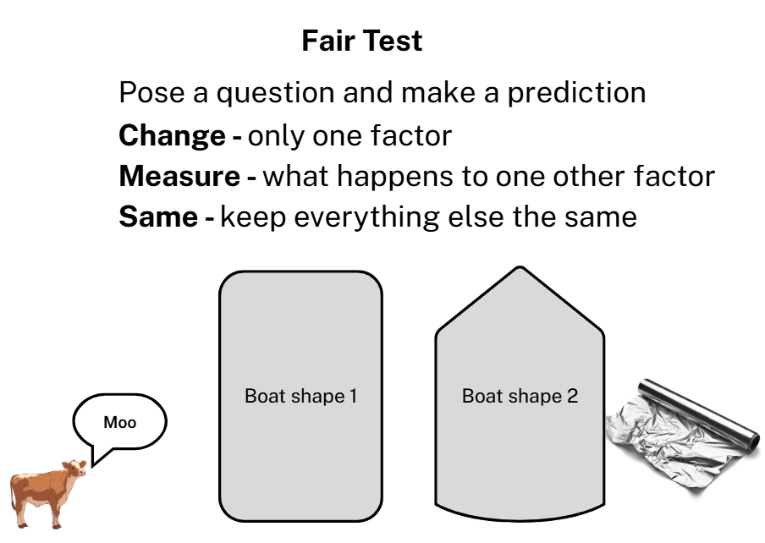
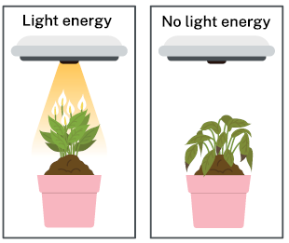
Science and technology – unit 1 spotlight (1)
Fair tests
Notes:
48. Purpose: To highlight activities within the unit.
Time: 1 minute 30 seconds
Presenter notes:
Before we dive into fair testing, can we ask you to share a reaction about whether you use the mnemonic Cows Moo Softly to support student understanding for fair tests.
Unit 1 includes the explicit modelling of fair testing principles, including:
The introduction of the idea that fair tests change one factor, measure the effect of the change and keep all other factors the same
The use of Cows Moo Softly as a mnemonic to support recall of Change, Measure, and Same
The unit also includes the modelling of two fair tests:
The first test models changing the shape of a boat made from the same sized piece of aluminium foil and measuring how many items it can hold.
The second fair test models how to investigate the effect of changing the amount of light energy received by a plant.
The unit continues to support student learning with guided instruction for two further tests:
In the first guided fair test, students observe the effects on plant growth of varying the amount of water a plant receives.
In the second guided fair test, students are supported to change the soil or substrate a seed grows in and measure the effects.
For the plant growing investigations, learning is supported with modelled and guided observations, data analysis and representation.
Opportunities for independent conducting of fair tests is scoped for later units.
Teachers should note that Stage 2 students are not expected to use the vocabulary of independent, dependent and controlled variable. This vocabulary is introduced in Stage 3.
The next few slides will focus on activities within the unit.
[NEXT SLIDE]
Image credit: Canva Education. 2025. Images via Canva. https://www.canva.com/ accessed 30 September 2025.

Slide 49
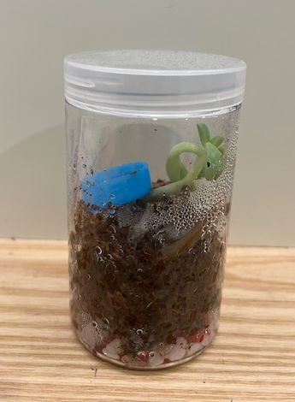
Science and technology – unit 1 spotlight (2)
Mini terrarium
Atmosphere
Biosphere
Lithosphere
Hydrosphere
Notes:
49. Purpose: To highlight activities within the unit.
Time: 30 seconds
Presenter notes:
The second activity we would like to highlight is the construction of a mini terrarium. This activity comes directly after explicit teaching of each of the Earth’s systems.
The lithosphere is represented in rocks and soil.
The biosphere is represented in the plants.
The atmosphere is contained within the sealed jar.
By adding water and sealing the container, students generate a hydrosphere.
This kind of hands-on activity provides an opportunity for students to represent the Earth’s systems; use learnt Tier 3 vocabulary and to observe changes such as condensation of water vapour and plant growth.
[NEXT SLIDE]

Slide 50
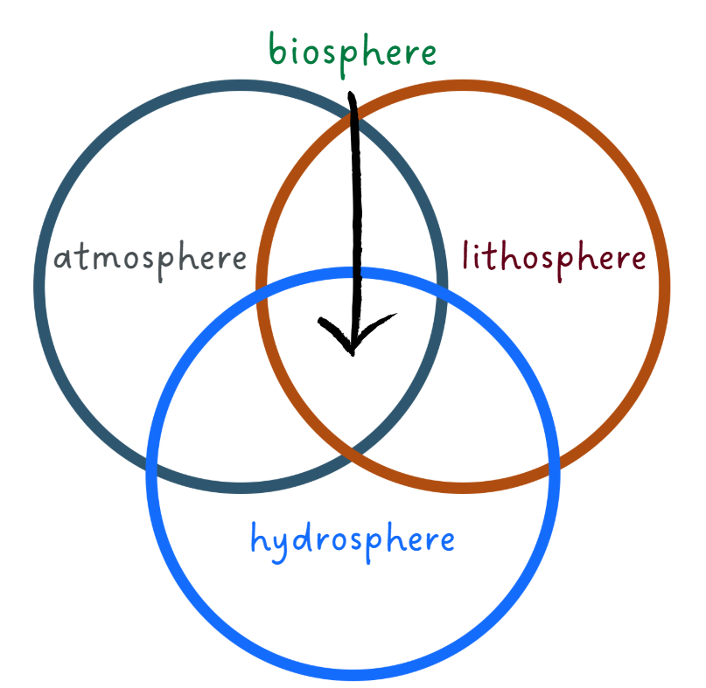
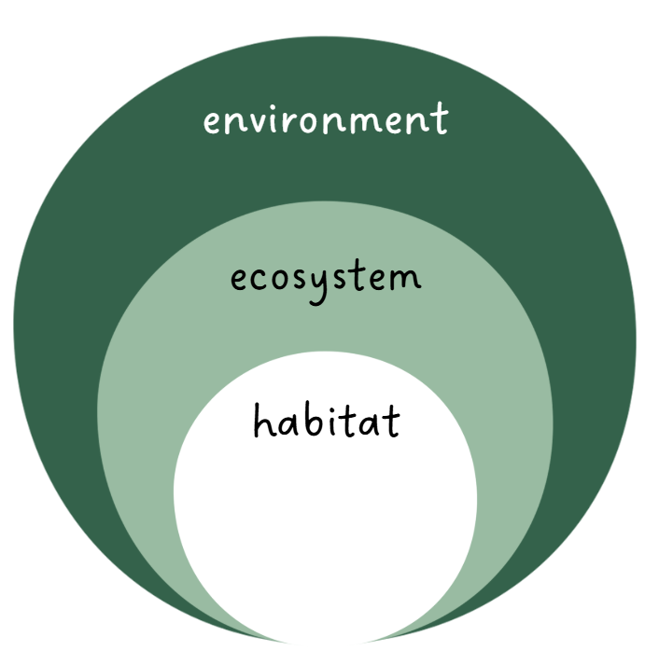
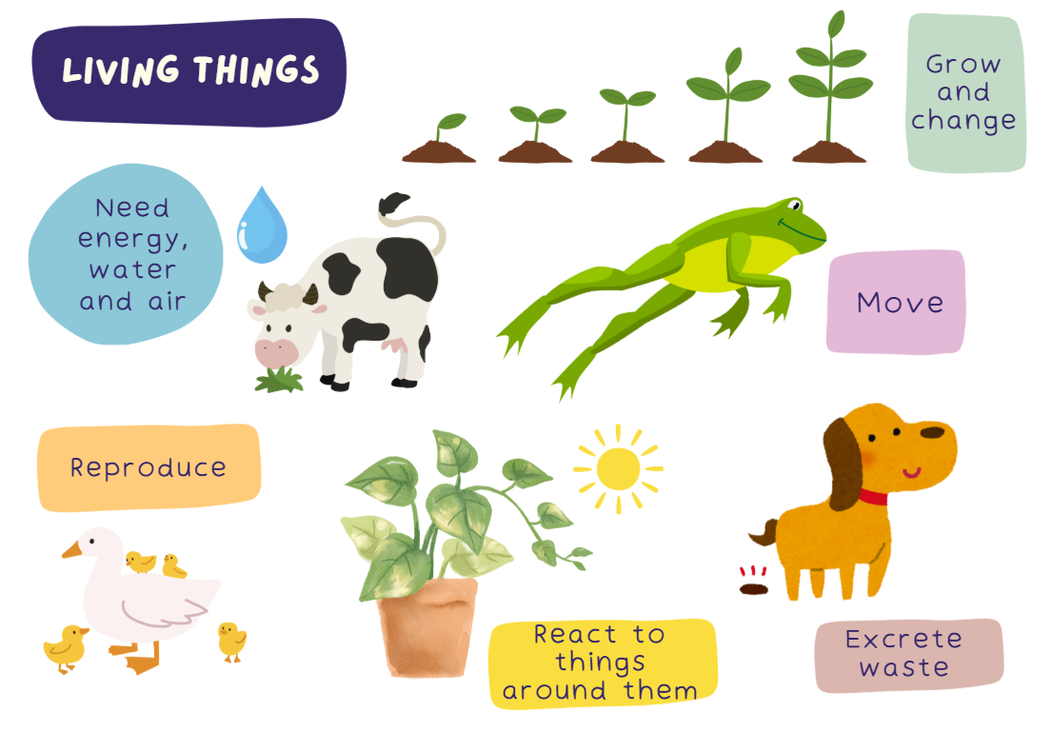
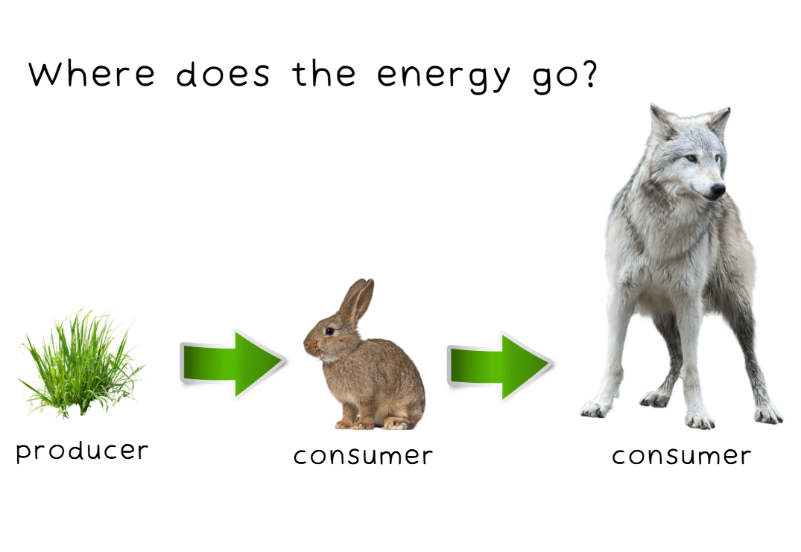
Science and technology – unit 1 misconceptions
Common student misconceptions addressed
Notes:
50. Purpose: To summarise some misconceptions addressed in the unit.
Time: 40 seconds
Presenter notes:
As with many areas of science education, part of the teacher's role is to understand and to address student misconceptions using evidence-based approaches.
Being aware of common misconceptions is the first step in addressing them. The sample units include note boxes to alert teachers to possible student misconceptions.
The lesson content uses evidence-based approaches to surfacing misconceptions and to addressing them.
This unit seeks to address student misconceptions, such as.
Students may think that the Earth’s systems (atmosphere, hydrosphere, lithosphere and biosphere) operate independently when in fact, they are interconnected.
Students my use habitat, ecosystem and environment as synonyms when in science they have specific meanings
Student understanding of the characteristics of living and non-living things.
Finally, in a food chain the arrows indicate the direction of energy flow, not what eats what.
[NEXT SLIDE]
Image credit: Canva Education. 2025. Images via Canva. https://www.canva.com/ accessed 30 September 2025.
State of NSW (Department of Education) (n.d.) affinity template from the Digital Learning Selector website accessed 16 September 2025.

Slide 51
Science and technology – unit 5
Unit 5
Notes:
51. Purpose: To transition to the next sample unit.
Time: 10 seconds
Presenter notes:
We will now explore Unit 5.
[NEXT SLIDE]

Slide 52

Science and technology – unit 5 overview
This unit explores:
the Earth’s revolution around the Sun
how solar energy is used
using multimodal representations of features of the solar system
introductory aspects of gravity
cultural references to the solar system.
Notes:
52. Purpose: To provide an overview of the unit
Time: 30 seconds
Presenter notes:
The content of Unit 5 aligns with Term 5 of the department’s sample scope and sequence.
Supported by using digital tools and creating written texts, students learn that The Sun is the centre of our solar system and provides our world with energy.
Students learn about:
[CLICK] The Earth’s revolution around the Sun
[CLICK] How solar energy is used
[CLICK] Using multimodal representations of features of the solar system
[CLICK] Introductory aspects of gravity
[CLICK] Cultural references to the solar system
[NEXT SLIDE]
Image credit: Canva Education. 2025. Images via Canva. https://www.canva.com/ accessed 30 September 2025.

Slide 53
Science and technology – unit 5 syllabus outcomes
Focus area: Physical and living systems depend on energy
ST2-SCI-01 uses information to investigate the solar system and the effects of energy on living, physical and geological systems
ST2-PQU-01 poses questions to create fair tests that investigate the effects of energy on living things and physical systems
ST2-DAT-02 designs and uses algorithms, represents data and uses digital systems for a purpose
Focus area: Digital and design outcomes
ST2-DDT-02 designs and uses algorithms, represents data and uses digital systems for a purpose
Notes:
53. Purpose: To outline the outcomes and content in the unit.
Time: 30 seconds
Presenter notes:
Again, the outcomes covered in this unit are multi-faceted, so we have underlined the aspects covered in this unit.
For the posing questions outcomes, there is no specific opportunity in this sample unit for students to conduct fair test.
Similar to Unit 1, this unit includes digital content but also has no design content scoped.
Please take a moment to read through them.
[NEXT SLIDE]

Slide 54
Science and technology – unit 5 syllabus content (1)
Content Group: The Sun is the centre of our solar system and provides our world with energy
Model Earth’s revolution around the Sun and recognise that a complete revolution takes 365.25 days
Research how energy from the Sun is used
Describe features of our solar system using multimodal representations
Demonstrate that gravity is a force of attraction between objects and Earth
Recognise that the force of gravity keeps Earth, moons and planets in their positions in the solar system
Research cultural references to the solar system including Aboriginal and/or Torres Strait Islander Knowledges of the night sky
Notes:
54. Purpose: To outline the outcomes and content in the unit.
Time: 30 seconds
Presenter notes:
Throughout the unit, there are opportunities for students to develop their questioning skills and pose questions about the solar system and relating to a demonstration of gravity.
Please take a moment to read through the content points covered in unit 5.
[NEXT SLIDE]

Slide 55
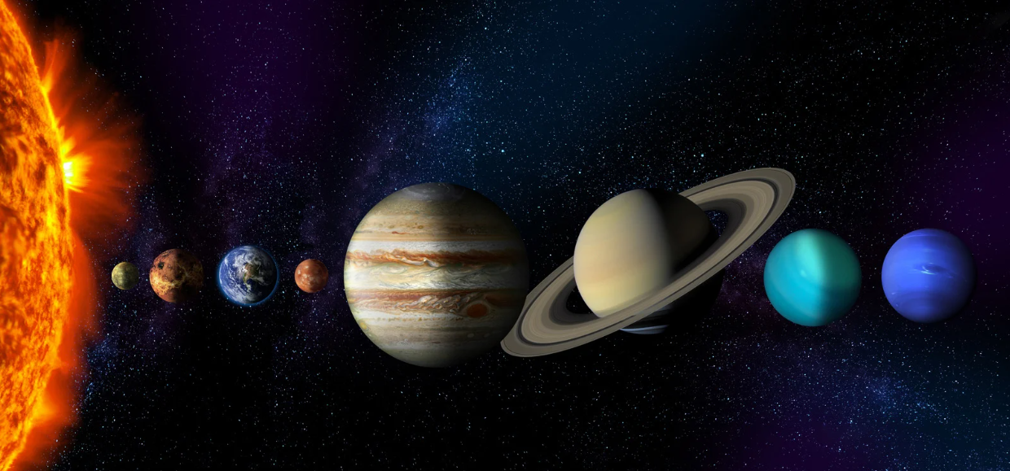
Science and technology – unit 5 syllabus content (2)
Content Group: Digital systems can be created and controlled
Use core features of common digital tools to locate, select, store and retrieve relevant information
Use core features of common digital tools to share content, plan tasks and collaborate safely following an agreed code of conduct
Explore how data can be represented by letters, numbers, symbols, images and sounds depending on the purpose
Notes:
55. Purpose: To outline the outcomes and content in the unit.
Time: 30 seconds
Presenter notes:
As with our first unit, the technologies content points are interwoven with the science content. They do not stand alone.
Please take a moment to read through the content points.
[NEXT SLIDE]

Slide 56
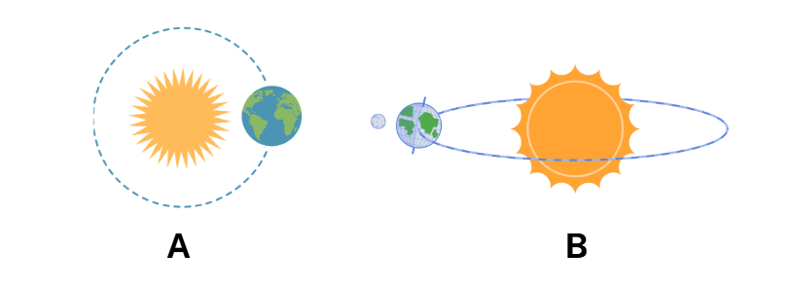
Science and technology – unit 5 misconceptions (1)
Notes:
56. Purpose: To identify one misconception addressed in Stage 2 Unit 5.
Time: 40 seconds
Presenter notes:
One common misconception is that orbits of the planets are circular, when they are elliptical.
Misleading resources can reinforce this misconception, so carefully choosing images and other materials can help prevent it.
Consider the two representations on the slide.
Which of the two is more likely to reinforce a misconception?
Is an elliptical path clearly shown in either model?
How could you represent it clearly to the students in your class?
It is also almost impossible to accurately reflect the scale of the solar system and the relative sizes of the planets in a single model that will fit onto a screen or onto a page.
The careful construction of models and use of representations will:
make a difference to the mental models that students build and
avoid reinforcing misconceptions about the solar system.
We will look at some other misconceptions in later slides.
[NEXT SLIDE]
Image credit: Canva Education. 2025. Images via Canva. https://www.canva.com/ accessed 30 September 2025.

Slide 57
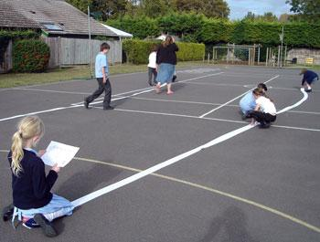


Science and technology – unit 5 misconceptions (2)
Image: nrich © University of Cambridge
Notes:
57. Purpose: To identify other misconception addressed in Stage 2 Unit 5.
Time: 2 minutes
Presenter notes:
Another misconception can arise from many representations of the solar system with the planets aligned, in order, an equal distance from each of the other planets. Building a scale model to show the respective distances from the Sun and the enormous differences in the distances between the planets can address this issue. In the image on screen, students are building a scale model using a roll of toilet paper to provide a scale.
One thing to consider here is that some aspects of Stage 2 science content can precede the explicit teaching of related mathematical content. For example, the vast distances in space are measured in millions of kilometres. Both millions and kilometres are introduced in Stage 3. The units have guidance on making appropriate connections with the Mathematics and other syllabuses.
Returning now to misconceptions in this unit, other common misconceptions may include:
Earth’s rotation and revolution being confused with each other
The Earth revolves around the Sun every day
The Sun orbits the Earth
The Earth is the centre of our solar system
Heavier objects fall faster
Gravity only acts on things that are falling
[NEXT SLIDE]
https://www.menti.com/alod1akmgb8y
Image credit: Canva Education. 2025. Images via Canva. https://www.canva.com/ accessed 30 September 2025.

Slide 58
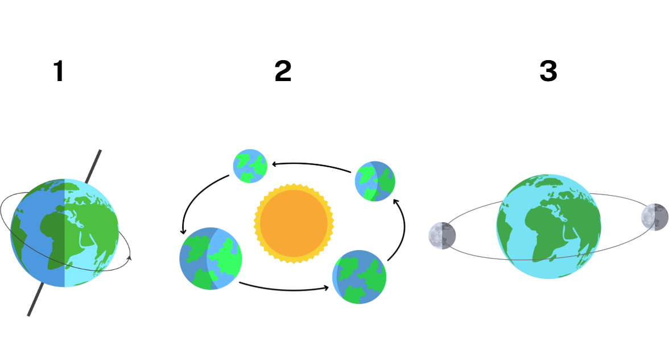
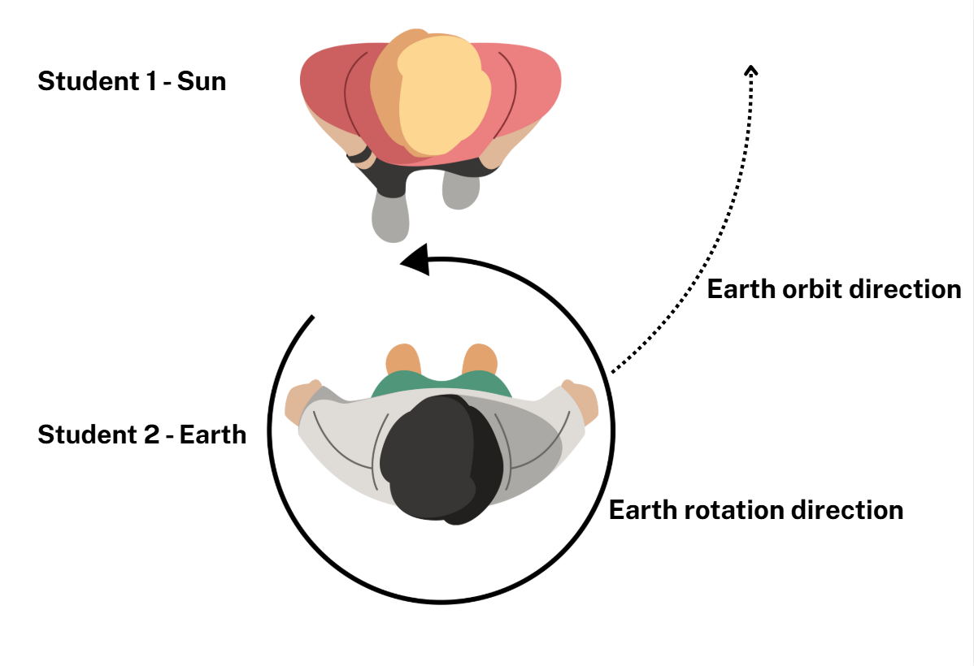
Science and technology – unit 5 spotlight (1)
Rotation and revolution
Notes:
58. Purpose: To highlight exciting activities included in this sample unit of work.
Time: 45 seconds
Presenter notes:
One series of lessons from this unit relate to common misconceptions about rotation and revolution.
Each of those concepts are explicitly taught, with students first revising Stage 1 content about the Earth’s rotation. Students then learn about the Earth’s revolution or orbit around the Sun.
Students are provided with multiple opportunities to develop their understanding.
They make models, write and draw to represent and demonstrate their understanding of the two concepts.
Following that, students are asked to role play the Moon’s orbit of the Earth and the Earth’s rotation, and its orbit of the Sun. Rotating and revolving in the correct direction can be a powerful way for students to consolidate their learning and demonstrate their understanding.
One of the unit’s optional consolidation activities is to represent the movement of the Moon and the Earth using Scratch Jr.
Using multiple representations can enrich the learning experience, help to clarify complex concepts and consolidate student learning.
[NEXT SLIDE]
Image credit: Canva Education. 2025. Images via Canva. https://www.canva.com/ accessed 30 September 2025.

Slide 59
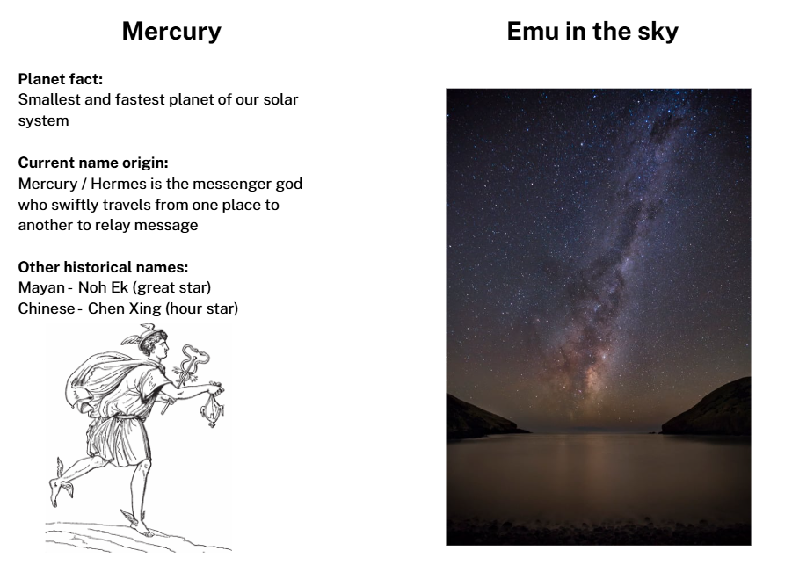
Science and technology – unit 5 spotlight (2)
Cultural connections
Notes:
59. Purpose: To highlight exciting activities included in this sample unit of work.
Time: 45 seconds
Presenter notes:
A second series of lessons recognises the significance of the solar system and the night sky across cultures and history.
Students can research the Roman/Greek origin of the planet’s name and at least one other culture such as Hebrew, Chinese, Egyptian, or Norse mythology.
Students also explore how Aboriginal Peoples have developed detailed Knowledge about the solar system.
These lessons have connections to learning in HSIE.
For this content group, take care to select resources that develop knowledge and understanding about the solar system such as the moon, the sun and the planets.
Many cultural references include celestial objects outside our solar system, such as constellations like the Southern Cross, or those from the zodiac. Emu in the Sky comes from dark patches in the Milky Way, visible in part of that galaxy that extend far beyond our solar system.
Be conscious that Stage 2 content is limited to our solar system.
[NEXT SLIDE]

Slide 60
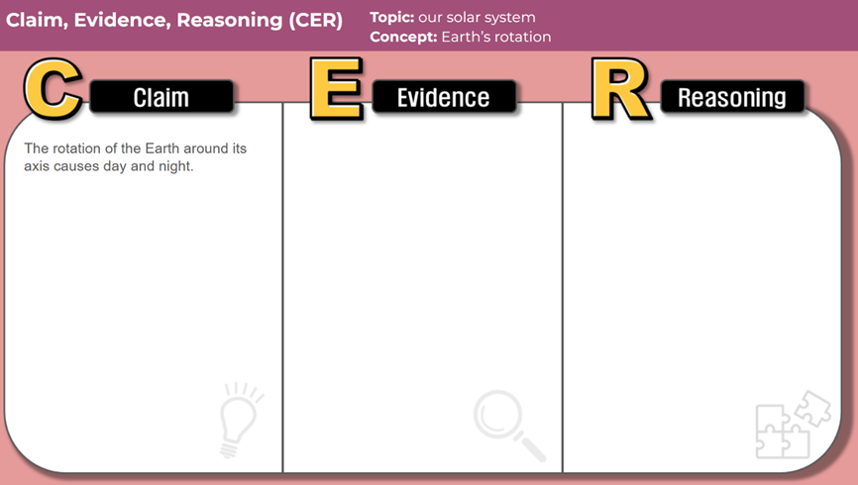
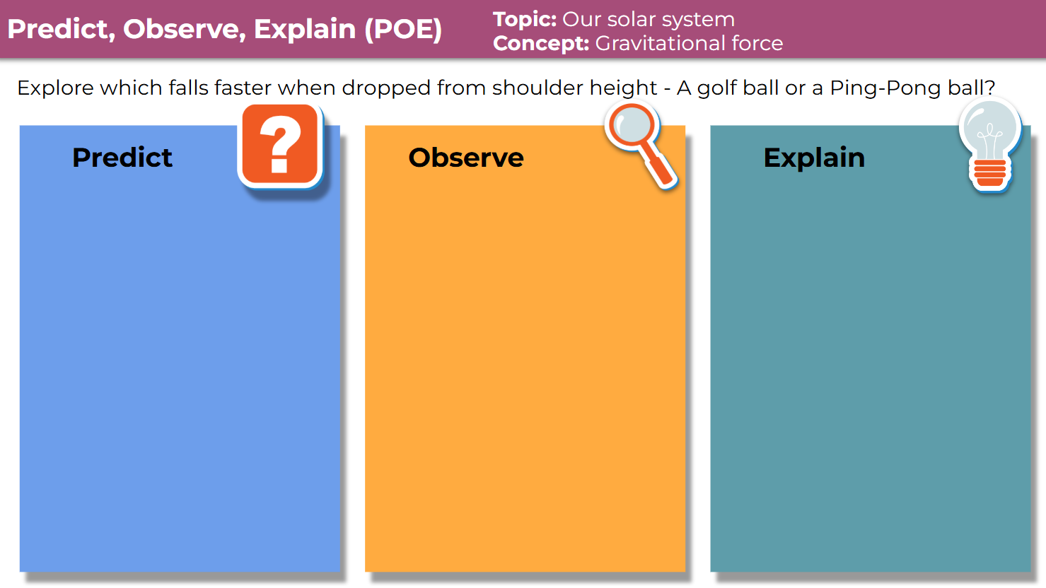

Science and technology – unit 5 explicit teaching
Notes:
60. Purpose: To share teaching approaches
Time: 45 seconds
Presenter notes:
Throughout the units you will see explicit teaching strategies such as connecting to prior learning, gradual release of responsibility, chunking and checks for understanding.
The sample units also incorporate purposefully selected science specific strategies such as Claim-Evidence-Reasoning and Predict Observe Explain.
For Claim–Evidence–Reasoning (CER): Students first make a claim about a selected topic. They then use evidence from observations or research to support it, and finish by giving the reasoning that connects the evidence to the claim.
For Predict–Observe–Explain (POE): Students make a prediction then observe carefully during the test and finally explain why the outcome happened that way.
Combined with explicit teaching strategies, purposefully selected science specific strategies can promote engagement, build critical thinking skills and deepen conceptual understanding.
Editable templates for both strategies are available on the department’s Digital Learning Selector.
[NEXT SLIDE]

Slide 61
Science and technology – unit 5 reflection
What excites you about these units?
What changes did you notice which you will need to make some considerations about or do some preparation for?
What is still circling that you need some further clarification on?
Notes:
61. Purpose: To reflect on the units presented and take notes.
Time: 5 minutes
Presenter notes:
Take a moment now to consider what you’ve observed record any thoughts and begin to imagine how this might be applied within your own school setting.
Return to your participant workbook reflection section.
You will again have 5 minutes to add some notes.
After 5 minutes
Thank you everyone, we will continue now.
[NEXT SLIDE]

Slide 62
Creative arts
Unit 1 and 5
Notes:
62. Purpose: Divider slide to introduce Creative arts units.
Time: 20 seconds
Presenter notes:
Each creative arts sample unit provides students with opportunities to engage in syllabus content in meaningful and connected ways. Students are supported to meet the aim of the syllabus by developing curiosity, creativity, imagination, self-expression and collaboration as they develop knowledge, understanding and skills in dance, drama, music and visual arts.
[NEXT SLIDE]

Slide 63
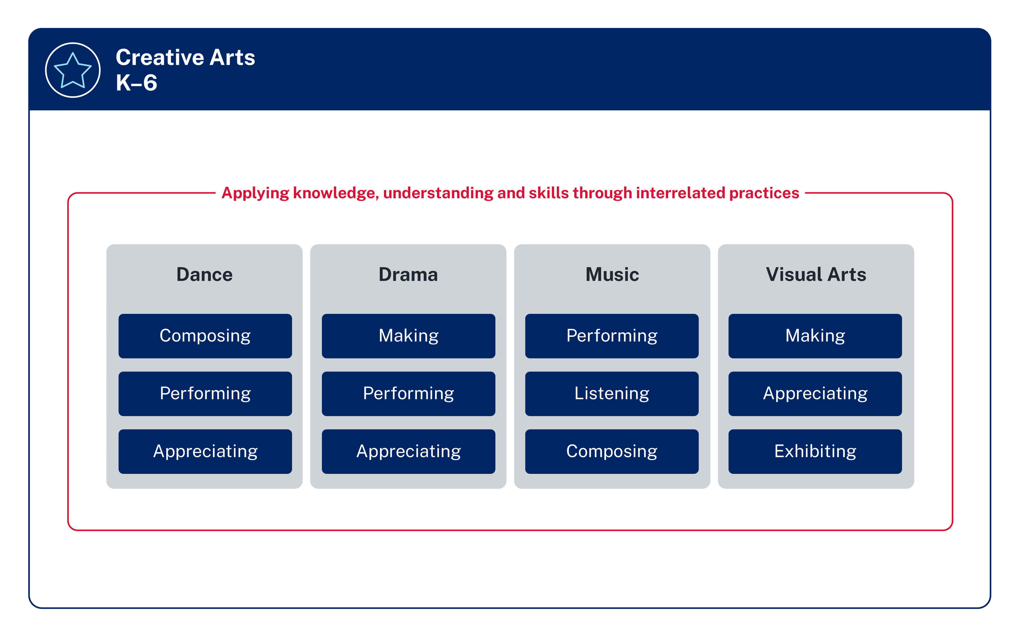
Syllabus content
Summary
2 focus areas each semester
Interrelated practices
Semester 1
Semester 2
Applying knowledge, understanding and skills through interrelated practices
Dance and Music
Drama and Visual arts
Notes:
63. Purpose: To highlight the structure of Creative arts learning across a stage
Time: 1 minute 30 seconds
Presenter notes: ​
Each semester, students will learn about 2 focus areas.
[CLICK] In Semester 1, the sample scope and sequence identifies Dance and Music, while in Semester 2, attention shifts to Drama and Visual Arts. Focus areas are repeated across 2 terms to support students in making connections and building schema by activating prior learning. This approach provides students with greater opportunities to consolidate learning and supports assessment and reporting practices on 2 focus areas each semester.
[CLICK] Across these areas, students apply knowledge, understanding and skills. The content groups in creative arts are not isolated or linear and should not be taught in a sequential way. What is learnt in one content group connects to the others and supports students to understand, interpret, critique and apply their learning in meaningful ways.
In Dance, the interrelated practices are composing, performing and appreciating. Students are not just learning dance steps — they are creating, expressing, analysing, interpreting, appreciating, reflecting and applying their learning.
In Music, the interrelated practices are performing, listening and composing. Students experience music as performers and as creators, while also developing their ability to reflect and respond through listening to a range of music from cultures all around the world.
This structure allows students to experience the creative arts holistically. It provides multiple entry points for expression, while building students' confidence and deepening their understanding across all four focus areas.
[NEXT SLIDE]

Slide 64
Key Features
Sample Creative arts units
Equal time allocation
Connections across dance and music
Context
Resources
Notes:
64. Purpose: To identify key features of Creative arts Units
Time: 2 minutes
Presenter notes:
Let’s take a closer look at some of the key features of the creative arts sample units.
[CLICK] Firstly, equal time allocation. Each unit contains 10 dance lessons and 10 music lessons. Of these, 4 lessons are optional consolidation lessons, allowing for interruptions to regular timetables and supporting teachers to extend learning where needed.
[CLICK] Second, the units make clear connections across dance and music. Students aren’t learning in silos, in Semester 1 they’re seeing how movement and sound work together to communicate meaning. The dance and music components connect, but do not rely on each other. If a school chooses to teach only the music component or only the dance component, the lessons still maintain a consistent flow and meet the syllabus requirements and intent.
[CLICK] Third, the units are designed with context in mind. Whether they’re delivered by a classroom teacher, timetabled as RFF, or taught by a specialist teacher, the design allows schools to adapt while still staying true to the syllabus.
[CLICK] And finally, resources. Each unit contains direct links to songs and videos that will support the learning, with opportunities for teachers to adapt and select alternatives if preferred. Lesson templates, visuals and posters are provided. The units are intentionally designed to support all school contexts: if percussion instruments aren't available, an alternative is provided so students can use body percussion, digital applications or their voice to achieve the same learning.
[NEXT SLIDE]

Slide 65
Creative arts – unit 1 and 5
Unit 1 and 5
Notes:
65. Purpose: Divider slide to introduce Creative arts units.
Time: 10 seconds
Presenter notes:
The spotlight in the Creative arts preview is on Unit 1 and 5.
[NEXT SLIDE]

Slide 66
Creative arts – unit 1 and 5 syllabus outcomes
Focus Areas: Dance and Music
CA2-DAN-01
composes and performs dance to communicate ideas to an audience, and describes ways the elements of dance are used to convey ideas through movement
CA2-MUS-01
performs, uses listening skills and composes to communicate musical ideas, and describes ways the elements of music are
Notes:
66. Purpose: To outline the outcomes in the unit.
Time: 30 seconds
Presenter notes:
The outcomes for Units 1 and 5 are:
experiments with and identifies ways shapes and movements are used in dance
experiments with and identifies ways sound is organised in music through singing, moving, playing instruments and using listening skills.
[NEXT SLIDE]

Slide 67
Creative arts – unit 1 and 5 syllabus content
Dance
Composing: Dance is composed using the elements of dance to communicate ideas
Performing: Dance is performed to communicate ideas to audiences
Appreciating: The elements of dance are used in various ways to convey ideas through movement
Music
Performing: Music is performed to communicate musical ideas in various ways
Listening: Musical ideas are conveyed in various ways using the elements of music
Composing: Music is composed to communicate musical ideas in various ways
Notes:
67. Purpose: To outline the content in the featured units.
Time: 30 seconds
Presenter notes:
On screen you can see how content is organised through the interrelated practices.
[NEXT SLIDE]

Slide 68

Creative arts – unit 1 overview
Students explore how dance and music are inspired by people, time and place.
Dance focus: investigate decade-defining styles, learn signature steps from across the decades, perform short group-devised dances.
  Music focus: Listen and compare tracks from different decades, identify features of musical styles, consider influences, compose music.
Notes:
68. Purpose: To provide an overview of the Stage 2 Unit 1.
Time: 1 minute
Presenter notes:
Unit 1 explores how dance and music reflect people, time and place across different decades.
In dance, the lessons investigate decade-defining styles and explore how choreographers use the elements of dance to communicate ideas. Students learn signature steps from those eras and use these moves to compose movement sequences.
In music lessons, students listen to and compare tracks from different decades to investigate how popular styles of music have evolved. They will explore beat, rhythm, pitch, texture and structure. Students use vocals, classroom instruments and digital tools to compose music in a range of styles.
[NEXT SLIDE]

Slide 69
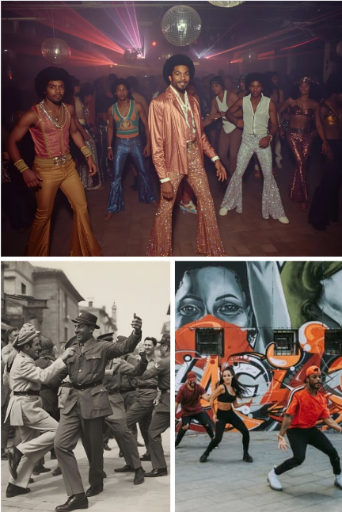
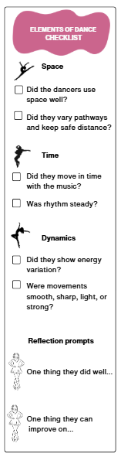
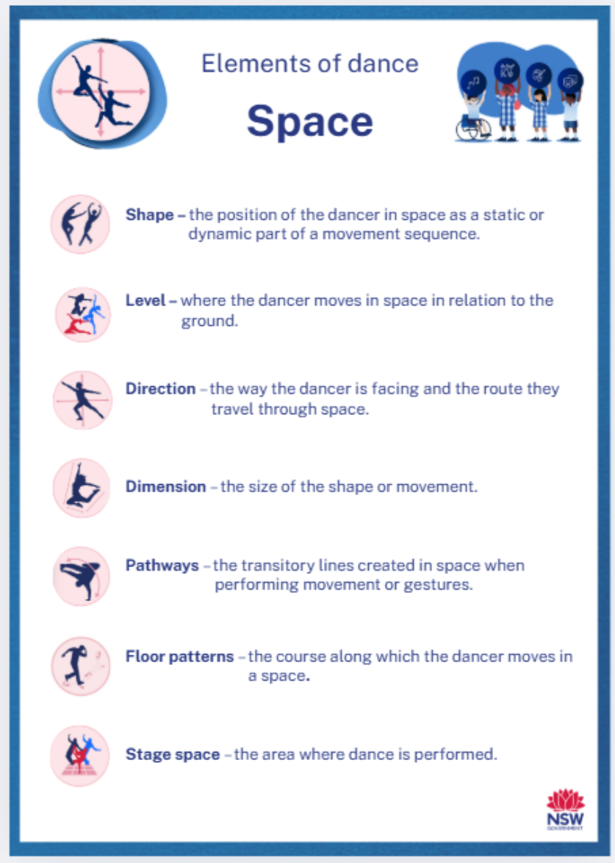
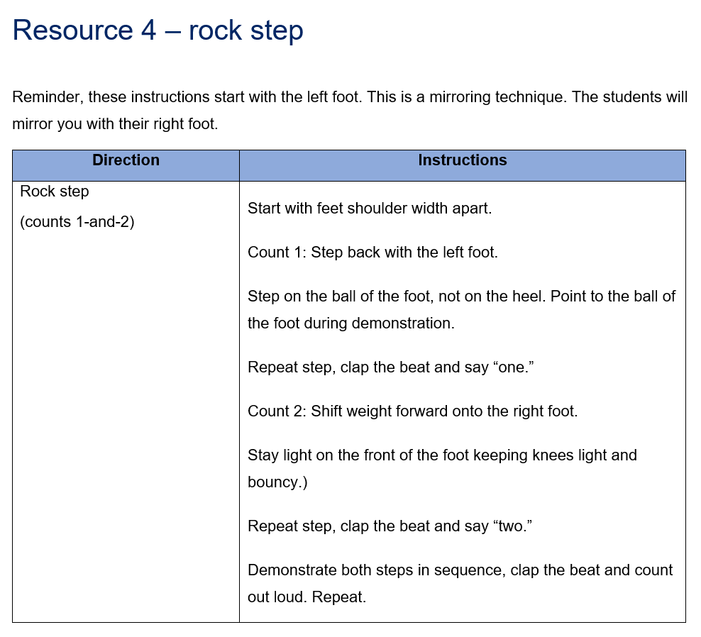
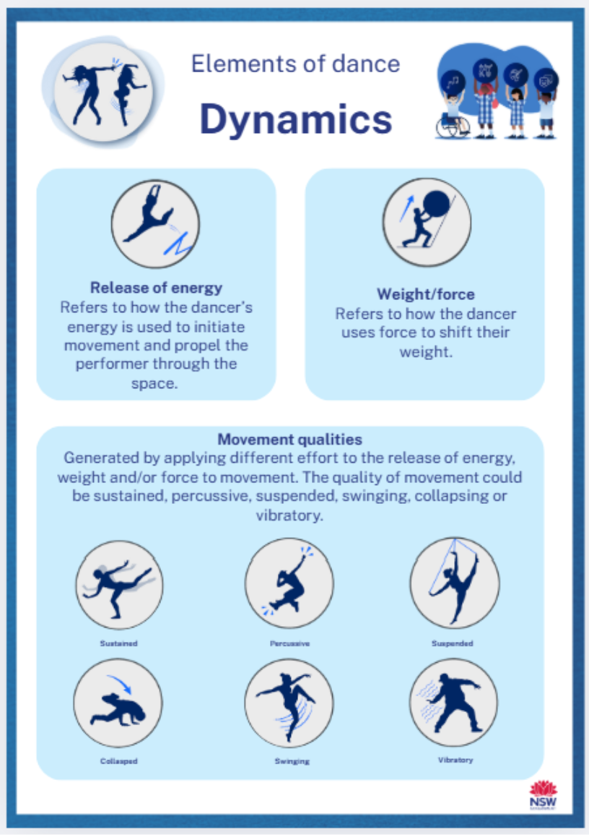
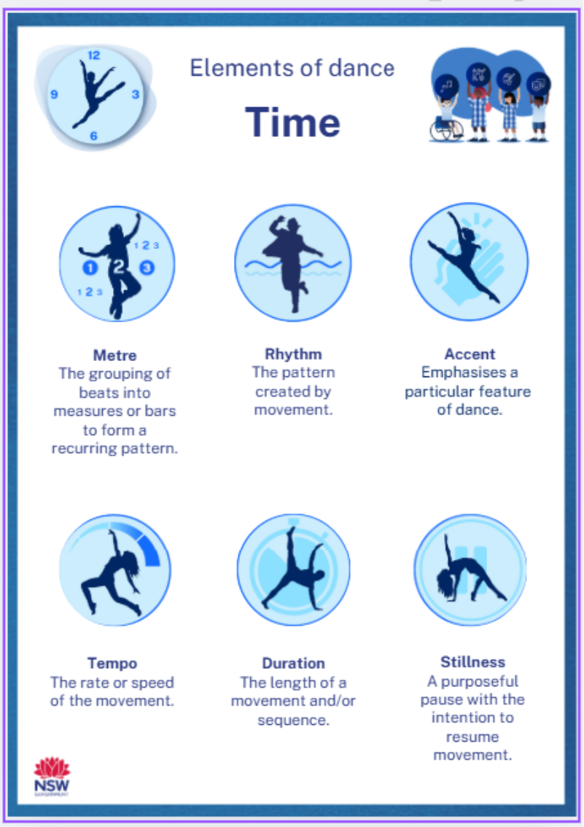
Creative arts – unit 1 spotlight (1)
Dance
Notes:
69. Purpose: To explore the Stage 2 Unit 1 spotlight on dance.
Time: 50 seconds
Presenter notes:
In dance, students journey through three iconic styles, the jive, disco, and hip-hop. Each style is connected to its time and place. Students begin by investigating the cultural context such as the links the jive has to post-war rock ’n’ roll, disco reflecting the 1970s club scene, and hip-hop emerging as a cultural movement in the 1980s.
Students then learn and practise the basic steps and qualities of each style. Teacher resources include step-by-step notes for every move in the unit, with clear counts, cues, safety tips and differentiation.
Students experiment with space, time, and dynamics to communicate ideas, and use these elements to compose, rehearse, and refine their own short sequences in groups.
[NEXT SLIDE]
Image credit: Canva Education. 2025. Images via Canva. https://www.canva.com/ accessed 30 September 2025.

Slide 70


Creative arts – unit 1 spotlight (2)
Music
Notes:
70. Purpose: To explore the Stage 2 Unit 1 spotlight on music
Time: 50 seconds
Presenter notes:
In music, students explore how each decade brought new sounds, influences and technologies.
The unit explores rock ’n’ roll to identify performing media, hear the strong backbeat, and recognise key structural patterns.
Students examine disco to understand the steady four-on-the-floor beat, syncopated basslines, and polished production.
Students also investigate hip-hop to understand sampling, looping, hooks, and rhythmic spoken lyrics.
Across the unit, students build a musical timeline and use Tier 2 and Tier 3 vocabulary to describe music, justify opinions, and reflect on how people, time and place shaped these styles.
[NEXT SLIDE]

Slide 71



Creative arts – unit 1 lesson spotlight
Lesson 1 – dance: exploring Jive
Screenshot from Dancing Mashup 1930s Style (gluecement, 2015), YouTube, (00:16).
Notes:
71. Purpose: To diver deeper into lesson 1
Time: 1 minute
Presenter notes:
Lesson 1 teaches the basic jive step, the rock step followed by the chassés. The focus is on moving lightly on the balls of the feet, with balance and body control.
The lesson ends with a short reflection on the key features of jive and a cool down, revisiting safe dance practices through breathwork and gentle stretching.
This lesson highlights how cultural context, technical skill, and creativity all come together. Students don’t just learn a dance step — they also explore how jive expressed the energy and optimism of its time.
[NEXT SLIDE]

Slide 72
Creative arts
Unit 5
Notes:
72. Purpose: Divider slide for Stage 2 Unit 5
Time: 10 seconds
Presenter notes:
Let’s explore Unit 5.
[NEXT SLIDE]

Slide 73

Creative arts – unit 5 overview
Students explore how dance and music are inspired by people, time and place.
Dance focus: Compose, rehearse and perform Korean-pop (K-pop) inspired routines that experiment with space, time and dynamics.
Music focus: investigate K-pop features and create accompaniments and original compositions using elements such as pitch, rhythm, timbre and structure.
Notes:
73. Purpose: To provide an overview of Stage 2 Unit 5
Time: 30 seconds
Presenter notes:
Unit 5 explores how global culture and technology shape dance and music today, using K-pop as a contemporary lens.
In dance, students apply the interrelated practices of composing, performing, and appreciating, developing technical skills while also making cultural connections.
In music, students apply the interrelated practices of performing, listening and composing to investigate K-pop features. They will create accompaniments and compositions using elements such as pitch, rhythm, timbre and structure.
This unit explores the global phenomenon of K-pop to build student’s understanding of how dance and music is composed and performed to communicate ideas to audiences.
[NEXT SLIDE]

Slide 74



Creative arts – unit 5 spotlight (1)
Dance
Notes:
74. Purpose: To explore the Stage 2 Unit 5 spotlight on dance
Time: 1 minute
Presenter notes:
Students learn key movement features of the K-pop style and apply the elements of dance — space, time and dynamics — to communicate intent. Each lesson introduces a short choreographic sequence that is revisited and built on throughout the unit.
Each routine is broken into clear movement instructions with floor patterns, timing cues and lyric prompts. This scaffolded design builds confidence and ensures the choreography is accessible for all teachers, including those new to teaching dance.
[NEXT SLIDE]

Slide 75



Creative arts – Unit 5 spotlight (2)
Music
Virtual drums from https://www.musicca.com/drums
Song section key
Notes:
75. Purpose: To explore the Stage 2 Unit 5 spotlight on music
Time: 30 seconds
Presenter notes:
In music, students explore the cultural influences on K-pop music. This includes the importance of singing and dance in South Korean culture and the influence of technology and streaming services in the globalisation of K-pop. They investigate features of K-pop music, such as repeated hooks, production techniques and up-tempo beats, and consider how these elements communicate ideas and make songs catchy. Students will create their own compositions, rehearse, refine and perform their songs as a group.
[NEXT SLIDE]

Slide 76




Creative arts – unit 5 lesson spotlight
Lesson 5 – dance: space – levels and directions
Communicate intent through movement
Element of space – levels and directions
K-pop choreography
K-pop cultural connections
Notes:
76. Purpose: To zoom in on lesson 5 – dance: space – levels and directions
Time: 40 seconds
Presenter notes:
In Lesson 5 students use lyrics from What It Sounds Like by Huntrix as a stimulus to communicate intent through movement. The lesson zooms in on the element of space, focusing on level and direction as components of space.
Students explore how K-pop choreography uses the element of space to add visual interest to a dance and how movement pathways, formations and directional changes can shape meaning and audience.
They are guided to experiment with level and direction as they compose a group-devised movement sequence to communicate ideas to an audience. The learning is purposeful, engaging and technically focused.
[NEXT SLIDE]
Image reference - https://rollingstoneindia.com/the-100-greatest-songs-in-the-history-of-korean-pop-music/
Focus on 5 focus on space – floor patterns – zooming in to ET components of space & component of floor patterns. Through the len of K Pop dance. Explaining why – engaging with the cultural perspective.

Slide 77
Creative arts – unit 5 lesson 1
Dance – activate prior knowledge
Explain the learning intention and refer to it throughout the lesson, making connection to prior learning. Unpack the success criteria and ensure students understand the learning goals.
The following steps activate prior knowledge of safe dance practices and ways students connect to dance and music.
Introduce the unit. Explain that students will explore key features of K-pop dance and ways dance practices are influenced by people, time and place.
Assess students prior knowledge of pop music. Ask.
What is pop music?
What are some examples of pop music you are familiar with?
How might pop music be influenced by time and place?
How has pop music changed over time?
Notes:
77. Purpose: To highlight an activity that students will complete
Time: 3 minutes 30 seconds
Presenter notes:
On you screen you can see four questions that students will be asked at the beginning of lesson 1. These questions will activate student’s prior knowledge of pop music which has been taught previously and lead into the core lesson which focuses on the introduction of K-pop.
Let’s look at the first two questions a little more closely. In the chat please put a very brief answer to What is pop music?
Presenter to read out some of the responses – identify themes
The second question you can see, What are some examples of pop music you are familiar with? Once again please add your brief responses to the chat.
Presenter to read out some of the responses – identify themes
Thanks everyone I appreciate your engagement with this task.
Pause 3 mins
[NEXT SLIDE]

Slide 78
PDHPE – unit 1 reflection
What excites you about these units?
What changes did you notice which you will need to make some considerations about or do some preparation for?
What is still circling that you need some further clarification on?
Notes:
78. Purpose: To reflect on the units presented and take notes.
Time: 5 minutes
Presenter notes:
We would again like to give you some time now to reflect on what you have seen, make some notes and start to think about what this could look like in your school context.
Return to your participant workbook reflection section.
You will again have 5 minutes to add some notes.
Pause 5 minutes
We will continue now.
[NEXT SLIDE]

Slide 79
Personal Development, Health and Physical Education – unit 1
Unit 1
Notes:
79. Purpose: To introduce the PDHPE Stage 2 Unit 1.
Time: 10 seconds
Presenter notes:
We will now shift our focus to the key learning area of Personal development, health and physical education. The following slides will unpack Unit 1.
[NEXT SLIDE]

Slide 80

PDHPE – unit 1 overview
Students learn:
safety strategies at home, school, and in the community, including road safety behaviours
how to create written texts to promote safety and explore the physical, social, and emotional changes of growing up, identifying trusted adults and reliable sources for support
skills and strategies in different types of games and how to be inclusive in physical activity to cater for the different ways people move
how to strengthen self-management skills through goal setting and reflection and apply interpersonal skills to support respectful and positive interactions.
Notes:
80. Purpose: To provide the unit overview for the PDHPE Stage 2 Unit 1.
Time: 30 seconds
Presenter notes:
In this PDHPE unit, students explore safety strategies across various environments, including road safety, while also learning to identify trusted adults and reliable support sources as they navigate growing up.
The unit also focuses on developing inclusivity in physical activity, self-management through goal setting and reflection and interpersonal skills to support respectful, positive interactions during games and group activities.
[NEXT SLIDE]

Slide 81
PDHPE – unit 1 syllabus outcomes
PH2-MSP-01 applies movement skills, strategies and teamwork in physical activities
PH2-RRS-02 describes and applies skills and strategies to interact safely in offline and online contexts
PH2-IHW-01 explains how related factors influence identity, health and wellbeing
PH2-SMI-01 explains and applies self-management and interpersonal skills in a range of contexts
Notes:
81. Purpose: To outline the outcomes and content in the unit.
Time: 10 seconds
Presenter notes:
These are the syllabus outcomes covered in unit 1. I will give you a moment to review them.
[NEXT SLIDE]

Slide 82
PDHPE – unit 1 syllabus content (1)
Focus areas and content groups
Movement skill and physical activity:
Cooperate and communicate for teamwork in physical activities
Consolidating fundamental movement skills improves health and wellbeing
Respectful relationships and safety:
Actions and strategies promote safety
Notes:
82. Purpose: To outline the outcomes and content in the unit.
Time: 30 seconds
Presenter notes:
All the focus areas are covered in Unit 1:
Movement skill and physical activity
Respectful relationships and safety
Identity health and wellbeing, and
Self-management and interpersonal skills.
In Movement skill and physical activity students apply movement skills and strategies across a range of games and modified sports, while cooperating and communicating effectively in team settings. They learn to adapt their actions to include others and improve health by developing fundamental movement skills such as passing, catching and throwing.
In Respectful relationships and safety, students are learning to describe and apply strategies to stay safe in various environments, including road and online contexts. They learn to recognise safety messages, use clear communication and take responsibility for promoting safe behaviours in their communities.
[NEXT SLIDE]

Slide 83
PDHPE – unit 1 syllabus content (2)
Identity health and wellbeing:
Factors can support and strengthen identity
Self-management and interpersonal skills:
Interpersonal skills promote positive interactions and collaboration.
Notes:
83. Purpose: To outline the outcomes and content in the unit.
Time: 30 seconds
Presenter notes:
In the focus area Identity health and wellbeing students explore how physical, social and emotional changes influence their identity and overall wellbeing. They identify trusted adults and reliable sources to support them through life changes and challenges.
In Self-management and interpersonal skills, students develop self-management by setting and monitoring goals and build interpersonal skills to support respectful interactions and collaboration. They practise positive communication, inclusive behaviours and respectful participation in group activities and decision-making.
[NEXT SLIDE]

Slide 84

PDHPE – unit 1 time allocation
PDH/PE lesson structure: balanced approach with equal focus in line with NESA guidelines
8 PDH lessons and 8 PE lessons designed for weekly implementation (1 each per week)
PE supports the recommended 150 minutes of physical activity per week
Notes:
84. Purpose: To demonstrate the balanced approach of lessons and how the 150 minutes of moderate to vigorous physical activity can be achieved across the school week.
Time: 2 minutes
Presenter notes:
PDH and PE lessons are structured to ensure an equal emphasis on both subject areas, following the recommendation of 8% (approximately 2 hours) provided by NESA.
The units are written based on a 10-week term approach. The design includes 8 PDH lessons and 8 PE lessons, which allows us to implement one PDH lesson and one PE lesson each week, maintaining a balanced and consistent approach throughout the term. The 4 remaining optional consolidation lessons are used to revise keys concepts or skills.
Time allocation is applied in the same way across all sample units.
Importantly, the PE lessons contribute directly to meeting the recommended 150 minutes of physical activity per week, supporting students’ health and wellbeing goals.
This graphic demonstrates how schools can meet the recommended requirements of the department’s Sport and Physical Activity procedures. Note the red circle, this represents NESA (therefore the syllabus), and the blue circle represents the department's Sport and Physical Activity Procedures. Let's now identify what contributes to the 150 minutes of physical activity per week.
PE is part of the mandatory PDHPE key learning area. Physical activity performed in PE lessons contributes towards meeting the 150 minutes. PDH lessons do not contribute to the 150 minutes unless they include physical activity.
School sport is a mandatory part of whole school planning which offers students weekly planned opportunities to participate in physical activities which also contributes to the 150 minutes. Schools are able to design their own programs for weekly school sport. Schools must provide a minimum 60 minutes of sport per week for years 3-6. There is no set amount of time allocated to weekly sport for students in Years K– 2, although some schools choose to run a weekly sport session across classes or stages.
Other structured physical activity may include:
Classroom Energisers - these are fun and moderate to vigorous activities designed to break up long periods of sitting and stimulate learning. For example, a class takes part in a 10-minute energiser activity every day making a total of 50 minutes of physical activity for the week. The frequency and duration of classroom energisers should be represented in class timetables.
This information is available in the FAQs of the PDHPE channel in the Primary curriculum Statewide staffroom.
[NEXT SLIDE]

Slide 85

PDHPE – unit 1 skill development
Personal development and health (PDH) content supports the development of class and school routines and expectations through:
road safety- pedestrian, passenger and wheel users
respectful relationships
life changes- social, physical and emotional
self-management and interpersonal skills
Physical education (PE) structure and content includes:
fast starts
fundamental movement skills- overarm and underarm throw, catch and strike
skills and strategies of games, including Aboriginal and/or Torres Strait Islander games
self-management and interpersonal skills, including goal setting.
Notes:
85. Purpose: To describe the skill development across PDH and PE for Stage 2 Unit 1.
Time: 1 minute 30 seconds
Presenter notes:
In this unit, personal development and health (PDH) content supports the development of class and school routines and expectations through:
[CLICK] identifying and explaining safe road safety behaviours as pedestrians, passengers and wheel users, as well as analysing how school practices and community messaging support road safety
[CLICK] developing interpersonal skills like kindness, empathy and listening to support inclusion and respectful interactions. Through group activities and reflection, students practise communication and cooperation to build positive relationships.
[CLICK] developing skills to explain social, physical and emotional changes associated with growing up, and
[CLICK] applying interpersonal and self-management strategies to strengthen student identity, wellbeing and relationships.
[CLICK] In this unit, the physical education (PE) structure and content includes:
[CLICK] fast starts, which are short, energising warm-up activities that engage students quickly and prepare them for learning, examples in this unit include flip it, hit the target and follow the line
[CLICK] developing and applying a range of fundamental movement skills, including overarm and underarm throw, catch and strike
[CLICK] developing the skills and strategies in target, net and court, territory and striking and fielding games, including Aboriginal and/or Torres Strait Islander games, and
[CLICK] building the self-management and interpersonal skills of inclusivity, cooperation and goal-setting to support student progress and participation.
[NEXT SLIDE]

Slide 86

PDHPE – unit 1 spotlight (1)
Goal setting- physical education (PE)
Focus area – Self-management and interpersonal skills
Unit 1:
Content – create and monitor goals to enhance learning
PE lessons – 9, 13, 16
Lesson 9 create a goal
Lessons 13 and 16 reflect and modify
Notes:
86. Purpose: To highlight an exciting feature of Stage 2 Unit 1 sample unit.
Time: 1 minute
Presenter notes:
Goal setting is included in the PDHPE K-10 syllabus in the focus area of ‘self-management and interpersonal skills’, from Early stage 1 through to stage 3.
Goal setting content in Early stage 1 is for students to ‘co-create goals to assist learning’, this progresses in stage 1 to ‘develop goals to improve learning’.
[CLICK] Stage 2 Unit 1 builds on this prior knowledge to address the stage 2 content, ‘create and monitor goals to enhance learning’.
[CLICK] Activities for goal setting have been included in the conclusion of three PE lessons, 9, 13 and 16 for opportunities to create and monitor a PE goal.
[CLICK] In lesson 9 students create goals using strategies introduced in a stage 1 PDH lesson. Students create a goal for PE this time, utilising the same template, thereby reducing cognitive load, to record and plan for monitoring their goal.
[CLICK] In lessons 13 and 16 students revisit their goal to reflect and make modifications where necessary for achievement of the goal.
This learning continues in stage 3, where students ‘apply goal-setting strategies and evaluate the effectiveness’.
[NEXT SLIDE]

Slide 87



PDHPE – unit 1 spotlight (2)
PE activities- variation and differentiation
PE lessons in sample units of work include:
a resources list
instructions on how to set up the playing area and equipment- with images
how to play the game or modified sport
differentiation and variation opportunities
Adapted from: Playing for life, Australian Sports Commission
Notes:
87. Purpose: To highlight an exciting feature of Stage 2 Unit 1 sample unit.
Time: 2 minutes
Presenter notes:
PE lessons in sample units of work include:
[CLICK] a resources list at the beginning of the sample unit
[CLICK] instructions on how to set up the playing area and equipment for games and modified sports, [CLICK] including helpful images this example is from Follow the line from lesson 11.
[CLICK] clear and concise steps on how to play the game or modified sport, and
[CLICK] differentiation and variation opportunities for students to be able to engage in activities.
Variations and differentiation opportunities may be based on skills, equipment, space and/or time.
[CLICK] Variation opportunities are highlighted in blue text boxes as notes. This example from lesson 11 includes suggested variations for the warm-up game ‘Follow the line’.
[CLICK] Differentiation options appear in the differentiation table at the end of the core lesson. This example is from lesson 10.
Additional scaffolding suggestions for students who can not confidently perform the underarm and overarm throw includes:
use larger balls
reduce the throwing distance
use visual targets
teach in parts, and
the use of ramps or slope boards to support release control.
Extending and challenging suggestions for students who can confidently perform the underarm and overarm throw includes:
throw from a longer distance or through narrower targets
create obstacle courses
timed challenges, and
hit smaller targets for points.
Variation opportunities and differentiation options for games and modified sports are included to make activities more accessible or challenging depending on student need.
[NEXT SLIDE]

Slide 88
Personal Development, Health and Physical Education
Unit 5
Notes:
88. Purpose: to introduce the PDHPE Stage 2 Unit 5.
Time: 5 seconds
Presenter notes:
The following slides will unpack Unit 5.
[NEXT SLIDE]

Slide 89

PDHPE – unit 5 overview
Students learn to:
make good choices in friendships, managing emotions, healthy eating, and staying safe
explore respectful relationships and how they change, the benefits of healthy eating (including bush foods)
stay safe as road users
develop and apply balance, running, sprinting and catching skills in games that encourage safety, inclusion and enjoyment
build self-management skills by setting goals, practising self-regulation strategies and responding thoughtfully to different situations.
Notes:
89. Purpose: to provide the unit overview for the PDHPE Stage 2 Unit 5.
Time: 30 secs
Presenter notes:
In this unit, students explore how stereotypes influence attitudes and how connections with family, community and Aboriginal and Torres Strait Islander cultures support wellbeing and relationships.
They develop road safety awareness, understand physical, social and emotional changes and identify personal strengths to manage challenges.
Through PDH and PE, students practise goal setting, respectful communication and teamwork to build inclusion and cooperation.
[NEXT SLIDE]

Slide 90
PDHPE – unit 5 syllabus outcomes
PH2-MSP-01 applies movement skills, strategies and teamwork in physical activities
PH2-RRS-02 describes and applies skills and strategies to interact safely in offline and online contexts
PH2-IHW-01 explains how related factors influence identity, health and wellbeing
PH2-SMI-01 explains and applies self-management and interpersonal skills in a range of contexts
Notes:
90. Purpose: To outline the outcomes and content in the unit.
Time: 10 seconds
Presenter notes:
The syllabus outcomes are also covered in unit 5. I will pause for you to read them.
[NEXT SLIDE]

Slide 91
PDHPE – unit 5 syllabus content (1)
Focus areas and content groups
Movement skill and physical activity:
Cooperate and communicate for teamwork in physical activities
Consolidating fundamental movement skills improves health and wellbeing
Respectful relationships and safety:
Actions and strategies promote safety
Notes:
91. Purpose: To outline the outcomes and content in the unit.
Time: 1 minute
Presenter notes:
All four focus area are covered again in unit 5:
Movement skill and physical activity
Respectful relationships and safety
Identity health and wellbeing, and
Self-management and interpersonal skills.
Students will revisit applying movement skills and strategies in games and team settings, while also reinforcing respectful relationships and safety practices in various environments including road and online contexts.
[NEXT SLIDE]

Slide 92
PDHPE – unit 5 syllabus content (2)
Focus areas and content groups
Movement skill and physical activity:
Cooperate and communicate for teamwork in physical activities
Consolidating fundamental movement skills improves health and wellbeing
Respectful relationships and safety:
Actions and strategies promote safety
Notes:
92. Purpose: To outline the outcomes and content in the unit.
Time: 1 minute
Presenter notes:
In Unit 5, students will revisit exploring how physical, social, and emotional changes affect identity and wellbeing, while developing self-management and interpersonal skills for goal-setting, respectful communication, and collaboration.
[NEXT SLIDE]

Slide 93

PDHPE – unit 5 skill development
Personal development and health (PDH) content includes:
personal strengths and applying interpersonal skills
Aboriginal and/or Torres Strait Islander connections to Country, Community and Culture
life changes and help-seeking
stereotypes
financial wellbeing
road safety- pedestrian, passenger (bus) and wheel users
Physical education (PE) content includes:
skills and strategies- target, net and court, striking and fielding and territory games
fundamental movement skills- strike, catch, underarm and overarm throw
self-management and interpersonal skills, including communication, cooperation and goal setting.
Notes:
93. Purpose: To describe the skill development across PDH and PE for Stage 2 Unit 1.
Time: 2 minutes
Presenter notes:
In this unit, personal development and health (PDH) content supports students to:
[CLICK] identify and apply personal strengths like empathy and perseverance to build identity and respectful relationships through teamwork and reflection
[CLICK] explore how Aboriginal and Torres Strait Islander Peoples' connections to Country, Community and Culture support wellbeing and reflect on their own connections to build appreciation for diversity
[CLICK] learn to manage emotional and social changes by identifying trusted adults and practising help-seeking strategies through storytelling and role play
[CLICK] examine how stereotypes affect belonging and promote inclusion by experiencing the impacts of bias and fairness through group activities
[CLICK] understand the importance of responsible saving and use SMART goal setting to manage money and support their wellbeing, and
[CLICK] build real-world safety knowledge by engaging in practical, reflective activities about how to stay safe as pedestrians, bus passengers and wheel users.
[CLICK] In this unit, the physical education (PE) structure and content supports students to:
[CLICK] develop and apply the fundamental movement skills of throwing, striking and catching across various game types, with a focus on teamwork, accuracy and inclusive participation
[CLICK] strengthen fundamental movement skills through repeated practice, targeted feedback and application of correct technique in game contexts
[CLICK] demonstrate empathy, kindness and respect to foster inclusion, cooperation and enjoyment in competitive and team-based games and create and monitor SMART goals.
[NEXT SLIDE]

Slide 94

PDHPE – unit 5 spotlight (1)
Financial wellbeing
Focus area: Identity health and wellbeing
Unit 5 content: describe the benefits of responsible saving and spending money for wellbeing.
PDH lesson 5:
responsible saving positively impacts wellbeing
financial goal setting
budgeting activities using real-life scenarios.
Notes:
94. Purpose: To highlight an exciting feature of Stage 2 Unit 5 sample unit.
Time: 1 minute
Presenter notes:
Financial wellbeing is new content that sits within the focus area of Identity, health and wellbeing beginning in stage 1 through to stage 3.
Financial wellbeing content in Stage 1 is for students to ‘identify how money can be saved and spent on needs and wants’.
[CLICK] Unit 5 builds on this prior knowledge to address the stage 2 content, ‘describe the benefits of responsible saving and spending money for wellbeing’.
[CLICK] This content is addressed in one lesson in this sample unit, in the PDH lesson 5.
In this lesson, students learn about responsible saving and how it positively impacts wellbeing. This content is connected to goal setting, focusing on how setting financial goals can improve saving habits.
A highlight of this lesson is a hands-on budgeting activity which helps students practise real-world decision-making by managing pretend money, prioritising needs over wants and deciding how much to save. It encourages critical thinking, collaboration and financial responsibility in a meaningful and engaging way.
[NEXT SLIDE]

Slide 95

PDHPE – unit 5 spotlight (2)
Aboriginal and/or Torres Strait Islander connections to Country, Community and Culture
Focus area: Respectful relationships and safety
Unit 5 content:
Explain how Aboriginal and/or Torres Strait Islander Peoples’ connections to Country, Community and Culture strengthen relationships
Describe how connecting to family, people, groups, community organisations and places strengthens relationships and supports health and wellbeing
PDH Lesson 2:
story-based learning- key vocabulary such as Elders, Kinship, Country and totems
mapping personal connections- Google maps
circles of connection activity.
Muir F. & Lawson S. (2020). Family. Magabala Books.
Notes:
95. Purpose: To highlight an exciting feature of Stage 2 Unit 5 sample unit.
Time: 2 minutes
Presenter notes:
This unit has many highlights, I have selected Aboriginal and/or Torres Strait Islander connections to Country, Community and Culture content to spotlight.
[CLICK] In the focus area of respectful relationships and safety the following content points are addressed in Stage 2 Unit 5. [CLICK] I will pause for a moment for you to read the content points on the slide.
PAUSE 5 secs
[CLICK] This important content is the focus of one PDH lesson. I have thoughtfully selected three, engaging activities that spark discussion, build cultural understanding and help students explore the value of connection to family, community, and Country from Lesson 2 that I will share with you now:
[CLICK] Story-based learning helps students understand how Aboriginal and/or Torres Strait Islander Peoples’ connections to Country, Community and Culture strengthen identity, belonging and wellbeing. Using texts like [CLICK] Family, by Fay Muir and Sue Lawson, students explore key terms such as Elders, Kinship and Country and are introduced to totems as a way of deepening connection to Clan, traditional land and the Dreaming.
[CLICK] Mapping by using Google maps or similar, to locate personal connections to family, groups, community organisations and places makes abstract ideas tangible, helping students recognise how their own connections support their wellbeing and relationships, and
[CLICK] The Circles of Connection activity visually reinforces the layers of connection, of family, community and country. This encourages students to reflect on how each layer contributes to their sense of belonging and overall health.
These activities not only address syllabus content but also create meaningful learning experiences that foster respect, connection and a deeper understanding of self and others.
[NEXT SLIDE]

Slide 96
PDHPE – unit 5 reflection
What excites you about these units?
What changes did you notice which you will need to make some considerations about or do some preparation for?
What is still circling that you need some further clarification on?
Notes:
96. Purpose: To reflect on the units presented and take notes.
Time: 5 minutes
Presenter notes:
We would again like to give you some time now to reflect on what you have seen, make some notes and start to think about what this could look like in your school context.
Return to your participant workbook reflection section.
You will again have 5 minutes to add some notes.
After 5 minutes
Let’s continue.
[NEXT SLIDE]

Slide 97

Gap analysis
Notes:
97. Purpose: To explain that there have been some content changes across all CHPS syllabuses and conduct a gap analysis to identify how to support teachers' awareness of these gaps.
Time: 30 seconds
Presenter notes:
Let’s continue to explore the content changes across the new CHPS syllabuses.
We will also introduce the Gap Analysis tool, which supports schools in identifying differences in content, timing, and potential gaps in student knowledge.
You’ll see how this tool can guide future planning and discussions in your teams
[NEXT SLIDE]

Slide 98

Changes in the CHPS syllabus content (1)
Key updates
the introduction of new content aligned with contemporary needs
shift in timing to ensure learning is developmentally appropriate
the merging and strengthening of existing areas for greater clarity and impact.
Notes:
98. Purpose: To explain why the changes to the CHPS syllabus matters to identifying the gaps in the sequence of learning.
Time: 1 minute
Presenter notes:
The CHPS syllabuses have been updated to better reflect current knowledge, skills, and priorities. The new syllabuses focus on what is essential to know and do for success in education and life.
These changes are designed to create a more streamlined, relevant, and future-focused curriculum. By understanding and engaging with these updates, we can:
adapt and refine teaching programs to reflect current priorities
plan strategically for resourcing across the school
engage in targeted professional learning to build teacher confidence
provide consistent and equitable support for students, ensuring every learner can thrive
[NEXT SLIDE]

Slide 99

Changes in the CHPS syllabus content (2)
Notes:
99. Purpose: To explain why the changes to the CHPS syllabus matters to identifying the gaps in the sequence of learning.
Time: 1 minute
Presenter notes:
To identify gaps students will have when you implement the new syllabuses you can compare the content with what students were expected to learn in the previous syllabus. Think about your school curriculum, your stage, scope and sequences and class programs. Then cross check whether students have these understandings through assessments, class discussion and observation of their learning.
To support you to identify new syllabus content, you have access to information on the NSW department of education intranet page through the curriculum tab. On the screen you can see the pathway to find the overview of HSIE content that has changed.
The links to all the CHPS key learning areas overviews can be found on page 23 of your participant workbook.
[NEXT SLIDE]
Leaders' information CHPS
Human Society and its Environment K–6 Syllabus (2024) – information for school leaders
Science and Technology K–6 Syllabus (2024) – information for school leaders
Creative Arts K–6 Syllabus (2024) – information for school leaders
PDHPE K–6 Syllabus (2024) – information for school leaders

Slide 100

Overview of key changes across CHPS (1)
HSIE
Aboriginal Cultures and Histories strengthened from ES1–S3
Ancient Cultures and Histories now in Stage 1 and 2
Resourcing/teacher knowledge of maps and geographical information critical
History + Geography now integrated into one HSIE KLA
Notes:
100. Purpose: To provide an overview of key changes across KLA’s.
Time: 1 minute
Presenter notes:
[CLICK] In HSIE:
Aboriginal Cultures and Histories outcomes and content are strengthened from ES1–S3. The updated syllabus places a stronger emphasis on Aboriginal Cultures and Histories across all stages of learning. This requires teachers to embed Aboriginal perspectives consistently and authentically, not just in isolated units. This will require consultation with local Aboriginal communities to ensure respectful, authentic learning.
[CLICK] Students will now begin exploring Ancient Cultures and Histories earlier in their schooling, from Stage 1 and 2. This shift introduces historical inquiry skills at a younger age, allowing students to engage with the diversity of human experiences and compare past and present societies in more meaningful ways.
[CLICK] There is an increased focus on students using maps and other geographical tools to build spatial awareness and interpret information. Teachers will need to strengthen their own knowledge and confidence with geographical skills, and schools may need to invest in updated resources such as atlases, digital mapping tools, and classroom globes.
[CLICK] Previously taught as separate syllabuses, History and Geography are now combined into one HSIE KLA. This integration encourages teachers to plan more connected units that draw on both historical and geographical perspectives, supporting students to see the links between people, place, and time. It also reduces duplication and provides more flexibility in program design.
[NEXT SLIDE]

Slide 101

Overview of key changes across CHPS (2)
PDHPE
Financial wellbeing is now a focus in Stages 1–3
Media literacy is explicitly embedded from Stage 1–3
PE has a stronger focus on small-sided games (requiring new resources and game structures)
PE K–2 includes explicit teaching of all fundamental movement skills to be achieved by the end of Stage 1, which may require targeted PL and resourcing
Notes:
101. Purpose: To provide an overview of key changes across KLA’s.
Time: 1 minute
Presenter notes:
In PDHPE:
Financial wellbeing is now an explicit focus from Stage 1 to Stage 3. Students are supported to develop foundational skills in managing money, such as understanding needs versus wants, making responsible spending and saving choices, and recognising the value of financial planning. Integrating financial literacy from an early age equips students with practical life skills, helping them to make informed decisions and build long-term economic resilience.
[CLICK] Media literacy is explicitly embedded from Stage 1 to Stage 3, recognising the increasingly complex media environment students navigate. Students learn to critically analyse and interpret information, identify bias or misinformation, and respond thoughtfully to media messages across multiple platforms. Early and consistent teaching of media literacy supports informed citizenship and encourages safe, responsible engagement with digital media.
[CLICK] Physical Education now places a stronger emphasis on small-sided games, which promote higher levels of participation, teamwork, spatial awareness, and decision-making compared with traditional large-group formats. Implementing small-sided games requires new teaching approaches, modified resources, and adaptable game structures to ensure all students are actively engaged and developing their skills. This approach also supports differentiation, allowing students of varying abilities to participate meaningfully.
[CLICK] PE for K–2 now includes the explicit teaching of all fundamental movement skills, with the goal that students achieve proficiency by the end of Stage 1. This ensures that students have a strong foundation in core movement patterns such as running, jumping, catching, throwing, balancing, and dodging. Achieving this goal may require targeted professional learning for teachers, additional resources, and structured practice opportunities to provide consistent and effective skill development for all students.
[NEXT SLIDE]

Slide 102

Overview of key changes across CHPS (3)
Science and technology
Human body content is new across K–6, including knowledge of the ear, eyes, digestive system, muscles, and skeleton
Additional practical investigation, demonstration and hands-on learning
Working Scientifically skills are embedded across all years, not treated as a separate component
Notes:
102. Purpose: To provide an overview of key changes across KLA’s.
Time: 1 minute
Presenter notes:
[CLICK] In Science and technology:
Human body content is a new focus across K–6, with students learning about key systems and structures such as the ear, eyes, digestive system, muscles, and skeleton. This development provides a strong foundation for understanding how the body functions, promoting health awareness and scientific literacy from an early age. Integrating this content across all year levels ensures students build progressively deeper knowledge and can make connections between body systems, health, and everyday experiences.
[CLICK] Electricity syllabus content requires additional practical investigation, demonstration, and hands-on learning. This may require additional resources to provide appropriate materials and equipment. Teacher guidance is essential to ensure students can explore concepts safely, engage with experiments, and develop a deep understanding of electrical circuits and energy transfer.
[CLICK] Working Scientifically skills are now embedded across all year levels rather than treated as a separate component. Students consistently develop skills such as questioning, predicting, planning, conducting investigations, collecting and interpreting data, and evaluating results. Embedding these skills throughout the curriculum ensures they are applied in context, strengthening students’ problem-solving, critical thinking, and scientific reasoning capabilities from K–6.
[NEXT SLIDE]

Slide 103

Overview of key changes across CHPS (4)
Creative arts
Dance and music elements have been updated from the previous syllabus
There is a strengthened focus on historical and cultural arts practices globally, including Aboriginal and/or Torres Strait Islander practices
Greater emphasis on vocabulary development, critical and creative writing (CWT)
Digital technology and digital safety are now explicitly referenced in essential content
Notes:
103. Purpose: To provide an overview of key changes across KLA’s.
Time: 2 minutes
Presenter notes:
[CLICK] In Creative Arts:
Dance and music elements have been updated from the previous syllabus, providing students with more contemporary, engaging, and developmentally appropriate learning experiences. These updates support skill progression, creativity, and expression while ensuring alignment with current educational standards.
[CLICK] There is a strengthened focus on historical and cultural arts practices from around the world, including Aboriginal and Torres Strait Islander traditions. This approach enables students to appreciate the diversity of artistic expression, understand cultural contexts, and develop respect for both local and global creative practices.
[CLICK] Through creating written text there is now greater emphasis on vocabulary development, critical and creative writing. Students are encouraged to articulate ideas effectively, analyse artistic works critically, and engage in imaginative and reflective thinking, which strengthens both literacy and cognitive skills in meaningful arts contexts.
[CLICK] Digital technology and digital safety are explicitly referenced in the essential content, ensuring students understand how to use digital tools responsibly, ethically, and safely within arts learning. This inclusion reflects the growing role of technology in creative practice and prepares students to confidently navigate digital spaces.
[NEXT SLIDE]

Slide 104

Introducing the gap analysis tool
Notes:
104. Purpose: To introduce the gap analysis tool.
Time: 2 minutes
Presenter notes:
The Gap Analysis tool is designed to help systematically identify differences in content and timing between the old and new syllabuses.
It allows you to map where content has moved, been added, or consolidated, and to identify potential gaps in student knowledge.
To use the tool.
First identify the new content. Look at the updated syllabus for your stage. Record what is new or different compared to the previous syllabus in the New Content column.
Second, check prior stage learning. Consider what students should already know from previous stage/s. Note what they have may have missed or had less exposure to in the Prior Stage Content column. (e.g. due to timing changes, merged content, or new additions).
Third, pinpoint possible gaps. In the Gaps column, outline how you will find out if students have this gap. This could include quick check in activities, pre-assessments/ quizzes, class discussions and observations of student work.
Finally plan your actions, in the Action column, write how you will address the gap through your teaching. Examples could include incorporating revision activities, scaffolding with visuals or hands-on tasks, adjusting the sequence of lessons, small group support or targeted interventions.
On completion of a gap analysis tool, it is important to review and refine. Revisit your gap analysis during and after teaching the new content. Update the actions based on student progress to ensure consistent support across the stage.
An example will be modelled next to show how it works
[NEXT SLIDE]

Slide 105

Gap analysis tool – using content points
Notes:
105. Purpose: To model an example to identify gaps in content points.
Time: 30 seconds
Presenter notes:
The image on the screen shows all content covered in Stage 2 Unit 5 for each of the CHPS syllabus. A copy of content for unit 1 and unit 5 has been included in the participant workbook. Our example is based on stage 2 syllabus content, and the process can be replicated for other stages.
Considering PDHPE as the example, highlighted is one area of new content.
Looking at the PDHPE syllabus content, financial literacy within the focus area Identity, Health and Wellbeing. The Stage 2 content group – Decisions and actions promote health, and wellbeing has a content point – describe the benefits of responsible saving and spending of money for wellbeing.
This is one area that can now be completed using the gap analysis tool.
[NEXT SLIDE]

Slide 106

Example of the gap analysis tool
Stage 2 Unit 5
Notes:
106. Purpose: To model an example to identify gaps between the old and new syllabus to support the sequence of learning.
Time: 3 minutes
Presenter notes:
Think of this example from the perspective of a classroom teacher in Stage 2 planning to implement the PDHPE syllabus.
The new content is from PDHPE syllabus, financial literacy within the focus area Identify, Health and Wellbeing. Stage 2 content group –Decisions and actions promote health and wellbeing. Content point – describe the benefits of responsible saving and spending of money for wellbeing.
In Stage 1 it is planned for students to learn the basics, recognising that money can be save or spent on needs and wants.
In Stage 2, they build on this be deciding the benefits of responsible saving and spending, making clearer connections to wellbeing.
The Stage 2 teacher needs to think about the gaps the students will have because they are in Stage 2 and have not experienced the new syllabus until now. The teacher might identify gaps in students' knowledge, that they may not be able to consistently differentiate between needs and wants. They may not yet link money behaviours to wellbeing, for example how saving can reduce stress or support long term goals.
To find these gaps exist the teacher can use pre assessment, observation and check ins. For example, asking students to draw or write what how they would spend or save an imaginary $20 or a similar contextually relevant scenario. The teacher could pose questions, for example ‘If you save money every week, what could that help you do?”
Once the gaps have been identified, the teacher can take deliberate actions, for example building financial vocabulary word wall to help students use and understand key terms. Model goal setting together, create a class savings goal and reflect on how it felt to achieve the goal.
Importantly the teacher should link these activities to wellbeing, making it clear that informed financial decisions help us feel safe, proud and happy. This supports not only money management but embeds it within health and wellbeing helping students see the real-life benefits of their choices.
As you can see, this process helps leaders and teachers identify both content gaps and implications for practice.
[NEXT SLIDE]

Slide 107
Gap analysis – activity
Choose a key learning area relevant to your current work
List the new content in the tool
Check prior stages of learning to identify gaps
Decide on strategies to assess gaps in student learning
Record how you will address identified gaps
Notes:
107. Purpose: To provide time for participants to choose a KLA of their own preference and use the gap analysis tool.
Time: 3 minutes explanation of task + 15 minutes activity time + 1 minute reflection
Presenter notes:
Now there is time to complete your own gap analysis based on a KLA you are implementing or planning to implement in 2026 at your school.
Please map key content changes identified in this professional learning and consider implications for your planning and assessment.
Some examples include:
In HSIE, Ancient Cultures and Histories now in Stage 1 and 2
For PDHPE, PE has a stronger focus on small-sided games (requiring new resources and game structures)
In Science, Human body content is new across K–6, including knowledge of the ear, eyes, digestive system, muscles, and skeleton
Creative Arts, Dance and music elements have been updated from the previous syllabus
First, choose a key learning area relevant to your work, open the relevant digital syllabus and identify the new content.
Then check prior stage learning, think about what students should already know from the prior stage/s.
Decide on the strategies that you could use to pinpoint the gaps in students learning.
In the action column record how, you will address any identified gaps through your teaching.
You have 15 minutes to begin your gap analysis in your chosen KLA.
I will turn my camera off for this activity, but if you have any questions please place them I the QandA.
Presenter turn off camera and allow participants to engage with activity.
Return after 15 minutes.
Thank you for engaging with the activity.
After this online session, with your teams use the Gap Analysis tool and complete this activity together.
By working with this tool, your team will be able to adapt to the changes with clarity and confidence, ensuring students experience a smooth and consistent transition into the new syllabuses.
[NEXT SLIDE]

Slide 108

Resources
Notes:
108. Purpose: To introduce the resource and vocabulary list for the sample units of work in CHPS
Time: 10 seconds
Presenter notes:
Supporting the CHPS sample units of work are carefully curated resources and vocabulary lists.
[NEXT SLIDE]

Slide 109

Resource and vocabulary toolkit
Resource lists and key vocabulary have been provided, detailing all required materials and including checkboxes to track availability.
Freely available and digital alternatives are included to ensure all schools can access necessary resources.
Vocabulary lists support EAL/D students and consistent teaching of subject-specific terms, making planning and delivery more efficient.
Notes:
109. Purpose: To identify the resources for each KLA to support unit implementation and purchasing of equipment.
Time: 1 minute
Presenter notes:
To support your preparation for implementing the new CHPS sample units a suggested resource list and key vocabulary for sample unit 1 and unit 5 will be provided in microlearning module 4 which will be available later this term. These resource lists detail materials required for each unit.
Recognising that many schools may not have access to these materials, the units also incorporate freely available and digital alternatives. For example, in HSIE, when a globe is needed for an activity, a link to a digital version is provided, with similar alternatives for maps and other resources.
Vocabulary lists are identified in each sample unit and provide teachers with a clear reference to reinforce consistent teaching and learning of subject specific terms. They support EAL/D students by offering focused language to improve comprehension and communication.
Overall, these resources are designed to make your planning and delivery as efficient as possible, allowing you to focus on effectively engaging your students.
[NEXT SLIDE]

Slide 110

Reflect
See – How did the information presented today connect to what you already do?
Think – What will you do with the information you previewed today?
Wonder – What would you like to explore further?
Notes:
110. Purpose: To support participants to make connections between new ideas and prior knowledge.
Time: 5 minutes
Presenter Notes:
See, think, wonder is a great routine to make connections between new learning and prior knowledge. Take a moment to reflect on what we have learned by previewing the sample units today from the CHPS key learning areas.
We will give you 5 minutes to return to your participant workbook and reflect on these questions.
After 5 minutes
Thank you, this reflection tool can be used collaboratively with your team who attended with you today or shared with colleagues at school.
[NEXT SLIDE]

Slide 111

Key takeaways
CHPS sample units have a common lesson structure across all four key learning areas
Key sample unit features support explicit teaching, assessment and differentiation
Support materials will be available for teaching and learning in term 1 2026 including resource lists
Vocabulary lists will be available to support EAL/D students and strengthen whole class planning
Consider:
How will you identify next steps for 2026 at year and stage levels including actions for leaders and teachers?
Notes:
111. Purpose: To reflect on the key takeaways of the creative arts presentation.
Time: 1 minute
Presenter notes:
To conclude this professional learning, take a moment to reflect on the key takeaways that you see on screen.
The common lesson structure across CHPS sample units provides a consistent framework that supports explicit teaching, assessment, and differentiation.
The upcoming support materials, including resource and vocabulary lists, will enhance planning and effectively assist EAL/D students.
Moving forward, it will be important to identify next steps at year and stage levels by collaborating with leaders and teachers to implement targeted actions to incorporate these resources into teaching and learning.
[NEXT SLIDE]

Slide 112

Contact us
Primary Curriculum Statewide Staffroom
primarycurriculum@det.nsw.edu.au
Notes:
112. Purpose: Contact details for the Primary Curriculum team
Time: 1 minute
Presenter notes:
If you have any questions or would like to reach out to the Primary Curriculum Team, please contact us via this email address, or through the Statewide Staffroom.
This QR code takes you to the enrolment page to join the primary curriculum statewide staffroom.
[NEXT SLIDE]

Slide 113
References (1)
This presentation contains NSW Curriculum and syllabus content. The NSW Curriculum is developed by the NSW Education Standards Authority. This content is prepared by NESA for and on behalf of the Crown in the right of the State of New South Wales. The material is protected by Crown copyright.
Please refer to the NESA Copyright Disclaimer for more information https://educationstandards.nsw.edu.au/wps/portal/nesa/mini-footer/copyright.
NESA holds the only official and up-to-date versions of the NSW Curriculum and syllabus documents. Please visit the NSW Education Standards Authority (NESA) website https://educationstandards.nsw.edu.au/wps/portal/nesa/home and the NSW Curriculum website https://curriculum.nsw.edu.au.
Creative Arts K–6 Syllabus © NSW Education Standards Authority (NESA) for and on behalf of the Crown in right of the State of New South Wales, 2024.
Human Society and its Environment K–6 Syllabus © NSW Education Standards Authority (NESA) for and on behalf of the Crown in right of the State of New South Wales, 2024.
Personal Development, Health and Physical Education K–6 Syllabus @ NSW Education Standards Authority (NESA) for and on behalf of the Crown in right of the State of New South Wales, 2024.
Science and Technology K–6 Syllabus © NSW Education Standards Authority (NESA) for and on behalf of the Crown in right of the State of New South Wales, 2024.
NSW Education Standards Authority (NESA) (2025) Teaching resources | Syllabus support | NSW Curriculum | NSW Education Standards Authority, NESA website, accessed 7 August 2025.

Slide 114
References (2)
State of New South Wales (Department of Education) (2025) Creative arts K-6 sample scope and sequence [website],accessed on 7 August 2025.
State of New South Wales (Department of Education) (2025) HSIE K-6 sample scope and sequence [website],accessed on 7 August 2025.
State of New South Wales (Department of Education) (2025) PDHPE K-6 sample scope and sequence [website], accessed on 7 August 2025.
State of New South Wales (Department of Education) (2025) Science and technology K-6 sample scope and sequence [website],accessed on 7 August 2025

Slide 115
Copyright
© State of New South Wales (Department of Education), 2025
The copyright material published in this resource is subject to the Copyright Act 1968 (Cth) and is owned by the NSW Department of Education or, where indicated, by a party other than the NSW Department of Education (third-party material).
Copyright material available in this resource and owned by the NSW Department of Education is licensed under a Creative Commons Attribution 4.0 International (CC BY 4.0) license.
This license allows you to share and adapt the material for any purpose, even commercially.
Attribution should be given to © State of New South Wales (Department of Education), 2025.
Material in this resource not available under a Creative Commons license:
the NSW Department of Education logo, other logos and trademark-protected material
Material owned by a third party that has been reproduced with permission. You will need to obtain permission from the third party to reuse its material.
Links to third-party material and websites
Please note that the provided (reading/viewing material/list/links/texts) are a suggestion only and implies no endorsement, by the New South Wales Department of Education, of any author, publisher, or book title. School principals and teachers are best placed to assess the suitability of resources that would complement the curriculum and reflect the needs and interests of their students.
If you use the links provided in this document to access a third-party’s website, you acknowledge that the terms of use, including licence terms set out on the third-party’s website apply to the use which may be made of the materials on that third-party website or where permitted by the Copyright Act 1968 (Cth). The department accepts no responsibility for content on third-party websites.

