Slide 1
Student use of digital devices and online services
An information guide for parents and carers
Notes:
A new Student Use of Digital Device and Online Service policy has been released for implementation in NSW Public Schools from the start of Term 1 2020

Slide 2
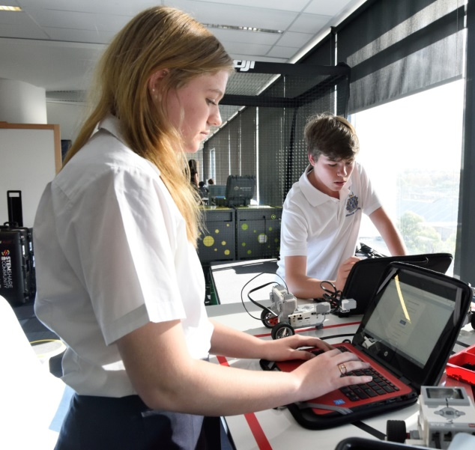
Key Ideas
Digital technology can empower authentic, meaningful, collaborative and engaged learning but has both opportunities and risks
Children and young people need to be supported to use technology in safe, respectful and responsible ways
This is a shared responsibility for school staff, parents and carers, and the students themselves

Slide 3
For primary schools
From the start of Term 1 2020, Primary-aged students will not be allowed to use digital devices during class time, recess and lunch, unless for an educational purpose or other reasons, such as an adjustment to support learning and wellbeing.
Notes:
For many schools, this reflects current practice and will not be a major change

Slide 4
For high schools
Secondary school principals, in consultation with
their communities, will continue to determine
how digital devices and online services are
restricted or permitted in their schools.
Notes:
The policy acknowledges that technology plays an important and increasing role as students’ progress through their education and gives secondary schools the flexibility to find a balance between the benefits and risks that best supports their diverse communities.

Slide 5
RESPONSIBLE
Key points
SAFE
RESPECTFUL
Notes:
Students’ safe, responsible and respectful use of digital devices and online services is a key message of this policy.
Safe, responsible and respectful behaviour is the greatest protective factor when students use technology.
We want our students to have enough information to be clear about what is this looks like when hey are using digital technology.
This also relates well the Departments Behaviour Code for Students and Discipline Policies and positions inappropriate behaviour to be addressed by our school’s behaviour procedures and practices.
Examples of Safe, Responsible and Respectful behaviour are on the next 3 slides

Slide 6
Be safe
Protect your personal information
Don’t share your usernames and passwords
Ask for help if someone online asks for or offers you something that makes you suspicious
Let a teacher or other responsible adult know immediately if you come across something online that is inappropriate or makes you uncomfortable

Slide 7
Be responsible
Follow all school rules and instructions from school staff
Take care with the digital devices you use
Never hack, disable or bypass any hardware or software security, including any virus protection, spam and filter settings
Use online services in responsible and age-appropriate ways
Notes:
Further detail is below if required
What does taking care of the devices mean
Make sure the devices you bring to school are fully charged each day and are stored appropriately when not in use.
You and your parents and carers are responsible for any repairs or IT support your personal devices might need.
Take care with the school-owned devices you share with others, so that other people can use them after you.
What is age-appropriate and responsible behaviour?
Always adhere to the age restrictions on websites or apps
Only use online services in the ways agreed to with your teacher
Only access appropriate content and websites, including when using the school’s filtered network and personal, unfiltered networks.
Do not use online services to buy or sell things online, to gamble or to do anything that breaks the law.

Slide 8
Be respectful
Respect and protect the privacy, safety and wellbeing of others.
Get permission before you take a photo or video of someone
Do not harass or bully anyone
Do not send or share messages or content that could cause harm
Notes:
Further detail is below if required
Harm may include things that might be:
inappropriate, offensive or abusive ;
upsetting or embarrassing another person or group;
bullying;
sharing private or confidential information;
sending a virus or other harmful software.

Slide 9
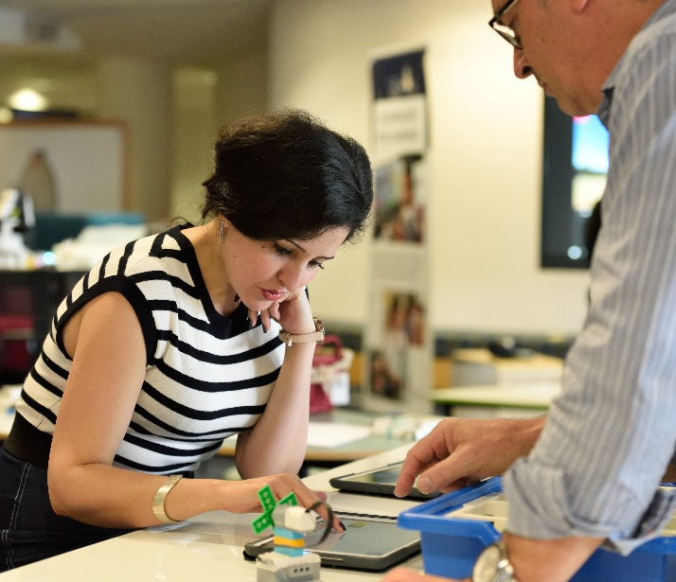
Why do we need a change?
The learning, wellbeing and safety of our students is a priority
Digital devices present a new challenge for schools, teachers, parents and carers and students
Digital technology can empower authentic, meaningful, collaborative and engaged learning
Schools need to manage the benefits and risks of these devices
The 2018 Review into the non-educational use of mobile devices in NSW schools
Notes:
The learning and wellbeing of all our students is our priority.
We know digital technology is important to the way children and young people, learn, interact and play.
The use of digital technology by students in school-related settings is fundamentally intended to enhance learning, wellbeing and educational attainment. It can support education and help students develop the skills needed for the 21st century.
We also know that ways they may be used could put children and young people’s safety and wellbeing at risk.
This presents a new challenge for schools, teachers, parents and carers and students.
We need to balance these opportunities and risks.
We also understand that this balancing act will mean that implementing the policy is potentially controversial – depending on different view points - for some it won’t be tough enough and for others if will be too tough.
This policy also responds to a government review on non-educational use of mobile devices held in 2018

Slide 10
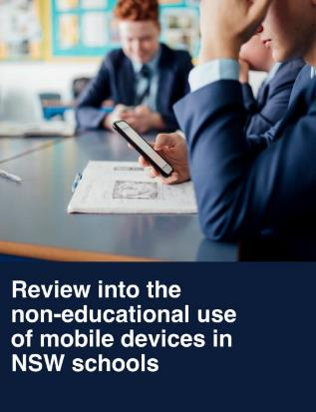
2018 Government review into mobile devices
Findings and feedback from over 14,000 respondents includes:
Devices can support school-related learning activities
Devices can support learning needs and help students to manage medical conditions
Mobile devices can be a useful alternative in some circumstances
Devices can offer parents peace of mind when children are travelling
Notes:
Further detail is below if required
In 2018 the Government had a review into mobile devices
The review identified significant benefits identified by teachers, students and parents. As part of this review, the government surveyed educators, parents and students. Nearly 14,000 people responded, of which approximately 9,000 were students, 3,000 were educators and 2,000 were parents and carers.
Approximately 15% of students who responded identified as primary school students.
83% of students claimed to use a mobile digital device at school (this does not distinguish between primary and secondary school students).
87% of students do not think the government should restrict the use of digital devices in school time (again this does not distinguish between primary and secondary students).
60% of students considered there to be no risks associated with using mobile devices at school
88% of parents who responded to the same survey said the government should restrict the use of devices in primary schools.
Mobile devices offer parents peace of mind when children are travelling.
Mobile devices can support students in school-related activities including:
Using educational websites and apps
Checking timetables and accessing diary
Accessing information and researching online
Capturing records of work on the board
Using calculator, clock and camera functions
Some students rely on mobile devices to support learning needs or manage medical conditions.
Principals, teachers and students prefer laptops and tablets but smart phones can be a useful alternative in some circumstances

Slide 11
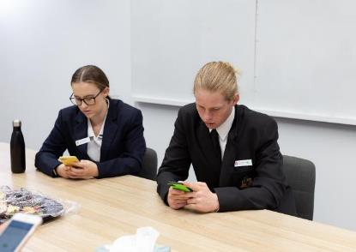
2018 Government review into mobile devices
Feedback also included challenges for parents, students and teachers
Distraction or disruption to learning
Cyberbullying and image-based abuse
Less time spent face-to-face and on physical activity
Parents, teachers and students saw minimal additional educational value for smartphones where there was alternative access to technology
Notes:
If further detail is required
Considering the findings of the review, the NSW Government announced in 2018 that mobile devices would be restricted during class, at recess and at lunch in all public primary schools.
We all have duty of care responsibilities to children and young people and a shared responsibility to help them become safe, responsible and respectful users of technology.

Slide 12
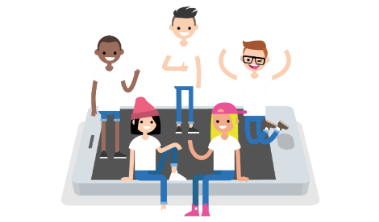
What’s will this mean for our school?
Our school will develop and implement a new procedure on the use of digital technology (Schools to modify this text as appropriate)
For our primary school students, digital devices will not be permitted at recess and lunch and during class, unless approved by a teacher.
Our school, in consultation with our community, will determine and any restriction to be applied for secondary students
The procedure will
set expectations for safe, responsible and respectful use
apply to students at school, on excursions and where there is a clear and close connection to the school
Our school will work with students and their parents or carers where an adjustment or exemption may be required
Notes:
Our school will develop and implement a new procedure on the use of digital technology. This new school procedure sets school-wide expectations for staff, students, parents and carers. We will be further engaging with our community to develop this procedure
(Please choose the points relevant to you school type – Primary, Secondary, Central, Community, SSP, etc.).
For our primary school students, digital devices will not be permitted at recess and lunch and during class, unless approved by a teacher for educational purposes .
Our school, in consultation with our community, will determine any restriction to be applied for secondary students
It covers use at school, at school-related events off-site and where a clear and close connection between the student and schools exists.
Our school will work with students and their parents or carers where an adjustment or exemption my be required for a student learning and/or wellbeing need
Further Information
The school procedure applies for all students while they are at school. The procedure also applies to school-related settings including excursions, camps, other teaching venues, and other places and times where there is a clear and close connection between the student and the school.
A clear and close connection can include issues that occur outside of school but are then reported to a school staff member or have an impact in the school.
This connection may exist in situations where:
online contact has flow on consequences at school
students are online in digital classrooms
there is harassment or vilification of another student or staff member
there is inappropriate discussion about school matters taking place publically and online
Exemptions
An exemption from parts of this policy or the school procedure can be requested from the principal by parents, carers, school counsellors and other student support staff, and, if required, students themselves. This may cover times when or places where use would otherwise be restricted.
Except where required by law, the school principal has discretion to consider and approve exemptions and to choose which parts of the school procedure the exemptions applies.
The exemption may be ongoing or for a certain time period.
Examples of exemptions include but are not limited to:
A student has a wellbeing need to privately contact a support service or their parents or carers. Examples of support services include but are not limited to Headspace, FACS, juvenile justice case workers and religious leaders.
A student is a young carer.
Family circumstances may require an exemption for compassionate reasons. This may include circumstances such as a family member having a new baby, undergoing an operation or facing terminal illness. It may also include restriction on times when a student can contact a parent such as a family member living overseas or parental incarceration.
A student has a compelling, short term reason such as hearing back from an employment interview.
Adjustments
Some students require reasonable adjustments to their learning and support needs.
A disability includes a medical condition impacting a student.
Reasonable adjustments include access to digital technologies to participate in the education on the same basis as a student without a disability.
The school must consult the student, and their parents or carers as appropriate, in determining the adjustments for the student.
Providing reasonable adjustments to students with disability is an obligation under the Disability Standards and does not require students or parents or carers to seek an exemption under this policy.

Slide 13
What will our school procedure cover?
Our plan for managing digital devices that students bring to school
At our school, we want digital devices to be:
Over the next term, we will be refining our school procedures in line with the new digital devices and online services policy.
We will be communicating with the school community regularly to keep you updated. schools to modify this text to reflect possible consultation and update schedule
schools to delete this text and add in their specific school priorities
Notes:
This slide is to be modified by each school to describe your specific approach.
While the use of mobile phones by students has been receiving a lot of media attention lately, this restriction on mobile phones forms just one part of this new school procedure. This new procedure will govern all digital devices and online services that students can use at school. It is not just a restriction on mobile phones.
Digital devices at school include :
Personal devices like mobile phones, tablets, laptops and smart watches that a student may bring to school
School-provided devices
Personal devices students bring to school as part of a BYOD program.
If student is using a digital device or online service in a way that is safe, responsible, respectful and teacher-approved, then under our school procedure that use is approved. If, however, a student is found using a digital device or an online service in a way that isn’t safe, responsible, respectful or teacher-approved, that student could find themselves in breach of school procedure. In that situation, the teacher would follow our school’s behaviour management plan and welfare and discipline policy.
This is a reasonable test that can be easily made by teachers in line with our existing classroom- and school-rules. This doesn’t restrict teachers from incorporating innovative technology into their classrooms where there is an educational use.
We understand that parents and carers may rely on their child having a mobile phone in order to contact them before or after school, for example to coordinate and organise transport home at the end of the day. For this reason, our only procedure specifically restricts digital devices during class, at recess and at lunch and not before and after school.
The procedure will also cover practical management of devices at school.
[Schools to amend if they wish to prescribe arrangements before and after school.]

Slide 14
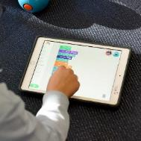
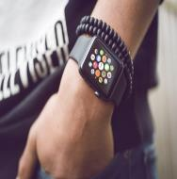
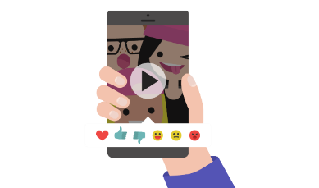
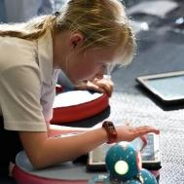
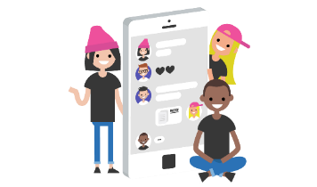
Is this procedure just about smart phones?
A procedure for all technology our students use, not just phones
Notes:
The policy, and our school’s procedure defines digital devices and online services.
A digital device is any electronic device that can receive, store, process and share digital information, e.g. desktops, laptops, tablets, smartwatches and smartphones.
An online service is any technical means to gather, process or communicate information, e.g. websites, apps, social media, and other technical means for communicating and sharing.
Digital devices are the tools we use to connect to the internet or communicate with other people. As more devices become internet-capable, it’s an impossible task to try and define every possible piece of hardware that can connect to the internet or to another device. The same thing is true with all the new websites, apps, games, social media, and other online services that are appearing and disappearing every day.
For this reason, the NSW Department of Education has given us these broad definitions. Rather than definitions that rely on examples from current technology, these broad definitions are flexible enough to include all current and future technologies. At the end of the day, it doesn’t matter what bit of hardware our students are holding or touching, and it doesn’t matter what actual bit of software they are using to communicate. Instead, the test is simply whether our students are using digital devices or online services in ways that are safe, responsible, respectful and teacher-approved.
Image: https://www.shutterstock.com/image-photo/hilversum-netherlands-march-03-2017-young-595300772?src=E3mrr33aSt02iSydxSLKBg-1-87

Slide 15
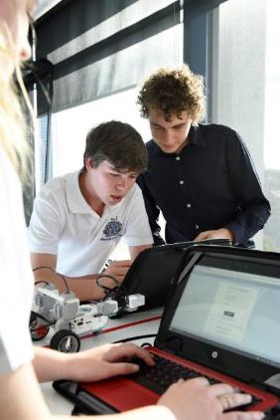
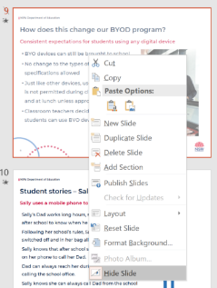
How will this change our BYOD program?
Optional slide for schools with BYOD Program
Consistent expectations for students using any digital device
Right click Slide 9 and deselect ‘Hide Slide’ if you wish to present this slide
BYO devices can still be brought to school
No change to the types of devices or specifications allowed
All student devices will be covered by the new procedure
Classroom teachers decide when and how students can use their devices in class
Right click
Notes:
This is an optional slide for schools who have a BYOD program. This slide is hidden by default. There are instructions on this slide to explain how to show this slide if necessary.
The new procedure also governs students participating in our school’s BYOD program.
Devices used in our school’s BYOD program are to be considered just like any other digital device at school, and the restriction on the use of these devices applies here just as it does with school-owned digital devices.
Teachers will continue to incorporate digital devices into their classroom practice, and will decide when and how they are best used in their classrooms.
The student behaviour code covers all behaviour related to digital devices, including those brought in as part of our BYOD policy.
In summary:
There is no change to the types of devices allowed, or their specifications. BYO devices can still be brought to school.
Students are expected to use all digital devices in safe, responsible and respectful ways.
The school procedure on digital devices and online services applies whether the student is using a device they own or one the school has provided.
Just like other devices, use of BYO devices are not permitted during class, at recess and at lunch unless approved by a teacher.
Classroom teachers decide when and how students can use digital devices for BYOD/educational purposes.
Students agree that their use of any digital devices, including BYOD devices, will be safe, responsible and respectful.

Slide 16
Digital parenting
How can you support your children?
Share online experiences together.
Teach and model respectful online communication and have regular screen-free family time.
Reassure them that they will not lose their device if they tell you about something that happened to make them feel unsafe or suspicious.
Use parental controls.
Help them manage their digital reputation.
Talk about the golden rule: if you wouldn’t say something to someone’s face then don’t share it online.
Establish clear guidelines for managing screen time and where devices can be used.
Adapted from Growing up Digital: Opportunities and challenges for parents, by Victorian Government with Robyn Treyvaud
Notes:
Tips for parents looking to manage their child’s use of technology at home.
Share online experiences together.
The more enthusiastic and engaged you are in their digital world the more likely they will come to you for help navigating it. If you use social media, share your feed regularly with your kids so that they don’t feel like they should hide theirs.
Teach and model respect for devices and have regular screen-free family time.
Explain what responsible ownership and behavior entails. Provide alternatives to screen time, and make it a family rule that devices are not taken into the bedroom overnight. Put them all together for recharging. If you need to use your device during screen-free time, explain why it’s important.
Reassure them that they will not lose their device if they tell you about something that happened to make them feel unsafe or suspicious. Discuss the kind of things they see online and that if they are exposed to content that makes them feel uncomfortable, scared or concerned to come to you or someone they trust. The main reason many children do not tell their parents about their bad experiences online is that they are terrified that they will lose their device. This does not mean that you should not consider consequences like this for serious misbehavior – for example, if your child is engaging in bullying behavior, losing access to their device for a set amount of time would be a reasonable consequence.
Learn about and use parental controls on computers, mobiles and game consoles and adjust them in line with your child’s age and maturity in consultation with your children.
Apple and Google both have family group settings that allow control over screen time, app downloads and permissions.
All social networking sites have privacy features – make sure your children know how to check and change them.
Help them manage their digital reputation.
Discuss that what they post and share online – photos, videos, and comments – form their digital reputation, and that once you post something online it’s practically impossible to take back.
A private comment to one person can be shared on Twitter in a few seconds.
Remind them that their profiles can be seen by all sorts of people depending on their privacy settings. Employers often investigate job applicants’ online presence. Ask your teens to think about who might see their pages and how they might interpret the posts or photos.
Talk about the golden rule…if you wouldn’t say something to someone’s face then don’t post it. 21st century version: ‘Text unto others as you would have them text unto you”
Establish clear guidelines for managing screen time and where devices can be used. Younger kids should have their online activities monitored by having the device in a place where the family spend time. Kitchen, family room, but not bedrooms after a time negotiated. Make sure you have some rules that you stick to as well.
Let them know you are always there for them.
Remind teens often that you’re always available to talk to. While you’re at it, put in a plug for the school counselor, a teacher, or even a friend’s parent—knowing that they have a trusted adult to talk to may encourage teens to open up.
2018 Common Sense Media report on teenager use of social media: https://www.commonsensemedia.org/social-media-social-life-infographic

Slide 17
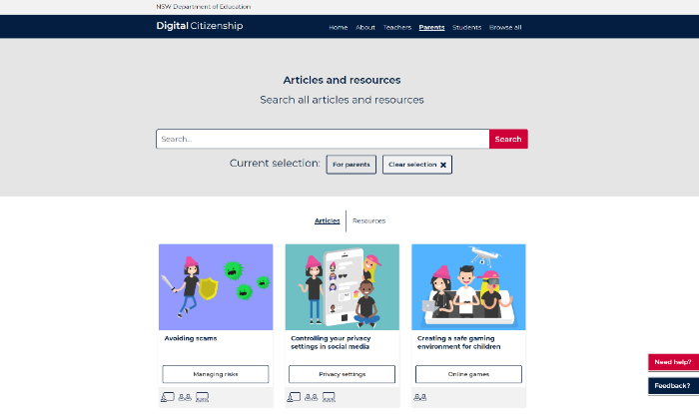
Where can I find more information?
Digital Citizenship (NSW Department of Education)
https://www.digitalcitizenship.nsw.edu.au/parents-articles
Notes:
If parents are looking for additional resources, the following two sites are recommended by the Department of Education.
The NSW Department of Education’s Digital Citizenship website provides practical advice to students, teachers and parents on the responsible use of technology, addressing safe and ethical online behaviour. Articles and resources are aligned to the NSW Syllabus and Australian Curriculum.
Website can be found at https://www.digitalcitizenship.nsw.edu.au/parents-articles

Slide 18
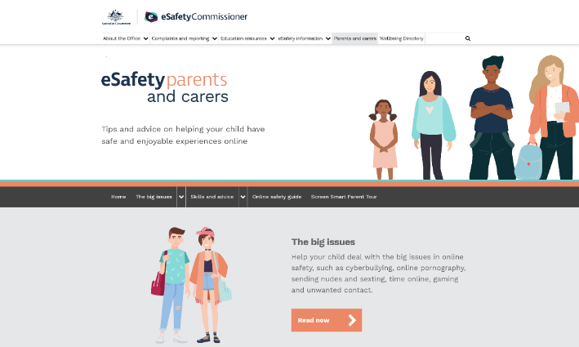
Where can I find more information?
Office of the eSafety Commissioner
www.esafety.gov.au
Notes:
The Office of the eSafety Commissioner was established in 2015 with a mandate to coordinate and lead the online safety efforts across government, industry and the not-for profit community.
It provides:
a complaints service for young Australians who experience serious cyberbullying
identifying and removing illegal online content
tackling image-based abuse.
The Office also provides audience-specific content to help educate all Australians about online safety including young people, women, teachers, parents, seniors and community groups.
They can be found at https://www.esafety.gov.au/

Slide 19
Any questions?
Notes:
This is an opportunity for parents to ask any questions that they have about the procedure.
Here are some suggested frequently asked questions:
What if my child requires an adjustment or exemption?
Some students may need an exemption or adjustment from the school procedure. Parents and carers should approach the principal to ask for an exemption for their child. The principal has final discretion to consider and approve exemptions on a case-by-case basis.
How do I contact my child when they are school?
During school time, parents and carers will need to contact the school office if they need to talk to their children.
Are digital devices also being restricted in NSW secondary schools?
Secondary principals have discretion to decide whether to allow or restrict digital devices. Secondary principals can choose to implement a restriction similar to the one in primary schools but are at no obligation to do so and could choose another approach that best suits the needs of the school.
Are smart watches banned in our school?
Yes they are a digital device and they are governed by our school procedure. Students are restricted from using smart watches unless the teacher has explicitly authorised the use, or the principal has approved an adjustment or exemption. Students who bring a smart watch to school will store them in the same way that smart phones are stored at school.
What about smart phones on excursions?
Excursions and other events away from school are governed by this and other school procedures.

